Slide 1
Database Design
DAVID M. KROENKE and DAVID J. AUER
DATABASE CONCEPTS, 7th Edition
Chapter Five

Slide 2
Chapter Objectives
Learn how to transform E-R data models into relational designs
Practice applying the normalization process
Understand the need for denormalization
Learn how to represent weak entities with the relational model
Know how to represent 1:1, 1:N, and N:M binary relationships

Slide 3
Chapter Objectives (Cont’d)
Know how to represent 1:1, 1:N, and N:M recursive relationships
Learn SQL statements for creating joins over binary and recursive relationships

Slide 4
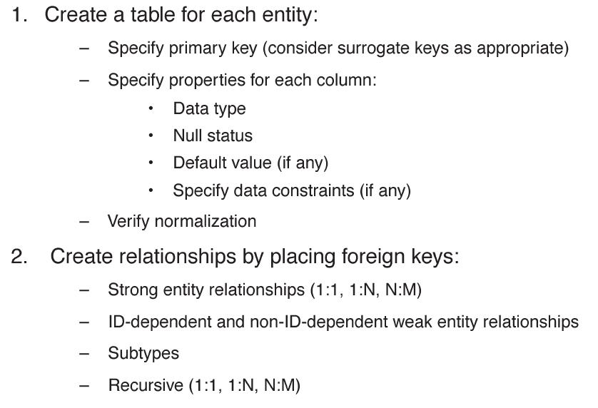
Transforming a Data Model into a Relational Design

Slide 5
Representing Entities with the Relational Model
Create a relation for each entity.
A relation has a descriptive name and a set of attributes that describe the entity.
Specify a primary key.
Specify column properties:
Data type
Null status
Default values (if any)
Data constraints (if any)
The relation is then analyzed using the normalization rules.
As normalization issues arise, the initial relation design may need to change.

Slide 6
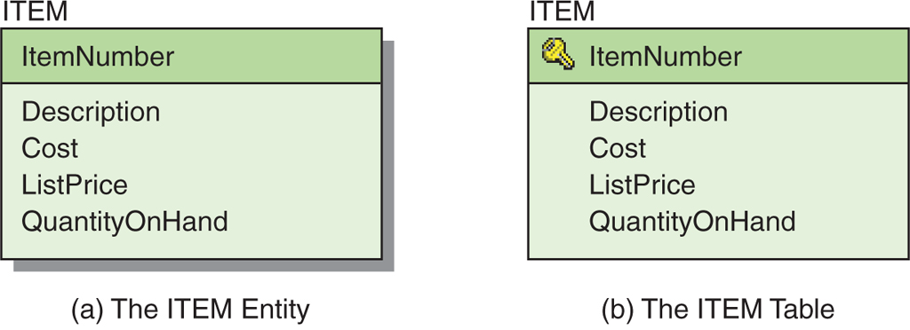
Representing an Entity as a Table
ITEM (ItemNumber, Description, Cost, ListPrice, QuantityOnHand)
Figure 5-2: The ITEM Entity and Table

Slide 7
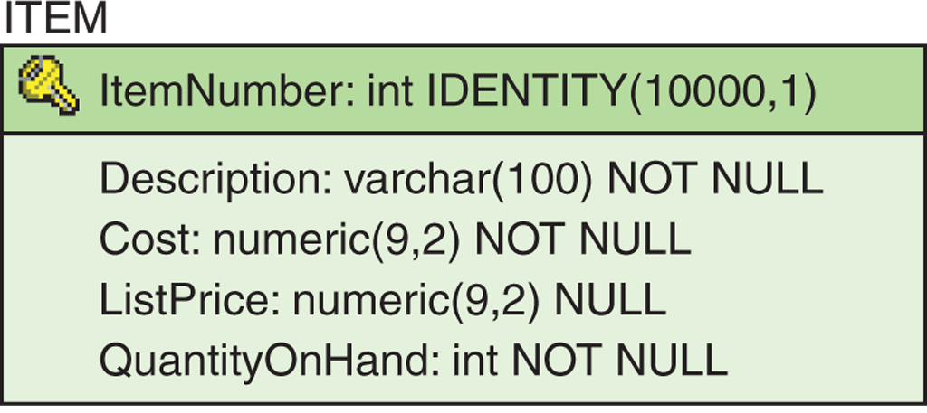
The Entity Table with Column Characteristics
ITEM (ItemNumber, Description, Cost, ListPrice, QuantityOnHand)
Figure 5-3: The Final ITEM Table

Slide 8
Normalization Review: Modification Problems
Tables that are not normalized will experience issues known as modification problems.
Insertion problems
Difficulties inserting data into a relation
Modification problems
Difficulties modifying data into a relation
Deletion problems
Difficulties deleting data from a relation

Slide 9
Normalization Review: Solving Modification Problems
Most modification problems are solved by breaking an existing table into two or more tables through a process known as normalization.

Slide 10
Normalization Review: Definition Review
Functional dependency
The relationship (within the relation) that describes how the value of one attribute may be used to find the value of another attribute.
Determinant
The attribute that can be used to find the value of another attribute in the relation
The right-hand side of a functional dependency

Slide 11
Normalization Review: Definition Review II
Candidate key
The value of a candidate key can be used to find the value of every other attribute in the table.
A simple candidate key consists of only one attribute.
A composite candidate key consists of more than one attribute.

Slide 12
Normalization Review: Normal Forms
There are many defined normal forms:
First Normal Form (1NF)
Second Normal Form (2NF)
Third Normal Form (3NF)
Boyce-Codd Normal Form (BCNF)
Fourth Normal Form (4NF)
Fifth Normal Form (5NF)
Domain/Key Normal Form (DK/NF)

Slide 13
Normalization Review: Normalization
For our purposes, a relation is considered normalized when:
Every determinant is a candidate key.
[Technically, this is Boyce-Codd Normal Form (BCNF)]

Slide 14
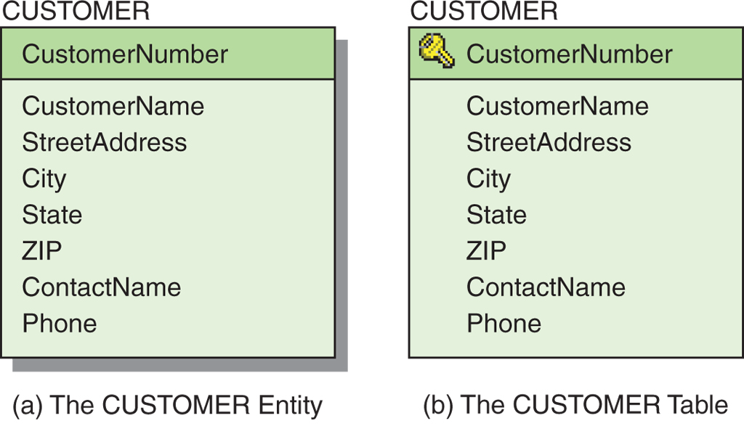
The CUSTOMER Table
CUSTOMER (CustomerNumber, CustomerName, StreetAddress,
City, State, ZIP, ContactName, Phone)
ZIP→(City, State)
ContactName→Phone
Figure 5-4: The CUSTOMER Entity and Table

Slide 15
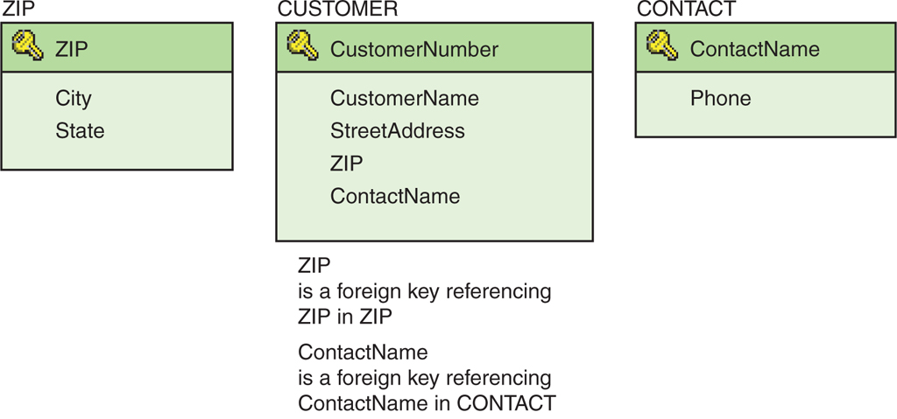
The CUSTOMER Entity: The Normalized Set of Tables
CUSTOMER (CustomerNumber, CustomerName, StreetAddress,
ZIP, ContactName)
ZIP (ZIP, City, State)
CONTACT (ContactName, Phone)
Figure 5-5: The Normalized CUSTOMER and Associated Tables

Slide 16
Denormalization
Normalizing relations (or breaking them apart into many component relations) may significantly increase the complexity of the data structure.
The question is one of balance.
Trading complexity for modification problems
There are situations where denormalized relations are preferred.

Slide 17
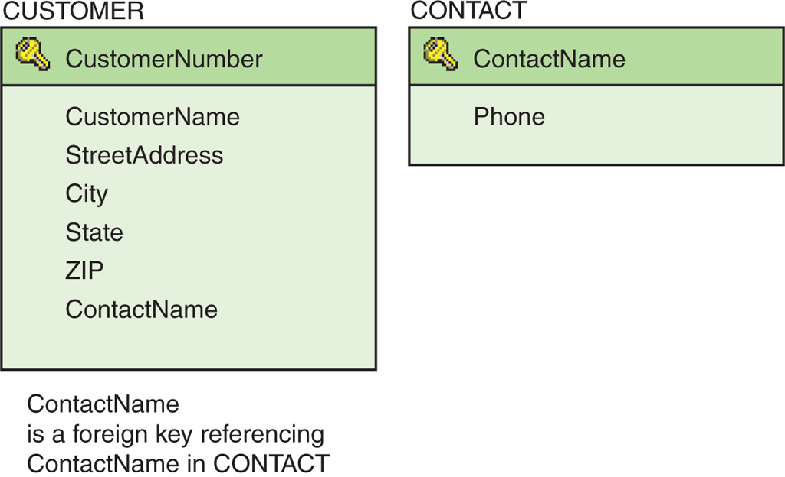
The CUSTOMER Entity: The Denormalized Set of Tables
CUSTOMER (CustomerNumber, CustomerName, StreetAddress,
City, State, ZIP, ContactName)
CONTACT (ContactName, Phone)
Figure 5-6: The Denormalized CUSTOMER and Associated CONTACT Tables

Slide 18
Representing Weak Entities
If not ID-dependent, use the same techniques as for strong entities.
If ID-dependent, then must add primary key of the parent entity.

Slide 19
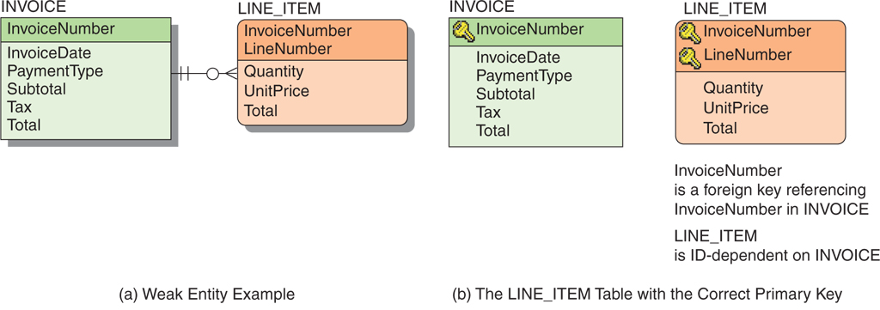
Representing Weak Entities Example
Figure 5-9: Relational Representation of a Weak Entity

Slide 20
Representing Relationships 1:1 Relationships
The maximum cardinality determines how a relationship is represented.
1:1 relationship
The key from one relation is placed in the other as a foreign key.
It does not matter which table receives the foreign key.

Slide 21
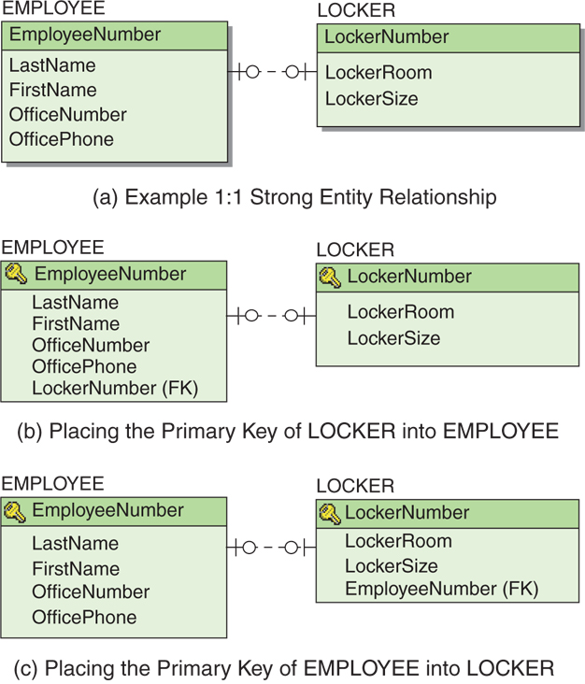
Representing Relationships 1:1 Relationship Example
Figure 5-10: 1:1 Strong Entity Relationships

Slide 22
Representing Relationships SQL for 1:1 Relationships
SELECT *
FROM LOCKER, EMPLOYEE
WHERE LOCKER.LockerNumber =
EMPLOYEE.LockerNumber;
SELECT *
FROM LOCKER, EMPLOYEE
WHERE LOCKER.EmployeeNumber =
EMPLOYEE.EmployeeNumber;

Slide 23
Representing Relationships 1:N Relationships
Like a 1:1 relationship, a 1:N relationship is saved by placing the key from one table into another as a foreign key.
However, in a 1:N the foreign key always goes into the many-side of the relationship.
The 1 side is called the parent.
The N side is called the child.

Slide 24
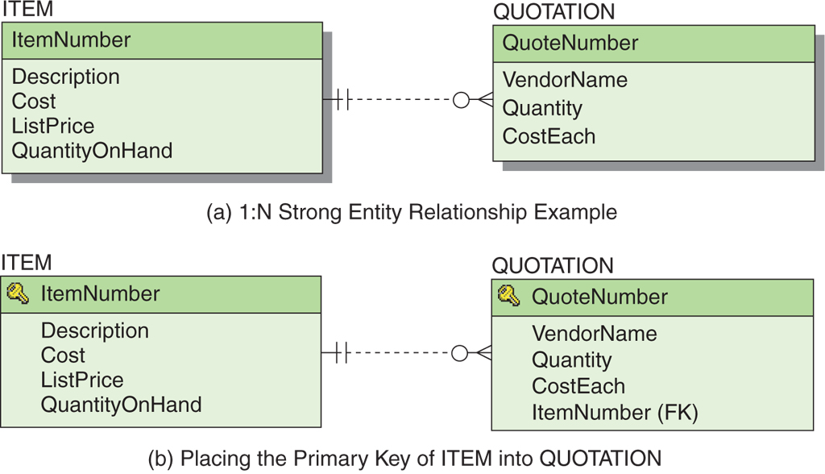
Representing Relationships 1:N Relationship Example
Figure 5-12: 1:N Strong Entity Relationships

Slide 25
Representing Relationships SQL for 1:N Relationships
SELECT *
FROM ITEM, QUOTATION
WHERE ITEM.ItemNumber =
QUOTATION.ItemNumber;

Slide 26
Representing Relationships N:M Relationships
To create an N:M relationship, a new table is created. This table is called an intersection table.
An intersection table has a composite key consisting of the keys from each of the tables that it connects.

Slide 27
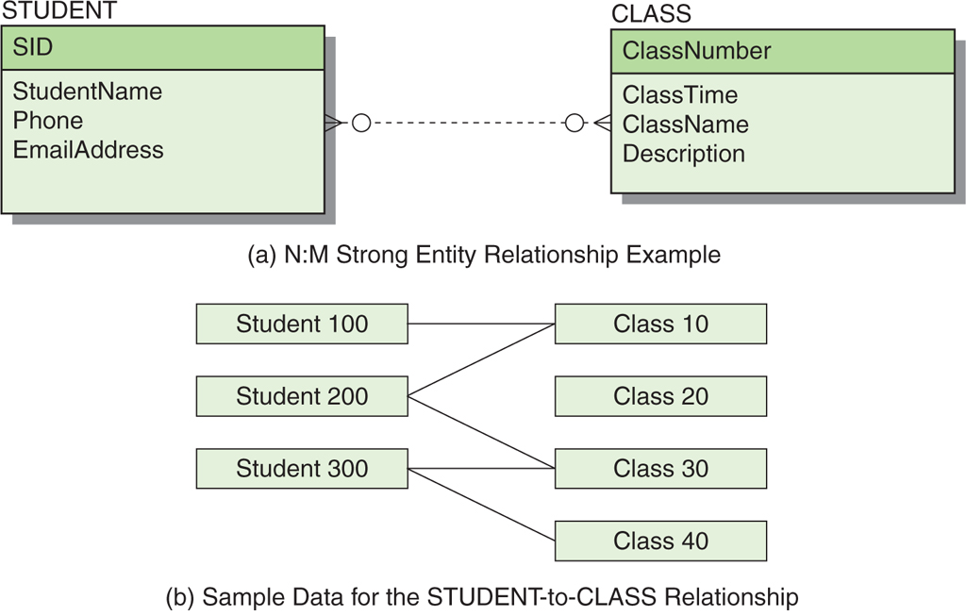
Representing Relationships N:M Relationship – Data Model
Figure 5-13: N:M Strong Entity Relationships

Slide 28
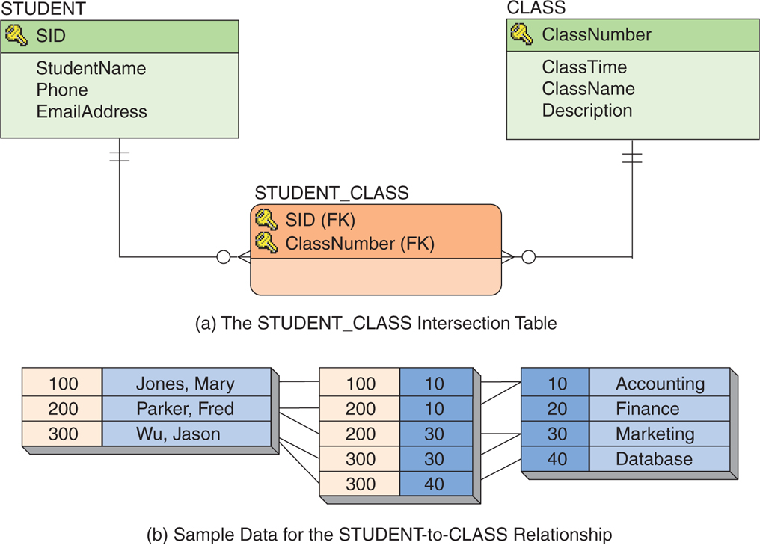
Representing Relationships N:M Relationship – Database Design
Figure 5-15: Representing an N:M Strong Entity Relationship

Slide 29
Representing Relationships SQL for N:M Relationships
SELECT *
FROM STUDENT, CLASS, STUDENT_CLASS
WHERE STUDENT.SID = STUDENT_CLASS.SID
AND STUDENT_CLASS.ClassNumber = CLASS.ClassNumber;

Slide 30
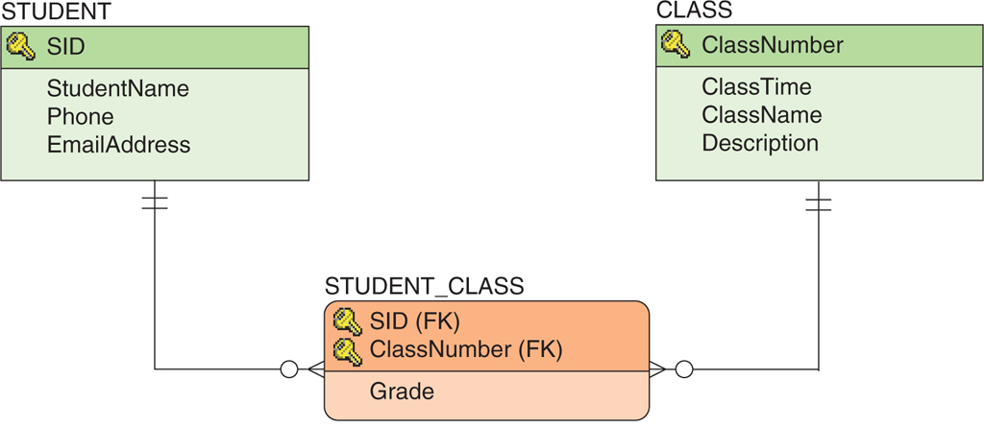
Representing Relationships Association Relationships
When an intersection table has columns beyond those in the primary key, the relationship is called an association relationship.
Figure 5-18: The Association Relationship

Slide 31
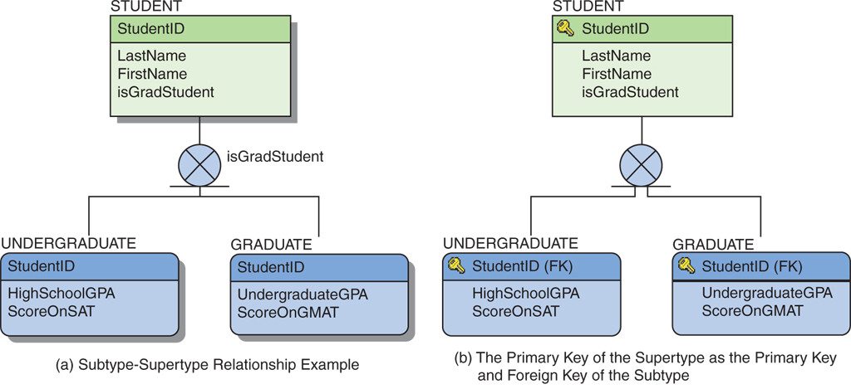
Representing Relationships Supertype/Subtype Relationships
The identifier of the supertype becomes the primary key and the foreign key of each subtype.
Figure 5-20: Representing Subtypes

Slide 32
Representing Relationships Recursive Relationships
A recursive relationship is a relationship that a relation has with itself.
Recursive relationships adhere to the same rules as binary relationships.
1:1 and 1:M relationships are saved using foreign keys.
M:N relationships are saved by creating an intersecting relation.

Slide 33
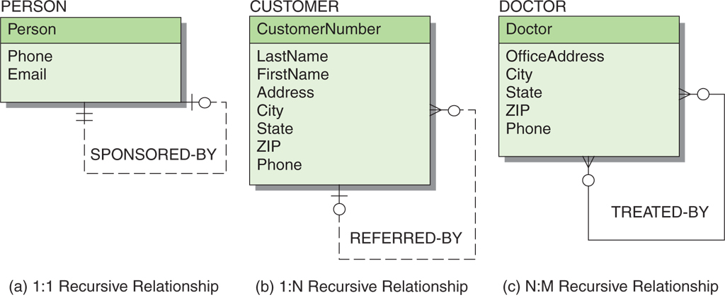
Representing Relationships Recursive Relationships—Examples
Figure 5-21: Example Recursive Relationships

Slide 34
Representing Relationships 1:1 Recursive Relationship Examples
SELECT *
FROM PERSON1 AS A, PERSON1 AS B
WHERE A.Person = B.PersonSponsored;
SELECT *
FROM PERSON2 AS C, PERSON2 AS D
WHERE C.Person = D.PersonSponsoredBy;
Figure 5-22: Example 1:1 Recursive Relationships

Slide 35
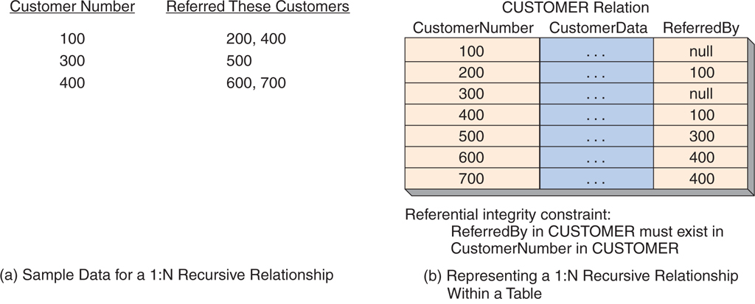
Representing Relationships 1:N Recursive Relationship Example
SELECT *
FROM CUSTOMER AS A, CUSTOMER AS B
WHERE A.CustomerNumber = B.ReferredBy;
Figure 5-23: Example 1:N Recursive Relationship

Slide 36
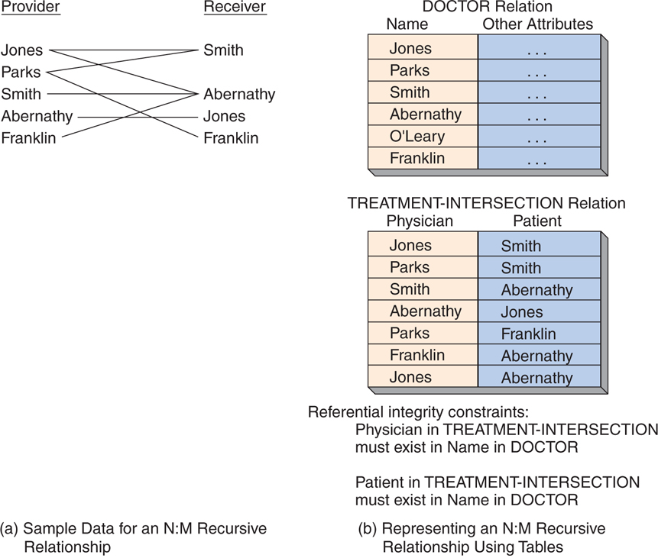
Representing Relationships N:M Recursive Relationship Example
Figure 5-24: Example of an N:M Recursive Relationship

Slide 37
SQL for N:M Recursive Relationships
SELECT *
FROM DOCTOR AS A,
DOCTOR AS B,
TREATMENT-INTERSECTION
WHERE A.Name = TREATMENT-INTERSECTION.Physician
AND TREATMENT-INTERSECTION.Patient = B.Name;

Slide 38
Heather Sweeney Designs: Developing a Database Design
Heather Sweeney Designs will be used as on ongoing example throughout Chapters 4, 5, 6, 7, and 8.
Heather Sweeney is an interior designer who specializes in home kitchen design.
She offers a variety of free seminars at home shows, kitchen and appliance stores, and other public locations.
She earns revenue by selling books and videos that instruct people on kitchen design.
She also offers custom-design consulting services.

Slide 39
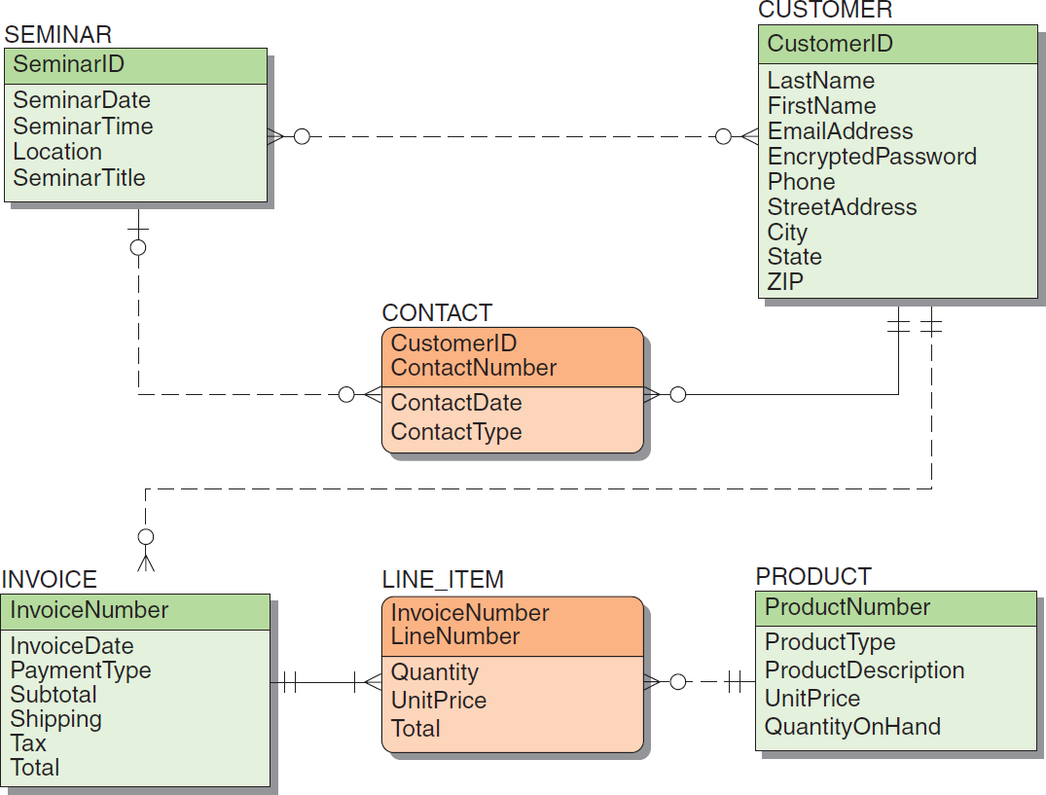
Heather Sweeney Designs: Final Data Model
Figure 5-25: The Final Data Model for Heather Sweeney Designs

Slide 40
Specifying Column Properties
Column properties must be specified for each table.
The finalized column properties for the HSD tables are on the next set of slides-these are the column characteristics after additional needed foreign keys (shown in bold) have been added. This includes any new intersection tables.

Slide 41
HSD Column Property Specifications SEMINAR
SEMINAR
Figures 5-26 & 5-28: Heather Sweeney Designs Column Specifications

Slide 42
HSD Column Property Specifications SEMINAR_CUSTOMER
SEMINAR_CUSTOMER
Figures 5-26 & 5-28: Heather Sweeney Designs Column Specifications

Slide 43
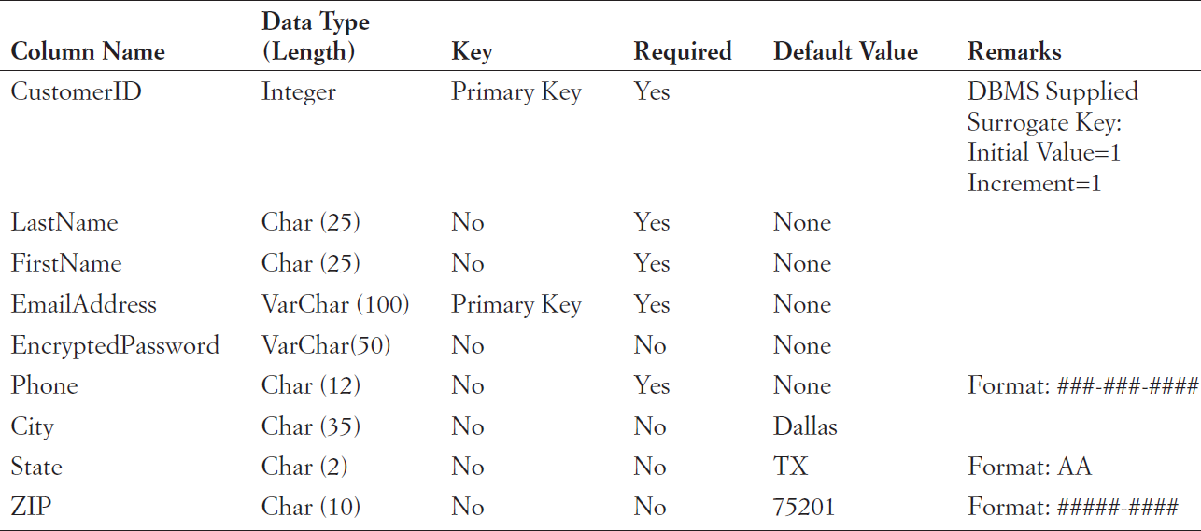
HSD Column Property Specifications CUSTOMER
CUSTOMER
Figures 5-26 & 5-28: Heather Sweeney Designs Column Specifications

Slide 44
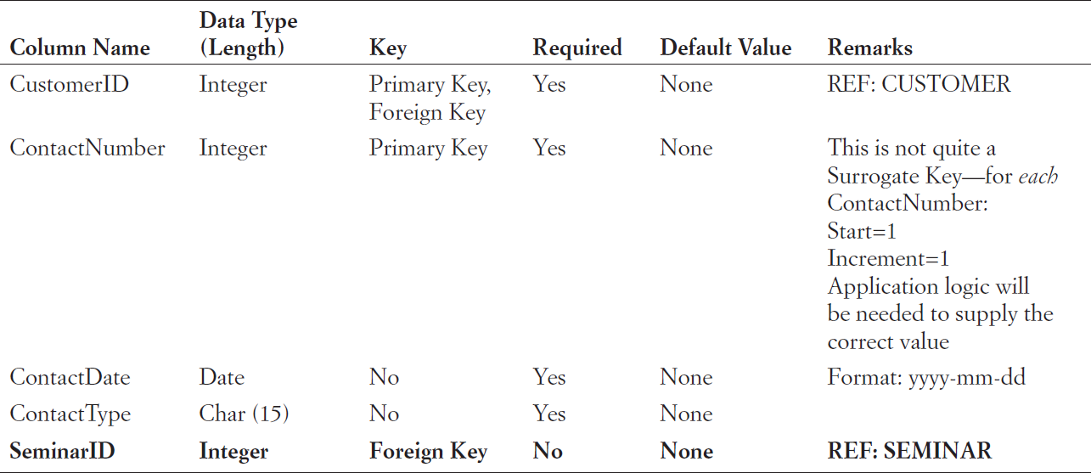
HSD Column Property Specifications CONTACT
CONTACT
Figures 5-26 & 5-28: Heather Sweeney Designs Column Specifications

Slide 45
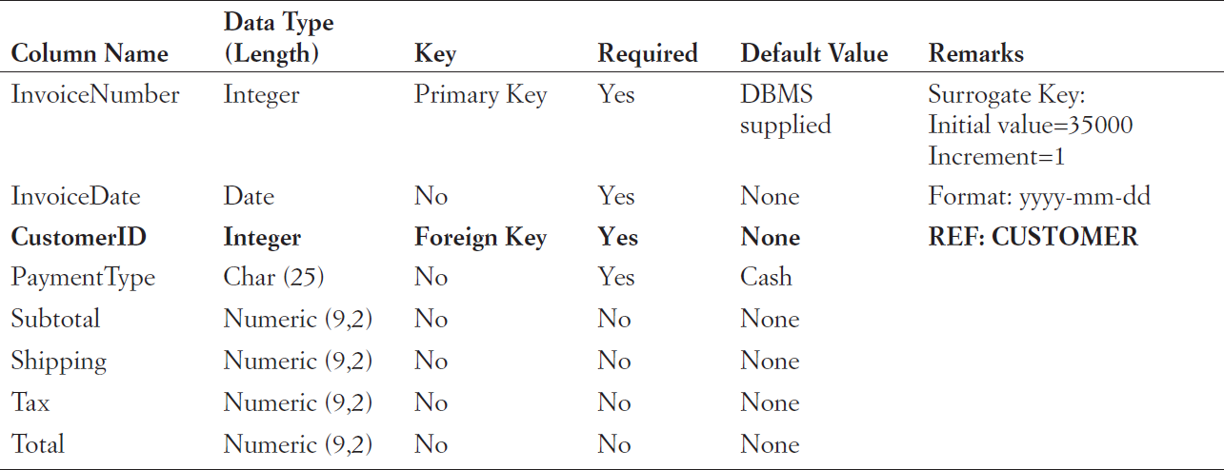
HSD Column Property Specifications INVOICE
INVOICE
Figures 5-26 & 5-28: Heather Sweeney Designs Column Specifications

Slide 46
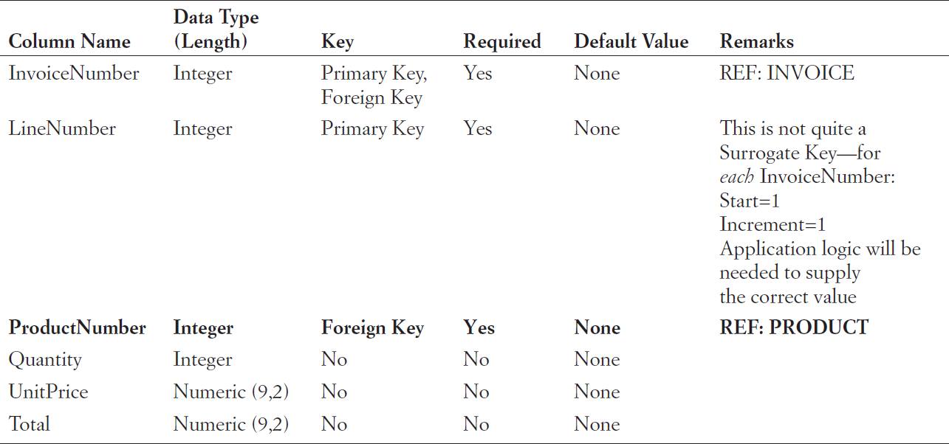
HSD Column Property Specifications LINE_ITEM
LINE_ITEM
Figures 5-26 & 5-28: Heather Sweeney Designs Column Specifications

Slide 47
HSD Column Property Specifications PRODUCT
PRODUCT
Figures 5-26 & 5-28: Heather Sweeney Designs Column Specifications

Slide 48
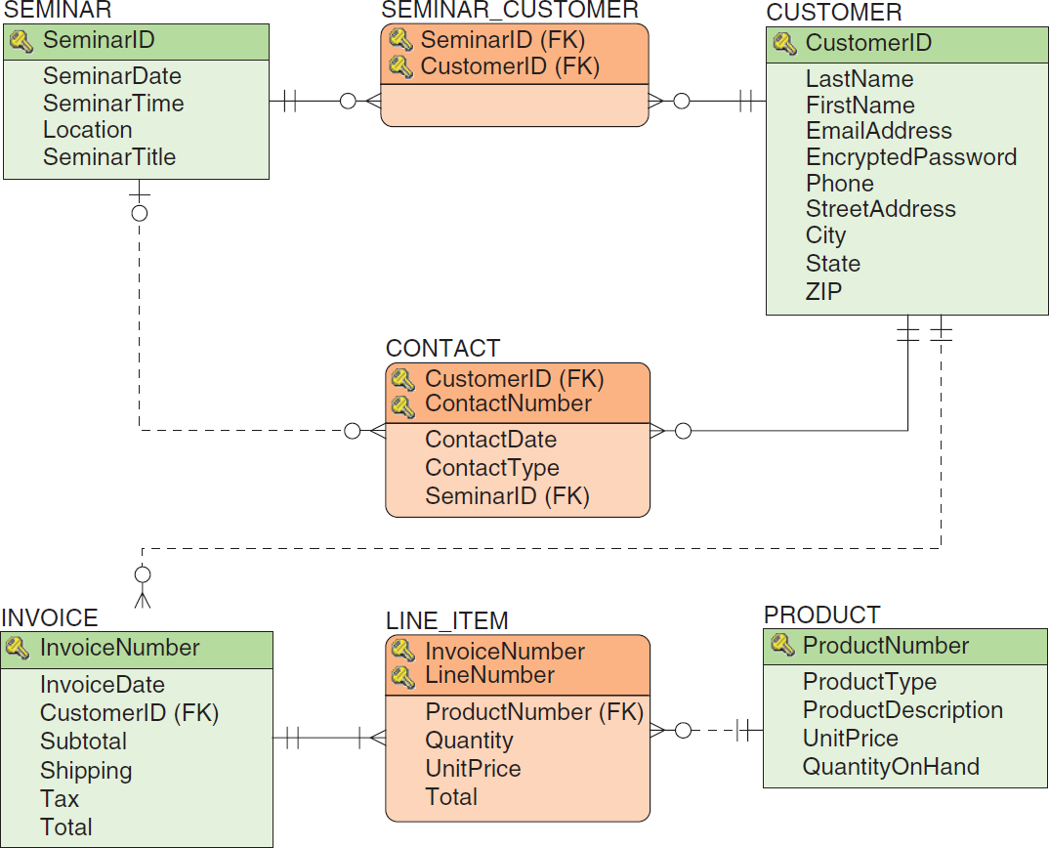
Heather Sweeney Designs: Database Design
Figure 5-27: Database Design for Heather Sweeney Designs

Slide 49
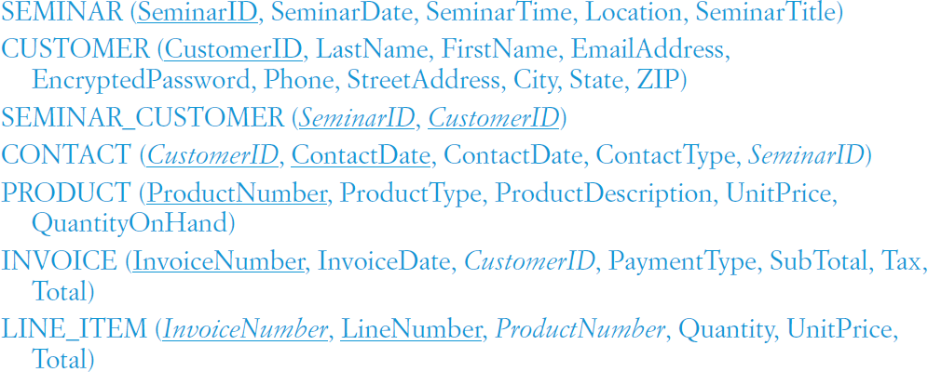
Heather Sweeney Designs: Database Design Schema

Slide 50
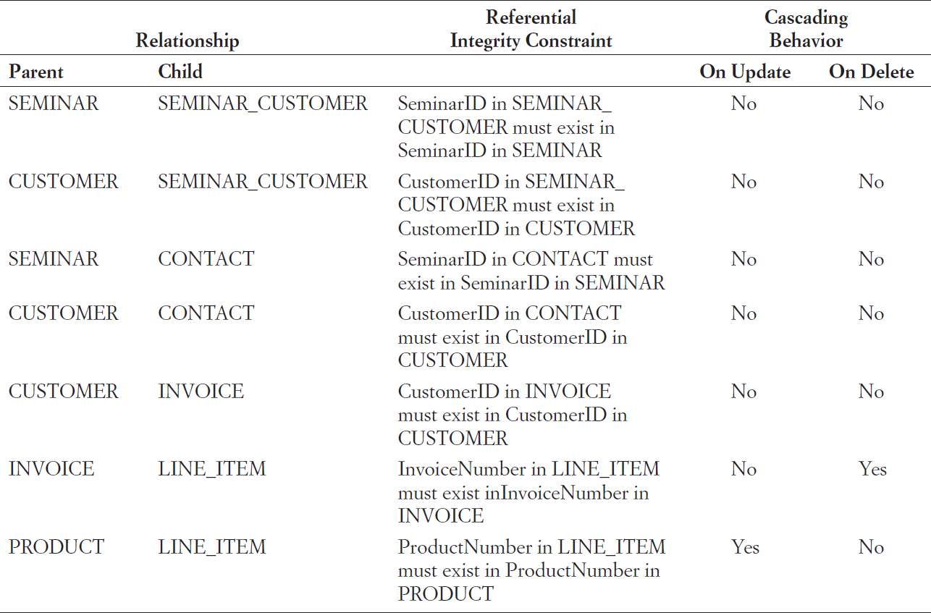
Heather Sweeney Designs: Referential Integrity Constraints
Figure 5-29: Referential Integrity Constraint Enforcement for Heather Sweeney Designs

Slide 51
DAVID M. KROENKE and DAVID J. AUER
DATABASE CONCEPTS, 7th Edition
All rights reserved. No part of this publication may be reproduced, stored in a retrieval system, or transmitted, in any form or by any means, electronic, mechanical, photocopying, recording, or otherwise, without the prior written permission of the publisher. Printed in the United States of America.
Copyright © 2015 Pearson Education, Inc.
Publishing as Prentice Hall

Slide 52
Database Design
DAVID M. KROENKE and DAVID J. AUER
DATABASE CONCEPTS, 7th Edition
End of Presentation on Chapter Five

