Slide 1
The Relational Model
DAVID M. KROENKE and DAVID J. AUER
DATABASE CONCEPTS, 7th Edition
Chapter Two

Slide 2
Chapter Objectives
Learn the conceptual foundation of the relational model
Understand how relations differ from nonrelational tables
Learn basic relational terminology
Learn the meaning and importance of keys, foreign keys, and related terminology
Understand how foreign keys represent relationships

Slide 3
Chapter Objectives (Cont’d)
Learn the purpose and use of surrogate keys
Learn the meaning of functional dependencies
Learn to apply a process for normalizing relations

Slide 4
Entity
An entity is something of importance to a user that needs to be represented in a database.
An entity represents one theme or topic.
In an entity-relationship model (discussed in Chapter 4), entities are restricted to things that can be represented by a single table.

Slide 5
Relation
A relation is a two-dimensional table that has specific characteristics.
The table dimensions, like a matrix, consist of rows and columns.

Slide 6
Characteristics of a Relation
Rows contain data about an entity.
Columns contain data about attributes of the entity.
Cells of the table hold a single value.
All entries in a column are of the same kind.
Each column has a unique name.
The order of the columns is unimportant.
The order of the rows is unimportant.
No two rows may be identical.

Slide 7
A Sample Relation
EmployeeNumber | FirstName | LastName
100 | Mary | Abernathy
101 | Jerry | Cadley
104 | Alex | Copley
107 | Megan | Jackson

Slide 8
A Nonrelation Example
Cells of the table hold multiple values
EmployeeNumber | Phone | LastName
100 | 335-6421, 454-9744 | Abernathy
101 | 215-7789 | Cadley
104 | 610-9850 | Copley
107 | 299-9090 | Jackson

Slide 9
Example of a Nonrelational Table
No two rows may be identical
EmployeeNumber | Phone | LastName
100 | 335-6421 | Abernathy
101 | 215-7789 | Cadley
104 | 610-9850 | Copley
100 | 335-6421 | Abernathy
107 | 299-9090 | Jackson

Slide 10
Terminology
Synonyms…
Table | Row | Column
File | Record | Field
Relation | Tuple | Attribute
Figure 2-6: Equivalent Sets of Terms

Slide 11
A Key
A key is one (or more) column(s) of a relation that is (are) used to identify a row.

Slide 12
Uniqueness of Keys
Unique Key | Nonunique Key
Data value is unique for each row. Consequently, the key will uniquely identify a row. | Data value may be shared among several rows. Consequently, the key will identify a set of rows.

Slide 13
A Composite Key
A composite key is a key that contains two or more attributes.
For a key to be unique, it must often become a composite key.

Slide 14
Composite Key Characteristics
To identify a family member, you need to know a FamilyID, a FirstName, and a Suffix (e.g., Jr.).
The composite key is:
(FamilyID, FirstName, Suffix).
One needs to know the value of all three columns to uniquely identify an individual.

Slide 15
A Candidate Key
A candidate key is called “candidate” because it is a candidate to become the primary key.
A candidate key is a unique key.

Slide 16
A Primary Key
A primary key is a candidate key chosen to be the main key for the relation.
If you know the value of the primary key, you will be able to uniquely identify a single row.

Slide 17
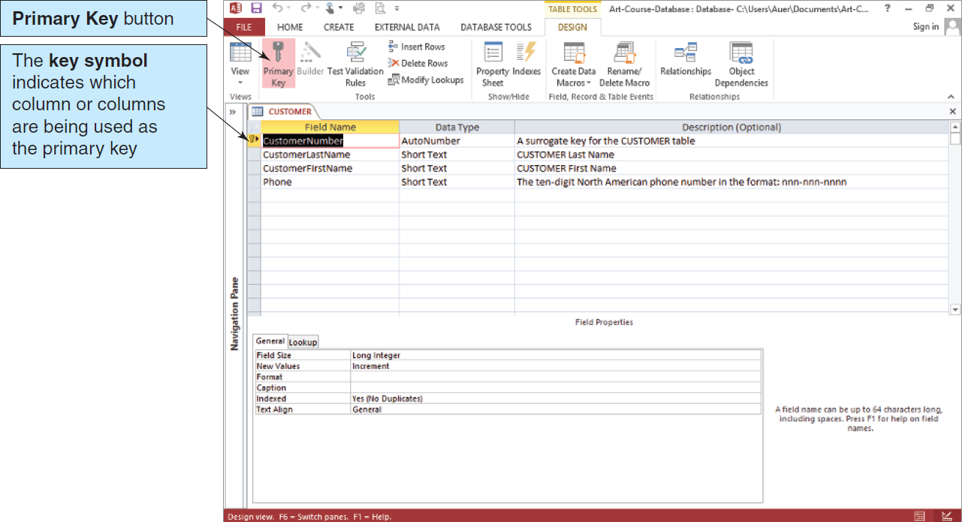
Defining the Primary Key in Microsoft Access
Figure 2.7: Defining a Primary Key in Microsoft Access 2013

Slide 18
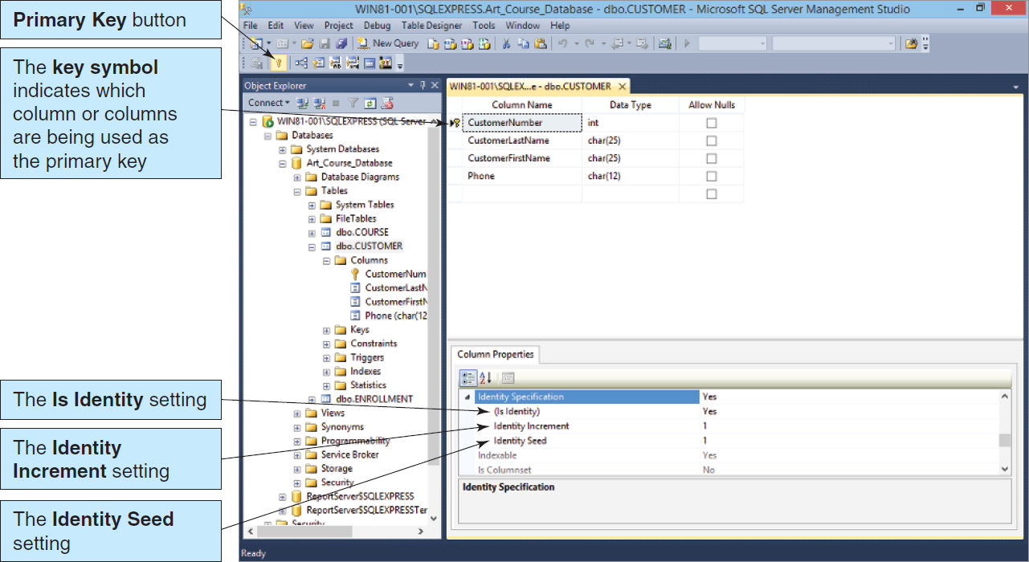
Defining the Primary Key in Microsoft SQL Server 2014
Figure 2.8: Defining a Primary Key in Microsoft SQL Server 2014

Slide 19
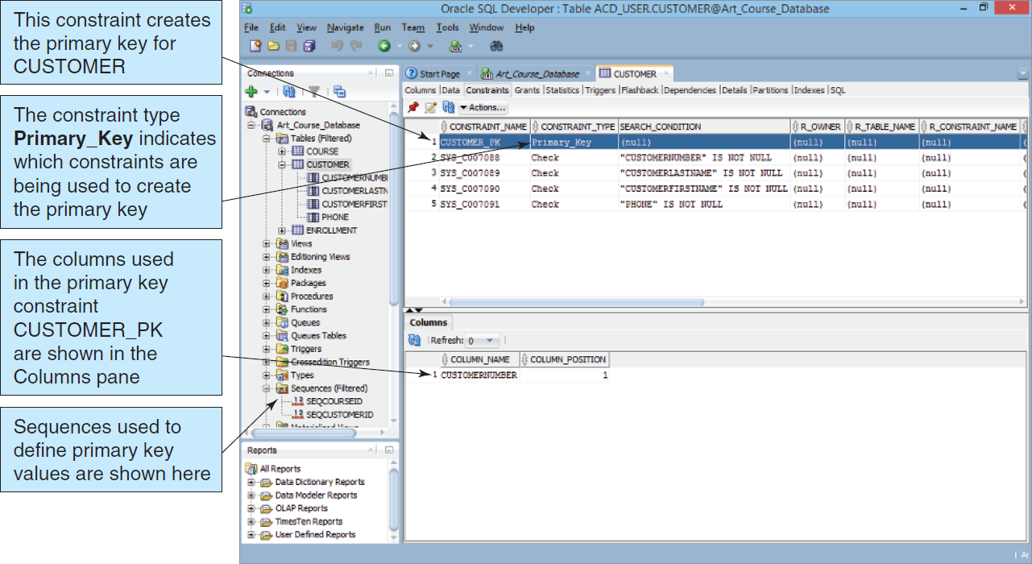
Defining the Primary Key in Oracle Database Express Edition 11g Release 2
Figure 2-9: Defining a Primary Key in Oracle Database Express Edition 11g Release 2

Slide 20
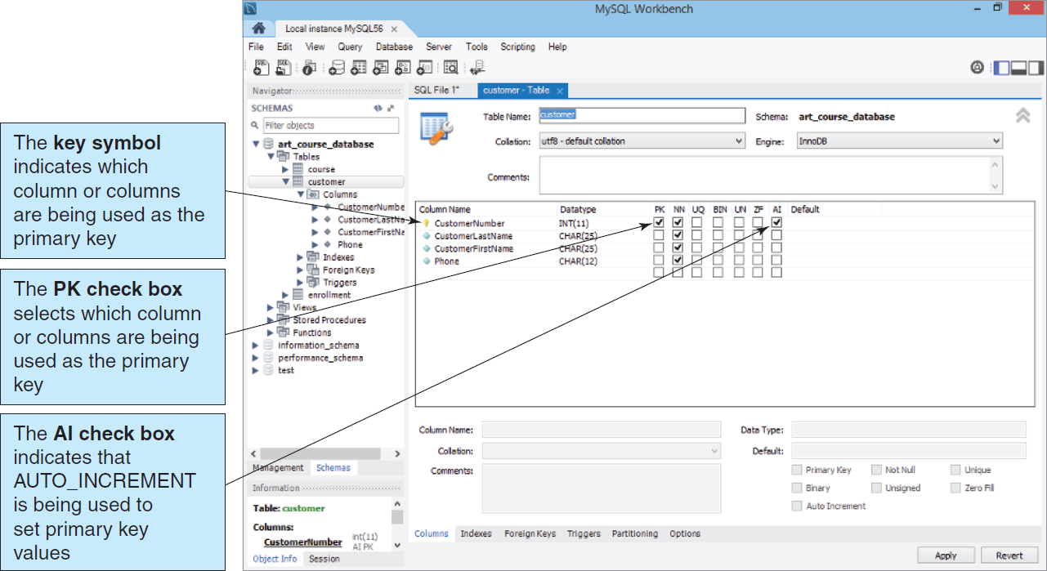
Defining the Primary Key in Oracle MySQL 5.6 Community Server
Figure 2-10: Defining a Primary Key in Oracle MySQL 5.6 Community Server

Slide 21
A Surrogate Key
A surrogate key is a unique, numeric value that is added to a relation to serve as the primary key.
Surrogate key values have no meaning to users and are usually hidden on forms, queries, and reports.
A surrogate key is often used in place of a composite primary key.

Slide 22
Surrogate Key Example
If the Family Member primary key is FamilyID, FirstName, Suffix, it would be easier to append and use a surrogate key of FamMemberID.
FamilyID, FirstName and Suffix remain in the relation.

Slide 23
Relationships Between Tables
A table may be related to other tables.
For example
An Employee works in a Department
A Manager controls a Project

Slide 24
A Foreign Key
To preserve relationships, you may need to create a foreign key.
A foreign key is a primary key from one table placed into another table.
The key is called a foreign key in the table that received the key.

Slide 25
Foreign Key Example I
Project
ProjID
ProjName
MgrID
Manager
MgrID
MgrName
Primary Key
Foreign Key

Slide 26
Foreign Key Example II
Department
DeptID
DeptName
Location
Employee
EmpID
DeptID
EmpName
Primary Key
Foreign Key

Slide 27
Referential Integrity
Referential integrity states that every value of a foreign key must match a value of an existing primary key.
Example (see previous slide):
If EmpID = 4 in EMPLOYEE has a DeptID = 7 (a foreign key), a Department with DeptID = 7 must exist in DEPARTMENT.
The primary key value must exist before the foreign key value is entered.

Slide 28
Referential Integrity (Cont’d)
Another perspective…
The value of the Foreign Key EmployeeID in EQUIPMENT
must exist in
The values of the Primary Key EmployeeID
in EMPLOYEE

Slide 29
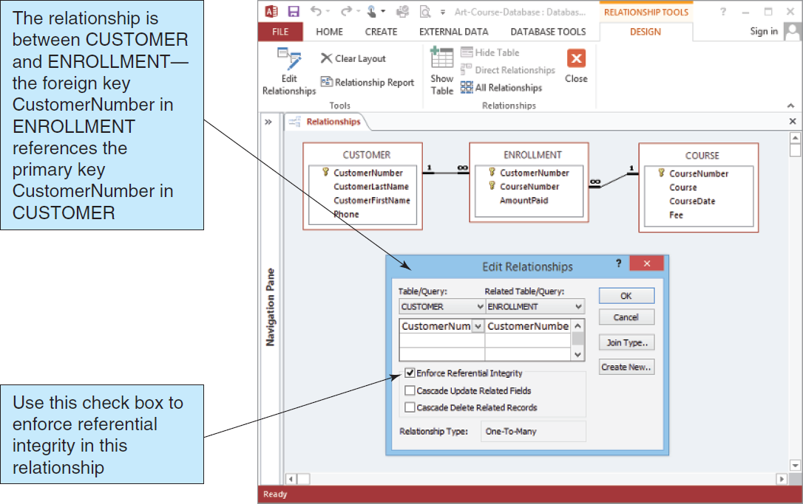
Foreign Keys in Microsoft Access 2013
Figure 2-11: Enforcing Referential Integrity in Microsoft Access 2013

Slide 30
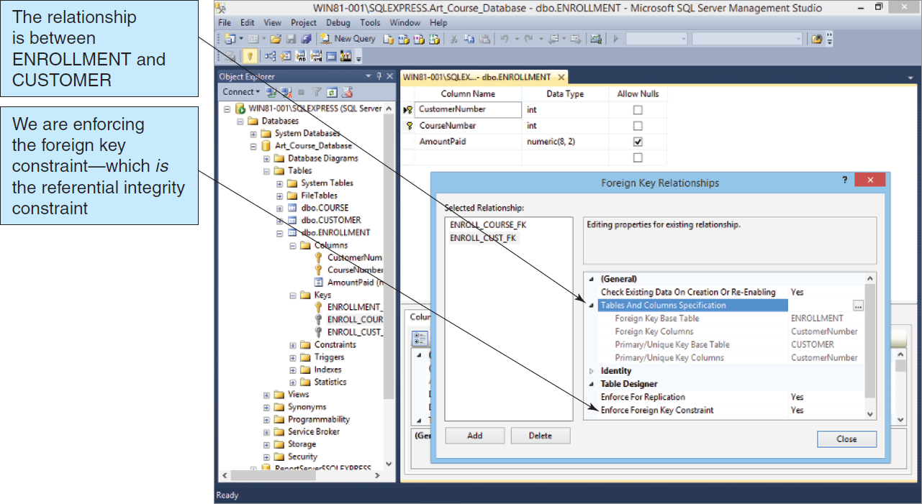
Foreign Keys in Microsoft SQL Server 2014
Figure 2-12: Enforcing Referential Integrity in Microsoft SQL Server 2014

Slide 31
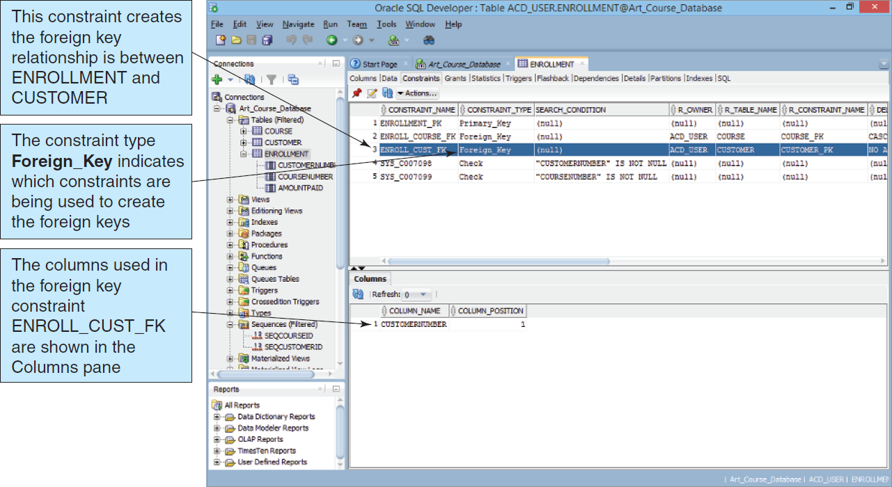
Foreign Keys in Oracle Database Express Edition 11g Release 2
Figure 2-13: Enforcing Referential Integrity in Oracle Database Express Edition 11g Release 2

Slide 32
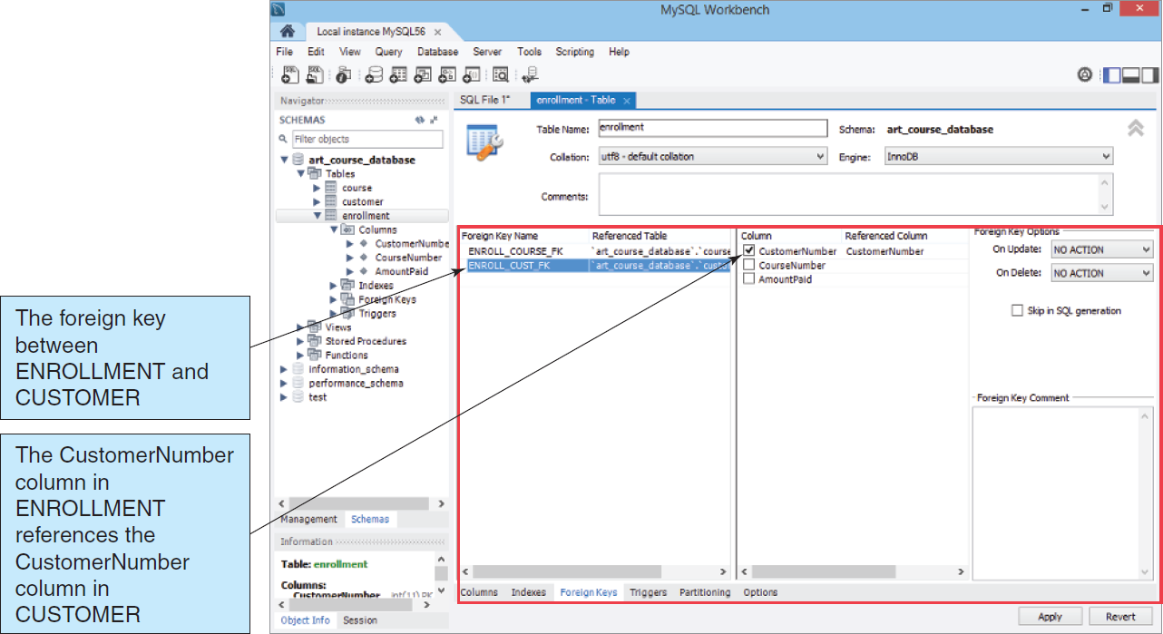
Foreign Keys in Oracle MySQL 5.6 Community Server
Figure 2-14: Enforcing Referential Integrity in Oracle MySQL 5.6 Community Server

Slide 33
The Null Value
A Null value means that no data was entered.
This is different from a zero, space character, or tab character.

Slide 34
The Problem of Null Values
A Null is often ambiguous. It could mean…
The column value is not appropriate for the specific row.
The column value is not decided.
The column value is unknown.
Each may have entirely different implications.

Slide 35
Functional Dependency
Functional Dependency—A relationship between attributes in which one attribute (or group of attributes) determines the value of another attribute in the same table
Illustration…
The price of one cookie can determine the price of a box of 12 cookies.
(CookiePrice, Qty)
BoxPrice

Slide 36
Determinants
The attribute (or attributes) that we use as the starting point (the variable on the left side of the equation) is called a determinant.
(CookiePrice, Qty)
BoxPrice
Determinant

Slide 37
Candidate/Primary Keys and Functional Dependency
By definition… A candidate key of a relation will functionally determine all other attributes in the row.
Likewise, by definition… A primary key of a relation will functionally determine all other attributes in the row.

Slide 38
Primary Key and Functional Dependency Example
(EmpLastName,
EmpPhone)
(EmployeeID)
(ProjectID)
(ProjectName,
StartDate)

Slide 39
Normalization
Normalization—A process of analyzing a relation to ensure that it is well formed
More specifically, if a relation is normalized (well formed), rows can be inserted, deleted, or modified without creating update anomalies.

Slide 40
Normalization Principles
Relational design principles for normalized relations:
To be a well-formed relation, every determinant must be a candidate key.
Any relation that is not well formed should be broken into two or more well-formed relations.

Slide 41
Modification Problems
Tables that are not normalized will experience issues known as modification problems.
Insertion problems
Difficulties inserting data into a relation
Modification problems
Difficulties modifying data into a relation
Deletion problems
Difficulties deleting data from a relation

Slide 42
Solving Modification Problems
Most modification problems are solved by breaking an existing table into two or more tables through a process known as normalization.

Slide 43
Definition Review
Functional dependency
The relationship (within the relation) that describes how the value of one attribute may be used to find the value of another attribute.
Determinant
The attribute that can be used to find the value of another attribute in the relation
The right-hand side of a functional dependency

Slide 44
Definition Review II
Candidate key
The value of a candidate key can be used to find the value of every other attribute in the table.
A simple candidate key consists of only one attribute.
A composite candidate key consists of more than one attribute.

Slide 45
Normal Forms
There are many defined normal forms:
First Normal Form (1NF)
Second Normal Form (2NF)
Third Normal Form (3NF)
Boyce-Codd Normal Form (BCNF)
Fourth Normal Form (4NF)
Fifth Normal Form (5NF)
Domain/Key Normal Form (DK/NF)

Slide 46
Normalization to BCNF
For our purposes, a relation is considered normalized when:
Every determinant is a candidate key.
This is Boyce-Codd Normal Form (BCNF)

Slide 47
Normalization Example
(StudentID)
(StudentName, DormName, DormCost)
However, if…
(DormName)
(DormCost)
Then DormCost should be placed into its own relation,
resulting in the relations:
(StudentID)
(StudentName,
DormName)
(DormName)
(DormCost)

Slide 48
Normalization Example (Cont’d)
(AttorneyID,ClientID)
(ClientName, MeetingDate, Duration)
However, if…
(ClientID)
(ClientName)
Then ClientName should be placed into its own relation,
resulting in the relations:
(AttorneyID,ClientID)
(MeetingDate, Duration)
(ClientID)
(ClientName)

Slide 49
DAVID M. KROENKE and DAVID J. AUER
DATABASE CONCEPTS, 7th Edition
All rights reserved. No part of this publication may be reproduced, stored in a retrieval system, or transmitted, in any form or by any means, electronic, mechanical, photocopying, recording, or otherwise, without the prior written permission of the publisher. Printed in the United States of America.
Copyright © 2015 Pearson Education, Inc.
Publishing as Prentice Hall

Slide 50
The Relational Model
DAVID M. KROENKE and DAVID J. AUER
DATABASE CONCEPTS, 7th Edition
End of Presentation on Chapter Two

