Slide 1
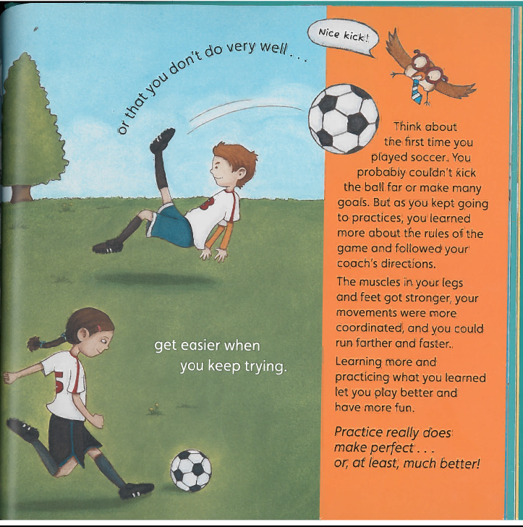

Slide 2
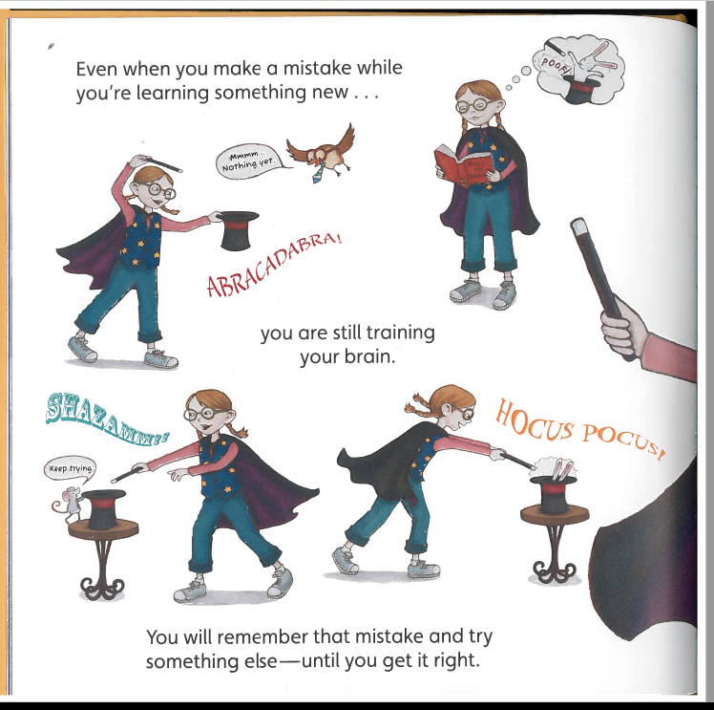

Slide 3
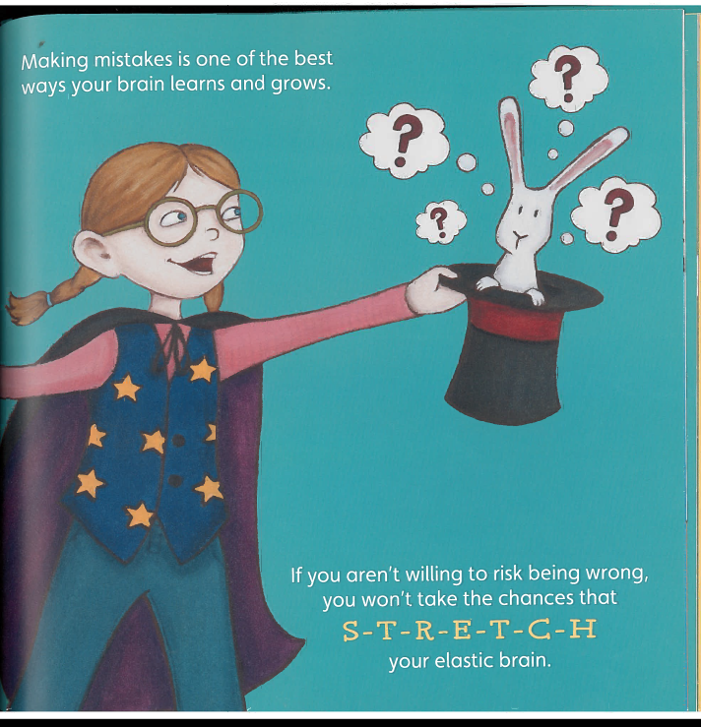

Slide 4
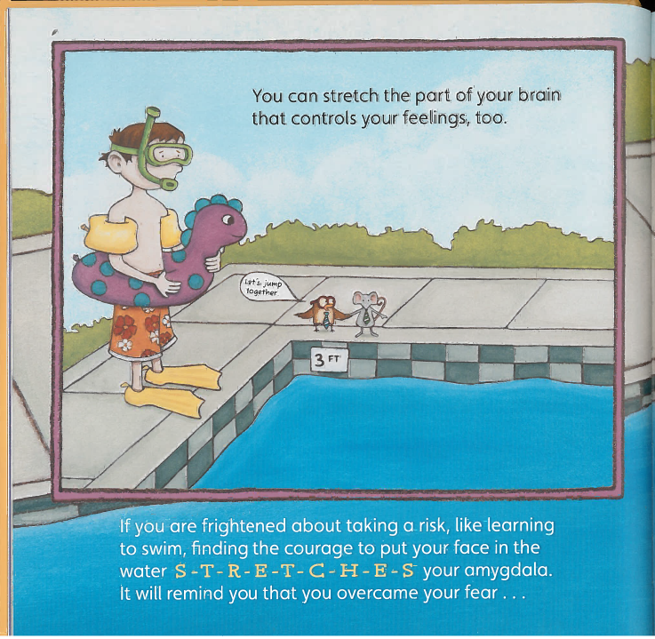

Slide 5
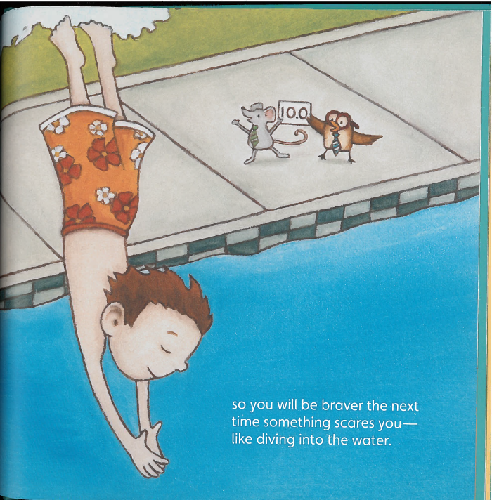

Slide 6
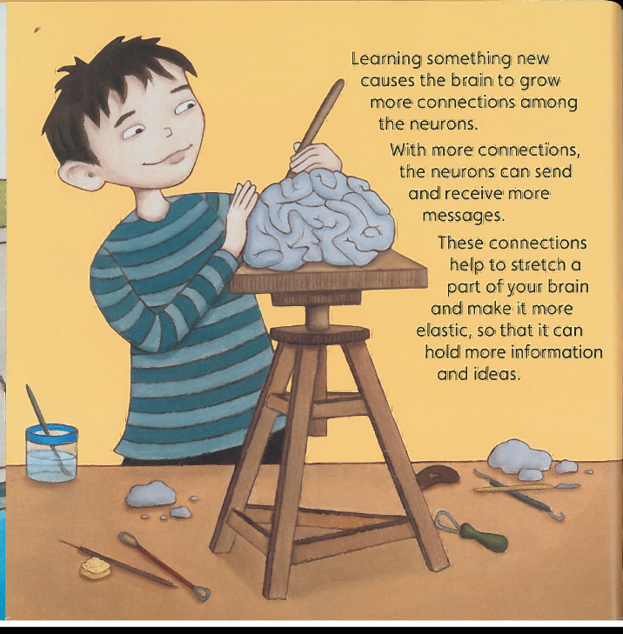

Slide 7
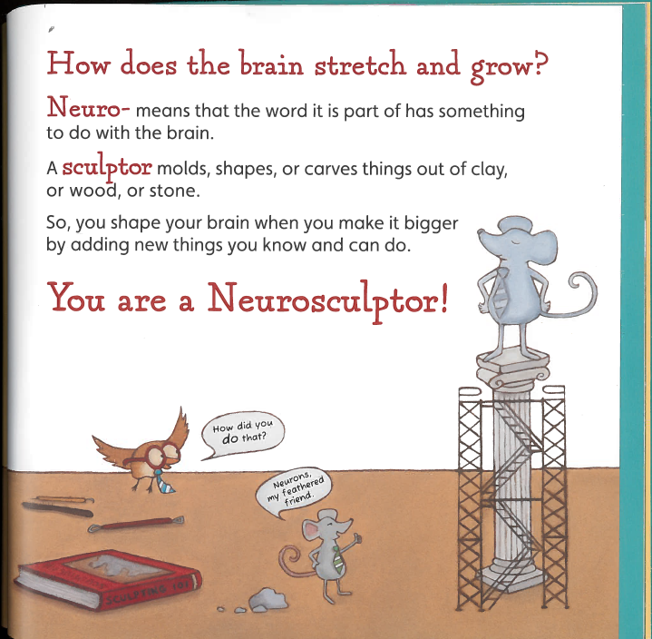

Slide 8
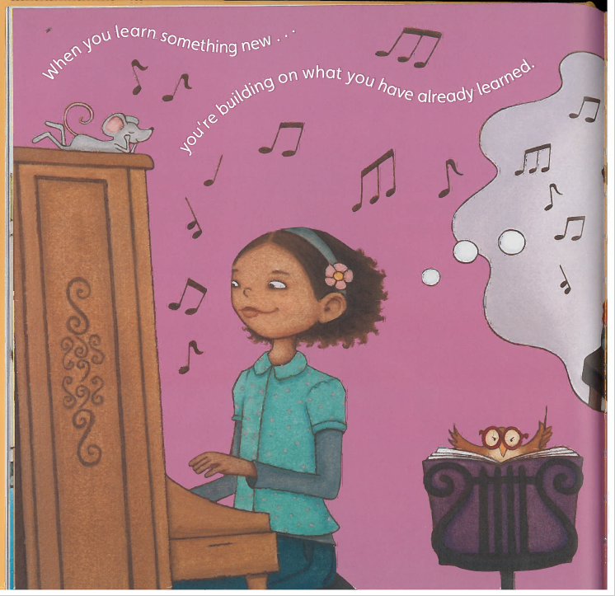

Slide 9
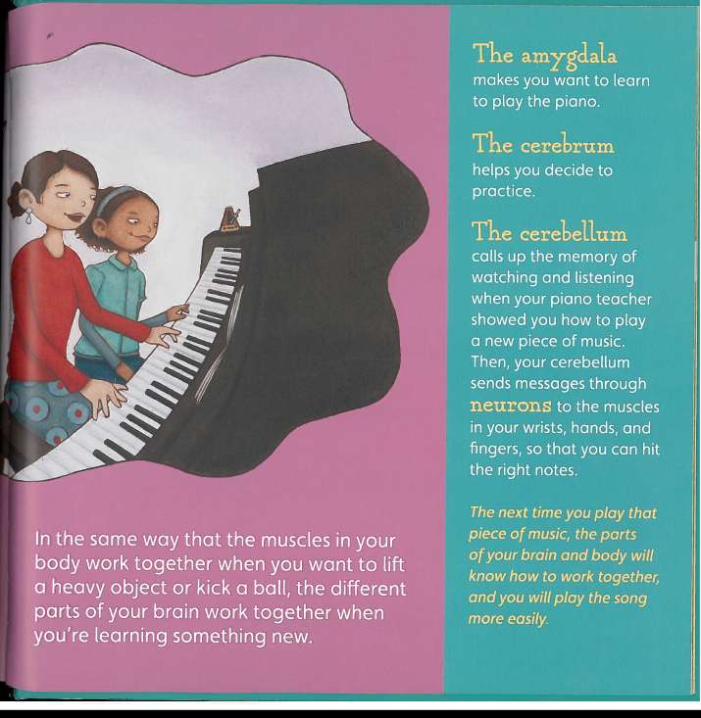

Slide 10
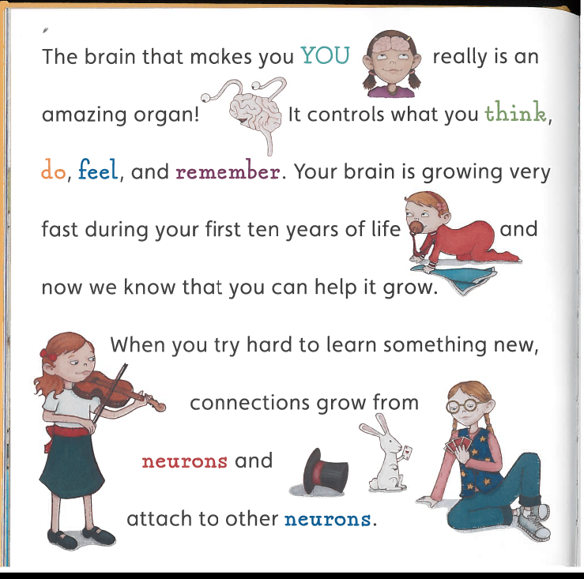

Slide 11
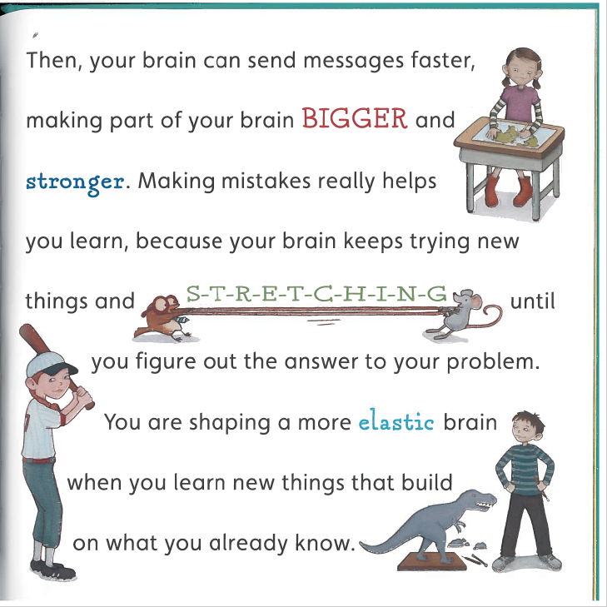

Slide 12
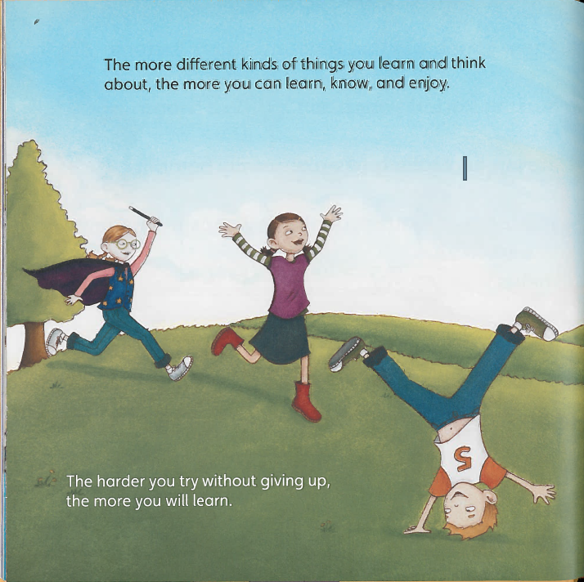

Slide 13
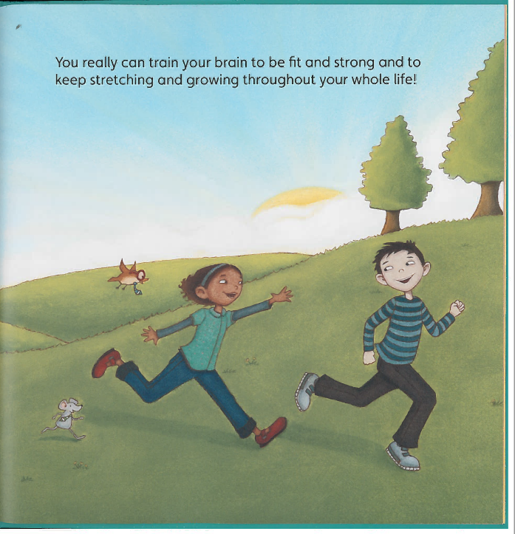

Slide 14
Respond & Create Something Memorable (during class)
How does knowing about the function of the brain change the way you make decisions or choices in your life?
Does your understanding of the brain affect your courage to try something new? Why or why not?
How might your outlook change when you are faced with a challenge that feels impossible?
Discuss each part of the brain and its function by creating a catchy tune, poem, story, etc.

