Slide 1


The Devil is in the Details: Can I Really Say “God” in School??
Jill Heinrich
Education Department
Cornell College

Slide 2

Issues at Stake:
What does “separate” mean when determining the role of religion in American public education?
What role does the notion of civil religion play in the interpretation of this mandate?
How has litigation driven educational policy?
Is this separation mandate unique to our system?

Slide 3
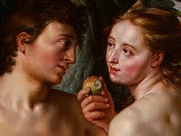
Milton’s Paradise Lost & Genesis:
You Can’t Teach That…Can You???
Book IX The Temptation of Eve - “For inferior, who is free?”
Genesis 3: Then the Lord God said to the woman, “What is this that you have done?” the woman said, “the serpent beguiled me, and I ate.” …To the woman he said, “I will greatly multiply your pain in childbearing; in pain you shall bring forth children, yet your desire shall be for your husband, and he shall rule over you.”

Slide 4
A New Nation, Religion & an Enlightened Notion of Separate
We must erect a “wall of separation” between
church and state.”
Thomas Jefferson, 1802
U.S. Constitution - Bill of Rights: 1st Amendment states that “Congress shall make no law respecting an establishment of religion or prohibiting the free exercise thereof.”
  Establishment Clause- freedom from
  Free Exercise Clause – freedom to

Slide 5
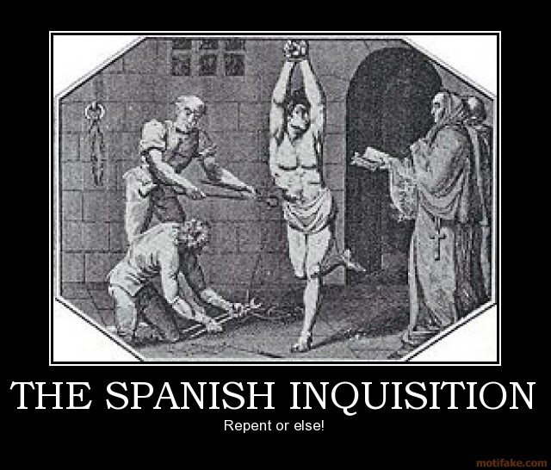
Founding Fathers, Theocracy & its Discontents
Spanish Inquisition 1233-1808
est. 31, 912 burned at stake in Asia
Europe and New World Colonies
(Durant The Reformation, 1957)
St. Bartholomew’s Day Massacre
August 24th, 1572- 3,000 killed in Paris and est. 70,000 in provinces
On-going religious wars – Huguenots & Catholics
English Civil Wars: Commonwealth vs. Monarchy
1638-1660: est. 190,000 died
(Ellerbe The Dark Side of Christian History, 1995)

Slide 6
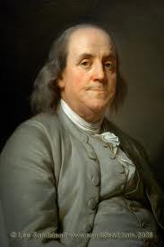
American Colonies &
Witchcraft
New England Witch-hunts
1648 – 1663
13 women and 2 men hanged
Salem Witch Trials: 1692-1693
19 people and 2 dogs hanged
Benjamin Franklin: 1706 – 1790
Grew up in Cotton Mather’s Quaker Pennsylvania
Experienced theocracy first-hand
Familiar with the hysteria and dangers religion could incite
(Brands, 2000)

Slide 7

Enlightenment Ideas
Enlightenment thinkers – Voltaire, Hume, Locke and Kant
Targeted religious orthodoxy & what they considered “religious fanaticism.” Advocated separation of church and state.
Challenged divine right of kings: Louis XIV & XV,
Charles I & II and James I
Believed human reason can combat ignorance, superstition, and tyranny to build a better world.
Kant – “Enlightenment means thinking for yourself.”

Slide 8
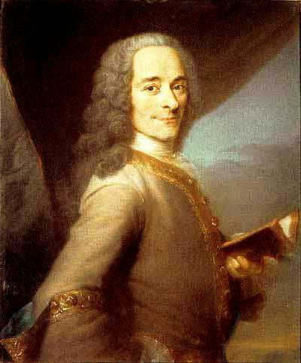
Voltaire’s Campaign Against Fanaticism
“You can’t argue with a fanatic.”
Religious tyranny will naturally align itself in a world where church and state are not separated.
Henry IV of Navarre: Politique Ruler
Edict of Nantes (1598): “Paris is worth a mass.”
Conclusion: Recognized that most people needed some type of religion but it must be a religion driven by reason and divorced from fanaticism.

Slide 9
Voltaire: Letters Concerning the
English Nation (1733)
England: created a world which combined religious non-conformity and toleration
Religious Pluralism: the key to eliminating religious antagonism and the evils of fanaticism.
“It is the number of religions that allow for toleration; if there were only one, there exists the danger of tyranny; only two they would cut each others throats, but there are 30 and they live happily together and in peace.”

Slide 10
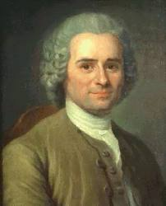
Rousseau The Social Contract:
Principles of Civil Religion
Ideas became part of the political &
Cultural landscape of 18th century
America (1762)
Belief in a divinity
Religion not attached to any particular religious belief or organized church
Religion designed & controlled by the state

Slide 11
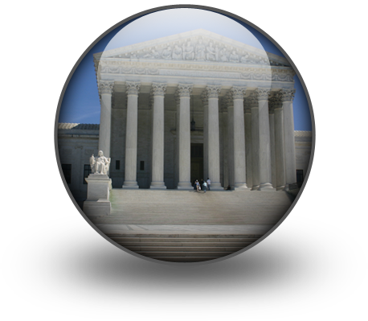
Enlightenment’s Influence on a New American Nation
Washington, Franklin, Jefferson & Paine:
influenced by English & French thinkers
Notion of God: The God who underwrites the Declaration of Independence is the same deist God who
Champions common sense and tolerance over superstition
Sanctions the authority of the state
Is perpetuated through the notion of civil religion

Slide 12
Washington & Adams: Religion, Moral Character & Public Order
Washington:
In his Farewell Address of September 1796, Washington referred to religion as "a necessary spring of popular government” and argued that:
"Religion and morality" were the "great Pillars of human happiness, these firmest props of the duties of Men and citizens.”
"National morality," could not exist "in exclusion of religious principle."
"Virtue or morality," were the products of religion and "a necessary spring of popular government."
Adams:
Adams claimed that statesmen "may plan and speculate for Liberty, but it is Religion and Morality alone, which can establish the Principles upon which Freedom can securely stand.“
.

Slide 13

Civil Religion’s Mandate:
“God Bless America”
Bellah (1968) in American Civil Religion
defines civil religion as the “institutionalized collection of sacred beliefs about the American nation” expressed in our founding documents and presidents’ inaugural addresses (180). Based upon the following beliefs:
Existence of a transcendent being called “God” and that our nation is subject to God’s laws
Assurance that God will guide and protect the American nation
Foundation is based upon and perpetuated through symbols: holidays such as 4th of July, flag, memorials, nat’l anthem, and oaths of office.

Slide 14

Our National Anthem
Francis Scott Key’s poem "The Star Spangled Banner," was penned in 1814 and was officially adopted as the national anthem on March 3, 1931. The fourth verse states:
Praise the power that hath made and preserved us a nation!
Then conquer we must when our cause it is just,
And this be our motto—"In God is our Trust.’
And the Star-Spangled Banner in triumph shall wave
O’er the land of the free and the home of the brave."

Slide 15
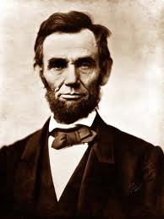

Sanctioning God’s Place in America’s Heritage
Executive Branch
Abraham Lincoln: “…that this nation, under God, shall have a new birth of freedom.”
Judicial Branch
Supreme Court Justice William O. Douglas: “We are a religious people whose institutions presuppose a Supreme Being.”

Slide 16
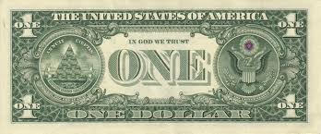
A New National Motto: Farewell to “E pluribus unum”
Make way for “In God We Trust”
PL 84-851 (1955) required the inscription “In God We Trust” on all coins and paper money.
“In these days when imperialistic and materialistic communism seeks to attack and destroy freedom, we should continuously look for ways to strengthen the foundations of our freedom. At the base of our freedom is our faith in God and the desire of Americans to live by His will and His guidance. As long as this country trusts in God, it will prevail.”

Slide 17
The Battle Begins: Civil Religion & Separation of Church & State
Abingdon v. Schempp (1955): motto “in God we trust” complies with notion of civil religion (1955).
Justice William Brennan:
“It is not that the use of these four words (In God We Trust) can be dismissed as ‘de minimis’… The truth is that we have simply interwoven the motto so deeply into the fabric of our civil policy that its present use may well not present that type of involvement which the First Amendment prohibits."

Slide 18

Pledge of Allegiance
Congress (1954) voted to add the phrase "Under God" to the Pledge of Allegiance arguing that:
“Our American Government is founded on the concept of the individuality and the dignity of the human being. Underlying this concept is the belief that the human person is important because he was created by God and endowed by Him with certain inalienable rights which no civil authority may usurp. The inclusion of God in our Pledge therefore would further acknowledge the dependence of our people and our Government upon the moral directions of the Creator.

Slide 19
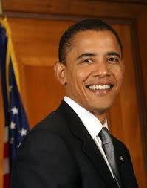
Presidential Invocations:
“God Bless America”
“May God bless you. And may God bless the United States of America.”
(President Obama - May 2, 2011 on the death of Osama bin Laden)
Presidents ending all speeches with “God Bless America”
Ronald Regan & George Bush: 90%
Bill Clinton: 89%
George W. Bush: 84%
Domke & Coe (2010) The God Strategy: How Religion Became a Political
Weapon in America

Slide 20
Sorting out Separate in School:
“It’s Complicated”
Everson v. Board of Education (1947):
Can federal money be given to parochial schools for busing? Answer: Yes
Justice Hugo Black, referencing Jefferson’s ideological mandate, held “The establishment of the religious clause of the 1st Amendment means at least this: Neither a state nor the federal government can set up a church.”
Precedent in public education: Tolerance or Advocacy – that is the question!

Slide 21
Freedom from and Freedom to:
The Lemon Test
Lemon vs. Kurtzman (1971): Three-pronged test to balance the Establishment & Free Exercise Clauses.
Schools must:
Neither prohibit nor promote religion
Be motivated by a secular purpose
Avoid excessive entanglement

Slide 22

The Balance:
Free Exercise vs. Establishment
Points of Controversy:
Religious holidays & excusal
Religious displays – Christmas trees, music programs
Prayer in school – locker rooms, silent prayer, prayer groups
Student exercise: “material and substantial disruption”
Teacher – consideration of “in loco parentis” and “arm of the state.”

Slide 23
Schools as Religious Battlegrounds
Abington v. Schempp (1963): Supreme Court ruled religious exercises in public schools are unconstitutional but the study of the Bible for secular purposes is acceptable: Justice Clark: “It certainly may be said that the Bible is worthy of study for its literary and historic qualities…when presented objectively as part of a secular program of education.”
Wallace vs. Jaffree (1985): Supreme Court deemed silent meditation or voluntary prayer unconstitutional because school-sponsored.
Cooper vs. Eugene SD # 4J (1986): Oregon Supreme Court forbid a Sikh teacher from wearing a dastaar (turbin) on grounds of in loco parentis.
Westside Bd. of Ed. Vs. Mergens (1990): Supreme Court ruled students have the right to organize their own religious, political or philosophical groups but school personnel may only attend in “nonparticipatory capacity.”

Slide 24
School Prayer & the Establishment Clause
Lee vs. Weisman (1992): in a 5-4 decision, Supreme Ct. held that school-sponsored prayer at graduation ceremonies violated 1st Amendment.
Jones v. Clear Creek ISD (1993): 5th Circuit Court in Texas allowed such prayer as it was student-initiated, student-led and non-sectarian and non-proselytizing. Supreme Court refused to hear appeal.
Santé Fe ISD v. Doe (2000): High school in Texas allowed student to deliver school-wide prayer prior to football games. In a 6-3 decision, Supreme Ct. held that because speech was “public” and “school-sponsored,” it violated Est. Clause.

Slide 25
Free Exercise Clause
Wisconsin vs. Yoder (1972): Amish exception
Ruling: allowed to violate compulsory education on grounds of religious beliefs.
Board of Ed. Of Westside SD vs. Mergens (1990): Christian student group prohibited from meeting because school required all groups to have faculty sponsor.
Ruling: prohibited free exercise; group has right to meet under Equal Access Act but faculty must not participate.
Precedent - School prayer: If private and student-led then typically allowed, but faculty and coaches should not participate as it’s considered advocacy.

Slide 26
Religious holidays: students must be given excusals and opportunity to make up work with no grade penalty.
Religious symbols: justified if they have assumed secular meaning e.g. Christmas trees, Easter bunny.
Pledge of Allegiance: the words “under God”
Current rulings: Students may be required to “respectfully” stand but not to recite pledge.

Slide 27
American Public Education:
In loco parentis
Schools must honor a student’s right to freely exercise his/her religious beliefs.
Limitation: “Clear and present danger” and/or “material and substantial disruption” justifies limitation.
Teachers: “arm of the state” and thus limited in their expression of religious beliefs because in loco parentis grants them authority and influence.

Slide 28
Current Crusades: “Whatever you do, don’t say ‘God!’”
Controversy and litigation have prompted schools to avoid religion, even when addressed in a secular fashion. Is this problematic? Some would argue…
“The search for the sacred: America’s quest for spiritual meaning” should be honored (Goodrich 1994).
“…religion is a significant part of the lives of millions of Americans and thus worthy of being studied by their children” (Uphoff 2003).

Slide 29
Religion is Art, History & Culture
Literature:
Chaucer’s The Canterbury Tales
Milton’s Paradise Lost
Art: Michelangelo, Raphael, daVinci, Rubens, Titian
History: Medieval Crusades, Spanish Inquisition, Protestant Reformation, 9/11
Thought to Ponder: Has the American school system over the past two decades ignored historical and cultural analysis of religion to avoid controversy and potential litigation?

Slide 30
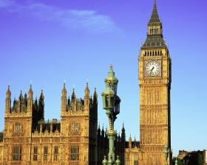
English School System
Levels: Infant ages 5 – 7
Junior ages 8 – 11
Comprehensive ages 12 – 16 or 18
Legal mandate: Religious education is taught ‘according to an agreed local syllabus.” Religion must be taught every year and at every level so that: (www.schoolswork.co.uk)
Students become culturally-aware of major world religions including Islam, Christianity, Hinduism, Buddhism and Judaism.
Students recognize the historical, as well as the contemporary, importance that religion has exercised in our world.

Slide 31
Religion through the Auspices of 7th grade Social Studies
Gray’s Academy in Essex County, England: Ms. Crofton’s 7th grade class
working-class, public school; class comprised of 13 year olds with diverse ethnic and religious backgrounds
Curriculum: studied major world religions including Judaism, Christianity, Buddhism, Hinduism and Islam
Studying Christianity and the events associated with the crucifixion and resurrection of Jesus Christ during the Easter season.

Slide 32
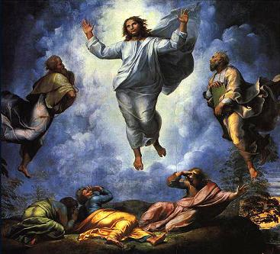
The Transfiguration by Raphael

Slide 33
Fact or Faith:
“Did he rise from the dead?”
Teaching objective: Through careful analysis of the resurrection of Jesus Christ, students will contrast the factual elements of the story with the faith-based elements, thereby gaining a deeper understanding of Christian religious ideology.
Analysis activity: Now that we’ve studied the crucifixion and resurrection of Jesus Christ, list those elements of the story that are factual in that they are recorded in history. Then list those elements that cannot be proven and thus must be categorized as expressions of Christian faith.

Slide 34
Faith vs. Reason:
Analyzing Easter
Factual
Life
Born to Mary and Joseph (“maybe not in a manger”)
Crucifixion by the Romans
Death & burial in the tomb
Elements of Faith
Divinity: Son of God
Miracles: wedding of Canae, Lazarus, curing lepers
Tomb: stone removed from the entrance
Resurrection: Mary Magdeline, and in some gospels other women, claiming to see Jesus return to earth after his death

Slide 35
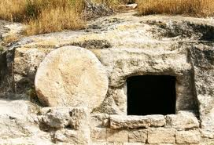
“From the mouths of babes”:
Brandt: “The faith part would say that he rose from the dead after being put in the tomb but fact would say that couldn’t happen.”
Sauvik: “Fact would say that someone removed the body but faith would say no…that he rose from the dead because you couldn’t have removed the stone because it was too heavy.”
Beth: “Faith would say that Mary saw Jesus return to earth but fact would say she might have just imagined it.”
Kate: “It can be proved that he lived and that the Romans crucified him but maybe not that he was the son of God.”

Slide 36
Christmas Lesson: The Immaculate Conception
Luke 1:26
“’Do not be afraid, Mary, for you have found favor with God. And now, you will conceive in your womb and bear a son, and you will name him Jesus. He…will be called the Son of the Most High’….Mary said to the angel, ‘How can this be, since I am a virgin?’ The angel said to her, ‘The Holy Spirit will come upon you, and the power of the Most High will overshadow you; therefore the child to be born will be holy; he will be called the Son of God….For nothing will be impossible with God.’”

Slide 37
Can you really say God in school?...
Yes, at least in Britain
Ms. Crofton: “We study the major religions of the world because we want our students to understand and respect them. It’s also important because we have Hindu students, Muslim students, Christian and Jewish students and probably even some atheist students. We’re not afraid to talk about those differences, because, like I tell the students, it’s when you don’t talk about them that we tend to stereotype and suspect others because of their religious differences.”

Slide 38
Civil Religion: God is still blessing America!
The Declaration of Independence
“We hold these truths to be self-evident, that all men are created equal; that they are endowed by their Creator with certain unalienable rights; that among these are life, liberty, and the pursuit of happiness.”
Thomas Jefferson, 1776
"Declare church and state forever separate and distinct; but each free within their proper spheres."
Ulysses S. Grant, December 7, 1875

Slide 39
Presidential Guarantees
“…It was Jefferson, as governor of Virginia, who wrote the Statute of Religious Liberty in 1786, which said that ‘no man shall be compelled to frequent or support any religious worship’ but that all people ‘shall be free to profess…their opinion in matters of religion.’”
Harry S. Truman
"I believe in an America that is officially neither Catholic, Protestant nor Jewish – where…no religious body seeks to impose its will directly or indirectly upon the general populace or the public acts of its officials -- and where religious liberty is so indivisible that an act against one church is treated as an act against all.“
John F. Kennedy

Slide 40
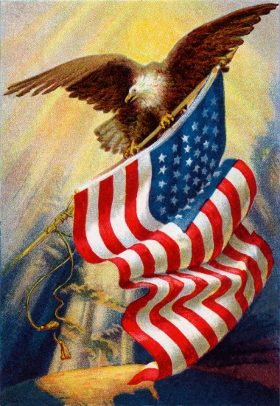
Freedom from…Freedom to
The Establishment Clause
“Those who cannot remember the past are condemned to repeat it.”
George Santayana (1905)
"The Government of the United States is not in any sense founded upon the Christian Religion."
Treaty of Tripoli (1797) signed by President Washington
The Free Exercise Clause
"I consider the government of the United States as interdicted by the Constitution from intermeddling with religious institutions, their doctrines, disciplines or exercises." Thomas Jefferson, Jan. 23, 1808

Slide 41
Bibliography
Alexander, K. and M. D. Alexander. (1992). American Public School Law 3rd ed.
St. Paul, MN: West.
Bellah, R.N. (1967). “Civil Religion in America.” Daedalus 96: 1-21.
Bellah, R.N. (1970). Beyond Belief. New York: Harper.
Brand, H.W. (2000). The 1st American: The Life and Times of Benjamin Franklin.
New York: Doubleday.
Durant, W. (1957). The Reformation: A Story of Civilization. New York: Simon
& Schuster.
Domke, D. and K. Coe. ( 2010). The God Strategy: How Religion Became a Political Weapon. Oxford, England: Oxford UP.

Slide 42
Bibliography continued
Ellerbe, H. (1995). The Dark Side of Christian History. Orlando: Morningstar &
Lark.
Goodrich, L.J. (1994). “Religion is Alive and Diverse in U.S.” The Christian
Science Monitor (Jan. 10), 11-13.
Rousseau, J. (1997). ‘The Social Contract’ and Other Later Political Writings.
Cambridge, England: Cambridge UP.
Uphoff, J.K. (2003). “Religious Diversity and Education.” In Multi-cultural
Education. Ed. J. Banks and C. McGee-Banks. Hoboken, NJ: Wiley.
Wilson, J.F. (1979). Public Religion in American Culture. Philadelphia:
Temple U.

