Slide 1
THE 18TH SALONNIERE: HOW CONSTRUCTIVISM COURTED GENIUS IN THE ENLIGHTENMENT SALON
Kerry Bostwick
&
Jill Heinrich
Notes:
Thanks for coming to our HAIG today which examines the 18th century French salon and the particular influence that the women who planned and orchestrated these salons had upon the Enlightenment cause. Historians refer to these women as salonnieres and the men of letters who frequented their salons as philosophes, and in just a bit we’ll introduce you to some of these remarkable people.

Slide 2
WHERE WORLDS COALESCE
Salon: a place to congregate for the purposes of intellectual discourse.
Notes:
So a brief word on what the salon was and what it became. In the 17th: entry was limited primarily to the 2nd estate, the nobility, and some higher ranking members of the clergy, the 1st estate, and so it primarily a place of elite sociability. By the dawning of the 18th, however, the philosophe, who was a member of the burgoisie and thus 3rd estate, had become its feature act. This change was engendered by the salonniere, and, as mentioned, it was the coming together of these two forces that allowed the production, exchange and dissemination of ideas that would contribute to the Republic of Letters and make the Enlightenment possible.

Slide 3
THE SALONNIERE’S CONSTRUCTIVIST CRAFT
The salonniere established an egalitarian yet structured “classroom” space based upon mutual respect and collaboration—a marriage of sorts that allowed the genius in her midst to come to full fruition.
She placed her male guests at the center of the conversation so she could function as the silent hand to guide their inquiry and scaffold their conversation.
She established a democratic space that fostered mutual respect and collaboration.
Notes:
Ours is an interdisciplinary but admittedly anachronistic analysis as it examines the 18th century French salonniere’s influence upon the Enlightenment albeit through a contemporary constructivist lens. Specifically we argue that…

Slide 4
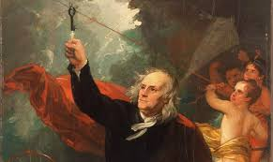
THE AGE OF THE ENLIGHTENMENT: 1680’S TO THE END OF 18TH CENTURY
Played a central role in shaping the world in which we live and raised science to its current level of prestige.
Combatted fanaticism, superstition and religious intoleration.
Advanced the notion that individuals possess inalienable rights that must be enshrined in law.
Fostered the ideals of liberty, equality, and justice that would influence our Founding Fathers and our own nation state.
Gave birth to a host of new cultural institutions—known as “the public sphere.”
Notes:
Pope Pius VI – San Marco in Venice Bells “to ward off lightening and other malignant forces.”

Slide 5
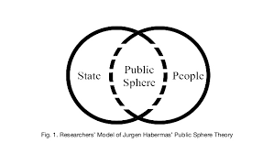
Jürgen Habermas The Structural Transformation of the Public Sphere
Public sphere: a domain in which private individuals came together to discuss matters of public concern.
Professional societies which disseminated useful knowledge to a broader community (Royal Society & French Academies).
Coffeehouses, salons, Masonic lodges, societies for reading & discussion of books and journals.
Notes:
German philosopher Jürgen Habermas (1962) The Structural Transformation of the Public Sphere
Royal Society of England- royal in name only Continent – more state sponsored French Academy of Sciences Louis XIV founded

Slide 6
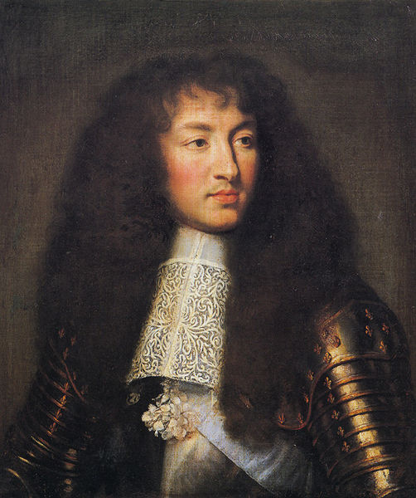
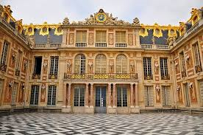
THE SALON AS AN EVOLVING CULTURAL INSTITUTION
Louis XIV Versailles
The Sun King bids farewell to Paris 1689
Notes:
Jill

Slide 7
SALON: FROM A LEISURE INSTITUTION TO AN INTELLECTUAL WORKING SPACE
Steven Kale French Salons: High Society & Political Sociability from the Old Regime to the Revolution of 1848
The social amalgamation of these two previously segregated groups allowed the salon to become a site for two important innovations:
the contestation of social conventions
the discussion of progressive ideas
Notes:
By mid 18th century the salon had become a well-structured institution that.

Slide 8
18TH CENTURY SALON CULTURE
The salonniere was the catalyst that allowed this innovation to move forward by providing a space where men of letters could…
hold equal footing with aristocrats and even royalty.
debut their great works & solicit feedback prior to publication.
sound subversive ideas that if voiced in the public sphere would have been felled by the censor’s hand.
challenge the old order through the auspices of philosophical thought and reason.
Notes:
Jill

Slide 9
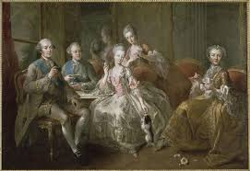
WHO WERE THESE WOMEN?
The salonniere was a woman …
of wealth & privilege but whose life’s circumstances had typically precluded her from entering court society.
who employed her considerable personal, financial and organizational skills to orchestrate salon life & support the philosophes of their day.
Notes:
Jill

Slide 10
THE MEASURE OF THE SALONNIERE
Dena Goodman The Republic of Letters…
the salonnieres were the very “lifeblood of the Enlightenment.”
“…the salon could have never existed without women and the Enlightenment could have never existed without the salon.”
Erika Harth Cartesian Women: Versions and Subversions of Rational Discourse in the Old Regime.
“It is hardly possible to evoke the cultural and intellectual life of early modern France without mentioning the special role played by the salonniere.”
Notes:
Jill

Slide 11
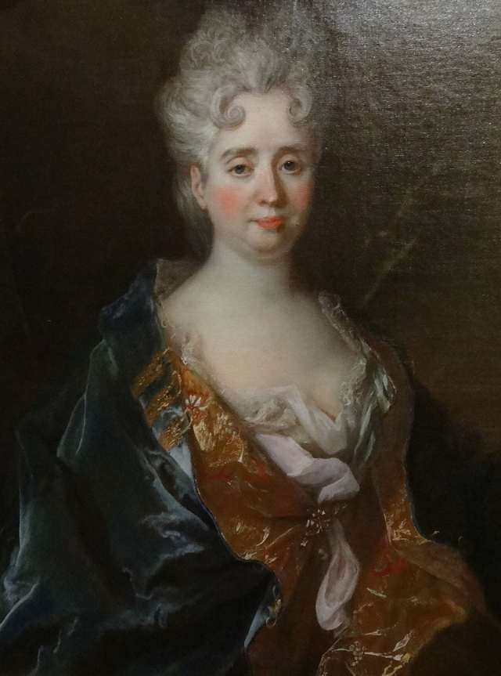
MARQUISE DE LAMBERT 1647 - 1733
Most prominent salonniere during the
reign of Louis XIV
Hosted men and women of letters on
Tues. and aristocracy on Weds.;
eventually brought two groups together.
Philosopher, essayist & feminist
Notes:
Mar keese

Slide 12
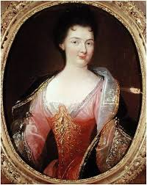
BARONESS DE TENCIN 1682 – 1749
Popular novelist although used the names
of her nephews as her pseudonym
D’Alembert was her illegitimate son
First to welcome foreigners to her salon
Mentored salonniere Madame de Geoffrin
Notes:
de taw sa jeff rahn

Slide 13
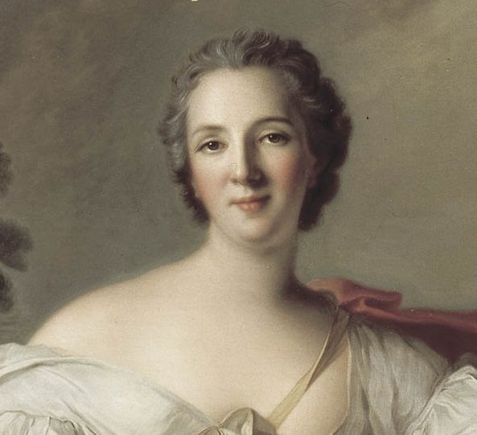
MADAME DE GEOFFRIN 1699 - 1777
Hosted artists on Mon. and writers on Weds.
Elevated salon from a leisure institution to
a working space & her salon became the basis
for the Republic of Letters
Major sponsor of Diderot’s Encyclopedia
Mentored Julie de Lespinasse & Suzanne Necker
Notes:
Jeff ran Became Grande dame of Paris salon society . Helped secure prestigous appointments to the French Academy

Slide 14
MARQUISE DU DEFFAND 1697 – 1780
Lifelong friend to Voltaire & patron to D’Alembert
Contemporaries described her as having the best wit and worst character of the salonnieres
Mentored Julie de Lespinasse
Notes:
Mar keese doo de faw

Slide 15
MADEMOISELLE JULIE DE LESPINASSE 1732 - 1776
Illegitimate daughter to the Comtesse d’Alban & Claude Lespinasse
Hosted five salons per week from 5:00 – 9:00 p.m., each offering a full-course meal
Lifelong friend to Jean Le Rond D’Alembert
Notes:
Les pin oss

Slide 16
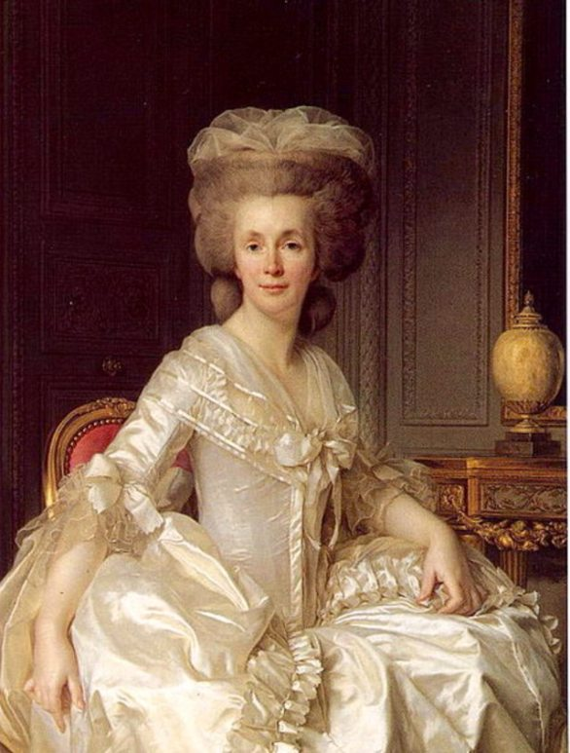
MADAME SUZANNE NECKER 1739 - 1794
Her husband, Jacques Necker, served
as Finance Minister to Louis XVI
Her Memoires offer unique insight
into the salonniere’s life

Slide 17
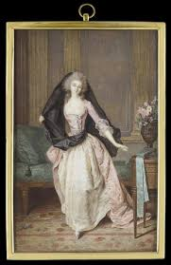
WHY WOULD THESE WOMEN SACRIFICE THEIR FREEDOM AND FORTUNE TO SUCH AN ARDUOUS CAUSE?
“Our world is a tissue of chains.”
Duchesse de Duras
Notes:
Jill

Slide 18
INTELLECTUAL STIMULATION
Evelyn Bodek “Salonnieres & Bluestockings: Education Obsolescence and Germinated Feminism”
The salon speaks to the ingenuity of women who“when excluded from the educational mainstream”created an “alternative educational route which satisfied their desire to learn while camouflaging their activities behind the role of acceptable female role of hostess.”
Notes:
The salon offered them a type of higher education society has systematically denied them.

Slide 19
ADVANCING THE GENIUS IN THEIR MIDST
Bonnie Calhoun “Shaping the Public Sphere: English Coffeehouses & French Salons in the Age of the Enlightenment”
The “salon was a superb place for artists to establish themselves” by reading their unpublished work aloud, soliciting feedback and finding support to publish and advance their careers.
Notes:
They recognized the genius in their midst and saw themselves as the vehicle through which it might be honed and disseminated in the public sphere.

Slide 20
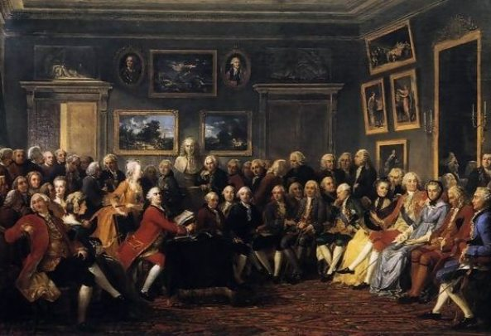
THE SALONNIERE’S CRAFT: CRITICISMS & COMPLIMENTS
Critics: She adorned but she did not impact—a beau monde society hostess.
Devotees: She was a sine qua non, absolute necessity, to the Enlightenment cause.
Notes:
See nay qua non Duh vote tee Both in her own time and still today, the substance of the salonniere’s contributions have been questioned.

Slide 21
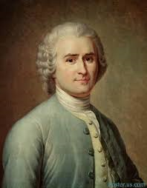
JEAN JACQUES ROUSSEAU
Letter to D’Alembert on the Theater—derides fellow philosophes for their surrender to the rules of civility that regulated salon life because it undermined “manly virtues.”
Notes:
Dahl em bear

Slide 22
ROUSSEAU’S DIATRIBE
“Every woman in Paris gathers in her apartment a harem of men more womanish than she...Imagine what can be the temper of the soul of a man who is uniquely occupied with the important business of amusing women and who spends his entire life doing for them what out to do for us.”
“French gallantry has given women a universal power… Everything depends upon them; nothing is done that is not by or for them…they decide sovereignty about the highest knowledge…”
Jean Jacques Rousseau
Notes:
ill

Slide 23
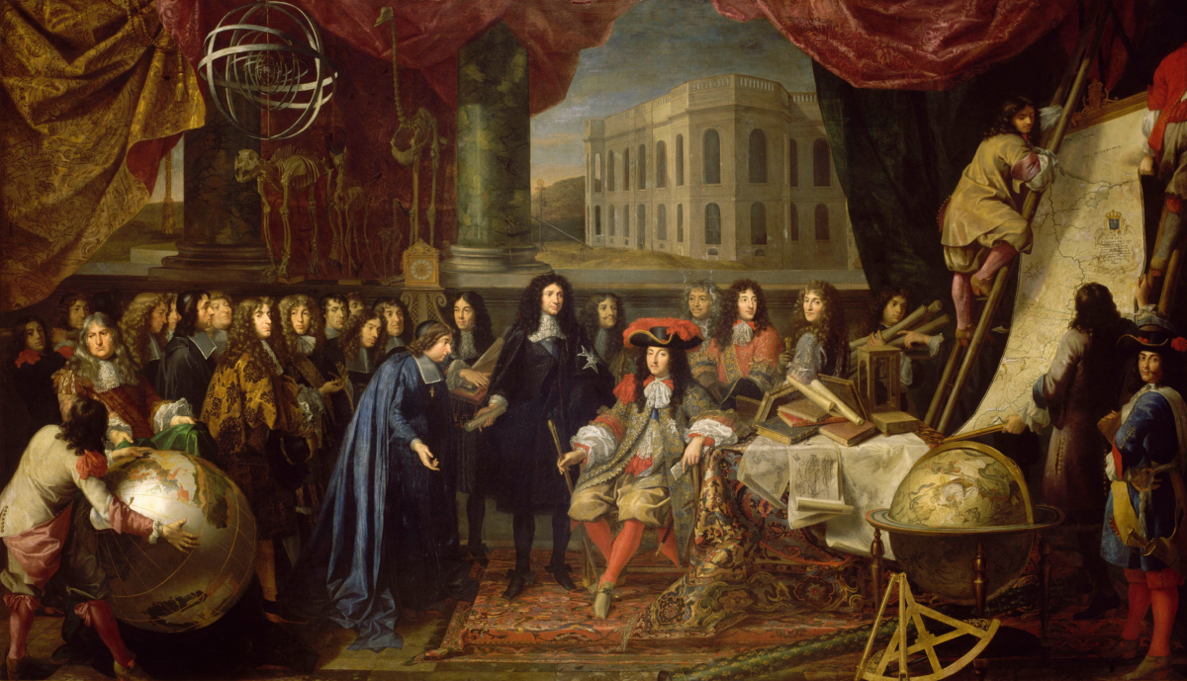
ROUSSEAU MISSED THE MARK
What Rousseau regarded as mere civility was in fact a substantive phenomenon unfolding in the salon—namely an innovative form of constructivist pedagogy that stood in stark contrast to the male centered academy he valued and was unwilling to abandon.
Notes:
Could not fathom a world in which men empowered women to direct the course of their intellectual lives because it was a world that demanded the forfeiture of those hegemonic masculine dispositions so highly prized in his native Geneva.

Slide 24
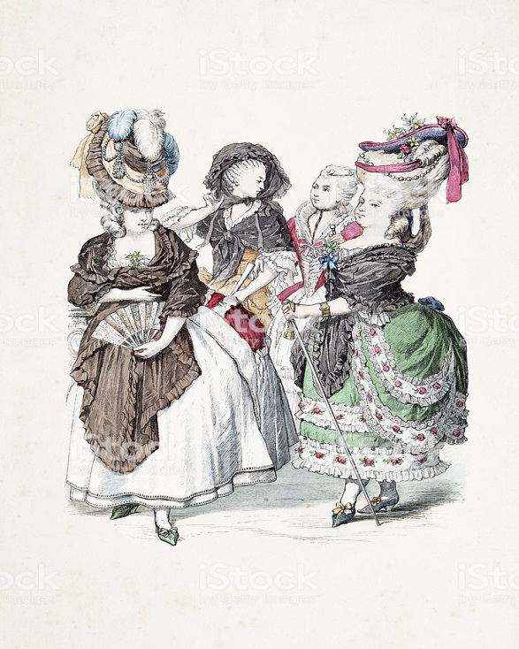
SALONNIERE AS BEAU MONDE SOCIETY HOSTESS
Antoine Lilti The World of the Salons:
Sociability & Worldliness in 18th Century Paris
Salons were not the egalitarian open spaces imagined by some historians for entry was still very limited.
Philosophes who attended were motivated by the desire to gain entry to le monde society more than any need to sound their ideas before publishing them in the public sphere.
Notes:
challenges any conflation of the salon with the Republic of Letters because they were primarily “social spaces of elite leisure” that were “deeply rooted in court society.”

Slide 25
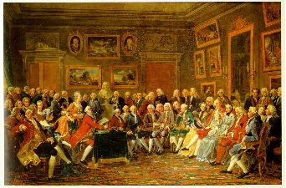
THE PHILOSOPHES’ TRIBUTES
Notes:
Neither the substance of the salonnieres’ contributions nor the debt owed to them was lost upon many of the men who became salon habitués and lifelong devotees to these remarkable women. They offer them tribute in their memoirs and letters.

Slide 26
Voltaire
Morellet

Slide 27
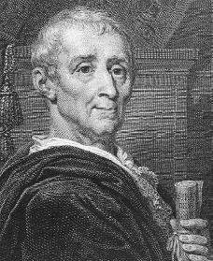
Baron de Montesquieu
Denis Diderot

Slide 28
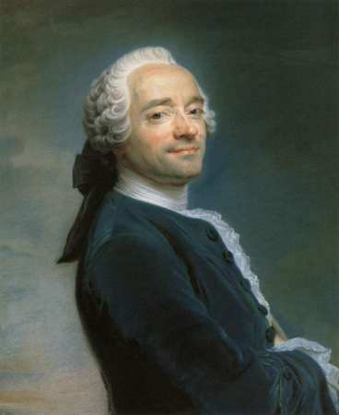
JEAN LE ROND D’ALEMBERT
Illegitimate son of Madame de
Tencin; took his name from the
Saint-Jean-le-Rond church where
she abandoned him on its steps.
Co-editor of the Encyclopedia
with Diderot
Notes:
De taw sa long de tau sa

Slide 29
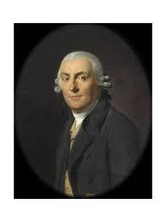
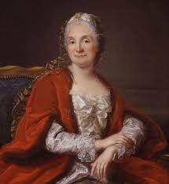
ANDRE MARMONTEL MEMOIRES
Madame Geoffrin’s ability to
manage so many competing egos:
“She was the mistress of the amiable
art of suppressing herself.”
“The brains she stirred at will were
neither feeble nor frivolous; d’Alembert
was like a simple, docile child beside her.”
“
Notes:
Speaks to the magnanimity Madame Geoffrin maintained in the midst of so many competing egos:

Slide 30
DENA GOODMAN THE REPUBLIC OF LETTERS
Modern feminist historians’ challenge of
these limited constructions:
endorse Rousseau’s critique by “accepting without question his basic premise—that women undermine seriousness.”
perpetuate a consistently negative view of the role these women played in shaping the Enlightenment, “even though the gratitude owed to them is substantial.”
Notes:
Modern feminist historians have challenged these limited constructions of the salonniere, foremost among them Dena Goodman who in her influential text The Republic of Letters argues that such constructions endorse…read slide

Slide 31
SINE QUA NON TO THE ENLIGHTENMENT CAUSE
Goodman argues that the salonnieres rendered the Parisian salons the “civil working spaces of the project of the Enlightenment” by doing for the philosophes what they could not do for themselves—namely…
keeping discussion polite and debate from degenerating into the personal attacks and physical altercations commonplace in the French Academy.
maintaining order in the Republic of Letters by “enforcing the rules of polite conversation,” thus making the Enlightenment a “collaborative and successful project.”
Notes:
We would argue that what has been mistaken for either pedantry on the part of the salonniere or a perfunctory civility among the salon participants was in fact a substantive phenomenon unfolding in the Enlightenment salon, namely an innovative pedagogy that stood in stark contrast to the male-centered academy so highly valued at the time. We believe the idiosyncrasies of this pedagogy are best understood when viewed through the lens of social constructivism, and so what follows is an analysis of the salonniere’s practice as it aligns itself with this theoretical framework.

Slide 32
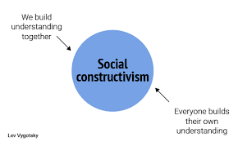
Jill & Kerry’s take: What has often been mistaken for pedantry on the part of the salonniere and a perfunctory civility among the salon participants was in fact a substantive phenomenon unfolding in the salon space—namely an innovative pedagogy that stood in stark contrast to the male-centered academy so highly valued at the time.
Notes:
We believe the idiosyncrasies of this pedagogy are best understood when viewed through the lens of social constructivism, and so what follows is an analysis of the salonniere’s practice as it aligns itself with this theoretical framework.

Slide 33
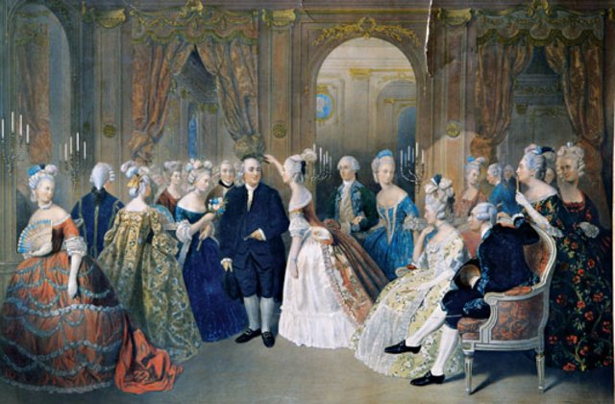
THE SALONNIERE AS A SOCIAL CONSTRUCTIVIST TEACHER
.
Notes:
Keep this image in mind and think back to the behaviors accepted in the French Academy – rambunctious and contentious….like school boys.
Also, keep this image in mind as principles of constructivist theory are discussed and more specifically, how the saloniere’s put the principles into practice.

Slide 34
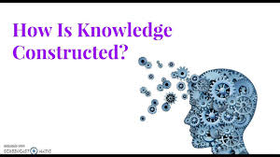
SOCIAL CONSTRUCTIVIST THEORY
Social Constructivism: concerned with the construction of knowledge in the social setting - how knowledge emerges & how it comes to have significance in society.
Specifically, it…
highlights the role social & cultural interactions play in the learning process.
contends that knowledge is actively constructed by the learner and the community of learners rather than passively absorbed.
Notes:
There are many constructivist theories. My top three are: Cognitive constructivism – which is attributed to Piaget. Piaget’s premise is that people construct their own knowledge by building knowledge themselves via experience.
Radical Constructivism – associated with Von Glasersfeld – revolves around the notion that all learning must be constructed. His theory is called radical because he found that there is no utility or meaning in instruction that is teacher or textbook driven.
Social Constructivism – associated with the work of Lev Vygotsky is the lens we used when analyzing the saloniere’s practice.
Before, I begin the analysis of the salonieere’s practice, it is important to provide a brief overview of the social constructivist theory.
Frist, and most obviously, is that social constructivism focuses on how knowledge is constructed in social settings – like a classroom or salon space.
Therefore, when people gather together to engage ”academically”, social and cultural constructs play a role the learning process.
And, when in the midst of others, learning is naturally and actively constructed by the learner through conversations…not passively absorbed.

Slide 35
SOCIAL CONSTRUCTIVIST THEORY CONTINUED
assumes ability and knowledge exist within the learner and the teacher need only facilitate, manage and inspire to bring pre-existing experiences and knowledge to the fore via open dialogue.
emphasizes personal relationships with learners to forge bonds of trust, sincerity and respect.
ensures learners that if they take risks in a classroom culture enmeshed with social and political tensions, they will be protected from the forces of ridicule and rebuke(safe space).
Notes:
Social Constructivist theory assumes that knowledge exists within the learner as a result of pre-existing experiences.
It also emphasizes the power of personal relationships. Therefore, developing trust, sincerity and respect for all is much of the glue the binds the process of learning together.
Trust, sincerity and respect can only be developed in a learning environment enmeshed with social and political tensions when a classroom culture free of ridicule, censure, and rebuke.

Slide 36
THE SALONNIERE AS A SOCIAL CONSTRUCTIVIST TEACHER
Her Silent Hand: Places learners at the center of the instruction while assuming the role of facilitator (guided participation).
Republican Virtues: Facilitates a civil learning process while helping learners to construct their own knowledge (scaffolding).
Salon Space: Promotes and develops the principles of equality, democracy & ownership to create a community
(inter-subjectivity).
Notes:
We have distilled elements of social constructivist theory into 3 important principles the solonnier’s employed.
The first principle of social constructivist theory we found in the saloniere’s practice is her Silent Hand – remember the image where all the people, saloniere, and philosophe were gathered? It was this image and others like it that captured my imagination when Jill and I began discussing this line of inquiry. Because what I saw in that picture was learners (in social constructivist theory all are learners) gathered together – each important -- which is what placing learners at the center means. And, when people gather together for a purpose, someone must facilitate the ebb and flow of the conversation. In social constructivist theory the facilitator guides the instruction by creating an inclusive environment, keeping discussions constructive and positive, and encouraging or supporting participants.
Second social constructivist principle we found in the saloniere’s practice relates to Republican Virtues or civility. She supported republican virtues as a facilitator of the learning process by helping learners/participants to construct their own knowledge – known as scaffolding. Teachers can scaffold learning directly – through modeling and coaching – or indirectly, by selecting structures and protocols that will shape and guide student interactions.
Third, she created a safe solon space so as to promote equality, democracy and ownership of ideas thereby creating a community – this principle is known as inter-subjectivity or the coordination of participants’ contributions and human agency to enhance the learning process.

Slide 37
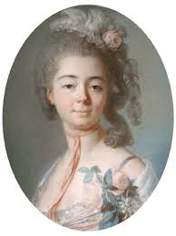
MADAME DE GENLIS: ON THE IDEAL SALONNIERE
# 1 Her Silent Hand: Placing the Learners at the Center of the
Conversation
Her treatise offers an insightful portrait, one that projects the
archetypal image of the women behind the curtain, the one who pushes the
levers that initiate dialogue, understanding and civility in the social group but who remains in the background so that the show might go on.
“One must, finally, encourage the timid, put them at their ease, maintain the conversation by directing it with skill rather than keeping it up oneself, such that each person gets the reception that can satisfy him.”
Notes:
It is difficult to cleanly separate how the salonnieres facilitated the conversation while also holding the learners at the center with her silent hand and to facilitate & scaffold the learning process so all learners are able to construct their own knowledge.
But here Madame De Genlis’s treatise addresses how the two principles come together by offering an insightful portrait, one that projects the archetypal image of the women behind the curtain, the
one who pushes the levers that initiate dialogue, understanding and civility in the social group but who remains in the background so that the show might go on.
She wrote, “One must, finally, encourage the timid, put them at their ease, maintain the conversation by directing it with skill rather than keeping it up oneself, such that each person gets the reception that can satisfy him.”

Slide 38
PHILOSOPHES: MARMONTEL & MONTESQUIEU # 1 HER SILENT HAND: PLACING LEARNERS AT THE CENTER OF THE CONVERSATION
The salonniere’s ability to guide these conversations is evidenced in the letters and memoirs of the men who witnessed her craft:
Marmontel on Julie de Lespinasse: “Nowhere was conversation more lively, more brilliant, or better regulated than at her house.
Montesquieu in his Persian Letters: “Whosoever observes the action of those in power, if he does not know the women who govern them, is like a man who see the action of a machine but does not know its secret springs.”
Notes:
Here, Marmontel and Montesquieu, who witnessed her craft, commented on the salonniere’s ability to facilitate these conversations.
Marmomtel –talking about Julie de Lay pin oss stated, “Nowhere was conversation more lively, more brilliant, or better regulated than at her house”.
Montesquieu, in his Persian Letters wrote about the skill of the salonnieres’ silent hand noting, “Whoever observes the action of those in power, if he does not know the women who govern them, is like a man who sees the action of a machine but does not know its secret springs.” Facilitating learning while keeping the learners and learning at the center, when done well is natural and seamless.

Slide 39
# 2 REPUBLICAN VIRTUES: FACILITATING CIVILITY DURING THE LEARNING PROCESS VIA SCAFFOLDING
The salonnieres’ sustained emphasis upon the rules of civility provided a structure upon which their male guests came to depend to regulate their discourse & let discovery unfold.
They confide the idiosyncrasies of their craft in their letters & memoirs.
Notes:
Social Constructivist Principle #2 we used to analyze her process is an important one. The silent hand is about facilitating while keeping the focus on the learners and learning. Here, the focus is on the facilitation of the learning process using scaffolding, which provided the structure that regulated discourse so discovery could unfold. Teachers can scaffold learning – through modeling and coaching or by asking new questions or redirecting the focus to new ideas so as to mediate tensions when they bubble up.
.

Slide 40
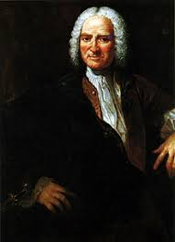
# 2 Republican Virtues: Facilitating A Civil Learning Process
via Scaffolding
Andre Morellet: Codified the rules of civility by
noting behaviors that would not be tolerated:
“Inattention, interrupting or speaking all at once: egoism,
despotism or the spirit of domination, pedantry, illogic, the spirit
of pleasantry; the spirit of contradiction, dispute and personal
conversation substituted for general conversation.”
The salonniere reinforced these rules to shape the dispositions of her male guests. Morellet wrote that he had “never seen consistently good conversation except where a salonniere was.”
Notes:
We have supported the analysis of our three principles from the words of philosophes and salonnieres who participated and shared their ideas in the solon space.
The first principle – Her Silent Hand – Morellet listed the rules of civility by noting behaviors that would not be tolerated. He wrote…“Inattention, interrupting or speaking all at once: egoism,
despotism or the spirit of domination, pedantry, illogic, the spirit of pleasantry; the spirit of contradiction, dispute and personal conversation substituted for general conversation.” And, then he wrote about his experience, stating he had “never seen consistently good conversation except where a salonniere was.” Again, a tribute to her ability facilitate a conversation while keep the learners and the learning at the center.
Her ability to keep the conversation going is a way to keep the ideas, the learning and the learners at the center.

Slide 41
SALONNIERE SUZANNE NECKER # 2 REPUBLICAN VIRTUES: SCAFFOLDING
Echoes this need to mediate social and political tensions to ensure that all voices are equally heard: “the salonniere’s great art…is to prevent anyone of her society from taking up too much room at the expense of others.”
It is a charge, she writes, that must be realized by an impeccable sense of timing, for the salonniere must know when to facilitate conversation and when to “adroitly interrupt those people who get bogged down in private arrangements.”
Notes:
Salonniere Suzanne Necker noted the import of facilitating and scaffolding skills by echoing the need to mediate social and political tensions to ensure that all voices are equally heard: she wrote “the salonniere’s great art…is to prevent anyone of her society from taking up too much room at the expense of others.” Have you been in a class where the conversation got heated. A skillful facilitator can lower the heat by redirecting the focus or asking a new question for the group to contemplate.
She wrote, It is a charge that must be realized by an impeccable sense of timing, for the salonniere must know when to facilitate conversation and when to “adroitly ( a’ droi – ly) interrupt those people who get bogged down in private arrangements.” Skillful facilitators know how to move the conversation along if participants get off track or conversations get contensious.
Salonniere Suzanne Necker noted the import of facilitating and scaffolding skills by echoing the need to mediate social and political tensions to ensure that all voices are equally heard: she wrote “the salonniere’s great art…is to prevent anyone of her society from taking up too much room at the expense of others.” Have you been in a class where the conversation got heated. A skillful facilitator can lower the heat by redirecting the focus or asking a new question for the group to contemplate.
It is a charge, she wrote, that must be realized by an impeccable sense of timing, for the salonniere must know when to facilitate conversation and when to “adroitly ( a’ droi – ly) interrupt those people who get bogged down in private arrangements.”
Skillful facilitators know how to move the conversation along if participants get off track or conversations get contensious.

Slide 42
# 3 SALON SPACE: PROMOTES EQUALITY, DEMOCRACY, OWNERSHIP & COMMUNITY
Although the salonniere’s charge, much like the constructivist teacher, was to emphasize the rules of this republic, she was, as Goodman points out, “neither that source of law nor above it.”
“While the salonniere, too, created order in an otherwise disorderly society, she did so…in republican fashion, by consent of the governed.”
“true liberty rested upon the equal right of each to speak, on mutual respect for the rules of discourse by which such rights were guaranteed, and on acceptance of the salonniere’s role in enforcing them.”
Notes:
Although the salonniere’s charge, much like the constructivist teacher, was to emphasize the rules of this republic, she was, as Goodman points out, “neither that source of law nor above it.” Goodman wrote,

Slide 43
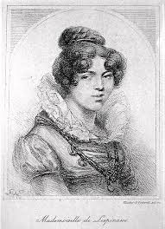
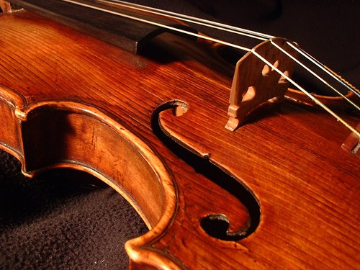
# 3 SALON SPACE: PROMOTES EQUALITY, DEMOCRACY, OWNERSHIP & COMMUNITY
Marmontel on Julie de Lespinasse:
“The circle was formed of persons who were not bound together. She had taken them here and there in society, but so well assorted were they that once there they fell into harmony like the strings of an instrument touched by an able hand… I may say that she played the instrument with an art that came of genius.”
Marmontel Memoires
Notes:
Marmontel’s holistic analysis of Julie de Lespinasse offers insight into the salonnieres’ ability to simultaneously manage so many disparate souls to create community:

Slide 44
# 3 SALON SPACE: PROMOTES EQUALITY, DEMOCRACY, OWNERSHIP & COMMUNITY
Marmontel on Julie de Lespinasse’s process:
Her finesse in achieving this feat, he writes, stemmed from her intuitive understanding of their inner-most natures:
“…she seemed to know what tone each string would yield before she touched it; I mean to say that our minds and our natures were so
well known to her that in order to bring them into play she had
but to say a word.”
Marmontel Memoires
Notes:
Here Marmontel continues his analysis of bring disparate souls together -- Her finesse in achieving this feat, he writes, stemmed from her intuitive understanding of their inner-most natures: “I mean to say that our minds and natures were so well known to her that she had but to say a word.”
This is a skill all teachers or salonnieres who espouse a social constructivist methodology must have -- the knowing and understanding the participants, which provides insight when developing a sense of ownership, democracy and community.

Slide 45
# 3 SALON SPACE: PROMOTES EQUALITY, DEMOCRACY, OWNERSHIP & COMMUNITY
“It was a rare phenomenon indeed, the degree of tempered, equable heat which she knew so well how to maintain, sometimes by moderating it, sometimes by quickening it. The continual activity of her soul was communicated to our souls, but measurably; her imagination was the mainspring, her reason the regulator.”
Marmontel Memoires
Notes:
Marmontel also complimented her ability to scaffold & regulate what, in any other setting, like the French Academy, would have been a heated and contentious conversation. He wrote, “It was a rare phenomenon indeed, the degree of tempered, equable heat which she knew so well how to maintain, sometimes by moderating it, sometimes by quickening it. The continual activity of her soul was communicated to our souls, but measurably; her imagination was the mainspring, her reason the regulator.”

Slide 46
MONTESQUIEU THE PERSIAN LETTERS # 3 SALON SPACE: PROMOTES EQUALITY, DEMOCRACY, OWNERSHIP & COMMUNITY
Montesquieu The Persian Letters
Montesquieu marveled at the salonnieres’
ability to fashion a culture that seemed
so unassuming but that in reality demanded
considerable thought, planning and finesse.
“They (the salonnieres) form a kind of republic
whose members always actively aid one another.”
Notes:
How is equality, democracy, ownership and community created. Well as any social constructivist teacher knows, it is with considerable thought and planning so as to seamlessly establish a democratic and respectful space. Here Montisquieu notes the salonniere’s skill in creating a climate for members always actively aiding one another. From Montesquieu’s writing in The Persian (Per’ shun) Letters he wrote, about the salonnieres’ ability to fashion a culture that seemed so unassuming but that in reality demanded considerable thought, planning and finesse.
And, He was equally impressed with their ability to seamlessly establish a democratic space that allowed for collaboration and mutual respect to flourish, he wrote, “They (the salonnieres) form a kind of republic whose members always actively aid one another.”

Slide 47
SALONNIERE: THE EMBODIMENT OF A CONSTRUCTIVIST TEACHER
Her Silent Hand: Places learners at the center of the instruction while assuming the role of facilitator (guided participation)
Republican Virtues: Facilitates a civil learning process by helping learners to construct their own knowledge (scaffolding)
Salon Space: Promotes and develops the principles of equality, democracy & ownership to create a community (inter-subjectivity)
Notes:
In summary, we consider the salonniere the embodiment of a constructivist teacher who, in putting her students at the center of her instruction, understood that teaching has less to do with her and more to do with them.

Slide 48
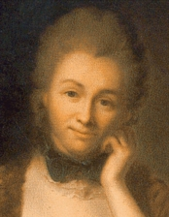
“ “FULL MANY A FLOWER IS BORN TO BLUSH UNSEEN AND WASTE ITS SWEETNESS ON THE DESERT AIR.” THOMAS GRAY ELEGY WRITTEN IN A COUNTRY CHURCHYARD
Notes:
The salonniere’s portrait, although painted long ago and with the stroke of many different brushes, survives, revealing an uncanny resemblance to that of a constructivist teacher. It is somewhat serendipitous, then, that this contemporary constructivist lens renders the salonniere’s contributions most visible.

Slide 49
BIBLIOGRAPHY
Bodek, Evelyn Gordon. “Salonnieres and Bluestockings: Educated Obsolescence & Germinating Feminism,” Feminist Studies 3, ¾ (Spring/Summer 1976): 185-186.
Bruner, J. (1986). Actual Minds, Possible Worlds. Cambridge, MS: Harvard UP.
Calhoun, Bonnie. “Shaping the Public Sphere: English Coffeehouses and French Salons and the Age of the Enlightenment.” Colgate Academic Review Vol. 3 Spring 2008.
Comtesse de la Genlis, Dictionaire Critique et Raisonne Des Etiquettes de La Cour. qtd. in Andre Morellet, De la Conversation. Suivi d’ un essai de Jonathan Swift. (Paris: Payot & Rivages, 1995). 278.
Goodman, Dena. (1994). The Republic of Letters: A Cultural History of the French Enlightenment. Ithaca, NY: Cornell UP.
Gray, Thomas, Elegy Written in a Country Churchyard qtd. in X. J. Kennedy, An Introduction to Poetry 6th edition. (Boston, MA: Little, Brown & Company, 1986). 258.
Erica Harth, Cartesian Women: Versions and Subversions of Rational Discourse in the Old Regime (Ithaca: Cornell University Press, 1992). 4.

Slide 50
Kale, Steven. French Salons: High Society and Political Sociability from the Old Regime to the Revolution of 1848, First Edition edition (Baltimore: Johns Hopkins University Press, 2004). 19.
Lilti, Antoine. “The Kingdom of Politesse: Salons and the Republic of Letters in Eighteenth-Century Paris,” Republics of Letters: A Journal for the Study of Knowledge, Politics, and the Arts 1, no. 1 (2009): 1–11. & The World of the Salons: Sociability and Worldliness in Eighteenth-Century Paris. Translated by Lydia G. Cochrane. New York: Oxford University Press, 2014. 4.
Marmontel, Jean Francois. Memoires. 1827. Translated by Brigit Patmore. London: Routledge, 1930. 270
Morellet, Andre. “"De La Convversation,” n.d. 77
Charles de Secondat Montesquieu, Persian Letters translated by John Davidson. London: Privately Printed, 1892. 57.
Necker, Suzanne. Nouveaux melanges extraits des manuscrits de Mme Necker. Edited by Jacques Necker. 2 vols. Paris: C. Pougens, 1801:100-101.

Slide 51
Rousseau, Jean-Jacques. Politics & the Arts: Letter a’M. d’Alembert. Edited & translated by Allan Bloom. Ithaca, NY: Cornell University Press, 1968, p. 100.
Vygotsky, Lev. Mind in Society: The Development of Higher Psychological Processes, New Ed. (Harvard University Press, 1978).

