Slide 1
Freedom From…Freedom To

Slide 2
Freedom from…
Laws must be put into place to protect us.
However, lack of balance may result in totalitarianism.
"Those who would give up essential Liberty, to purchase a little temporary Safety, deserve neither Liberty nor Safety.“
Benjamin Franklin

Slide 3
Freedom to
We have natural and inherent freedoms in a society; however, lack of balance may lead to anarchy:
Speech, press, assembly, right to property, right to bodily integrity, due process, etc.
The 4th & 5th Amendments to the U.S. Constitution guarantee these rights.

Slide 4
Rights, Limitations & Responsibilities
No right is absolute, for there will always be limitations – it is just a matter of degree & balance.
With rights comes responsibilities:
Jury duty
Military service
Taxation, etc.

Slide 5
The Liberal Tradition: Freedom To
Draws from the English tradition: Basis for Common Law
Emphasis upon protecting the rights of the individual: 4th, 5th, 8th, 9th & 10th Amendments
To ensure those rights, they are enshrined in law:
Code of Hammurabi-1745 BC Babylon
Magna Carta – England 1215
Bill of Rights to the U.S. Constitution 1791

Slide 6
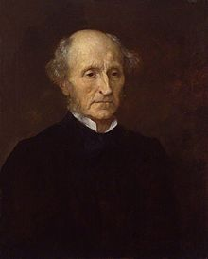
John Stuart Mill
The individual has the right to live his life as he chooses as long as he does not harm others.
In a democracy, no right is absolute but in this tradition, the curtailing of individual rights is minimal.

Slide 7
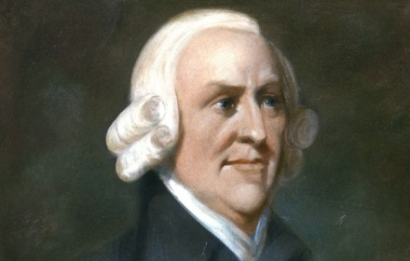
Adam Smith The Wealth of Nations
The individual has the right to economic freedom.
Belief that free markets, the protection of private property rights, and a minimal government presence in the economy lead to prosperity.
Economic freedom leads to economic growth, thus he makes the case that prosperity is produced through a competitive market economy.
Taxes: would be an infringement upon this freedom.

Slide 8
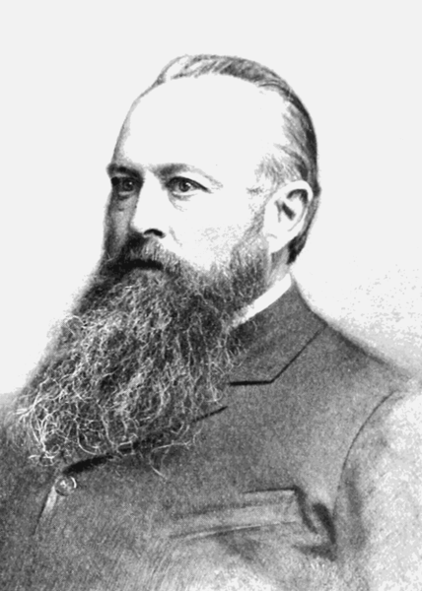
Lord Acton
“Power tends to corrupt and absolute power corrupts absolutely. Great men are almost always bad men, even when they exercise influence and not authority; still more when you superadd the tendency of the certainty of corruption by authority.”
Freedom in the state cannot exist without morality, hence the state must answer for its actions.
Acton believed religion was inherent in this definition of freedom, but that religion should be not forced upon the individual.

Slide 9
Characteristics of a Liberal Democracy
Freedom of the press
Public space for civil discourse & debate
Popular sovereignty
Majority rule balanced minority rights
Limited government
Institutional checks & balances
The rule of law prevails
Individual political & economic rights

Slide 10
Illiberal Tradition: Freedom From
Roman Law: Sanctions the limiting of individual rights:
Freedom of expression, thought & behavior.
State can be a democracy and still have an illiberal tradition in that it imposes limits on individual freedom, arguing that such limitations are necessary to maintain the authority of the state and civil order.

Slide 11
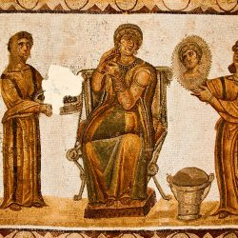
Roman Law
The state is the force of the law.
Everything the state does is considered in the best interests of the people.
The state is essentially not answerable to the law.

Slide 12
Common Law: British Tradition
No one, including the state,
is above the law.
Rulers must answer to the law.
U.S. system based upon the common law tradition—innocent until proven guilty
Amendments codify this notion:
1st, 4th, 5th, 6th, 7th & 8th

Slide 13
Illiberal Governments
In more extreme forms, it limits individual freedoms in the name of the state, thus making it authoritarian at best, totalitarian at worst.
Nazi German
Stalin’s Communist Russia
Communist China

Slide 14
Democracies that have illiberal features
Sweden: restricts individual property rights
France: state media monopoly
Taxation: infringement of economic liberty through high taxation. 38% Germany, 41% in Ireland, 45% Sweden, 60% France & Denmark.
England: established state religion Anglican Church.
Saudi Arabia: theocratic Islamic monarchy & legal system based upon Sharia law.

Slide 15
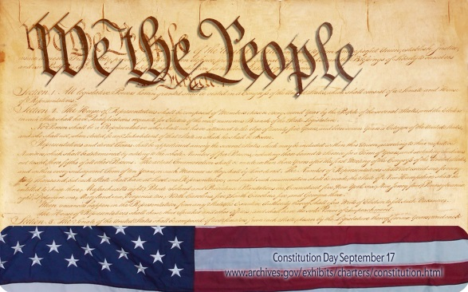
U.S. Constitution
The first ten amendments are known as the Bill of Rights which protect the freedoms and rights of individuals. This protection is not limited to citizens but to anyone on U.S. soil.
Bill of Rights guarantee our civil liberties which are defined as the limitations on government power, intended to protect freedoms that governments may not legally intrude on.

Slide 16
Bill of Rights: Amendments
1st: freedom of speech, press, religion & assembly
4th: The right of the people to be secure in their persons, houses, papers, and effects, against unreasonable search & seizure.
5th: …nor be deprived of life, liberty, or property without due process of law.
8th: …nor cruel and unusual punishment

Slide 17
Civil Liberties
Our basic rights and freedoms that are guaranteed -- either explicitly in the Bill of Rights & Constitution, or interpreted or inferred through the years by legislatures or the courts. They include the right to…
Free speech
Privacy
To remain silent in a police interrogation
To be free from unreasonable searches of your home
The right to a fair court trial
The right to marry
The right to vote

Slide 18
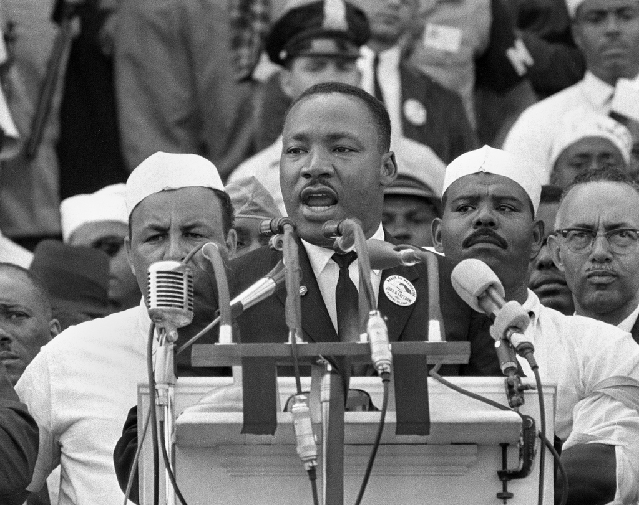
Civil Rights
The right to be free from unequal treatment based on certain protected characteristics (race, gender, disability, etc.) in settings such as employment, education, housing, and access to public facilities.
Violation: occurs when an individual is discriminated against on the basis of a protected characteristic. Most civil rights laws are established through the federal government via federal legislation or case law.

Slide 19
Civil Rights v. Civil Liberties: What the Law has to Say
Civil rights—the basic right of freedom from discrimination based on certain personal characteristics such as gender, race, or disability; the treatment of an individual regarding certain rights.
Civil liberties—broad-based rights the government grants to individuals.

Slide 20
Writ of Habeas Corpus
Legal procedure that keeps the government from holding one indefinitely without showing cause. One can challenge detention by filing a habeas corpus petition.
Pillar of western law since Magna Carta.
Founders enshrined in Article 1 of Constitution

Slide 21
Suspension of Habeas Corpus
Executive branch has the authority to suspend in time of warfare. Has been suspended 4 times:
Lincoln in Civil War
Grant in 1871 Reconstruction South
Hawaii after the attack on Pearl Harbor
George W. Bush in 2006 after Terror Attacks

Slide 22
Terrorism Today
Congress passed the Military Commisions Act in 2006 (MCA)
Revoked the right to habeas corpus for those detained in Guantanamo Bay.
Also applies to any foreigner or U.S. citizen the government detains anywhere or labels an “enemy combatant.”

Slide 23
How the courts evaluate school rules
The courts have ruled that “reasonableness” depends upon circumstance. Five criteria have typically been applied to school rules to determine their appropriateness:
Is the rule reasonable?
Has appropriate and advance notice been given?
Is the rule vague?
Is the rule constitutional?
Does the rule discriminate in any way?

Slide 24
5th Amendment – Due Process
Individual rights are guaranteed to us through the 5th Amendment to the U.S. Constitution which states that the federal government shall deny no person the right to life, liberty or property.
The 14th Amendment (1868) extends due process to individual states.

Slide 25
Procedural Due Process
Ensures that certain types of procedures must be followed if you are depriving someone of life, liberty or property. Before a person is deprived of one or all of these three things, they must be given:
-+*
A fair notice
A fair hearing
An opportunity to be heard

Slide 26
Substantive Due Process
Asks whether the government’s deprivation of a person’s, life, liberty or property is justified by a sufficient purpose. In other words, there must a GOOD reason for the deprivation.
Sometimes called “gut-level” fairness, this type of due process asks the question “Even if all of the rules have been followed, is the rule itself still fair?”
State courts have used the words “arbitrary” and “capricious” when determining the “ridiculousness” of the rule itself.
Hence, the procedure may be “good” but the rule may not, and so substantive due process allows us to evaluate a rule on the basis of its “fairness.”

Slide 27
What Constitutes a Property Interest?
Teacher – in terms of property, the courts have ruled that teachers have a property interest in their profession.
Schools that wish to fire teachers must provide due process before doing so.
However, if the property interest is fulfilled, due process is not necessary (i.e. if a coach is fired but still paid for the remainder of his/her contract, then due process has been fulfilled).

Slide 28
Student’s Property Interest
Student – the courts have ruled that students have a property interest in being educated; they have a reasonable expectation to be educated (because of compulsory education) as guaranteed by the U.S. Constitution.
When suspended, students must be given due process.. However, due process is also flexible, meaning that the greater the punishment, the greater the expectation for due process.
Court Cases: Goss vs. Lopez – courts ruled that suspension over 10 days must be given greater due process.

Slide 29
What Constitutes a Liberty Interest?
Corporal Punishment
We have a liberty interest in terms of freedom of bodily integrity (punishment), freedom in movement, and the right to pursue employment and educational opportunities.
In the lives of students, liberty interests have sometimes been violated through corporal punishment.

Slide 30
In Ingram v. Wright (1988)
Supreme Court ruled that the 8th Amendment prohibition against cruel and unusual punishment did not apply to corporal punishment against students.
Reasoning: school was relatively open to community surveillance and that the 8th was intended to protect the rights of incarcerated persons.

Slide 31
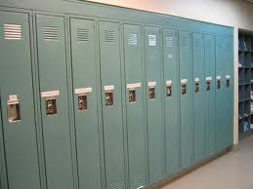
Drug Testing & Locker Searches
Lockers are “school” property so
searches are permissable.
Mandatory drug testing: Generally allowed for students involved in extra-curricular activities who have signed “Athletic Codes.”
Widespread drug testing for the entire student body has been frowned upon by the courts.

Slide 32
Freedom of Speech – Teachers
Teachers: free to choose topics and materials as long as their curricular decisions are professionally defensible.
School board has ultimate authority – so teachers must defer to their mandates.
Essentially, courts have tried to define the difference between the idea of censorship and idea of educational development.

Slide 33
Freedom of Speech: Students
Courts have generally ruled that the school is justified in limiting student speech if it poses a “clear and present danger” or causes a “material and substantial disruption.
Tinker vs. Des Moines: protected silent speech.
Hazelwood vs. Kuhlmeier: limited student curricular speech (school newspaper)
Bethel vs. Fraser: limited student non-curricular speech (assembly).

Slide 34
Duty of Care: In loco parentis
Teachers must be concerned with the legal liability of their conduct within the school setting.
A general rule of thumb should be followed when determining a teacher’s liability – does the teacher owe the student a duty of care (was the teacher expected to supervise the student at the time of the incident)?

Slide 35
Negligence
Teacher negligence—whether the injury was the result of negligence and whether compensation is due (this is usually the point of controversy).
The question to ask is:
To what extent was the teacher’s lack of vigilance, lack of action, or lack of foresight related to the occurrence of the injury?

