Slide 1
Non-Traditional Adaptive Activities in Physical Education
Mickey Hines

Slide 2
Reasoning behind New Activities
Statement: Involving Non-Traditional Activities in the Physical Education classroom
Why: This teaches students what other activities they can do if they have an impairment of some sort along with teaching games and activities they do not see on TV regularly.
Benefit: Students eyes will be opened on how others learn and live life. Students will also know how to play games even if they cannot see, walk, or have mental impairments. Along with students are learning a new way to develop their motor skills and the fundamentals.

Slide 3
Students feeling Pressure / Offended
An arguing point always brought up on will if the student with the “disability” feel to much pressure and do not like the idea
Student might get offended
As an educator one must talk with the student and ask if it is okay to do such activities before doing them
Typically students enjoy this process and there are no problems
Example: Wheelchair basketball and asking said student who is limited to a wheelchair if THEY are okay with the activity
Crone Middle School - Drew Beutel

Slide 4
Why is this needed
Physical education is developing the fundamentals motor skills of students
Does not say that there is one way
Develops stronger social experiences when approaching individuals with these impairments
Reduces stigmas
Gives real life examples on activities they will never encounter
Also creates opportunities for collaboration, communication, cooperation, critical thinking, decision making, leadership, and problem solving.
Supports inclusion for students with impairments such as visual and walking.

Slide 5
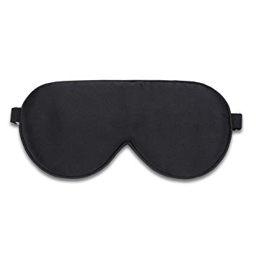
Warm Up activities
Blindness - Blindfold students and have partner drive them like a car. This works on teamwork, collaboration, and trust. Students may use their voice and have arms on their partner (the “car”) and if students are successful have them only use their voice
Unable to use legs - If possible give all students a wheelchair and play red light green light. Instead of running students will roll the wheelchair when they hear green and stop when they hear red.
Ball play - Have balls with bells inside of them and have students be blindfolded and have pairs roll the ball back and forth. Ball can be $30 or put plastic bags around the balls and makes noise as well.

Slide 6
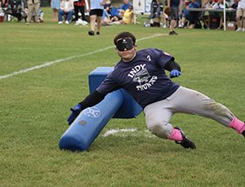
Beep Baseball
Visual Impairment individuals
Beep baseball, Two bases, blindfolds, bat
Outfield and batters are visually impaired
Ball beeps so students know when and where to swing bat along with run or crawl to get the ball
After contact batter who is still visually impaired must run to a long beep either left or right and tackle or touch the base before outfield gets the ball
Point is scored if runner makes it to the base before ball is picked up
Works on communication, listening, teamwork, striking, throwing,
Costly $340 but can have modifications

Slide 7
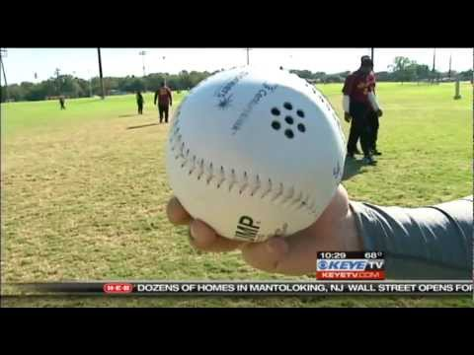

Slide 8
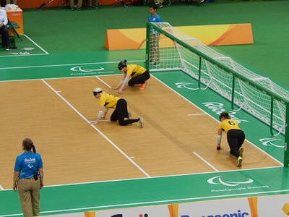
GoalBall
Paralympic Sport
Game starts with a teacher or referee yelling Play, and now the team has an opportunity to roll the ball towards the goals. This can be soccer nets or wall. Defenders cannot be inside the of the goal but in front of it in the team area. Points are awarded if ball makes it past the defenders and hit the goal. Students may stand up and roll but ball must be on the ground rolling before the half court
Works on teamwork, listening, reaction speed, throwing / rolling, problem solving

Slide 9
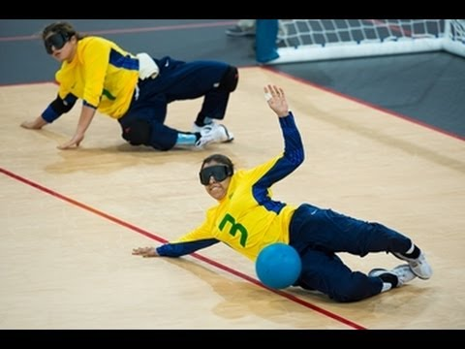

Slide 10
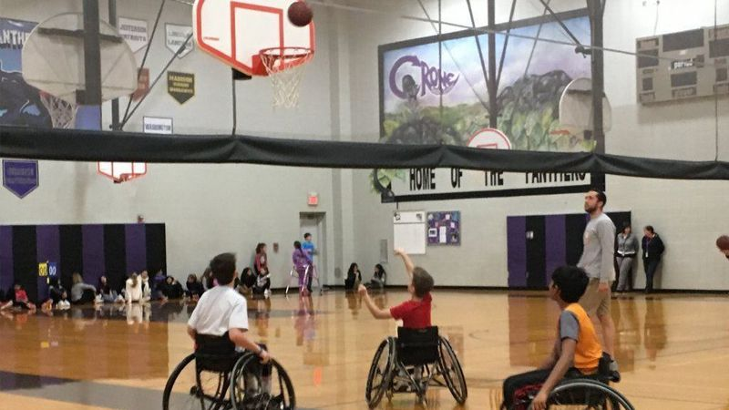
Wheelchair Basketball
Crone Middle School has actually played this in P.E.
Drew who has a walking impairment wanted to play his favorite game with classmates
Wheelchair basketball does not have to be a legit game but can work on the skills of shooting and moving around in a wheelchair
Drills like shooting and small games can be done in P.E.
Do not need to dribble
Most likely a teacher must borrow wheelchairs from a community center or a nearby place
Can result into damages that school or teacher would have to pay for
Works on shooting, different movements, teamwork, leadership, problem solving

Slide 11
Other Games and Ideas
Wheelchair curling
Blind Bowling
Velcro ball - attach velcro pads to ball and have shirts that student can catch with
Another way is have a bucket tied around a string
Sit Volleyball
Wheelchair Golf

Slide 12
Last Words
Games and Activities can be modified to fit all students.
Opens eyes of students and helps them learn about disabilities and impairments their own classmates might have.
Gives knowledge of Paralympic sports
These sports can also help master other skills needed in the P.E curriculum
Learning in a different way

Slide 13
Thank You!
Adapted Physical Education - The IDEA Mandates, Trends and Issues, Training. (n.d.). Retrieved from https://education.stateuniversity.com/pages/1733/Adapted-Physical-Education.html.
Moca, D. (2019, May 16). Wheelchair basketball event allows 12-year-old to play favorite sport with classmates. Retrieved from https://www.chicagotribune.com/suburbs/naperville-sun/ct-nvs-crone-wheelchair-basketball-students-st-1209-story.html.
Physical Education Adaptations for Students who are Blind or Visually Impaired. (n.d.). Retrieved from https://www.teachingvisuallyimpaired.com/pe-adaptations.html.

