Slide 1
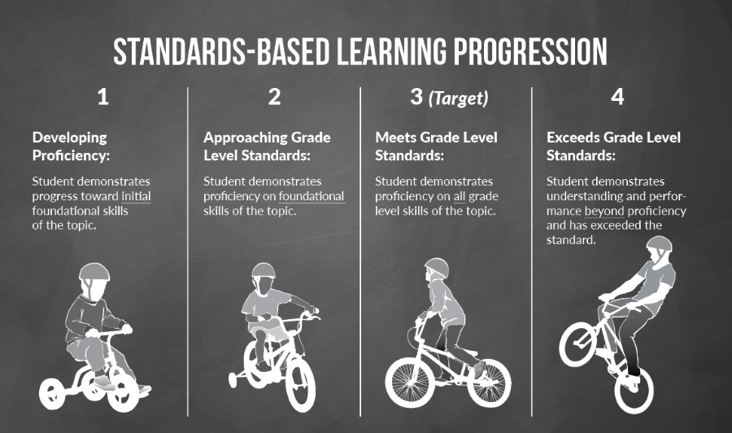
Standards Based Grading:
What I learned from Solon High School

Slide 2
Solution Oriented Question
How can we improve the revision process to make sure students reflect on their learning strategies and better master the learning target.
-Every teacher/subject has different processes
-Should the revision process be consistent?
Notes:
Create a tailored revision process for your desired class or help me with my revision process

Slide 3
What is standards based grading?
Standards-based grading allows for teachers to track students progress/achievements with the focus on students reaching their highest potential through students displaying signs of mastery/understanding of various learning targets.
https://www.youtube.com/watch?v=2kRHC2WF8JI

Slide 4
What was new to me
No extra credit
No homework enforcement
Questions on tests did not have a point value
Report learning, not tasks
Can reassess any test (called learning targets)
Every teacher was different

Slide 5
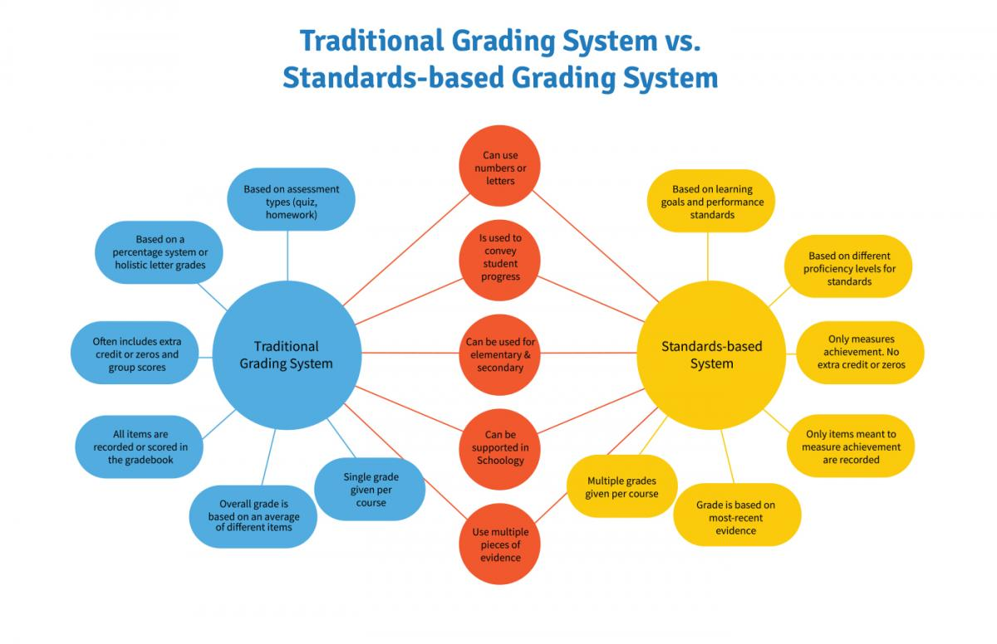

Slide 6
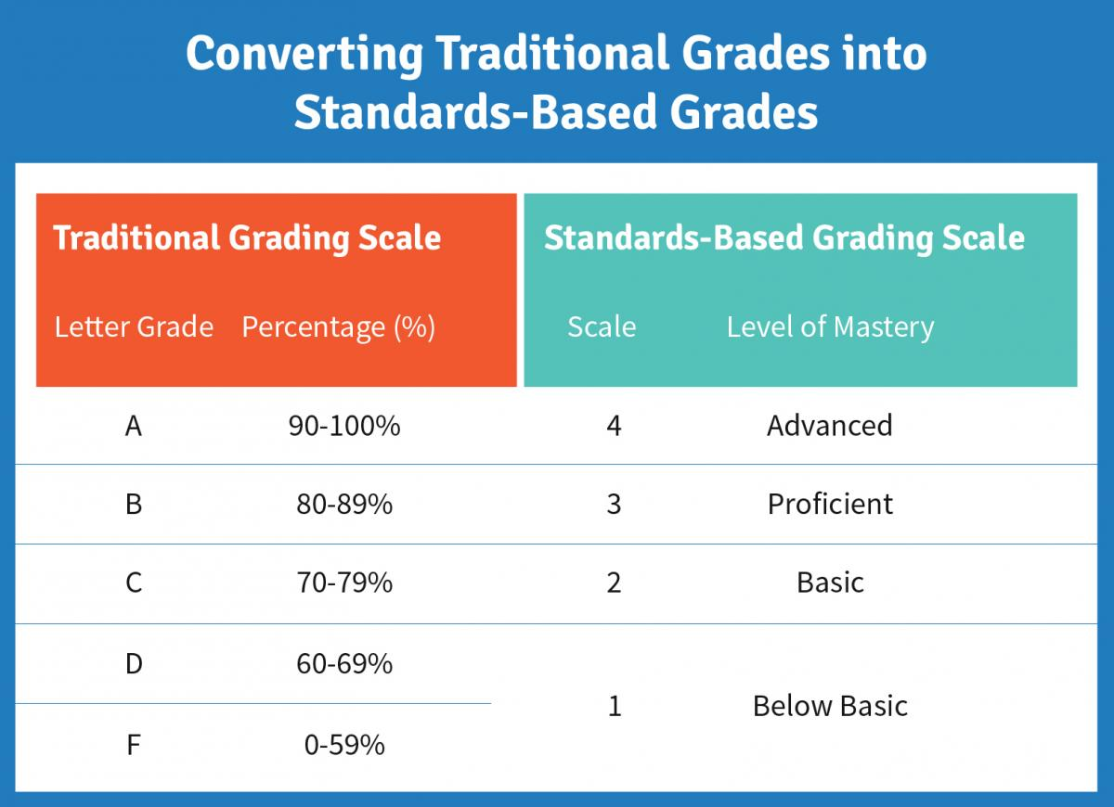
Grades from 4-1 were still placed into percentages (or letter grades)

Slide 7
11th and 12th grade Anatomy and Physiology

Slide 8
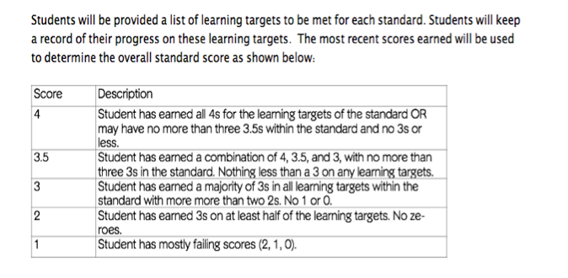

Slide 9
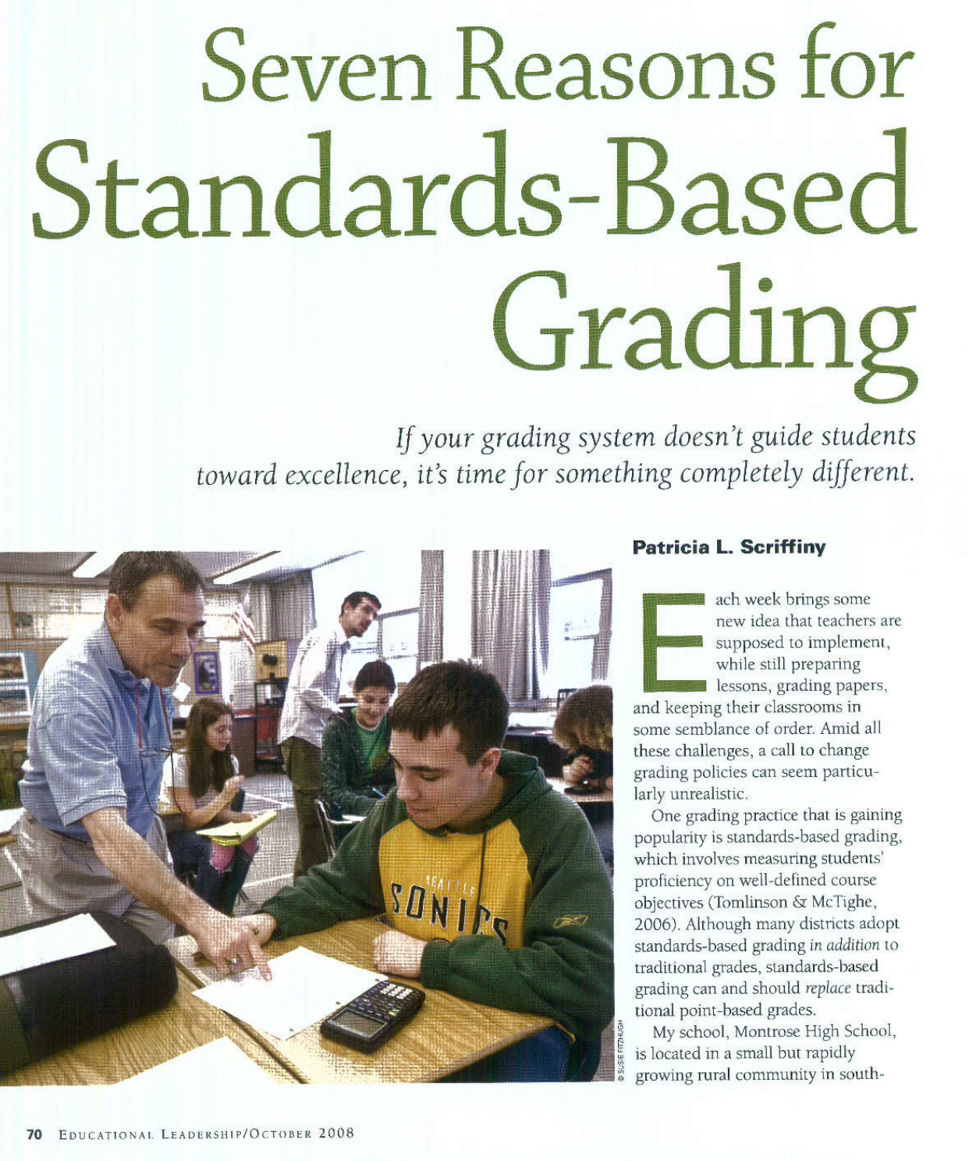
Article #1
Grades should have meaning:
Completes proficient work on all targets and advanced work on some
Completes proficient work on all targets
Completed proficient work on most important targets
Completes proficient work on at least half the targets, missing some important targets and at risk of failing next course
Complete Proficient work on less than half of targets and can’t complete next course.

Slide 10
Should we challenge status quo, awarding points for homework?
Students who are clearly learning but learn low grades due to missing work
Students who learned little but were good at ‘playing school’
Feedback on homework pushes students to complete it
Explain to students how homework connects to learning target and assessments
Notes:
Playing school: students can receive high test scores but have ern decent grades due to turning in homework and doing extra credit. This would lead them to struggle in future courses

Slide 11
What do we control?
Can’t control: socioeconomic levels, school funding, salaries, class sizes, ect.
Can control: How we assess students
System doesn't allow students to mask understanding with attendance or effort

Slide 12
Should we reduces paperwork, or ‘busy work’?
Focus and feedback on formative assessments
Test objective when most students can score proficiently
Students who are still struggling can retest individually
When you review student work you walk away with a better understanding of their mastery level of learning objective

Slide 13
How can teachers adjust instruction?
Should we?
Teacher can see what targets need extra class instruction versus students needing individual instruction
Struggling students not penalized for needing extra time for mastery
Students can demonstrate in different ways their proficiency level
Students who maser the learning target can be pushed higher in bloom's taxonomy
Notes:
Grade book shows if they are meeting the standards. Not how they are. How students demonstrate or what modifications were needed are not shown

Slide 14
We need to teach what quality looks like
Ability to measure the quality of your own work is a skill used in the real world
Demand quality and students need to revise if standards are not met
Base grades on learning targets > attendance, behavior, organization, extra credit students can better understand the quality of their learning
Report attendance/effort separately*

Slide 15
Launchpad
Classes need clear learning objectives/standards
Many students feel like they have better control over their grades (many dislike revision process)
Parents want opportunities for children to succeed
Notes:
Need clear standards for using standards based grading.

Slide 16
Grading:
* Should show how well students have mastered and performed a learning objective
*We need to distinguish the difference between product, process, and progress

Slide 17
The Norm
Teachers typically merge scores of: Major exams, quizzes, reports, homework, attendance, organization, participation, work habits, and effort.
This results in difficulty determining how well the student has mastered the learning target
Usually students are not well informed of their expected learning targets
Notes:
Scores may be weighted differently, but how much each of these categories matter varies from classroom to classroom

Slide 18
Product
Grading with purpose on summative evaluations (focus on outcome, high stakes high point value)
Focus on students ability at a certain point in time

Slide 19
Process
Grades reflect not just final results, but also how students got there
Focus on effort, attendance, home work, work habits, ect
Grades given for these things. Examples: participation, formative assessments (during learning process)

Slide 20
Progress
Grading depends on how much students learn from experience in the classroom
Improvement over time, not at a given moment
Scoring criteria may be individualized (example: grades based on number of learning targets mastered and their levels of mastery)

Slide 21
Reporting Multiple Grades
Assigning separate grades to product, process, and progress learning
Grades for responsibility, learning skills, effort, work habits, and learning progress are distinct from students level of understanding of leanri g targets.
By individualizing these factors students can better evaluate themselves in these particular areas
Increases reliability and fairness of grading process

Slide 22
Elementary
Each subject has specific standards for separate grades. Requires teachers to keep detailed notes of student performance to grade student learning strengths and areas for growth.
Rubrics help grade process of learning related to preparation, participation, homework, cooperation, and respect (and even work habits, study skills, or citizenship)
Grade reports need descriptions of where/how students can improve

Slide 23
Secondary-merges class schedule
Section for academic achievement (does not include factors such as work habit, class behavior, organization, ect.)
Process goals with rubrics reported (participation, homework, punctuality). These are more like comments and descriptions rather than a letter grade.
Both secondary and Elementary have custom scoring options for students with modified standards (IEP, ISP, ect)

Slide 24
Summary of Article
Grading should be linked with students mastery of content
Grading should have a clear purpose and help display how to fill in gaps of learning targets
Curriculum standards need to be clear and explicitly linked to grades
Grading should be fair and used as a tool for improving students learning

Slide 25
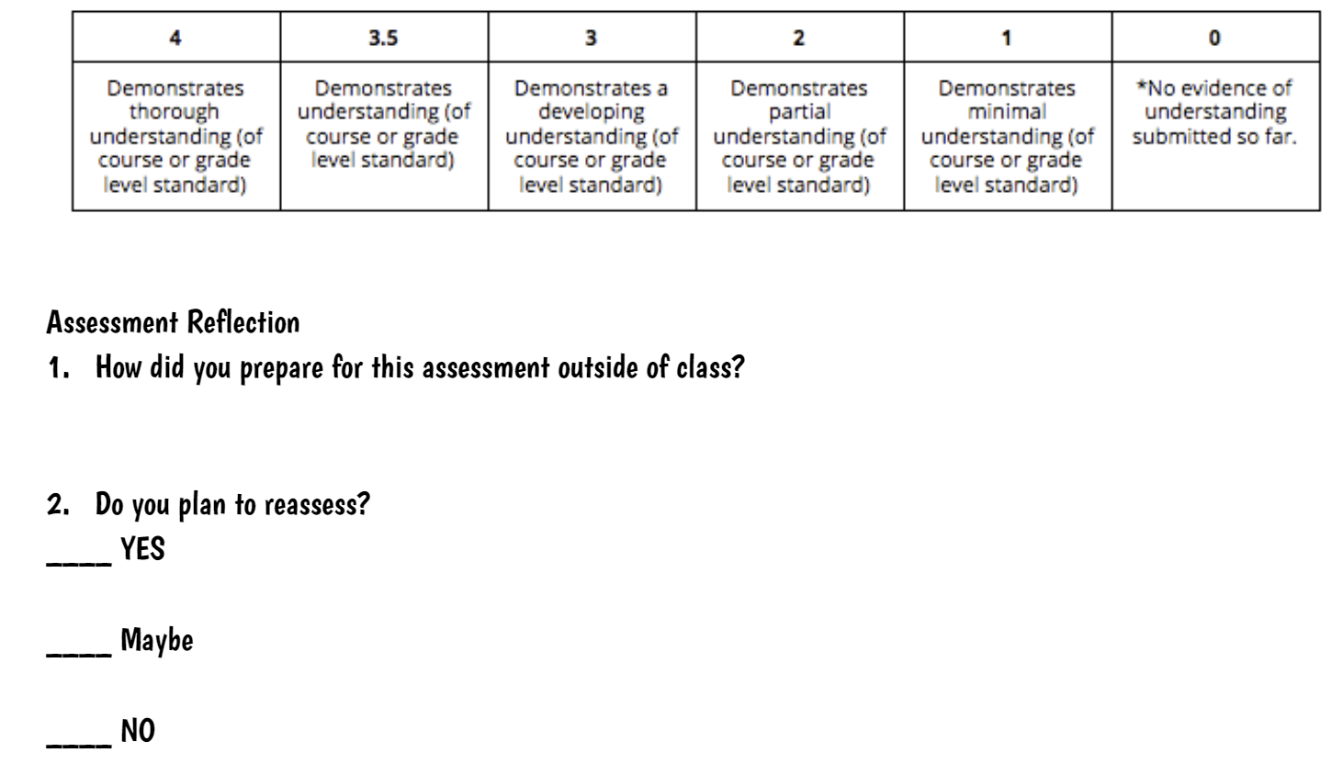
Reassessment was full of reflection for students to see how they can improve their study/learning skills and tp self reflect on how they used class time and out of class time to prepare for the test

Slide 26
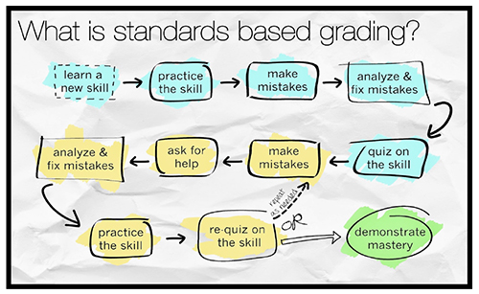
Cell Cycle and cancer example:
Learn the steps of the cell cycle
Practice the phases cell cycle through an entrance ticket
Look over ticket and fix mistakes
Take test on test. (say a student gets a 3 on the test and wants a 4)
Reassessment process:
Notebook check. Do we have all the practice/notes from in cass?
Test correct
Walk through test corrections with teacher
Practice test due before reassessment
Reassess
Notes:
Entrace tickets are common, or exit tickets. I also did study stations with multiple chances for practice tests (multiple choice and diagrams)

Slide 27
Consider the following
Please revise the reassessment process that I used for learning targets

