Slide 1
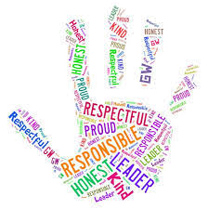
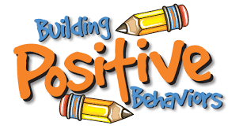
P.B.I.S
Tiffany Ludwig

Slide 2
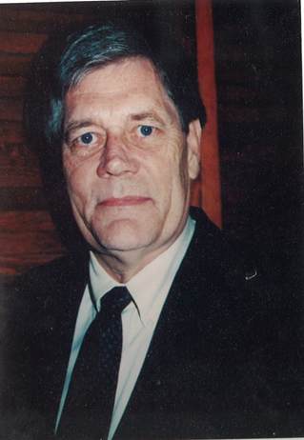
Quote
“If a child doesn’t know how to read, we teach.
If a child doesn’t know how to swim, we teach.
If a child doesn’t know how to multiply, we teach.
If a child doesn’t know how to drive, we teach.
If a child doesn’t know how to behave, we… teach? …punish?
Why can’t we finish the last sentence as automatically as we do the others?”
-Tom Herner (NASDE President 1998) (National Association of State Directors of Special Education)
(“What Is PBIS?”)

Slide 3
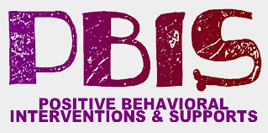
What is P.B.I.S?
Positive Behavior Interventions and Supports
1997- amendment of the Individuals with Disabilities Education Act (IDEA)
The Goal: reduce or eliminate poor behavior through the encouragement of positive behaviors.
(“What Is PBIS?”)
How many of your schools had PBIS and what are your thoughts on it?

Slide 4
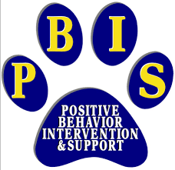
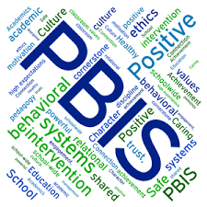
More Background
P.B.I.S originally was to be used for special education and behavioral students.
Another Goal: create a positive school climate, where students learn and grow
For PBIS to work and produce change, the whole school needs to follow it
PBIS represents a radical change in thinking about behavior and discipline. Instead of allowing poor behavior to escalate into disciplinary measures, the focus is on teaching and promoting positive behaviors.
(“What Is PBIS?”)

Slide 5
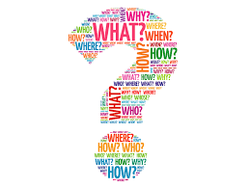
Focus Question
What are the principles of PBIS and how are schools implementing them?

Slide 6
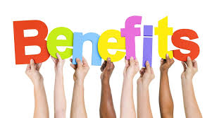
Benefits
Have you seen any of these in your experiences?
What do you think the negatives would be and have you seen any of those?
Improves school culture
Builds social skills
Reduces office discipline referrals
Increases instructional time
Improves social and emotional development
Improves school safety
Increases student engagement
Improves academic performance
Improves faculty retention
Improves classroom management
(“What Is PBIS?”)

Slide 7
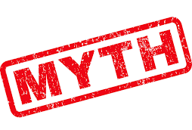
Myths
PBIS rewards students for what they are supposed to be doing.
The “Positive” in PBIS just means handing out treats and other goodies whenever kids behave.
“10 PBIS Myths in Implementing and Maintaining a PBIS Program.”

Slide 8
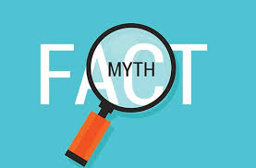
More Myths
3. Once you stop rewarding a specific behavior, students stop doing that particular behavior.
4. Setting up a store for rewards is expensive and time-consuming.
5. PBIS will add more responsibilities to my daily schedule.
“10 PBIS Myths in Implementing and Maintaining a PBIS Program.”

Slide 9
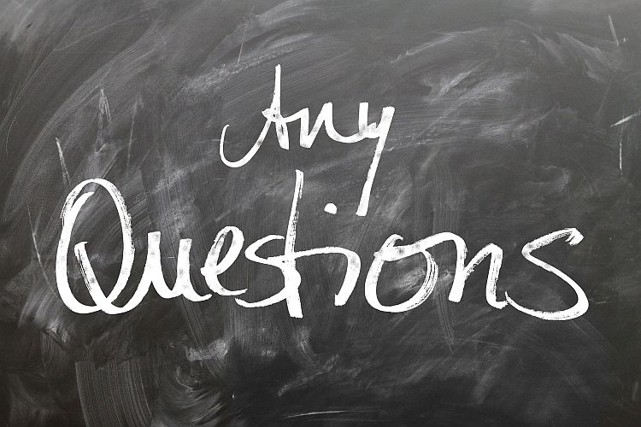
Thank you!
Do you have any questions for me?

Slide 10
Works Cited
“What Is PBIS?” PBIS Rewards, 2 Apr. 2019, https://www.pbisrewards.com/blog/what-is-pbis/.
“10 PBIS Myths in Implementing and Maintaining a PBIS Program.” PBIS Rewards, 30 Apr. 2018, https://www.pbisrewards.com/blog/debunking-top-ten-pbis-myths/.

