Slide 1
Teaching Vocabulary
Morgan Barnard

Slide 2
Why Teach Vocab?
Number one thing missing from class lessons
Student teaching experience teacher survey
Improves reading comprehension
Especially important for ESL students
Notes:
When I was student teaching in Iowa City, teachers voted on the number one thing they wished they included more of in their teaching. The most popular answer, regardless of content area, was vocabulary.

Slide 3
ESL Students
Difference between incidental and intentional learning
Incidental occurs most when interacting with others, through conversation
Intentional is during direct instruction and purposeful school work
Vocab retention is higher with incidental learning
Higher when meanings were inferred correctly than when explained by synonyms

Slide 4
ESL Vocab Strategies
Target vocab items
Retained longer when given targets
Providing both pictorial and written annotations increases understanding and retention

Slide 5
Vocab for EFL Students (English First Language)
Retention is higher when engaged in composition
Composition rather than fill-in tasks
More involved with learning

Slide 6
Vocab Strategies
Post-reading comprehension tasks
Communication tasks that require interactions
Summarize the text after reading
“Use it or lose it”

Slide 7
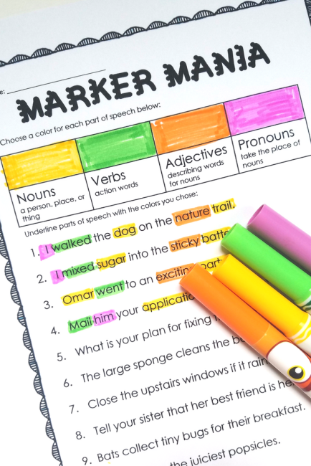
Ways to Implement Vocab in the Classroom
Using color
Used in treatment of mental problems/diseases
Important tool in visual thinking
Separates ideas
Stimulates creativity

Slide 8
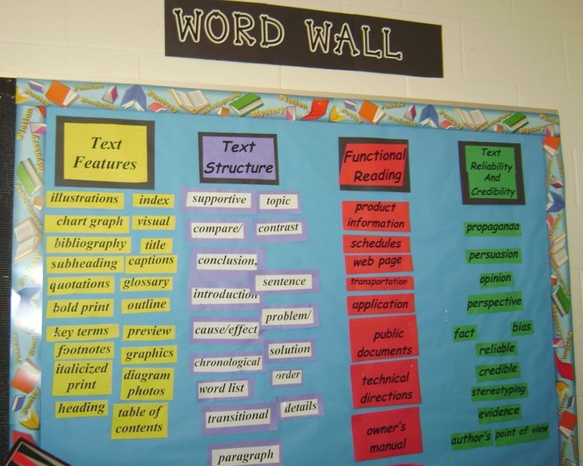
Implementing Vocab Cont.
Word wall
Visually see and be surrounded by the words
Multiple exposure, allows students to draw connections and build contexts
Large in-class resource
Repetition and recycling

Slide 9
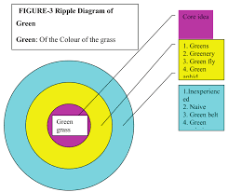
Implementing Vocab Cont.
Ripple Effect
Core meaning, expanding outward to more definitions
Helps explain metaphors
Visual learning tool

Slide 10
Teaching Vocabulary
Reading aloud
Have students follow along, take notes, draw pictures
Mark unknown words
Activity: video reading aloud with pictures https://www.youtube.com/watch?v=eAG81edmarA –”Daffodils” William Wordsworth
https://www.youtube.com/watch?v=ptrICcPddcE –”Oranges” Gary Soto

Slide 11
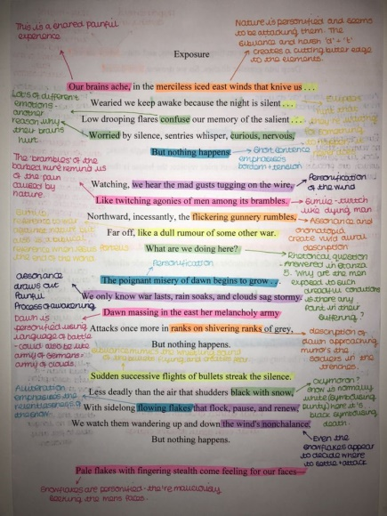
Teaching Vocab. Cont.
Underline or highlight different parts of speech in colors
Read through several times, each time focusing on a different part of writing (parts of speech, sensory details, figurative language, etc.)

Slide 12
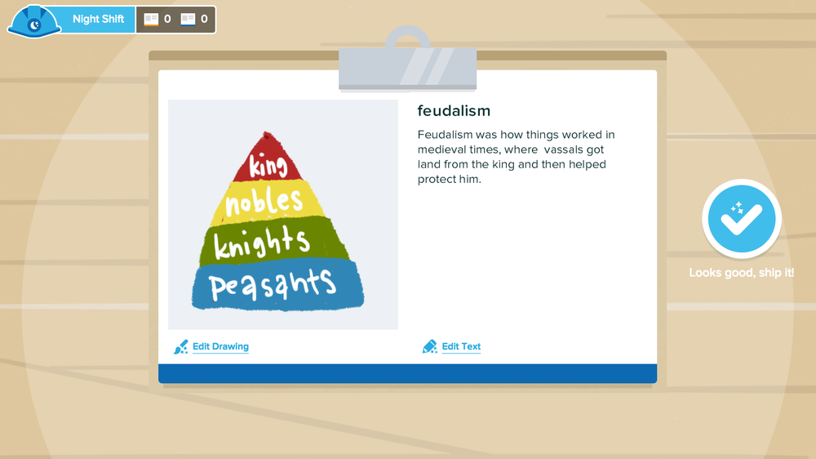
Learning Tools/Games
Gimkit
Fun game to earn “money” and learn different concepts
Flashcard Factory
Create flashcards with a partner
Draw pictures to represent the word and definition

Slide 13
Conclusion
Vocabulary is a vital part of students’ learning that often goes overlooked
Important to know strategies for incorporating vocabulary in lessons, not just intentional learning
Strengthens comprehension and critical thinking skills

Slide 14
Works Cited
Anuthama, B. “Strategies for Teaching Vocabulary.” Journal of NELTA, Vol. 15, No. 1-2, Dec. 2010, pp. 10-15
“Doing It Differently: Tips for Teaching Vocabulary.” Edutopia, https://www.edutopia.org/blog/vocabulary-instruction-teaching-tips-rebecca-alber. Accessed 5 May 2020.
Nam, Jihyun. “Linking Research and Practice: Effective Strategies for Teaching Vocabulary in the ESL Classroom.” TESL Canada Journal, Nov. 2010, pp. 127–127. teslcanadajournal.ca, doi:10.18806/tesl.v28i1.1064.

