Slide 1
Introductions
Artificial Intelligence
Ajit Chavan
Cornell College

Slide 2
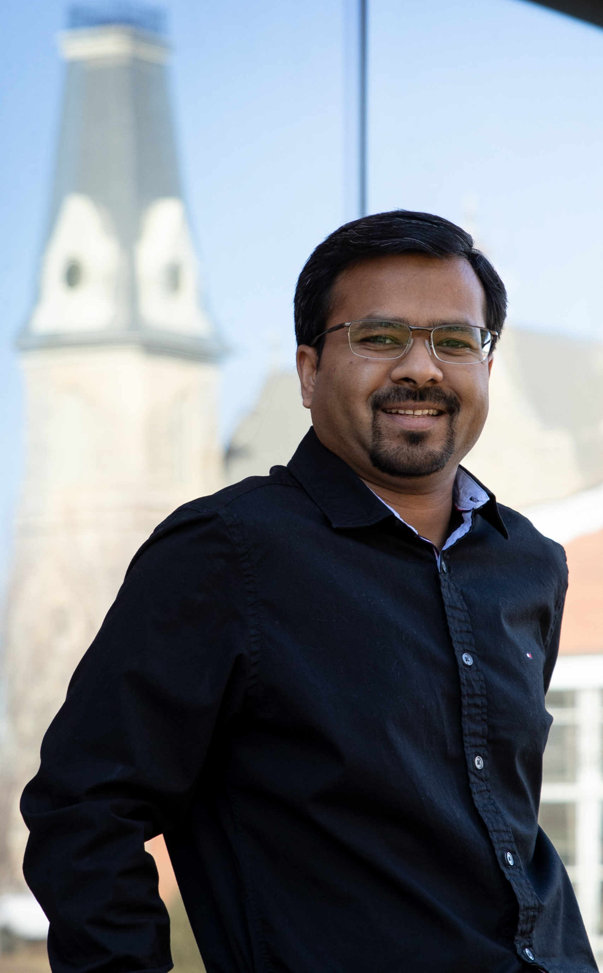

Teacher Introduction
Dr. Ajit Chavan
Born in India
Came to the USA in 2011
Joined Cornell College in 2019

Slide 3
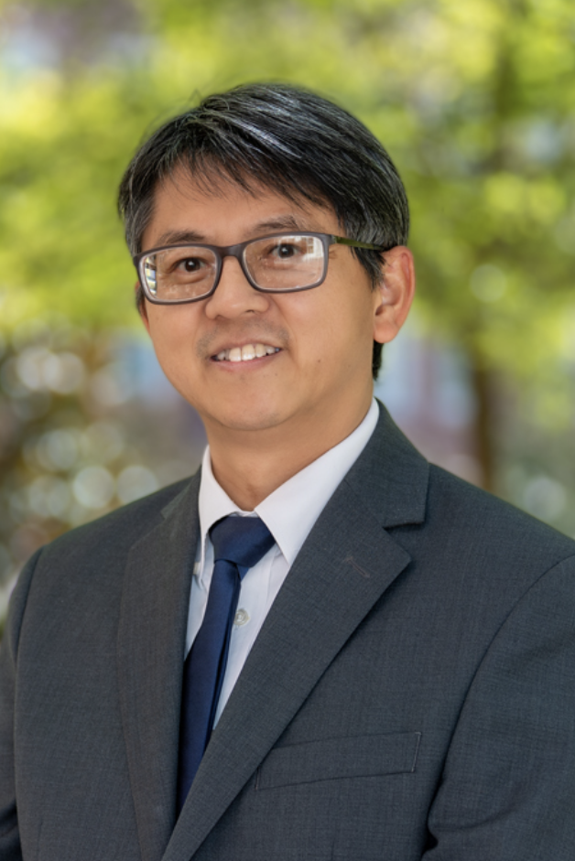
PhD in Computer Science
University: Auburn University
Advisor: Prof. Xiao Qin
Dissertation: Distributed Systems
Areas: Machine Learning, Big Data

Slide 4
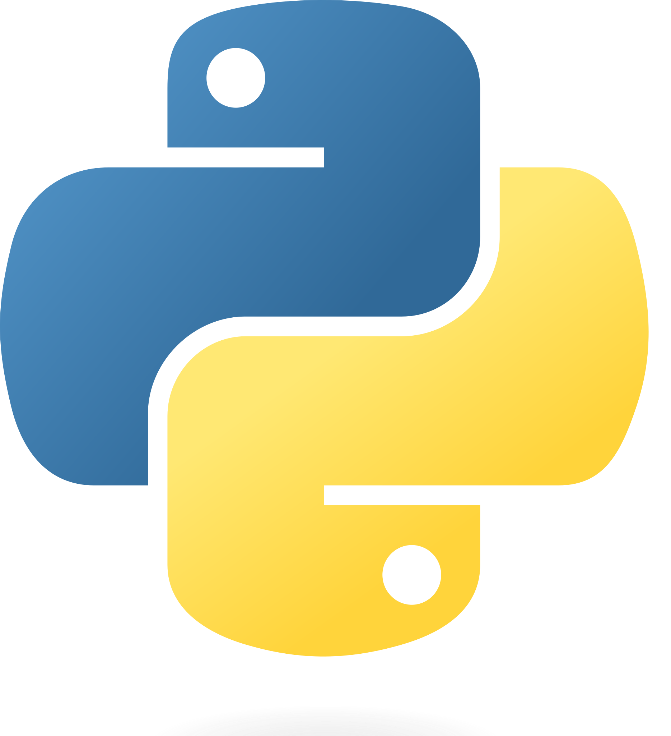
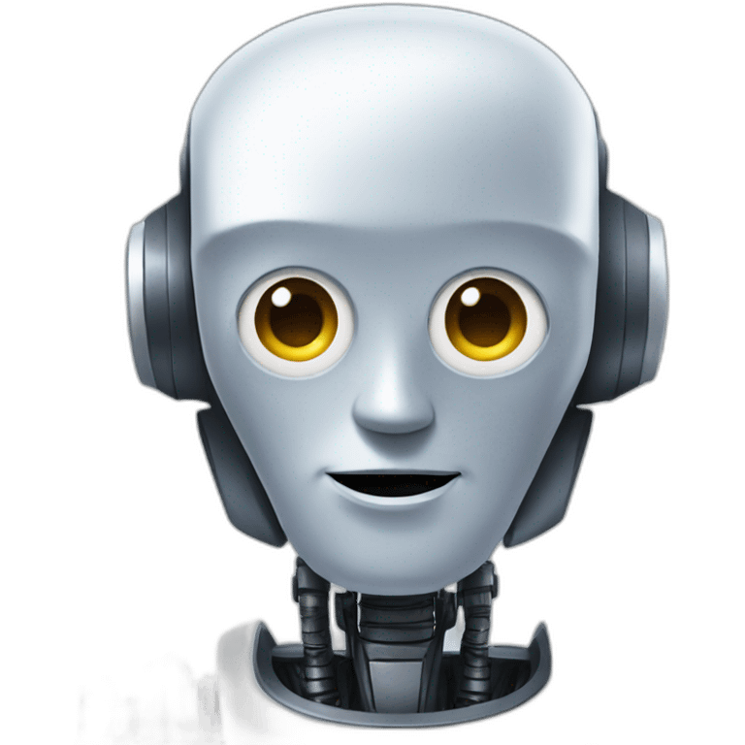
Course: Artificial Intelligence
First Priority: Python Programming
We will learn programming concepts that will help you for the rest of the college
We will also learn basics of Machine learning
With this knowledge, you can start learning about artificial intelligence
4

Slide 5

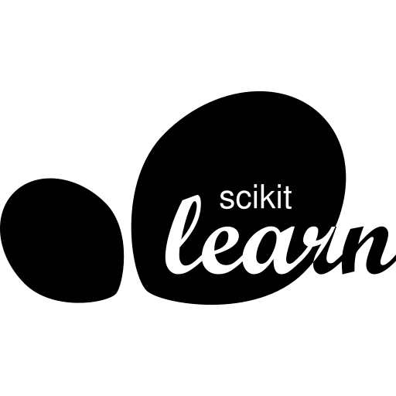
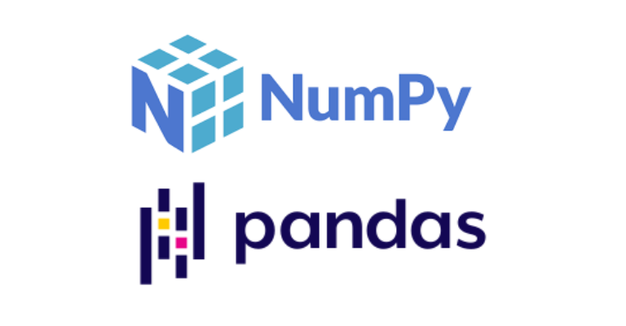
Course Structure
Videos will be focused on explaining concepts
You will get a couple of practice exercises
We will discuss the answers to the exercise and do more hands on practice during interactive sessions
5

Slide 6
Part 1: Python Basics
Interpreting Vs Compiled Languages
Basic syntax of Python
Variables, functions, statements, and expressions
conditions and loops
6

Slide 7
Part 2: Data Structures
Lists
Dictionaries
Arrays
DataFrames
7

Slide 8
Part 3: Machine Learning
Reading and Cleaning data
Libraries that provide ML models
Selecting and training a model
Evaluating the trained model
8

Slide 9
Learning Programming
Similar to learning to drive a car
Cannot learn by watching someone else driving
You have to get your hands dirty and practice
9

Slide 10
Next Video
Set up environment to start running python
Walk through installing Anaconda
Complete suit including Python and ML
10

