Slide 1
Compiler Vs Interpreter
Artificial Intelligence
Ajit Chavan
Cornell College

Slide 2
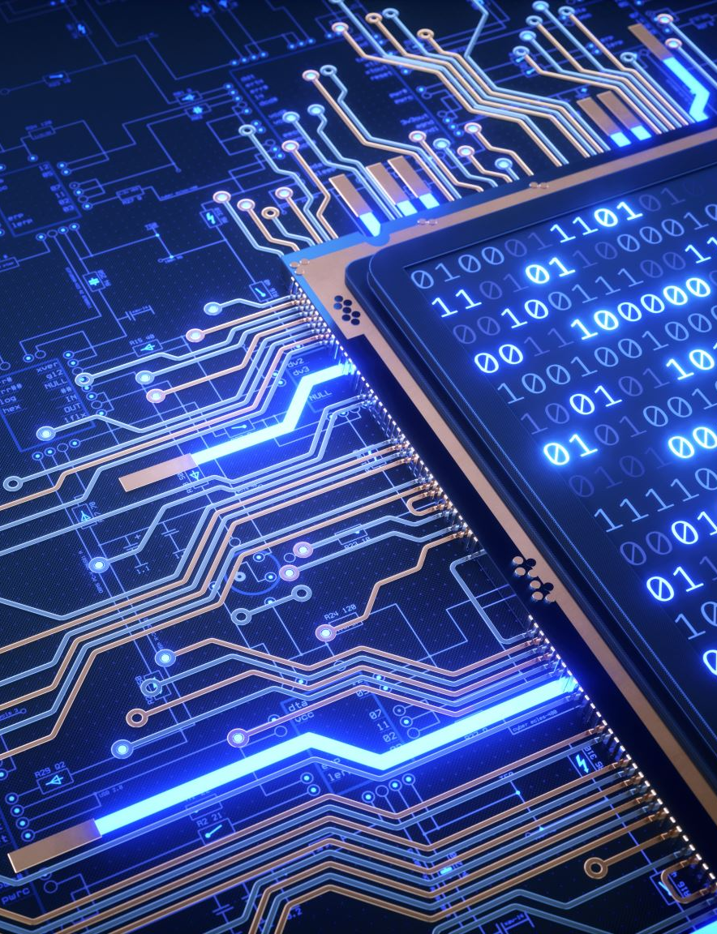

Processor (CPU)
CPU is made up of gates
Gates work in binary language
1000 1010 1010 1101
very difficult for humans to understand and work with

Slide 3
High-Level Programming Language
Meant to be used by programmers
CPU does not understand it
Translation is needed

Slide 4
Translation is needed
We need another program to translate high level programming language into machine language
There are two ways the translation works:
Compiler: Translates entire program at a time
Interpreter: Translates one line at a time

Slide 5

Compiler
Translates entire program and returns an executable file
Then, you can run the executable file

Slide 6
Interpreter
Translation and execution happens on a line by line basis
Translates one line to machine language
Executes that line and then go to the next line
E.g., Java, JavaScript, R

Slide 7
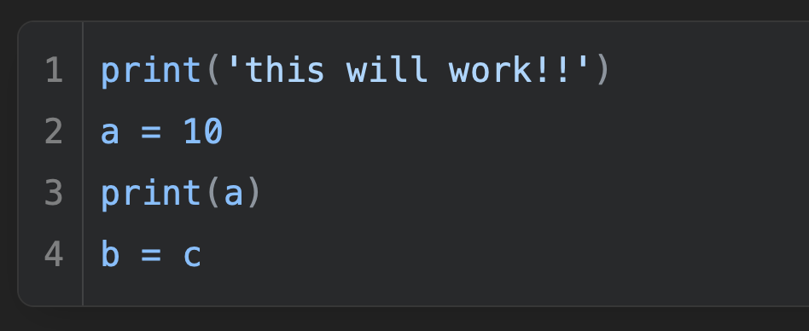

Python
Python is an interpreting language
All errors are runtime error

