Slide 1
Expressions
Artificial Intelligence
Ajit Chavan
Cornell College

Slide 2

Quiz 1
Which of the following variable names are valid?
_x
abc1
first name
1abc

Slide 3
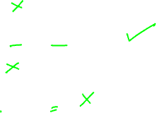
Quiz 2
Which of the following variable names are good names?
_x
gradePointAverage
fn
last_name?

Slide 4
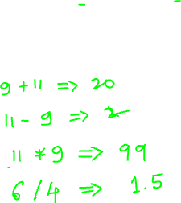
Arithmetic Expressions
Work on numbers, including integers and floats
We will now learn operators:
Addition
Subtraction
Multiplication
Division

Slide 5
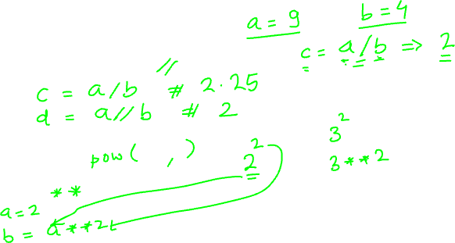
Arithmetic Operators (contd..)
Two Different Operators
Integer Division
Power

Slide 6
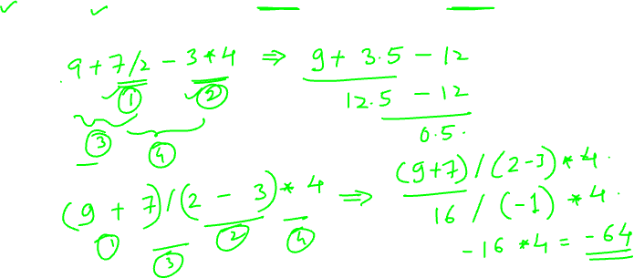
Order of Precedence
Parentheses, power, multiplication, division, addition, subtraction

Slide 7
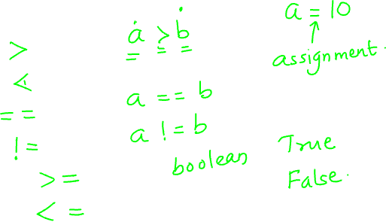
Comparison Operators
greater than
less than
equal to
not equal to
greater than equal to
less than equal to

Slide 8
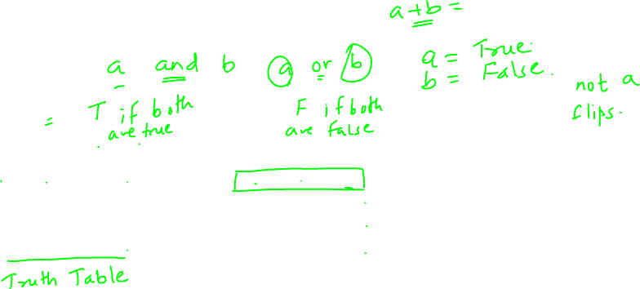
Boolean Operators
and
or
not
X | Y | X and Y
F | F | F
F | T | F
T | F | F
T | T | T
X | Y | X or Y
F | F | F
F | T | T
T | F | T
T | T | T
X | not X
T | F
F | T

