Slide 1

Quiz 2
Q. 1) What this expression evaluates to?
5+4/2+10*2-3

Slide 2

Quiz 2
Q. 1) What this expression evaluates to?
5+4/(2+10)*(2-3)

Slide 3

Quiz 2
Q. 1) What this expression evaluates to?
5+4//(2+10)*(2-3)

Slide 4
Statements
Artificial Intelligence
Ajit Chavan
Cornell College

Slide 5
Basics
Each statement on new line
Types of statements
Assignment
Function call, return statements
Conditional statements
Loop statements

Slide 6



Assignment and calls
Usually used to create variables
Also used to assign values to collections
function call

Slide 7
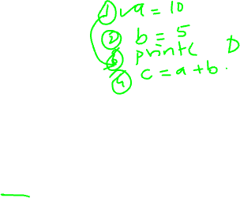
Conditional Statements
Also known as branch statements
They are used to change the sequence of program statements
They also use Boolean expressions (comparison most of the time)

Slide 8
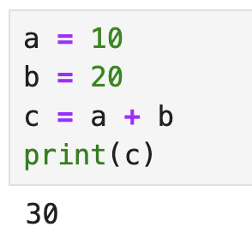
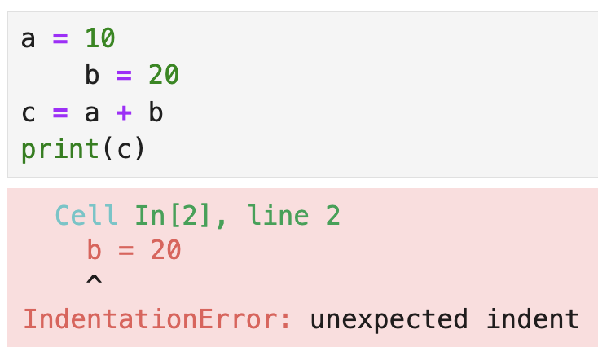
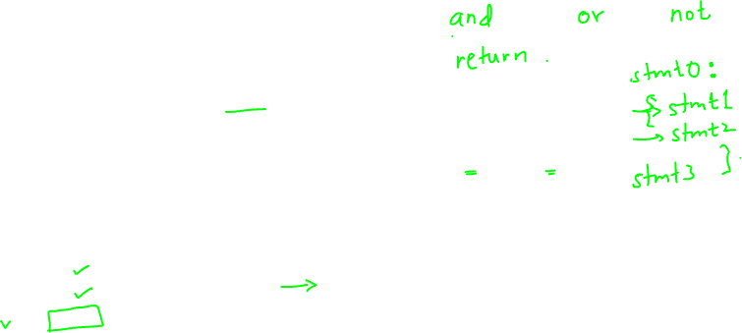
More about Python
Keywords: reserved words with predefined meaning
Block of statements: block is created with : and tab
Indentation is very important in Python

Slide 9
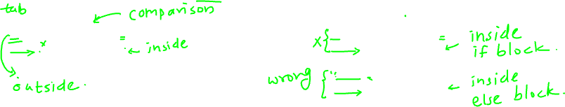
If-else
Three keywords: if, else, elif
if <condition>:
  statement1
  statement2
if <condition>:
  statement1
  else:
  statement2

Slide 10
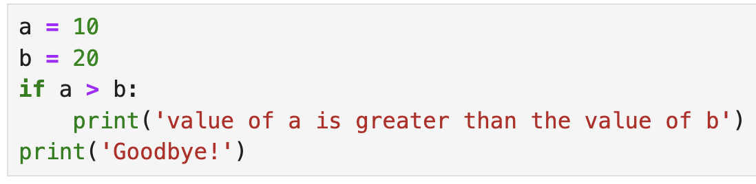
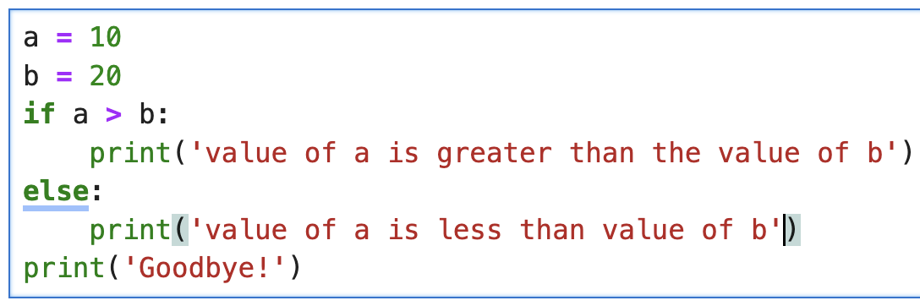
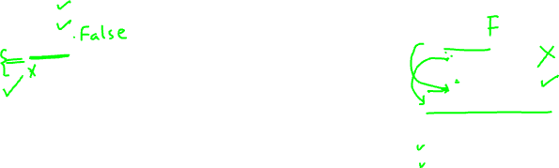
If-else
Example:

Slide 11
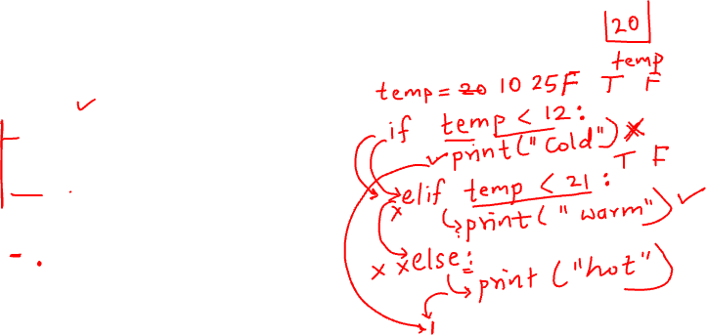
If-elif-else
Used when you have multiple conditions to test
if <condition1>:
  statement1
  elif <condition2>:
  statement2
  else:
  statement3

