Slide 1
Lesson Review
Work Last Day Review

Slide 2
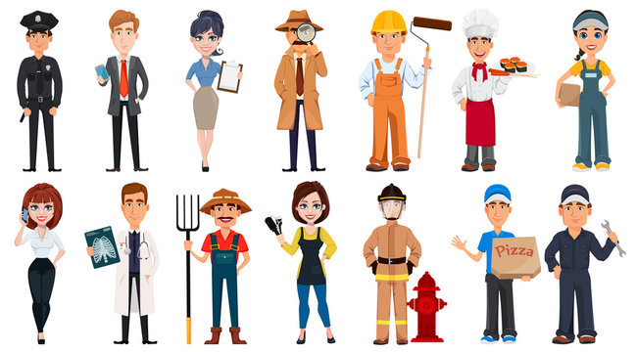
Let’s reflect on different occupations. Who are these people and what do they do?
Police officer
Business man and women
Detective
Construction worker
Chief
Package delivery person
Receptionist
Doctor
Farmer
Beautician
Firefighter
Pizza delivery person
Mechanic

Slide 3
Let’s get to work! Review Words REPEAT AFTER ME!
security officer | flight attendant | pilot | server | mechanic | receptionist
taxi driver | bus driver | train driver | vacation | travel | shopping
car | tire | bumper | hood | light | Steering wheel
engine | snacks | drinks | teacher | cashier | teller
 | baker | nurse | doctor | stylist | librarian

Slide 4
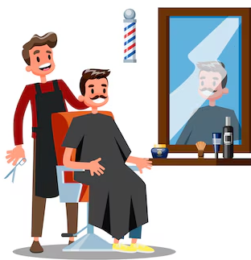
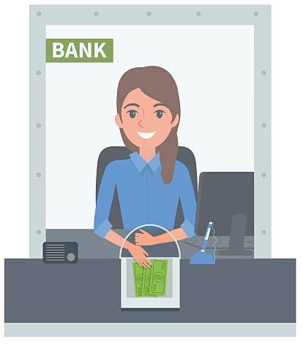
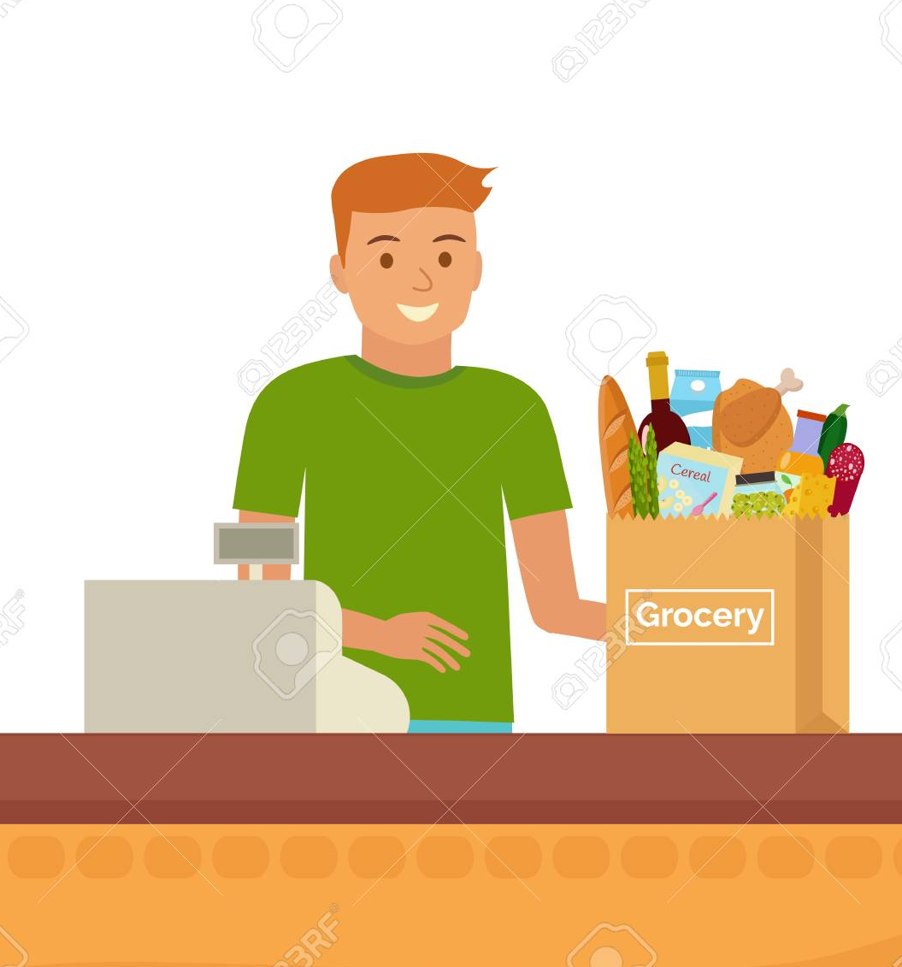
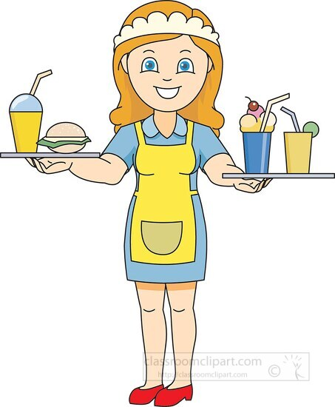
Repeat after me!
Let’s learn about different jobs people can do.
nurse doctor baker stylist
teller cashier server librarian

Slide 5
Let’s have a conversation
At the barber shop
Person- I need to get my hair cut.
Barber- Great how short do you want it.
Person- I just need a trim
Barber- ok great, put on the cape and let’s get started.
Person- I love it, how much?
Barber- $35.00

Slide 6
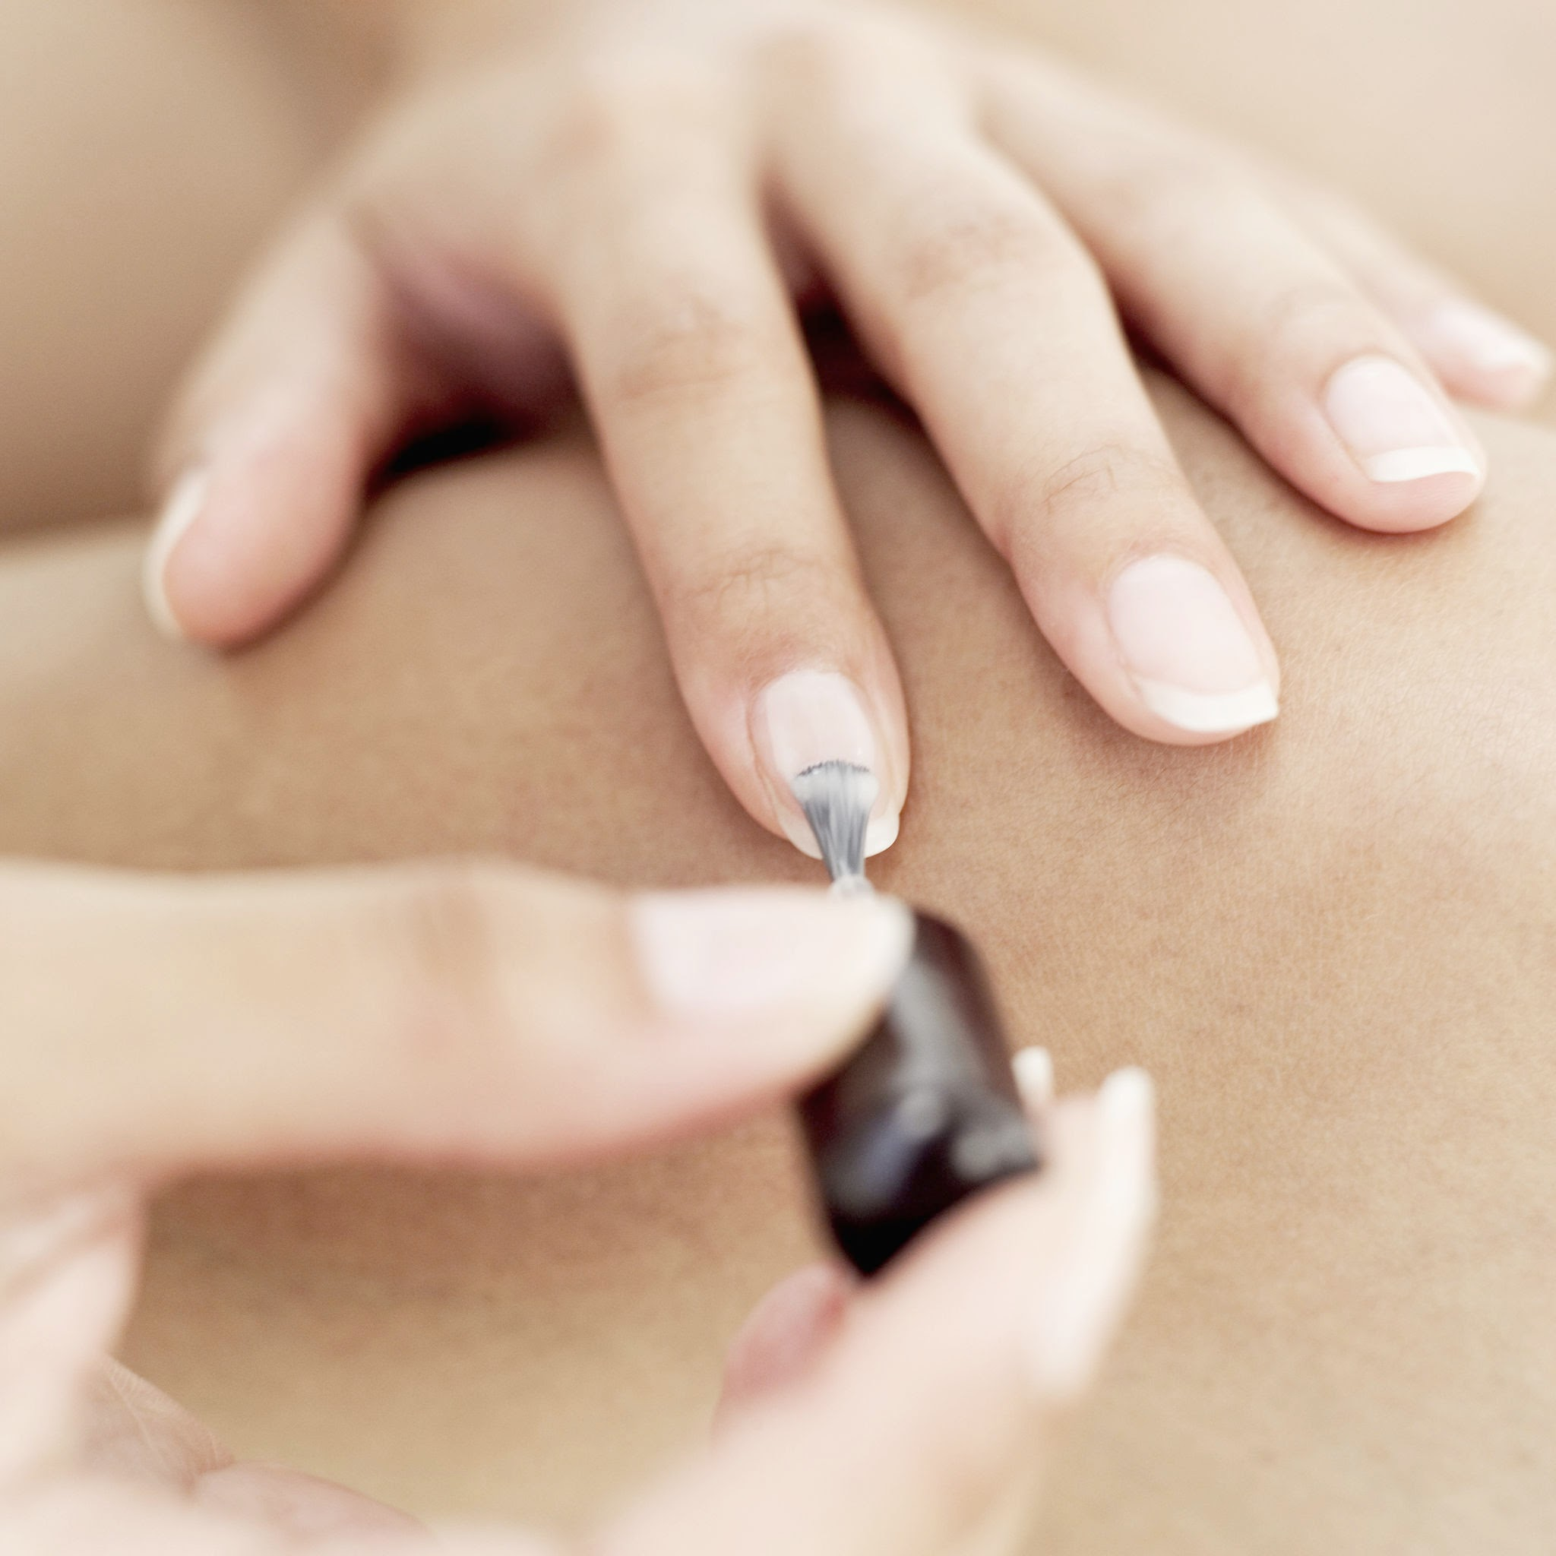
Let’s have a conversation:
Beauty Salon
Person- Hi I want to get my hair colored and cut
Stylist- great, what color do you want?
Person- I think I want to go blonde.
Stylist- great I have the perfect color
Person- Wow, I love it, before I go can I also get my
Nails painted.
Stylist- Yes, total it will cost $150.00

Slide 7
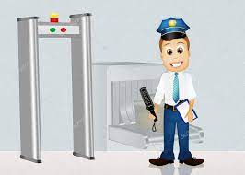
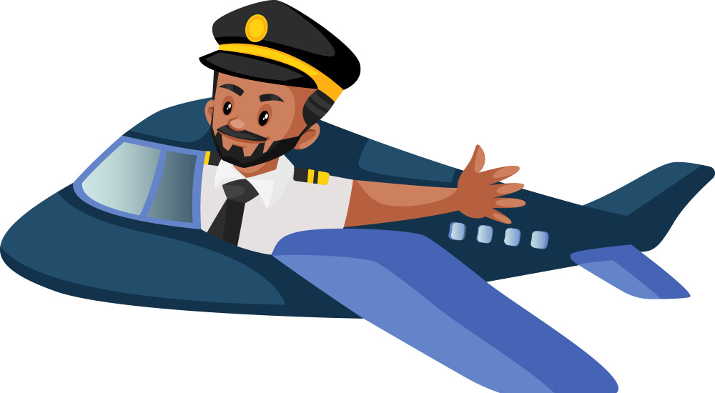
Repeat after me!
Different jobs at the airport
pilot flight attendant security officer
bus driver / train driver / taxi driver

Slide 8
Let’s have a conversation
Flight attendant: Welcome to the airport how can I help you?
I am heading to the United States
Flight attendant: Do you have your passport?
Yes, I do: Here is my information (share information about yourself- Name, date of birth, where are you from and where are you going?
Flight Attendant: Thank you, please go through security

Slide 9
On the plane- 3 people
Pilot- Welcome to flight 299, we are off to the United States: California.
Flight Attendant: Can I get you a drink sir?
Person- Yes, I will take a cola and a bag of peanuts
Flight Attendant: Yes, here it is, make sure to keep you seatbelt fastened, it is going to be a bumpy flight, there is a storm.
Person- Thanks, I will. Can’t wait to get there!
Pilot- Welcome to California, we finally made it!

Slide 10
Let’s get a ride- 4 people
Person- I am going to need a lift home from the airport
Taxi driver- It will be $150 from the airport to your home.
Person- Ok, let me how much the bus or train cost first
Bus driver- There are no bus stops near your home sorry, it will be too far of a walk to where you need to go.
Person- Ok, thanks anyway, I will look at the train schedule
Train Conductor- The next stop will be here in 10 minutes and the train station is walking distance to your home.
Person- Great! Looks like I will take the train home.

Slide 11
Repeat after me!
The nurse and doctor work at the hospital.

Slide 12
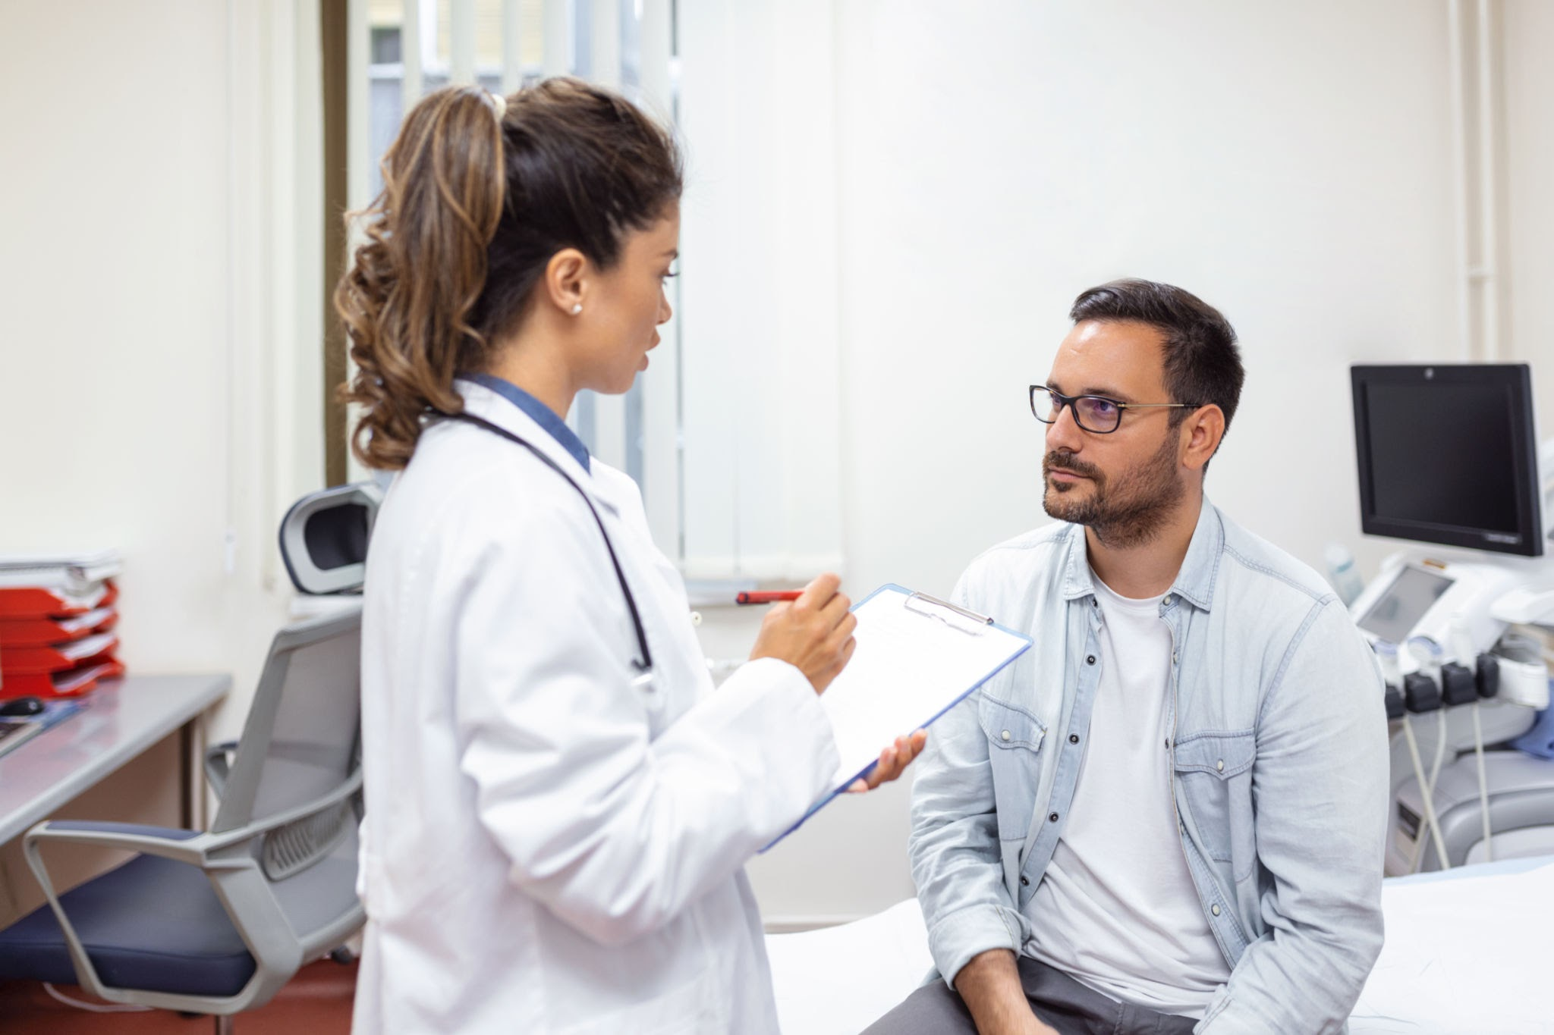
Let’s have a conversation:
3 people
Nurse: welcome to the doctor’s office, how can I help you?
Patient: I am here because I am not feeling well
Nurse: Please tell me what hurts?
My arm hurts and I think I broke it.
Nurse: Ok let me get the doctor, she will be right in
Doctor: Ok let’s take a look.
Ouch it really hurts, I can’t move it without pain!
Doctor: It does seem to be broken, Let’s get X-rays to find out!

Slide 13
Repeat after me!
The teachers work at the school.
The librarian works at the library.

Slide 14
Let’s have a conversation: 3 people
Teacher: For homework you need to go to the library and do research on different engineer jobs.
Student: Ok where is the library?
Teacher: down the hall you will see the library.
Librarian: Welcome to the library.
Student: Where are your engineer books located.
Librarian: They will be found on the back shelf.

Slide 15
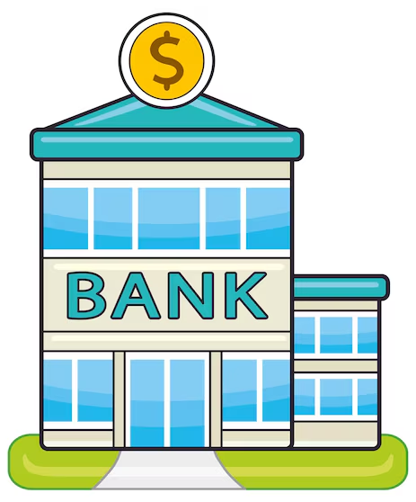
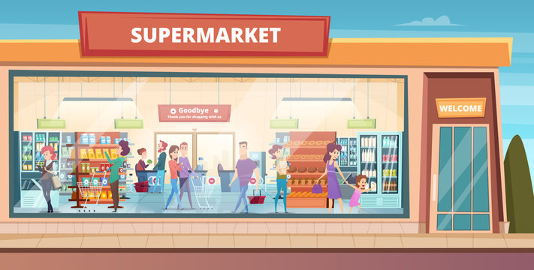
Repeat after me!
The cashier works at the supermarket.
The teller works at the bank.
The baker works at the bakery.
Errands around town

Slide 16
Let’s have a conversation: 4 people
Person - I have a busy day, I have to run errands. I have to go to the bank first.
Banker: Welcome to the bank, how much money do you need to take out?
Person- I need to take out $100, I have to get groceries and go to the bakery.
Grocery Store Clerk: That will be $80.00 for all of your groceries
Person- thanks, I only have $20.00 left for my cake at the bakery now.
Baker: Welcome to the bakery are you picking up your cake?
Person: Yes, the chocolate round cake with sprinkles.
Baker- Here it is, enjoy! It cost $19.99

Slide 17
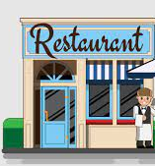
Welcome to the restaurant
See the breakfast menu on the next slide and order your breakfast with the server
The server works at the restaurant.

Slide 18
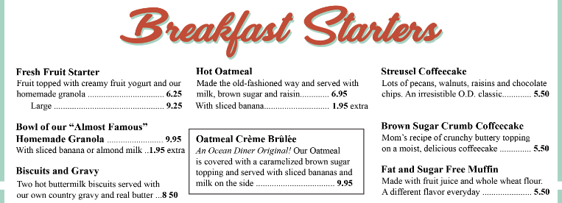
Server: Welcome to the diner what would you like for breakfast?
Customer: I would like to order _______________
Server: Great, that will be out shortly, It will cost _________

Slide 19
REPEAT AFTER ME!
The lights are on the front and back of the car.
The windshield is on the front of the car.
The steering wheel is inside the car.
The engine is under the hood.
There are four tires on the car.
The bumper is on the front and back of the car.
The hood is in the front of the car.

Slide 20
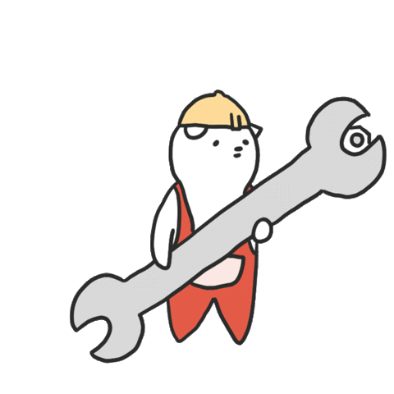
Mechanic
Person: Hi my car is having problems can you help me?
Mechanic- yes, can you tell me where the problem is?
Person: My car is making a strange noise ?
Mechanic- Ok, put open the hood and let’s take a look.
Person: I think it is the engine. I also would like my tires looked at.
Mechanic- Ok, it will be an hour wait, I will get it fixed!

Slide 21
There are many other types
of work. But let’s talk about
different types of
ENGINEERS.

Slide 22
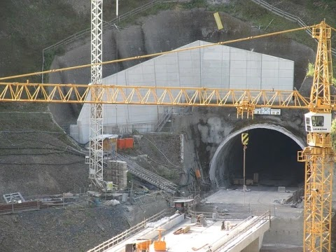
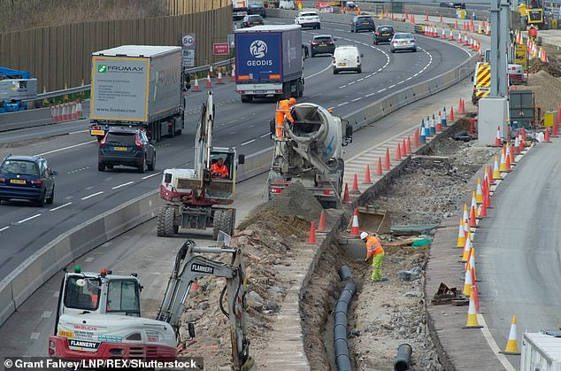
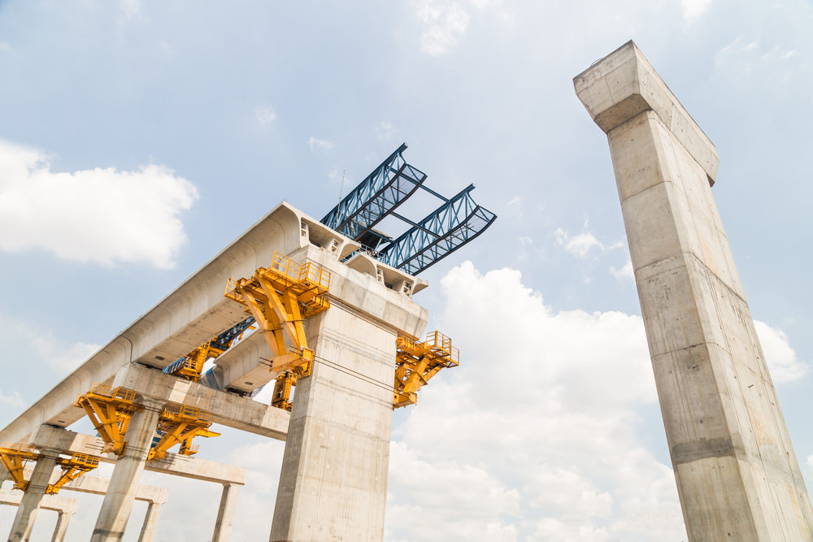
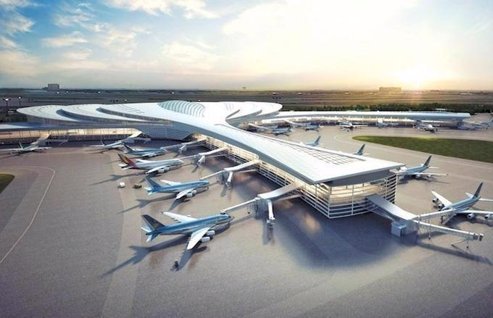
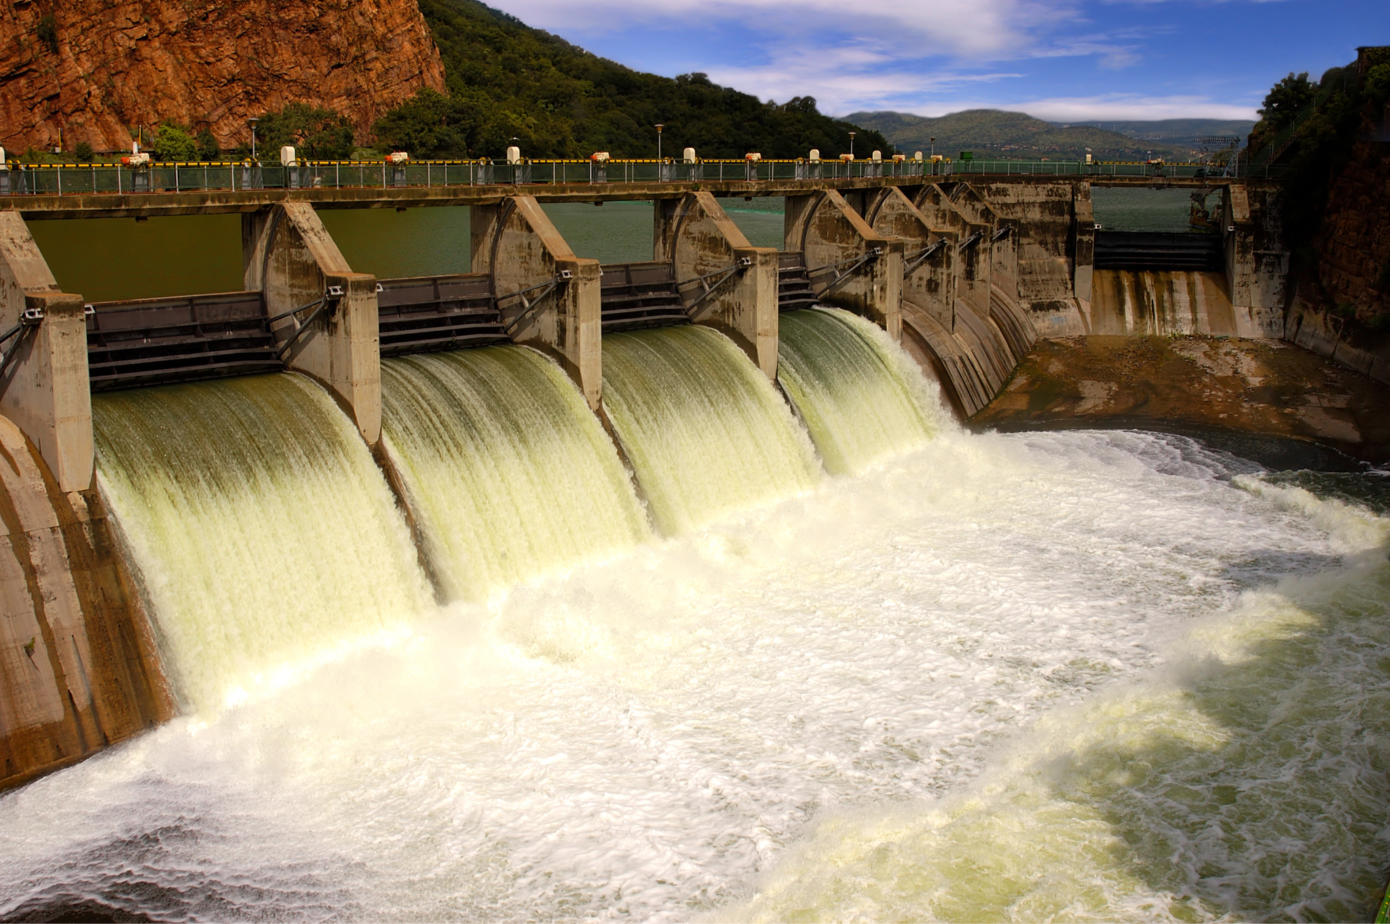
Civil Engineer Review Words REPEAT AFTER ME!
tunnels
roads
bridges
airports
dams

Slide 23
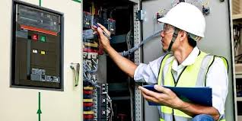
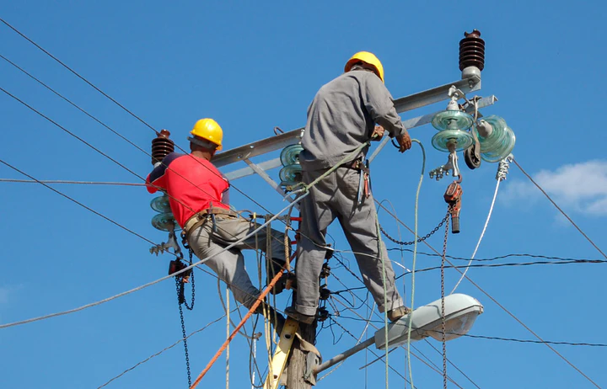
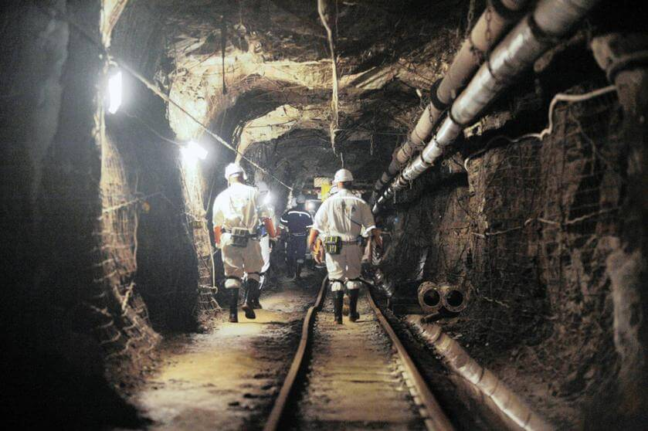
Electrical Engineer Review Words REPEAT AFTER ME!
technology
power utilities
mining

Slide 24
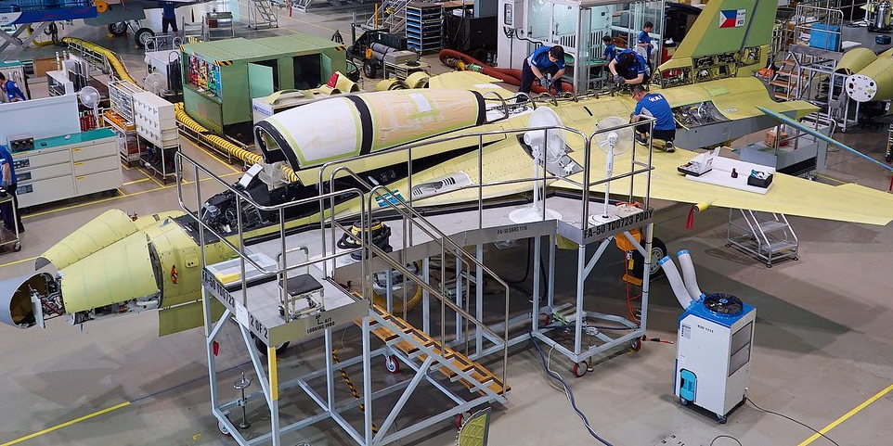
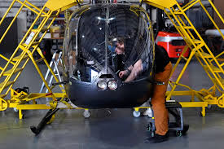
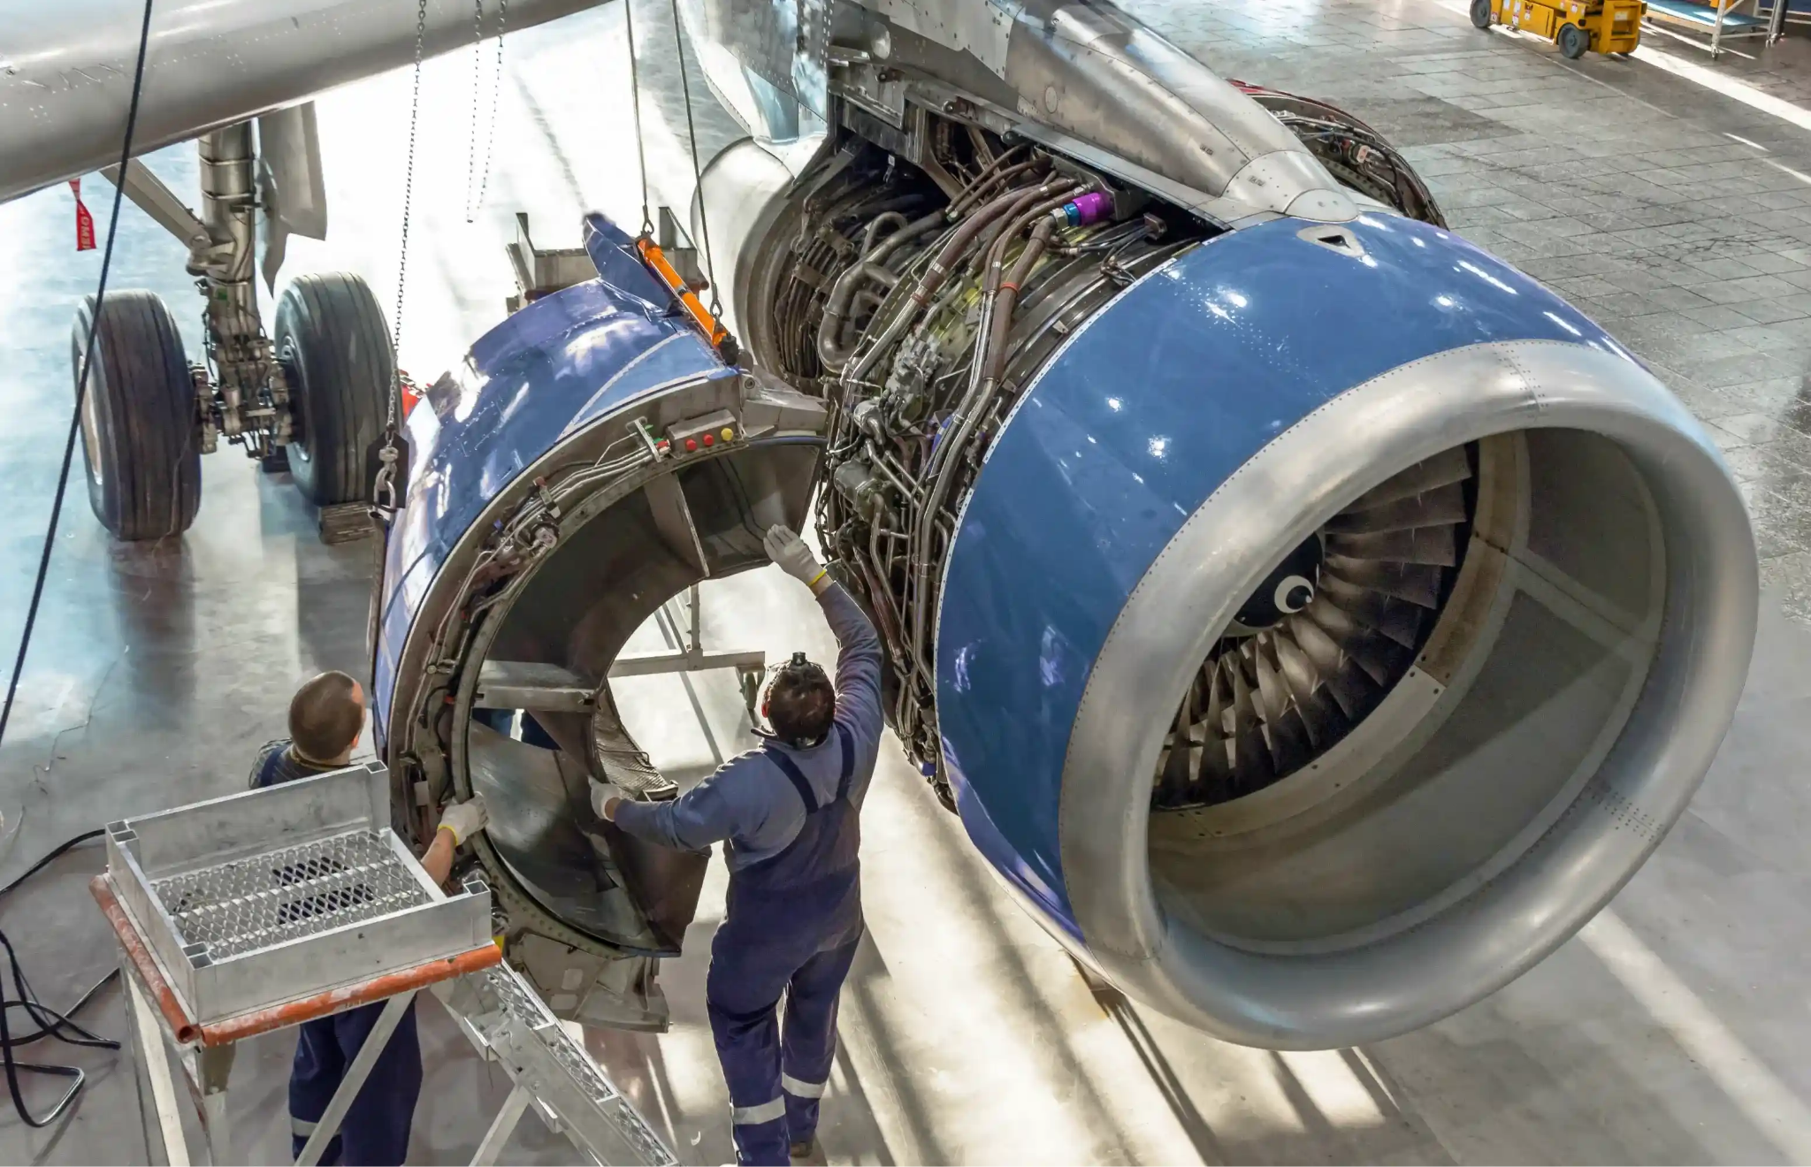
Aerospace Engineer Review Words REPEAT AFTER ME!
fighter jets
helicopters
spacecrafts
aeroplanes

Slide 25
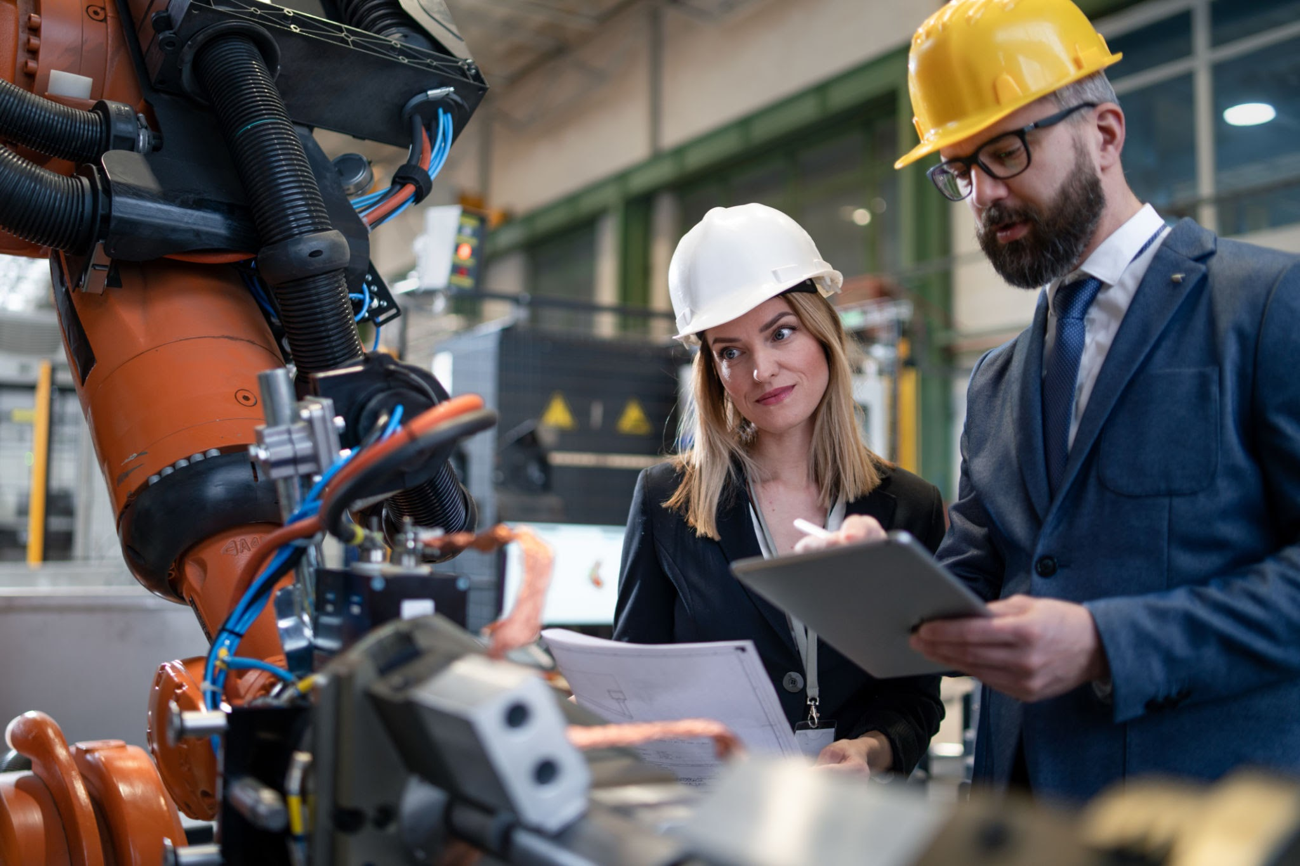
Extension Activity: Fluency
You and a partner have a
Conversation. (use the slides : 17-20)
Talk about being an Engineer. What will you design, develop, and or build?

