Slide 1
Analog Electronics Technology
Diodes

Slide 2
Analog Electronics Technology
Diodes
Semiconductor basics
Diode electrical characteristics
Solving diode circuits with known inputs
Solving diode circuits with unknown inputs
BJTs
Op Amps

Slide 3
What you should learn today
Diode electrical characteristics
Diffusion Currents
Drift Currents
Shockley Diode Equation
Deviations from Ideal Diode Equation
Avalanche Breakdown
Zener Breakdown

Slide 4
Energy Band Diagram for Forward Biased Diode
drift current
diffusion current
p type silicon
n type silicon
+
-
Polarity of applied voltage
Increasing energy of electron
E_{c}
Energy band for unbiased junction
E_{v}
eV_{a}

Slide 5
Energy Band Diagram for Forward Biased Diode
drift current
diffusion current
n type silicon
p type silicon
+
-
Polarity of applied voltage
Increasing energy of electron
E_{c}
Energy band for unbiased junction
E_{v}
eV_{a}

Slide 6
Energy Band Diagram for Reverse Biased Diode
drift current
diffusion current
n type silicon
p type silicon
-
Polarity of applied voltage
+
Increasing energy of electron
Energy band for unbiased junction
E_{c}
eV_{a}
E_{v}

Slide 7
Reverse Bias vs. Forward Bias
A forward biased diode has very little resistance to current flow.
Diffusion current predominates because of reduced barrier height
A reversed biased diode has very little current flow for moderate voltages.
Diffusion current reduced because of increased barrier height
Minority carriers depleted by drift current

Slide 8
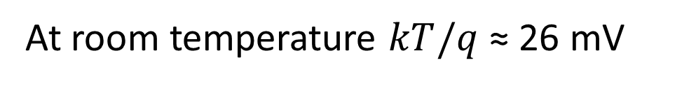
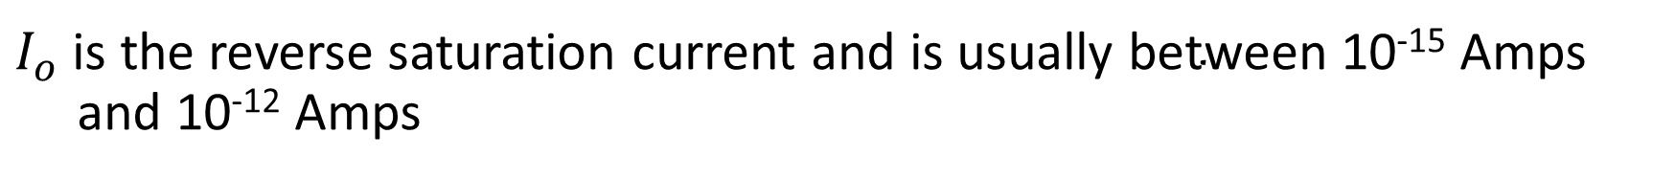
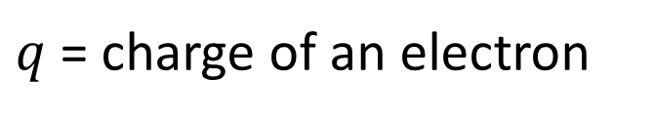

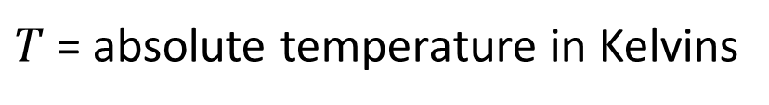
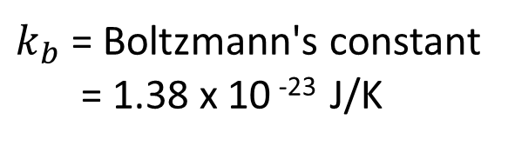
Shockley Ideal Diode Equation
For an ideal diode, the current through the diode is given by the following equation:
$$I= I_{o} \left(e^{V/{V_{T}}}−1\right)$$
$I_{o}$ is the reverse saturation current and is usually $\text{between}$ 10⁻¹⁵ Amps and 10⁻¹² Amps
$k_{b}$ = Boltzmann's constant
= 1.38 x 10 ⁻²³ J/K
$V_{T}$ is the thermal voltage. $V_{T}= \frac{k_{b}T}{q}$
$T$= absolute temperature in Kelvins
$q$= charge of an electron
At room temperature $kT/q$ ≈ 26 mV

Slide 9
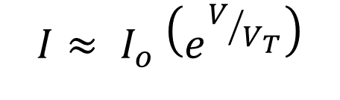
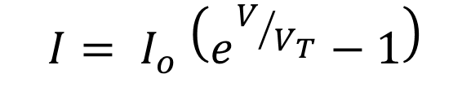


Shockley Ideal Diode Equation
$$I= I_{o} \left(e^{V/{V_{T}}}−1\right)$$
When V is large compared to V_{T}
When V is zero
$$I≈ I_{o} \left(e^{V/{V_{T}}}\right)$$
$$I=0$$
When V is negative, and its magnitude is large compared to V_{T}
$$I≈ {− I}_{o}$$

Slide 11
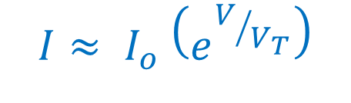
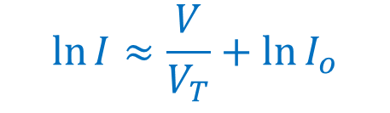
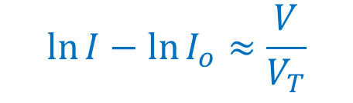

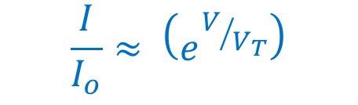
Shockley Ideal Diode Equation
$$I= I_{o} \left(e^{V/{V_{T}}}−1\right)$$
$$\frac{I}{I_{o}}≈ \left(e^{V/{V_{T}}}\right)$$
When V is large compared to V_{T}
$$\ln{\frac{I}{I_{o}}}≈\frac{V}{V_{T}}$$
$$I≈ I_{o} \left(e^{V/{V_{T}}}\right)$$
$$\ln{I}−\ln{I_{o}}≈\frac{V}{V_{T}}$$
$$\ln{I}≈\frac{V}{V_{T}}+\ln{I_{o}}$$
Only a good approximation when V is large compared to V_{T}
Slope = 1/V_{T}
“Intercept” = ln ( I_{o})

Slide 13
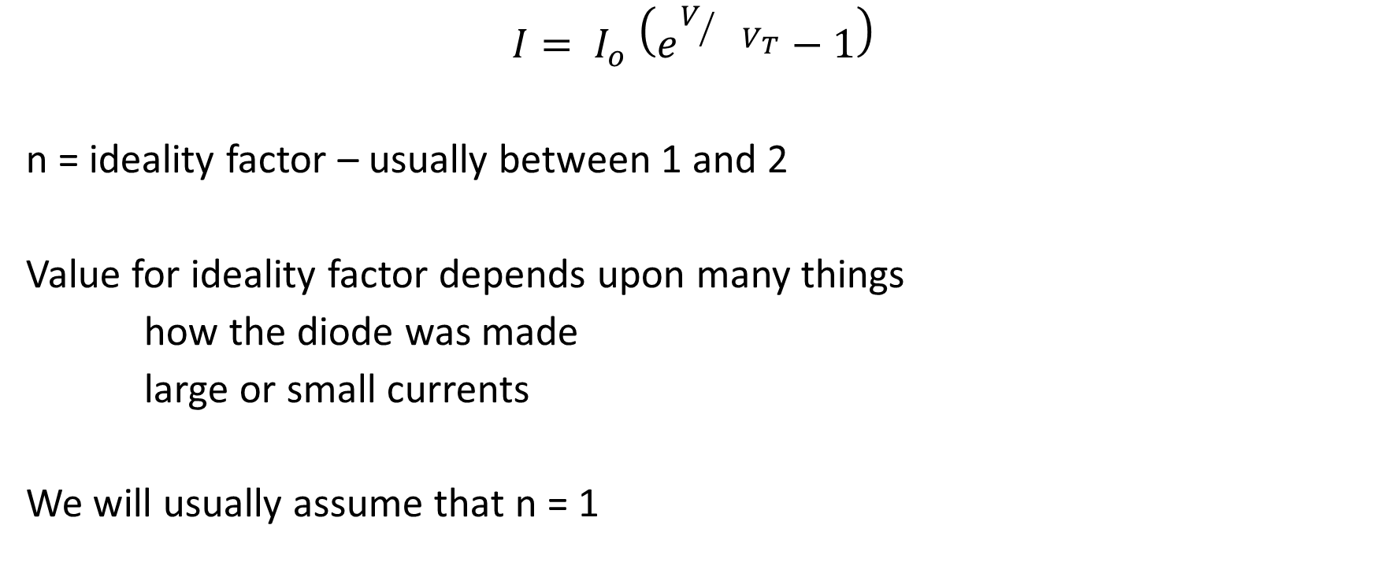
Adjusted Shockley Diode Equation
$$I= I_{o} \left(e^{V/{{ V}_{T}}}−1\right)$$
n = ideality factor – usually between 1 and 2
Value for ideality factor depends upon many things
how the diode was made
large or small currents
We will usually assume that n = 1
n

Slide 14
Deviations of diode current from Schokley’s equation in forward bias
ln I
resistance in bulk region
n ≈ 2
high level injection
n ≈ 1 for integrated circuit diodes
slope = q/[n kT]
for discrete diodes n ≈ 2 here
n ≈ 2
generation / recombination
V

Slide 15



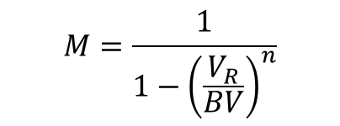
Deviations of diode current from Schokley’s equation in reverse bias – Avalanche breakdown
I
BV = breakdown voltage
Actual reverse current
V
Theoretical reverse current
$$−I_{0}$$
ideal diode
$$I_{RA}=M I_{0}$$
Multiplication factor
generation in depletion region
Real diode
Avalanche multiplication
$$M=\frac{1}{1−{\left(\frac{V_{R}}{BV}\right)}^{n}}$$
$$n is between 3 and 6$$
V_{R} = applied reverse voltage
BV = breakdown voltage

Slide 16
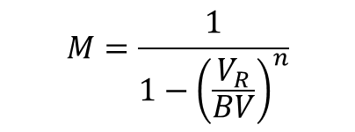

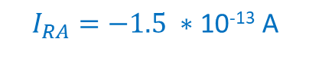
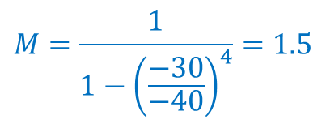

Deviations of diode current from Schokley’s equation in reverse bias – Avalanche breakdown
Example:
I
BV = -40 V
BV = breakdown voltage
n = 4
V
I₀ = 10⁻¹³ A
$$−I_{0}$$
V_{R} = -30 V
ideal diode
$$I_{RA}=M I_{0}$$
$$M=\frac{1}{1−{\left(\frac{V_{R}}{BV}\right)}^{n}}$$
Real diode
Avalanche multiplication
$$M=\frac{1}{1−{\left(\frac{−30}{−40}\right)}^{4}}=1.5$$
$$I_{RA}=−1.5 ∗\text{10}\text{−13} \text{A}$$

Slide 17
Deviations of diode current from Schokley’s equation in reverse bias -- Zener breakdown
I
Zener Voltage
V
ideal diode
Zener breakdown occurs because of quantum mechanical tunneling
Real diode
Zener breakdown voltages can be designed with doping levels
Zener breakdown voltages are less than avalanche breakdown voltages
The onset of Zener breakdown is more abrupt than avalanche breakdown

Slide 18
Tunnelling
-
+
Increasing energy of electron
E_{c}
E_{v}

Slide 19
What we studied today
Diode electrical characteristics
Diffusion Currents
Drift Currents
Shockley Diode Equation
Deviations from Ideal Diode Equation
Avalanche Breakdown
Zener Breakdown

