Slide 1
Analog Electronics Technology
Diodes
Semiconductor basics
Diode electrical characteristics
Solving diode circuits
Diode Models
Solving simple circuits using diode models
Solving more complex circuits
Standard diode application circuits
BJTs
Op Amps

Slide 2
Diode Models & Different Methods of Solution
Most accurate
Use Shockley equation
Iterative solution
Graphical solution
Piecewise linear model
Semi-ideal model with resistance
Semi-ideal model
Ideal model
Easiest

Slide 3
Solving Diode Circuits

Slide 4
The schematic for a diode in a circuit
12 Ω
Diode symbol
+
8 V
-
“Arrow” points in forward direction (from p region to n region)

Slide 5
Ideal Model

Slide 6
Simple ideal model of diode
Replace the forward biased diode with a wire
Perfect conductor when forward biased
Perfect insulator when reverse biased
This model can occasionally useful be for qualitative analysis of circuit.
Remove the reverse biased diode from the circuit
I
V

Slide 7
Using the simple ideal model of diode
From the circuit we can see that the diode is forward biased.
12 Ω
V_{diode} = 0 V
+
8 V
-
8 V = I_{resistor} * 12 Ω
I_{diode} = I_{resistor} = 8 V / 12 Ω = 0.67A
Replace the diode with a wire
Use KCL and KVL to solve the circuit

Slide 8
Using the simple ideal model of diode
From the circuit we can see that the diode is reverse biased.
12 Ω
V_{diode} = 8 V
+
8 V
-
I_{diode} = I_{resistor} = 0 A
Replace the diode with an open circuit (just remove the diode from the circuit)

Slide 9
Semi-Ideal Model

Slide 10
Semi-ideal model of diode
Perfect conductor when forward biased beyond turn-on voltage
Perfect insulator when reverse biased
Replace the forward biased diode with a voltage source, V_{turn-on}
Remove the reverse biased diode from the circuit
I
V
V_{turnon} (≈ 0.7 V for silicon or 0.3 V for germanium)
Useful for semiquantitative analysis of circuit.

Slide 11
Using the semi-ideal model of diode
From the circuit we can see that the diode is forward biased.
12 Ω
V_{diode} = 0.7 V
+
+
0 = 8 V – I_{resistor} ( 12 Ω) - (0.7 V)
8 V
-
0.7 V
-
I_{diode} = I_{resistor} = (8 V – 0.7 V) / 12 Ω
= 0.61A
Replace the diode with a voltage source equivalent to the turn-on voltage
Use KCL and KVL to solve the circuit

Slide 12
Semi-Ideal Model With Resistance

Slide 13
Semi-ideal model of diode with resistance
Has output resistance when forward biased beyond certain voltage
Perfect insulator when reverse biased
Better model if parameters V_{on} and r_{o} are known
Often not a practical model.
I
slope = 1/r_{o}
V
V_{on}
Values of r_{o} are usually between 2 Ω and 20 Ω

Slide 14
Using the semi-ideal model of diode with resistance
From the circuit we can see that the diode is forward biased.
12 Ω
+
I_{diode} = I_{resistor} = (8 V – 0.5 V) / 15 Ω
= 0.5 A
0.5 V
-
+
8 V
-
3 Ω
V_{diode} = V_{on} + I_{diode} * r_{o}
= 0.5 V + 3 Ω * 0.5 A
= 2.0 V
Replace the diode with a voltage source equivalent to the on voltage and a series resistor

Slide 15
Graphical Analysis

Slide 16
Graphical Analysis
Write equation from Kirchhoff's voltage law (KVL)
R₁ = 12 Ω
V_{A} – R₁ I_{D} – V_{D} = 0
I_{D}
solve for the diode current, I_{D}
+
+
V_{A} = 8 V
-
-
V_{D}
I_{D} = – V_{D} /R₁ + V_{A} /R₁
Load line
I_{D} = – V_{D} /12 + 2/3

Slide 17
Graphical Analysis
Can be used with diode curve obtained from equation or from manufacturer.
Plot load line
I_{D} = – V_{D} /12 + 2/3
intercept = 2/3
slope = -1/12
Load line
From graph estimate:
I_{D} ≈ 0.60 A
V_{D} ≈ 0.76 V
This plot came from Excel, using I_{o} = 10⁻¹³ and T = 300 K

Slide 18
Numerical Solutions
Automatic Calculator or Iterative

Slide 19
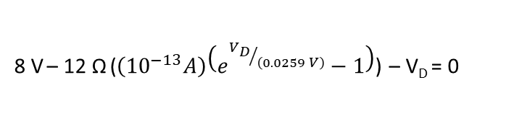
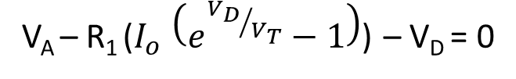
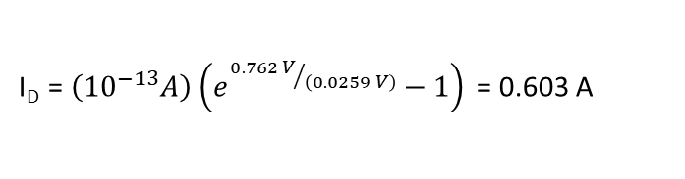
Numerical Solution – Automatic Calculator Solution
Write equation from Kirchhoff's voltage law (KVL)
R₁ = 12 Ω
V_{A} – R₁ I_{D} – V_{D} = 0
Replace the diode current, I_{D}, with the expression from Shockley's equation
I_{D}
+
+
V_{A} – R₁ ($I_{o} \left(e^{{V_{D}}/{V_{T}}}−1\right)$) – V_{D} = 0
V_{A} = 8 V
-
V_{D}
-
substituting values for our circuit gives
8 V – 12 Ω ($\left({10}^{−13}A\right)\left(e^{{V_{D}}/{\left(0.0259 V\right)}}−1\right)$) – V_{D} = 0
Some calculators will automatically solve this equation for V_{D}, giving V_{D} = 0.762 V
Once V_{D} is found, use the Shockley equation to find I_{D}
I_{D} = $\left({10}^{−13}A\right)\left(e^{{0.762 V}/{\left(0.0259 V\right)}}−1\right)$ = 0.603 A

Slide 20
Numerical Solution – Iterative Calculator Solution
Write equation from Kirchhoff's voltage law (KVL)
R₁ = 12 Ω
V_{A} – R₁ I_{D} – V_{D} = 0
Replace the diode current, I_{D}, with the expression from Shockley's equation
I_{D}
+
+
V_{A} – R₁ ($I_{o} \left(e^{{V_{D}}/{V_{T}}}−1\right)$) – V_{D} = 0
V_{A} = 8 V
-
V_{D}
-
Solve for the V_{D} in the exponential

Slide 21
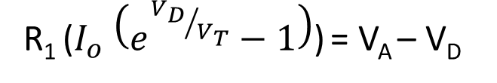
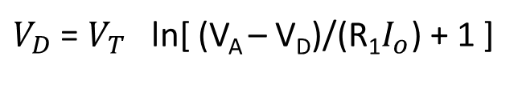
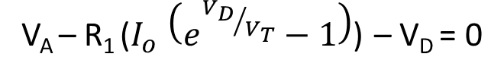
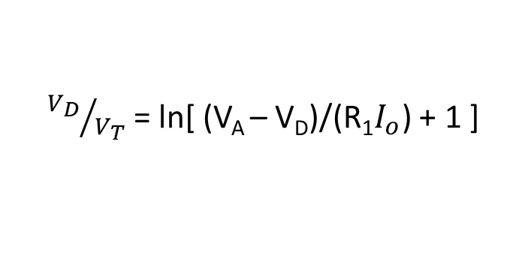
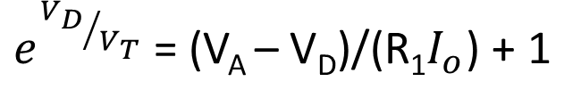
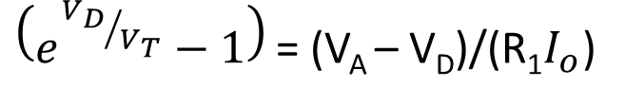
Numerical Solution – Iterative Calculator Solution
V_{A} – R₁ ($I_{o} \left(e^{{V_{D}}/{V_{T}}}−1\right)$) – V_{D} = 0
Solve for the V_{D} in the exponential
R₁ ($I_{o} \left(e^{{V_{D}}/{V_{T}}}−1\right)$) = V_{A} – V_{D}
$\left(e^{{V_{D}}/{V_{T}}}−1\right)$ = (V_{A} – V_{D})/(${\text{R}\text{1}I}_{o}$)
$e^{{V_{D}}/{V_{T}}}$= (V_{A} – V_{D})/(${\text{R}\text{1}I}_{o}$) + 1
${V_{D}}/{V_{T}}$= ln[ (V_{A} – V_{D})/(${\text{R}\text{1}I}_{o}$) + 1 ]
$V_{D}$ = $V_{T}$ ln[ (V_{A} – V_{D})/(${\text{R}\text{1}I}_{o}$) + 1 ]

Slide 22
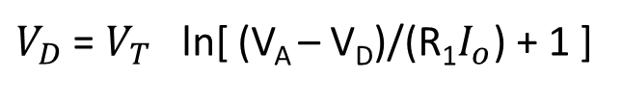

Numerical Solution – Iterative Calculator Solution
$V_{D}$ = $V_{T}$ ln[ (V_{A} – V_{D})/(${\text{R}\text{1}I}_{o}$) + 1 ]
We now use this equation for iterative solution. Plug in our known values.
$V_{D}$ = $\left(0.0259 V\right)$ ln[ ((8 V) – V_{D})/($\text{(}\text{12}\text{Ω})($10⁻¹³ A) + 1 ]
Guess a reasonable value for the diode voltage drop.
V_{D} = 0.7 V is reasonable guess.
Plug the guess into the right side of the equation in order to calculate a new guess.
$V_{D}$ = $\left(0.0259 V\right)$ ln[ ((8 V) – 0.7 V)/($\text{(}\text{12}\text{Ω})($10⁻¹³ A) + 1 ]
Calculate a new value.
$V_{D}$ = $\left(0.762407 V\right)$
Plug this calculated value back into the right side of the equation in order to calculate a new guess.

Slide 23
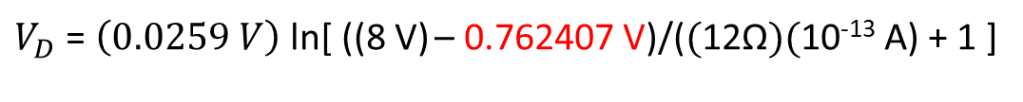


Numerical Solution – Iterative Calculator Solution
$V_{D}$ = $\left(0.0259 V\right)$ ln[ ((8 V) – V_{D})/($\text{(}\text{12}\text{Ω})($10⁻¹³ A) + 1 ]
Value calculated last time
$V_{D}$ = $\left(0.0259 V\right)$ ln[ ((8 V) – 0.762407 V)/($\text{(}\text{12}\text{Ω})($10⁻¹³ A) + 1 ]
$V_{D}$ = $\left(0.762185 V\right)$
Plug this calculated value back into the right side of the equation in order to calculate a new guess.
$V_{D}$ = $\left(0.0259 V\right)$ ln[ ((8 V) – 0.762185 V)/($\text{(}\text{12}\text{Ω})($10⁻¹³ A) + 1 ]
$V_{D}$ = $\left(0.762186 V\right)$
Since this is essentially the same as what we plugged in, it is the answer.

Slide 24
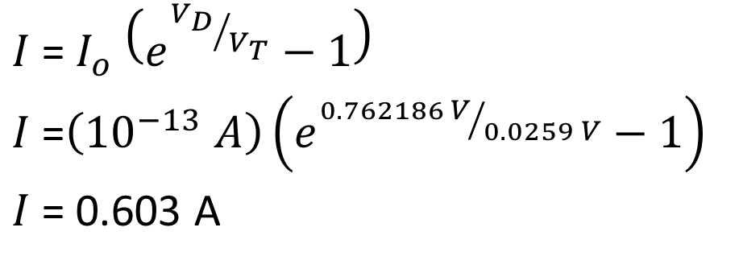

Numerical Solution – Iterative Calculator Solution
$V_{D}$ = $\left(0.762186 V\right)$
Now use the Shockley equation to calculate the current.
$I$= $I_{o} \left(e^{{V_{D}}/{V_{T}}}−1\right)$
$I$=$\left({10}^{−13} A\right)\left(e^{{0.762186 V}/{0.0259 V}}−1\right)$
$I$= 0.603 A

Slide 26
More complex circuits
If one diode is connected to a complex linear circuit, find the Thevenin equivalent of the linear circuit and then solve in a similar manner.

Slide 27
Example
12 Ω
4 Ω
0.25 A
+
6 Ω
3 V
-
Find the Thevenin resistance and then use the superposition principle to find the Thevenin voltage equivalent of everything to the left of the diode.

Slide 28
Example
Find the Thevenin Resistance
12 Ω
4 Ω
Replace the current source with an open circuit.
0.25 A
+
6 Ω
Replace the voltage source with a wire (short circuit).
3 V
-

Slide 29
Example
Find the Thevenin Resistance
4 Ω
12 Ω
4 Ω
Find the equivalent resistance of the 12 Ω resistor in parallel with the 6 Ω resistor.
0.25 A
+
6 Ω
3 V
-
R_{eq} = (1/12 + 1/6)⁻¹ = 4 Ω
Now the two 4 Ω resistors are in series. Adding them together gives
R_{th} = (4 Ω + 4 Ω) = 8 Ω

Slide 30
Example
12 Ω
4 Ω
0.25 A
+
6 Ω
3 V
-
Now use the superposition principle to find the Thevenin voltage equivalent of everything to the left of the diode.

Slide 31
Example
12 Ω
4 Ω
0.25 A
+
6 Ω
3 V
-
First remove the current source to find the Thevenin voltage that results from the voltage source. The current source is replaced by an open circuit.

Slide 32
Example
12 Ω
4 Ω
0.25 A
+
6 Ω
3 V
-
Since there is no current flowing through the 4 Ω resistor, there is no voltage drop across it. It can be replaced by a wire.

Slide 33
Example
12 Ω
4 Ω
+
0.25 A
+
6 Ω
V_{out}
3 V
-
-
The output voltage can now be calculated using the voltage divider rule:
V_{out, voltage source} = (3 V) (6 Ω)/(6 Ω + 12 Ω) = 1 V

Slide 34
Example
12 Ω
4 Ω
0.25 A
+
6 Ω
3 V
-
Now find the Thevenin voltage attributable to the current source. To do this, short circuit the voltage source.

Slide 35
Example
Find the equivalent resistance of the 12 Ω resistor in parallel with the 6 Ω resistor.
12 Ω
4 Ω
R_{eq} = (1/12 + 1/6)⁻¹ = 4 Ω
0.25 A
+
6 Ω
Now find the equivalent resistance of the two 4 Ω resistors in series.
3 V
-
R_{eq,tot} = (4 Ω + 4 Ω) = 8 Ω
V_{out, current source} = (0.25 A) (8 Ω) = 2 V
V_{th} = 1 V + 2 V = 3 V

Slide 36
Example
8 Ω
+
3 V
-
Thevenin equivalent circuit.

Slide 37
Example
We will use the semi-ideal model
R_{th} = 8 Ω
Replace diode with voltage source
I_{D}
+
+
V_{th} = 3 V
-
-
V_{on} = 0.7 V
Using Kirchhoff’s voltage law:
I_{D} =(V_{th} – V_{on})/R_{th}
I_{D} =(2.3 V)/8Ω = 0.29 A

Slide 38
Example 2. Find the current through the diode and through the 8 Ohm resistor
R = 8 Ω
+
V_{in} = 3 V
-
R = 4 Ω
I_{D}

Slide 39
Example 2. Find the current through the diode and through the 8 Ohm resistor
Find Thevenin Equivalent Resistance
R_{th} = (8 Ω) (4 Ω) / (8 Ω + 4 Ω) = 2.67 Ω
R = 8 Ω
+
V_{in} = 3 V
-
R = 4 Ω
I_{D}
Find Thevenin Equivalent Voltage
V_{th} = (3 V) (4 Ω) / (8 Ω + 4 Ω) = 1.0 V

Slide 40
Example 2. Find the current through the diode and through the 8 Ohm resistor
Use Semi-ideal Model
Replace diode with voltage source
R_{th} = 2.67 Ω
+
+
V_{on} = (0.7 V)
V_{th} = 1 V
-
-
I_{D}
I_{D} = (1 V – 0.7 V) / (2.67 Ω) = 0.1124 A

Slide 41
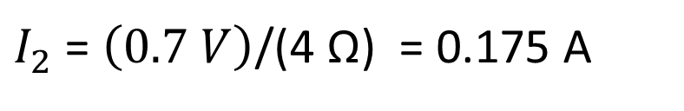
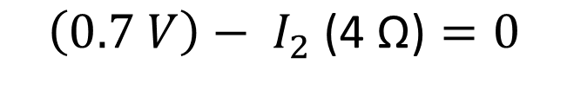
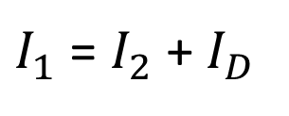
Example 2. Find the current through the diode and through the 8 Ohm resistor
Using Kirchhoff’s current law:
$I_{1}$ = $I_{2}$ + $I_{D}$
R = 8 Ω
I₁
Use Kirchhoff’s voltage law around loop on the right :
+
+
V_{on} = (0.7 V)
V_{th} = 3 V
-
R = 4 Ω
I₂
-
I_{D}
$$\left(0.7 V\right)− I_{2}\text{ (4 }\text{Ω}\text{)}=0$$
$I_{2}$ = $\left(0.7 V\right)$/(4 Ω) = 0.175 A
$I_{1}$ = 0.175 A + 0.1124 A = 0.287 A

Slide 42
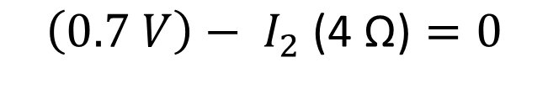
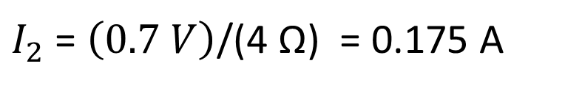
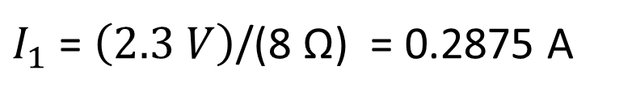
Example 2. Alternate Solution. Find the current through the diode and through the 8 Ohm resistor
Use Kirchhoff’s voltage law around loop on the right:
R = 8 Ω
I₁
$$\left(0.7 V\right)− I_{2}\text{ (4 }\text{Ω}\text{)}=0$$
$I_{2}$ = $\left(0.7 V\right)$/(4 Ω) = 0.175 A
+
+
V_{on} = (0.7 V)
V_{th} = 3 V
-
R = 4 Ω
I₂
-
I_{D}
Use Kirchhoff’s voltage law around the outer loop:
$$\left(3 V\right)− I_{1}\text{ (}\text{8} \text{Ω}\text{)}−\left(0.7 V\right)=0$$
$I_{1}$ = $\left(2.3 V\right)$/(8 Ω) = 0.2875 A

Slide 43
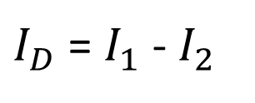
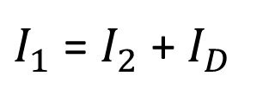
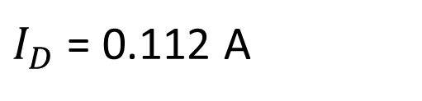
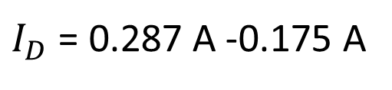
Example 2. Alternate Solution. Find the current through the diode and through the 8 Ohm resistor
Using Kirchhoff’s current law:
$I_{1}$ = $I_{2}$ + $I_{D}$
R = 8 Ω
I₁
$I_{D}$ = $I_{1}$ - $I_{2}$
$I_{D}$ = 0.287 A -0.175 A
+
+
V_{on} = (0.7 V)
V_{th} = 3 V
-
R = 4 Ω
I₂
-
I_{D}
$I_{D}$ = 0.112 A

Slide 44

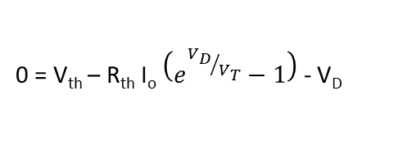
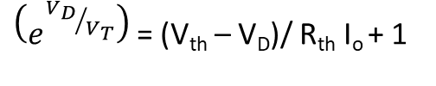

Example 2. Solve Using Iteration Equations
Equivalent Circuit
0 = V_{th} – R_{th} I_{D} - V_{D}
R_{th} = 2.67 Ω
0 = V_{th} – R_{th} I_{o} $\left(e^{{V_{D}}/{V_{T}}}−1\right)$- V_{D}
R_{th} I_{o} $\left(e^{{V_{D}}/{V_{T}}}−1\right)$ = V_{th} - V_{D}
+
V_{th} = 1 V
-
I_{D}
$\left(e^{{V_{D}}/{V_{T}}}−1\right)$ = (V_{th} – V_{D})/ R_{th} I_{o}
$\left(e^{{V_{D}}/{V_{T}}}\right)$ = (V_{th} – V_{D})/ R_{th} I_{o} + 1
V_{D} = V_{T} ln[(V_{th} – V_{D})/ R_{th} I_{o} + 1]

Slide 45
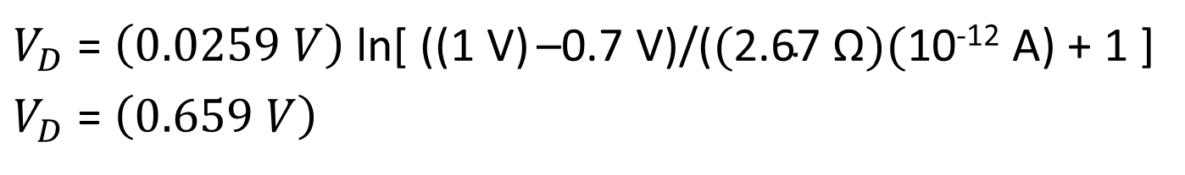
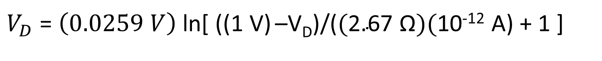

Example 2. Solve Using Iteration Equations
Equation for iterating
V_{D} = V_{T} ln[(V_{th} – V_{D})/ R_{th} I_{o} + 1]
$V_{D}$ = $\left(0.0259 V\right)$ ln[ ((1 V) –V_{D})/($\text{(}\text{2.67 }\text{Ω})($10⁻¹² A) + 1 ]
$V_{D}$ = $\left(0.0259 V\right)$ ln[ ((1 V) –0.7 V)/($\text{(}\text{2.67 }\text{Ω})($10⁻¹² A) + 1 ]
$V_{D}$ = $\left(0.659 V\right)$
$eventually$ $V_{D}$ = $\left(0.6621 V\right)$
$I_{D}$ = $I_{o} \left(e^{{V_{D}}/{V_{T}}}−1\right)$ = (10⁻¹² A) *[ e^{(0.6621/0.0259)} – 1 ] = 0.1265 A

Slide 46
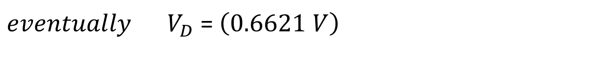
Example 2. Solve Using Iteration Equations
R = 8 Ω
+
V_{in} = 3 V
-
R = 4 Ω
I_{D}
$eventually$ $V_{D}$ = $\left(0.6621 V\right)$
$I_{D}$ = $I_{o} \left(e^{{V_{D}}/{V_{T}}}−1\right)$ = (10⁻¹² A) *[ e^{(0.6621/0.0259)} – 1 ] = 0.1265 A
$I_{2}$ = $\left(0.6621 V\right)$/(4 Ω) = 0.1655 A
$I_{1}$ = 0.1655 A + 0.1265 A = 0.292 A

Slide 47
We also did an iterative solution

Slide 48
Comparison of results
 | Numerical Iteration | Semi-Ideal Model
Diode Voltage | 0.6621 V | 0.7 V (assumed)
Diode Current | 0.1265 A | 0.1124 A
Resistor Current | 0.292 A | 0.287 A

Slide 49
Multiple diode circuits
+10 V
Find whether each diode is conducting (forward biased) or nonconducting (reverse biased).
All voltages relative to ground
Find the output voltage and the currents through each diode.
The voltage at node A will be key in determining this.
R₁ = 6 kΩ
First assume that diode D₁ is reversed biased, and look at the remaining circuit with D₁ removed.
D₁
D₂
A
4 V
-
+
V_{out}
V_{on} = (0.7 V)
We can easily see that diode D₂ is forward biased under these conditions.
R₂ = 2 kΩ
I = 9.3 V /8 kΩ = 1.1625 mA
If D₁ is reverse biased
V_{A} = 1.1625 mA * 2 kΩ = 2.325 V
0 V

Slide 50
Multiple diode circuits
+10 V
What happens if we connect diode D1 to the circuit?
All voltages relative to ground
If it were reverse biased, nothing would happen.
Find the output voltage and the currents through each diode.
R₁ = 6 kΩ
It will be forward biased.
V_{A} = 3.3 V
V_{A} = 2.325 V
The current through R₂ will rise.
D₁
D₂
A
V_{A} = 4.0 V
The voltage at node A will rise.
4 V
V_{out}
The output voltage will rise.
Can the voltage at node A rise enough to reverse bias diode D₂?
No!
R₂ = 2 kΩ
I_{R1} = 6 V /6 kΩ = 1.0 mA
I_{R2} = 3.3 V /2 kΩ = 1.625 mA
I_{D2} = I_{R1} = 1.0 mA
I_{D1} = I_{R2} - I_{D2} = 1. 625 mA - 1.0 mA
= 0. 625 mA
0 V

Slide 51
Multiple diode circuits
+10 V
Find whether each diode is conducting (forward biased) or nonconducting (reverse biased).
R₁ = 6 kΩ
D₁
D₂
A
2 V
-
+
V_{out}
V_{on} = (0.7 V)
We can easily see that diode D₂ is forward biased under these conditions.
R₂ = 2 kΩ
I = 9.3 V /8 kΩ = 1.1625 mA
If D₁ is reverse biased
V_{A} = 1.1625 mA * 2 kΩ = 2.325 V
0 V

Slide 52
Practice Problems
Use the semi-ideal model of the diode to solve the following problems

Slide 53
Practice Problem: Find the current through the diode and through the 8 Ohm resistor
R = 8 Ω
+
V_{in} = 3 V
-
R = 4 Ω
I_{D}

Slide 54
Practice Problem: Find the current through the diode and the output voltage
5 V
5 V
20 kΩ
20 kΩ
V_{out}
I_{D}
I_{D}
V_{out}
20 kΩ
-5 V
-3 V

Slide 55
Practice Problem: Find the current through the diode and the output voltage
2 V
5 V
5 kΩ
20 kΩ
V_{out}
V_{out}
I_{D}
I_{D}
20 kΩ
-8 V
-5 V

Slide 56
Practice Problem: Find the current through the diode and through the 8 Ohm resistors
R = 8 Ω
+
V_{in} = 16 V
-
R = 4 Ω
I_{D}
R = 8 Ω

Slide 57
Practice Problem: Find the current through the diode and through the 8 Ohm resistors
R = 8 Ω
+
V_{in} = 16 V
-
R = 16 Ω
I_{D}
R = 8 Ω
R = 2 Ω

Slide 58
Diode Models & Different Methods of Solution
What we talked about today
Most accurate
Use Shockley equation
Iterative solution
Graphical solution
Piecewise linear model
Semi-ideal model with resistance
Semi-ideal model
Ideal model
Easiest

