Slide 1
Analog Electronics Technology
Diodes
Semiconductor basics
Diode electrical characteristics
Solving diode circuits
Diode Models
Solving simple circuits using diode models
Solving more complex circuits
Standard diode application circuits
BJTs
Op Amps

Slide 2
What we will do today
Solving diode circuits
Use Thevenin equivalent circuits to solve more complicated diode circuits
We will mainly use the semi-ideal model of the diode to solve the circuit.
We will demonstrate that other models of the diode can be used to solve a problem once the Thevenin equivalent circuit has been found.

Slide 4
More complex circuits
If one diode is connected to a complex linear circuit, find the Thevenin equivalent of the linear circuit and then solve like before.

Slide 5
Example 1.
12 Ω
4 Ω
0.25 A
+
6 Ω
3 V
-
Find the Thevenin resistance and then use the superposition principle to find the Thevenin voltage equivalent of everything to the left of the diode.

Slide 6
Example 1.
Find the Thevenin Resistance
12 Ω
4 Ω
Replace the current source with an open circuit.
0.25 A
+
6 Ω
Replace the voltage source with a wire (short circuit).
3 V
-

Slide 7
Example 1.
Find the Thevenin Resistance
4 Ω
12 Ω
4 Ω
Find the equivalent resistance of the 12 Ω resistor in parallel with the 6 Ω resistor.
0.25 A
+
6 Ω
3 V
-
R_{eq} = (1/12 + 1/6)⁻¹ = 4 Ω
Now the two 4 Ω resistors are in series. Adding them together gives
R_{th} = (4 Ω + 4 Ω) = 8 Ω

Slide 8
Example 1.
12 Ω
4 Ω
0.25 A
+
6 Ω
3 V
-
Now use the superposition principle to find the Thevenin voltage equivalent of everything to the left of the diode.

Slide 9
Example 1.
12 Ω
4 Ω
0.25 A
+
6 Ω
3 V
-
First remove the current source to find the Thevenin voltage that results from the voltage source. The current source is replaced by an open circuit.

Slide 10
Example 1.
12 Ω
4 Ω
0.25 A
+
6 Ω
3 V
-
Since there is no current flowing through the 4 Ω resistor, there is no voltage drop across it. It can be replaced by a wire.

Slide 11
Example 1.
The output voltage can now be calculated using the voltage divider rule
12 Ω
4 Ω
+
0.25 A
+
6 Ω
V_{out}
3 V
-
-
V_{out, voltage source} = (3 V) (6 Ω)/(6 Ω + 12 Ω) = 1 V

Slide 12
Example 1.
Now find the Thevenin voltage attributable to the current source. To do this, short circuit the voltage source.
12 Ω
4 Ω
0.25 A
+
6 Ω
3 V
-

Slide 13
Example 1.
Find the equivalent resistance of the 12 Ω resistor in parallel with the 6 Ω resistor.
12 Ω
4 Ω
R_{eq} = (1/12 + 1/6)⁻¹ = 4 Ω
0.25 A
Now find the equivalent resistance of the two 4 Ω resistors in series.
+
6 Ω
3 V
-
R_{eq,tot} = (4 Ω + 4 Ω) = 8 Ω
V_{out, current source} = (0.25 A) (8 Ω) = 2 V
V_{th} = 1 V + 2 V = 3 V

Slide 14
Example 1.
Thevenin equivalent circuit.
8 Ω
+
3 V
-

Slide 15
Example 1.
We will use the semi-ideal model
R_{th} = 8 Ω
Replace diode with voltage source
I_{D}
+
+
V_{th} = 3 V
-
-
V_{on} = 0.7 V
Using Kirchhoff’s voltage law:
V_{th} – I_{D} R_{th} – V_{on} = 0
I_{D} =(V_{th} – V_{on})/R_{th}
I_{D} =(2.3 V)/8Ω = 0.29 A

Slide 16
Example 2a. Find the current through the diode and through the 8 Ohm resistor
R = 8 Ω
+
V_{in} = 3 V
-
R = 4 Ω
I_{D}

Slide 17
Example 2a. Find the current through the diode and through the 8 Ohm resistor
Find Thevenin Equivalent Resistance
R_{th} = (8 Ω) (4 Ω) / (8 Ω + 4 Ω) = 2.67 Ω
R = 8 Ω
+
V_{in} = 3 V
-
R = 4 Ω
I_{D}
Find Thevenin Equivalent Voltage
V_{th} = (3 V) (4 Ω) / (8 Ω + 4 Ω) = 1.0 V

Slide 18
Example 2a.
Use Semi-ideal Model
Replace diode with voltage source
R_{th} = 2.67 Ω
I_{D}
+
+
V_{on} = (0.7 V)
V_{th} = 1 V
-
-
I_{D}
V_{th} – I_{D} R_{th} – V_{on} = 0
I_{D} = (V_{th} – V_{on})/R_{th}
I_{D} = (1 V – 0.7 V) / (2.67 Ω)
I_{D} = 0.1124 A

Slide 19
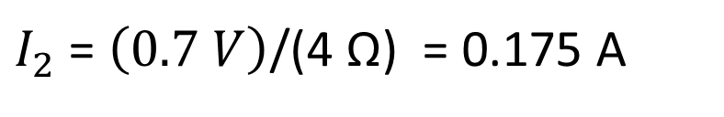
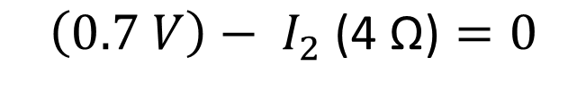
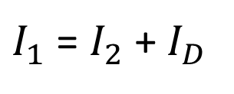
Example 2a. Find the current through the diode and through the 8 Ohm resistor
Using Kirchhoff’s current law:
$I_{1}$ = $I_{2}$ + $I_{D}$
R = 8 Ω
I₁
Use Kirchhoff’s voltage law around loop on the right :
+
+
V_{on} = (0.7 V)
V_{th} = 3 V
-
R = 4 Ω
I₂
-
I_{D}
$$\left(0.7 V\right)− I_{2}\text{ (4 }\text{Ω}\text{)}=0$$
$I_{2}$ = $\left(0.7 V\right)$/(4 Ω) = 0.175 A
$I_{1}$ = 0.175 A + 0.1124 A = 0.287 A

Slide 20


Example 2 b. Alternate Solution (without Thevenin equivalent). Find the current through the diode and through the 8 Ohm resistor
Determine that it is forward biased
R = 8 Ω
I₁
Remove from circuit
Use voltage divider rule
+
+
V_{on} = (0.7 V)
V_{th} = 3 V
-
R = 4 Ω
I₂
-
I_{D}
$$V_{out}= \left(3 V\right)\frac{\left(4 Ω\right)}{\left(4 Ω+8 Ω \right)}$$
$$V_{out}=1 V$$

Slide 21
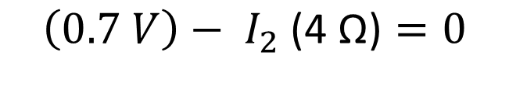
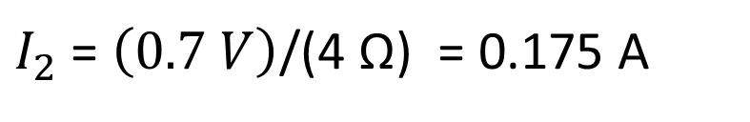
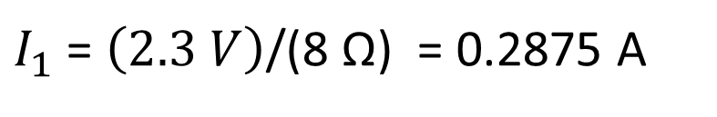
Example 2 b. Alternate Solution (without Thevenin equivalent). Find the current through the diode and through the 8 Ohm resistor
Use Kirchhoff’s voltage law around loop on the right:
R = 8 Ω
I₁
$$\left(0.7 V\right)− I_{2}\text{ (4 }\text{Ω}\text{)}=0$$
$I_{2}$ = $\left(0.7 V\right)$/(4 Ω) = 0.175 A
+
+
V_{on} = (0.7 V)
V_{th} = 3 V
-
R = 4 Ω
I₂
-
I_{D}
Use Kirchhoff’s voltage law around the outer loop:
$$\left(3 V\right)− I_{1}\text{ (}\text{8} \text{Ω}\text{)}−\left(0.7 V\right)=0$$
$I_{1}$ = $\left(2.3 V\right)$/(8 Ω) = 0.2875 A

Slide 22
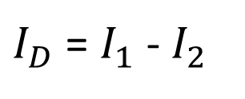
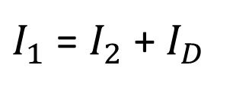
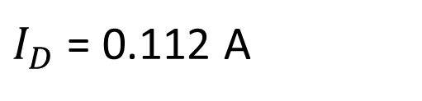
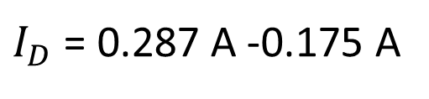
Example 2 b. Alternate Solution. Find the current through the diode and through the 8 Ohm resistor
Using Kirchhoff’s current law:
$I_{1}$ = $I_{2}$ + $I_{D}$
R = 8 Ω
I₁
$I_{D}$ = $I_{1}$ - $I_{2}$
$I_{D}$ = 0.287 A -0.175 A
+
+
V_{on} = (0.7 V)
V_{th} = 3 V
-
R = 4 Ω
I₂
-
I_{D}
$I_{D}$ = 0.112 A

Slide 23
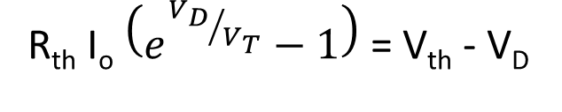
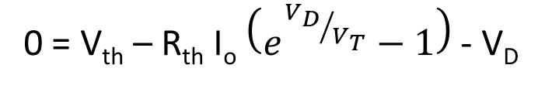
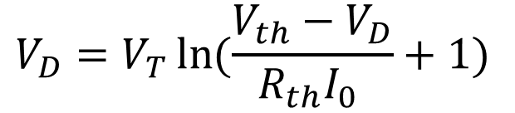
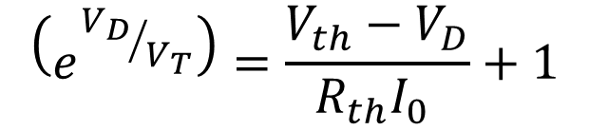
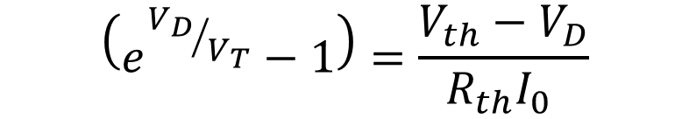
Example 2 c. Solve Using Shockley Equations
Iteration
KVL
0 = V_{th} – R_{th} I_{D} - V_{D}
Solve for V_{D}
Thevenin Equivalent Circuit
Substitute
0 = V_{th} – R_{th} I_{o} $\left(e^{{V_{D}}/{V_{T}}}−1\right)$- V_{D}
R_{th} = 2.67 Ω
I_{o} must be known
R_{th} I_{o} $\left(e^{{V_{D}}/{V_{T}}}−1\right)$ = V_{th} - V_{D}
+
$$\left(e^{{V_{D}}/{V_{T}}}−1\right)=\frac{V_{th}−V_{D}}{R_{th}I_{0} }$$
V_{th} = 1 V
-
I_{D}
$$\left(e^{{V_{D}}/{V_{T}}}\right)=\frac{V_{th}−V_{D}}{R_{th}I_{0} }+1$$
$$V_{D}=V_{T}\ln{(\frac{V_{th}−V_{D}}{R_{th}I_{0} }+1) }$$

Slide 24
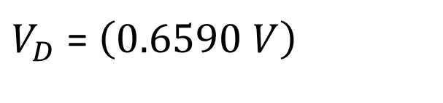

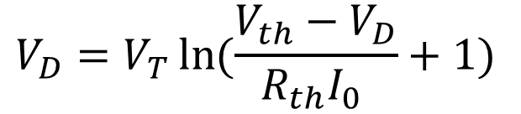

Example 2 c. Solve Using Iteration Equations
Thermal voltage
Thevenin voltage
$$V_{D}=V_{T}\ln{(\frac{V_{th}−V_{D}}{R_{th}I_{0} }+1) }$$
Equation for iterating
Substitute known values
Guess a value
$$V_{D}=\left(0.0259 V\right) \ln\left[\frac{1 V −V_{D}}{\left(\text{2.67 }\text{Ω}\right)\left({10}^{−12} A\right)}+1\right]$$
Calculate a new value
$$V_{D}=\left(0.0259 V\right) \ln\left[\frac{1 V −0.7 V}{\left(\text{2.67 }\text{Ω}\right)\left({10}^{−12} A\right)}+1\right]$$
$V_{D}$ = $\left(0.6590 V\right)$

Slide 25
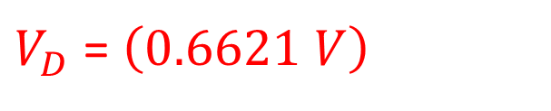
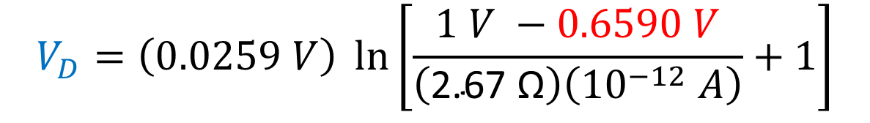
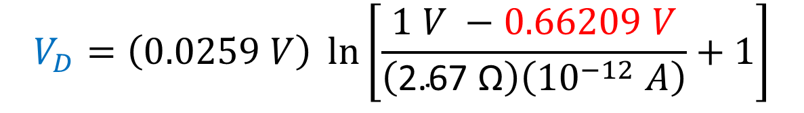
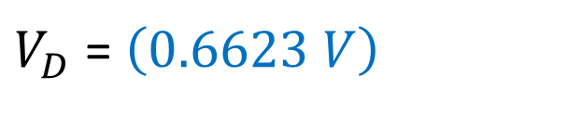
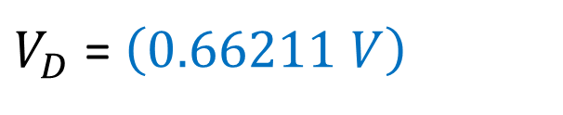
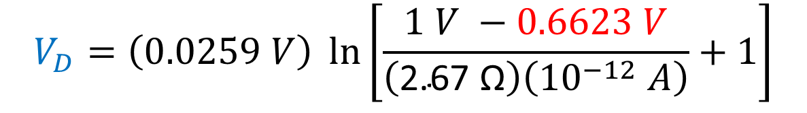
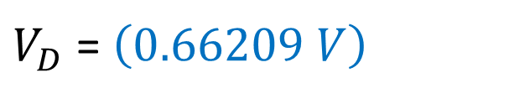
Example 2 c. Solve Using Iteration Equations
$$V_{D}=\left(0.0259 V\right) \ln\left[\frac{1 V −0.6590 V}{\left(\text{2.67 }\text{Ω}\right)\left({10}^{−12} A\right)}+1\right]$$
iterating
$V_{D}$ = $\left(0.6623 V\right)$
$$V_{D}=\left(0.0259 V\right) \ln\left[\frac{1 V −0.6623 V}{\left(\text{2.67 }\text{Ω}\right)\left({10}^{−12} A\right)}+1\right]$$
$V_{D}$ = $\left(0.66209 V\right)$
$$V_{D}=\left(0.0259 V\right) \ln\left[\frac{1 V −0.66209 V}{\left(\text{2.67 }\text{Ω}\right)\left({10}^{−12} A\right)}+1\right]$$
$V_{D}$ = $\left(0.66211 V\right)$
$V_{D}$ = $\left(0.6621 V\right)$

Slide 26
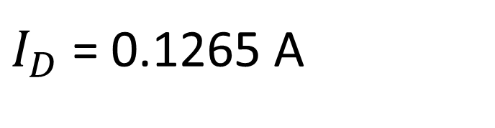
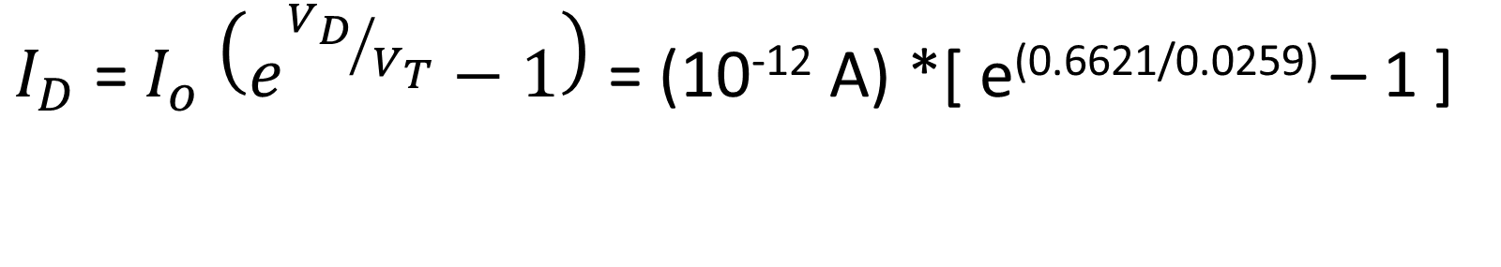
Example 2 c. Solve Using Iteration Equations
$I_{D}$ = $I_{o} \left(e^{{V_{D}}/{V_{T}}}−1\right)$ = (10⁻¹² A) *[ e^{(0.6621/0.0259)} – 1 ]
$I_{D}$ = 0.1265 A

Slide 27
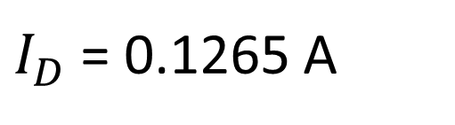
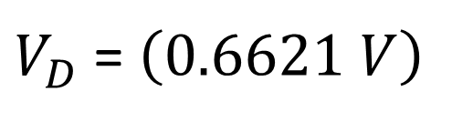
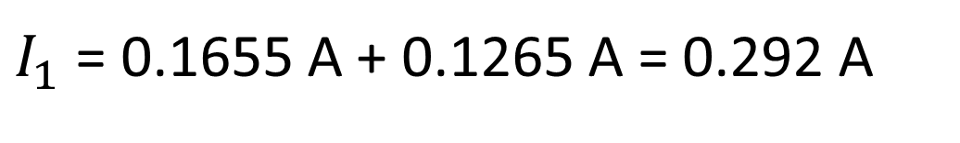
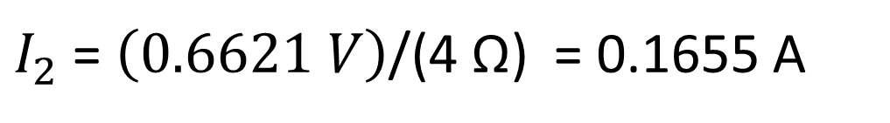
Example 2 c. Solve Using Iteration Equations
R = 8 Ω
I₁
$V_{D}$ = $\left(0.6621 V\right)$
+
$I_{D}$ = 0.1265 A
V_{in} = 3 V
-
R = 4 Ω
I₂
I_{D}
$I_{2}$ = $\left(0.6621 V\right)$/(4 Ω) = 0.1655 A
$I_{1}$ = 0.1655 A + 0.1265 A = 0.292 A

Slide 28
Comparison of results
 | Numerical Iteration | Semi-Ideal Model
Diode Voltage | 0.6621 V | 0.7 V (assumed)
Diode Current | 0.1265 A | 0.1124 A
Resistor Current | 0.292 A | 0.287 A

Slide 29
Example 3. Find the currents through the diode and through the 200 Ω resistor
R = 400 Ω
I₁
R = 1 kΩ
Find the Thevenin equivalent resistance at the diode
I₂
+
R = 200 Ω
V_{in} = 8 V
-
I_{S} = 11.5 mA
R = 400 Ω
I_{D}

Slide 30
Example 3.
R = 400 Ω
I₁
R = 1 kΩ
Find the Thevenin equivalent resistance at the diode
I₂
+
R = 200 Ω
Remove the current source
V_{in} = 8 V
-
I_{S} = 11.5 mA
Short out the voltage source
R = 400 Ω
The 1 kΩ resistor can be removed since only one of its terminals is connected to the circuit
The Thevenin equivalent resistance is 1 kΩ

Slide 31
Example 3.
Use the superposition principle to find the Thevenin equivalent voltage.
R = 400 Ω
I₁
R = 1 kΩ
I₂
Find the Thevenin equivalent voltage that is due to the voltage source
+
R = 200 Ω
V_{in} = 8 V
-
I_{S} = 11.5 mA
Remove the current source
-
+
R = 400 Ω
V_{th}
No current flows through any resistor, so there are no voltage drops
V_{th,V} = 8 V

Slide 32
Example 3. Find the currents through the diode and through the 200 Ω resistor
R = 400 Ω
I₁
R = 1 kΩ
Find the Thevenin equivalent voltage that is due to the current source
I₂
+
R = 200 Ω
Short out the voltage source
V_{in} = 8 V
-
I_{S} = 11.5 mA
No current flows through the 400 Ω resistors, so there are no voltage drops across them.
-
+
R = 400 Ω
V_{th}
They can be replaced with wires
V_{th,I} = ‒ 11.5 mA * 200 Ω
= ‒ 2.3 V

Slide 33
Example 3.
Thevenin Equivalent Circuit
R_{th} = 1 kΩ
I₁
The diode is forward biased.
Replace the diode with a voltage source
+
V_{th} = 5.7 V
-
Apply KVL to the loop
-
+
V_{on} = 0.7 V
I_{D}
5.7 V ‒ I_{D} * ( 1 kΩ ) ‒ 0.7 V = 0
I_{D} = 5.0 V / ( 1 kΩ )
= 5.0 mA

Slide 34
Example 3. Find the currents through the diode and through the 200 Ω resistor
R = 400 Ω
I₁
R = 1 kΩ
Use KCL to find the current through the 200 Ω resistor
I₂
+
R = 200 Ω
V_{in} = 8 V
-
I₂ = I_{D} + I_{S}
I_{S} = 11.5 mA
I₂ = 5.0 mA + 11.5 mA
R = 400 Ω
I_{D}
I₂ = 16.5 mA
I_{D} = 5.0 mA

Slide 36
Example 3 b. Find the currents through the diode and through the 200 Ω resistor
R = 400 Ω
I₁
R = 1 kΩ
Find the Thevenin equivalent resistance at the diode
I₂
+
R = 200 Ω
V_{in} = 8 V
-
I_{S} = 45 mA
R = 400 Ω
I_{D}

Slide 37
Example 3 b. Find the currents through the diode and through the 200 Ω resistor
R = 400 Ω
I₁
R = 1 kΩ
Find the Thevenin equivalent resistance at the diode
I₂
+
R = 200 Ω
Remove the current source
V_{in} = 8 V
-
I_{S} = 45 mA
Short out the voltage source
R = 400 Ω
The 1 kΩ resistor can be removed since only one of its terminals is connected to the circuit
The Thevenin equivalent resistance is 1 kΩ

Slide 38
Example 3 b. Find the currents through the diode and through the 200 Ω resistor
R = 400 Ω
I₁
R = 1 kΩ
Use the superposition principle to find the Thevenin equivalent voltage.
I₂
+
Find the Thevenin equivalent voltage that is due to the voltage source
V_{in} = 8 V
-
R = 200 Ω
I_{S} = 45 mA
Remove the current source
-
+
R = 400 Ω
V_{th}
No current flows through any resistor, so there are no voltage drops
V_{th,V} = 8 V

Slide 39
Example 3 b. Find the currents through the diode and through the 200 Ω resistor
R = 400 Ω
I₁
R = 1 kΩ
Find the Thevenin equivalent voltage that is due to the current source
I₂
+
R = 200 Ω
Short out the voltage source
V_{in} = 8 V
-
I_{S} = 45 mA
No current flows through the 400 Ω resistors, so there are no voltage drops across them.
-
+
R = 400 Ω
V_{th}
They can be replaced with wires
V_{th,I} = ‒ 45 mA * 200 Ω
= ‒ 9.0 V
V_{th,tot} = V_{th,v} + V_{th,I} = ‒ 1.0 V Ω

Slide 40
Example 3 b. Find the currents through the diode and through the 200 Ω resistor
R_{th} = 1 kΩ
I₁
Thevenin Equivalent Circuit
The diode is reverse biased.
+
V_{th} = -1.0 V
-
Replace the diode with an open circuit
I_{D}
I_{D} = 0

Slide 41
Example 3 b. Find the currents through the diode and through the 200 Ω resistor
R = 400 Ω
I₁
R = 1 kΩ
= I_{D} = 0 mA
Use KCL to find the current through the 200 Ω resistor
I₂
+
R = 200 Ω
V_{in} = 8 V
-
I₂ = I_{D} + I_{S}
I_{S} = 45 mA
I₂ = 0 mA + 45 mA
R = 400 Ω
I_{D}
I₂ = 45 mA
I_{D} = 0 mA

Slide 42
What have we learned today?
Thevenin equivalent circuits can help us solve more complicated diode circuits
Once we find the Thevenin equivalent circuit, we can use any of the methods that we learned last time to solve the circuit.
We will normally use the semi-ideal model of the diode to solve the circuit.
If it is obvious if the diode is forward biased or reverse biased, the appropriate model can be substituted (voltage source or open circuit) and normal methods used to solve the circuit without finding the Thevenin equivalent circuit.

Slide 44
Practice Problems
Use the semi-ideal model of the diode to solve the following problems

Slide 45
Practice Problem: Find the current through the diode and through the 8 Ohm resistor
R = 8 Ω
+
V_{in} = 3 V
-
R = 4 Ω
I_{D}

Slide 46
Practice Problem: Find the current through the diode and the output voltage
5 V
5 V
5 V
+
-
20 kΩ
20 kΩ
V_{out}
I_{D}
I_{D}
V_{out}
+
20 kΩ
5 V
-
-5 V
-3 V

Slide 47
Practice Problem: Find the current through the diode and the output voltage
2 V
5 V
5 kΩ
20 kΩ
V_{out}
V_{out}
I_{D}
I_{D}
20 kΩ
-8 V
-5 V

Slide 48
Practice Problem: Find the current through the diode and through the 8 Ohm resistors
R = 8 Ω
+
V_{in} = 16 V
-
R = 4 Ω
I_{D}
R = 8 Ω

Slide 49
Practice Problem: Find the current through the diode and through the 8 Ohm resistors
R = 8 Ω
+
V_{in} = 16 V
-
R = 16 Ω
I_{D}
R = 8 Ω
R = 2 Ω

