Slide 1
Analog Electronics Technology
Solving diode circuits with varying inputs

Slide 2
Analog Electronics Technology
Diodes
Semiconductor basics
Diode electrical characteristics
Solving diode circuits
Diode Models
Solving simple circuits using diode models
Solving more complex circuits
Circuits with varying inputs
Standard diode application circuits

Slide 3
What we will do today
Solving diode circuits with varying inputs
Small signal response of diodes
Large signal response of diodes
Transfer characteristics

Slide 4
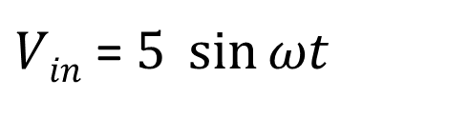
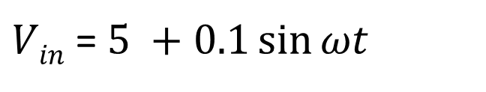
Inputs to diode circuits often change
The input changes slightly around an average value that doesn’t change
Small signal changes
Example:
$Vin$= $5 +0.1\sin{ωt }$
Large signal changes
The input changes by large amounts
Example:
$Vin$= $5 \sin{ωt }$

Slide 5
Small signal response of diode circuits

Slide 6
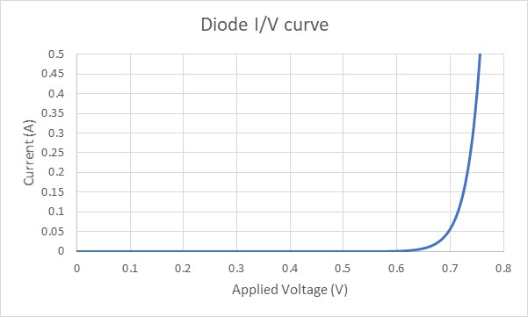

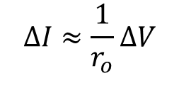
Look at the current voltage curve
We can approximate the curve with a tangent line
slope of tangent line is $\frac{∂I}{∂V}$ = $\frac{1}{r_{o}}$
Causes an increased current
$$∆I≈\frac{1}{r_{o}}∆V$$
quiescent (DC) point
V_{D} = 0.727 V
I_{D} = 160 mA
An increased voltage

Slide 7
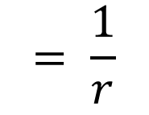
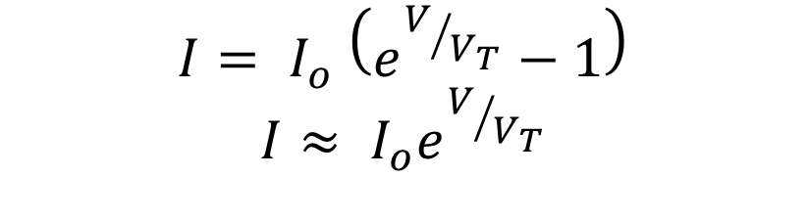
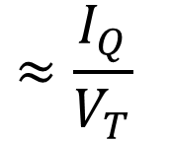
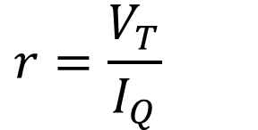
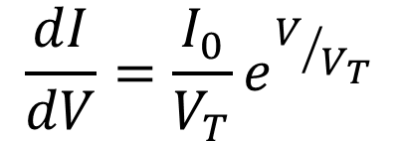
Shockley Ideal Diode Equation
$$I= I_{o} \left(e^{V/{V_{T}}}−1\right)$$
$$I≈ I_{o}e^{V/{V_{T}}}$$
R₁ = 80 Ω
+
+
V_{AC}
-
$$\frac{dI}{dV}=\frac{I_{0}}{V_{T}}e^{V/{V_{T}}}$$
$$≈\frac{I_{Q}}{V_{T}}$$
$$= \frac{1}{r}$$
V_{D}
V_{out}
r_{d} = V_{T}/I_{Q}
V_{DC} = 10 V
-
$$r=\frac{V_{T}}{I_{Q}}$$

Slide 8
To analyze a circuit with a DC component and a small AC component
R₁ = 80 Ω
+
+
V_{AC}
-
V_{D}
V_{out}
V_{DC} = 10 V
-

Slide 9
First we find the quiescent point (DC conditions)
Then we find the small signal response
R₁ = 80 Ω
R₁ = 80 kΩ
+
+
V_{out} = V_{Q}
+
v_{out}
V_{D}
V_{AC}
-
r_{d} = V_{T}/I_{Q}
I_{Q}
V_{DC} = 10 V
-
-
quiescent point analysis (ignore V_{AC})
small signal analysis

Slide 10
quiescent point
V_{AC} must be small

Slide 11
Example 1: Find the ac voltage across the diode if the input voltage V_{AC} is 500 mV sin(ω t)
DC component of output voltage
R₁ = 80 Ω
+
+
V_{AC}
-
V_{D}
V_{out} = V_{Q} + v_{ac}
V_{DC} = 10 V
-
ac component of output voltage

Slide 12
Example 1: Find the ac voltage output if the input voltage V_{AC} is 500 mV sin(ω t)
Replace diode with voltage source
First do the DC analysis with V_{AC} = 0
R₁ = 80 Ω
The diode is forward biased, so V_{D} ≈ 0.7 V
+
I_{D}
V_{AC}
-
+
V_{on} = (0.7 V)
-
V_{D}
V_{DC} = 10 V
Use Kirchhoff’s voltage law and Ohm’s law to solve for the current
I_{D} = (10.0 V - 0.7 V) / (80 Ω)
I_{D} = 116 mA

Slide 13
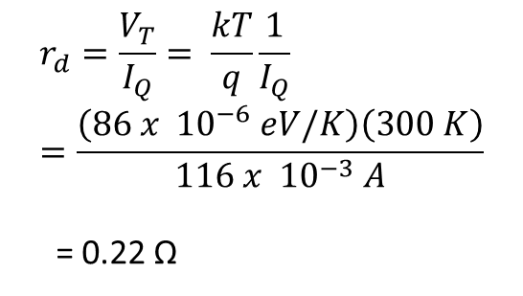
Example 1: Find the ac voltage output if the input voltage V_{AC} is 500 mV sin(ω t)
R₁ = 80 Ω
Calculate the resistance r_{d}
+
$$r_{d}=\frac{V_{T}}{I_{Q}}= \frac{kT}{q}\frac{1}{I_{Q}}=\frac{\left(86 x {10}^{−6} eV/K\right)\left(300 K\right)}{116 x {10}^{−3} A}$$
= 0.22 Ω
V_{AC}
-
r_{d} = V_{T}/I_{Q}

Slide 14
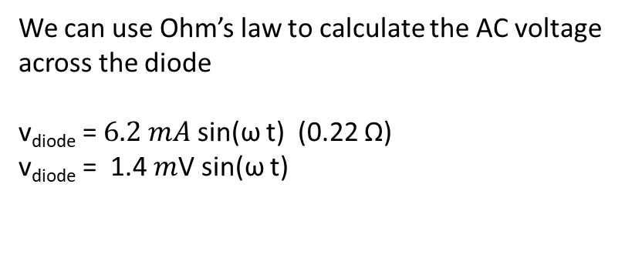
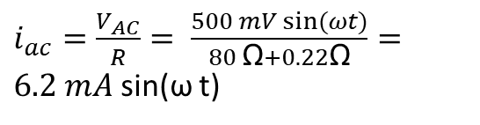
Example 1: Find the ac voltage output if the input voltage V_{AC} is 500 mV sin(ω t)
Calculate the ac component of the current
R₁ = 80 Ω
$i_{ac}=\frac{V_{AC}}{R}= \frac{500 mV sin⁡(ωt)}{80 \text{Ω}+0.22\text{Ω}}=6.2 mA$ sin(ω t)
+
We can use Ohm’s law to calculate the AC voltage across the diode
v_{diode} = $6.2 mA$ sin(ω t) (0.22 Ω)
v_{diode} = 1.4 $m$V sin(ω t)
V_{AC}
-
r_{d} = V_{T}/I_{Q} = 0.22 Ω

Slide 16
Example 2: Find the ac voltage across the diode if the input voltage V_{AC} is 20 mV sin(ω t)
DC component of output voltage
R₁ = 2 kΩ
+
+
V_{AC}
-
V_{D}
V_{out} = V_{Q} + v_{ac}
V_{DC} = 5.9 V
ac component of output voltage
-

Slide 17
Example 2: Find the ac voltage across the diode if the input voltage V_{AC} is 20 mV sin(ω t)
Short out the AC source
R₁ = 2 kΩ
+
Replace diode with voltage source
Calculate dc current
V_{AC}
-
+
I_{Q} = 5.2 V /2 k Ω = 2.6 mA
V_{on} = (0.7 V)
-
Calculate ac diode resistance
V_{DC} = 5.9 V
r_{AC} = V_{T} / I_{Q} = 0.026 v /2.6 mA = 10 Ω

Slide 18
Example 2: Find the ac voltage across the diode if the input voltage V_{AC} is 20 mV sin(ω t)
R₁ = 2 kΩ
V_{out} = V_{Q} + v_{ac}
+
+
Replace diode with resistor
Calculate dc current
V_{AC}
-
I_{Q} = 5.2 V /2 k Ω = 2.6 mA
r_{d} = V_{T}/I_{Q}
= 10 Ω
Calculate ac diode resistance
V_{DC} = 5.9 V
r_{AC} = V_{T} / I_{Q} = 0.026 v /2.6 mA = 10 Ω
-
Calculate ac current
Calculate ac voltage
I_{ac} = 20 mV sin(ω t) /2010 Ω ≈10 μA sin(ω t)
v_{ac} = 10 μA sin(ω t) * 10 Ω ≈100 μV sin(ω t)

Slide 19
Large signal response of diode circuits

Slide 20
Transfer Characteristics
V_{out}
Calculate the output voltage if the diode is forward biased
For what input voltages is the diode forward biased?
V_{in}
+
Calculate the output voltage if the diode is not forward biased
+
V_{out}
V_{in}
-
R
For what input voltages is the diode not forward biased?
-

Slide 21
Transfer Characteristics
V_{out}
Calculate the output voltage if the diode is forward biased
Kirchhoff's Voltage Law
0.7 V
V_{in}
V_{on} = (0.7 V)
+
-
+
Replace diode with voltage source
V_{in} - (0.7 V) - V_{out} = 0
+
V_{out}
V_{in}
-
R
V_{out} = V_{in} - (0.7 V)
-
For what input voltages is the diode forward biased?
V_{in} ≥ (0.7 V)

Slide 22
Transfer Characteristics
Calculate the output voltage if the diode is not forward biased
V_{out}
+
Remove diode from circuit
+
V_{out}
V_{in}
-
R
0.7 V
V_{in}
No current flows through the resistor
-

Slide 23
Find the Transfer Characteristics of the same Circuit but with the Diode Reversed
+
+
V_{out}
V_{in}
-
R
-

Slide 24
Find the Transfer Characteristics of the same Circuit but with the Diode Reversed
Calculate the output voltage if the diode is forward biased
Kirchhoff's Voltage Law
V_{on} = (0.7 V)
-
+
+
Replace diode with voltage source
V_{in} + (0.7 V) - V_{out} = 0
+
V_{out}
V_{in}
-
R
V_{out} = V_{in} + (0.7 V)
-
For what input voltages is the diode forward biased?
V_{in} ≤ (-0.7 V)

Slide 25
Find the Transfer Characteristics of the same Circuit but with the Diode Reversed
What will the output be if the diode is not forward biased?
V_{out}
+
+
V_{out}
-0.7 V
V_{in}
-
R
V_{in}
-

Slide 26
Find the Transfer Characteristics of this Circuit
V_{on} = (0.7 V)
+
-
+
V_{in} - (0.7 V) - V_{out} - (0.7 V) = 0
+
V_{out}
V_{in}
-
R
V_{out} = V_{in} - (1.4 V)
V_{on} = (0.7 V)
-
+
-
For what input voltages is the diode forward biased?
V_{in} ≥ (1.4 V)

Slide 27
Find the Transfer Characteristics of this Circuit
V_{out}
+
+
V_{out}
V_{in}
-
R
1.4 V
V_{in}
-

Slide 28
What we studied today
Solving diode circuits with varying inputs
Small signal response of diodes
Large signal response of diodes
Transfer characteristics

Slide 30
Practice 1: Find the ac voltage across the diode if the input voltage V_{AC} is 100 mV sin(ω t)
DC component of output voltage
R₁ = 8 kΩ
+
+
V_{AC}
-
V_{D}
V_{out} = V_{Q} + v_{ac}
V_{DC} = 6.7 V
ac component of output voltage
-

Slide 31
Practice Problem 2 a) Find the transfer characteristic of the following circuit
V_{in}
Practice Problem 2 b) Find the current through the diode and the output voltage when the input is 6.3 volts
10 kΩ
I_{D}
V_{out}
Practice Problem 2 c) Find the current through the diode and the output voltage when the input is -2.0 volts
10 kΩ
-4.4 V

Slide 32
Practice Problem 3 a) Find the transfer characteristic of the following circuit
V_{in}
Practice Problem 3 b) Find the current through the diode and the output voltage when the input is 5.0 volts
2 kΩ
V_{out}
I_{D}
Practice Problem 3 c) Find the current through the diode and the output voltage when the input is -2.0 volts
2 kΩ
-3 V

Slide 33
Practice Problem 4 a: Find the transfer characteristic of the following circuit
V_{in}
Practice Problem 4 b) Find the current through the diode and the output voltage when the input is 5.0 volts
20 kΩ
V_{out}
I_{D}
Practice Problem 4 c) Find the current through the diode and the output voltage when the input is -4.5 volts
2 kΩ
-5 V

