Slide 1
Analog Electronics Technology
BJT operation

Slide 2
Analog Electronics Technology
Diodes
BJT’s
BJT basics
Common Emitter Amplifier Circuits
Voltage Divider Biasing
Degenerate Resistor
Rules of Thumb
Other Biasing Methods
Common Base & Common Collector Amplifier Circuits
Op Amps

Slide 3
What we will talk about today
Parts of a BJT
Base, Emitter, Collector
Electrical symbols for BJTs
Regions of operation
BJT configurations
Common emitter, common base, common collector
Characteristic curves for common emitter configuration
Underlying physics
Equations for BJTs
Model for the BJT

Slide 4
PNP Bipolar Junction Transistor (BJT)
space charge region
space charge region
p⁺-type
p-type
p
n
n
p
n-type
Base
Emitter
Collector
It looks like two back to back diodes.
A BJT has three terminals (metal contacts)
The small base width causes it to behave much differently.
This is a pnp bipolar junction transistor. There is also an npn bipolar junction transistor.

Slide 5
Bipolar Junction Transistor (BJT) types
space charge region
space charge region
p⁺-type
n-type
p-type
This is a pnp bipolar junction transistor.
Base
Emitter
Collector
emitter
collector
electrical symbol
space charge region
base
space charge region
There is always an arrow between the emitter and the base
n⁺-type
p-type
n-type
The arrow points in the direction of current flow
This is an npn bipolar junction transistor.
Base
Emitter
Collector
emitter
collector
electrical symbol
base

Slide 6
What types of transistors are these? Identify the terminals.
emitter
collector
base
base
base
emitter
collector
emitter
collector
A pnp bipolar junction transistor.
An npn bipolar junction transistor.
An npn bipolar junction transistor.

Slide 7
pnp BJT regions of operation
space charge region
space charge region
This is a pnp bipolar junction transistor.
p⁺-type
n-type
p-type
emitter
collector
Base
Emitter
Collector
electrical symbol
base
V_{EB}
A BJT has four regions of operation, corresponding to the four combinations of forward or reverse biasing for the p-n junctions
Emitter-base junction forward biased
Active
Saturation
V_{CB}
The normal region of operation is the active region
Emitter-base junction reverse biased
Cutoff
Inverted
Collector-base junction reverse biased
Collector-base junction forward biased

Slide 8
npn BJT regions of operation
space charge region
space charge region
This is an npn bipolar junction transistor.
n⁺-type
p-type
n-type
emitter
collector
Base
Emitter
Collector
electrical symbol
base
V_{EB}
Inverted
Cutoff
Here are the four regions of operation for an npn BJT
Emitter-base junction reverse biased
V_{CB}
Emitter-base junction forward biased
Saturation
Active
It is important to identify which type of transistor you are designing for
Collector-base junction forward biased
Collector-base junction reverse biased

Slide 9
Configurations of BJTs in circuits
They are named for the terminal that is shared by the input and the output
-
+
input
output
output
output
+
-
input
-
V_{EC}
+
V_{EC}
input
V_{EB}
V_{BC}
V_{EB}
V_{BC}
-
+
+
-
+
-
common base
common collector
common emitter

Slide 10
Output characteristics of a pnp BJT in common emitter configuration
space charge region
space charge region
p⁺-type
n-type
p-type
emitter
collector
Base
Emitter
Collector
Saturated
base
I_{C}
This is because of different doping levels and physical geometry.
V_{CB}= 0
A small change in base current causes a large change in collector current
E
We choose an operating point in the active region.
B
C
p⁺
n
p⁺
Active
Increasing base current
n
n
p⁻
p⁺
I_{B}= 0
n⁻
V_{EC}
Inverted
Cutoff
Notice that in the inverted region the transistor is less responsive

Slide 11
Note: base expanded in drawing only for ease of showing currents
What happens on a small scale (for pnp BJT)
space charge region
space charge region
n-type
p⁺-type
Base
p-type
I_{Ep}
I_{Cp}
I_{E}
I_{C}
Emitter
I_{B2}
Collector
I_{En}
I_{Cn}
I_{B1}
I_{B}
The main current comes from holes injected into the forward biased diode.
Most of the holes injected from the emitter into the base diffuse across the base before they can recombine. These holes become the major part of the collector current.
Some of the holes injected from the emitter into the base recombine in the base and become a part of the base current (I_{B2}).

Slide 12

Figures of Merit of Bipolar Junction Transistors
space charge region
space charge region
n-type
p⁺-type
Base
p-type
I_{Ep}
I_{Cp}
I_{E}
I_{C}
Emitter
I_{B2}
Collector
I_{En}
I_{Cn}
I_{B1}
I_{B}
The common base current gain (α ) is the ratio of the collector current to the emitter current.
$$α≡ \frac{I_{C}}{I_{E}}$$

Slide 13
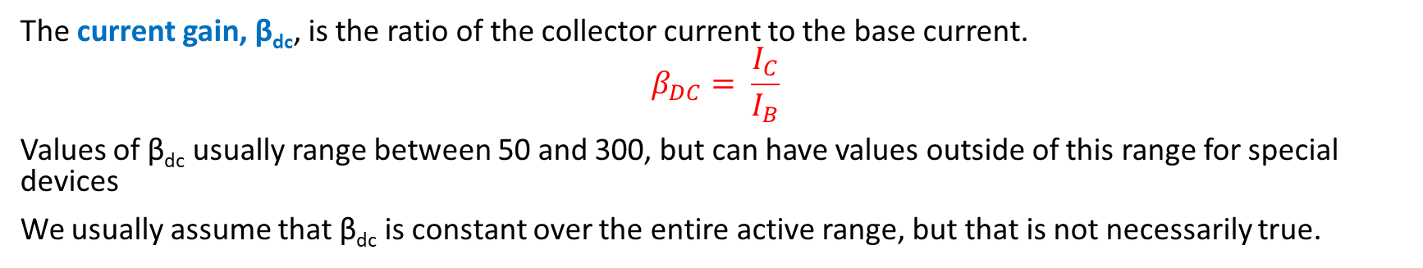
Figures of Merit of Bipolar Junction Transistors
space charge region
space charge region
n-type
p⁺-type
Base
p-type
I_{Ep}
I_{Cp}
I_{E}
I_{C}
Emitter
I_{B2}
Collector
I_{En}
I_{Cn}
I_{B1}
I_{B}
The current gain, β_{dc}, is the ratio of the collector current to the base current.
$$β_{DC}= \frac{I_{C}}{I_{B}}$$
Values of β_{dc} usually range between 50 and 300, but can have values outside of this range for special devices
We usually assume that β_{dc} is constant over the entire active range, but that is not necessarily true.

Slide 14
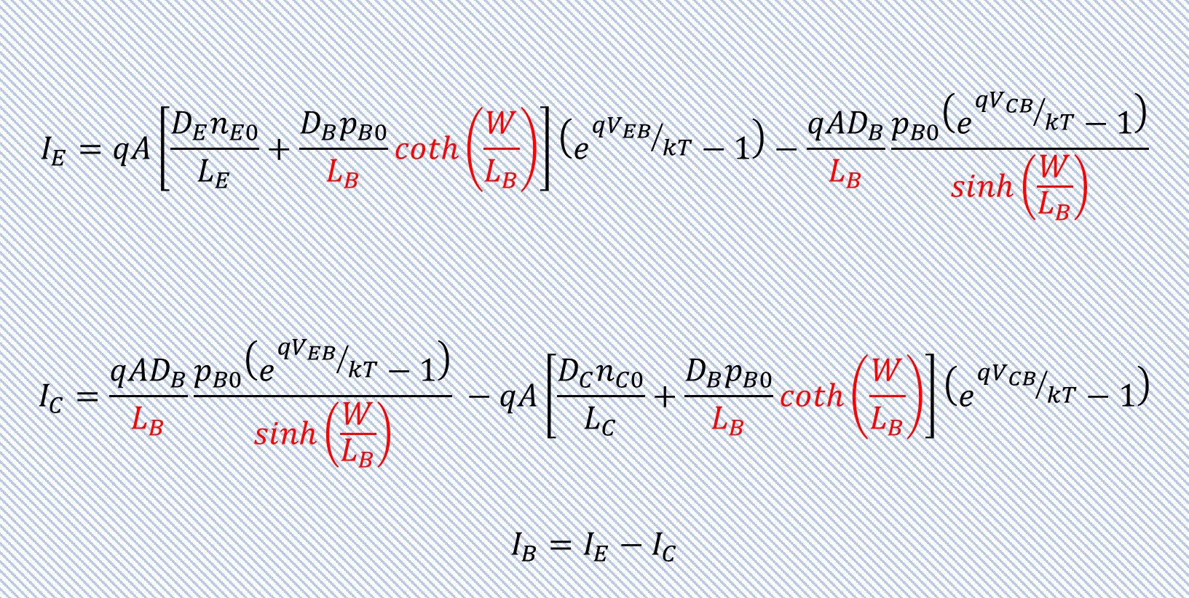
Equations for real pnp BJT
(We will use approximations)
$$I_{E}=qA\left[\frac{D_{E}n_{E0}}{L_{E}}+\frac{D_{B}p_{B0}}{L_{B}}coth\left(\frac{W}{L_{B}}\right)\right]\left(e^{{qV_{EB}}/{kT}}−1\right)−\frac{{qAD}_{B}}{L_{B}}\frac{p_{B0}\left(e^{{qV_{CB}}/{kT}}−1\right)}{sinh\left(\frac{W}{L_{B}}\right)}$$
$$I_{C}=\frac{{qAD}_{B}}{L_{B}}\frac{p_{B0}\left(e^{{qV_{EB}}/{kT}}−1\right)}{sinh\left(\frac{W}{L_{B}}\right)} −qA\left[\frac{D_{C}n_{C0}}{L_{C}}+\frac{D_{B}p_{B0}}{L_{B}}coth\left(\frac{W}{L_{B}}\right)\right]\left(e^{{qV_{CB}}/{kT}}−1\right)$$
$$I_{B}=I_{E}−I_{C}$$
Saturated
I_{C}
V_{CB}= 0
Active
Increasing base current
I_{B}= 0
V_{EC}
Inverted
Cutoff

Slide 15
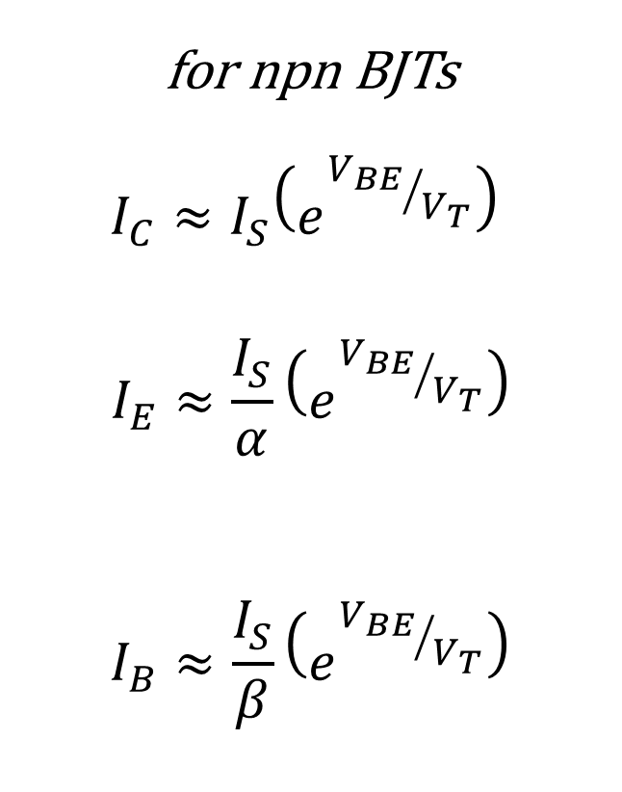
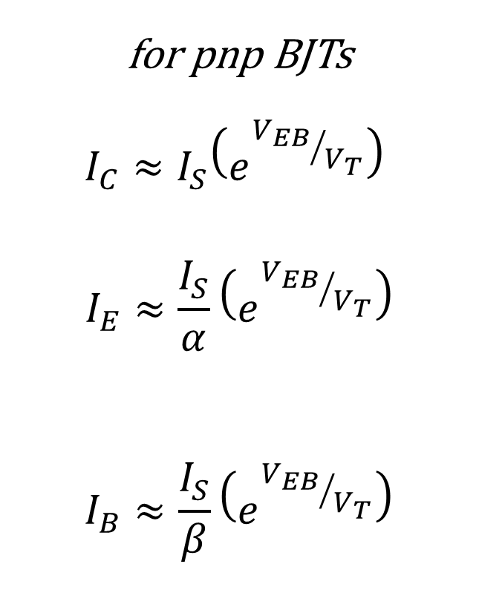
Approximations valid for forward active region only
for pnp BJTs
$$I_{C}≈I_{S}\left(e^{{V_{EB}}/{V_{T}}}\right)$$
$$I_{E}≈\frac{I_{S}}{α}\left(e^{{V_{EB}}/{V_{T}}}\right)$$
$$I_{B}≈\frac{I_{S}}{β}\left(e^{{V_{EB}}/{V_{T}}}\right)$$
for npn BJTs
$$I_{C}≈I_{S}\left(e^{{V_{BE}}/{V_{T}}}\right)$$
$$I_{E}≈\frac{I_{S}}{α}\left(e^{{V_{BE}}/{V_{T}}}\right)$$
$$I_{B}≈\frac{I_{S}}{β}\left(e^{{V_{BE}}/{V_{T}}}\right)$$
Saturated
I_{C}
V_{CB}= 0
Active
Increasing base current
I_{B}= 0
Inverted
V_{EC}
Cutoff

Slide 16


More relationships valid for both pnp and npn BJTs
Our most important equations
$${I_{E}=I}_{C}+I_{B}$$
$$I_{E}= \left(1+β\right)I_{B}$$
$$β=\frac{α}{1−α}$$
$$I_{C}=β I_{B}$$
$$I_{C}=α I_{E}$$
$$α=\frac{β}{1+β}$$
for active region

Slide 17
One model of BJT in forward active region – diode and dependent current source
pnp BJT
npn BJT
collector
collector
base
base
I_{D}
β I_{D}
I_{D}
β I_{D}
emitter
emitter

Slide 18
What we talked about today
Parts of a BJT
Base, Emitter, Collector
Electrical symbols for BJTs
Regions of operation
BJT configurations
Common emitter, common base, common collector
Characteristic curves for common emitter configuration
Underlying physics
Equations for BJTs
Model for the BJT

Slide 19
Practice Problems

Slide 20
What types of transistors are these? Identify the terminals.

Slide 21
What types of transistors are these? Identify the terminals.

