Slide 1
Analog Electronics Technology
BJT operation

Slide 2
Practice Problem Solutions
Common Base Amplifiers

Slide 3
















Practice Problem 1 Common Base Amplifier Circuit Design
Given the circuit below, calculate what resistors should be used to bias the circuit so that the current through the emitter is 100 mA, and so that V_{out} equals -4 Volts. Assume that V_{in} equals zero, that β = 100, and that the turn-on voltage of the forward biased p-n junction is 0.7 V.
$$I_{C}$$
$$+$$
$$R_{E}$$
$$I_{E}$$
$$R_{C}$$
$$I_{B}$$
$$V_{out}$$
$$+$$
$$−$$
$$V_{in}$$
$$−$$
$$+$$
$V_{CC}$ = 10 V
V_{bb} = 4 V
$$+$$
$$−$$
$$−$$

Slide 4
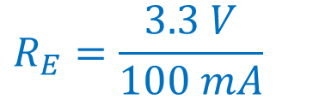
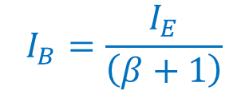
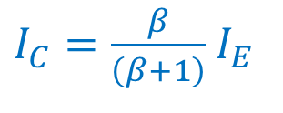





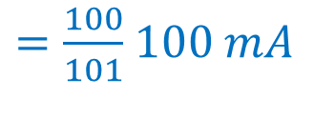
Practice Problem 1 Common Base Amplifier Circuit Design
Given the circuit below, calculate what resistors should be used to bias the circuit so that the current through the emitter is 100 mA, and so that V_{out} equals -4 Volts. Assume that V_{in} equals zero, that β = 100, and that the turn-on voltage of the forward biased p-n junction is 0.7 V.
Apply Kirchhoff’s Voltage Law around the base-emitter loop
$$I_{C}$$
$$+$$
$$0=4 V −I_{E} ∗R_{E}−0.7 V$$
$$R_{E}$$
$$I_{E}$$
$$R_{C}$$
$$R_{E}=\frac{3.3 V}{100 mA}$$
$$=33Ω$$
$$I_{B}$$
$$V_{out}$$
$$I_{B}=\frac{I_{E}}{\left(β+1\right)}$$
$$+$$
$$−$$
$$I_{C}=βI_{B}$$
$$I_{E}=\left(β+1\right)I_{B}$$
$$V_{in}$$
$$−$$
$$+$$
$V_{CC}$ = 10 V
V_{bb} = 4 V
$$+$$
$I_{C}=\frac{β}{\left(β+1\right)}$ $I_{E}$
$=\frac{100}{101}$ $100 mA$
$$−$$
$$−$$
$$=99.0 mA$$

Slide 5
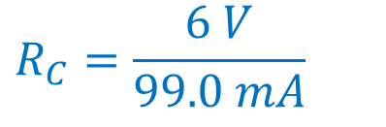





Practice Problem 1 Common Base Amplifier Circuit Design
Given the circuit below, calculate what resistors should be used to bias the circuit so that the current through the emitter is 10 mA, and so that V_{out} equals -4 Volts. Assume that V_{in} equals zero, that β = 100, and that the turn-on voltage of the forward biased p-n junction is 0.7 V.
$$V_{out}−I_{C}∗R_{C}{+ V}_{CC}=0$$
$$I_{C}$$
$$+$$
$$−4 V−99.0 mA ∗R_{C}+10 V=0$$
$$R_{E}$$
$$I_{E}$$
$$R_{C}$$
$$I_{B}$$
$$V_{out}$$
$$R_{C}=\frac{6 V}{99.0 mA}$$
$$=60.6 Ω$$
$$+$$
$$−$$
$$V_{in}$$
$$−$$
$$+$$
$V_{CC}$ = 10 V
V_{bb} = 4 V
$$+$$
$$−$$
$$=61.9 Ω$$
$$−$$
$$nearest 2\% tolerance$$

Slide 7
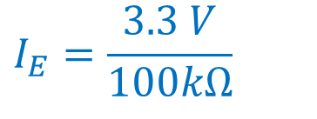
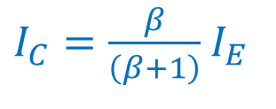
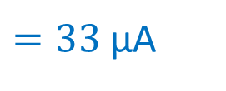



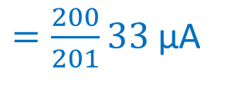
Practice Problem 2 Common Base Amplifier Circuit Design
Given the circuit below, calculate the emitter current, the collector current, and the collector voltage. Assume that the transistor β is 200.
$$I_{C}$$
Apply Kirchhoff’s Voltage Law around the base-emitter loop
$$+$$
$$100 kΩ$$
$$I_{E}$$
$$200 kΩ$$
$$0=4 V −I_{E} ∗100 kΩ−0.7 V$$
$$I_{B}$$
$$V_{out}$$
$$I_{E}=\frac{3.3 V}{100kΩ}$$
$$+$$
$$−$$
$=33$ μA
$$V_{in}$$
$$−$$
$$+$$
$V_{CC}$ = 10 V
V_{bb} = 4 V
$$+$$
Find the collector current
$$−$$
$$−$$
$I_{C}=\frac{β}{\left(β+1\right)}$ $I_{E}$
$=\frac{200}{201}33$ μA
$$≈33 \text{μ}\text{A}$$

Slide 8


Practice Problem 2 Common Base Amplifier Circuit Design
Given the circuit below, calculate the emitter current, the collector current, and the collector voltage. Assume that the transistor β is 200.
$$I_{C}$$
Find the collector voltage
$$+$$
$$I_{E}$$
$${V_{C}=V}_{out}=−10 V+I_{C} ∗200 kΩ$$
$$100 kΩ$$
$$200 kΩ$$
$$I_{B}$$
$$V_{out}$$
$$=−10 V+33 \text{μ}\text{A}∗200 kΩ$$
$$+$$
$$−$$
$$V_{in}$$
$$−$$
$$+$$
$V_{CC}$ = 10 V
$$+$$
$$=−3.4 V$$
V_{bb} = 4 V
$$−$$
$$−$$

Slide 10












Practice Problem 3 Common Base Amplifier Circuit Design
Given the circuit below, if I_{B} = 100 μA, calculate what the resistors should be used to bias the circuit so that V_{out} equals 5 Volts. Assume that β = 100, and that the turn-on voltage of the forward biased p-n junction is 0.7 V.
From the base current, we can calculate the collector current and the emitter current
$$R_{C}$$
$$+$$
$$I_{C}$$
I_{C} = β I_{B}
= 100 * 100 μA
= 10 mA
$$V_{bb}=10 V$$
$$V_{out}$$
$$−$$
We can calculate I_{E}.
$$I_{B}$$
$$I_{E}$$
I_{E} = I_{B} * (1+ β)
= 10.1 mA
$$+$$
$V_{CC}$ = 4 V
$$−$$
$$R_{E}$$

Slide 11
Practice Problem 3 Common Base Amplifier Circuit Design
Given the circuit below, if I_{B} = 100 μA, calculate what the resistors should be used to bias the circuit so that V_{out} equals 5 Volts. Assume that β = 100, and that the turn-on voltage of the forward biased p-n junction is 0.7 V.
We can calculate R_{E}.
$$R_{C}$$
R_{E} = ( -0.7 V – (-4 V) )/ 10.1 mA
$$+$$
$$I_{C}$$
$$V_{bb}=10 V$$
$$V_{out}$$
= 327 Ω
$$−$$
$$I_{B}$$
We can calculate R_{C}.
V_{E} = -0.7 V
$$+$$
$$I_{E}$$
$V_{CC}$ = 4 V
R_{C} = ( 10 V – (5 V) )/ 10 mA
$$−$$
$$R_{E}$$
= 500 Ω

