Slide 1
Analog Electronics Technology
Common Collector BJT Biasing

Slide 2
Analog Electronics Technology
Diodes
BJT’s
BJT basics
Common Emitter Amplifier Circuits
DC Biasing
Voltage Divider Biasing
Degenerate Resistor
Rules of Thumb
Other Biasing Methods
Common Base Amplifier Circuits -- DC Biasing
Common Collector Amplifier Circuits -- DC Biasing
Small Signal Analysis
Op Amps

Slide 3













Configurations of BJTs in circuits
$$R_{1}$$
$$R_{C}$$
$$+$$
$$V_{out}$$
$$V_{CC}$$
$$−$$
$$V_{E}$$
$$R_{2}$$
$$R_{S}$$
$$R_{E}$$
$$+$$
$$V_{in}$$
$$−$$
-
+
input
output
output
output
+
-
input
-
V_{EC}
+
V_{EC}
input
V_{EB}
V_{BC}
V_{EB}
V_{BC}
-
+
+
-
+
-
common base
common collector
common emitter

Slide 4
Common Collector Circuit
(Emitter Follower)
+
pnp
input
output
+
V_{EC}
V_{BC}
-
-
common collector

Slide 5
Common Collector Circuit
(Emitter Follower)
+
+
npn
input
V_{CB}
output
-
V_{CE}
-
common collector

Slide 6













Common Collector Circuit
(Emitter Follower)
+
+
$$V_{in}$$
$$+$$
$$V_{in}$$
$$+$$
$$−$$
input
$$−$$
V_{CB}
$$+$$
$$R_{S}$$
$$V_{bb}$$
output
$$−$$
-
V_{CE}
R_{B}
$$+$$
$$V_{CC}$$
-
$$−$$
R_{E}

Slide 7



Common Collector Circuit
(Emitter Follower)
+
+
input
V_{CB}
$$V_{bb}$$
$$+$$
$$−$$
output
-
V_{CE}
R_{B}
$$+$$
$$+$$
$$V_{CC}$$
$$V_{bb}$$
-
$$−$$
$$−$$
R_{E}

Slide 8
Common Collector Circuit
(Emitter Follower)
+
+
input
V_{CB}
output
-
V_{CE}
R_{B}
$$+$$
$$+$$
$$V_{CC}$$
$$V_{bb}$$
-
$$−$$
$$−$$
R_{E}

Slide 9



Common Collector Circuit
(Emitter Follower)
AC part
+
+
V_{B,ac} ≈ - v_{in}
$$V_{in}$$
$$+$$
input
$$−$$
V_{CB}
$$R_{S}$$
output
When the input voltage increases, the base voltage goes down
-
V_{CE}
R_{B}
When the base voltage goes down, the emitter voltage goes down
$$+$$
$$V_{CC}$$
$$+$$
-
$$−$$
$$V_{bb}$$
$$−$$
V_{E} = V_{B} - V_{on}
R_{E}
When the emitter voltage goes down, the output voltage increases

Slide 10












Review -- Common Emitter Amplifier Circuit
When V_{in} increases, V_{B} increases
10 V
When V_{B} increases, the collector current increases
$$R_{1}$$
$$R_{C}$$
$$V_{out}$$
When the collector current increases, the voltage drop across the collector resistor increases
$$+$$
$V_{CC}$= 10 V
$$−$$
$$V_{E}$$
$$V_{in}$$
$$+$$
$$R_{2}$$
When the voltage drop across the collector resistor increases, the output decreases
$$−$$
$$R_{E}$$
The gain is negative since the input and the output are out of phase

Slide 11
Common Collector Circuit
(Emitter Follower)
The input and the output are in phase with each other
+
+
$$V_{in}$$
$$+$$
input
$$−$$
V_{CB}
The gain will be positive
$$R_{S}$$
output
-
V_{CE}
R_{B}
$$+$$
$$V_{CC}$$
$$+$$
-
$$−$$
$$V_{bb}$$
$$−$$
R_{E}

Slide 12




Common Collector Circuit
(Emitter Follower)
In practice, the input is normally between ground and the base
+
$$V_{in}$$
$$+$$
$$−$$
$$R_{S}$$
Now the base voltage is in phase with the input.
output
V_{CE}
That makes the input out of phase with the output.
R_{B}
$$+$$
$$V_{CC}$$
$$+$$
$$R_{S}$$
-
$$−$$
$$V_{bb}$$
To compensate, the output is moved to the voltage drop across the emitter resister, making it again in phase with the input.
$$−$$
$$V_{in}$$
$$+$$
R_{E}
$$−$$

Slide 13
Common Collector Circuit
(Emitter Follower)
Let’s look at this circuit without the ac input
It is very similar to our original circuit for the common emitter amplifier
Differences:
No collector resistor
R_{B}
$$+$$
Emitter resistor
$$V_{CC}$$
$$+$$
$$R_{S}$$
+
V_{E}
$$−$$
$$V_{bb}$$
$$−$$
The output is V_{E} instead of V_{C}
$$V_{in}$$
$$+$$
R_{E}
output
$$−$$
For the common emitter amplifier we showed that resistive ladder biasing was equivalent
-

Slide 14













Common Collector Circuit
(Emitter Follower)
Normal Emitter Follower Circuit
Keys to recognizing:
$$R_{1}$$
The output is at the emitter
$$R_{S}$$
$$+$$
$$V_{B}$$
$$V_{CC}$$
$$−$$
There is no collector resistor
$$V_{E}$$
$$V_{out}$$
$$V_{in}$$
$$+$$
$$−$$
$$R_{2}$$
$$R_{E}$$

Slide 15
Common Collector Circuit
(Emitter Follower)
Normal Emitter Follower Circuit
Biasing can be done similar to common emitter biasing
$$R_{1}$$
The output voltage is normally set near the midpoint (half of V_{cc})
$$R_{S}$$
$$+$$
$$V_{B}$$
$$V_{CC}$$
$$−$$
$$V_{E}$$
$$V_{out}$$
$$V_{in}$$
$$+$$
$$−$$
$$R_{2}$$
$$R_{E}$$

Slide 17











Common Collector Amplifier Circuit
This is almost identical to the common emitter configuration that had the emitter resistor
$$I_{C}$$
$$R_{B}$$
$$+$$
$$V_{CC}$$
$$V_{out}$$
There is no collector resistor
$$−$$
$$I_{B}$$
$$+$$
$$I_{E}$$
$$V_{bb}$$
$$R_{E}$$
$$−$$
The output is the voltage across the emitter resistor

Slide 18
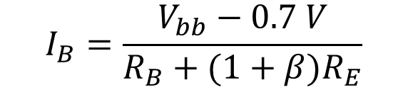
Common Collector Amplifier Circuit
First look at Kirchhoff’s voltage law around the lower right loop. Assume V_{in} = 0
$$I_{C}$$
V_{bb} - I_{B} R_{B} – 0.7 V - I_{E} R_{E} = 0
$$R_{B}$$
$$+$$
In the active region I_{E} = ( 1+ β) I_{B}
$$V_{CC}$$
$$V_{out}$$
$$−$$
$$I_{B}$$
$$+$$
$$I_{E}$$
Substitute into the above equation
$$V_{bb}$$
$$R_{E}$$
$$−$$
V_{bb} - I_{B} R_{B} – 0.7 V - ( 1+ β) I_{B} R_{E} = 0
Solve for the base current
$$I_{B}=\frac{V_{bb}−0.7 V}{R_{B}+(1+β)R_{E}}$$

Slide 19
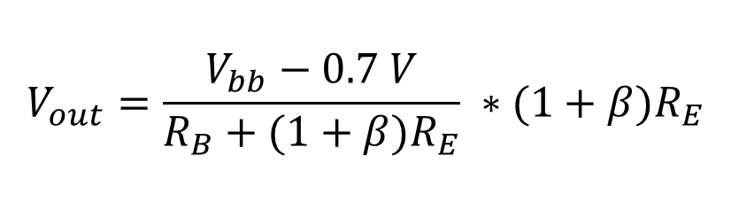

Common Collector Amplifier Circuit
$$I_{B}=\frac{V_{bb}−0.7 V}{R_{B}+(1+β)R_{E}}$$
$$I_{C}$$
The output voltage is equal to the voltage drop across the emitter resistor
$$R_{B}$$
$$+$$
$$V_{CC}$$
$$V_{out}$$
V_{out} = I_{E} R_{E}
$$−$$
$$I_{B}$$
The emitter current equals (1+ β) times the base current
$$+$$
$$I_{E}$$
$$V_{bb}$$
$$R_{E}$$
$$−$$
V_{out} = ( 1+ β) I_{B} R_{E}
$$V_{out}=\frac{V_{bb}−0.7 V}{R_{B}+(1+β)R_{E}} ∗(1+β)R_{E}$$

Slide 20
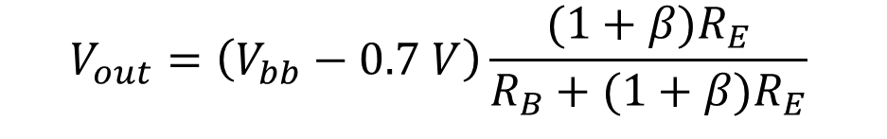

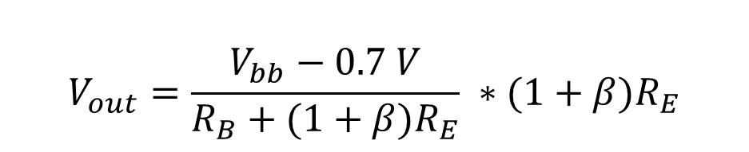

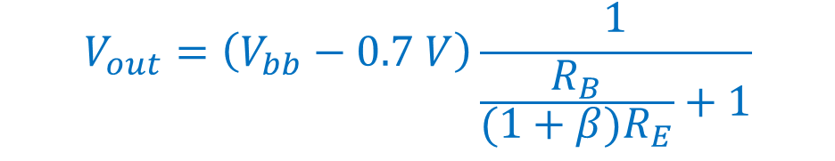
Common Collector Amplifier Circuit
$$V_{out}=\frac{V_{bb}−0.7 V}{R_{B}+(1+β)R_{E}} ∗(1+β)R_{E}$$
$$I_{C}$$
$$R_{B}$$
$$V_{out}=\left(V_{bb}−0.7 V\right)\frac{(1+β)R_{E}}{R_{B}+(1+β)R_{E}}$$
$$+$$
$$V_{CC}$$
$$V_{out}$$
$$−$$
$$I_{B}$$
$$+$$
$$I_{E}$$
$$V_{bb}$$
$$R_{E}$$
$$V_{out}=\left(V_{bb}−0.7 V\right)\frac{1}{\frac{R_{B}}{(1+β)R_{E}}+1}$$
$$−$$
$$V_{out}<\left(V_{bb}−0.7 V\right)$$

Slide 22

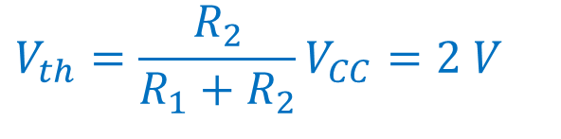











Common Collector Amplifier Circuit Example 1
Find the value for the emitter resistor to bias the circuit so that V_{out} = 5.2 V. The transistor has β = 97.
Ignore v_{in} to find DC bias
Find the Thevenin equivalent circuit looking from the base of the transistor towards the bias circuit
$R_{1}$= 30 kΩ
$$R_{th}=\frac{R_{1}R_{2}}{R_{1}{+ R}_{2}}$$
$$−$$
$V_{CC}$= 12 V
$$+$$
$$V_{out}$$
$$R_{th}=\frac{180}{36} kΩ=5kΩ$$
$$V_{in}$$
$$−$$
$$+$$
$R_{2}$ = 6 kΩ
$$R_{E}$$
$$V_{th}=\frac{R_{2}}{R_{1}{+ R}_{2}}V_{CC}=2 V$$

Slide 23













Common Collector Amplifier Circuit Example 1
Find the value for the emitter resistor to bias the circuit so that V_{out} = 5.2 V. The transistor has β = 97.
Thevenin equivalent circuit
1.3 V
$$V_{out}=\left(V_{bb}−0.7 V\right)\frac{1}{\frac{R_{B}}{(1+β)R_{E}}+1}$$
$$I_{C}$$
$R_{B}$= 5 kΩ
$$+$$
$$V_{CC}$$
$$V_{out}$$
$$−$$
$$I_{B}$$
Impossible!
$$+$$
$$I_{E}$$
$$V_{bb}=2 V$$
$$R_{E}$$
$$−$$

Slide 25
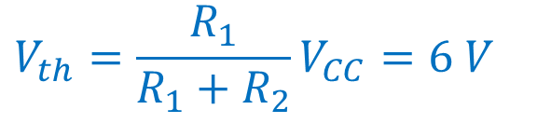




Common Collector Amplifier Circuit Example 2
Find the value for the emitter resistor to bias the circuit so that V_{out} = 5.25 V. The transistor has β = 99.
Ignore v_{in} to find DC bias
Find the Thevenin equivalent circuit looking from the base of the transistor towards the bias circuit
$R_{1}$= 4 kΩ
$$R_{th}=\frac{R_{1}R_{2}}{R_{1}{+ R}_{2}} = \frac{16}{8} kΩ$$
$$−$$
$V_{CC}$= 12 V
$$+$$
$$V_{out}$$
$$R_{th}=2 kΩ$$
$$V_{in}$$
$$−$$
$$+$$
$R_{2}$ = 4 kΩ
$$R_{E}$$
$$V_{th}=\frac{R_{1}}{R_{1}{+ R}_{2}}V_{CC}=6 V$$

Slide 26

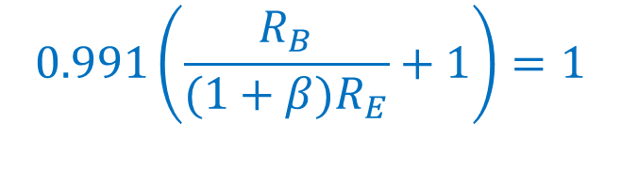


Common Collector Amplifier Circuit Example 2
Find the value for the emitter resistor to bias the circuit so that V_{out} = 5.25 V. The transistor has β = 99.
We are OK.
Thevenin equivalent circuit
5.3 V
$$V_{out}=\left(V_{bb}−0.7 V\right)\frac{1}{\frac{R_{B}}{(1+β)R_{E}}+1}$$
$$I_{C}$$
$R_{B}$= 2 kΩ
$$+$$
$$V_{CC}$$
$$V_{out}$$
$$\frac{5.25 V}{5.3 V}=\frac{1}{\frac{R_{B}}{(1+β)R_{E}}+1}$$
$$−$$
$$I_{B}$$
$$+$$
$$I_{E}$$
$$V_{bb}=6 V$$
$$R_{E}$$
$$−$$
$$0.991\left(\frac{R_{B}}{(1+β)R_{E}}+1\right)=1$$

Slide 27

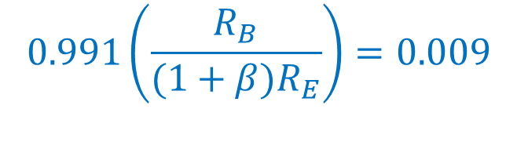

Common Collector Amplifier Circuit Example 2
Find the value for the emitter resistor to bias the circuit so that V_{out} = 5.25 V. The transistor has β = 99.
$$0.991\left(\frac{R_{B}}{(1+β)R_{E}}+1\right)=1$$
Thevenin equivalent circuit
$$I_{C}$$
$$0.991\left(\frac{R_{B}}{(1+β)R_{E}}\right)=0.009$$
$R_{B}$= 2 kΩ
$$+$$
$$V_{CC}$$
$$V_{out}$$
$$−$$
$$I_{B}$$
$$\left(R_{B}\right)=0.0091\left((1+β)R_{E}\right)$$
$$+$$
$$I_{E}$$
$$V_{bb}=6 V$$
$$R_{E}$$
$$−$$
$$\left(2 kΩ\right)=0.0091\left((100)R_{E}\right)$$
$$R_{E}=2.2 kΩ$$

Slide 29






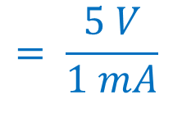

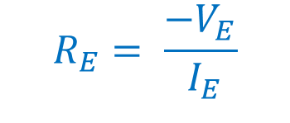








Common Collector Amplifier Circuit Example 3
Find values for the resistors to bias the circuit so that I_{B} = 10 μA. The transistor has β = 99. Make V_{out} = -5 V and make the current through R₁ equal ten times the base current.
$$I_{E}= \left(β+1\right){ I}_{B}$$
$$R_{1}$$
$$= \left(100\right)\text{10 }\text{μ}\text{A}$$
$$−$$
$$= \text{1 }\text{m}\text{A}$$
$V_{CC}$= 10 V
$$+$$
Now we can calculate R_{E}
$$V_{E}$$
$$V_{out}$$
$$V_{in}$$
$$−$$
$$R_{2}$$
$$+$$
$$R_{E}= \frac{{−V}_{E}}{{ I}_{E}}$$
$$= \frac{5 V}{1 mA}$$
$$R_{E}$$
$$=5 kΩ$$

Slide 30


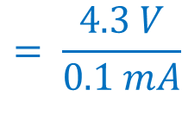
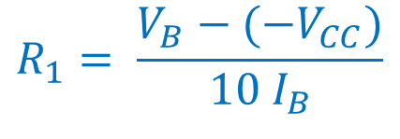


Common Collector Amplifier Circuit Example 3
Find values for the resistors to bias the circuit so that I_{B} = 10 μA. The transistor has β = 99. Make V_{out} = -5 V and make the current through R₁ equal ten times the base current.
$$V_{B}=V_{E} −V_{on}$$
$$R_{1}$$
$$=−5 V −0.7 V$$
$$−$$
$$=− \text{5.7 }\text{V}$$
$V_{CC}$= 10 V
$$+$$
Now we can calculate R₁
$$V_{E}$$
$$V_{out}$$
$$V_{in}$$
$$−$$
$$R_{2}$$
$$+$$
$$= \frac{4.3 V}{0.1 mA}$$
$$R_{E}$$
$$R_{1}= \frac{V_{B}−{(−V}_{CC})}{{10 I}_{B}}$$
$$=43 kΩ$$

Slide 31
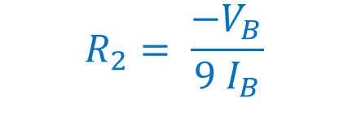

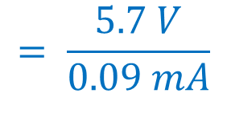
Common Collector Amplifier Circuit Example 3
Find values for the resistors to bias the circuit so that I_{B} = 10 μA. The transistor has β = 99. Make V_{out} = -5 V and make the current through R₁ equal ten times the base current.
Now we can calculate R₂
$$R_{1}$$
$$R_{2}= \frac{{−V}_{B}}{{9 I}_{B}}$$
$$−$$
$V_{CC}$= 10 V
$$+$$
$$= \frac{5.7 V}{0.09 mA}$$
$$V_{E}$$
$$V_{out}$$
$$V_{in}$$
$$−$$
$$R_{2}$$
$$+$$
$$R_{E}$$
$$=63 kΩ$$

Slide 32
What we talked about today
Common collector biasing circuits
May be hard to recognize as common collector
Examples

Slide 33
Practice Problems

Slide 34











Practice Problem 1 Common Collector Amplifier Circuit
Find the values of the DC currents and voltages of the circuit. The transistor has β = 193.
$$8 kΩ$$
$$+$$
$V_{CC}$= 16 V
$$−$$
$$V_{E}$$
$$V_{out}$$
$$V_{in}$$
$$+$$
$$−$$
$$24 kΩ$$
$$1 kΩ$$

Slide 35
Practice Problem 2 Common Collector Amplifier Circuit
Find values for the resistors to bias the circuit so that I_{E} = 20 mA. The transistor has β = 99. Make V_{out} = -5 V and make the current through R₁ equal ten times the base current.
$$R_{1}$$
$$−$$
$V_{CC}$= 10 V
$$+$$
$$V_{E}$$
$$V_{out}$$
$$V_{in}$$
$$−$$
$$R_{2}$$
$$+$$
$$R_{E}$$

Slide 36










Practice Problem 3 Common Collector Amplifier Circuit
Find the values of the DC currents and voltages of the circuit. The transistor has β = 99.
$$90 kΩ$$
$$+$$
$V_{CC}$= 15 V
$$−$$
$$V_{E}$$
$$V_{out}$$
$$V_{in}$$
$$+$$
$$−$$
$$180 kΩ$$
$$1.8 kΩ$$

