Slide 1
Analog Electronics Technology
BJT operation

Slide 2
Practice Problem Solutions
Common Collector Biasing

Slide 3









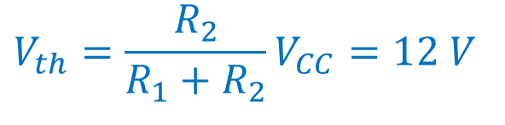




Practice Problem 1
Common Collector Amplifier Circuit
Find the values of the DC currents and voltages of the circuit. The transistor has β = 193.
Find the Thevenin equivalent circuit looking from the base of the transistor towards the bias circuit
$$8 kΩ$$
$$R_{th}=\frac{R_{1}R_{2}}{R_{1}{+ R}_{2}}$$
$$+$$
$V_{CC}$= 16 V
$$−$$
$$V_{E}$$
$$V_{out}$$
$$R_{th}=\frac{192}{32} kΩ=6 kΩ$$
$$V_{in}$$
$$+$$
$$−$$
$$24 kΩ$$
$$1 kΩ$$
$$V_{th}=\frac{R_{2}}{R_{1}{+ R}_{2}}V_{CC}=12 V$$

Slide 4







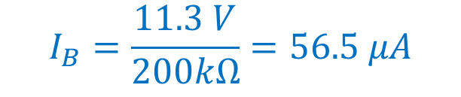








Practice Problem 1
Common Emitter Amplifier Circuit
Find the values of the DC currents and voltages of the circuit. The transistor has β = 193.
Apply Kirchhoff’s Voltage Law around the base-emitter loop
Thevenin equivalent circuit
$$I_{C}$$
$$0=12 V −I_{B} ∗6 kΩ −0.7 V − I_{E} ∗1 kΩ$$
$R_{B}$= 6 kΩ
$$I_{E}=\left( β+1\right) I_{B}$$
$$=\left( 194\right) I_{B}$$
$$+$$
$$V_{CC}\text{= 15 }\text{V}$$
$$V_{out}$$
$$−$$
$$0=12 V −I_{B} ∗6 kΩ −0.7 V −194 I_{B} ∗1 kΩ$$
$$I_{B}$$
$$+$$
$$I_{E}$$
$$1 kΩ$$
$$V_{bb}=12 V$$
$$0=11.3 V −I_{B} ∗200 kΩ$$
$$−$$
$$I_{B}=\frac{11.3 V}{200kΩ}=56.5 μA$$

Slide 5




Practice Problem 1
Common Emitter Amplifier Circuit
Find the values of the DC currents and voltages of the circuit. The transistor has β = 193.
Find the collector current and the emitter current
Thevenin equivalent circuit
$$I_{C}=β I_{B}=\left( 193\right)56.5 μA$$
$$I_{C}$$
$R_{B}$= 6 kΩ
$$I_{C}=10.9 mA$$
$$+$$
$$V_{CC}\text{= 15 }\text{V}$$
$$V_{out}$$
$$−$$
$$I_{E}=(β+1) I_{B}=\left( 194\right)56.5 μA$$
$$I_{B}$$
$$+$$
$$I_{E}$$
$$1 kΩ$$
$$V_{bb}=12 V$$
$$I_{E}=10.96 mA$$
$$−$$

Slide 6





Practice Problem 1
Common Emitter Amplifier Circuit
Find the values of the DC currents and voltages of the circuit. The transistor has β = 193.
Find the emitter voltage
Thevenin equivalent circuit
$$I_{C}$$
$$V_{E}=I_{E} ∗R_{E}=\left(10.96 mA\right)1 kΩ$$
$R_{B}$= 6 kΩ
$$V_{E}=10.96 V$$
$$+$$
$$V_{CC}\text{= 15 }\text{V}$$
$$V_{out}$$
$$V_{E}≈11 V$$
$$−$$
$$I_{B}$$
$$+$$
$$I_{E}$$
$$1 kΩ$$
$$V_{bb}=12 V$$
$$V_{B}=V_{E}+V_{on}$$
$$−$$
$$V_{B}≈11.7 V$$

Slide 8











Practice Problem 2
Common Collector Amplifier Circuit
Find values for the resistors to bias the circuit so that I_{E} = 20 mA. The transistor has β = 99. Make V_{out} = -5 V, and make the current through R₁ equal ten times the base current.
$$R_{1}$$
$$−$$
$V_{CC}$= 10 V
$$+$$
$$V_{E}$$
$$V_{out}$$
$$V_{in}$$
$$−$$
$$R_{2}$$
$$+$$
$$R_{E}$$

Slide 9
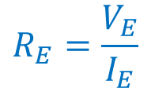

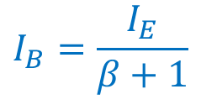
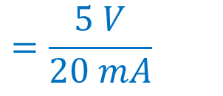

Practice Problem 2
Common Collector Amplifier Circuit
Find values for the resistors to bias the circuit so that I_{E} = 20 mA. The transistor has β = 99. Make V_{out} = -5 V, and make the current through R₁ equal ten times the base current.
Calculate the emitter resistance
$$R_{1}$$
$$R_{E}=\frac{V_{E}}{I_{E}}$$
$$=\frac{5 V}{20 mA}$$
$$=250 Ω$$
$$−$$
$V_{CC}$= 10 V
Calculate the base current
$$+$$
$$V_{E}$$
$$V_{out}$$
$$V_{in}$$
$$−$$
$$R_{2}$$
$$I_{B}=\frac{I_{E}}{β+1}$$
$$+$$
$$R_{E}$$
$$=0.2 mA$$

Slide 10


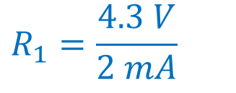



Practice Problem 2
Common Collector Amplifier Circuit
Find values for the resistors to bias the circuit so that I_{E} = 20 mA. The transistor has β = 99. Make V_{out} = -5 V, and make the current through R₁ equal ten times the base current.
Calculate the base voltage
$$V_{B}=V_{E}− V_{on}$$
$$=−5.7 V$$
$$R_{1}$$
Calculate the current through R₁
$$−$$
$V_{CC}$= 10 V
$$I_{1}=10 I_{B}$$
$$=2 mA$$
$$+$$
$$V_{E}$$
$$V_{out}$$
$$V_{in}$$
$$−$$
$$R_{2}$$
Calculate R₁
$$+$$
$$R_{E}$$
$$R_{1}=\frac{4.3 V}{2 mA}$$
$$=2.15 kΩ$$

Slide 11


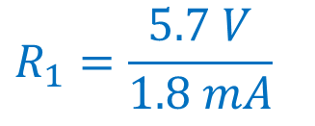

Practice Problem 2
Common Collector Amplifier Circuit
Find values for the resistors to bias the circuit so that I_{E} = 20 mA. The transistor has β = 99. Make V_{out} = -5 V, and make the current through R₁ equal ten times the base current.
Calculate the current through R₂
$$R_{1}$$
$$=1.8 mA$$
$$I_{2}=9 I_{B}$$
$$−$$
$V_{CC}$= 10 V
Calculate R₂
$$+$$
$$V_{E}$$
$$V_{out}$$
$$R_{1}=\frac{5.7 V}{1.8 mA}$$
$$V_{in}$$
$$−$$
$$=3.2 kΩ$$
$$+$$
$$R_{2}$$
$$R_{E}$$

Slide 13









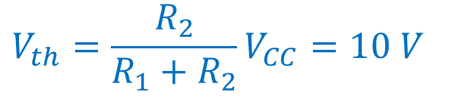



Practice Problem 3
Common Collector Amplifier Circuit
Find the values of the DC currents and voltages of the circuit. The transistor has β = 99.
Find the Thevenin equivalent circuit looking from the base of the transistor towards the bias circuit
$$90 kΩ$$
$$R_{th}=\frac{R_{1}R_{2}}{R_{1}{+ R}_{2}}$$
$$+$$
$V_{CC}$= 15 V
$$−$$
$$V_{E}$$
$$V_{out}$$
$$R_{th}=\frac{180∗90}{180+90} kΩ=60kΩ$$
$$V_{in}$$
$$+$$
$$−$$
$$180 kΩ$$
$$1.8 kΩ$$
$$V_{th}=\frac{R_{2}}{R_{1}{+ R}_{2}}V_{CC}=10 V$$

Slide 14


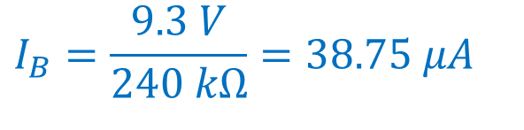








Practice Problem 3
Common Collector Amplifier Circuit
Find the values of the DC currents and voltages of the circuit. The transistor has β = 99.
Apply KVL around the base-emitter loop
Thevenin equivalent circuit
$$0=10 V −I_{B} ∗60 kΩ −0.7 V −I_{E} ∗1.8 kΩ$$
$$9.3 V=I_{B} ∗60 kΩ+I_{E} ∗1.8 kΩ$$
$$+$$
$$60 kΩ$$
Substitute the relationship between the base current and the emitter current
$V_{CC}$= 15 V
$$−$$
$$+$$
$$V_{E}$$
$$I_{E}= \left(β+1\right)I_{B}$$
$$V_{out}$$
$$10 V$$
$$−$$
$$1.8 kΩ$$
$$9.3 V=I_{B} ∗60 kΩ+100∗I_{B}∗1.8 kΩ$$
$$I_{B}=\frac{9.3 V}{240 kΩ}=38.75 μA$$

Slide 15





Practice Problem 3
Common Collector Amplifier Circuit
Find the values of the DC currents and voltages of the circuit. The transistor has β = 99.
Thevenin equivalent circuit
Find the emitter current
$$I_{E}= \left(β+1\right)I_{B}$$
$$I_{E}=3.875 mA$$
$$+$$
$$60 kΩ$$
$$I_{E}≈3.9 mA$$
$V_{CC}$= 15 V
$$−$$
$$+$$
$$V_{E}$$
$$V_{out}$$
Calculate the emitter voltage
$$10 V$$
$$−$$
$$1.8 kΩ$$
$$V_{E}=I_{E}∗1.8 kΩ$$
$$V_{E}=7.0 V$$

Slide 16

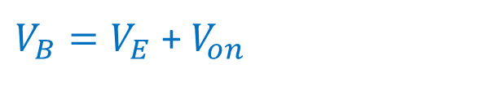
Practice Problem 3
Common Collector Amplifier Circuit
Find the values of the DC currents and voltages of the circuit. The transistor has β = 99.
Thevenin equivalent circuit
Find the base voltage
$V_{B}=V_{E}$ + $V_{on}$
$$+$$
$$60 kΩ$$
$$V_{B}=7.7 V$$
$V_{CC}$= 15 V
$$−$$
$$+$$
$$V_{E}$$
$$V_{out}$$
$$10 V$$
$$−$$
$$1.8 kΩ$$

