Slide 1
Analog Electronics Technology
BJT small signal response

Slide 2
Analog Electronics Technology
Diodes
BJT’s
BJT basics
DC Biasing
Common Emitter Amplifier Circuits
Common Base Amplifier Circuits
Common Collector Amplifier Circuits
Small Signal Analysis
Op Amps

Slide 3
What we will talk about today
Small signal analysis using DC results
Small signal models of BJT
Modification for Early Effect

Slide 4
Common Emitter Amplifier Circuit – graphical solution
I_{C}
Transistor curves
V_{cc} /R_{C}
Curves of constant base current
V_{bb} /R₁
On transistor characteristics drawing, find curve corresponding to base current
find base (diode) current
slope = -1 /R_{C}
V_{EC}
V_{cc}
load line
Choose a value for R_{c}
V_{bb}
Find quiescent (DC) operating point
Use semi-ideal diode model with load line

Slide 5














Small signal response of Common Emitter Amplifier
10 V
So far we have ignored the effects of this part of the circuit
$$R_{1}$$
$$R_{C}$$
The capacitor blocked DC signals
$$R_{S}$$
$$V_{out}$$
$$+$$
$$V_{CC}$$
$$V_{B}$$
The small signal response looks at how these signals are amplified
$$−$$
$$V_{E}$$
$$V_{in}$$
$$+$$
$$−$$
$$R_{2}$$
$$R_{E}$$

Slide 6
Easiest but not as Accurate Method:
Modify results from DC analysis

Slide 7












From Prior Lecture: Common Emitter Amplifier Circuit
V_{out} = - V_{cc} + R_{C} β ( V_{bb} - 0.7 V) / R₁
$$R_{C}$$
AC signal
$$R_{1}$$
$$V_{out}$$
$$−$$
Include v_{in} with V_{bb}
$$V_{CC}$$
$$v_{in}$$
$$+$$
$$−$$
$$+$$
$$−$$
V_{out} = - V_{cc} + R_{C} β ( [ V_{bb} + v_{in} ] - 0.7 V) / R₁
$$V_{bb}$$
$$+$$
Separate out the term with v_{in}
DC bias
V_{out} = - V_{cc} + R_{C} β ( V_{bb} - 0.7 V) / R₁ + R_{C} β v_{in} / R₁
Small signal part
DC part

Slide 8
From Prior Lecture: Common Emitter Amplifier Circuit
V_{out} = - V_{cc} + R_{C} β ( V_{bb} - 0.7 V) / R₁ + R_{C} β v_{in} / R₁
$$R_{C}$$
Small signal part
AC signal
$$R_{1}$$
DC part
$$V_{out}$$
$$−$$
$$V_{CC}$$
$$v_{in}$$
$$+$$
$$−$$
Small signal gain is the small signal output divided by the small signal input
$$+$$
$$−$$
$$V_{bb}$$
$$+$$
A_{V} = R_{C} β / R₁
DC bias
‒
Usually the small signal polarity is shown opposite of what we did
Which results in a negative sign here

Slide 9
Common Emitter
with
Emitter Resistor and Voltage Divider

Slide 10

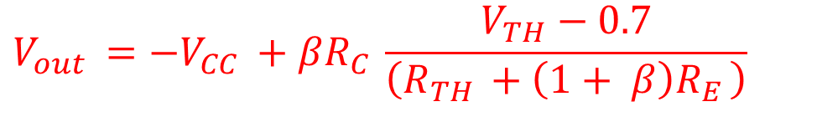













From Prior Lecture: Common Emitter Amplifier Circuit – Biasing with Voltage Divider and Emitter Resistor
$$V_{out }={−V}_{CC }+βR_{C }\frac{V_{TH}−0.7}{\left(R_{TH }+\left(1+ β\right)R_{E }\right)}$$
$$V_{th }= \frac{R_{2 }||Z_{S }}{{R_{1 }+R}_{2 }||Z_{S }}V_{CC }+ \frac{R_{1 }||R_{2 }}{Z_{S }+R_{1 }||R_{2 }}v_{in }$$
$$R_{1}$$
$$R_{C}$$
$$V_{out}$$
If Z_{s} >> R₁, R₂
$$−$$
$$V_{CC}$$
$$+$$
$$V_{th }≈V_{th, DC }$$
$$V_{in}$$
$$−$$
$$R_{2}$$
$$+$$
If Z_{s} << R₁, R₂
$$R_{E}$$
$$V_{th }≈V_{in}$$

Slide 11
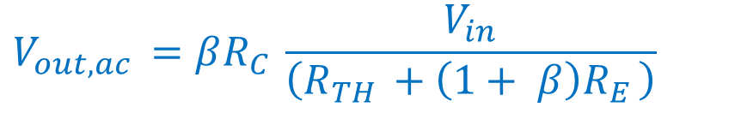
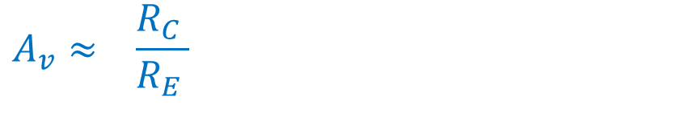
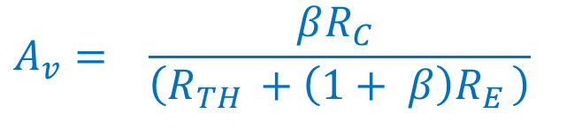
From Prior Lecture: Common Emitter Amplifier Circuit – Biasing with Voltage Divider and Emitter Resistor
$$V_{out,ac }=βR_{C }\frac{V_{in}}{\left(R_{TH }+\left(1+ β\right)R_{E }\right)}$$
$$R_{1}$$
$$R_{C}$$
$$A_{v}= \frac{βR_{C }}{\left(R_{TH }+\left(1+ β\right)R_{E }\right)}$$
‒
$$V_{out}$$
$$−$$
$$V_{CC}$$
For large β
$$+$$
$$V_{in}$$
$$−$$
$$R_{2}$$
$$+$$
$$A_{v}≈ \frac{R_{C }}{R_{E }}$$
$$R_{E}$$
‒

Slide 13
Small signal model of BJT

Slide 14
Large signal model of BJT in forward active region – diode and dependent current source
pnp BJT
npn BJT
collector
collector
base
base
I_{D}
β I_{D}
I_{D}
β I_{D}
emitter
emitter
Do you remember the small signal model of the diode?

Slide 15
Small signal model of BJT in forward active region – resistor and dependent current source
pnp BJT
npn BJT
collector
collector
base
base
I_{B}
r_{π}
β I_{B}
I_{B}
β I_{B}
r_{π}
emitter
emitter
r_{π}= V_{T} / I_{BQ}
This is the same resistance as the small signal resistance of the diode

Slide 16
Small Signal BJT Analysis
Use the large signal model of the transistor to determine biasing (quiescent point)
r_{π}= V_{T} / I_{BQ}
Use the small signal model of the transistor to determine response to small inputs

Slide 17
This model works well for the common base biased transistor.
For the common emitter BJT, we need to modify the model to improve accuracy.

Slide 18
Common Emitter Amplifier Operating Curves
I_{C}
Slope of line = 1/(output resistance)
I_{B8}
I_{B7}
I_{B6}
I_{B5}
Curves of constant base current
I_{B4}
I_{B3}
I_{B2}
I_{B1}
V_{EC}

Slide 19
Common Emitter Amplifier – Early Effect
I_{B7}
I_{C}
I_{B6}
I_{B5}
I_{B4}
I_{B3}
I_{B2}
I_{B1}
- V_{A}
V_{EC}
For a common emitter BJT operating in the forward active region, the linear portion of the curve has a non-zero slope (exaggerated here for clarity).
The extrapolated lines all converge at a common point on the negative voltage axis as shown.

Slide 20
Common Emitter Amplifier – Early Effect
I_{C}
- V_{A}
V_{EC}
This phenomenon is called the Early effect, named after the person who first analyzed it.
V_{A} is called the Early voltage

Slide 21
Bipolar Junction Transistor (BJT)
space charge region
space charge region
p⁺-type
n-type
p-type
Base
Emitter
Collector
As V_{CE} grows and the base collector junction gets more reverse biased, the space charge region grows making the base shrink.
A smaller base gives less opportunity for recombination in the base, so the efficiency of the transistor is increased.

Slide 22
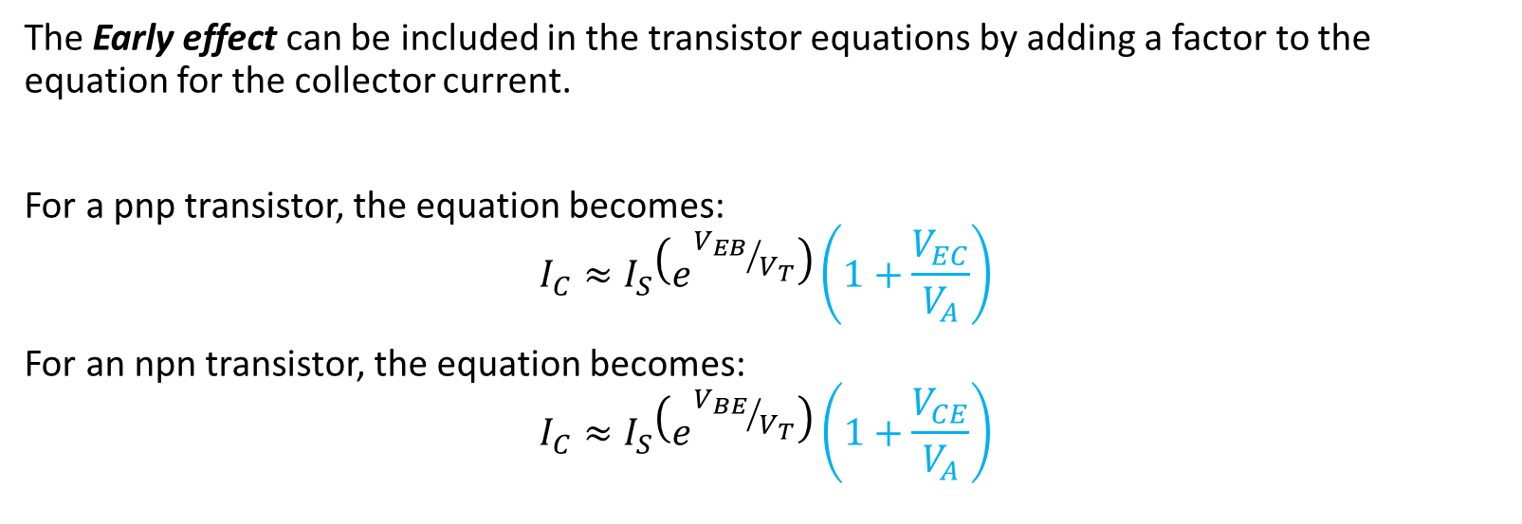
Common Emitter Amplifier – Early Effect
The Early effect can be included in the transistor equations by adding a factor to the equation for the collector current.
For a pnp transistor, the equation becomes:
$$I_{C}≈I_{S}\left(e^{{V_{EB}}/{V_{T}}}\right)\left(1+\frac{V_{EC}}{V_{A}}\right)$$
For an npn transistor, the equation becomes:
$$I_{C}≈I_{S}\left(e^{{V_{BE}}/{V_{T}}}\right)\left(1+\frac{V_{CE}}{V_{A}}\right)$$
Added factor for the Early effect.
Early voltages are typically between 50 V and 100 V.
The slope of the line is the reciprocal of the output impedance of the common emitter amplifier.
r_{o} = V_{A} / I_{C0}

Slide 23
Adjusted small signal model of common emitter BJT in forward active region
pnp BJT
npn BJT
collector
collector
base
base
I_{B}
β I_{B}
I_{B}
r_{π}
r_{o}
r_{π}
β I_{B}
r_{o}
emitter
emitter
r_{π}= V_{T} / I_{BQ}
r_{o}= V_{A} / I_{CQ}

Slide 24
Equivalent model of common emitter BJT in forward active region
Intrinsic capacitance can be added for high frequency analysis
g_{m} r_{π} = β
pnp BJT
collector
npn BJT
collector
base
base
-
+
I_{B}
V_{π}
g_{m} V_{π}
V_{π}
r_{π}
r_{o}
I_{B}
r_{π}
g_{m} V_{π}
r_{o}
+
-
emitter
emitter
transconductance
r_{π}= V_{T} / I_{BQ}
r_{o}= V_{A} / I_{CQ}

Slide 26
From Before: Common Emitter Amplifier Circuit
$$R_{C}$$
$$R_{1}$$
A_{V} = R_{C} β / R₁
AC signal
$$V_{out}$$
‒
$$−$$
$$V_{CC}$$
$$v_{in}$$
More accurate results using small signal model
$$+$$
$$−$$
$$+$$
$$−$$
$$V_{bb}$$
$$+$$
A_{V} = ‒ (R_{C} || r_{o} ) β / (R₁ + r_{π} )
DC bias
If r_{π} << R₁ and R_{C} << r_{o} then this is equivalent to the former result

Slide 27
From Prior Lecture: Common Emitter Amplifier Circuit – Biasing with Voltage Divider and Emitter Resistor
Next time we will use the small signal model of the transistor to analyze the common emitter amplifier with voltage divider biasing and with an emitter resistor.
$$R_{1}$$
$$R_{C}$$
$$V_{out}$$
$$−$$
$$V_{CC}$$
$$+$$
$$V_{in}$$
$$−$$
$$R_{2}$$
$$+$$
$$R_{E}$$

