Slide 1
Analog Electronics Technology
BJT small signal response

Slide 2
Analog Electronics Technology
Diodes
BJT’s
BJT basics
DC Biasing
Small Signal Analysis
Small Signal Model
Common Emitter Amplifier Circuits
Common Base Amplifier Circuits
Common Collector Amplifier Circuits
Op Amps

Slide 3
What we will talk about today
Small signal response of common emitter amplifier with resistive ladder biasing and emitter resistor.

Slide 4
Adjusted small signal model of common emitter BJT in forward active region
pnp BJT
npn BJT
collector
collector
base
base
I_{B}
β I_{B}
I_{B}
r_{π}
r_{o}
r_{π}
β I_{B}
r_{o}
emitter
emitter
Last time we added an output resistor

Slide 5
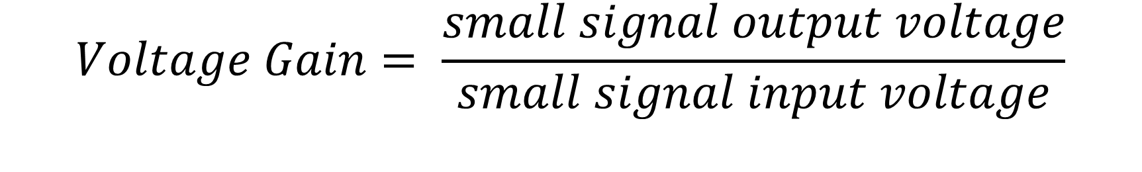
Determine the small signal gain of the common emitter BJT
$$Voltage Gain= \frac{small signal output voltage}{small signal input voltage}$$

Slide 6














Small signal response of Common Emitter Amplifier
$$R_{1}$$
$$R_{C}$$
$$R_{S}$$
$$V_{out}$$
$$+$$
$$V_{CC}$$
$$V_{B}$$
$$−$$
$$V_{E}$$
$$V_{in}$$
$$+$$
$$−$$
$$R_{2}$$
$$R_{E}$$

Slide 7











Small signal response of Common Emitter Amplifier
Substitute in the small signal model
$$R_{C}$$
$$R_{1}$$
collector
$$V_{out}$$
$$R_{S}$$
$$+$$
base
I_{B}
β I_{B}
$$V_{CC}$$
$$V_{B}$$
r_{o}
$$−$$
$$r_{π}$$
$$V_{E}$$
$$V_{in}$$
$$+$$
$$R_{2}$$
emitter
$$−$$
$$R_{E}$$

Slide 8
Small signal response of Common Emitter Amplifier
For the small signal analysis we short out all independent voltage sources.
$$R_{C}$$
$$R_{1}$$
collector
$$V_{out}$$
$$R_{S}$$
$$+$$
base
I_{B}
β I_{B}
$$V_{CC}$$
$$V_{B}$$
r_{o}
$$−$$
$$r_{π}$$
$$V_{E}$$
$$V_{in}$$
$$+$$
$$R_{2}$$
emitter
$$−$$
$$R_{E}$$

Slide 9












Small signal response of Common Emitter Amplifier
Rearrange to make an equivalent circuit
$$V_{out}$$
$$R_{S}$$
collector
$$V_{B}$$
base
β I_{B}
$$r_{π}$$
r_{o}
I_{B}
$$V_{E}$$
$$R_{C}$$
$$V_{in}$$
$$+$$
$$R_{2}$$
$$R_{1}$$
emitter
$$−$$
$$R_{E}$$

Slide 10


Small signal response of Common Emitter Amplifier
We assume that the capacitor that was used was large enough that no attenuation occurs at the frequencies of interest. Replace it with a wire.
$$V_{out}$$
$$R_{S}$$
collector
$$V_{B}$$
base
β I_{B}
$$r_{π}$$
r_{o}
I_{B}
$$V_{E}$$
$$R_{C}$$
$$V_{in}$$
$$+$$
$${R_{1}||R}_{2}$$
emitter
$$−$$
$$R_{E}$$
Replace the parallel resistors R₁ and R₂ with a single resistor of equivalent resistance

Slide 11






Small signal response of Common Emitter Amplifier
Label the current around each loop
$$V_{out}$$
$$R_{S}$$
collector
$$V_{B}$$
base
β I_{B}
$$i_{2}$$
$$i_{3}$$
r_{o}
$$i_{1}$$
$$r_{π}$$
I_{B}
$$i_{B}$$
$$V_{E}$$
$${R_{1}||R}_{2}$$
$$R_{C}$$
$$V_{in}$$
$$+$$
emitter
$$−$$
$$R_{E}$$
$$i_{4}$$
Recognize that i₂ is the same as I_{B}
Recognize that i₃ is - β I_{B}

Slide 12


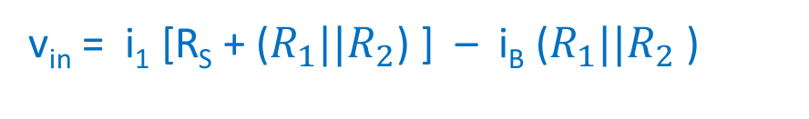




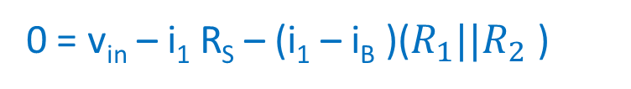









Small signal response of Common Emitter Amplifier
Apply KVL around loop 1
$$R_{S}$$
collector
$$V_{out}$$
$$V_{B}$$
base
β I_{B}
$$i_{3}$$
r_{o}
$$i_{1}$$
$$i_{B}$$
$$r_{π}$$
I_{B}
$$V_{E}$$
$${R_{1}||R}_{2}$$
$$R_{C}$$
$$V_{in}$$
$$+$$
emitter
$$−$$
$$R_{E}$$
$$i_{4}$$
0 = v_{in} – i₁ R_{S} – (i₁ – i_{B} )(${R_{1}||R}_{2}$ )
v_{in} = i₁ [R_{S} + (${R_{1}||R}_{2}$) ] – i_{B} (${R_{1}||R}_{2}$ )

Slide 13
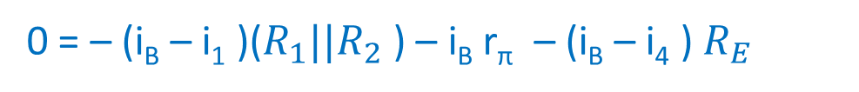
Small signal response of Common Emitter Amplifier
Apply KVL around loop 2 (labelled current i_{B})
$$R_{S}$$
collector
$$V_{out}$$
$$V_{B}$$
base
β I_{B}
$$i_{3}$$
r_{o}
$$i_{1}$$
$$i_{B}$$
$$r_{π}$$
I_{B}
$$V_{E}$$
$${R_{1}||R}_{2}$$
$$R_{C}$$
$$V_{in}$$
$$+$$
emitter
$$−$$
$$R_{E}$$
$$i_{4}$$
0 = – (i_{B} – i₁ )(${R_{1}||R}_{2}$ ) – i_{B} r_{π} – (i_{B} – i₄ ) $R_{E}$
0 = – (i_{B})[ (${R_{1}||R}_{2}$ ) + r_{π} + $R_{E}$ ] + (i₁) (${R_{1}||R}_{2}$ ) ${\text{+ (}\text{i}\text{4}\text{ )}R}_{E}$

Slide 14


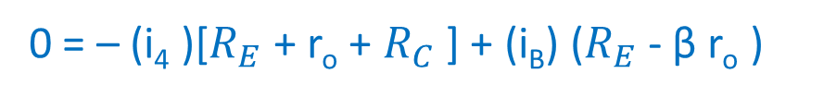




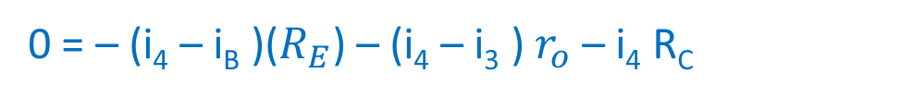

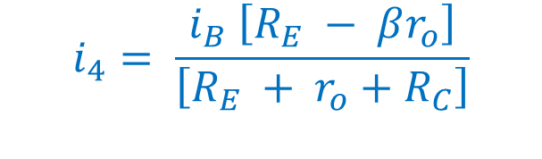





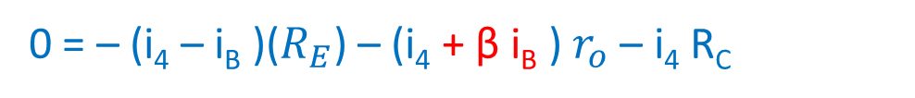



Small signal response of Common Emitter Amplifier
Apply KVL around loop 4
$$R_{S}$$
collector
$$V_{out}$$
$$V_{B}$$
base
β I_{B}
$$i_{3}$$
r_{o}
$$i_{1}$$
$$i_{B}$$
$$r_{π}$$
I_{B}
$$V_{E}$$
$${R_{1}||R}_{2}$$
$$R_{C}$$
$$V_{in}$$
$$+$$
emitter
$$−$$
$$R_{E}$$
$$i_{4}$$
0 = – (i₄ – i_{B} )($R_{E}$) – (i₄ – i₃ ) $r_{o}$ – i₄ R_{C}
i₃ = –β i_{B}
0 = – (i₄ – i_{B} )($R_{E}$) – (i₄ + β i_{B} ) $r_{o}$ – i₄ R_{C}
$$i_{4}= \frac{i_{B} \left[R_{E} − βr_{o}\right]}{\left[R_{E} + r_{o}+R_{C}\right]}$$
0 = – ($\text{i}\text{4}$)[$R_{E}$ + r_{o} + $R_{C}$ ] + (i_{B}) ($R_{E}$ - β r_{o} )
We now have three equations with three unknowns

Slide 15

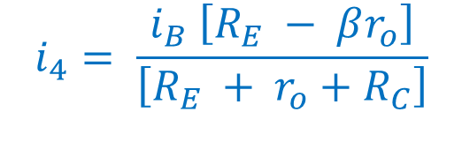
Small signal response of Common Emitter Amplifier
Our three equations:
$$R_{S}$$
collector
$$V_{out}$$
$$V_{B}$$
base
β I_{B}
$$i_{3}$$
r_{o}
$$i_{1}$$
$$i_{B}$$
$$r_{π}$$
I_{B}
$$V_{E}$$
$${R_{1}||R}_{2}$$
$$R_{C}$$
$$V_{in}$$
$$+$$
emitter
$$−$$
$$R_{E}$$
$$i_{4}$$
From loop 1:
From loops 3&4:
v_{in} = i₁ [R_{S} + (${R_{1}||R}_{2}$) ] – i_{B} (${R_{1}||R}_{2}$ )
$$i_{4}= \frac{i_{B} \left[R_{E} − βr_{o}\right]}{\left[R_{E} + r_{o}+R_{C}\right]}$$
From loop 2:
0 = – (i_{B})[ (${R_{1}||R}_{2}$ ) + r_{π} + $R_{E}$ ] + (i₁) (${R_{1}||R}_{2}$ ) ${\text{+ (}\text{i}\text{4}\text{ )}R}_{E}$

Slide 16
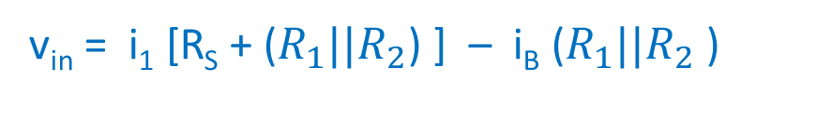
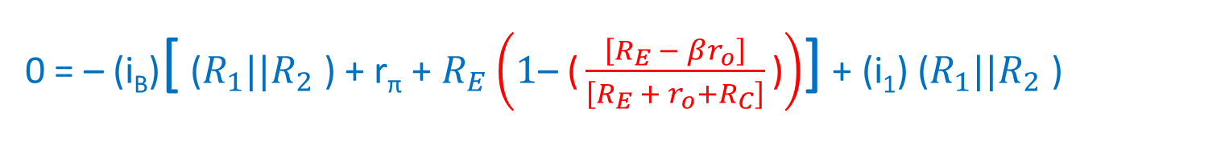
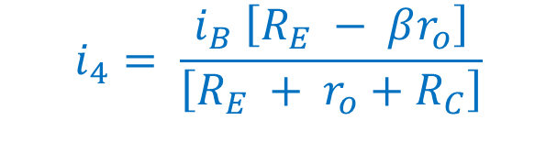
Small signal response of Common Emitter Amplifier
v_{in} = i₁ [R_{S} + (${R_{1}||R}_{2}$) ] – i_{B} (${R_{1}||R}_{2}$ )
$$i_{4}= \frac{i_{B} \left[R_{E} − βr_{o}\right]}{\left[R_{E} + r_{o}+R_{C}\right]}$$
0 = – (i_{B})[ (${R_{1}||R}_{2}$ ) + r_{π} + $R_{E}$ ] + (i₁) (${R_{1}||R}_{2}$ ) ${\text{+ (}\text{i}\text{4}\text{ )}R}_{E}$
0 = – (i_{B})[ (${R_{1}||R}_{2}$ ) + r_{π} + $R_{E}$ ] + (i₁) (${R_{1}||R}_{2}$ ) ${\text{+ (}\frac{i_{B} \left[R_{E} − βr_{o}\right]}{\left[R_{E} + r_{o}+R_{C}\right]}\text{)}R}_{E}$
Two equations with two unknowns
0 = – (i_{B})[ (${R_{1}||R}_{2}$ ) + r_{π} + $R_{E}$ ${\text{–} \text{(}\frac{\left[R_{E} − βr_{o}\right]}{\left[R_{E} + r_{o}+R_{C}\right]}\text{)}R}_{E}$] + (i₁) (${R_{1}||R}_{2}$ )
0 = – (i_{B})[ (${R_{1}||R}_{2}$ ) + r_{π} + $R_{E}\left(1\text{– }\text{(}\frac{\left[R_{E} − βr_{o}\right]}{\left[R_{E} + r_{o}+R_{C}\right]}\text{)}\right)$] + (i₁) (${R_{1}||R}_{2}$ )

Slide 17
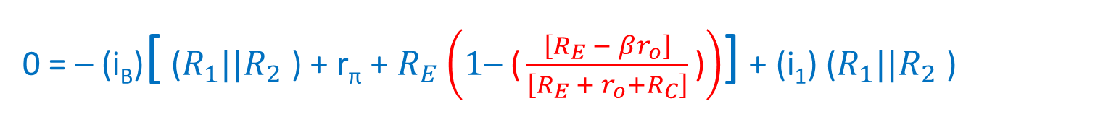
Small signal response of Common Emitter Amplifier
v_{in} = i₁ [R_{S} + (${R_{1}||R}_{2}$) ] – i_{B} (${R_{1}||R}_{2}$ )
0 = – (i_{B})[ (${R_{1}||R}_{2}$ ) + r_{π} + $R_{E}\left(1\text{– }\text{(}\frac{\left[R_{E} − βr_{o}\right]}{\left[R_{E} + r_{o}+R_{C}\right]}\text{)}\right)$] + (i₁) (${R_{1}||R}_{2}$ )
Solve the bottom equation for i₁
$$i_{1}=\frac{i_{b}}{\left(R_{1}∥R_{2}\right)}\left[\left(R_{1} ∥ R_{2}\right)+r_{π}+R_{E}\left(1\text{– }\text{(}\frac{\left[R_{E} − βr_{o}\right]}{\left[R_{E} + r_{o}+R_{C}\right]}\text{)}\right)\right]$$
Substitute into the top equation
$$v_{in}=\frac{i_{b}}{\left(R_{1}∥R_{2}\right)}\left[\left(R_{1}∥R_{2}\right)+r_{π}+R_{E}\left(1\text{– (}\frac{\left[R_{E} − βr_{o}\right]}{\left[R_{E} + r_{o}+R_{C}\right]}\text{)}\right)\right] \left[R_{s}+\left(R_{1}∥R_{2}\right)\right] −i_{b}\left(R_{1}∥R_{2}\right)$$

Slide 18
Small signal response of Common Emitter Amplifier
$$v_{in}=\frac{i_{b}}{\left(R_{1}∥R_{2}\right)}\left[\left(R_{1}∥R_{2}\right)+r_{π}+R_{E}\left(1\text{– (}\frac{\left[R_{E} − βr_{o}\right]}{\left[R_{E} + r_{o}+R_{C}\right]}\text{)}\right)\right] \left[R_{s}+\left(R_{1}∥R_{2}\right)\right] −i_{b}\left(R_{1}∥R_{2}\right)$$
Factor out i_{B} and rearrange
$$v_{in}=i_{b}\left\{\frac{\left[R_{s}+\left(R_{1}∥R_{2}\right)\right]}{\left(R_{1}∥R_{2}\right)}\left[\left(R_{1}∥R_{2}\right)+r_{π}+R_{E}\left(1\text{– (}\frac{\left[R_{E} − βr_{o}\right]}{\left[R_{E} + r_{o}+R_{C}\right]}\text{)}\right)\right] −\left(R_{1}∥R_{2}\right)\right\}$$
$$i_{b}=\frac{v_{in}}{\left\{\frac{\left[R_{s}+\left(R_{1}∥R_{2}\right)\right]}{\left(R_{1}∥R_{2}\right)}\left[\left(R_{1}∥R_{2}\right)+r_{π}+R_{E}\left(1\text{– (}\frac{\left[R_{E} − βr_{o}\right]}{\left[R_{E} + r_{o}+R_{C}\right]}\text{)}\right)\right] −\left(R_{1}∥R_{2}\right)\right\}}$$

Slide 19
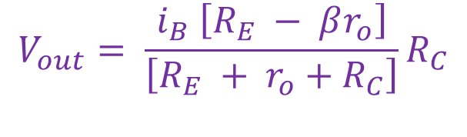
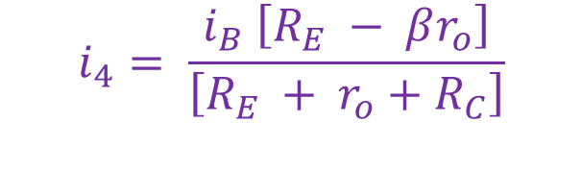
Small signal response of Common Emitter Amplifier
$$R_{S}$$
collector
$$V_{out}$$
$$V_{B}$$
base
β I_{B}
$$i_{3}$$
r_{o}
$$i_{1}$$
$$i_{B}$$
$$r_{π}$$
I_{B}
$$V_{E}$$
$${R_{1}||R}_{2}$$
$$R_{C}$$
$$V_{in}$$
$$+$$
emitter
$$−$$
$$R_{E}$$
$$i_{4}$$
From before:
We could now use substitution to solve for all of the currents
$$i_{4}= \frac{i_{B} \left[R_{E} − βr_{o}\right]}{\left[R_{E} + r_{o}+R_{C}\right]}$$
What we really want to determine is the output voltage
$$V_{out}= \frac{i_{B} \left[R_{E} − βr_{o}\right]}{\left[R_{E} + r_{o}+R_{C}\right]}R_{C}$$
V_{out} = i₄ R_{c}

Slide 20
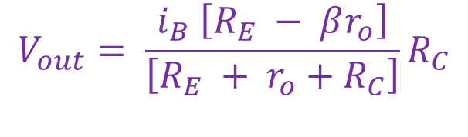
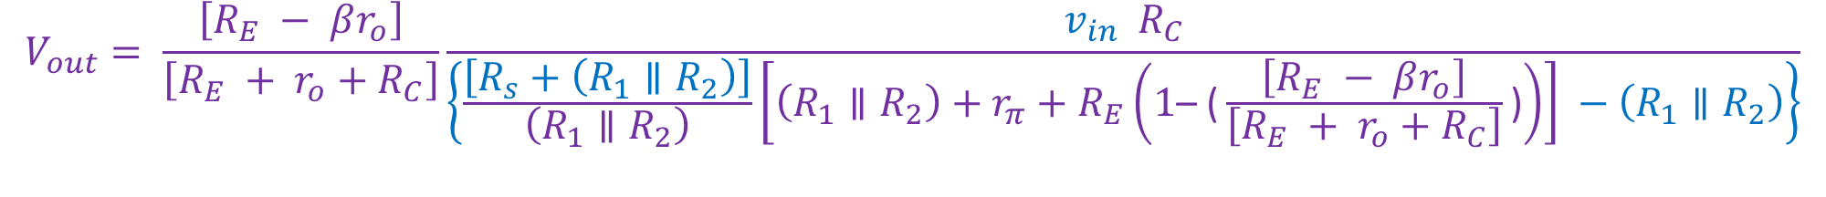
Small signal response of Common Emitter Amplifier
$$V_{out}= \frac{i_{B} \left[R_{E} − βr_{o}\right]}{\left[R_{E} + r_{o}+R_{C}\right]}R_{C}$$
$$i_{b}=\frac{v_{in}}{\left\{\frac{\left[R_{s}+\left(R_{1}∥R_{2}\right)\right]}{\left(R_{1}∥R_{2}\right)}\left[\left(R_{1}∥R_{2}\right)+r_{π}+R_{E}\left(1\text{– (}\frac{\left[R_{E} − βr_{o}\right]}{\left[R_{E} + r_{o}+R_{C}\right]}\text{)}\right)\right] −\left(R_{1}∥R_{2}\right)\right\}}$$
$$V_{out}= \frac{\left[R_{E} − βr_{o}\right]}{\left[R_{E} + r_{o}+R_{C}\right]}\frac{v_{in}{ R}_{C}}{\left\{\frac{\left[R_{s}+\left(R_{1}∥R_{2}\right)\right]}{\left(R_{1}∥R_{2}\right)}\left[\left(R_{1}∥R_{2}\right)+r_{π}+R_{E}\left(1\text{– (}\frac{\left[R_{E} − βr_{o}\right]}{\left[R_{E} + r_{o}+R_{C}\right]}\text{)}\right)\right] −\left(R_{1}∥R_{2}\right)\right\}}$$

Slide 21
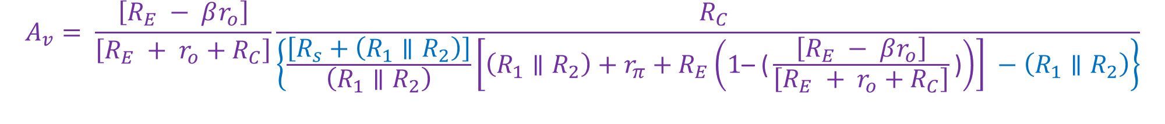

Small signal response of Common Emitter Amplifier
$$A_{v}= \frac{V_{out}}{V_{in}}$$
Voltage gain
$$A_{v}= \frac{\left[R_{E} − βr_{o}\right]}{\left[R_{E} + r_{o}+R_{C}\right]}\frac{{ R}_{C}}{\left\{\frac{\left[R_{s}+\left(R_{1}∥R_{2}\right)\right]}{\left(R_{1}∥R_{2}\right)}\left[\left(R_{1}∥R_{2}\right)+r_{π}+R_{E}\left(1\text{– (}\frac{\left[R_{E} − βr_{o}\right]}{\left[R_{E} + r_{o}+R_{C}\right]}\text{)}\right)\right] −\left(R_{1}∥R_{2}\right)\right\}}$$
We can look at approximations for various conditions

Slide 22
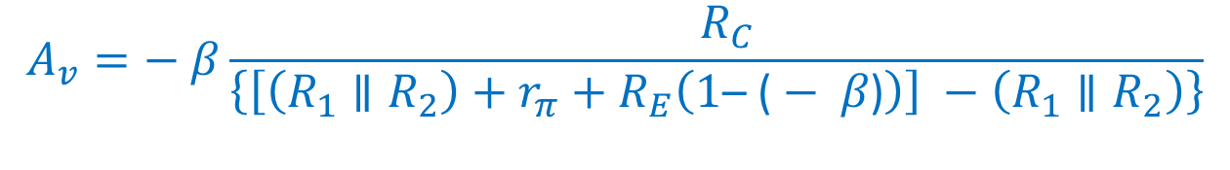
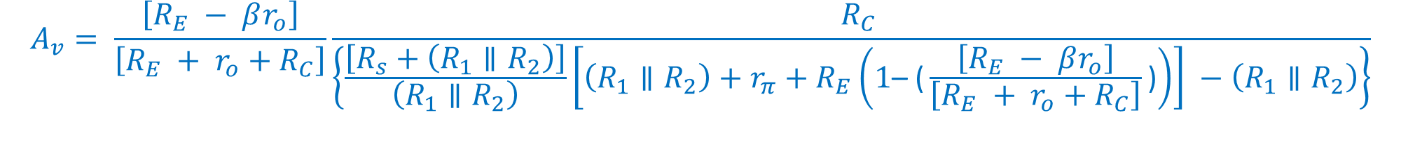
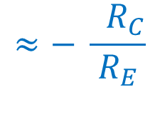
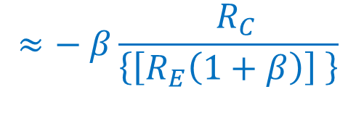
Small signal response of Common Emitter Amplifier
What happens if the source resistance is very small?
What happens if the output resistance is very large?
$$A_{v}= \frac{\left[R_{E} − βr_{o}\right]}{\left[R_{E} + r_{o}+R_{C}\right]}\frac{{ R}_{C}}{\left\{\frac{\left[R_{s}+\left(R_{1}∥R_{2}\right)\right]}{\left(R_{1}∥R_{2}\right)}\left[\left(R_{1}∥R_{2}\right)+r_{π}+R_{E}\left(1\text{– (}\frac{\left[R_{E} − βr_{o}\right]}{\left[R_{E} + r_{o}+R_{C}\right]}\text{)}\right)\right] −\left(R_{1}∥R_{2}\right)\right\}}$$
= ‒ β
= 1
= ‒ β
$$A_{v}=− β\frac{{ R}_{C}}{\left\{\left[\left(R_{1}∥R_{2}\right)+r_{π}+R_{E}\left(1\text{– (}− β\text{)}\right)\right] −\left(R_{1}∥R_{2}\right)\right\}}$$
$$≈− β\frac{{ R}_{C}}{\left\{\left[R_{E}\left(1+β\right)\right] \right\}}$$
$$≈− \frac{{ R}_{C}}{R_{E}}$$
If β is very large and r_{π} is small

Slide 24
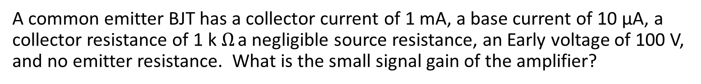

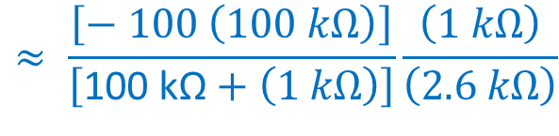
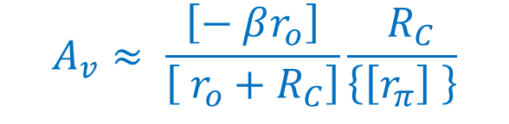
Example 1
A common emitter BJT has a collector current of 1 mA, a base current of 10 μA, a collector resistance of 1 k $Ω$ a negligible source resistance, an Early voltage of 100 V, and no emitter resistance. What is the small signal gain of the amplifier?
$$A_{v}= \frac{\left[R_{E} − βr_{o}\right]}{\left[R_{E} + r_{o}+R_{C}\right]}\frac{{ R}_{C}}{\left\{\frac{\left[R_{s}+\left(R_{1}∥R_{2}\right)\right]}{\left(R_{1}∥R_{2}\right)}\left[\left(R_{1}∥R_{2}\right)+r_{π}+R_{E}\left(1\text{– (}\frac{\left[R_{E} − βr_{o}\right]}{\left[R_{E} + r_{o}+R_{C}\right]}\text{)}\right)\right] −\left(R_{1}∥R_{2}\right)\right\}}$$
$$A_{v}≈ \frac{\left[− βr_{o}\right]}{\left[ r_{o}+R_{C}\right]}\frac{{ R}_{C}}{\left\{\left[r_{π}\right] \right\}}$$
$$≈ \frac{\left[− 100 \left(100 kΩ\right)\right]}{\left[\text{100 }\text{k}\text{Ω}+\left(1 kΩ\right)\right]}\frac{\left(1 kΩ\right)}{\left(2.6 kΩ\right)}$$
$$≈−38$$
r_{π} = V_{T} / I_{BQ} = 0.026 V / 10 μA = 2.6 kΩ
r_{o}= V_{A} / I_{CQ} = 100 V/ 1 mA = 100 kΩ
β= I_{CQ} / I_{BQ} = 1 mA / 0.01 mA = 100

Slide 25
A 500 Ω emitter resistor is added to the previous amplifier. Now what is the gain?

Slide 26
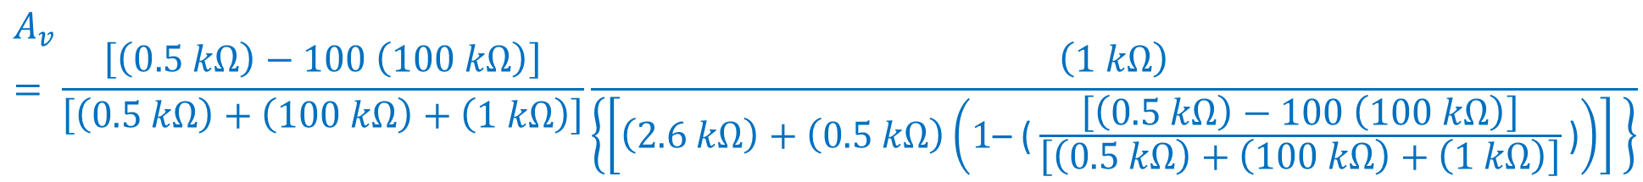
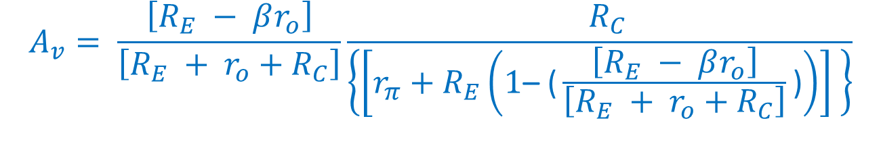

Example 2
r_{π} = V_{T} / I_{BQ} = 2.6 kΩ
r_{o}= V_{A} / I_{CQ} = 100 kΩ
β= I_{CQ} / I_{BQ} = 100
A common emitter BJT has a collector current of 1 mA, a base current of 10 μA, a collector resistance of 1 k $Ω$ a negligible source resistance, an Early voltage of 100 V, and no emitter resistance. What is the small signal gain of the amplifier?
R_{E} = 500 Ω
$$A_{v}= \frac{\left[R_{E} − βr_{o}\right]}{\left[R_{E} + r_{o}+R_{C}\right]}\frac{{ R}_{C}}{\left\{\frac{\left[R_{s}+\left(R_{1}∥R_{2}\right)\right]}{\left(R_{1}∥R_{2}\right)}\left[\left(R_{1}∥R_{2}\right)+r_{π}+R_{E}\left(1\text{– (}\frac{\left[R_{E} − βr_{o}\right]}{\left[R_{E} + r_{o}+R_{C}\right]}\text{)}\right)\right] −\left(R_{1}∥R_{2}\right)\right\}}$$
$$A_{v}= \frac{\left[R_{E} − βr_{o}\right]}{\left[R_{E} + r_{o}+R_{C}\right]}\frac{{ R}_{C}}{\left\{\left[r_{π}+R_{E}\left(1\text{– (}\frac{\left[R_{E} − βr_{o}\right]}{\left[R_{E} + r_{o}+R_{C}\right]}\text{)}\right)\right] \right\}}$$
$$A_{v}= \frac{\left[\left(0.5 kΩ\right)−100 \left(100 kΩ\right)\right]}{\left[\left(0.5 kΩ\right)+\left(100 kΩ\right)+\left(1 kΩ\right)\right]}\frac{\left(1 kΩ\right)}{\left\{\left[\left(2.6 kΩ\right)+\left(0.5 kΩ\right)\left(1\text{– (}\frac{\left[\left(0.5 kΩ\right)−100 \left(100 kΩ\right)\right]}{\left[\left(0.5 kΩ\right)+\left(100 kΩ\right)+\left(1 kΩ\right)\right]}\text{)}\right)\right] \right\}}$$
$$≈−1.88$$

Slide 27
Example 2
r_{π} = V_{T} / I_{BQ} = 2.6 kΩ
r_{o}= V_{A} / I_{CQ} = 100 kΩ
β= I_{CQ} / I_{BQ} = 100
A common emitter BJT has a collector current of 1 mA, a base current of 10 μA, a collector resistance of 1 k $Ω$ a negligible source resistance, an Early voltage of 100 V, and no emitter resistance. What is the small signal gain of the amplifier?
R_{E} = 500 Ω
Our simple model said that the gain should be -2
$$A_{v}= \frac{\left[R_{E} − βr_{o}\right]}{\left[R_{E} + r_{o}+R_{C}\right]}\frac{{ R}_{C}}{\left\{\left[r_{π}+R_{E}\left(1\text{– (}\frac{\left[R_{E} − βr_{o}\right]}{\left[R_{E} + r_{o}+R_{C}\right]}\text{)}\right)\right] \right\}}$$
$$A_{v}=−98.5 \frac{\left(1 kΩ\right)}{\left\{\left[\left(2.6 kΩ\right)+\left(0.5 kΩ\right)\left(1\text{– (}−98.5\text{)}\right)\right] \right\}}=−98.5 \frac{\left(1 kΩ\right)}{\left\{\left[\left(2.6 kΩ\right)+\left(49.8 kΩ\right)\right] \right\}}$$
Output resistance
Junction resistance
$$≈−1.88$$

