Slide 1
Analog Electronics Technology
BJT small signal response
Common Collector & Common Base

Slide 2
Analog Electronics Technology
Diodes
BJT’s
BJT basics
DC Biasing
Small Signal Analysis
Common Emitter Amplifier Circuits
Common Base Amplifier Circuits
Common Collector Amplifier Circuits
Op Amps
Last time

Slide 3















Small signal response of Common Emitter Amplifier
Collector
$$R_{1}$$
$$R_{C}$$
$$=0$$
$$R_{S}$$
$$V_{out}$$
$$+$$
$$V_{CC}$$
$$−$$
$$V_{B}$$
$$V_{E}$$
$$V_{in}$$
$$+$$
$$−$$
$$R_{2}$$
$$R_{E}$$

Slide 4


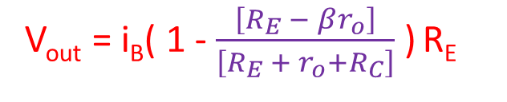



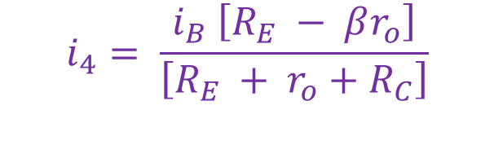










Small signal response of Common Emitter Amplifier
Collector
$$R_{S}$$
collector
$$V_{out}$$
$$V_{B}$$
base
β I_{B}
$$i_{3}$$
r_{o}
$$i_{1}$$
$$i_{B}$$
$$r_{π}$$
I_{B}
$$V_{E}$$
R_{C} = 0
$${R_{1}||R}_{2}$$
$$R_{C}$$
$$V_{in}$$
$$+$$
emitter
$$−$$
$$R_{E}$$
$$i_{4}$$
From before:
$$i_{4}= \frac{i_{B} \left[R_{E} − βr_{o}\right]}{\left[R_{E} + r_{o}+R_{C}\right]}$$
The mesh equations are the same as for the common emitter.
The only thing different is the output
V_{out} = ( i_{B} - i₄ ) R_{E}
V_{out} = i_{B}( 1 - $\frac{\left[R_{E} − βr_{o}\right]}{\left[R_{E} + r_{o}+R_{C}\right]}$ ) R_{E}

Slide 5
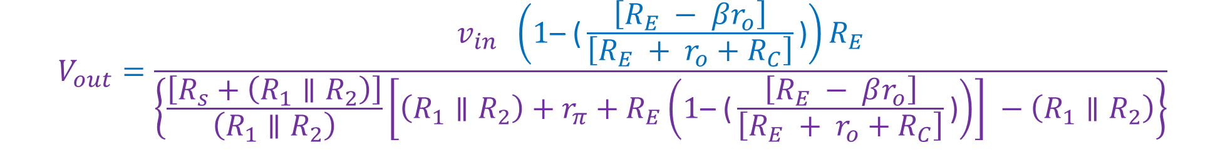
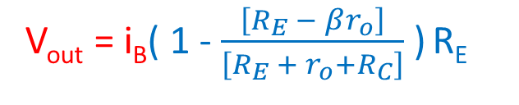
Small signal response of Common Emitter Amplifier
Collector
$$R_{S}$$
collector
$$V_{out}$$
$$V_{B}$$
base
β I_{B}
$$i_{3}$$
r_{o}
$$i_{1}$$
$$i_{B}$$
$$r_{π}$$
I_{B}
$$V_{E}$$
$${R_{1}||R}_{2}$$
$$R_{C}$$
$$V_{in}$$
$$+$$
emitter
$$−$$
$$R_{E}$$
$$i_{4}$$
V_{out} = i_{B}( 1 - $\frac{\left[R_{E} − βr_{o}\right]}{\left[R_{E} + r_{o}+R_{C}\right]}$ ) R_{E}
Using i_{B} from before:
$$V_{out}=\frac{v_{in} \left(1\text{– (}\frac{\left[R_{E} − βr_{o}\right]}{\left[R_{E} + r_{o}+R_{C}\right]}\text{)}\right)R_{E}}{\left\{\frac{\left[R_{s}+\left(R_{1}∥R_{2}\right)\right]}{\left(R_{1}∥R_{2}\right)}\left[\left(R_{1}∥R_{2}\right)+r_{π}+R_{E}\left(1\text{– (}\frac{\left[R_{E} − βr_{o}\right]}{\left[R_{E} + r_{o}+R_{C}\right]}\text{)}\right)\right] −\left(R_{1}∥R_{2}\right)\right\}}$$

Slide 6

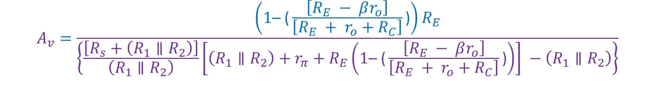


Small signal response of Common Emitter Amplifier
Collector
What happens if the source resistance is very small?
= ‒ β
What happens if the output resistance is very large?
$$A_{v}=\frac{\left(1\text{– (}\frac{\left[R_{E} − βr_{o}\right]}{\left[R_{E} + r_{o}+R_{C}\right]}\text{)}\right)R_{E}}{\left\{\frac{\left[R_{s}+\left(R_{1}∥R_{2}\right)\right]}{\left(R_{1}∥R_{2}\right)}\left[\left(R_{1}∥R_{2}\right)+r_{π}+R_{E}\left(1\text{– (}\frac{\left[R_{E} − βr_{o}\right]}{\left[R_{E} + r_{o}+R_{C}\right]}\text{)}\right)\right] −\left(R_{1}∥R_{2}\right)\right\}}$$
= 1
= ‒ β
$$A_{v}=\frac{\left(1+β \right)R_{E}}{\left\{\left[r_{π}+R_{E}\left(1+β \right)\right] \right\}}$$
Usually $A_{v}≈1$
$$A_{v}≤1$$

Slide 7
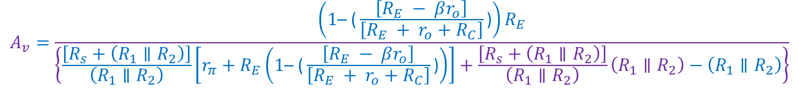
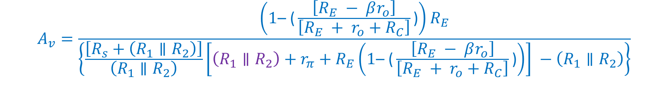

Small signal response of Common Emitter Amplifier
Collector
$$A_{v}=\frac{\left(1\text{– (}\frac{\left[R_{E} − βr_{o}\right]}{\left[R_{E} + r_{o}+R_{C}\right]}\text{)}\right)R_{E}}{\left\{\frac{\left[R_{s}+\left(R_{1}∥R_{2}\right)\right]}{\left(R_{1}∥R_{2}\right)}\left[\left(R_{1}∥R_{2}\right)+r_{π}+R_{E}\left(1\text{– (}\frac{\left[R_{E} − βr_{o}\right]}{\left[R_{E} + r_{o}+R_{C}\right]}\text{)}\right)\right] −\left(R_{1}∥R_{2}\right)\right\}}$$
Bring R₁ || R₂ outside of the square brackets
$$A_{v}=\frac{\left(1\text{– (}\frac{\left[R_{E} − βr_{o}\right]}{\left[R_{E} + r_{o}+R_{C}\right]}\text{)}\right)R_{E}}{\left\{\frac{\left[R_{s}+\left(R_{1}∥R_{2}\right)\right]}{\left(R_{1}∥R_{2}\right)}\left[r_{π}+R_{E}\left(1\text{– (}\frac{\left[R_{E} − βr_{o}\right]}{\left[R_{E} + r_{o}+R_{C}\right]}\text{)}\right)\right]+\frac{\left[R_{s}+\left(R_{1}∥R_{2}\right)\right]}{\left(R_{1}∥R_{2}\right)}\left(R_{1}∥R_{2}\right)−\left(R_{1}∥R_{2}\right)\right\}}$$
$$A_{v}=\frac{\left(1\text{– (}\frac{\left[R_{E} − βr_{o}\right]}{\left[R_{E} + r_{o}+R_{C}\right]}\text{)}\right)R_{E}}{\left\{\frac{\left[R_{s}+\left(R_{1}∥R_{2}\right)\right]}{\left(R_{1}∥R_{2}\right)}\left[r_{π}+R_{E}\left(1\text{– (}\frac{\left[R_{E} − βr_{o}\right]}{\left[R_{E} + r_{o}+R_{C}\right]}\text{)}\right)\right]+R_{s}\right\}}$$

Slide 8
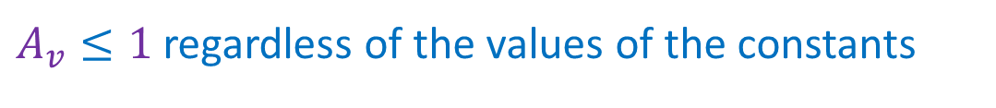

Small signal response of Common Emitter Amplifier
Collector
The denominator is always greater than the numerator
$$A_{v}=\frac{\left(1\text{– (}\frac{\left[R_{E} − βr_{o}\right]}{\left[R_{E} + r_{o}+R_{C}\right]}\text{)}\right)R_{E}}{\left\{\frac{\left[R_{s}+\left(R_{1}∥R_{2}\right)\right]}{\left(R_{1}∥R_{2}\right)}\left[r_{π}+R_{E}\left(1\text{– (}\frac{\left[R_{E} − βr_{o}\right]}{\left[R_{E} + r_{o}+R_{C}\right]}\text{)}\right)\right]+R_{s}\right\}}$$
We add a positive number
We multiply by a number that is greater than one
We add another positive number
$A_{v}≤1$ regardless of the values of the constants

Slide 10
Common Base Amplifier

Slide 11






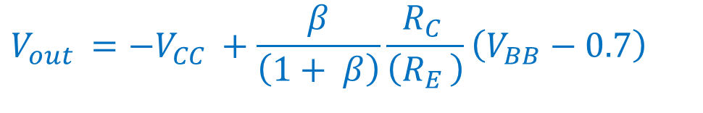

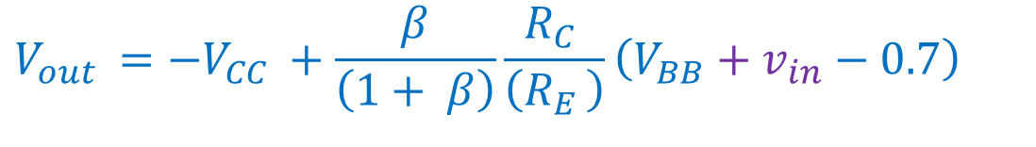





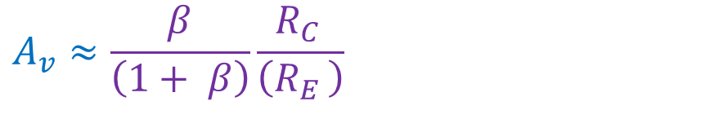



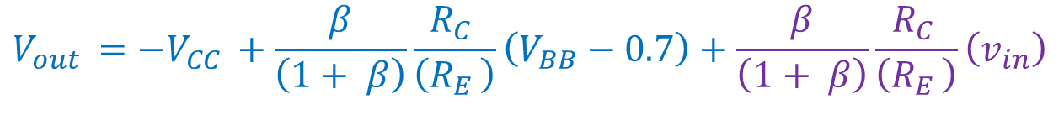
From Prior Lecture: Common Base Amplifier Circuit
$$V_{out }={−V}_{CC }+\frac{β}{\left(1+ β\right)}\frac{R_{C }}{\left(R_{E }\right)}\left(V_{BB}−0.7\right)$$
$$V_{in}$$
$$+$$
$$R_{E}$$
$$V_{out }={−V}_{CC }+\frac{β}{\left(1+ β\right)}\frac{R_{C }}{\left(R_{E }\right)}\left(V_{BB}+v_{in}−0.7\right)$$
$$−$$
$$V_{bb}$$
$$+$$
$$I_{E}$$
$$−$$
$$V_{out }={−V}_{CC }+\frac{β}{\left(1+ β\right)}\frac{R_{C }}{\left(R_{E }\right)}\left(V_{BB}−0.7\right)+\frac{β}{\left(1+ β\right)}\frac{R_{C }}{\left(R_{E }\right)}\left(v_{in}\right)$$
$$I_{B}$$
$$V_{out}$$
$$+$$
$$I_{C}$$
$$V_{CC}$$
$$−$$
$$R_{C}$$
$$A_{v}≈\frac{β}{\left(1+ β\right)}\frac{R_{C }}{\left(R_{E }\right)}$$

Slide 12


From Prior Lecture: Common Base Amplifier Circuit
This is a more normal input arrangement
$$+$$
$$R_{E}$$
$$V_{bb}$$
$$−$$
$$V_{in}$$
$$R_{S}$$
$$−$$
$$+$$
$$I_{E}$$
$$I_{B}$$
$$V_{out}$$
$$+$$
$$I_{C}$$
$$V_{CC}$$
$$−$$
$$R_{C}$$

Slide 13











Common Base Amplifier Circuit
Substitute the small signal model for the transistor
The output resistance, r_{o}, is usually omitted from the analysis of the common base amplifier.
$$+$$
$$R_{E}$$
$$V_{bb}$$
$$V_{in}$$
$$R_{S}$$
$$−$$
$$−$$
$$+$$
$$I_{E}$$
Short out the independent voltage sources for the small signal analysis
emitter
$$r_{π}$$
β I_{B}
I_{B}
$$I_{B}$$
Assume that the capacitor is an effective short at the frequencies of interest
$$I_{C}$$
$$V_{out}$$
$$+$$
collector
$$V_{CC}$$
$$−$$
$$R_{C}$$

Slide 14















Common Base Amplifier Small Signal Circuit
Rearrange
$$R_{E}$$
β I_{B}
$$V_{C}$$
$$+$$
$$R_{S}$$
$$V_{E}$$
$$I_{E}$$
$$V_{bb}$$
$$V_{in}$$
$$R_{S}$$
emitter
$$I_{C}$$
$$V_{out}$$
$$−$$
$$−$$
$$+$$
$$I_{E}$$
$$I_{E}$$
collector
emitter
$$r_{π}$$
β I_{B}
$$R_{C}$$
I_{B}
$$+$$
$$R_{E}$$
$$r_{π}$$
$$I_{B}$$
$$V_{in}$$
$$−$$
I_{B}
$$I_{C}$$
$$V_{out}$$
$$+$$
collector
$$V_{CC}$$
$$−$$
base
$$R_{C}$$

Slide 15


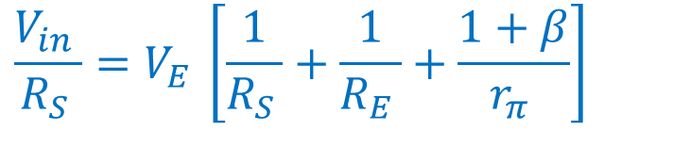



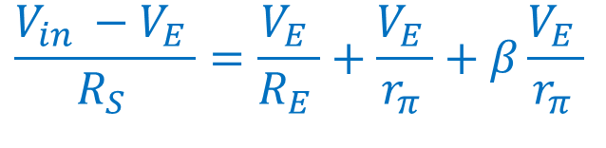

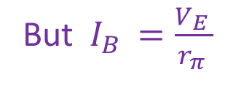



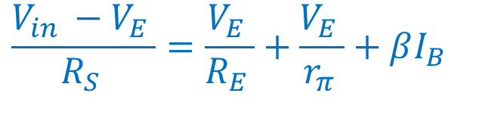




Common Base Amplifier Small Signal Circuit
β I_{B}
$$V_{C}$$
$$R_{S}$$
$$V_{E}$$
$$I_{E}$$
$$V_{out}$$
$$I_{C}$$
emitter
$$I_{E}$$
collector
Apply KCL to the emitter node.
$$R_{C}$$
But $I_{B }=\frac{V_{E }}{r_{π }}$
$$V_{in}$$
$$+$$
$$R_{E}$$
$$r_{π}$$
$$−$$
I_{B}
Collect like terms
base
$$\frac{V_{in }−V_{E }}{R_{S }}=\frac{V_{E }}{R_{E }}+\frac{V_{E }}{r_{π }}+β\frac{V_{E }}{r_{π }}$$
$$\frac{V_{in }−V_{E }}{R_{S }}=\frac{V_{E }}{R_{E }}+\frac{V_{E }}{r_{π }}+βI_{B }$$
$$\frac{V_{in }}{R_{S }}=V_{E }\left[\frac{1}{R_{S }}+\frac{1}{R_{E }}+\frac{1+β}{r_{π }}\right]$$

Slide 16

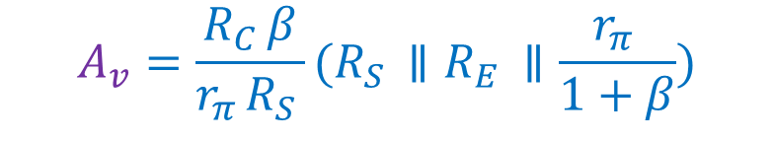
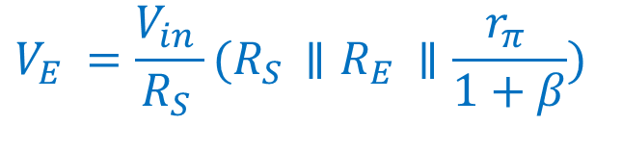
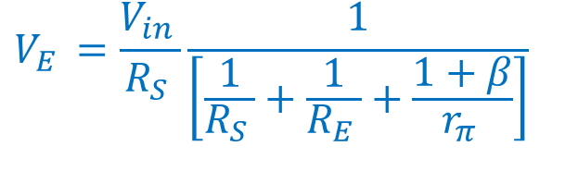
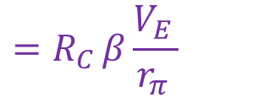
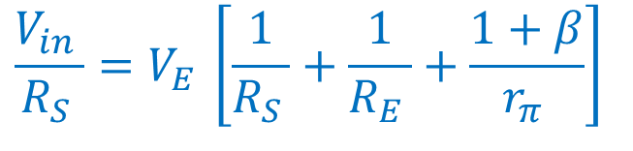

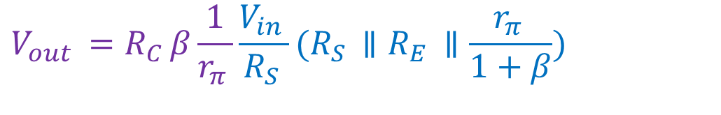
Common Base Amplifier Small Signal Circuit
β I_{B}
$$V_{C}$$
$$R_{S}$$
$$V_{E}$$
$$I_{E}$$
$$V_{out}$$
$$I_{C}$$
emitter
$$I_{E}$$
collector
$$\frac{V_{in }}{R_{S }}=V_{E }\left[\frac{1}{R_{S }}+\frac{1}{R_{E }}+\frac{1+β}{r_{π }}\right]$$
$$R_{C}$$
$$V_{in}$$
$$+$$
$$R_{E}$$
$$r_{π}$$
$$−$$
I_{B}
$$V_{E }=\frac{V_{in }}{R_{S }}\frac{1}{\left[\frac{1}{R_{S }}+\frac{1}{R_{E }}+\frac{1+β}{r_{π }}\right]}$$
base
$$V_{out }=R_{C }I_{C }$$
$$=R_{C }βI_{B }$$
$$=R_{C }β\frac{V_{E }}{r_{π }}$$
$$V_{E }=\frac{V_{in }}{R_{S }}(R_{S }∥R_{E }∥\frac{r_{π }}{1+β})$$
$$V_{out }=R_{C }β\frac{1}{r_{π }}\frac{V_{in }}{R_{S }}(R_{S }∥R_{E }∥\frac{r_{π }}{1+β})$$
$$A_{v}=\frac{R_{C }β}{r_{π }R_{S }}(R_{S }∥R_{E }∥\frac{r_{π }}{1+β})$$

Slide 17
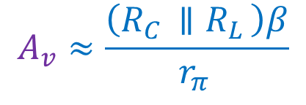

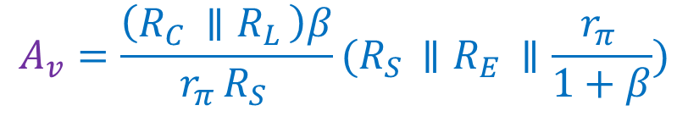
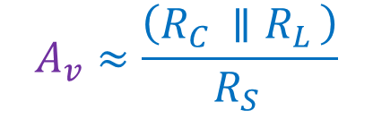
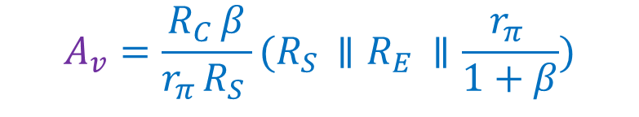

Common Base Amplifier Small Signal Circuit
β I_{B}
$$V_{C}$$
$$R_{S}$$
$$V_{E}$$
$$I_{E}$$
$$V_{out}$$
$$I_{C}$$
emitter
$$A_{v}=\frac{R_{C }β}{r_{π }R_{S }}(R_{S }∥R_{E }∥\frac{r_{π }}{1+β})$$
$$I_{E}$$
collector
$$R_{C}$$
$$R_{L}$$
$$V_{in}$$
$$+$$
$$R_{E}$$
$$r_{π}$$
$$−$$
I_{B}
If there is a load at the output:
base
If the source resistance is very small:
$$A_{v}=\frac{\left(R_{C }∥R_{L }\right)β}{r_{π }R_{S }}(R_{S }∥R_{E }∥\frac{r_{π }}{1+β})$$
$$A_{v}≈\frac{\left(R_{C }∥R_{L }\right)β}{r_{π }}$$
$$A_{v}≈\frac{\left(R_{C }∥R_{L }\right)}{R_{S }}$$
If $β$ is very large:

Slide 19
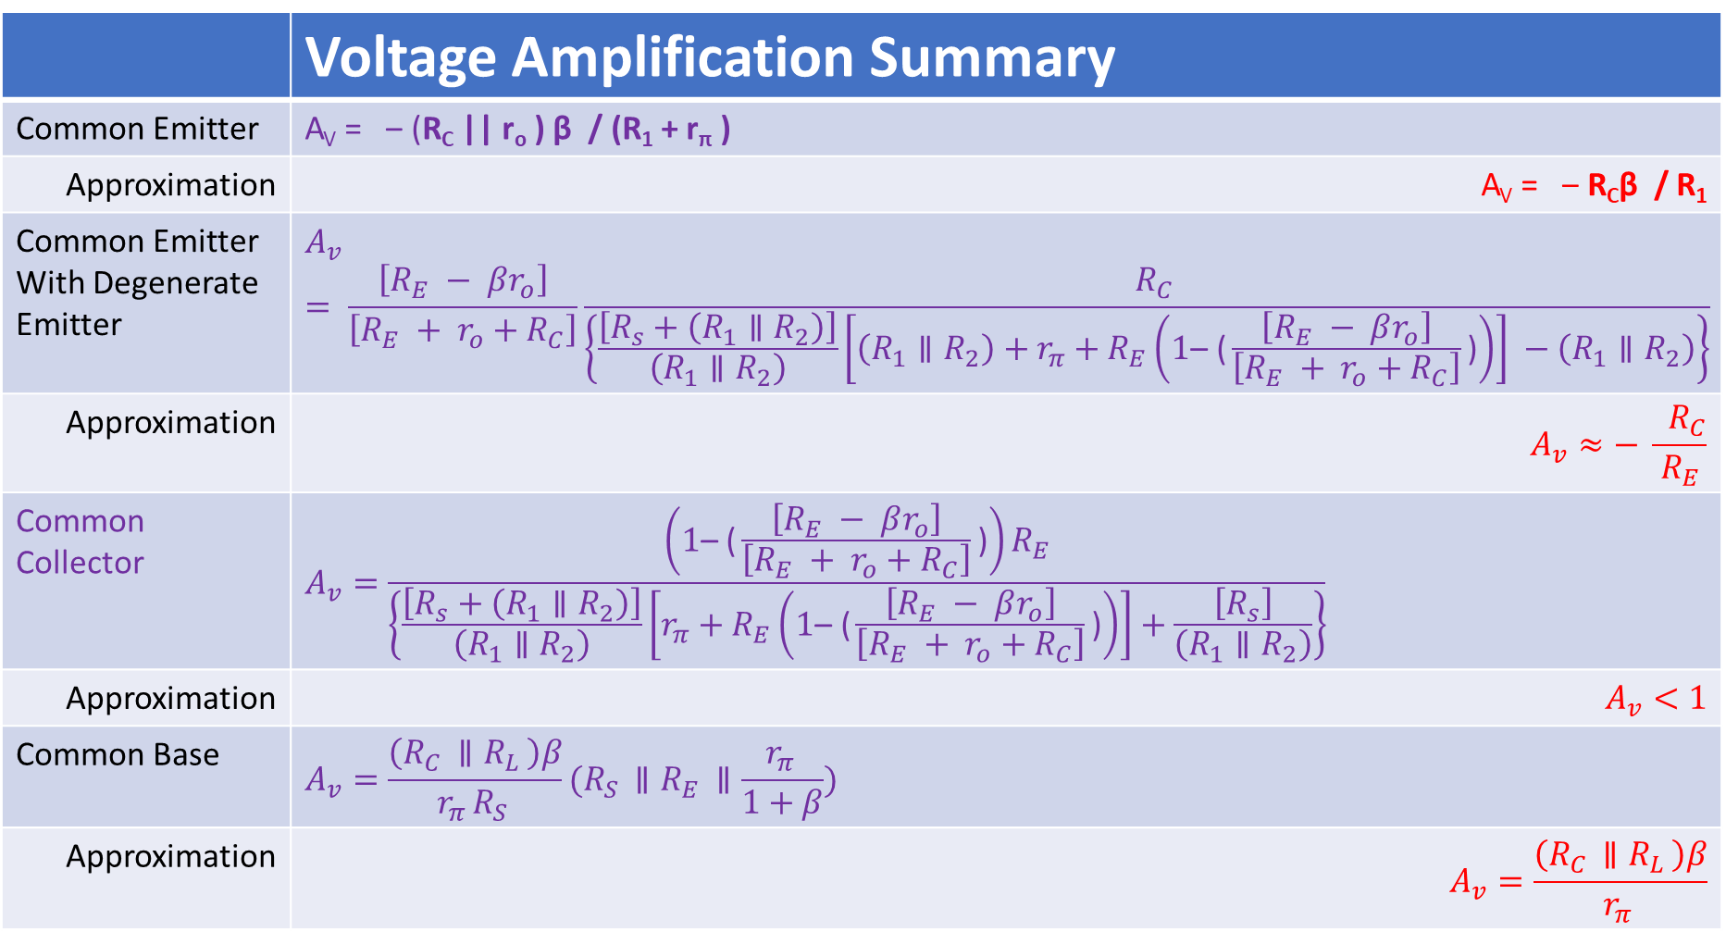
 | Voltage Amplification Summary
Common Emitter | A_{V} = ‒ (R_{C} || r_{o} ) β / (R₁ + r_{π} )
Approximation | A_{V} = ‒ R_{C}β / R₁
Common Emitter With Degenerate Emitter | $$A_{v}= \frac{\left[R_{E} − βr_{o}\right]}{\left[R_{E} + r_{o}+R_{C}\right]}\frac{{ R}_{C}}{\left\{\frac{\left[R_{s}+\left(R_{1}∥R_{2}\right)\right]}{\left(R_{1}∥R_{2}\right)}\left[\left(R_{1}∥R_{2}\right)+r_{π}+R_{E}\left(1\text{– (}\frac{\left[R_{E} − βr_{o}\right]}{\left[R_{E} + r_{o}+R_{C}\right]}\text{)}\right)\right] −\left(R_{1}∥R_{2}\right)\right\}}$$
Approximation | $$A_{v}≈− \frac{{ R}_{C}}{R_{E}}$$
Common Collector | $$A_{v}=\frac{\left(1\text{– (}\frac{\left[R_{E} − βr_{o}\right]}{\left[R_{E} + r_{o}+R_{C}\right]}\text{)}\right)R_{E}}{\left\{\frac{\left[R_{s}+\left(R_{1}∥R_{2}\right)\right]}{\left(R_{1}∥R_{2}\right)}\left[r_{π}+R_{E}\left(1\text{– (}\frac{\left[R_{E} − βr_{o}\right]}{\left[R_{E} + r_{o}+R_{C}\right]}\text{)}\right)\right]+\frac{\left[R_{s}\right]}{\left(R_{1}∥R_{2}\right)}\right\}}$$
Approximation | $$A_{v}<1$$
Common Base | $$A_{v}=\frac{\left(R_{C }∥R_{L }\right)β}{r_{π }R_{S }}(R_{S }∥R_{E }∥\frac{r_{π }}{1+β})$$
Approximation | $$A_{v}=\frac{\left(R_{C }∥R_{L }\right)β}{r_{π }}$$

Slide 20
What good is a unity gain amplifier???
To understand this we must look at how an amplifier interacts with the things around it.

Slide 21













Interaction of Source, Amplifier, and Load
Ideal Amplifier
$$Source$$
$$Ampifier with gain A_{V}$$
$$Load$$
$$A_{V} V_{in}$$
$$V_{in}$$
$$+$$
$$V_{out}$$
$$R_{L}$$
$$V_{S}$$
$$+$$
$$−$$
$$−$$
$$V_{in}=V_{S}$$
$$V_{out}=A_{V} V_{in}$$

Slide 22



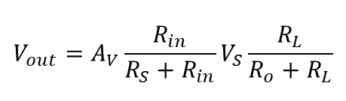



Interaction of Source, Amplifier, and Load
Real Amplifier
$$Source$$
$$Ampifier with gain A_{V}$$
$$Load$$
$$R_{S}$$
$$R_{o}$$
$$A_{V} V_{in}$$
$$V_{in}$$
$$+$$
$$V_{out}$$
$$R_{L}$$
$$V_{S}$$
$$+$$
$$R_{in}$$
$$−$$
$$−$$
$$V_{in}= \frac{R_{in}}{R_{S}+R_{in}}V_{S}$$
$$V_{out}=A_{V} V_{in}\frac{R_{L}}{R_{o}+R_{L}}$$
$$V_{out}=A_{V}\frac{R_{in}}{R_{S}+R_{in}}V_{S}\frac{R_{L}}{R_{o}+R_{L}}$$

Slide 23







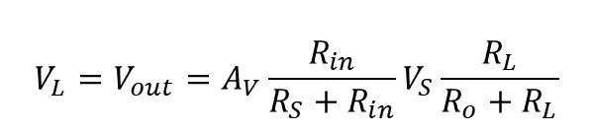


Interaction of Source, Amplifier, and Load
If R_{S} is significant compared to R_{L ,} then the non-amplified signal is reduced.
Real Amplifier
$$Source$$
Example: R_{S} = 1 kΩ
R_{L}= 1 kΩ
Since we can somewhat control R_{in} and R_{o} (by choosing the type of amplifier), we can prevent (or at least lessen) the signal degradation.
$$R_{S}$$
$$Load$$
$$+$$
$$V_{L}$$
$$R_{L}$$
$$V_{S}$$
$$+$$
Example: A_{v}= 0.95
R_{in} = 100 kΩ
R_{L}= 20 Ω
$$−$$
$$−$$
$$V_{L}=0.5 V_{S}$$
$$V_{L}= \frac{R_{L}}{R_{S}+R_{L}}V_{S}$$
$${V_{L}=V}_{out}=A_{V}\frac{R_{in}}{R_{S}+R_{in}}V_{S}\frac{R_{L}}{R_{o}+R_{L}}$$
$$V_{L}=0.92 V_{S}$$
Source voltage applied directly to load
Source voltage amplified before being applied to load

Slide 24
What we talked about today
Small signal analysis of common collector circuits
Small signal analysis of common base circuits
Effect of input and output resistance

Slide 25
Next lecture we will look at the input and output resistances of these amplifiers

