Slide 1
Analog Electronics Technology
BJT input & output Resistances

Slide 2
Analog Electronics Technology
Diodes
BJT’s
BJT basics
DC Biasing
Small Signal Analysis
Voltage Gain
Input & Output Resistances
Op Amps

Slide 3
What we will talk about today
Input and output resistances for the common emitter amplifier

Slide 4

Determine the small signal input resistance of BJT amplifiers
The small signal input resistance is equal to the small signal voltage input divided by the small signal current generated
$$Rin= \frac{vin}{iin}$$

Slide 5














Small Signal Input Resistance of Common Emitter Amplifier
We will find the input resistance and the output resistance of the voltage divider biased common emitter amplifier with an emitter resister
$$R_{1}$$
$$R_{C}$$
$$R_{S}$$
$$V_{out}$$
$$+$$
$$V_{CC}$$
$$V_{B}$$
$$−$$
$$V_{E}$$
$$V_{in}$$
$$+$$
$$−$$
$$R_{2}$$
$$R_{E}$$

Slide 6
















Small Signal Input Resistance of Common Emitter Amplifier
This is the small signal model that we developed when we looked at the small signal voltage gain
$$V_{out}$$
$$R_{S}$$
collector
$$V_{B}$$
base
β I_{B}
$$i_{2}$$
$$i_{3}$$
r_{o}
$$i_{1}$$
$$r_{π}$$
I_{B}
$$i_{B}$$
$$V_{E}$$
$${R_{1}||R}_{2}$$
$$R_{C}$$
$$V_{in}$$
$$+$$
emitter
$$−$$
$$R_{E}$$
$$i_{4}$$
In that lecture we developed loop equations which we will use again

Slide 7
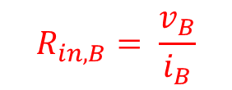
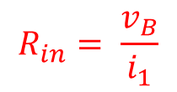


Small Signal Input Resistance of Common Emitter Amplifier
Sometimes two different input resistances are defined
$$R_{in,b}$$
$$V_{out}$$
$$R_{S}$$
$$R_{in}$$
collector
$$V_{B}$$
base
β I_{B}
$$i_{1}$$
$$r_{π}$$
r_{o}
I_{B}
$$i_{B}$$
$$V_{E}$$
$${R_{1}||R}_{2}$$
$$R_{C}$$
$$V_{in}$$
$$+$$
emitter
$$−$$
$$R_{E}$$
R_{in} is the resistance looking into the circuit at the input
$$R_{in}= \frac{v_{B}}{i_{1}}$$
R_{in,b} is the resistance looking directly into the base of the transistor
$$R_{in,B}= \frac{v_{B}}{i_{B}}$$

Slide 8


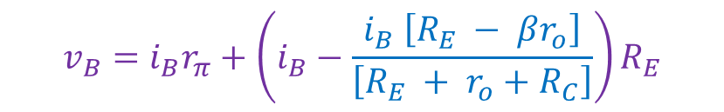



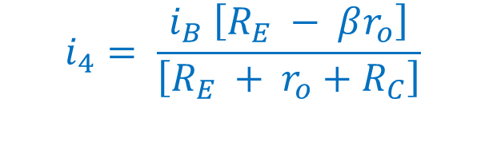

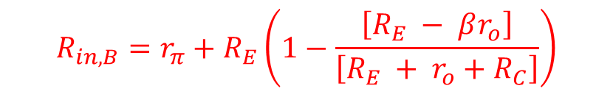





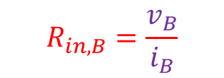



Small Signal Input Resistance of Common Emitter Amplifier
We can look at the base and see that the voltage is given by:
$$V_{out}$$
$$v_{B}=i_{B}r_{π}+\left(i_{B}−i_{4}\right)R_{E}$$
$$R_{S}$$
collector
$$V_{B}$$
base
From a previous lecture:
β I_{B}
$$i_{1}$$
$$r_{π}$$
r_{o}
I_{B}
$$i_{B}$$
$$V_{E}$$
$$i_{4}= \frac{i_{B} \left[R_{E} − βr_{o}\right]}{\left[R_{E} + r_{o}+R_{C}\right]}$$
$${R_{1}||R}_{2}$$
$$R_{C}$$
$$V_{in}$$
$$+$$
emitter
$$−$$
$$R_{E}$$
$$i_{4}$$
$$v_{B}=i_{B}r_{π}+\left(i_{B}−\frac{i_{B} \left[R_{E} − βr_{o}\right]}{\left[R_{E} + r_{o}+R_{C}\right]}\right)R_{E}$$
$$R_{in,B}=\frac{v_{B}}{i_{B}}$$
$$R_{in,B}=r_{π}+R_{E}\left(1−\frac{\left[R_{E} − βr_{o}\right]}{\left[R_{E} + r_{o}+R_{C}\right]}\right)$$

Slide 9


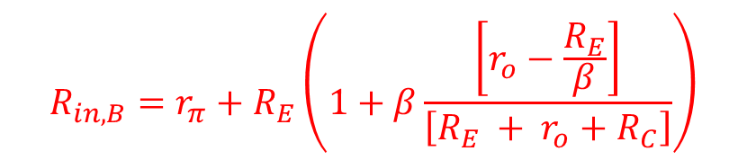



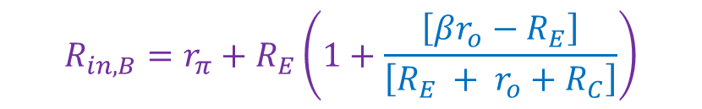

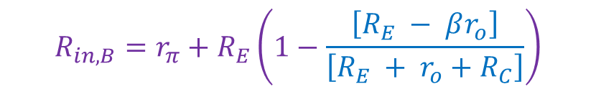








Small Signal Input Resistance of Common Emitter Amplifier
$$V_{out}$$
$$R_{S}$$
collector
$$R_{in,B}=r_{π}+R_{E}\left(1−\frac{\left[R_{E} − βr_{o}\right]}{\left[R_{E} + r_{o}+R_{C}\right]}\right)$$
$$V_{B}$$
base
β I_{B}
$$i_{1}$$
$$r_{π}$$
I_{B}
r_{o}
$$i_{B}$$
$$V_{E}$$
$${R_{1}||R}_{2}$$
$$R_{C}$$
$$R_{in,B}=r_{π}+R_{E}\left(1+\frac{\left[βr_{o}−R_{E}\right]}{\left[R_{E} + r_{o}+R_{C}\right]}\right)$$
$$V_{in}$$
$$+$$
emitter
$$−$$
$$R_{E}$$
$$i_{4}$$
$$R_{in,B}=r_{π}+R_{E}\left(1+β\frac{\left[r_{o}−\frac{R_{E}}{β}\right]}{\left[R_{E} + r_{o}+R_{C}\right]}\right)$$

Slide 10


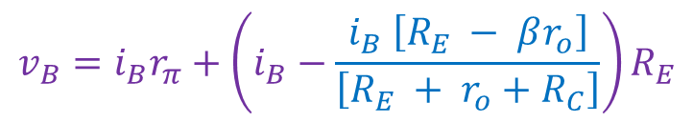




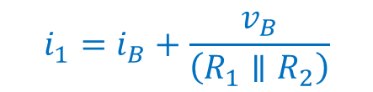

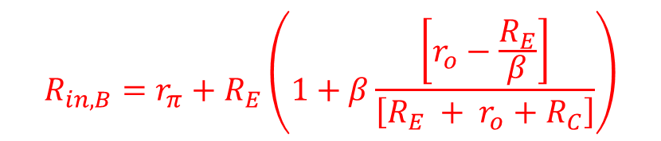
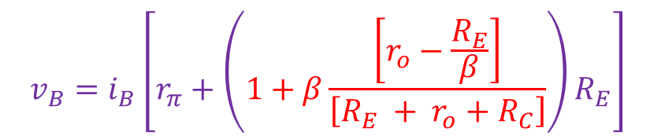





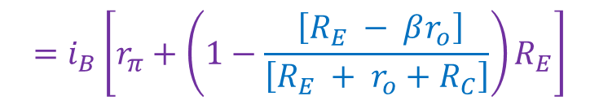



Small Signal Input Resistance of Common Emitter Amplifier
$$V_{out}$$
$$R_{S}$$
collector
$$R_{in,B}=r_{π}+R_{E}\left(1+β\frac{\left[r_{o}−\frac{R_{E}}{β}\right]}{\left[R_{E} + r_{o}+R_{C}\right]}\right)$$
$$V_{B}$$
base
β I_{B}
$$i_{1}$$
$$r_{π}$$
I_{B}
r_{o}
$$i_{B}$$
$$V_{E}$$
$$+$$
$${R_{1}||R}_{2}$$
$$R_{C}$$
Now find the input resistance at the input to the amplifier
$$V_{in}$$
$$−$$
emitter
$$R_{E}$$
$$i_{4}$$
$$R_{in}=\frac{v_{B}}{i_{1}}$$
From two slides ago:
$$i_{1}=i_{B}+\frac{v_{B}}{\left(R_{1}∥R_{2}\right)}$$
$$v_{B}=i_{B}r_{π}+\left(i_{B}−\frac{i_{B} \left[R_{E} − βr_{o}\right]}{\left[R_{E} + r_{o}+R_{C}\right]}\right)R_{E}$$
$$=i_{B}\left[r_{π}+\left(1−\frac{ \left[R_{E} − βr_{o}\right]}{\left[R_{E} + r_{o}+R_{C}\right]}\right)R_{E}\right]$$
$$v_{B}=i_{B}\left[r_{π}+\left(1+β\frac{\left[r_{o}−\frac{R_{E}}{β}\right]}{\left[R_{E} + r_{o}+R_{C}\right]}\right)R_{E}\right]$$

Slide 11

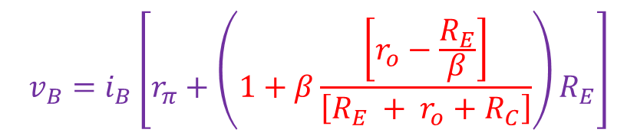
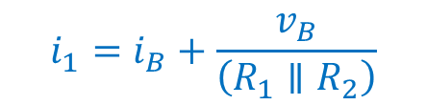

Small Signal Input Resistance of Common Emitter Amplifier
$$V_{out}$$
$$R_{S}$$
collector
$$V_{B}$$
base
$$i_{1}=i_{B}+\frac{v_{B}}{\left(R_{1}∥R_{2}\right)}$$
β I_{B}
$$i_{1}$$
$$r_{π}$$
I_{B}
r_{o}
$$i_{B}$$
$$V_{E}$$
$$v_{B}=i_{B}\left[r_{π}+\left(1+β\frac{\left[r_{o}−\frac{R_{E}}{β}\right]}{\left[R_{E} + r_{o}+R_{C}\right]}\right)R_{E}\right]$$
$$+$$
$${R_{1}||R}_{2}$$
$$R_{C}$$
$$V_{in}$$
$$−$$
emitter
$$R_{E}$$
$$i_{4}$$
$$i_{1}=i_{B}+\frac{i_{B}}{\left(R_{1}∥R_{2}\right)}\left[r_{π}+\left(1+β\frac{\left[r_{o}−\frac{R_{E}}{β}\right]}{\left[R_{E} + r_{o}+R_{C}\right]}\right)R_{E}\right]$$
$$i_{1}=i_{B}\left\{1+\frac{1}{\left(R_{1}∥R_{2}\right)}\left[r_{π}+\left(1+β\frac{\left[r_{o}−\frac{R_{E}}{β}\right]}{\left[R_{E} + r_{o}+R_{C}\right]}\right)R_{E}\right]\right\}$$

Slide 12

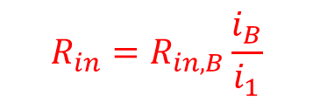
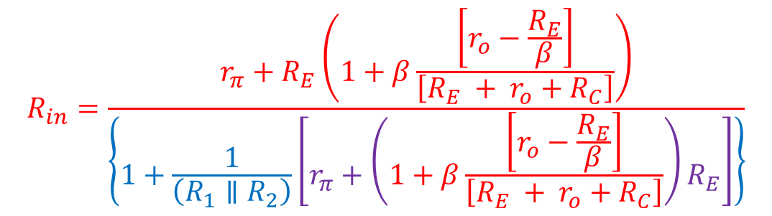
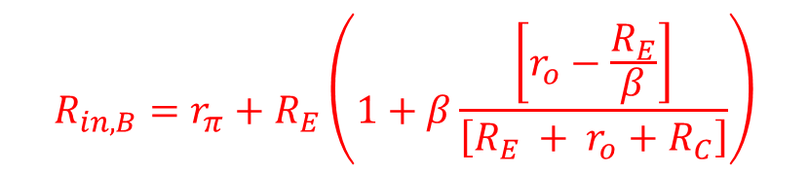
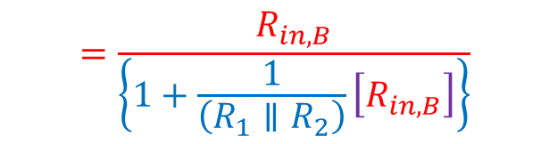


Small Signal Input Resistance of Common Emitter Amplifier
$$V_{out}$$
$$R_{S}$$
collector
From before:
$$V_{B}$$
base
$$R_{in,B}=r_{π}+R_{E}\left(1+β\frac{\left[r_{o}−\frac{R_{E}}{β}\right]}{\left[R_{E} + r_{o}+R_{C}\right]}\right)$$
β I_{B}
$$i_{1}$$
$$r_{π}$$
I_{B}
r_{o}
$$i_{B}$$
$$V_{E}$$
$$+$$
$${R_{1}||R}_{2}$$
$$R_{C}$$
$$V_{in}$$
$$−$$
emitter
$$R_{in,B}= \frac{v_{B}}{i_{B}}$$
$$i_{4}$$
$$R_{in}= \frac{v_{B}}{i_{1}}$$
$$R_{E}$$
$$R_{in}=R_{in,B}\frac{i_{B}}{i_{1}}$$
$$R_{in}=\frac{r_{π}+R_{E}\left(1+β\frac{\left[r_{o}−\frac{R_{E}}{β}\right]}{\left[R_{E} + r_{o}+R_{C}\right]}\right)}{\left\{1+\frac{1}{\left(R_{1}∥R_{2}\right)}\left[r_{π}+\left(1+β\frac{\left[r_{o}−\frac{R_{E}}{β}\right]}{\left[R_{E} + r_{o}+R_{C}\right]}\right)R_{E}\right]\right\}}$$
$$=\frac{R_{in,B}}{\left\{1+\frac{1}{\left(R_{1}∥R_{2}\right)}\left[R_{in,B}\right]\right\}}$$

Slide 13

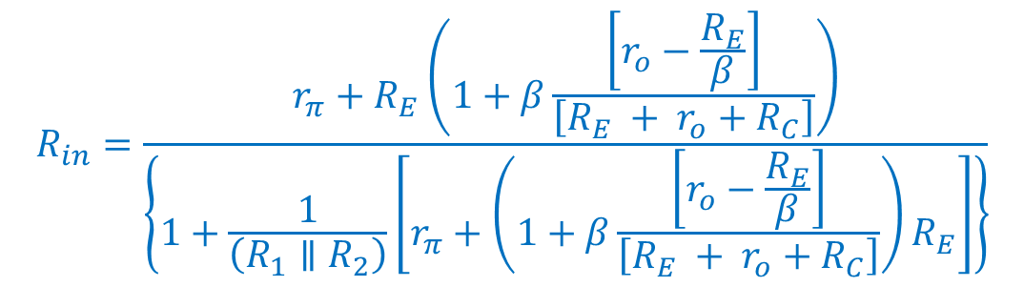
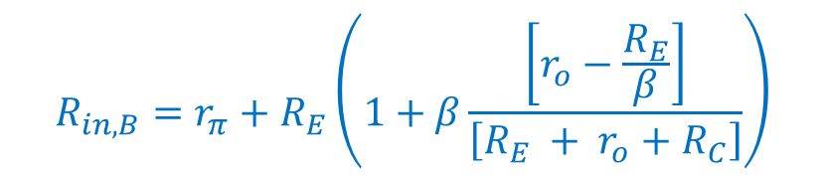

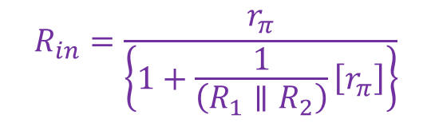
Small Signal Input Resistance of Common Emitter Amplifier
$$V_{out}$$
$$R_{in,B}=r_{π}+R_{E}\left(1+β\frac{\left[r_{o}−\frac{R_{E}}{β}\right]}{\left[R_{E} + r_{o}+R_{C}\right]}\right)$$
$$R_{S}$$
collector
$$V_{B}$$
base
β I_{B}
$$i_{1}$$
$$r_{π}$$
I_{B}
r_{o}
$$i_{B}$$
$$V_{E}$$
$$+$$
$${R_{1}||R}_{2}$$
$$R_{C}$$
$$V_{in}$$
$$−$$
emitter
$$R_{E}$$
$$i_{4}$$
If R_{E} = 0:
$$R_{in,B}=r_{π}$$
$$R_{in}=\frac{r_{π}+R_{E}\left(1+β\frac{\left[r_{o}−\frac{R_{E}}{β}\right]}{\left[R_{E} + r_{o}+R_{C}\right]}\right)}{\left\{1+\frac{1}{\left(R_{1}∥R_{2}\right)}\left[r_{π}+\left(1+β\frac{\left[r_{o}−\frac{R_{E}}{β}\right]}{\left[R_{E} + r_{o}+R_{C}\right]}\right)R_{E}\right]\right\}}$$
$$R_{in}=\frac{r_{π}}{\left\{1+\frac{1}{\left(R_{1}∥R_{2}\right)}\left[r_{π}\right]\right\}}$$
If also R₁ and R₁ >> r_{π} :
$$R_{in}≈r_{π}$$

Slide 14
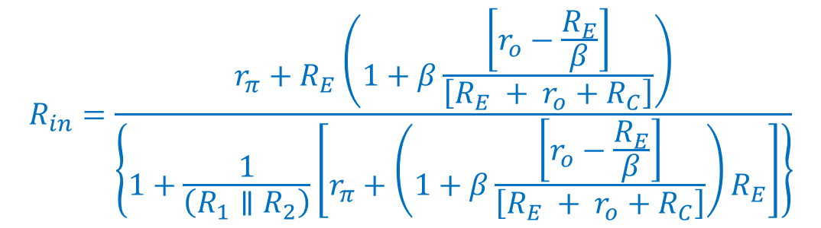


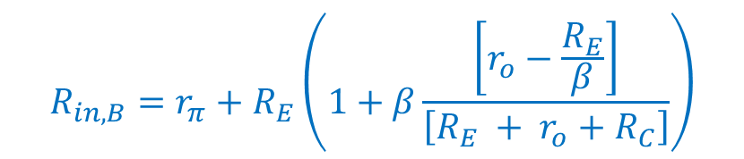
Small Signal Input Resistance of Common Emitter Amplifier
$$V_{out}$$
$$R_{S}$$
collector
$$R_{in,B}=r_{π}+R_{E}\left(1+β\frac{\left[r_{o}−\frac{R_{E}}{β}\right]}{\left[R_{E} + r_{o}+R_{C}\right]}\right)$$
$$V_{B}$$
base
β I_{B}
$$i_{1}$$
$$r_{π}$$
I_{B}
r_{o}
$$i_{B}$$
$$V_{E}$$
$$+$$
$${R_{1}||R}_{2}$$
$$R_{C}$$
$$V_{in}$$
$$−$$
emitter
If r_{o} is very large:
$$R_{E}$$
$$i_{4}$$
$$R_{in,B}≈r_{π}+R_{E}\left(1+β\right)$$
$$R_{in}=\frac{r_{π}+R_{E}\left(1+β\frac{\left[r_{o}−\frac{R_{E}}{β}\right]}{\left[R_{E} + r_{o}+R_{C}\right]}\right)}{\left\{1+\frac{1}{\left(R_{1}∥R_{2}\right)}\left[r_{π}+\left(1+β\frac{\left[r_{o}−\frac{R_{E}}{β}\right]}{\left[R_{E} + r_{o}+R_{C}\right]}\right)R_{E}\right]\right\}}$$
If R₁ and R₂ are also very large:
$$R_{in}≈r_{π}+R_{E}\left(1+β\right)$$

Slide 16



Small Signal Output Resistance of Common Emitter Amplifier
$$V_{out}$$
I_{test}
$$R_{S}$$
collector
Output resistance
$$V_{B}$$
base
β I_{B}
r_{o}
Assume source resistance is zero
$$r_{π}$$
I_{B}
$$i_{B}$$
$$V_{E}$$
$$+$$
$${R_{1}||R}_{2}$$
$$R_{C}$$
$$−$$
$$V_{test}$$
Short circuit the source
$$V_{in}$$
$$+$$
emitter
$$−$$
$$R_{E}$$
$$i_{4}$$
R₁ and R₂ are short circuited by the source
Apply a test voltage to the output

Slide 17


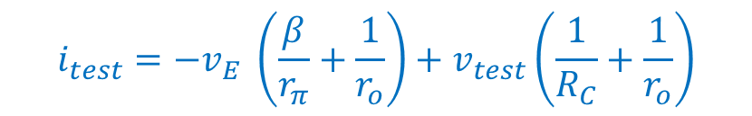



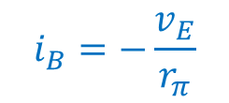

Small Signal Output Resistance of Common Emitter Amplifier
$$V_{E}$$
β I_{B}
I_{test}
emitter
collector
Do a current balance at the collector node
$$+$$
$$V_{test}$$
$$−$$
$$R_{C}$$
I_{B}
$$r_{π}$$
r_{o}
$$i_{test}=β i_{B}+\frac{v_{test}}{R_{C}}+\frac{\left(v_{test} −v_{E}\right)}{r_{o}}$$
$$R_{E}$$
base
$$i_{B}=−\frac{v_{E}}{r_{π}}$$
$$i_{test}=− β\frac{v_{E}}{r_{π}}+\frac{v_{test}}{R_{C}}+\frac{\left(v_{test} −v_{E}\right)}{r_{o}}$$
$$i_{test}=−v_{E} \left(\frac{β}{r_{π}}+\frac{1}{r_{o}}\right)+v_{test}\left(\frac{1}{R_{C}}+\frac{1}{r_{o}}\right)$$

Slide 18



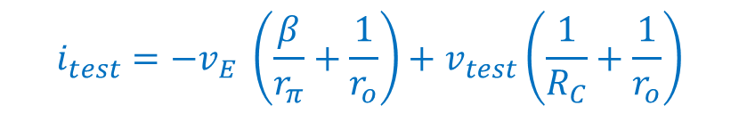

Small Signal Output Resistance of Common Emitter Amplifier
$$V_{E}$$
β I_{B}
I_{test}
$$i_{test}=−v_{E} \left(\frac{β}{r_{π}}+\frac{1}{r_{o}}\right)+v_{test}\left(\frac{1}{R_{C}}+\frac{1}{r_{o}}\right)$$
emitter
collector
$$+$$
$$V_{test}$$
$$−$$
$$R_{C}$$
I_{B}
$$r_{π}$$
r_{o}
$$R_{E}$$
Do a current balance at the emitter node
base
$$i_{B}=−\frac{v_{E}}{r_{π}}$$
$$β i_{B}=\frac{\left(v_{E}−v_{test}\right)}{r_{o}}+\frac{v_{E}}{R_{E}}+\frac{v_{E}}{r_{π}}$$
$$v_{E}=\frac{v_{test}}{r_{o}}\left(R_{E}∥r_{o}∥\frac{r_{π}}{1+β}\right)$$
$$−β \frac{v_{E}}{r_{π}} =\frac{\left(v_{E}−v_{test}\right)}{r_{o}}+\frac{v_{E}}{R_{E}}+\frac{v_{E}}{r_{π}}$$
$$\frac{v_{test}}{r_{o}}=v_{E}\left[\frac{β}{r_{π}}+\frac{1}{r_{o}}+\frac{1}{R_{E}}+\frac{1}{r_{π}}\right]$$

Slide 19



Small Signal Output Resistance of Common Emitter Amplifier
$$V_{E}$$
β I_{B}
I_{test}
$$i_{test}=−v_{E} \left(\frac{β}{r_{π}}+\frac{1}{r_{o}}\right)+v_{test}\left(\frac{1}{R_{C}}+\frac{1}{r_{o}}\right)$$
emitter
collector
$$+$$
$$V_{test}$$
$$−$$
$$R_{C}$$
$$v_{E}=\frac{v_{test}}{r_{o}}\left(R_{E}∥r_{o}∥\frac{r_{π}}{1+β}\right)$$
I_{B}
$$r_{π}$$
r_{o}
$$R_{E}$$
base
$$i_{test}=−\frac{v_{test}}{r_{o}}\left(R_{E}∥r_{o}∥\frac{r_{π}}{1+β}\right)\left(\frac{β}{r_{π}}+\frac{1}{r_{o}}\right)+v_{test}\left(\frac{1}{R_{C}}+\frac{1}{r_{o}}\right)$$
$$i_{test}=\frac{v_{test}}{r_{o}}\left[r_{o}\left(\frac{1}{R_{C}}+\frac{1}{r_{o}}\right)−\left(R_{E}∥r_{o}∥\frac{r_{π}}{1+β}\right)\left(\frac{β}{r_{π}}+\frac{1}{r_{o}}\right)\right]$$
$$R_{o}=\frac{r_{o}}{\left[r_{o}\left(\frac{1}{R_{C}}+\frac{1}{r_{o}}\right)−\left(R_{E}∥r_{o}∥\frac{r_{π}}{1+β}\right)\left(\frac{β}{r_{π}}+\frac{1}{r_{o}}\right)\right]}$$

Slide 20
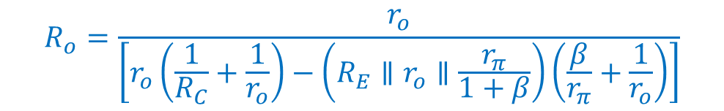

Small Signal Output Resistance of Common Emitter Amplifier
$$V_{E}$$
β I_{B}
I_{test}
$$R_{o}=\frac{r_{o}}{\left[r_{o}\left(\frac{1}{R_{C}}+\frac{1}{r_{o}}\right)−\left(R_{E}∥r_{o}∥\frac{r_{π}}{1+β}\right)\left(\frac{β}{r_{π}}+\frac{1}{r_{o}}\right)\right]}$$
emitter
collector
$$+$$
$$V_{test}$$
$$−$$
$$R_{C}$$
I_{B}
$$r_{π}$$
r_{o}
$$R_{E}$$
If there is no emitter resistor (R_{E} = 0)
base
$$R_{o}=\frac{r_{o}}{\left[r_{o}\left(\frac{1}{R_{C}}+\frac{1}{r_{o}}\right)\right]}$$
$$R_{o}=\left(R_{C}∥r_{o}\right)$$

Slide 21



Small Signal Output Resistance of Common Emitter Amplifier
$$V_{E}$$
β I_{B}
I_{test}
$$R_{o}=\frac{r_{o}}{\left[r_{o}\left(\frac{1}{R_{C}}+\frac{1}{r_{o}}\right)−\left(R_{E}∥r_{o}∥\frac{r_{π}}{1+β}\right)\left(\frac{β}{r_{π}}+\frac{1}{r_{o}}\right)\right]}$$
emitter
collector
$$+$$
$$V_{test}$$
$$−$$
$$R_{C}$$
I_{B}
$$r_{π}$$
r_{o}
$$R_{E}$$
Approximations are often made
If R_{C} >> r_{o}
base
$$R_{o}≈\frac{r_{o}}{\left[1−\left(R_{E}∥r_{o}∥\frac{r_{π}}{1+β}\right)\left(\frac{β}{r_{π}}+\frac{1}{r_{o}}\right)\right]}$$
If r_{o} >> R_{E} , $\frac{r_{π}}{β}$
$$R_{o}≈\frac{r_{o}}{\left[1−\left(R_{E}∥\frac{r_{π}}{1+β}\right)\left(\frac{β}{r_{π}}\right)\right]}$$

Slide 22

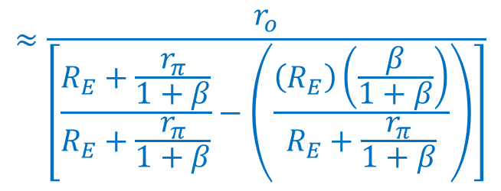
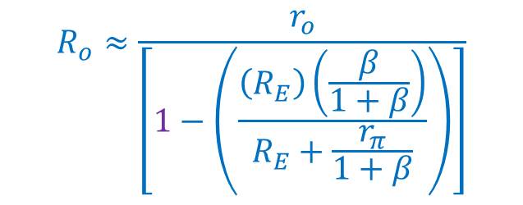
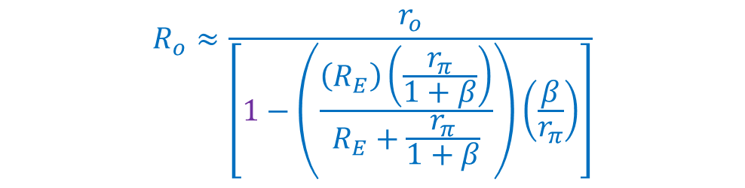
Small Signal Output Resistance of Common Emitter Amplifier
$$V_{E}$$
β I_{B}
I_{test}
emitter
collector
$$R_{o}≈\frac{r_{o}}{\left[1−\left(R_{E}∥\frac{r_{π}}{1+β}\right)\left(\frac{β}{r_{π}}\right)\right]}$$
$$+$$
$$V_{test}$$
$$−$$
$$R_{C}$$
I_{B}
$$r_{π}$$
r_{o}
$$R_{E}$$
$$R_{o}≈\frac{r_{o}}{\left[1−\left(\frac{\left(R_{E}\right)\left(\frac{r_{π}}{1+β}\right)}{R_{E}+\frac{r_{π}}{1+β}}\right)\left(\frac{β}{r_{π}}\right)\right]}$$
base
$$R_{o}≈\frac{r_{o}}{\left[1−\left(\frac{\left(R_{E}\right)\left(\frac{β}{1+β}\right)}{R_{E}+\frac{r_{π}}{1+β}}\right)\right]}$$
$$≈\frac{r_{o}}{\left[\frac{R_{E}+\frac{r_{π}}{1+β}}{R_{E}+\frac{r_{π}}{1+β}}−\left(\frac{\left(R_{E}\right)\left(\frac{β}{1+β}\right)}{R_{E}+\frac{r_{π}}{1+β}}\right)\right]}$$

Slide 23
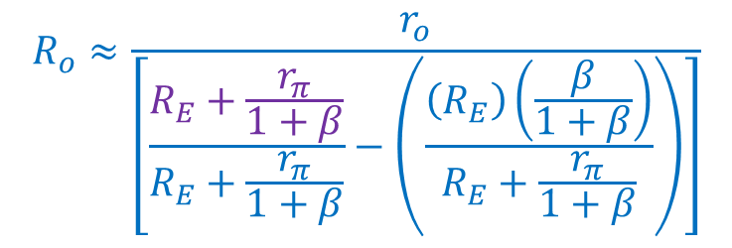
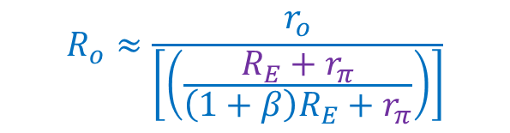
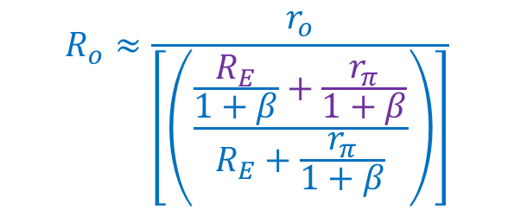
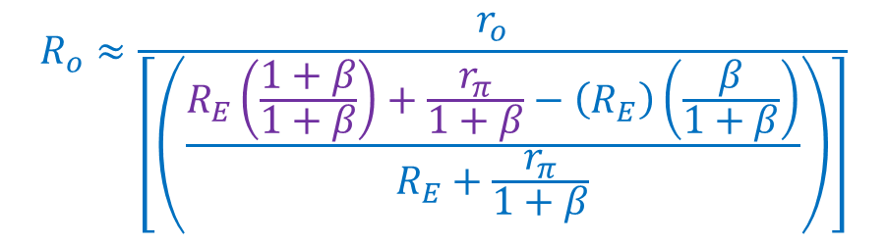
Small Signal Output Resistance of Common Emitter Amplifier
β I_{B}
I_{test}
$$R_{o}≈\frac{r_{o}}{\left[\frac{R_{E}+\frac{r_{π}}{1+β}}{R_{E}+\frac{r_{π}}{1+β}}−\left(\frac{\left(R_{E}\right)\left(\frac{β}{1+β}\right)}{R_{E}+\frac{r_{π}}{1+β}}\right)\right]}$$
$$V_{E}$$
emitter
collector
$$+$$
$$V_{test}$$
$$−$$
$$R_{C}$$
I_{B}
$$r_{π}$$
r_{o}
$$R_{E}$$
base
$$R_{o}≈\frac{r_{o}}{\left[\left(\frac{R_{E}\left(\frac{1+β}{1+β}\right)+\frac{r_{π}}{1+β}−\left(R_{E}\right)\left(\frac{β}{1+β}\right)}{R_{E}+\frac{r_{π}}{1+β}}\right)\right]}$$
$$R_{o}≈\frac{r_{o}}{\left[\left(\frac{\frac{R_{E}}{1+β}+\frac{r_{π}}{1+β}}{R_{E}+\frac{r_{π}}{1+β}}\right)\right]}$$
$$R_{o}≈\frac{r_{o}}{\left[\left(\frac{R_{E}+r_{π}}{\left(1+β\right)R_{E}+r_{π}}\right)\right]}$$

Slide 24
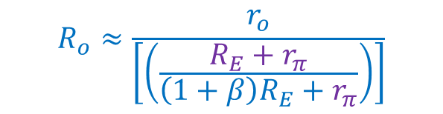
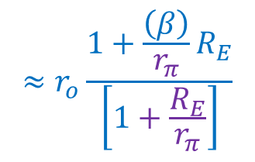
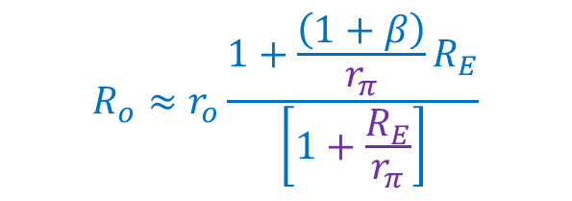

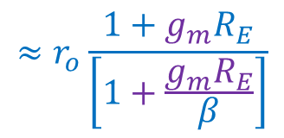
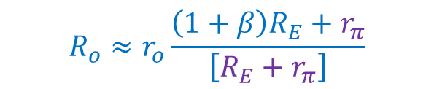

Small Signal Output Resistance of Common Emitter Amplifier
β I_{B}
I_{test}
$$R_{o}≈\frac{r_{o}}{\left[\left(\frac{R_{E}+r_{π}}{\left(1+β\right)R_{E}+r_{π}}\right)\right]}$$
$$V_{E}$$
emitter
collector
$$+$$
$$V_{test}$$
$$−$$
$$R_{C}$$
I_{B}
$$r_{π}$$
r_{o}
$$R_{o}≈r_{o}\frac{\left(1+β\right)R_{E}+r_{π}}{\left[R_{E}+r_{π}\right]}$$
$$R_{E}$$
base
$$R_{o}≈r_{o}\frac{{1+\frac{\left(1+β\right)}{r_{π}}R}_{E}}{\left[1+\frac{R_{E}}{r_{π}}\right]}$$
$$≈r_{o}\frac{{1+\frac{\left(β\right)}{r_{π}}R}_{E}}{\left[1+\frac{R_{E}}{r_{π}}\right]}$$
$$g_{m} r_{π}=β$$
$$≈r_{o}\frac{{1+g_{m}R}_{E}}{\left[1+\frac{g_{m}R_{E}}{β}\right]}$$
$$R_{o}≈r_{o}\left({1+g_{m}R}_{E}\right)$$

