Slide 1
Analog Electronics Technology
BJT input & output Resistances

Slide 2
Analog Electronics Technology
Diodes
BJT’s
BJT basics
DC Biasing
Small Signal Analysis
Voltage Gain
Input & Output Resistances
Op Amps

Slide 3
What we will talk about today
Input and output resistances for the common collector amplifier
Input and output resistances for the common base amplifier

Slide 4








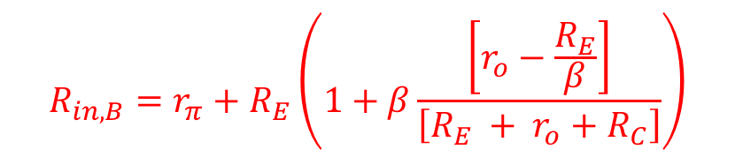








Small Signal Input Resistance of Common Collector Amplifier
$$V_{out}$$
$$R_{S}$$
collector
$$R_{in,B}=r_{π}+R_{E}\left(1+β\frac{\left[r_{o}−\frac{R_{E}}{β}\right]}{\left[R_{E} + r_{o}+R_{C}\right]}\right)$$
$$V_{B}$$
base
β I_{B}
$$i_{1}$$
$$r_{π}$$
I_{B}
r_{o}
$$i_{B}$$
$$V_{E}$$
$${R_{1}||R}_{2}$$
$$R_{C}$$
$$=0$$
$$V_{in}$$
$$+$$
emitter
$$−$$
$$R_{E}$$
$$i_{4}$$
$$R_{in}=\frac{r_{π}+R_{E}\left(1+β\frac{\left[r_{o}−\frac{R_{E}}{β}\right]}{\left[R_{E} + r_{o}+R_{C}\right]}\right)}{\left\{1+\frac{1}{\left(R_{1}∥R_{2}\right)}\left[r_{π}+\left(1+β\frac{\left[r_{o}−\frac{R_{E}}{β}\right]}{\left[R_{E} + r_{o}+R_{C}\right]}\right)R_{E}\right]\right\}}$$

Slide 5


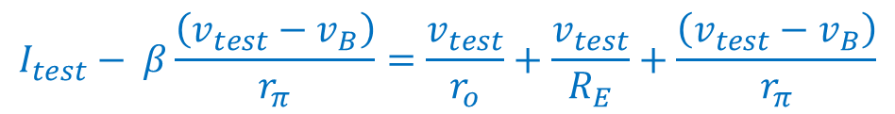



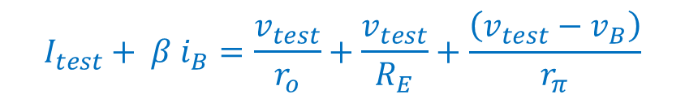







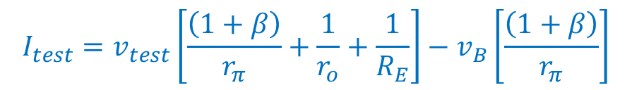



Small Signal Output Resistance of Common Collector Amplifier
$$R_{S}$$
$$V_{B}$$
base
Do a current balance at the emitter node
$$i_{1}$$
$$r_{π}$$
I_{B}
$$V_{out}$$
$$I_{test}+ β i_{B}=\frac{v_{test}}{r_{o}}+\frac{v_{test}}{R_{E}}+\frac{\left(v_{test}−v_{B}\right)}{r_{π}}$$
$$i_{B}$$
$$V_{E}$$
I_{test}
$${R_{1}||R}_{2}$$
emitter
$$V_{in}$$
$$+$$
$$−$$
r_{o}
$$+$$
$$V_{test}$$
$$R_{E}$$
β I_{B}
$$−$$
$$I_{test}− β\frac{\left(v_{test}−v_{B}\right)}{r_{π}}=\frac{v_{test}}{r_{o}}+\frac{v_{test}}{R_{E}}+\frac{\left(v_{test}−v_{B}\right)}{r_{π}}$$
collector
$$I_{test}=v_{test}\left[\frac{\left(1+β\right)}{r_{π}}+\frac{1}{r_{o}}+\frac{1}{R_{E}}\right]−v_{B}\left[\frac{\left(1+β\right)}{r_{π}}\right]$$

Slide 6

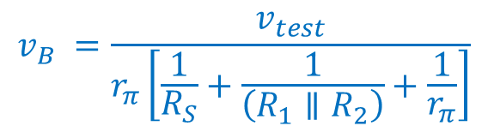
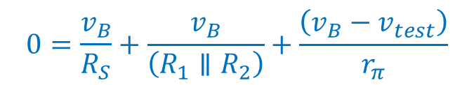

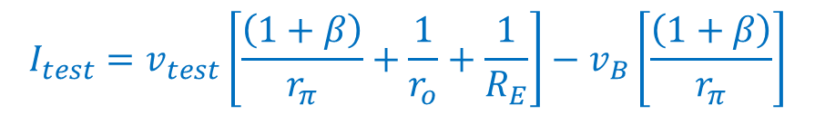
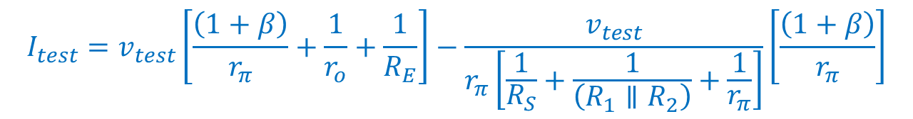
Small Signal Output Resistance of Common Collector Amplifier
$$R_{S}$$
$$V_{B}$$
base
Do a current balance at the base node
$$i_{1}$$
$$r_{π}$$
I_{B}
$$V_{out}$$
$$0=\frac{v_{B}}{R_{S}}+\frac{v_{B}}{\left(R_{1}∥R_{2}\right)}+\frac{\left(v_{B}−v_{test}\right)}{r_{π}}$$
$$i_{B}$$
$$V_{E}$$
I_{test}
$${R_{1}||R}_{2}$$
emitter
$$V_{in}$$
$$+$$
$$−$$
r_{o}
$$+$$
$$V_{test}$$
$$R_{E}$$
β I_{B}
$$−$$
$$\frac{v_{test}}{r_{π}}=\frac{v_{B}}{R_{S}}+\frac{v_{B}}{\left(R_{1}∥R_{2}\right)}+\frac{v_{B}}{r_{π}}$$
collector
$$I_{test}=v_{test}\left[\frac{\left(1+β\right)}{r_{π}}+\frac{1}{r_{o}}+\frac{1}{R_{E}}\right]−v_{B}\left[\frac{\left(1+β\right)}{r_{π}}\right]$$
$$\frac{v_{test}}{r_{π}}=v_{B}\left[\frac{1}{R_{S}}+\frac{1}{\left(R_{1}∥R_{2}\right)}+\frac{1}{r_{π}}\right]$$
$$I_{test}=v_{test}\left[\frac{\left(1+β\right)}{r_{π}}+\frac{1}{r_{o}}+\frac{1}{R_{E}}\right]−\frac{v_{test}}{r_{π}\left[\frac{1}{R_{S}}+\frac{1}{\left(R_{1}∥R_{2}\right)}+\frac{1}{r_{π}}\right]}\left[\frac{\left(1+β\right)}{r_{π}}\right]$$
$$v_{B} =\frac{v_{test}}{r_{π}\left[\frac{1}{R_{S}}+\frac{1}{\left(R_{1}∥R_{2}\right)}+\frac{1}{r_{π}}\right]}$$

Slide 7

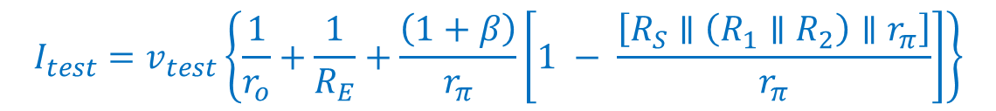
Small Signal Output Resistance of Common Collector Amplifier
$$I_{test}=v_{test}\left[\frac{\left(1+β\right)}{r_{π}}+\frac{1}{r_{o}}+\frac{1}{R_{E}}\right]−\frac{v_{test}}{r_{π}\left[\frac{1}{R_{S}}+\frac{1}{\left(R_{1}∥R_{2}\right)}+\frac{1}{r_{π}}\right]}\left[\frac{\left(1+β\right)}{r_{π}}\right]$$
$$I_{test}=v_{test}\left[\frac{1}{r_{o}}+\frac{1}{R_{E}}+\frac{\left(1+β\right)}{r_{π}}\right]−\frac{v_{test}\left(1+β\right)}{r_{π}}\left[\frac{\left[R_{S}∥\left(R_{1}∥R_{2}\right)∥r_{π}\right]}{r_{π}}\right]$$
$$I_{test}=v_{test}\left\{\frac{1}{r_{o}}+\frac{1}{R_{E}}+\frac{\left(1+β\right)}{r_{π}}\left[1 − \frac{\left[R_{S}∥\left(R_{1}∥R_{2}\right)∥r_{π}\right]}{r_{π}}\right]\right\}$$
$$I_{test}=v_{test}\left\{\frac{1}{r_{o}}+\frac{1}{R_{E}}+\frac{\left(1+β\right)}{r_{π}}\left[\frac{r_{π}−\left[R_{S}∥\left(R_{1}∥R_{2}\right)∥r_{π}\right]}{r_{π}}\right]\right\}$$

Slide 8

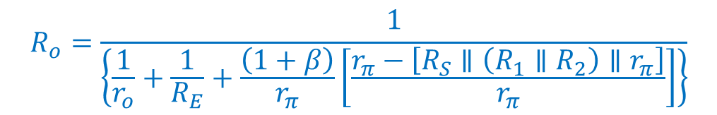

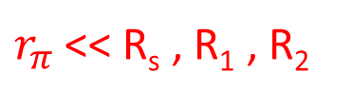
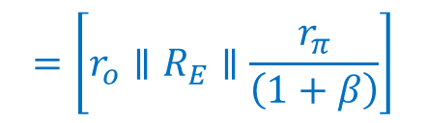
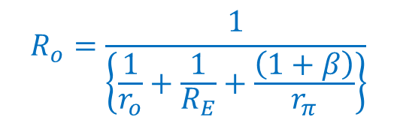
Small Signal Output Resistance of Common Collector Amplifier
$$I_{test}=v_{test}\left\{\frac{1}{r_{o}}+\frac{1}{R_{E}}+\frac{\left(1+β\right)}{r_{π}}\left[\frac{r_{π}−\left[R_{S}∥\left(R_{1}∥R_{2}\right)∥r_{π}\right]}{r_{π}}\right]\right\}$$
$$R_{o}=\frac{1}{\left\{\frac{1}{r_{o}}+\frac{1}{R_{E}}+\frac{\left(1+β\right)}{r_{π}}\left[\frac{r_{π}−\left[R_{S}∥\left(R_{1}∥R_{2}\right)∥r_{π}\right]}{r_{π}}\right]\right\}}$$
Limiting cases
R_{s} = 0
$$R_{o}=\frac{1}{\left\{\frac{1}{r_{o}}+\frac{1}{R_{E}}+\frac{\left(1+β\right)}{r_{π}}\right\}}$$
$$=\left[r_{o}∥R_{E}∥\frac{r_{π}}{\left(1+β\right)}\right]$$
$r_{π}$ << R_{s} , R₁ , R₂
$$R_{o}=\frac{1}{\left\{\frac{1}{r_{o}}+\frac{1}{R_{E}}\right\}}$$
$$=\left[r_{o}∥R_{E}\right]$$

Slide 10








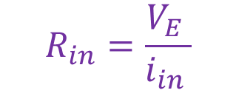



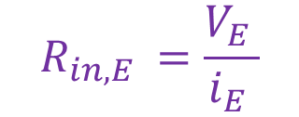




Small Signal Input Resistance of Common Base Amplifier
β I_{B}
$$V_{C}$$
$$R_{S}$$
$$R_{in}$$
$$V_{E}$$
$$R_{in,E}$$
$$I_{E}$$
$$V_{out}$$
emitter
$$I_{C}$$
$$R_{in,E }=\frac{V_{E }}{i_{E }}$$
$$I_{E}$$
collector
Resistance looking into the emitter.
$$R_{C}$$
$$V_{in}$$
$$+$$
$$R_{E}$$
$$r_{π}$$
$$R_{in}=\frac{V_{E }}{i_{in }}$$
$$−$$
I_{B}
Resistance looking into the amplifier
base

Slide 11


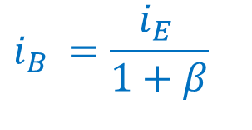
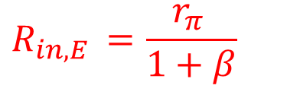


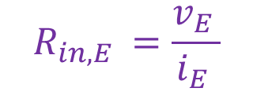
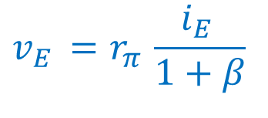

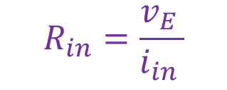


Small Signal Input Resistance of Common Base Amplifier
β i_{B}
$$v_{C}$$
$$R_{S}$$
$$v_{E}$$
$$i_{E}$$
$$V_{out}$$
emitter
$$i_{C}$$
$$R_{in,E }=\frac{v_{E }}{i_{E }}$$
$$I_{E}$$
collector
Resistance looking into the emitter.
$$R_{C}$$
$$v_{in}$$
$$+$$
$$R_{E}$$
$$r_{π}$$
$$R_{in}=\frac{v_{E }}{i_{in }}$$
$$−$$
i_{B}
Resistance looking into the amplifier
base
$$v_{E }=r_{π } i_{B }$$
$$i_{E }=i_{B }+βi_{B }$$
$$v_{E }=r_{π }\frac{i_{E }}{1+β}$$
$$i_{B }=\frac{i_{E }}{1+β}$$
$$R_{in,E }=\frac{r_{π }}{1+β}$$

Slide 12

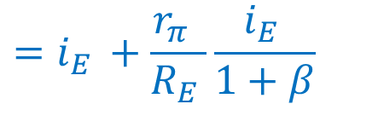
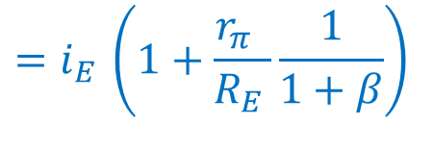

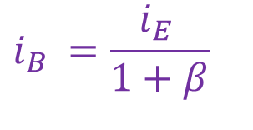

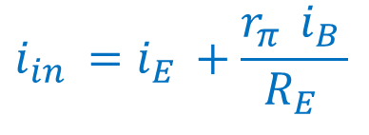
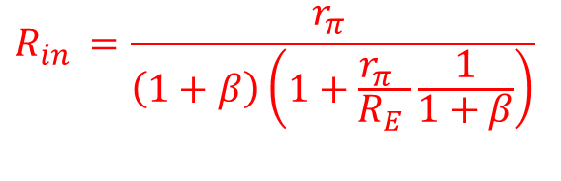
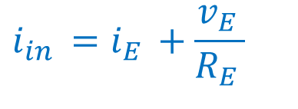
Small Signal Input Resistance of Common Base Amplifier
β i_{B}
$$v_{C}$$
$$R_{S}$$
$$i_{in}$$
$$v_{E}$$
$$i_{E}$$
$$V_{out}$$
emitter
$$i_{C}$$
$$R_{in,E }=\frac{v_{E }}{i_{E }}$$
$$I_{E}$$
collector
$$i_{1}$$
Resistance looking into the emitter.
$$R_{C}$$
$$v_{in}$$
$$+$$
$$R_{E}$$
$$r_{π}$$
$$R_{in}=\frac{v_{E }}{i_{in }}$$
$$−$$
i_{B}
Resistance looking into the amplifier
base
$$i_{B }=\frac{i_{E }}{1+β}$$
$$R_{in }=\frac{r_{π }}{\left(1+β\right)\left(1+\frac{r_{π } }{R_{E }}\frac{1}{1+β}\right)}$$
$$v_{E }=r_{π } i_{B }$$
$$i_{in }=i_{E }+\frac{v_{E }}{R_{E }}$$
$$i_{in }=i_{E }+\frac{r_{π } i_{B }}{R_{E }}$$
$$=i_{E }+\frac{r_{π } }{R_{E }}\frac{i_{E }}{1+β}$$
$$=i_{E }\left(1+\frac{r_{π } }{R_{E }}\frac{1}{1+β}\right)$$

Slide 14




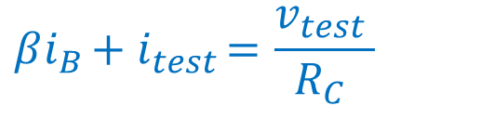



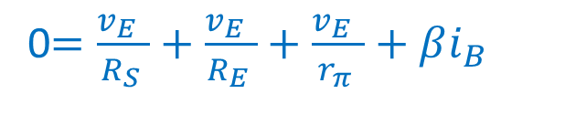
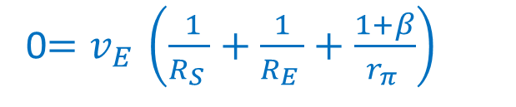



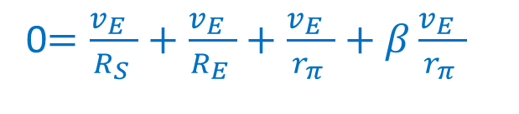
Small Signal Output Resistance of Common Base Amplifier
β i_{B}
$$v_{C}$$
$$R_{S}$$
$$v_{E}$$
$$i_{E}$$
$$V_{out}$$
i_{test}
emitter
$$i_{C}$$
Short out the independent voltage source
$$I_{E}$$
collector
Apply a test voltage to the output
$$R_{C}$$
$$+$$
$$V_{test}$$
$$R_{E}$$
$$r_{π}$$
$$−$$
We are neglecting r_{o}
i_{B}
Do a current balance at the collector
base
Do a current balance at the emitter
0$=\frac{v_{E } }{R_{S }}+\frac{v_{E } }{R_{E }}+\frac{v_{E } }{r_{π }}+βi_{B }$
$$βi_{B }+{ i}_{test }=\frac{v_{test }}{R_{C }}$$
$$v_{E }=0$$
$$i_{B }=0$$
0$=\frac{v_{E } }{R_{S }}+\frac{v_{E } }{R_{E }}+\frac{v_{E } }{r_{π }}+β\frac{v_{E } }{r_{π }}$
$$R_{o }=R_{C }$$
0$=v_{E }\left(\frac{ 1}{R_{S }}+\frac{1}{R_{E }}+\frac{1+β}{r_{π }}\right)$

Slide 15


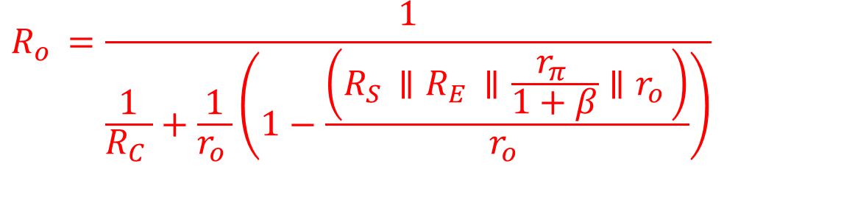



Small Signal Output Resistance of Common Base Amplifier
β i_{B}
$$v_{C}$$
$$R_{S}$$
$$v_{E}$$
$$i_{E}$$
$$V_{out}$$
i_{test}
emitter
$$i_{C}$$
We can include the resistance r_{o}
$$I_{E}$$
collector
$$r_{o}$$
$$R_{C}$$
If r_{o} << R_{S}, R_{E}, r_{π}/(1+β )
$$+$$
$$V_{test}$$
$$R_{E}$$
$$r_{π}$$
$$−$$
i_{B}
$$R_{o }=R_{C }$$
base
If r_{o} >> R_{S}, R_{E}, r_{π}/(1+β )
, R_{C}
$$R_{o }=\frac{1}{\frac{1}{R_{C }}+\frac{1}{r_{o }}\left(1−\frac{\left(R_{S }∥R_{E }∥\frac{r_{π }}{1+β}∥r_{o }\right)}{r_{o }}\right)}$$
$$R_{o }=R_{C }∥r_{o }$$
$$R_{o }=R_{C }$$
$${R_{C }≥R}_{o }≥\left(R_{C }∥r_{o }\right)$$

Slide 17
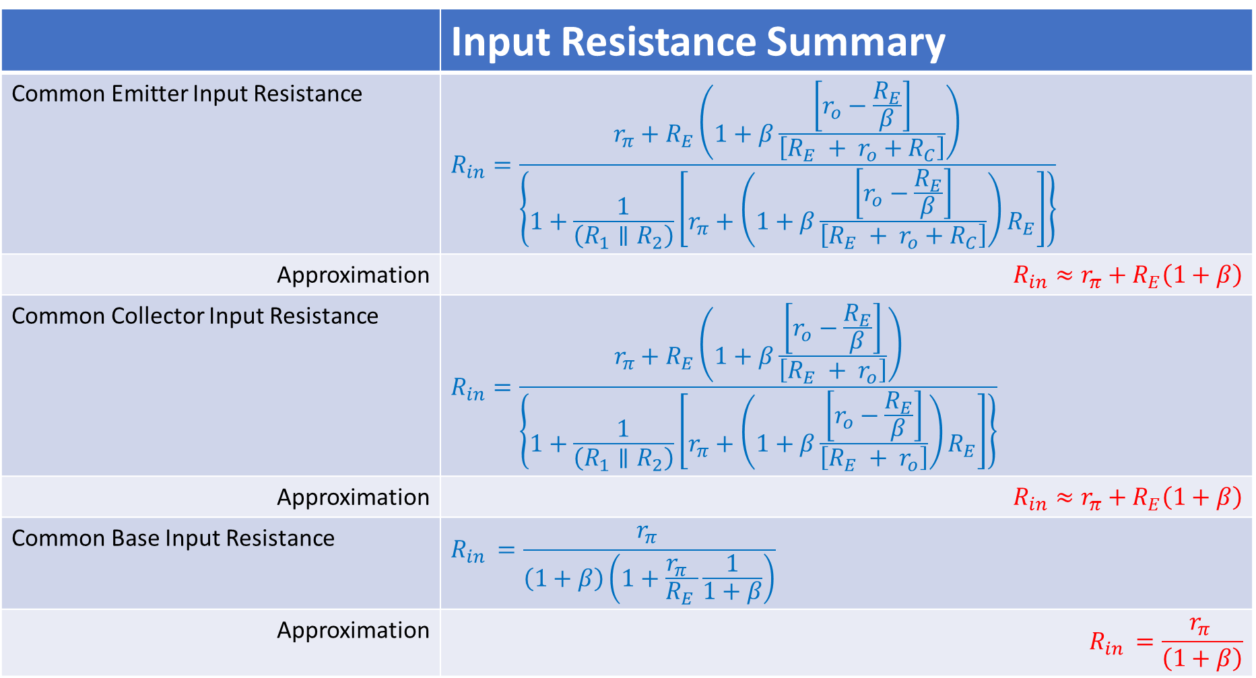
 | Input Resistance Summary
Common Emitter Input Resistance | $$R_{in}=\frac{r_{π}+R_{E}\left(1+β\frac{\left[r_{o}−\frac{R_{E}}{β}\right]}{\left[R_{E} + r_{o}+R_{C}\right]}\right)}{\left\{1+\frac{1}{\left(R_{1}∥R_{2}\right)}\left[r_{π}+\left(1+β\frac{\left[r_{o}−\frac{R_{E}}{β}\right]}{\left[R_{E} + r_{o}+R_{C}\right]}\right)R_{E}\right]\right\}}$$
Approximation | $$R_{in}≈r_{π}+R_{E}\left(1+β\right)$$
Common Collector Input Resistance | $$R_{in}=\frac{r_{π}+R_{E}\left(1+β\frac{\left[r_{o}−\frac{R_{E}}{β}\right]}{\left[R_{E} + r_{o}\right]}\right)}{\left\{1+\frac{1}{\left(R_{1}∥R_{2}\right)}\left[r_{π}+\left(1+β\frac{\left[r_{o}−\frac{R_{E}}{β}\right]}{\left[R_{E} + r_{o}\right]}\right)R_{E}\right]\right\}}$$
Approximation | $$R_{in}≈r_{π}+R_{E}\left(1+β\right)$$
Common Base Input Resistance | $$R_{in }=\frac{r_{π }}{\left(1+β\right)\left(1+\frac{r_{π } }{R_{E }}\frac{1}{1+β}\right)}$$
Approximation | $$R_{in }=\frac{r_{π }}{\left(1+β\right)}$$

Slide 18
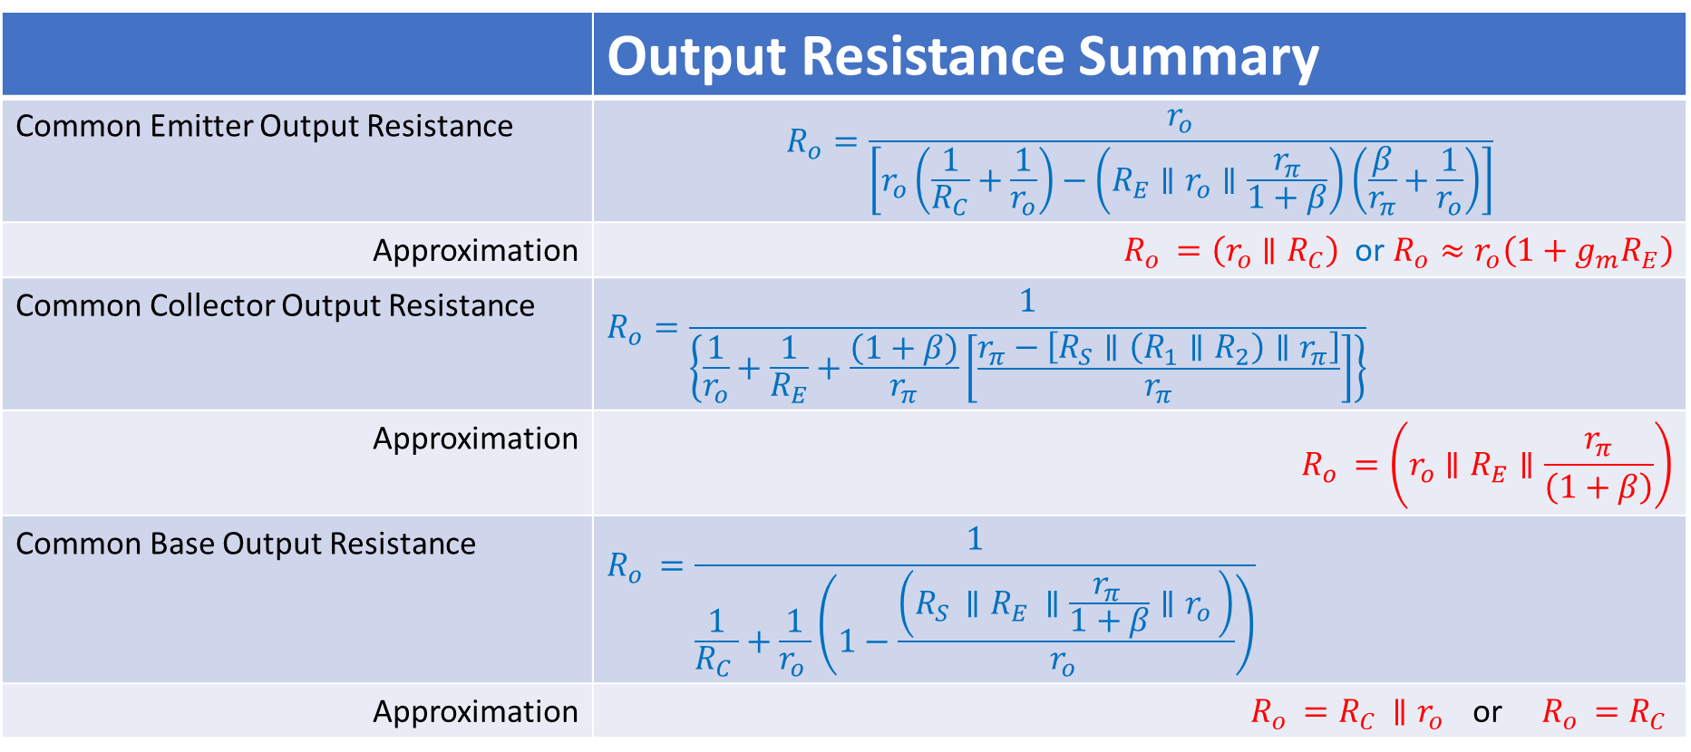
 | Output Resistance Summary
Common Emitter Output Resistance | $$R_{o}=\frac{r_{o}}{\left[r_{o}\left(\frac{1}{R_{C}}+\frac{1}{r_{o}}\right)−\left(R_{E}∥r_{o}∥\frac{r_{π}}{1+β}\right)\left(\frac{β}{r_{π}}+\frac{1}{r_{o}}\right)\right]}$$
Approximation | $R_{o }=\left(r_{o}∥R_{C}\right)$ or $R_{o}≈r_{o}\left({1+g_{m}R}_{E}\right)$
Common Collector Output Resistance | $$R_{o}=\frac{1}{\left\{\frac{1}{r_{o}}+\frac{1}{R_{E}}+\frac{\left(1+β\right)}{r_{π}}\left[\frac{r_{π}−\left[R_{S}∥\left(R_{1}∥R_{2}\right)∥r_{π}\right]}{r_{π}}\right]\right\}}$$
Approximation | $$R_{o }=\left(r_{o}∥R_{E}∥\frac{r_{π}}{\left(1+β\right)}\right)$$
Common Base Output Resistance | $$R_{o }=\frac{1}{\frac{1}{R_{C }}+\frac{1}{r_{o }}\left(1−\frac{\left(R_{S }∥R_{E }∥\frac{r_{π }}{1+β}∥r_{o }\right)}{r_{o }}\right)}$$
Approximation | $R_{o }=R_{C }∥r_{o }$ or $R_{o }=R_{C }$

