Slide 1
Analog Electronics Technology
Op Amps

Slide 2
Analog Electronics Technology
Diodes
BJT’s
Op Amps

Slide 3
What we will talk about today
Ideal Op Amps
Non-inverting Op Amp circuits
Inverting Op Amp circuits ??

Slide 4
An op amp is a differential amplifier.
The output of the amplifier equals the internal forward gain of the amplifier, a, times the difference of the inputs.
Negative input
V₋
—
V_{out}
V_{out} = a (V₊ - V₋)
Positive input
V₊
+
Internal forward gain

Slide 5
Ideal Op Amp
V_{n}
V_{out}
r_{d}
+
V_{p}
—
aV_{o}
r_{o}
The internal forward gain is infinite
The input current is zero for both terminals
The output resistance is zero
(The input resistance is infinite)

Slide 6
Noninverting Amplifier
R₁
R₂
—
V_{out}
+
V_{in}
+
—
The input voltage, V_{in}, is applied to the positive input of the amplifier
The resistors R₁ and R₂ form a voltage divider so that a portion of the output is applied to the negative terminal.
V₋ = V_{out} R₁ / (R₁ + R₂)

Slide 7
Noninverting Amplifier
R₁
R₂
—
V_{out}
+
V_{in}
+
—
Define feedback factor, b: b = R₁ / (R₁ + R₂)
Then: V₋ = b * V_{out}
The op amp output equals the internal gain times the input difference
V_{out} = a (V₊ - V₋) = a ( V_{in} - b * V_{out} )

Slide 8
Noninverting Amplifier
feedback factor
b = R₁ / (R₁ + R₂)
R₁
R₂
—
V_{out}
+
V_{out} = a ( V_{in} - b * V_{out} )
+
V_{in}
Factor out V_{out}
—
Distribute the a
V_{out} ( 1 + a*b) = a ( V_{in})
V_{out} = a V_{in} - a b * V_{out}
Solve for V_{out}
Rearrange to get terms with V_{out} together
V_{out} = ( V_{in}) a/ ( 1 + a*b)
V_{out} + a * b * V_{out} = a ( V_{in})

Slide 9

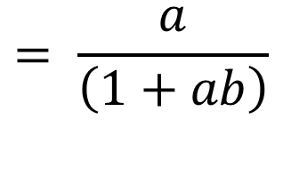
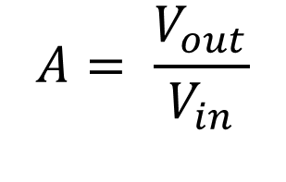

Noninverting Amplifier
feedback factor
b = R₁ / (R₁ + R₂)
R₁
R₂
—
V_{out}
+
V_{out} = ( V_{in}) a/ ( 1 + a*b)
V_{in}
+
—
$$A= \frac{1}{\left(b+\frac{1}{a}\right)}$$
Find the closed loop voltage gain, A
$$A= \frac{V_{out}}{V_{in}}$$
$$= \frac{a}{\left(1+ab\right)}$$
$$A= \frac{1}{b\left(1+\frac{1}{a∗b}\right)}$$

Slide 10

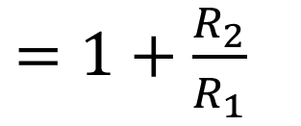
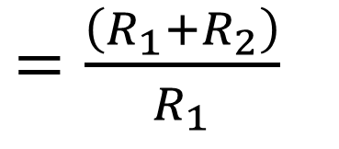
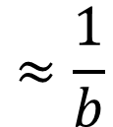
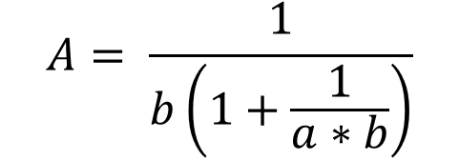
Noninverting Amplifier
feedback factor
b = R₁ / (R₁ + R₂)
R₁
R₂
—
V_{out}
+
$$A= \frac{1}{b\left(1+\frac{1}{a∗b}\right)}$$
V_{in}
+
—
If a*b >> 1
$$A= \frac{1}{b\left(1+\frac{1}{a∗b}\right)}$$
$$≈\frac{1}{b}$$
$=\frac{\left(R_{1}+R_{2}\right)}{R_{1}}$
$=1+\frac{R_{2}}{R_{1}}$

Slide 11
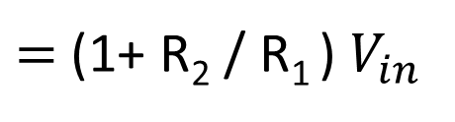

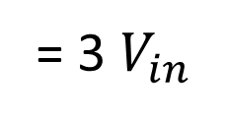
Noninverting Amplifier Example 1
Find the output of the following circuit.
R₁= 1 kΩ
R₂ = 2 kΩ
—
V_{out}
+
V_{in}
+
—
$$V_{out}= A V_{in}$$
$=$(1+ R₂ / R₁ ) $V_{in}$
= 3 $V_{in}$

Slide 12
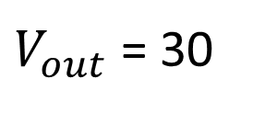
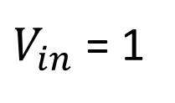
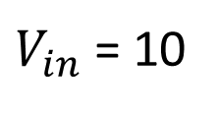

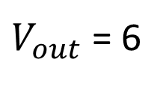
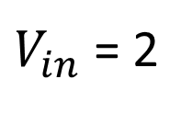

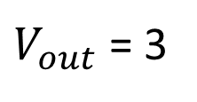

Noninverting Amplifier Example 1
A word of caution:
R₁= 1 kΩ
R₂ = 2 kΩ
$$V_{out}=\text{ 3 }V_{in}$$
$$V^{+}$$
$V_{out}$= 3
$V_{in}$= 1
—
V_{out}
+
$V_{out}$= 6
$V_{in}$= 2
+
$$V^{−}$$
Power supply for Op Amp
V_{in}
—
$V_{out}$= 30
$V_{in}$= 10
Often ±15 V
Could be ±18 V or ±12 V
The output is limited by the power supply voltage

Slide 13
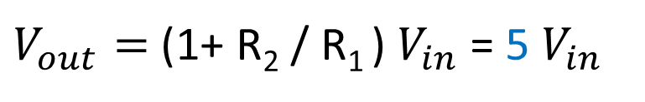
Noninverting Amplifier Example 2
Design a circuit whose output voltage will be 5 times the input voltage.
R₁
R₂
—
V_{out}
$V_{out}=$(1+ R₂ / R₁ ) $V_{in}$= 5 $V_{in}$
+
V_{in}
+
—
(1+ R₂ / R₁ ) = 5
Choose R₂ = 4 k Ω
R₁ = 1 k Ω
R₂ / R₁ = 4

Slide 14
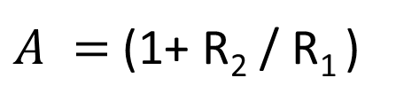
Noninverting Amplifier Example 3
What is the gain (V_{out} / V_{in}) of the following circuit.
R₁= 10 kΩ
R₂ = 2 kΩ
—
V_{out}
+
V_{in}
+
—
$A =$(1+ R₂ / R₁ )
= (1+ 2 kΩ / 10 kΩ )
= 1.2

Slide 15
Noninverting Amplifier Example 4
What is the gain (V_{out} / V_{in}) of the following circuit.
R₁= 100 kΩ
R₂ = 100 Ω
—
V_{out}
+
V_{in}
+
—
$A =$(1+ R₂ / R₁ )
= (1+ 0.1 kΩ / 100 kΩ )
= 1.001

Slide 16
Noninverting Amplifier Example 5
What is the gain (V_{out} / V_{in}) of the following circuit.
R₁= 10 MΩ
R₂ = 100 Ω
—
V_{out}
+
V_{in}
+
—
$A =$(1+ R₂ / R₁ ) = (1+ 0.1 kΩ / 10000 kΩ ) = 1.00001

Slide 17
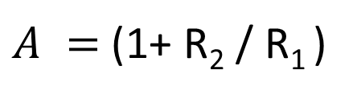
Noninverting Amplifier Example 6
What is the gain (V_{out} / V_{in}) of the following circuit.
R₂ = 100 Ω
—
V_{out}
+
V_{in}
+
—
$A =$(1+ R₂ / R₁ )
= (1+ 0.1 kΩ /
∞ kΩ )
= 1

Slide 18

Voltage Follower
—
V_{out}
+
V_{in}
+
—
for the special case of R₂ / R₁$≈$ 0
$$A≈1$$

