Slide 1
Analog Electronics Technology
Op Amps

Slide 2
Analog Electronics Technology
Diodes
BJT’s
Op Amps
Ideal Op Amps
Non-inverting Op Amps
Inverting Op Amps

Slide 3
What we will talk about today
Inverting Op Amp circuits

Slide 4
Inverting Amplifier
R₁
R₂
V_{in}
+
V_{out}
—
—
+
The positive input of the amplifier equals zero.
Use the superposition principle to find what V₋ is.

Slide 5
Inverting Amplifier
R₁
R₂
What is the voltage at V₋ from V_{out} ?
V_{in}
+
V_{out}
—
—
Short circuit V_{in}
+
R₁ and R₂ form a voltage divider so that a portion of the output is applied to the negative terminal.
V₋ = V_{out} R₁ / (R₁ + R₂)

Slide 6
Inverting Amplifier
What is the voltage at V₋ from V_{in} ?
R₁
R₂
Short circuit V_{out}
V_{in}
+
V_{out}
—
—
+
R₁ and R₂ form a voltage divider so that a portion of the output is applied to the negative terminal.
V₋ = V_{in} R₂ / (R₁ + R₂)

Slide 7
Inverting Amplifier
R₁
R₂
Add together the two contributions:
+
V₋ = V_{out} R₁ / (R₁ + R₂) + V_{in} R₂ / (R₁ + R₂)
V_{in}
—
V_{out}
—
+
Contribution from output
Contribution from input
V₊ = 0
Internal gain of the amplifier:
V_{out} = a (V₊ - V₋ )
Substitute:
V_{out} = -a [V_{out} R₁ / (R₁ + R₂) + V_{in} R₂ / (R₁ + R₂)]

Slide 8
Inverting Amplifier
R₁
R₂
V_{out} = -a [V_{out} R₁ / (R₁ + R₂) + V_{in} R₂ / (R₁ + R₂)]
V_{in}
+
V_{out}
—
—
+
V_{out} + a V_{out} R₁ / (R₁ + R₂) = - a V_{in} R₂ / (R₁ + R₂)
Multiply by (R₁ + R₂) :
V_{out} (R₁ + R₂) + a V_{out} R₁ = - a V_{in} R₂
V_{out} [(R₁ + R₂) + a R₁ ] = - a V_{in} R₂

Slide 9
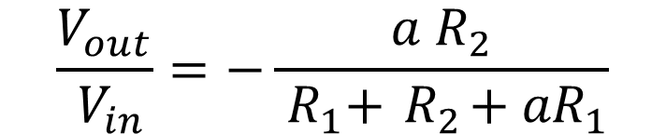
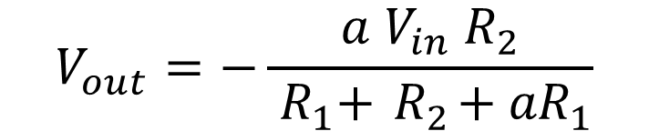
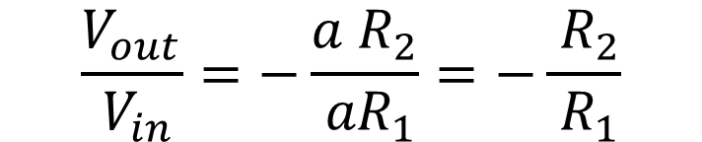
Inverting Amplifier
R₁
R₂
V_{out} [(R₁ + R₂) + a R₁] = - a V_{in} R₂
V_{in}
+
V_{out}
—
—
Solve for gain:
+
$$V_{out}=−\frac{a{ V}_{in}{ R}_{2}}{{ R}_{1}+{ R}_{2}+{ aR}_{1}}$$
$$\frac{V_{out}}{{ V}_{in}}=−\frac{a{ R}_{2}}{{ R}_{1}+{ R}_{2}+{ aR}_{1}}$$
Since a is extremely large:
$$\frac{V_{out}}{{ V}_{in}}=−\frac{a{ R}_{2}}{{ aR}_{1}}=−\frac{{ R}_{2}}{{ R}_{1}}$$

Slide 10
Inverting Amplifier
R₁
R₂
Alternate method based upon ideal op amp properties
V_{in}
+
V_{out}
—
—
+
Virtual Ground
The op amp will force its input terminals to be at the same voltage
Since the V₊ terminal is grounded, the V₋ terminal will also be at zero volts
The V₋ terminal will not actually be grounded. No current will flow from the terminal to ground, but the terminal will be at zero volts

Slide 11
Inverting Amplifier
R₁
R₂
I₁
I₂
V_{in}
+
V_{out}
—
—
+
Since the V₋ terminal is at virtual ground, we can determine the current through R₁
I₁ = V_{in} / R₁
No current flows into the terminals of an ideal op amp
Apply KCL to the V₋ node
I₁ = I₂

Slide 12
Inverting Amplifier
V₂
R₁
+
R₂
-
Calculate the voltage drop across I₂
I₁
I₂
V₂ = I₂ R₂
V_{in}
+
V_{out}
—
—
+
V_{out} = -V₂
= -I₂ R₂
= -I₁ R₂
= -(V_{in} / R₁ ) R₂
V_{out} /V_{in} = -(R₂/ R₁ )

Slide 13
Inverting Amplifier Example 1
1 kΩ
10 kΩ
V_{in}
+
V_{out}
—
—
+
Calculate the gain of the above circuit
V_{out} /V_{in} = -(R₂/ R₁ )
= -(10 kΩ/ 1 kΩ)
= - 10

Slide 14
Inverting Amplifier Example 2
10 kΩ
1 kΩ
V_{in}
+
V_{out}
—
—
+
Calculate the gain of the above circuit
V_{out} /V_{in} = -(R₂/ R₁ )
= -(1 kΩ/ 10 kΩ)
= - 0.1

Slide 15
Inverting Amplifier Example 3
R₁
R₂
V_{in}
+
V_{out}
—
—
+
Design a circuit that has a gain of -20
V_{out} /V_{in} = -(R₂/ R₁ ) = -20
Choose R₂ = 20 kΩ
R₁ = 1 kΩ

Slide 16
Circuit Designs of Various Gains

Slide 17
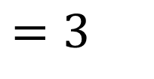
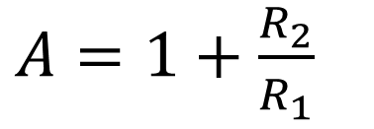
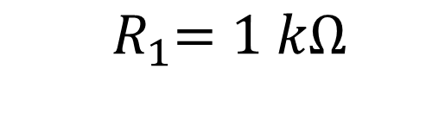
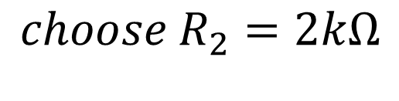
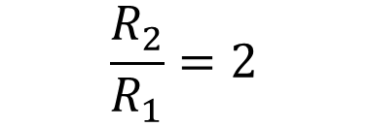
Example 4
Design a circuit that has a gain of 3
The gain is positive, so we need a non-inverting op amp.
$A=1+\frac{R_{2}}{R_{1}}$
$=3$
R₁
R₂
V_{out}
$$\frac{R_{2}}{R_{1}}=2$$
—
+
V_{in}
+
$${choose R}_{2}=2kΩ$$
—
$${ R}_{1}=1 kΩ$$

Slide 18
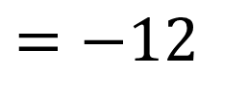
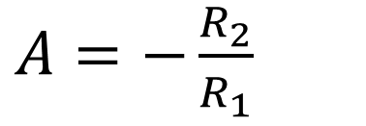
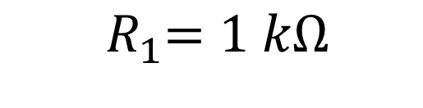
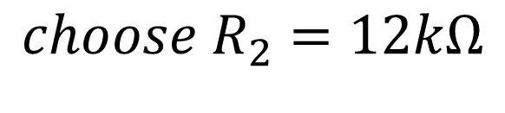
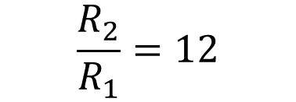
Example 5
Design a circuit that has a gain of -12
The gain is negative, so we need an inverting op amp.
$A=−\frac{R_{2}}{R_{1}}$
$=−12$
R₁
R₂
+
V_{out}
$$\frac{R_{2}}{R_{1}}=12$$
V_{in}
—
—
+
$${choose R}_{2}=12kΩ$$
$${ R}_{1}=1 kΩ$$

Slide 19
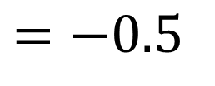
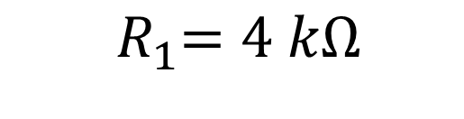

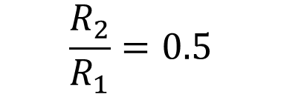
Example 6
Design a circuit that has a gain of -0.5
The gain is negative, so we need an inverting op amp.
$A=−\frac{R_{2}}{R_{1}}$
$=−0.5$
R₁
R₂
+
V_{out}
$$\frac{R_{2}}{R_{1}}=0.5$$
V_{in}
—
—
+
$${choose R}_{2}=2kΩ$$
$${ R}_{1}=4 kΩ$$

Slide 20
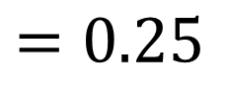
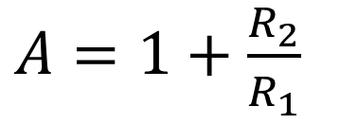
Example 6
Design a circuit that has a gain of 0.25
The gain is positive, so we need a non-inverting op amp.
$A=1+\frac{R_{2}}{R_{1}}$
$=0.25$
R₁
R₂
We don’t know how to do that.
—
V_{out}
+
V_{in}
+
—

Slide 21
Gain
-1
0
1
∞
-∞
R₂ > R₁
R₂ < R₁
Inverting amplifier
Noninverting amplifier
R₁
R₂
R₁
R₂
V_{in}
+
V_{out}
—
V_{out}
—
—
+
+
V_{in}
+
—

Slide 22


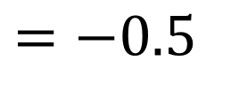
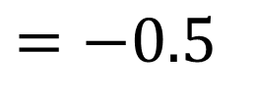
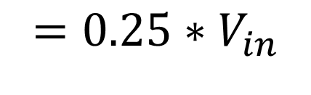
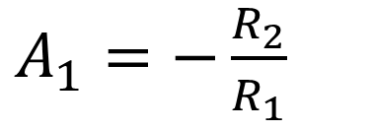
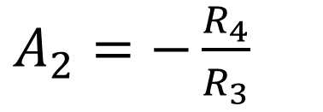
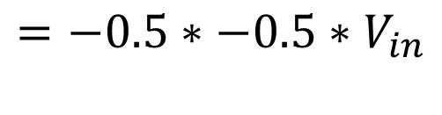

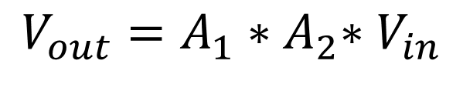



Method 1 – Two inverting op amps
$$4 kΩ$$
$$2kΩ$$
$${V_{out}=A}_{1}{∗A}_{2}{∗V}_{in}$$
R₁
R₂
$$4 kΩ$$
$$2kΩ$$
$$=−0.5∗−0.5{∗V}_{in}$$
+
$$8 kΩ$$
R₃
R₄
V_{in}
—
V_{out}
—
$$=0.25{∗V}_{in}$$
+
$$2 kΩ$$
V_{out}
—
+
$A_{1}=−\frac{R_{2}}{R_{1}}$
$=−0.5$
$A_{2}=−\frac{R_{4}}{R_{3}}$
$=−0.5$

Slide 23
There is another way that will not require two op amps

Slide 24
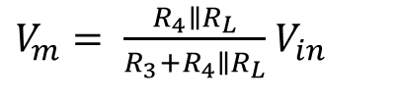
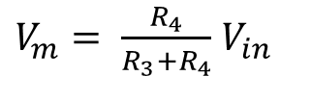

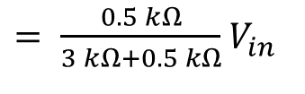
Method 2
A voltage divider will reduce the voltage
R₃ = 3 kΩ and R₄ = 1 kΩ will reduce the output by 3 fourths
V_{in}
+
3 kΩ
—
R₃
$V_{m}= \frac{R_{4}}{{R_{3}+R}_{4}}$ $V_{in}$
V_{m}
The problem with this is that a load will further reduce the voltage
1 kΩ
$V_{m}= \frac{R_{4}∥R_{L}}{{R_{3}+R}_{4}∥R_{L}}$ $V_{in}$
R₄
R_{L} =1 kΩ
$= \frac{0.5 kΩ}{3 kΩ+0.5 kΩ}$ $V_{in}$
$=0.14$ $V_{in}$
A voltage follower can solve this problem

Slide 25
Method 2 – Voltage Divider Followed by Voltage Follower
V_{in}
+
—
R₃
$V_{m}= \frac{R_{4}}{{R_{3}+R}_{4}}$ $V_{in}$
—
V_{out}
V_{m}
+
R₄
A voltage follower will provide a low resistance output so that a load will not cause voltage droop

Slide 26
-1
0
1
∞
-∞
R₂ > R₁
R₂ < R₁
Voltage divider with voltage follower
Inverting amplifier
Noninverting amplifier

Slide 28
Practice Problems – Circuit Designs of various gains

Slide 29
Practice Problem 1
Design a circuit that has a gain of 6

Slide 30
Practice Problem 2
Design a circuit that has a gain of -12

Slide 31
Practice Problem 3
Design a circuit that has a gain of 0.4

Slide 32
Practice Problem 4
Design a circuit that has a gain of ‒ 0.6

Slide 33
Practice Problem 5
Design a circuit that has a gain of 15

