Slide 1
Analog Electronics Technology
Solutions for Practice Problems
Designing Op Amp Circuits with Specified Gains

Slide 2

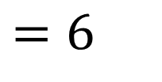

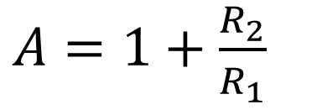
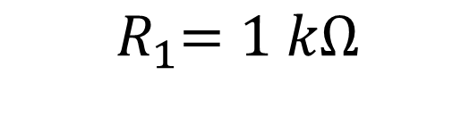
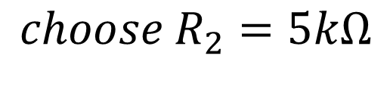
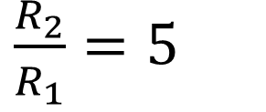
Practice Problem 1
Design a circuit that has a gain of 6
We will need a non-inverting op amp circuit
$$1 kΩ$$
$$5kΩ$$
R₁
R₂
$A=1+\frac{R_{2}}{R_{1}}$
$=6$
—
V_{out}
$\frac{R_{2}}{R_{1}}=5$
+
V_{in}
+
$${choose R}_{2}=5kΩ$$
—
$${ R}_{1}=1 kΩ$$

Slide 3
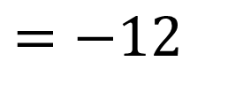

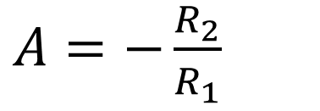

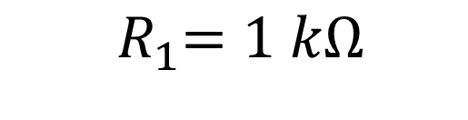

Practice Problem 2
Design a circuit that has a gain of -12
We will need an inverting op amp circuit
$$1 kΩ$$
$$12kΩ$$
$A=−\frac{R_{2}}{R_{1}}$
$=−12$
R₁
R₂
V_{in}
+
V_{out}
—
—
+
$${choose R}_{2}=12kΩ$$
$${ R}_{1}=1 kΩ$$

Slide 4

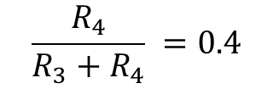

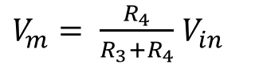



Practice Problem 3
Design a circuit that has a gain of 0.4
We will need a voltage divider followed by a voltage follower
$$\frac{R_{4}}{{R_{3}+R}_{4}} =0.4$$
+
R₃
$$3kΩ$$
—
—
V_{out}
$V_{m}= \frac{R_{4}}{{R_{3}+R}_{4}}$ $V_{in}$
$$R_{4}=0.4\left({R_{3}+R}_{4}\right)$$
+
$${0.6 R}_{4}=0.4{ R}_{3}$$
R₄
$$2 kΩ$$
$${1.5 R}_{4}={ R}_{3}$$

Slide 5
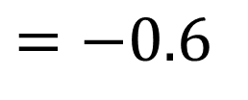


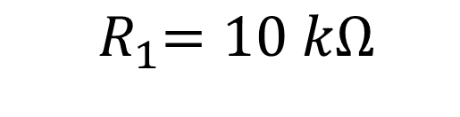

Practice Problem 4
Design a circuit that has a gain of ‒ 0.6
We will need an inverting op amp circuit
$$10 kΩ$$
$$6kΩ$$
$A=−\frac{R_{2}}{R_{1}}$
$=−0.6$
R₁
R₂
V_{in}
+
V_{out}
—
—
+
$${choose R}_{2}=6kΩ$$
$${ R}_{1}=10 kΩ$$

Slide 6
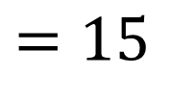

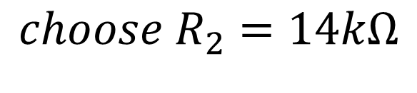
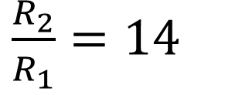
Practice Problem 5
Design a circuit that has a gain of 15
We will need a non-inverting op amp circuit
$$1 kΩ$$
$$14kΩ$$
R₁
R₂
$A=1+\frac{R_{2}}{R_{1}}$
$=15$
—
V_{out}
$\frac{R_{2}}{R_{1}}=14$
+
V_{in}
+
$${choose R}_{2}=14kΩ$$
—
$${ R}_{1}=1 kΩ$$

