Slide 1
Analog Electronics Technology
Op Amps

Slide 2
What we will talk about today
Input impedance of op amp amplifiers
Problems caused
Solutions
More op amp circuits
Adding voltages
(V₁ + V₂)
Weighted addition
(3V₁ + 5V₂)

Slide 3
Look at the input impedance of both amplifier types
Noninverting
Inverting
R₁
R₂
R₁
R₂
V_{in}
+
V_{out}
—
V_{out}
—
—
+
+
V_{in}
+
—
Ideal op amp
infinite
Real op amp
very high
Input resistance of the amplifier is approximately equal to the input resistance of the op amp
Input resistance of the amplifier is approximately equal to R₁

Slide 4
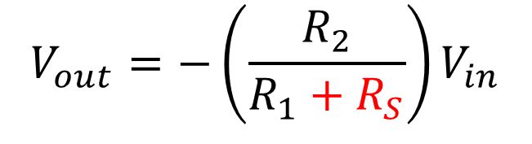
Why is input impedance important?
$$V_{out}=−\left(\frac{R_{2}}{R_{1}+R_{S}}\right)V_{in}$$
Inverting Amplifier
Source with internal resistance
R₁
R₂
R_{S}
V_{in}
+
—
V_{out}
—
+
The combination of the source resistance, R_{S}, and the input resistance of the amplifier, R₁, forms a voltage divider which attenuates the input voltage.

Slide 5
















Why is input impedance important?
$$V_{out}=−\left(\frac{R_{2}}{R_{1}+R_{S}}\right)V_{in}$$
Inverting Amplifier
R₁= 10 kΩ
R₂ = 50 kΩ
R₁= 100 Ω
R₂ = 500 Ω
Source
Source
R_{S}
—
V_{out}
R_{S}
—
V_{out}
+
+
V_{in}
+
V_{in}
+
—
—
$$A_{v}=−5$$
$$A_{v}=−5$$
$$A_{v}=−5$$
$$A_{v}=−4.9995$$
$$A_{v}=−4.95$$
$$R_{S}=1\text{Ω}$$
$$A_{v}=−5$$
$$A_{v}=−4.995$$
$$A_{v}=−4.54$$
$$R_{S}=10\text{Ω}$$
$$A_{v}=−5$$
$$A_{v}=−4.95$$
$$A_{v}=−2.5$$
$$R_{S}=100\text{Ω}$$
$$A_{v}=−5$$

Slide 6
A two-stage amplifier can solve the problem.
Voltage Follower
Inverting Amplifier
Source with internal resistance
V_{out}
R₁
R₂
—
R_{S}
+
—
V_{out}
V_{in}
+
—
+
The high input resistance of the voltage follower keeps the source from being loaded down.
The low output resistance of the voltage follower makes the inverting amplifier see the full voltage from the source.

Slide 7
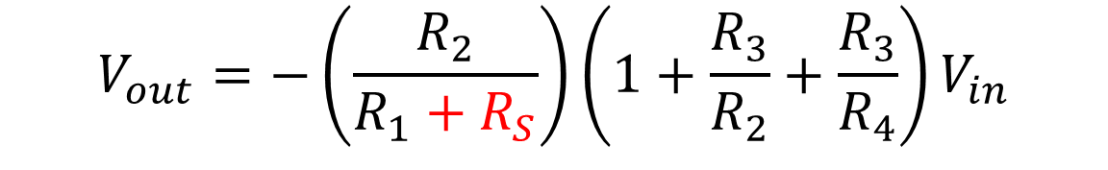
A “T” arrangement can also help
R₂
R₃
Source with internal resistance
R₁
R₄
R_{S}
V_{in}
+
V_{out}
—
—
+
The gain can be increased without using a very large feedback resistor or too small of an input resistor
$$V_{out}=−\left(\frac{R_{2}}{R_{1}+R_{S}}\right){\left(1+\frac{R_{3}}{R_{2}}+\frac{R_{3}}{R_{4}}\right)V}_{in}$$

Slide 8
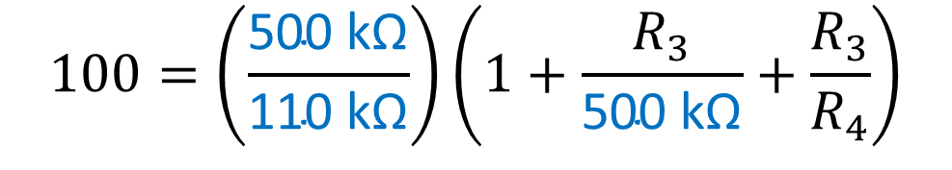
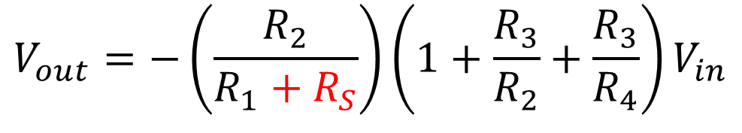
A “T” arrangement Example
R₂
R₃
We want a gain of -100
Source with internal resistance
R_{S} = 10 kΩ
We want R₁ = 100 kΩ to prevent too much loading
R₁
R₄
R_{S}
We want all resistors <= 500 kΩ
V_{in}
+
V_{out}
—
—
+
Choose R₂ = 500 kΩ
$$V_{out}=−\left(\frac{R_{2}}{R_{1}+R_{S}}\right){\left(1+\frac{R_{3}}{R_{2}}+\frac{R_{3}}{R_{4}}\right)V}_{in}$$
$$100=\left(\frac{\text{500 }\text{k}\text{Ω}}{\text{11}\text{0 }\text{k}\text{Ω}}\right)\left(1+\frac{R_{3}}{\text{500 }\text{k}\text{Ω}}+\frac{R_{3}}{R_{4}}\right)$$

Slide 9
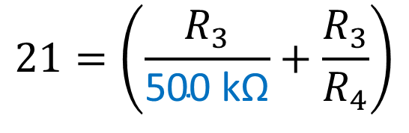
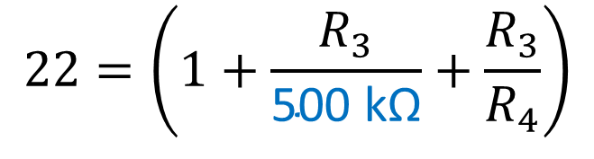
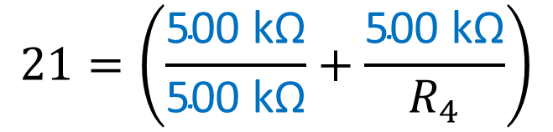
A “T” arrangement Example
R_{S} = 10 kΩ
R₂
R₃
We want a gain of -100
Source with internal resistance
R₁
R₄
R_{S}
We want R₁ = 100 kΩ to prevent too much loading
V_{in}
+
V_{out}
—
—
We want all resistors <= 500 kΩ
+
Choose R₃ = 500 kΩ
$$22=\left(1+\frac{R_{3}}{\text{500 }\text{k}\text{Ω}}+\frac{R_{3}}{R_{4}}\right)$$
$$21=\left(\frac{R_{3}}{\text{500 }\text{k}\text{Ω}}+\frac{R_{3}}{R_{4}}\right)$$
$$21=\left(\frac{\text{500 }\text{k}\text{Ω}}{\text{5}\text{00 }\text{k}\text{Ω}}+\frac{\text{500 }\text{k}\text{Ω}}{R_{4}}\right)$$

Slide 10
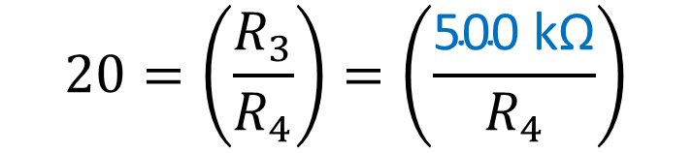
A “T” arrangement Example
R_{S} = 10 kΩ
R₂
R₃
We want a gain of -100
Source with internal resistance
R₁
R₄
R_{S}
We want R₁ = 100 kΩ to prevent too much loading
V_{in}
+
V_{out}
—
—
We want all resistors <= 500 kΩ
+
Choose R₃ = 500 kΩ
Choose R₄ = 25 kΩ
$$20=\left(\frac{R_{3}}{R_{4}}\right)=\left(\frac{\text{500 }\text{k}\text{Ω}}{R_{4}}\right)$$
We were able to get a gain of -100 without loading down the source and without using large resistors

Slide 12
A Summing Amplifier Circuit
Negative
R₃
Resistors provide weighting factors
V₃
+
R₂
—
For example:
3 V₁ + 2 V₂ + V₃
R₁
R_{f}
V₂
+
—
Inputs to be added
V₁
+
—
V_{out}
—
+
For simple addition, make all resistors identical

Slide 13
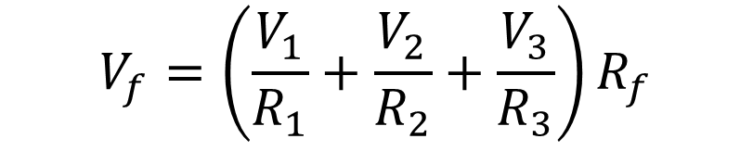
A Summing Amplifier Circuit
The negative input of the op amp is at virtual ground.
R₃
I₃ = V₃ / R₃
Since no current flows into the op amp inputs,
I_{f} = I₁ + I₂ + I₃
I₃
V₃
+
—
R₂
I₂ = V₂ / R₂
I₂
+
R₁
R_{f}
The voltage drop across the feed back resistor is:
V₂
—
I₁
I_{f}
+
I₁ = V₁ / R₁
V_{out}
V₁
—
—
V_{f} = I_{f} R_{f} = (I₁ + I₂ + I₃)R_{f}
+
$$V_{f}=\left(\frac{V_{1}}{R_{1}}+\frac{V_{2}}{R_{2}}+\frac{V_{3}}{R_{3}}\right)R_{f}$$

Slide 14
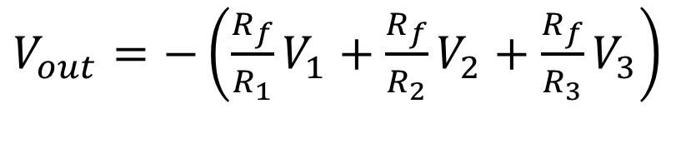
A Summing Amplifier Circuit
R₃
The output of the op amp is V_{out} = - V_{f}
I₃
V₃
+
—
R₂
I₂
R₁
R_{f}
$V_{out}=−\left(\frac{R_{f}}{R_{1}}V_{1}+\frac{R_{f}}{R_{2}}V_{2}+\frac{R_{f}}{R_{3}}V_{3}\right)$
V₂
+
—
I₁
I_{f}
V₁
+
—
V_{out}
—
+
The ratios of the resistors provide weighting factors.
Notice that it is always the negative of the sum

Slide 15
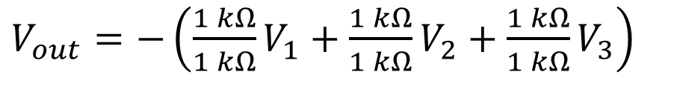
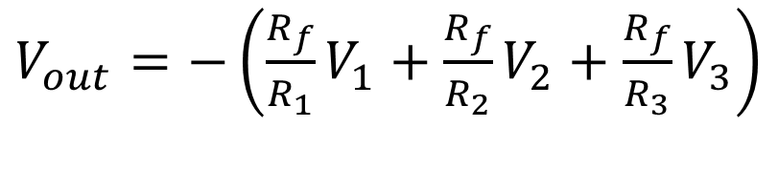

A Summing Amplifier Circuit Example 1
R₃
1 kΩ
$V_{out}=−\left(\frac{R_{f}}{R_{1}}V_{1}+\frac{R_{f}}{R_{2}}V_{2}+\frac{R_{f}}{R_{3}}V_{3}\right)$
I₃
V₃
+
1 kΩ
—
R₂
I₂
$V_{out}=−\left(\frac{1 kΩ}{1 kΩ}V_{1}+\frac{1 kΩ}{1 kΩ}V_{2}+\frac{1 kΩ}{1 kΩ}V_{3}\right)$
R_{f}
R₁
1 kΩ
V₂
+
1 kΩ
—
I₁
I_{f}
$V_{out}=−\left(V_{1}+V_{2}+V_{3}\right)$
V₁
+
—
V_{out}
—
+

Slide 16
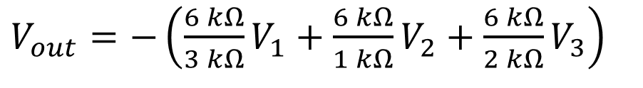

A Summing Amplifier Circuit Example 2
R₃
2 kΩ
$V_{out}=−\left(\frac{R_{f}}{R_{1}}V_{1}+\frac{R_{f}}{R_{2}}V_{2}+\frac{R_{f}}{R_{3}}V_{3}\right)$
I₃
V₃
+
1 kΩ
—
R₂
I₂
$V_{out}=−\left(\frac{6 kΩ}{3 kΩ}V_{1}+\frac{6 kΩ}{1 kΩ}V_{2}+\frac{6 kΩ}{2 kΩ}V_{3}\right)$
R_{f}
R₁
6 kΩ
V₂
+
3 kΩ
—
I₁
I_{f}
$V_{out}=−\left({2V}_{1}+{6V}_{2}+3V_{3}\right)$
V₁
+
—
V_{out}
—
+

Slide 17
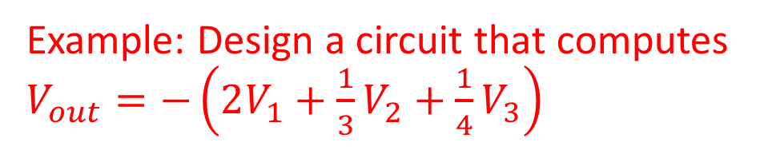
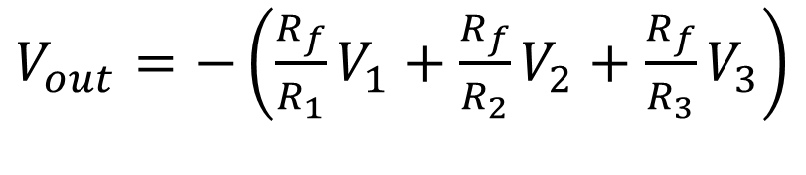
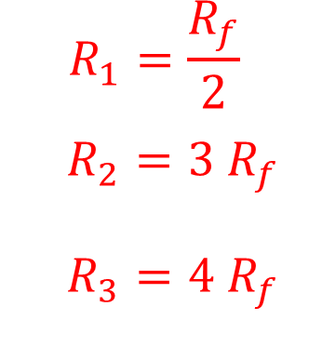
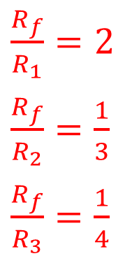

A Summing Amplifier Circuit -- Example 3
R₃
$V_{out}=−\left(\frac{R_{f}}{R_{1}}V_{1}+\frac{R_{f}}{R_{2}}V_{2}+\frac{R_{f}}{R_{3}}V_{3}\right)$
I₃
V₃
+
—
R₂
Example: Design a circuit that computes $V_{out}=−\left(2V_{1}+\frac{1}{3}V_{2}+\frac{1}{4}V_{3}\right)$
I₂
V₂
R₁
R_{f}
+
—
I₁
I_{f}
V₁
+
V_{out}
Choose a value for R_{f}, and then calculate the others
—
—
+
C$ompare the coefficients:$
$\frac{R_{f}}{R_{1}}=2$
$\frac{R_{f}}{R_{2}}=\frac{1}{3}$
$\frac{R_{f}}{R_{3}}=\frac{1}{4}$
$$R_{1}=\frac{R_{f}}{2}$$
$$R_{2}={3 R}_{f}$$
$R_{3}={4 R}_{f}$
Choose R_{f} = 10 kΩ
then R₁ = 5 kΩ
R₂ = 30 kΩ
R₃ = 40 kΩ

Slide 18
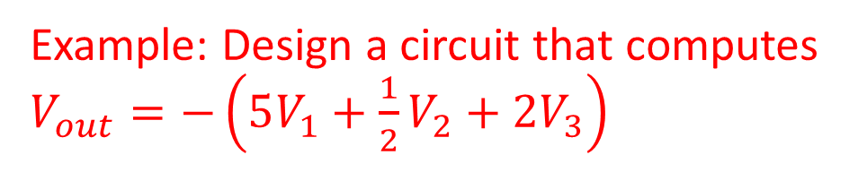
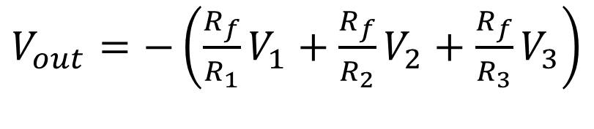
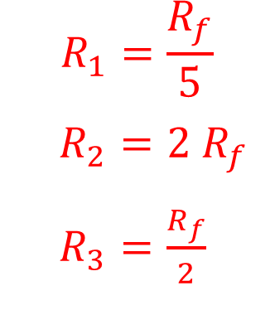
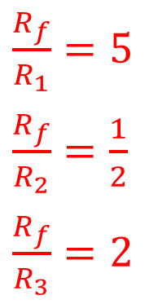

A Summing Amplifier Circuit -- Example 4
R₃
$V_{out}=−\left(\frac{R_{f}}{R_{1}}V_{1}+\frac{R_{f}}{R_{2}}V_{2}+\frac{R_{f}}{R_{3}}V_{3}\right)$
I₃
V₃
+
—
R₂
Example: Design a circuit that computes $V_{out}=−\left(5V_{1}+\frac{1}{2}V_{2}+2V_{3}\right)$
I₂
V₂
R₁
R_{f}
+
—
I₁
I_{f}
V₁
+
V_{out}
—
—
+
C$ompare the coefficients:$
Choose R_{f} = 10 kΩ
$\frac{R_{f}}{R_{1}}=5$
$\frac{R_{f}}{R_{2}}=\frac{1}{2}$
$\frac{R_{f}}{R_{3}}=2$
$$R_{1}=\frac{R_{f}}{5}$$
$$R_{2}={2 R}_{f}$$
$R_{3}=\frac{R_{f}}{2}$
then R₁ = 2 kΩ
R₂ = 20 kΩ
R₃ = 5 kΩ

Slide 19
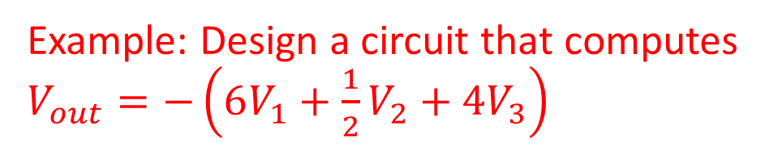
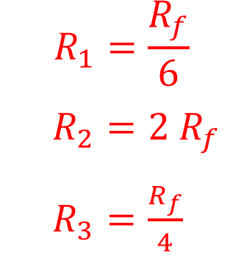
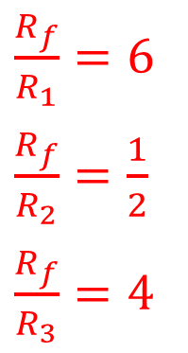
A Summing Amplifier Circuit -- Example 5
R₃
$V_{out}=−\left(\frac{R_{f}}{R_{1}}V_{1}+\frac{R_{f}}{R_{2}}V_{2}+\frac{R_{f}}{R_{3}}V_{3}\right)$
I₃
V₃
+
—
R₂
Example: Design a circuit that computes $V_{out}=−\left(6V_{1}+\frac{1}{2}V_{2}+4V_{3}\right)$
I₂
V₂
R₁
R_{f}
+
—
I₁
I_{f}
V₁
+
V_{out}
—
—
+
C$ompare the coefficients:$
Choose R_{f} = 12 kΩ
$\frac{R_{f}}{R_{1}}=6$
$\frac{R_{f}}{R_{2}}=\frac{1}{2}$
$\frac{R_{f}}{R_{3}}=4$
$$R_{1}=\frac{R_{f}}{6}$$
$$R_{2}={2 R}_{f}$$
$R_{3}=\frac{R_{f}}{4}$
then R₁ = 2 kΩ
R₂ = 24 kΩ
R₃ = 3 kΩ

