Slide 1
Analog Electronics Technology
Op Amps

Slide 2
Practice Problems
Adding and Subtracting

Slide 3
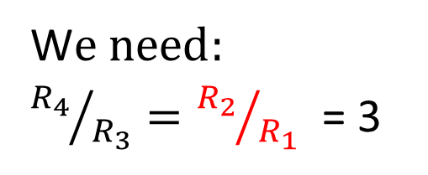
1. Design a circuit that has a voltage output V_{out} = 3 (V₂ – V₁)
Difference circuit
R₁
2 kΩ
R₂
6 kΩ
W$e need:$
${R_{4}}/{R_{3}}={R_{2}}/{R_{1}}$ = 3
V₁
+
—
V_{out}
—
+
Choose resistors
R₂ = 6 kΩ
R₁ = 2 kΩ
R₄ = 6 kΩ
R₃ = 2 kΩ
R₃
R₄
V₂
+
2 kΩ
6 kΩ
—

Slide 4
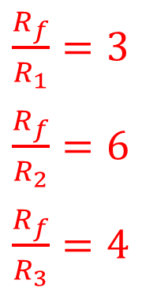

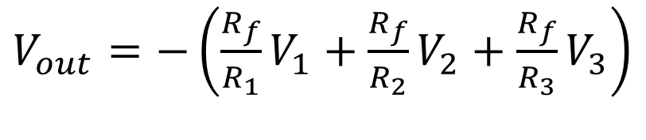
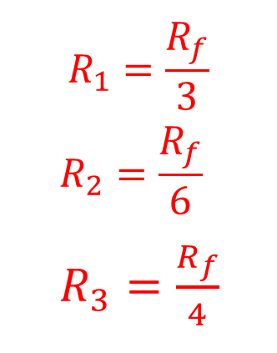
2. Design a circuit that has a voltage output V_{out} = ‒ (3 V₁ + 6 V₂ + 4 V₃ )
3 kΩ
R₃
Summing circuit
I₃
+
2 kΩ
$V_{out}=−\left(\frac{R_{f}}{R_{1}}V_{1}+\frac{R_{f}}{R_{2}}V_{2}+\frac{R_{f}}{R_{3}}V_{3}\right)$
V₃
—
R₂
I₂
12 kΩ
V₂
R₁
R_{f}
+
—
Choose a value for R_{f}, and then calculate the others
I₁
4 kΩ
I_{f}
V₁
+
V_{out}
—
—
+
C$ompare the coefficients:$
$$R_{1}=\frac{R_{f}}{3}$$
$$R_{2}=\frac{R_{f}}{6}$$
$R_{3}=\frac{R_{f}}{4}$
Choose R_{f} = 12 kΩ
$\frac{R_{f}}{R_{1}}=3$
$\frac{R_{f}}{R_{2}}=6$
$\frac{R_{f}}{R_{3}}=4$
then R₁ = 4 kΩ
R₂ = 2 kΩ
R₃ = 3 kΩ

Slide 5
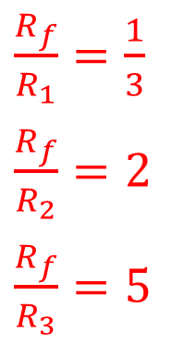
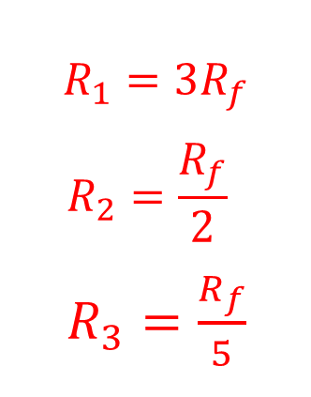
3. Design a circuit that has a voltage output V_{out} = ‒ (⅓ V₁ + 2 V₂ + 5 V₃ )
2 kΩ
R₃
Summing circuit
I₃
+
5 kΩ
$V_{out}=−\left(\frac{R_{f}}{R_{1}}V_{1}+\frac{R_{f}}{R_{2}}V_{2}+\frac{R_{f}}{R_{3}}V_{3}\right)$
V₃
—
R₂
I₂
10 kΩ
V₂
R₁
R_{f}
+
—
Choose a value for R_{f}, and then calculate the others
I₁
30 kΩ
I_{f}
V₁
+
V_{out}
—
—
+
C$ompare the coefficients:$
$$R_{1}=3R_{f}$$
$$R_{2}=\frac{R_{f}}{2}$$
$R_{3}=\frac{R_{f}}{5}$
Choose R_{f} = 10 kΩ
$\frac{R_{f}}{R_{1}}=\frac{1}{3}$
$\frac{R_{f}}{R_{2}}=2$
$\frac{R_{f}}{R_{3}}=5$
then R₁ = 30 kΩ
R₂ = 5 kΩ
R₃ = 2 kΩ

Slide 6
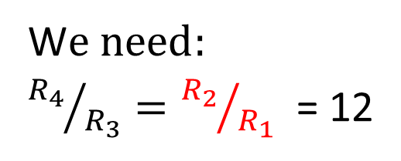
4. Design a circuit that has an output voltage V_{out} = 12 (V₁ – V₂)
Difference circuit
R₁
1 kΩ
R₂
12 kΩ
W$e need:$
${R_{4}}/{R_{3}}={R_{2}}/{R_{1}}$ = 12
V₁
+
—
V_{out}
—
+
Choose resistors
R₂ = 12 kΩ
R₁ = 1 kΩ
R₄ = 12 kΩ
R₃ = 1 kΩ
R₃
R₄
V₂
+
1 kΩ
12 kΩ
—

Slide 7
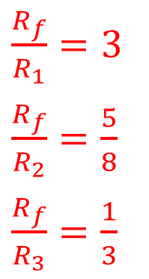
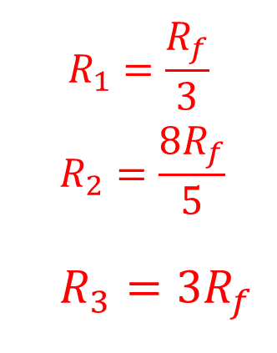
5. Design a circuit that has a voltage output V_{out} = ‒ (3 V₁ + ⅝ V₂ + ⅓ V₃ )
45 kΩ
R₃
Summing circuit
I₃
+
24 kΩ
$V_{out}=−\left(\frac{R_{f}}{R_{1}}V_{1}+\frac{R_{f}}{R_{2}}V_{2}+\frac{R_{f}}{R_{3}}V_{3}\right)$
V₃
—
R₂
I₂
15 kΩ
V₂
R₁
R_{f}
+
—
Choose a value for R_{f}, and then calculate the others
I₁
I_{f}
+
5 kΩ
V_{out}
V₁
—
—
+
C$ompare the coefficients:$
$$R_{1}=\frac{R_{f}}{3}$$
$$R_{2}=\frac{8R_{f}}{5}$$
$R_{3}=3R_{f}$
Choose R_{f} = 15 kΩ
$\frac{R_{f}}{R_{1}}=3$
$\frac{R_{f}}{R_{2}}=\frac{5}{8}$
$\frac{R_{f}}{R_{3}}=\frac{1}{3}$
then R₁ = 5 kΩ
R₂ = 24 kΩ
R₃ = 45 kΩ

Slide 8
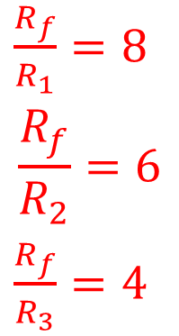
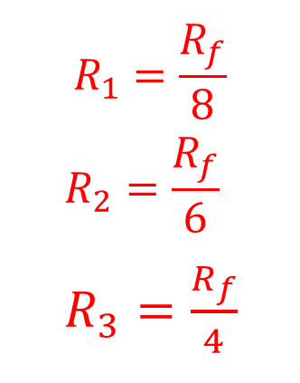
6. Design a circuit that has a voltage output V_{out} = ‒ (8 V₁ + 6 V₂ + 4 V₃ )
6 kΩ
R₃
Summing circuit
I₃
+
4 kΩ
$V_{out}=−\left(\frac{R_{f}}{R_{1}}V_{1}+\frac{R_{f}}{R_{2}}V_{2}+\frac{R_{f}}{R_{3}}V_{3}\right)$
V₃
—
R₂
I₂
24 kΩ
V₂
R₁
R_{f}
+
—
Choose a value for R_{f}, and then calculate the others
I₁
I_{f}
V₁
+
3 kΩ
V_{out}
—
—
+
C$ompare the coefficients:$
$$R_{1}=\frac{R_{f}}{8}$$
$$R_{2}=\frac{R_{f}}{6}$$
$R_{3}=\frac{R_{f}}{4}$
Choose R_{f} = 24 kΩ
$\frac{R_{f}}{R_{1}}=8$
$$\frac{R_{f}}{R_{2}}=6$$
$\frac{R_{f}}{R_{3}}=4$
then R₁ = 3 kΩ
R₂ = 4 kΩ
R₃ = 6 kΩ

Slide 9

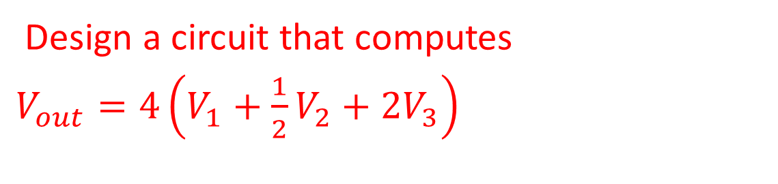
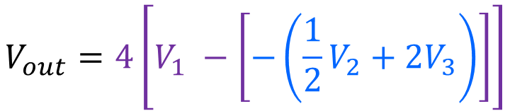
Challenge Problem!
Design a circuit that computes
$V_{out}=4\left(V_{1}+\frac{1}{2}V_{2}+2V_{3}\right)$
This will require more than one op amp.
$$V_{out}=−\left[−\left(4 V_{1}+2V_{2}+8V_{3}\right)\right]$$
$$V_{out}=4\left[V_{1} −\left[−\left(\frac{1}{2}V_{2}+2V_{3}\right)\right]\right]$$
Summing Amplifier
Unity gain inverter
DifferenceAmplifier
Summing Amplifier

Slide 10
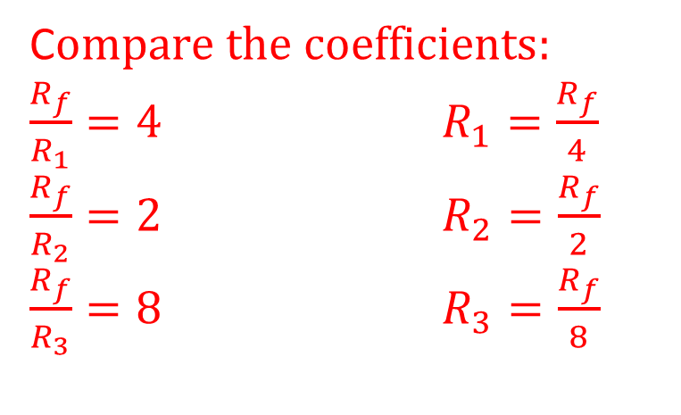
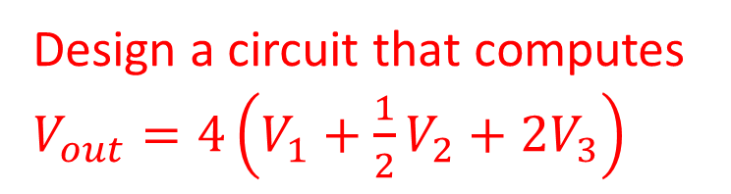

Challenge Problem Solution 1
Design a circuit that computes
$V_{out}=4\left(V_{1}+\frac{1}{2}V_{2}+2V_{3}\right)$
1 kΩ
R₃
I₃
$$V_{out}=−\left[−\left(4 V_{1}+2V_{2}+8V_{3}\right)\right]$$
V₃
+
4 kΩ
—
R₂
Summing Amplifier
I₂
8 kΩ
V₂
R₁
R_{f}
Unity gain inverter
+
—
I₁
I_{f}
+
2 kΩ
1 kΩ
1 kΩ
V₁
V_{out}
—
—
+
V_{out}
—
+
C$ompare the coefficients:$
$\frac{R_{f}}{R_{1}}=4$ $R_{1}=\frac{R_{f}}{4}$
$\frac{R_{f}}{R_{2}}=2$ $R_{2}=\frac{R_{f}}{2}$
$\frac{R_{f}}{R_{3}}=8$ $R_{3}=\frac{R_{f}}{8}$
Choose R_{f} = 8 kΩ then R₁ = 2 kΩ
R₂ = 4 kΩ
R₃ = 1 kΩ

Slide 11
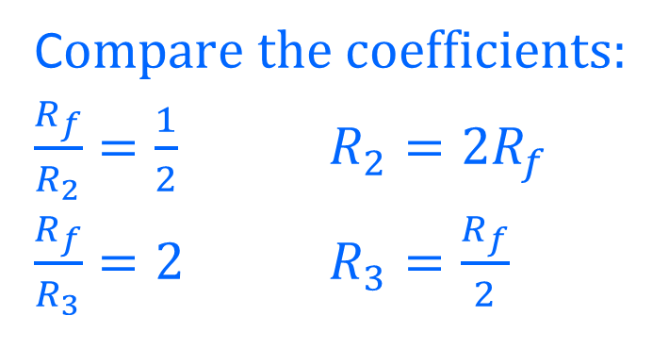
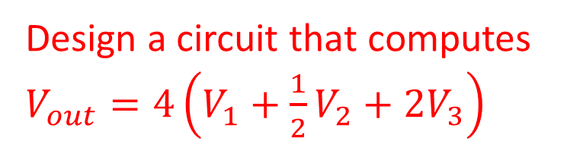
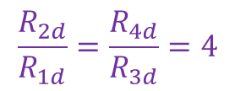
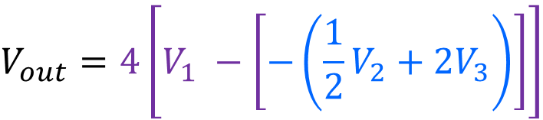
Challenge Problem Solution 2
Design a circuit that computes
$V_{out}=4\left(V_{1}+\frac{1}{2}V_{2}+2V_{3}\right)$
R₃
$$V_{out}=4\left[V_{1} −\left[−\left(\frac{1}{2}V_{2}+2V_{3}\right)\right]\right]$$
1 kΩ
2 kΩ
V₃
R₂
4 kΩ
R_{f}
+
DifferenceAmplifier
—
V₂
+
V_{out}
1 kΩ
R_{2d}
4 kΩ
Summing Amplifier
—
—
+
R_{1d}
—
V_{out}
1 kΩ
+
C$ompare the coefficients:$
$\frac{R_{f}}{R_{2}}=\frac{1}{2}$ $R_{2}=2R_{f}$
$\frac{R_{f}}{R_{3}}=2$ $R_{3}=\frac{R_{f}}{2}$
R_{3d}
V₁
+
—
R_{4d}
4 kΩ
Choose R_{f} = 2 kΩ then R₂ = 4 kΩ
R₃ = 1 kΩ
$$\frac{R_{2d}}{R_{1d}}=\frac{R_{4d}}{R_{3d}}=4$$

