Slide 1
Analog Electronics Technology
Op Amps

Slide 2
What we will talk about today
More op amp circuits
Integrators
Miller Integrators
Voltage Sources
Current to Voltage Conversion

Slide 3
An Integrator
R₁
C
Since the positive input is grounded, the negative input is a virtual ground.
I₁
I_{C}
V₁
+
—
V_{out}
—
+
Calculate the current through R₁.
I₁ = V₁ / R₁
No current flows into the input terminals of an op amp. What is the capacitor current?
I_{C} = I₁ = V₁ / R₁

Slide 4
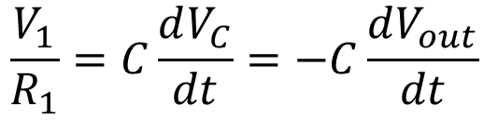
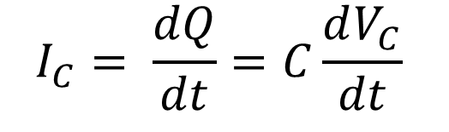
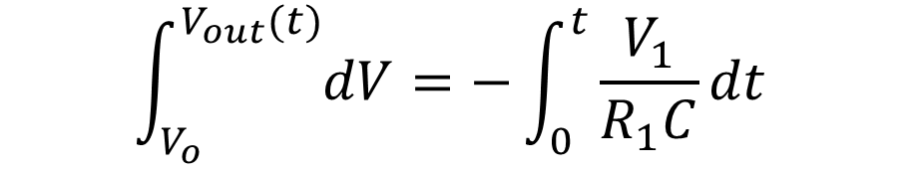
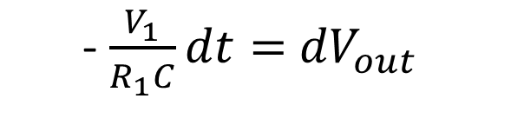
An Integrator
I_{C} = V₁ / R₁
For a capacitor: Q = C V
R₁
C
$$I_{C}= \frac{dQ}{dt}=C\frac{dV_{C}}{dt}$$
I₁
I_{C}
V₁
+
—
V_{out}
—
+
Therefore
$$\frac{V_{1}}{R_{1}}=C\frac{dV_{C}}{dt}=−C\frac{dV_{out}}{dt}$$
- $\frac{V_{1}}{R_{1}C}dt=$ ${dV}_{out}$
$$\int_{V_{o}}^{V_{out}(t)}{dV}=−\int_{0}^{t}{\frac{V_{1}}{R_{1}C}dt}$$

Slide 5
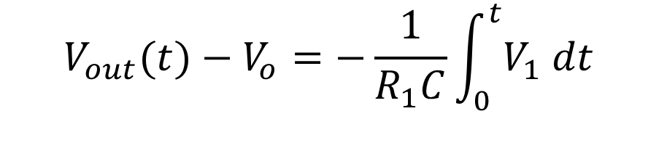
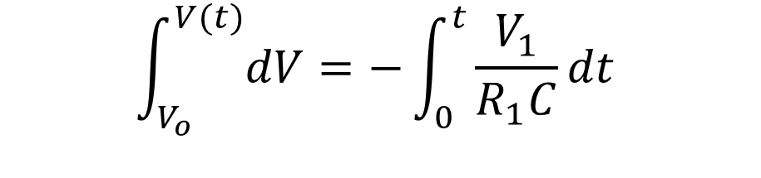
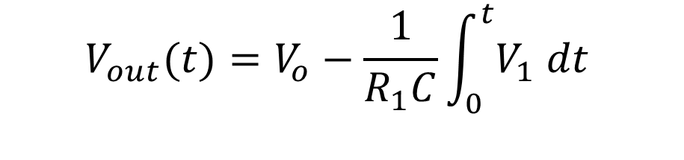
An Integrator
R₁
C
$$\int_{V_{o}}^{V(t)}{dV}=−\int_{0}^{t}{\frac{V_{1}}{R_{1}C}dt}$$
I₁
I_{C}
V₁
+
—
V_{out}
—
+
$$V_{out}(t)−V_{o}=−\frac{1}{R_{1}C}\int_{0}^{t}{V_{1} dt}$$
$$V_{out}(t)=V_{o}−\frac{1}{R_{1}C}\int_{0}^{t}{V_{1} dt}$$

Slide 6
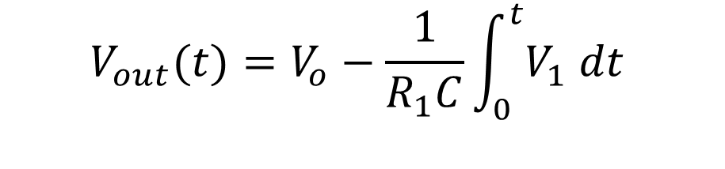
An Integrator
$$V_{out}(t)=V_{o}−\frac{1}{R_{1}C}\int_{0}^{t}{V_{1} dt}$$
R₁
C
I₁
I_{C}
V₁
V₁
+
—
V_{out}
Input
—
+
time
V_{out}
Output
time

Slide 7
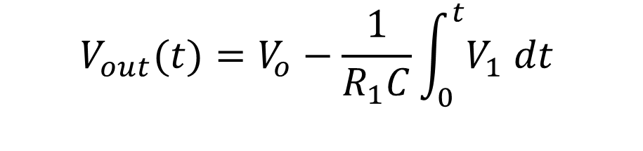
An Integrator
A problem with an integrator
R₁
C
$$V_{out}(t)=V_{o}−\frac{1}{R_{1}C}\int_{0}^{t}{V_{1} dt}$$
I₁
I_{C}
V₁
+
—
V_{out}
—
+
Input
Output
Small DC offset
Causes the output to eventually saturate

Slide 8
A Miller Integrator
R₂
A very large resistance
R₁
C
At DC and extremely low frequencies it acts like an inverting op amp
I₁
I_{C}
V₁
+
—
V_{out}
—
+
At normal frequencies it acts like an integrator

Slide 10
A Voltage Source
V_{CC} = 15 V
A load resistance can affect the voltage of a voltage divider
R₂ = 20 kΩ
V_{out} = 2.1 V
This is sometimes called voltage droop.
R₁ = 10 kΩ
R_{L} = 5 kΩ

Slide 11
A Voltage Source
We can solve this problem by using an op amp as a buffer
V_{CC} = 15 V
Now the op amp can drive the load, eliminating voltage droop.
R₂ = 20 kΩ
V_{out}
—
+
R_{L} = 5 kΩ
R₁ = 10 kΩ
A voltage follower
A voltage divider

Slide 12
A Voltage Source
V_{CC} = 15 V
What happens if there are fluctuations in the supply voltage?
R₂ = 200 kΩ
V_{out}
—
V_{out} = (1/3) V_{CC}
+
If V_{CC} drifts, so does V_{out}
R_{L} = 5 kΩ
R₁ = 100 kΩ
If V_{CC} = 15.09 V, V_{out} = 5.03 V

Slide 13
A Voltage Source with Zener Diode
Example:
1 kΩ
Example:
3 kΩ
V_{CC} = 15 V
R₃
R₄
Example:
V_{out} = 10.0 V
R₂ = 200 kΩ
—
V_{out}
+
A Zener diode provides a more stable reference
R_{L} = 5 kΩ
Example:
V_{Z} = 2.50 V

Slide 14
A Voltage Source with Zener Diode
V_{CC} = 15 V
R₃
R₄
A variable resistor makes the power supply adjustable
R₂ = 200 kΩ
—
V_{out}
+
R_{L} = 5 kΩ

Slide 15
A Voltage Source with Zener Diode
Even better methods exist involving a Zener diode reference and extra circuitry to provide stabilization
V_{CC} = 15 V
R₃
R₄
A variable resistor makes the power supply adjustable
R₂ = 200 kΩ
—
V_{out}
+
R_{L} = 5 kΩ
The Zener voltage does vary very slightly with current.

Slide 16
A Voltage Source with Zener Diode
Better voltage regulation, but there is a problem
1 kΩ
3 kΩ
R₁
R₂
Stable output
—
V_{out}
The diode is biased by the output of the op amp
V_{out} = 10.0 V
+
V_{Z} = 2.50 V
R_{L} = 5 kΩ
R_{F}
Stable Zener voltage
Stable current

Slide 17
A Voltage Source with Zener Diode
The problem
This is also a stable state!
1 kΩ
3 kΩ
R₁
R₂
—
V_{out}
V_{out} = 0.0 V
V₊ = 0.0 V
+
R_{L} = 5 kΩ
R_{F}
V_{Z} = 2.50 V
We need start-up circuitry

Slide 18
A Voltage Source
A better voltage regulator
V_{CC} = 15 V
1 kΩ
3 kΩ
R₁
R₂
100 kΩ
2.64 V
Diode reverse biased
—
V_{out}
10.0 V
Stable output
1.36 V
0.66 V
2.5 V
+
R_{F}
R_{L} = 5 kΩ
Zener turned on
10 kΩ
Stable Zener
voltage
Stable current
V_{Z} = 2.50 V

Slide 20
A Current to Voltage Converter
For our normal inverting op amp, the current flowing from the voltage source equals the voltage divided by the resistance R_{in}
R_{in}
R_{F}
V₁
+
V_{out}
—
—
+
This can be converted to a current-to-voltage converter by removing R_{in} and connecting a current source directly to the negative input of the op amp.

Slide 21
A Current to Voltage Converter
Since the input resistance of the op amp is extremely large, the current I₁ all flows through the feedback resistor R_{F}.
R_{F}
I₁
—
V_{out}
+
Since the negative input of the op amp is at virtual ground, the output of the op amp is given by:
V_{out} = -I₁ R_{F}

Slide 22
A Current to Voltage Converter
V_{out} = -I₁ R_{F}
A high sensitivity requires a large feedback resistor, R_{F}.
R_{F}
1 V/μA requires R_{f} = 1 MΩ
I₁
—
V_{out}
1 V/nA requires R_{f} = 1 GΩ
+

Slide 23
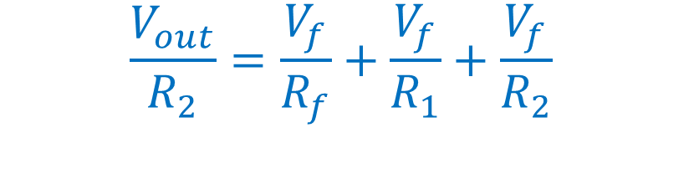
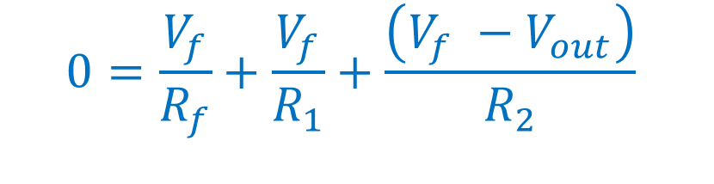
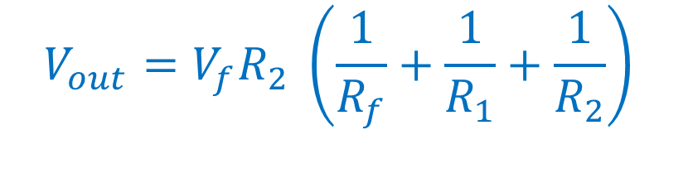
A High Sensitivity Current to Voltage Converter
R_{F}
A
R₁
V_{f}
Do a current balance on node A
I_{in}
I_{in}
R₂
$$0=\frac{V_{f}}{R_{f}}+\frac{V_{f}}{R_{1}}+\frac{\left(V_{f} −V_{out}\right)}{R_{2}}$$
—
+
V_{out}
$$\frac{V_{out}}{R_{2}}=\frac{V_{f}}{R_{f}}+\frac{V_{f}}{R_{1}}+\frac{V_{f}}{R_{2}}$$
$$V_{out}=V_{f}R_{2} \left(\frac{1}{R_{f}}+\frac{1}{R_{1}}+\frac{1}{R_{2}}\right)$$

Slide 24

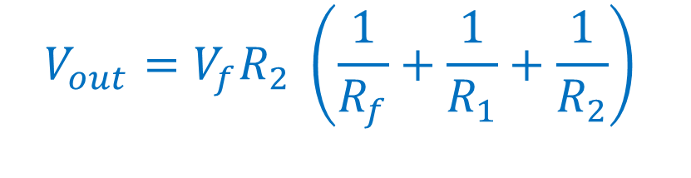
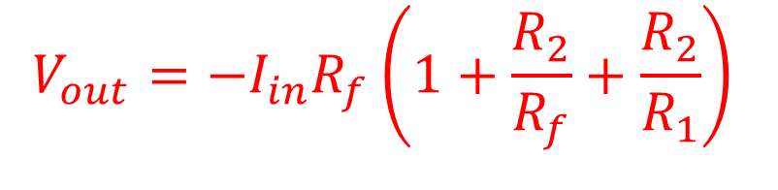
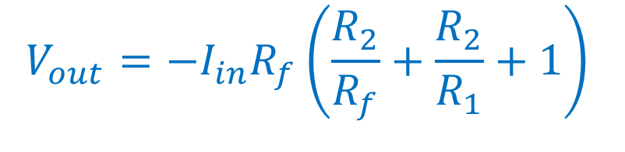
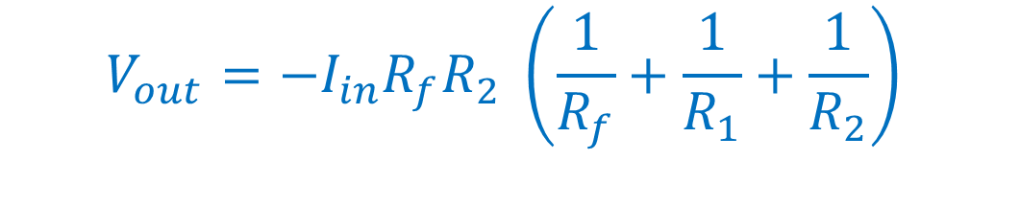
A High Sensitivity Current to Voltage Converter
R_{F}
A
R₁
V_{f}
$$V_{out}=V_{f}R_{2} \left(\frac{1}{R_{f}}+\frac{1}{R_{1}}+\frac{1}{R_{2}}\right)$$
I_{in}
I_{in}
R₂
Since no current flows into the input of an op amp, I_{in} flows through the feedback resistor, R_{f}
—
+
V_{out}
$$V_{out}=−I_{in}R_{f}R_{2} \left(\frac{1}{R_{f}}+\frac{1}{R_{1}}+\frac{1}{R_{2}}\right)$$
$$V_{f}=−I_{in}R_{f}$$
$$V_{out}=−I_{in}R_{f}\left(1+\frac{R_{2}}{R_{f}}+\frac{R_{2}}{R_{1}}\right)$$
$$V_{out}=−I_{in}R_{f}\left(\frac{R_{2}}{R_{f}}+\frac{R_{2}}{R_{1}}+1\right)$$

Slide 25
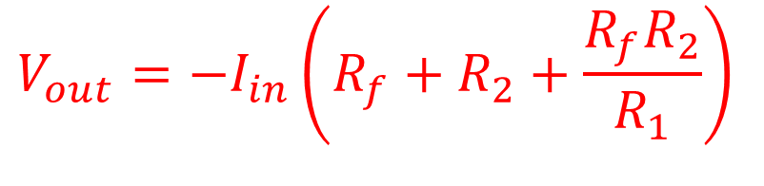

A High Sensitivity Current to Voltage Converter
R_{F}
A
R₁
V_{f}
I_{in}
I_{in}
R₂
$$V_{out}=−I_{in}R_{f}\left(1+\frac{R_{2}}{R_{f}}+\frac{R_{2}}{R_{1}}\right)$$
—
+
V_{out}
$$V_{out}=−I_{in}\left(R_{f}+R_{2}+\frac{{R_{f}R}_{2}}{R_{1}}\right)$$
If R₁ is small compared to R_{f} and R₂, this term can be much larger than both of them.

Slide 26
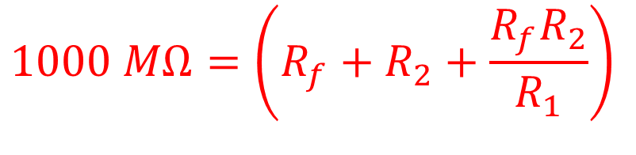

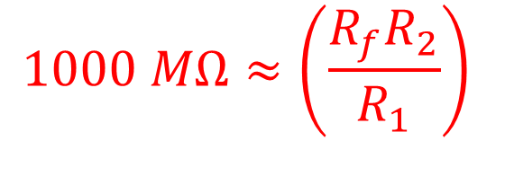
Example:
Design a current to voltage converter that has a sensitivity of 1 V per nanoamp. Do not use any resisters over 1 mΩ. Use standard 1% tolerance resistors.
R_{F}
A
R₁
V_{f}
I_{in}
I_{in}
R₂
—
$$V_{out}=−I_{in}\left(R_{f}+R_{2}+\frac{{R_{f}R}_{2}}{R_{1}}\right)$$
+
V_{out}
$$1000 MΩ=\left(R_{f}+R_{2}+\frac{{R_{f}R}_{2}}{R_{1}}\right)$$
$$1000 MΩ≈\left(\frac{{R_{f}R}_{2}}{R_{1}}\right)$$

Slide 27
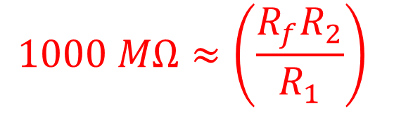
Example:
Design a current to voltage converter that has a sensitivity of 1 V per nanoamp. Do not use any resisters over 1 MΩ. Use standard 1% tolerance resistors.
R_{F}
A
R₁
V_{f}
I_{in}
I_{in}
R₂
—
+
V_{out}
If we choose R_{f} = 1 MΩ, then R₂/R₁ = 1000
$$1000 MΩ≈\left(\frac{{R_{f}R}_{2}}{R_{1}}\right)$$
Choose R₂ = 1 MΩ and R₁ = 1 kΩ

Slide 28
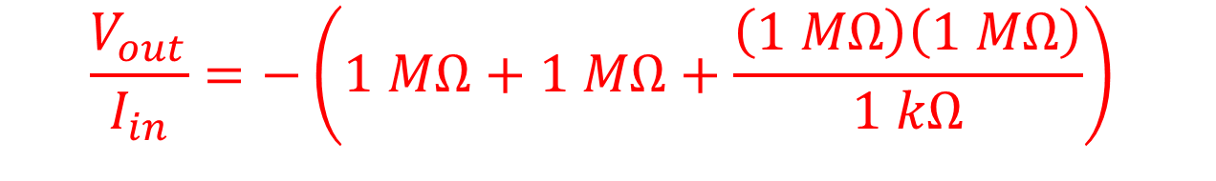
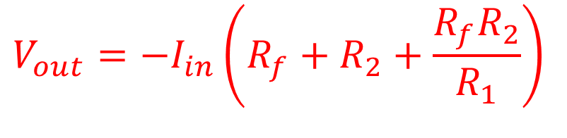
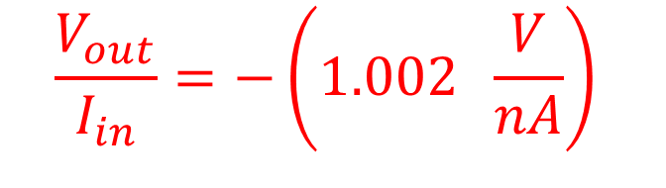
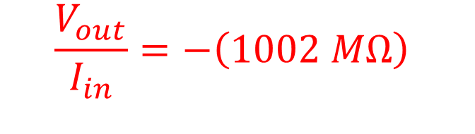
Example:
R₁ = 1 kΩ
Design a current to voltage converter that has a sensitivity of 1 V per nanoamp. Do not use any resisters over 1 MΩ. Use standard 1% tolerance resistors.
R_{f} = 1 MΩ
R_{F}
A
R₁
V_{f}
I_{in}
I_{in}
R₂
R₂ = 1 MΩ
—
$$V_{out}=−I_{in}\left(R_{f}+R_{2}+\frac{{R_{f}R}_{2}}{R_{1}}\right)$$
+
V_{out}
$$\frac{V_{out}}{I_{in}}=−\left(1 MΩ+1 MΩ+\frac{\left(1 MΩ\right)\left(1 MΩ\right)}{1 kΩ}\right)$$
$$\frac{V_{out}}{I_{in}}=−\left(1002 MΩ\right)$$
$$\frac{V_{out}}{I_{in}}=−\left(1.002 \frac{V}{nA}\right)$$

