Slide 1
Analog Electronics Technology
Lab 4
Op Amp Integrators

Slide 2
Op Amp Integrator Circuit
R₁= 10 kΩ
C = 1 μF
I₁
I_{C}
Function Generator
V_{in}
+
—
V⁺
V_{out}
—
+
V⁻
Figure 1. An Integrator Circuit
V⁺ (15 V) and V⁻ (-15 V) from DC Power Supply

Slide 3
Op Amp Integrator Theory
For an ideal op amp the input current is zero
I₁ = V_{in}/ R₁
I_{C} = I₁ = V_{in}/ R₁
R₁= 10 kΩ
C = 1 μF
I₁
I_{C}
V_{in}
+
—
V⁺
V_{out}
—
+
V⁻
Virtual ground
Inputs forced to the same voltage
Figure 1. An Integrator Circuit

Slide 4
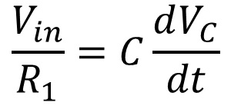
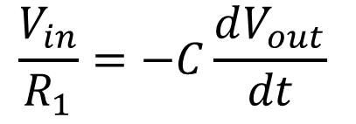
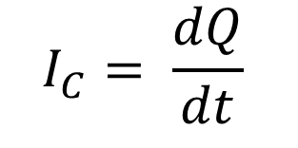

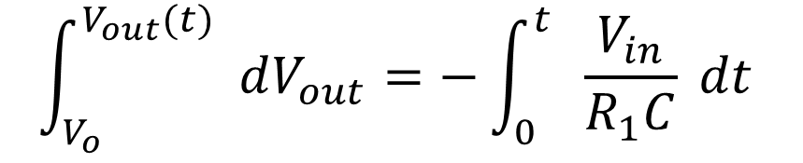
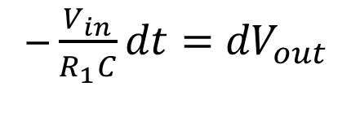
Integrator Theory
I_{C} = V_{in} / R₁
For a capacitor: Q = C V
R₁
V_{C}
+
—
C
$$I_{C}= \frac{dQ}{dt}$$
$$=C\frac{dV_{C}}{dt}$$
I₁
I_{C}
V_{in}
+
—
V_{out}
—
+
$$\frac{V_{in}}{R_{1}}=C\frac{dV_{C}}{dt}$$
$$\frac{V_{in}}{R_{1}}=−C\frac{dV_{out}}{dt}$$
Therefore
─ $\frac{V_{in}}{R_{1}C}dt=$ ${dV}_{out}$
$$\int_{V_{o}}^{V_{out}(t)}{ dV_{out}}=−\int_{0}^{t}{ \frac{V_{in}}{R_{1}C} dt}$$

Slide 5
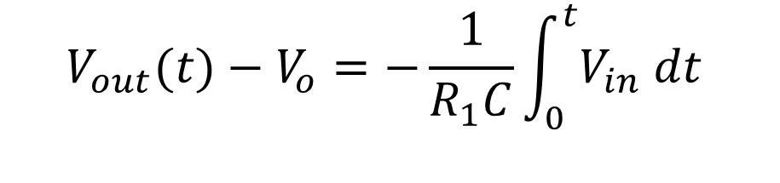
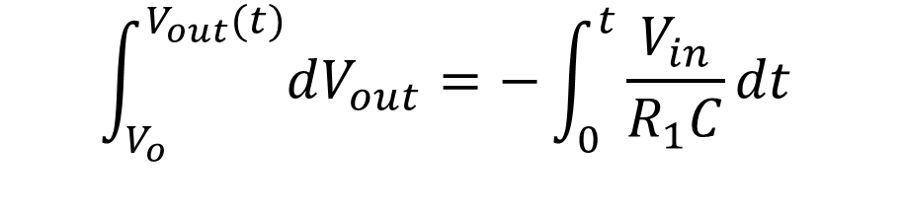
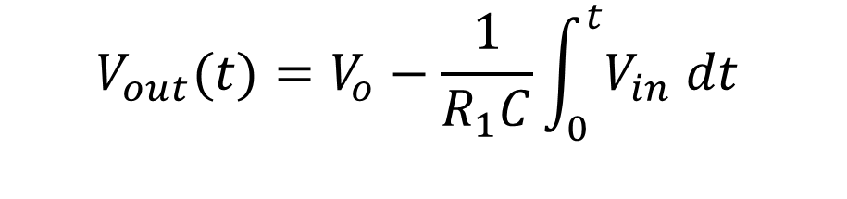
An Integrator
R₁
C
$$\int_{V_{o}}^{V_{out}(t)}{dV_{out}}=−\int_{0}^{t}{\frac{V_{in}}{R_{1}C}dt}$$
I₁
I_{C}
V_{in}
+
—
V_{out}
—
+
$$V_{out}(t)−V_{o}=−\frac{1}{R_{1}C}\int_{0}^{t}{V_{in} dt}$$
$$V_{out}(t)=V_{o}−\frac{1}{R_{1}C}\int_{0}^{t}{V_{in} dt}$$

Slide 6
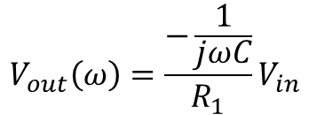

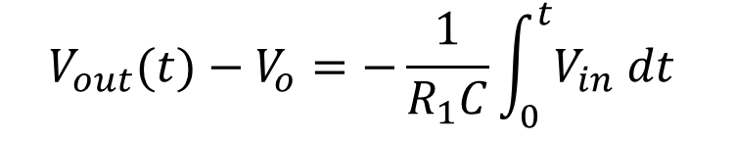

Op Amp Integrator – Alternate Calculation
Z₁
Z₂
R₁
R₂
Inverting Op Amp
V_{out} = -R₂/ R₁ * V_{in}
I₁
Switch to Frequency Domain
V_{out} = -Z₂/ Z₁ * V_{in}
V_{in}
+
—
V⁺
V_{out}
—
+
V⁻
$$V_{out}\left(ω\right)=\frac{−\frac{1}{jωC}}{R_{1}}V_{in}$$
$$V_{out}\left(ω\right)=−\frac{1}{jωR_{1}C}V_{in}$$
R₁
$$Z_{c}=\frac{1}{jωC}$$
C
Switch results back to time domain
I₁
V_{in}
+
—
V_{out}
1/(jω) in frequency domain pairs with integration in the time domain
—
+
$$V_{out}(t)−V_{o}=−\frac{1}{R_{1}C}\int_{0}^{t}{V_{in} dt}$$

Slide 7
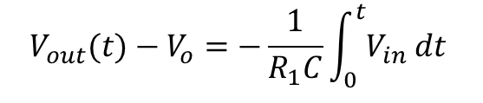
Op Amp Integrator Procedure
Adjust the DC offset to minimize drift
R= 1 kΩ
R₁= 10 kΩ
C = 1 μF
Theoretical Output
I₁
I_{C}
Real Output
Set function generator to zero output
V_{in}
+
V⁺
V_{out}
—
—
The problem: small DC offsets get integrated
+
V⁻
Probably the small DC offsets are internal to the op amp
$$V_{out}(t)−V_{o}=−\frac{1}{R_{1}C}\int_{0}^{t}{V_{in} dt}$$
Offset Null
Figure 1. An Integrator Circuit
One solution: use the “Offset Null” pins of the op amp
Instead, we will use the DC offset of the function generator

Slide 8
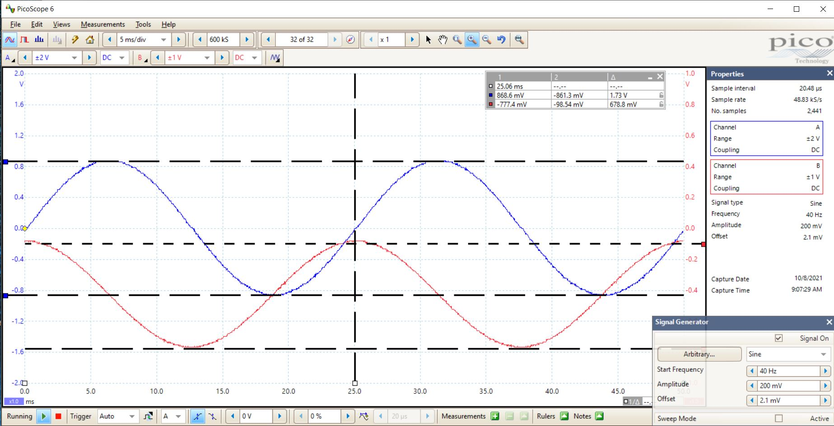
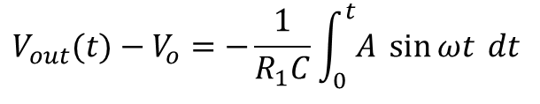
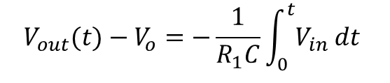
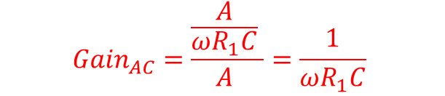
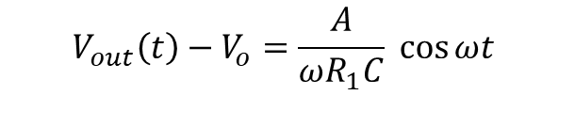
Op Amp Integrator Procedure
Look at AC amplitudes
R= 1 kΩ
R₁= 10 kΩ
C = 1 μF
6V amplitude sine wave at f=100 Hz
I₁
I_{C}
V_{in}
+
—
V⁺
V_{out}
DC offset to minimize drift
—
Look at phases
+
V⁻
Output should peak when the input crosses zero
$$V_{out}(t)−V_{o}=−\frac{1}{R_{1}C}\int_{0}^{t}{V_{in} dt}$$
$$V_{out}(t)−V_{o}=−\frac{1}{R_{1}C}\int_{0}^{t}{A \sin{ωt} dt}$$
Figure 1. An Integrator Circuit
Output should lead the input by 90°
$${Gain}_{AC}=\frac{\frac{A}{ωR_{1}C} }{A }=\frac{1}{ωR_{1}C}$$
$$V_{out}\left(t\right)−V_{o}=\frac{A}{ωR_{1}C} \cos{ωt}$$

Slide 10


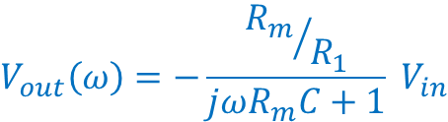
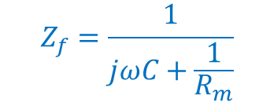

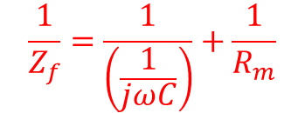




Miller Integrator Theory
$$Z_{R}=R_{m}$$
R_{m}
Active Low Pass Filter
Work in Frequency Domain
V_{out} = -Z_{f}/ Z₁ * V_{in}
$$\frac{1}{Z_{f}}=\frac{1}{\left(\frac{1}{jωC}\right)}+\frac{1}{R_{m}}$$
R₁
$$Z_{C}=\frac{1}{jωC}$$
$$Z_{f}=\frac{1}{jωC+\frac{1}{R_{m}}}$$
C
I₁
V_{in}
+
—
V_{out}
$$=\frac{R_{m}}{jωR_{m}C+1}$$
—
+
$$V_{out}\left(ω\right)=−\frac{{R_{m}}/{R_{1}}}{jωR_{m}C+1} V_{in}$$
At very low frequencies
At high frequencies
$$V_{out}\left(ω\right)=−\frac{{R_{m}}/{R_{1}}}{jωR_{m}C+1} V_{in}$$
$$V_{out}\left(ω\right)=−\frac{{R_{m}}/{R_{1}}}{jωR_{m}C+1} V_{in}$$
$$≈−{R_{m}}/{R_{1}}V_{in}$$
$$≈−\frac{1}{jωR_{1}C} V_{in}$$
Inverting op amp
Integrator

Slide 11
Miller Integrator Procedure
Make sure that any DC offset is not integrated
R= 1 kΩ
R_{m} = 1 MΩ
Make sure that the output does not saturate
R₁ = 10 kΩ
C = 1 μF
Set function generator to zero output
I₁
V_{in}
+
—
V_{out}
—
+

Slide 12
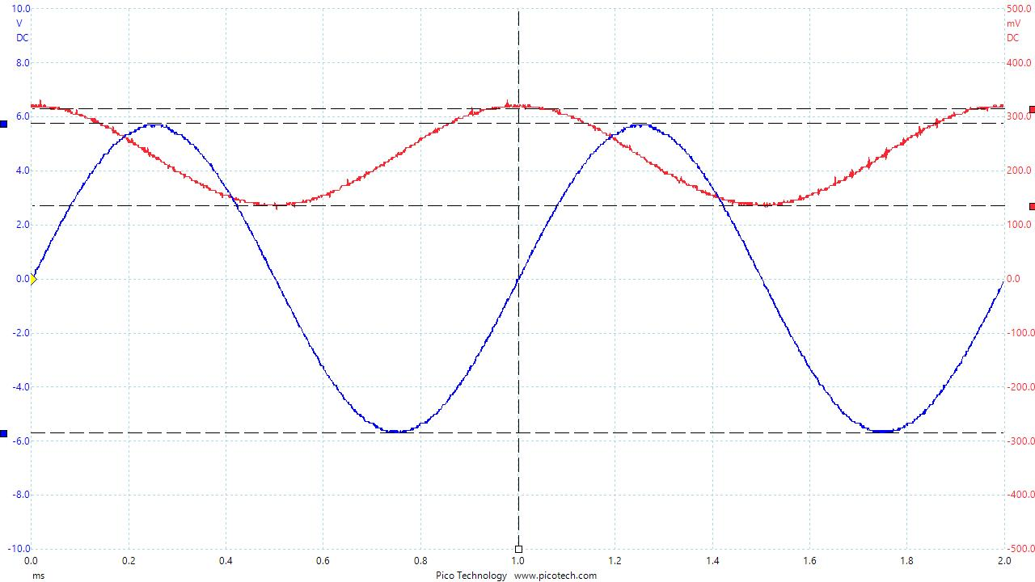
Miller Integrator Procedure (cont.)
Capture the input & output
Ch. B
Ch. A
R_{m}
Compare magnitudes of input and output waves
Set function generator to give 6V amplitude sine wave
at f=1 kHz
R₁
Is the gain what you would expect?
C
I₁
Use the DC offset of the function generator to minimize DC component of output
V_{in}
+
—
V_{out}
—
+
Compare phases of input and output waves
Is the phase difference what you would expect?

Slide 13
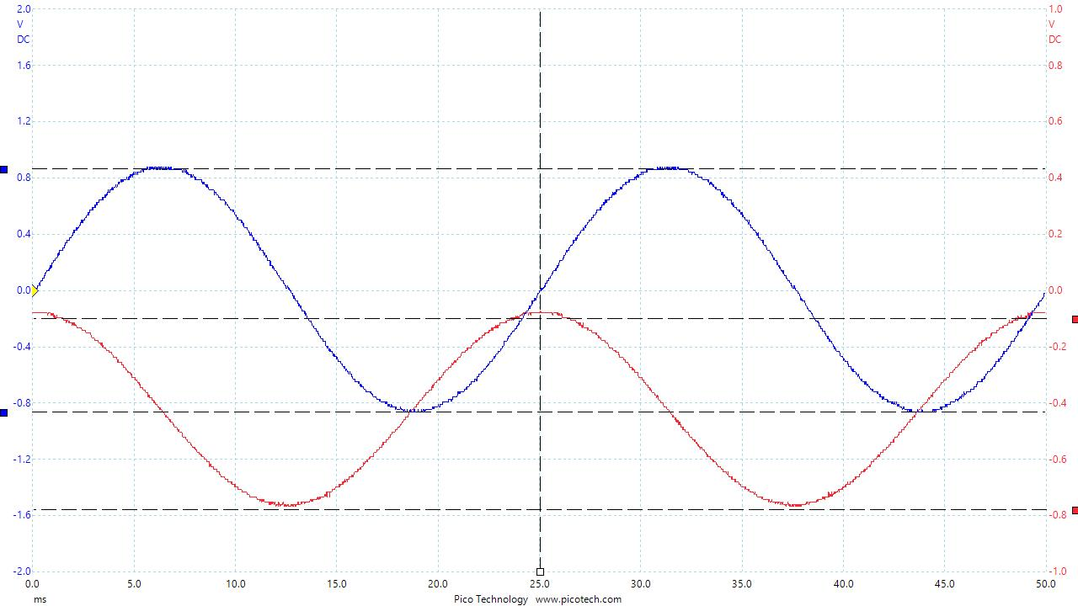
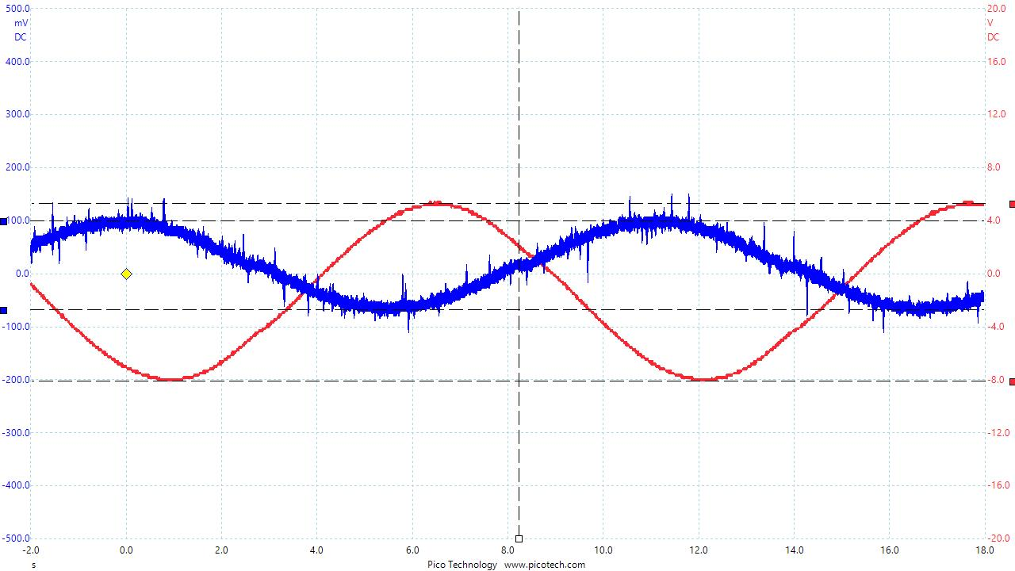
Miller Integrator Procedure (cont.)
R_{m}
Change the frequency to a lower frequency
Compare magnitudes of input and output waves
R₁
Compare phases of input and output waves
The amplitude of the sine wave will need to be adjusted
C
I₁
V_{in}
+
—
V_{out}
Capture the traces that show it acting like an integrator and traces showing it acting less like an integrator.
Adjust DC offset to minimize DC component of output
—
+
Keep changing to lower frequencies until you see a noticeable change.
The change of phase will probably be more noticeable than the change in the gain
The change will probably not be noticeable until the frequency is less than 1 Hz

