Slide 1
Analog Electronics Technology
Lab 5
Active Filters

Slide 2
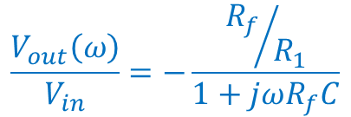
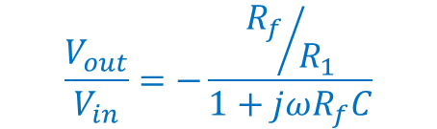

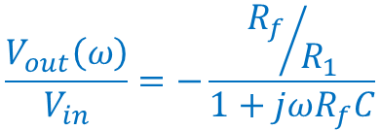

Active Low-Pass Filter Circuit
I renamed the resistor R_{f} (f for feedback) instead of R_{m} (m for Miller)
Output can have more energy than the input
Miller 1 MΩ
LP 100 kΩ
R_{f}
Miller 10 kΩ
The circuit is the same as the Miller integrator, but with different component values
LP 10 kΩ
R₁
Miller 1 μF
LP 10 nF
, 1 nF
, 100 pF
$$\frac{V_{out}}{V_{in}}=−\frac{{R_{f}}/{R_{1}}}{1+jωR_{f}C}$$
C
I₁
V_{in}
+
—
V_{out}
—
+
At very low frequencies
At high frequencies
$$\frac{V_{out}\left(ω\right)}{V_{in}}=−\frac{{R_{f}}/{R_{1}}}{1+jωR_{f}C}$$
$$\frac{V_{out}\left(ω\right)}{V_{in}}=−\frac{{R_{f}}/{R_{1}}}{1+jωR_{f}C}$$
$$≈−{R_{f}}/{R_{1}}$$
$$≈−\frac{1}{jωR_{1}C}$$
Inverting op amp
Integrator

Slide 3

Comparing Integrator and Miller Integrator
Make a log-log plot of the transfer function, V_{out}/V_{in}
Corner Frequency
$$\frac{1}{2πR_{f}C}$$
Inverting op amp
Integrator

Slide 4
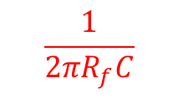
Comparing Miller Integrator and Active Low-Pass Filter
$$\frac{1}{2πR_{f}C}$$
Inverting op amp
R_{f}/R₁
Integrator

Slide 5
Comparing Active Low-Pass Filters
Calculate Corner Frequency

Slide 6
Active Low-Pass Filter Procedure
Ch. A
R_{f} =100kΩ
Calculate the corner (knee) frequency
R₁ =100kΩ
Ch. B
C = 10 nF
Set the function generator to produce a sine wave of 1.3 Volts at a frequency below the corner frequency
Function Generator
I₁
V_{in}
+
—
V_{out}
—
+
Adjust the DC level of the function generator if necessary.
Measure the input and output magnitude and phase.
Repeat the measurements at two additional frequencies below the corner frequency, two or three frequencies near the corner frequency, and three frequencies above the corner frequency.
Adjust the magnitude and offset of the sine wave as warranted.

Slide 7
Active Low-Pass Filter Procedure (cont.)
R_{f} =100kΩ
Change the capacitor to a 1 nF capacitor
Repeat the procedure from the previous slide
R₁ =100kΩ
C = 1 nF
Calculate the corner (knee) frequency
I₁
Set the function generator to produce a sine wave of 1.3 Volts at a frequency below the corner frequency
V_{in}
+
V_{out}
—
—
+
Adjust the DC level of the function generator if necessary.
Measure the input and output magnitude and phase.
Repeat the measurements at two additional frequencies below the corner frequency, two or three frequencies near the corner frequency, and three frequencies above the corner frequency.
Adjust the magnitude and offset of the sine wave as warranted.

Slide 8
Active Low-Pass Filter Procedure (cont.)
R_{f} =100kΩ
Change the capacitor to a 100 pF capacitor
Repeat the procedure from the previous slide
R₁ =100kΩ
C = 100 pF
Calculate the corner (knee) frequency
I₁
Set the function generator to produce a sine wave of 1.3 Volts at a frequency below the corner frequency
V_{in}
+
V_{out}
—
—
+
Adjust the DC level of the function generator if necessary.
Measure the input and output magnitude and phase.
Repeat the measurements at two additional frequencies below the corner frequency, two or three frequencies near the corner frequency, and at least two frequencies above the corner frequency.
Adjust the magnitude and offset of the sine wave as warranted.

Slide 9
Active Low-Pass Filter
For each filter make a log-magnitude vs. log-frequency plot and make a phase vs. log-frequency plot.
Compare the plots with the expected results.

