Slide 1
Digital Signal Processing
Fall 2025

Slide 2
Who am I?
Informal Greetings:
Formal Greetings:
“Hi Kendall”
“Hello Professor Stephenson”
“Hello Mr. Stephenson”
Name:
Kendall Stephenson
Given name
Family name
Instructor at Cornell College
Mount Vernon, Iowa

Slide 3
What are Digital Signals?
Also called discrete signals
They can only have specific values
The opposite of analog (continuous) signals

Slide 4
Example of an Analog (Continuous)Signal

Slide 5
Example of Function with Discrete Values for Vertical Axis

Slide 6
Example of Function with Discrete Values for Both Axes
Kilograms of Peaches
Continuous

Slide 7
Analog Signals are often Sampled to Make Digital Signals

Slide 8
Input & Output of a Discrete System
n is an integer
We will define the inputs of a discrete system as x[ n ]
n is the index number
x[ 1 ]
x[ 2 ]
it tells us the position in the list
x[ 0 ]
x[ 3 ]
x[ 4 ]
we usually start with zero
Example:
x[ ] = { 1, 7, 4, 2, 5 }
The inputs might be samples from a continuous variable
We often call n the sample number even if it is not a sample of a continuous variable
We will define the output of a discrete system as y[n]
Our goal or objective usually is to find a relationship between the outputs, y[n], and the inputs (and the other outputs)

Slide 9
Multiplying a Sequence by a Constant
When we multiply (or divide) a sequence by a constant, each term is individually multiplied by that constant
Example:
y[ n ] = 3 x[ n ]
For inputs:
x[ ] = { 1, 7, 4, 2, 5 }
y[ ] = { 3, 21, 12, 6, 15 }

Slide 10
Delays (Shifts)
A delay (or shift) in a sequence is indicated by subtracting an integer from the argument n
Example:
y[ n ] = x[ n - 2 ]
For inputs:
x[ ] = { 1, 7, 4, 2, 5 }
Assume x[ n ] = 0 for all n < 0
y[ ] = { 0, 0, 1, 7, 4}
advancement instead of delay
An expression such as
y[ n ] = x[ n + 2 ]
indicates that the system is noncausal
This is not possible for a time-based systems operating in real time
The current output depends upon a “future” input
Noncausal systems can be used for recorded signals and for systems that are not time based
filtering vocal recordings
image processing

Slide 11


Basic Signals
The analysis of discrete signals uses basic signals that are similar to those used in systems with continuous signals
Unit Impulse
$$δ[ n ]$$
Unit Step
$$u[ n ]$$

Slide 12



Basic Signals
Real Exponential
$$y\left[ n \right]=A α^{n} u[ n ]$$
$$y\left[ n \right]=4 {\left(0.7\right)}^{n} u[ n ]$$
Decaying Exponential
$$y\left[ n \right]=3 {\left(1.2\right)}^{n} u[ n ]$$
Increasing Exponential

Slide 13



Basic Signals
sinusoidal
$$ω_{o}$$
$$y\left[ n \right]=A \cos\left(Ω_{o}n+ φ\right){ }$$
$$y\left[ n \right]=4\sin\left(0.1 π n\right) u[ n ]$$
compare to analog signals

Slide 14


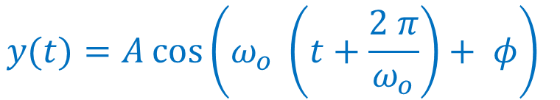





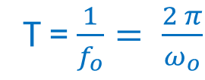
Basic Signals
Compare analog and digital sinusoidal signals
$$y(t)=A\cos\left(ω_{o} t+ φ\right){ }$$
$$y\left[ n \right]=A \cos\left(Ω_{o}n+ φ\right){ }$$
The functions are periodic (values repeat)
The function may repeat in a period, N
Period, T, is time in which the function repeats
$$k$$
$$y(t+ T)=y(t)$$
for every t
$$y\left[ n+N \right]=y\left[ n \right]$$
for every n
T = $\frac{1}{f_{o}}= \frac{2 π}{ω_{o}}$
$$y\left[ n+N\right]=A \cos\left(Ω_{o}\left(n+N\right)+ φ\right){ }$$
$$y(t)=A\cos\left(ω_{o} \left(t+\frac{2 π}{ω_{o}}\right)+ φ\right){ }$$
$$y\left[ n+N\right]=A \cos\left(Ω_{o}n+Ω_{o}N+ φ\right){ }$$
This is true if
$$Ω_{o}N=m ∗2 π$$
$$y(t)=A\cos\left(ω_{o}t+2 π+ φ\right){ }$$
m is an integer
Relationships between periods and frequencies are not as simple for digital signals

Slide 15

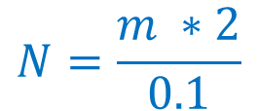


Basic Signals
sinusoidal
$$y\left[ n \right]=A \cos\left(Ω_{o}n+ φ\right){ }$$
$$y\left[ n \right]=4\sin\left(0.1 π n\right) u[ n ]$$
$$Ω_{o}N=m ∗2 π$$
$$0.1 π N=m ∗2 π$$
$$N=\frac{m ∗2}{0.1}$$
$$N=20$$

Slide 16


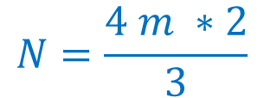


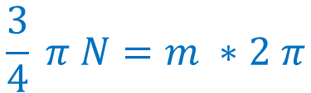
Basic Signals
sinusoidal
Sampled every 1.25 mS
300 Hz Signal
$$y\left[ n \right]=A \cos\left(Ω_{o}n+ φ\right){ }$$
$$y\left[ n \right]=4\sin\left(0.75 π n\right)$$
$$Ω_{o}N=m ∗2 π$$
$$0.75 π N=m ∗2 π$$
$$\frac{3}{4} π N=m ∗2 π$$
3 Cycles
6 π radians
$$N=\frac{4 m ∗2}{3}$$
Let m = 3
$$N=8$$

Slide 17


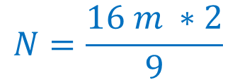

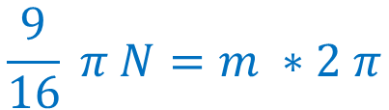
Basic Signals
sinusoidal
Sampled every 312.5 μS
900 Hz Signal
$$y\left[ n \right]=A \cos\left(Ω_{o}n+ φ\right){ }$$
$$y\left[ n \right]=4\sin\left(0.5625 π n\right)$$
$$Ω_{o}N=m ∗2 π$$
$$0.5625 π N=m ∗2 π$$
$$\frac{9}{16} π N=m ∗2 π$$
9 Cycles
18 π radians
$$N=\frac{16 m ∗2}{9}$$
Let m = 9
$$N=32$$

Slide 18

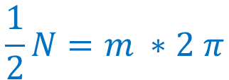


Basic Signals
sinusoidal
$$y\left[ n \right]=A \cos\left(Ω_{o}n+ φ\right){ }$$
$$y\left[ n \right]=4\sin\left(0.5 n\right)$$
$$Ω_{o}N=m ∗2 π$$
$$0.5 N=m ∗2 π$$
$$\frac{1}{2}N=m ∗2 π$$
$$N=m ∗4 π$$
No integer value of m will make N an integer
The function is not periodic

Slide 19
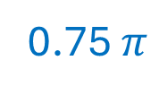
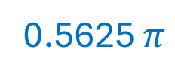
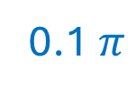
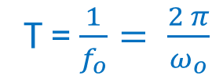
Basic Signals
Compare analog and digital sinusoidal signals
$$y(t)=A\cos\left(ω_{o} t+ φ\right){ }$$
$$y\left[ n \right]=A \cos\left(Ω_{o}n+ φ\right){ }$$
The functions are periodic
The function may be periodic
The period is inversely proportional to the frequency
Frequency
Period, N
T = $\frac{1}{f_{o}}= \frac{2 π}{ω_{o}}$
0.1 $π$
20
0.5
nonperiodic
If you double the frequency, you halve the period
0.5625 $π$
32
0.75 $π$
8

Slide 20
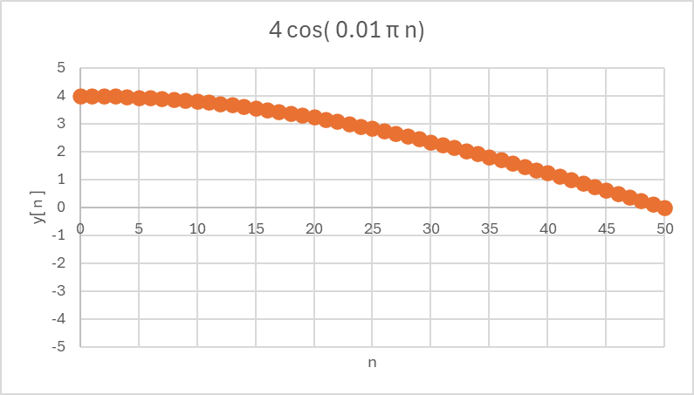
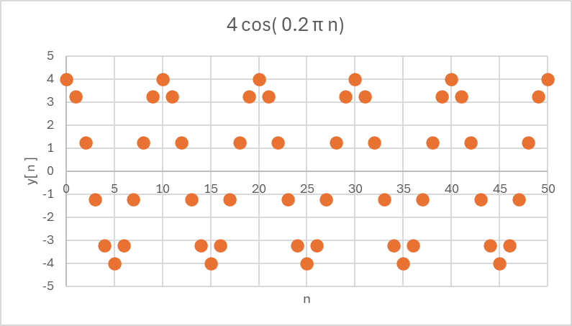
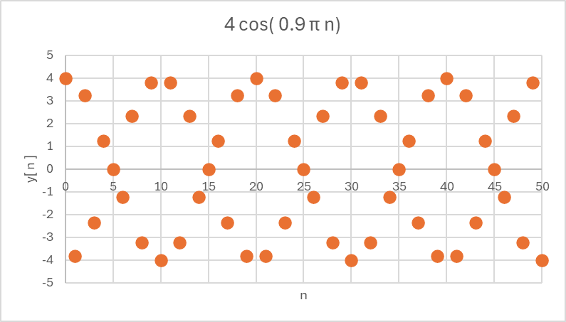
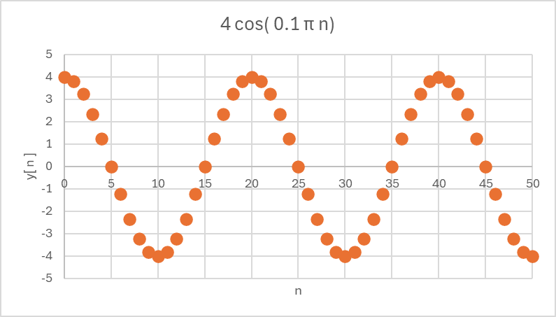
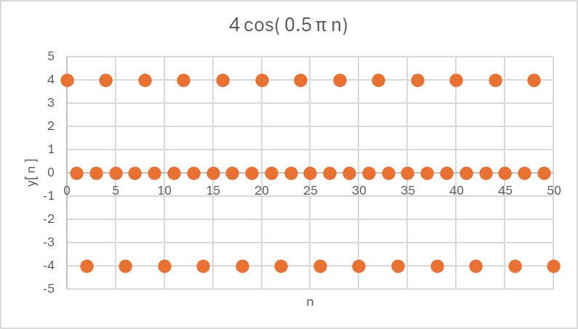
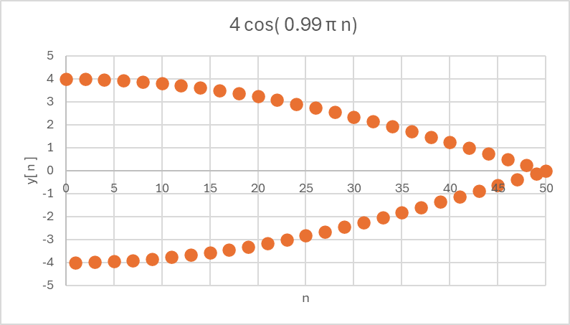

Basic Signals
Oscillations of digital sinusoidal signals do not increase uniformly
$$y\left[ n \right]=A \cos\left(Ω_{o}n\right){ }$$

Slide 21
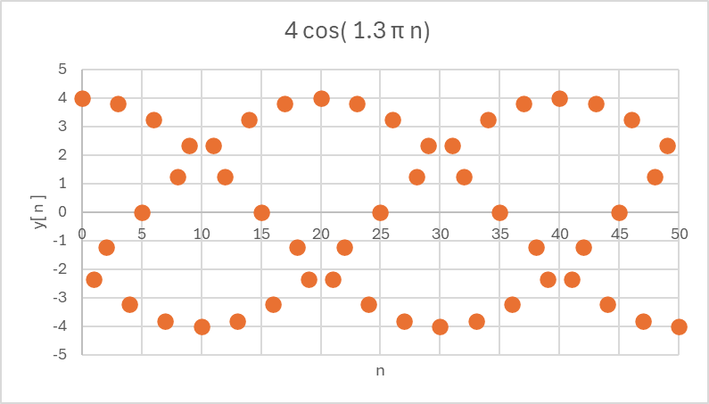

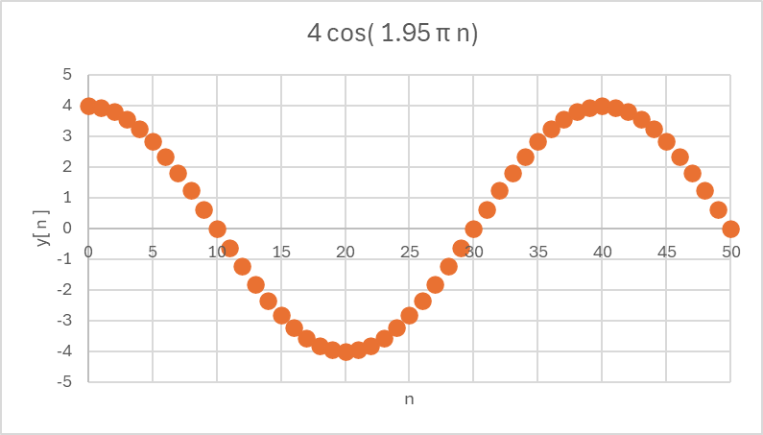
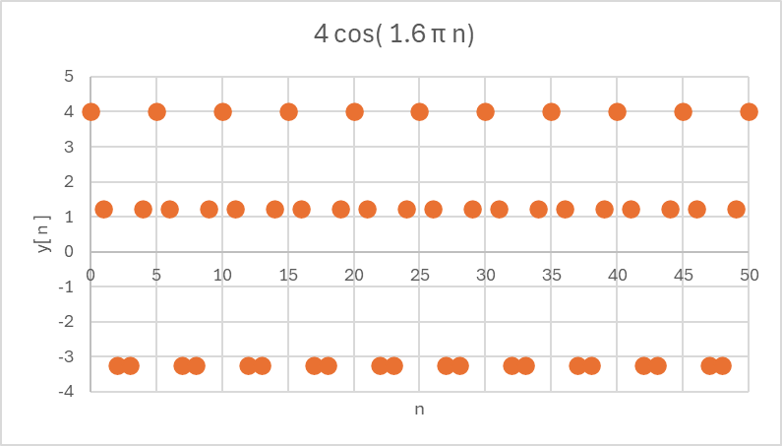
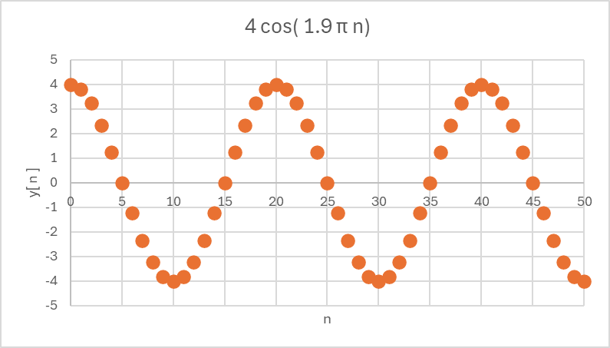
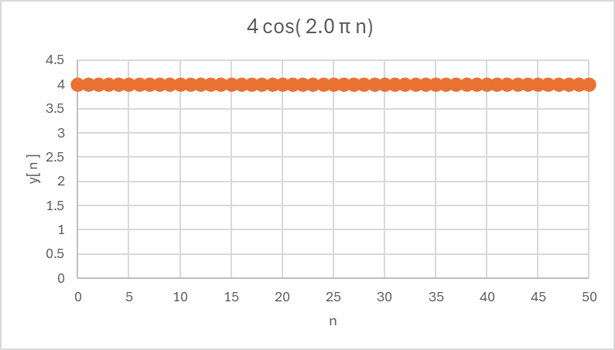
Basic Signals
Oscillations of digital sinusoidal signals do not increase uniformly
$$y\left[ n \right]=A \cos\left(Ω_{o}n\right){ }$$

Slide 22
Memoryless Systems
A system is said to be memoryless if the output only depends upon the current input
Examples:
y[ n ] = 3 x[ n ]
y[ n ] = ( x[ n ] )²
The output of systems with memory depends upon past inputs or past outputs.
They can also depend upon the current input.
Example:
y[ n ] = ( x[ n ] + x[ n-1 ] )/2

Slide 23
Linear Systems
A system is linear if the principle of superposition applies
If the response of the system to the input x₁[n] is y₁[n]
and the response of the system to the input x₂[n] is y₂[n]
Then the system is linear if the response of the system to the input (a * x₁[n] + b * x₂[n]) is y[n] = a * y₁[n] + b * y₂[n]
where a and b are constants

Slide 24
Time Invariant Systems
A system is time invariant (shift invariant) if a shift in time (index) of the input signal only changes the output by the same shift experienced by the input
y₁[ n ] = f( x₁ [ n ] )
input shifted by k
y₂[ n ] = f( x₁ [ n - k ] )
The system is time invariant if
y₂[ n ] = y₁[ n - k ] )

Slide 25
Practice Problems

Slide 26

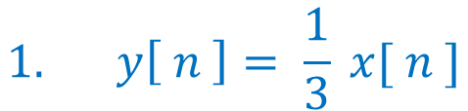


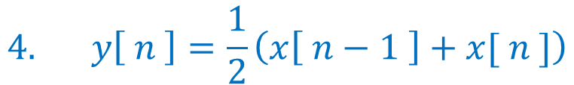
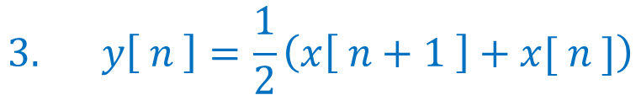

Each of the equations below represents a system. For each system state whether the system is
causal and memoryless
causal with memory
noncausal
$$1. y\left[ n \right]= \frac{1}{3} x[ n ]$$
$$4. y\left[ n \right]=\frac{1}{2}\left(x\left[ n−1 \right]+x[ n ]\right)$$
$$5. y\left[ n \right]=2 \cos\left(0.3 π n \right){ }$$
$$2. y\left[ n \right]=2\left(y\left[ n −1 \right]+x[ n ]\right)$$
$$6. y\left[ n \right]=2 ( y\left[ n −1 \right]∗x\left[ n \right]){ }$$
$$3. y\left[ n \right]=\frac{1}{2}\left(x\left[ n+1 \right]+x[ n ]\right)$$
$$7. y\left[ n \right]=4 {\left(0.7\right)}^{n} u[ n ]$$

Slide 27

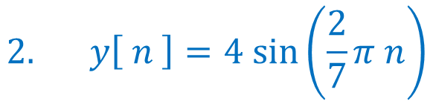
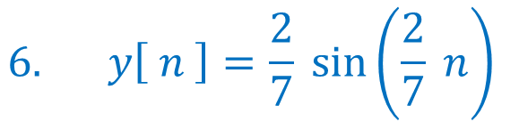

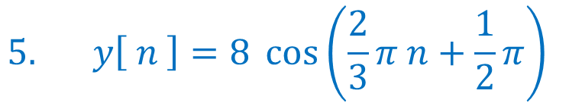
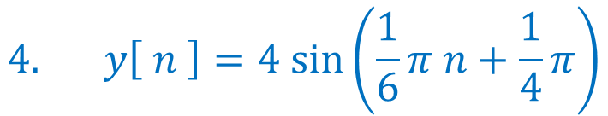
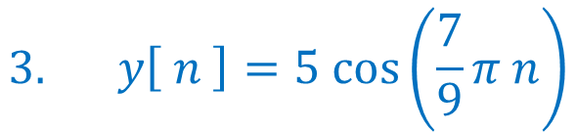
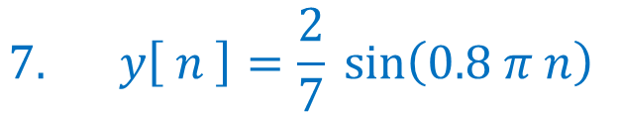
Each of the following, state if the system is periodic
If the system is periodic, give the period, N
$$5. y\left[ n \right]=8 \cos\left(\frac{2}{3}π n+\frac{1}{2}π\right){ }$$
$$1. y\left[ n \right]=2 \cos\left(0.3 π n \right){ }$$
$$2. y\left[ n \right]=4 sin⁡\left(\frac{2}{7}π n\right)$$
$$6. y\left[ n \right]=\frac{2}{7} sin\left(\frac{2}{7} n\right){ }$$
$$3. y\left[ n \right]=5 cos⁡\left(\frac{7}{9}π n\right)$$
$$7. y\left[ n \right]=\frac{2}{7} sin\left(0.8 π n\right){ }$$
$$4. y\left[ n \right]=4 sin⁡\left(\frac{1}{6}π n+\frac{1}{4}π\right)$$
$$8. y\left[ n \right]=\cos\left(1.5 π n\right){ }$$

