Slide 1
Digital Signal Processing
Fall 2025

Slide 2
What we will talk about today
Quantization noise
Adding uncorrelated Gaussian noise
Analog/Digital conversion
Aliasing
Nyquist theorem

Slide 3
Analog Signals are often Sampled to Make Digital Signals

Slide 4
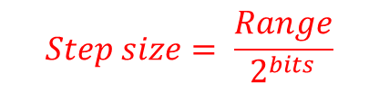
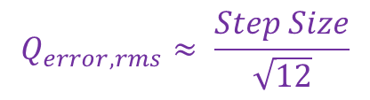
Analog Signals are often Sampled to Make “Digital” Signals
Circuit Voltage
If signal variation >> Step size
$$Q_{error,rms}≈ \frac{Step Size}{\sqrt{12}}$$
Output of A/D Converter
Quantization error
The quantized value is held constant until the next sample is taken
Values are “Quantized”
For each sample the actual value is rounded to the nearest quantized value
10 for this example
$$Step size= \frac{Range}{2^{bits}}$$
Samples every 2 mS
8 for this example
Sampling period, T

Slide 5
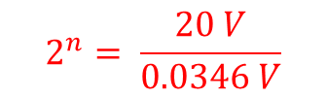



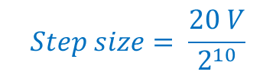
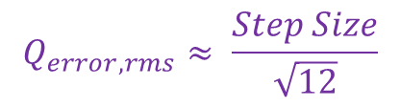


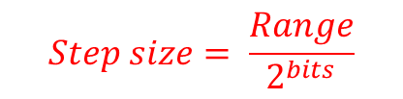




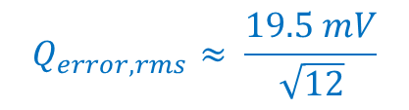
Example: Specifying A/D converter based upon Quantization noise
Problem: A quiet signal (with a minimal level of noise) has a range from -10 Volts to +10 Volts. The signal is to be digitized by an A/D converter. The maximum noise level permissible in the digitized signal is 10 mV rms. How many bits of accuracy must the A/D converter have?
$$Step size= \frac{Range}{2^{bits}}$$
$$Step size= \frac{20 V}{2^{10}}$$
$$Q_{error,rms}≈ \frac{Step Size}{\sqrt{12}}$$
$$2^{n}= \frac{Range}{Step size}$$
$$=19.5 mV$$
$$Step Size=\sqrt{12} (10 mV)$$
$$2^{n}= \frac{20 V}{0.0346 V}$$
$$Q_{error,rms}≈ \frac{19.5 mV}{\sqrt{12}}$$
$$=578$$
$$=5.6 mV$$
$$= (34.6 mV)$$
$$=0.0346 V$$
$$n= \log_{2}{578}$$
$$≈9.2$$
10 bits required

Slide 6
Noise in Signals
All signals have some noise

Slide 7
Noise in Signals
Noise usually has a Gaussian distribution
Terms to know:
Bell curve
Average
(mean)
Standard deviation
Variance

Slide 8
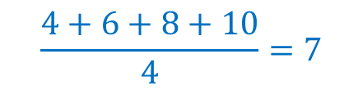
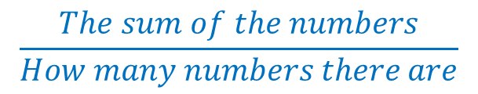



Definitions of the word mean:
Normal people talking
Definition
What does that word mean?
What is the definition of that word?
What do you mean?
What thought are you trying to indicate?
to treat poorly
He was mean to me.
He treated me poorly.
Scientists, mathematicians, or engineers talking
The average of a group of numbers
The mean of 4, 6, 8, and 10 is 7
$$\frac{The sum of the numbers}{How many numbers there are}$$
$$\frac{4+6+8+10}{4}=7$$
symbol (true mean):
$$μ$$
symbol (estimated mean):
line over the variable name
$$\overline{x}$$
$$\overline{y}$$

Slide 9
Noise in Signals
Noise usually has a Gaussian distribution
Terms to know:
Bell curve
Average
(mean)
How spread out the data are
Standard deviation
Variance

Slide 10

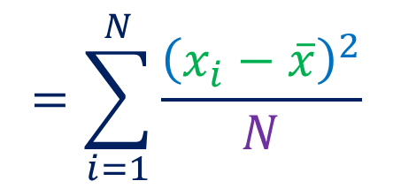
Variance
For each of a group of N numbers
Subtract the mean from the number
Square the result
$$=\sum_{i=1}^{N}{\frac{{\left(x_{i}−\overline{x}\right)}^{2}}{N}}$$
σ²
(N – 1)
Divide by how many numbers there are
Divide by one less than how many numbers there are
Add together the results
This is the formula for the variance of an entire group of numbers
If the numbers are a sample of a larger group, the formula changes
Standard Deviation = σ
$$=\sqrt{Variance}$$

Slide 11

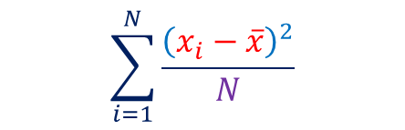
Data with different standard deviations
$$σ=\sqrt{\begin{aligned} \\ \end{aligned}}$$
$$\sum_{i=1}^{N}{\frac{{\left(x_{i}−\overline{x}\right)}^{2}}{N}}$$
mean = 6.0
mean = 6.1
σ = 0.94
σ = 0.56

Slide 12
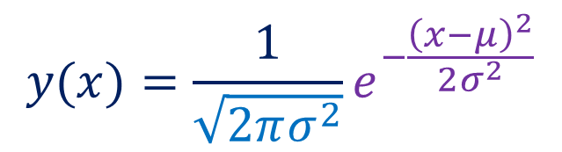
Standard Normal Distribution
$$y(x)=\frac{1}{\sqrt{2πσ^{2}}}e^{−\frac{{\left(x−μ\right)}^{2}}{2σ^{2}}}$$
mean of zero
standard deviation of one
A value close to the average (or mean) is likely to occur
The area under the curve (integral) gives the probability that a measurement will be within those bounds
68 % of data should be within one standard deviation of the mean
A value far from the average (or mean) is less likely to occur

Slide 13
Data with different standard deviations
mean = 6.0
mean = 6.1
σ = 0.94
σ = 0.56

Slide 14
Changing the mean causes the distribution to be displaced along the x axis

Slide 15
Changing the standard deviation causes the distribution to become wider or narrower
A larger standard deviation causes the distribution to become wider

Slide 16
A smaller standard deviation causes the distribution to become narrower

Slide 17
Noise in Signals
Noise considerations can influence our choice of A/D converter
Quantization error adds to other noise sources to determine the overall noise
Noise is usually Gaussian
For uncorrelated sources of Gaussian noise, the variances add

Slide 18



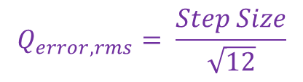
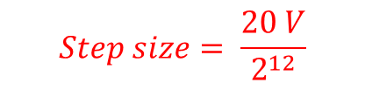

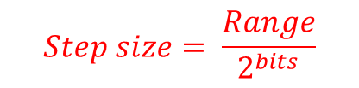



Example2: Determining total noise when two noise sources contribute
Problem: A signal has a range from -10 Volts to +10 Volts and contains noise that has a root-mean-squared (rms) value of 1 mV. The signal is to be digitized by a 12-bit A/D converter. What will be the noise level in the output of the A/D converter?
Find quantization noise
We need to add variances
Quantization has increased the rms noise level by 73%
$$Step size= \frac{Range}{2^{bits}}$$
$$Step size= \frac{20 V}{2^{12}}$$
${σ^{2}}_{tot}={σ^{2}}_{q}+$ ${σ^{2}}_{other}$
It is decided that the quantization noise should increased the rms noise level by no more than 10%
$$=4.88 mV$$
$={(1.41 mV)}^{2}+$ ${(1.mV)}^{2}$
$$Q_{error,rms}= \frac{Step Size}{\sqrt{12}}$$
$$=2.99 {( mV)}^{2}$$
$$=1.41 mV$$
$$σ_{tot}=√2.99 {( mV)}^{2}$$
What is the minimum number of A/D conversion bits to accomplish this?
This is standard deviation
$$σ_{tot}=1.73 mV$$

Slide 19










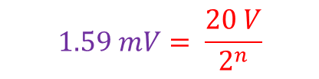
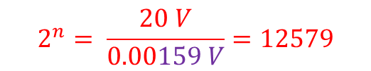

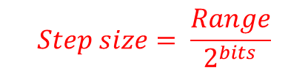


Example2b: Determining total noise when two noise sources contribute
Problem: A signal has a range from -10 Volts to +10 Volts and contains noise that has a root-mean-squared (rms) value of 1 mV. What is the minimum number of A/D conversion bits so that the overall noise level is not increased by more than 10%?
Find quantization noise (rms)
Find number of bits
Find step size
$$σ_{tot}=1.1{ σ}_{other}$$
$$Step size= \frac{Range}{2^{bits}}$$
$$σ_{tot}=1.1 mV$$
$$Q_{error,rms}= \frac{Step Size}{\sqrt{12}}$$
${σ^{2}}_{tot}={σ^{2}}_{q}+$ ${σ^{2}}_{other}$
$$1.59 mV= \frac{20 V}{2^{n}}$$
$${(1.1 mV)}^{2} ={σ^{2}}_{q}+{(1.mV)}^{2}$$
$$Step Size=\left(0.458 mV\right)\sqrt{12}$$
$$2^{n}= \frac{20 V}{0.00159 V}=12579$$
$${σ^{2}}_{q}={(1.1 mV)}^{2} − {(1.mV)}^{2}$$
$Step Size=$ $1.59 mV$
$${σ^{2}}_{q}=1.21{ (mV)}^{2} −1.0{ (mV)}^{2}$$
$$n= \log_{2}{12579}$$
$$σ_{q}=\sqrt{0.21{ (mV)}^{2}}=0.458 mV$$
$$n=13.6$$
$$n=14$$

Slide 20
Analog Signals are often Sampled to Make “Digital” Signals
A/D Sampling Process
Circuit Voltage
(sample and hold)
Values are “Quantized”
Samples every 2 mS

Slide 21
Sample and Hold Output
Digital signals have discrete values
(both on the x axis and the y axis)
25
26
4
5
6
2
3
29
30
31
7
0
1
27
28
32
Horizontal axis is no longer time
Sample Number (n)
Sample number may be related to time

Slide 22
Nyquist Theorem and Aliasing
If sampling is done correctly, the original signal can be exactly reconstructed
We will now look at the requirements to achieve this
First we will look at some proper sampling
Then we will see what can go wrong

Slide 23
Nyquist Theorem and Aliasing
Sample at 10 kHz

Slide 24
Nyquist Theorem and Aliasing
Sample at 6.5 kHz

Slide 25
Nyquist Theorem and Aliasing
Sample at 3.3 kHz

Slide 26
Nyquist Theorem and Aliasing
Sample at 2.2 kHz

Slide 27
Nyquist Theorem and Aliasing
Sample at 1.8 kHz

Slide 28
Nyquist Theorem and Aliasing
Sample at 2.2 kHz
Sample at 1.8 kHz

Slide 29


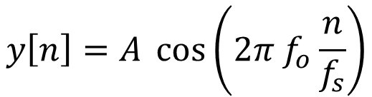
Nyquist Theorem and Aliasing
Consider a sinusoidal signal:
$$y=A \cos\left(ω_{o}t\right)$$
$$=A \cos\left(2π f_{o}t\right)$$
If we sample it at a frequency f_{s}, the sampling period will be $\frac{1}{f_{s}}$
The data points will be given by:
The time that we reach the nth data point
$$y\left[n\right]=A \cos\left(2π f_{o}\frac{n}{f_{s}}\right)$$

Slide 30

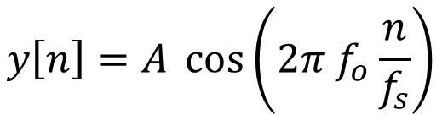
Nyquist Theorem and Aliasing
$$y\left[n\right]=A \cos\left(2π f_{o}\frac{n}{f_{s}}\right)$$
This same series of data points would be obtained if the frequency was
$$f=f_{o}+k ∗f_{s}$$
where k is any integer
We can prove this by substituting the expression and using some trigonometry

Slide 31
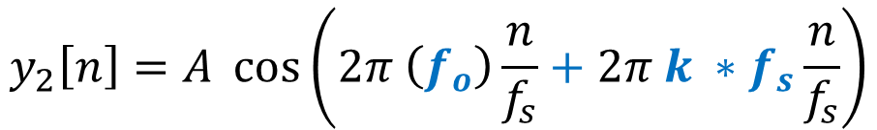
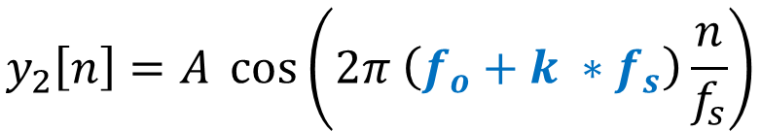
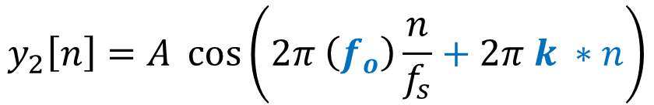
Nyquist Theorem and Aliasing
$$y_{2}\left[n\right]=A \cos\left(2π \left(f_{o}+k ∗f_{s}\right)\frac{n}{f_{s}}\right)$$
multiply things out (distribute multiplication over addition)
$$y_{2}\left[n\right]=A \cos\left(2π \left(f_{o}\right)\frac{n}{f_{s}}+2π k ∗f_{s}\frac{n}{f_{s}}\right)$$
Cancel the sampling frequency, f_{s}
$$y_{2}\left[n\right]=A \cos\left(2π \left(f_{o}\right)\frac{n}{f_{s}}+2π k ∗n\right)$$

Slide 32
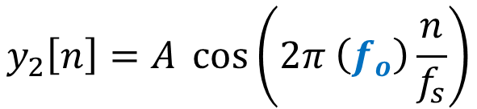
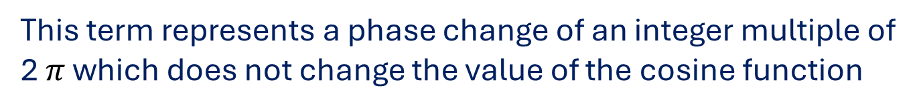
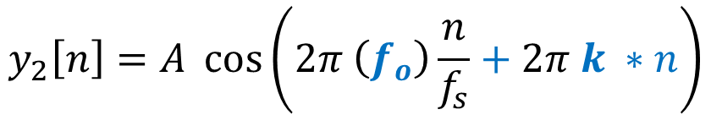
Nyquist Theorem and Aliasing
$$y_{2}\left[n\right]=A \cos\left(2π \left(f_{o}\right)\frac{n}{f_{s}}+2π k ∗n\right)$$
n and k are both integers
This term represents a phase change of an integer multiple of 2 $π$ which does not change the value of the cosine function
$$y_{2}\left[n\right]=A \cos\left(2π \left(f_{o}\right)\frac{n}{f_{s}}\right)$$
This is the exact same sequence of values that we had previously

Slide 33
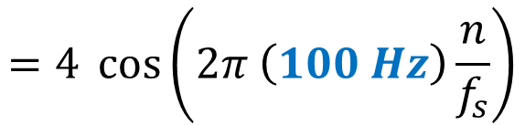
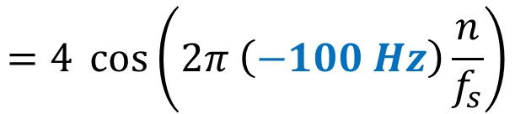
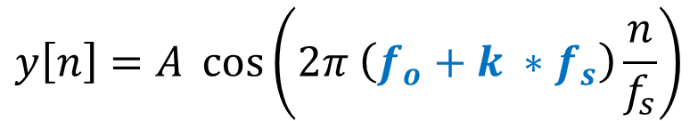
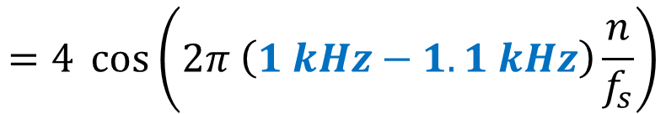
Nyquist Theorem and Aliasing
Sample at 1.1 kHz
100 Hz curve
$$y\left[n\right]=A \cos\left(2π \left(f_{o}+k ∗f_{s}\right)\frac{n}{f_{s}}\right)$$
$$=4 \cos\left(2π \left(1 kHz−1.1 kHz\right)\frac{n}{f_{s}}\right)$$
$$=4 \cos\left(2π \left(−100 Hz\right)\frac{n}{f_{s}}\right)$$
$$=4 \cos\left(2π \left(100 Hz\right)\frac{n}{f_{s}}\right)$$

Slide 34
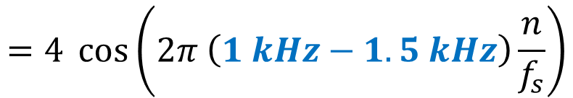
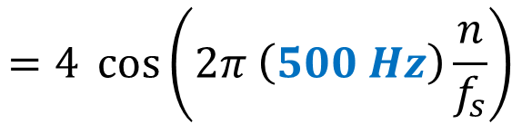
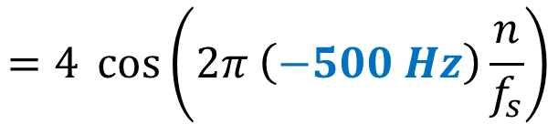
Nyquist Theorem and Aliasing
Sample at 1.5 kHz
500 Hz curve
$$y\left[n\right]=A \cos\left(2π \left(f_{o}+k ∗f_{s}\right)\frac{n}{f_{s}}\right)$$
$$=4 \cos\left(2π \left(1 kHz−1.5 kHz\right)\frac{n}{f_{s}}\right)$$
$$=4 \cos\left(2π \left(−500 Hz\right)\frac{n}{f_{s}}\right)$$
$$=4 \cos\left(2π \left(500 Hz\right)\frac{n}{f_{s}}\right)$$

Slide 35
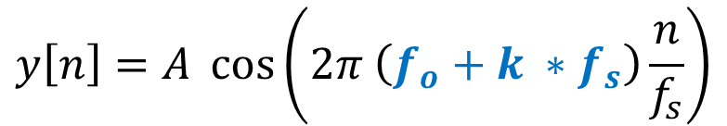
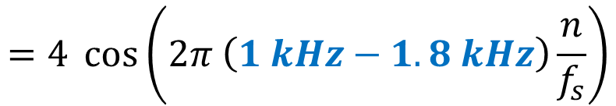

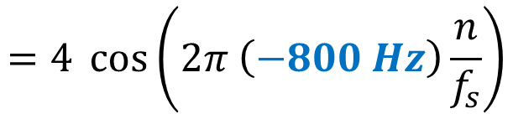
Nyquist Theorem and Aliasing
Sample at 1.8 kHz
800 Hz curve
$$y\left[n\right]=A \cos\left(2π \left(f_{o}+k ∗f_{s}\right)\frac{n}{f_{s}}\right)$$
$$=4 \cos\left(2π \left(1 kHz−1.8 kHz\right)\frac{n}{f_{s}}\right)$$
$$=4 \cos\left(2π \left(−800 Hz\right)\frac{n}{f_{s}}\right)$$
$$=4 \cos\left(2π \left(800 Hz\right)\frac{n}{f_{s}}\right)$$

Slide 36
Nyquist Theorem and Aliasing
To prevent aliasing, the sampling frequency must be at least twice the frequency of the highest frequency present in the signal
If these conditions (Nyquist criterion) are met, then the original analog signal can be successfully restored

Slide 37
Nyquist Theorem and Aliasing
Remember that periodic nonsinusoidal signals can have harmonics at much higher frequencies than the fundamental frequency
Fourier coefficients
1 mS
f_{o} = 1 kHz
also components at 2 kHz, 3 kHz, 4 kHz …
These higher frequency components can cause aliasing
Signals are often low pass filtered prior to sampling

Slide 39
Practice Problems

Slide 40
Problem 1: A signal has a range from 0 Volts to +5 Volts and contains noise that has a root-mean-squared (rms) value of 2 mV. The signal is to be digitized by an A/D converter. The maximum permissible noise (after conversion) is 2.2 mV rms. What is the minimum number of bits for the A/D converter? What will be the noise level in the output of the A/D converter if this number of bits are used?

Slide 41




Each of the signals below is to be sampled at the indicated frequency or period.
Indicate if aliasing will occur
If aliasing will occur, indicate the frequency at which the aliased signal will appear
If aliasing will occur, state the minimum sampling frequency (or maximum sampling period) needed to prevent aliasing
$$2. y\left(t\right)=2 \cos\left(600 π t\right)$$
sampled at a frequency of 1000 Hz
$$3. y\left(t\right)=2 \sin\left(50 π t\right)$$
sampled at a period of 25 mS
$$4. y\left(t\right)=2 \sin\left(200 π t\right)$$
sampled at a period of 10 mS
$$5. y\left(t\right)=5 \cos\left(1000 π t\right)$$
sampled at a frequency of 800 Hz

