Slide 1
Digital Signal Processing
Fall 2025

Slide 2
Difference Equations
Difference equations are used in the analysis of discrete functions

Slide 3






Compare to analysis of continuous functions
Look for relationships between variables
Differential equations
$$v_{y} =\frac{dh}{dt}$$
$$a_{y}= \frac{dv_{y}}{dt} =\frac{d^{2}h}{dt^{2}}$$
$$=−9.8 \frac{m}{s^{2}}$$
$$=−g$$
Integrate twice
$$v_{y}= v_{o} −g t$$
$$h=−\frac{1}{2}g t^{2}+ v_{o} t+h_{o}$$
Initial values [boundary conditions] affect the results

Slide 4



Comparison of Analog and Digital Functions
Analog functions
Digital Functions
$$h=−\frac{1}{2}g t^{2}+ v_{o} t+h_{o}$$
$$h=f\left(t\right)$$
$$h=f\left(n\right)$$
Differential equations
Difference equations

Slide 5
Example: Fibonacci’s Problem
[assume that the first pair are babies]
One pair of rabbits put into an enclosure
There is plenty of food
There are no predators
Each month, each pair of adult rabbits produces a pair of baby rabbits
After one month, baby rabbits become adult rabbits [they will start producing baby rabbits]
How many rabbits are there at the end of a year [12 months]

Slide 6
Example: Fibonacci’s Problem
[assume that they are babies]
One pair of rabbits put into an enclosure
month
0 1 2 3 4 5 6 7 8 9 10 11 12
children
1
0
1
1
2
3
5
8
13
21
34
55
89
adults
0
1
1
2
3
5
8
13
21
34
55
89
144
total
1
1
2
3
5
8
13
21
34
55
89
144
233

Slide 7
Example: Fibonacci’s Problem
Look for function describing the total number of rabbits each month
One pair of rabbits put into an enclosure
n = month number
month
0 1 2 3 4 5 6 7 8 9 10 11 12
c[ n ]
children
1
0
1
1
2
3
5
8
13
21
34
55
89
a[ n ]
adults
0
1
1
2
3
5
8
13
21
34
55
89
144
t[ n ]
total
1
1
2
3
5
8
13
21
34
55
89
144
233
y[ n ]
n-1
n-1
9
9
3
3
2
2
time invariant
a[ n+1 ] = y[ n ]
c[ n+1 ] = a[ n ]
y[ n ] = c[ n ] + a[ n ]
(shift invariant)
a[ n ] = y[ n – 1]
c[ n ] = a[ n - 1 ]
y[ n ] = a[ n - 1 ] + a[ n ]
a[ n -1] = y[ n – 2]
y[ n ] = y[ n - 2 ] + y[ n - 1 ]

Slide 8
Example: Fibonacci’s Problem
n = month number
Total number of rabbits each month
y[ n ] = y[ n - 2 ] + y[ n - 1 ]
n ≥ 2
Boundary conditions
y[ 0 ] = 1
y[ 1 ] = 1
month
0 1 2 3 4 5 6 7 8 9 10 11 12
c[ n ]
children
1
0
1
1
2
3
5
8
13
21
34
55
89
a[ n ]
adults
0
1
1
2
3
5
8
13
21
34
55
89
144
y[ n ]
total
1
1
2
3
5
8
13
21
34
55
89
144
233
noncausal
Equations from previous slide
a[ n+1 ] = y[ n ]
a[ n +1 ] = a[ n - 1 ] + a[ n ]
a[ n ] = a[ n +1 ] - a[ n - 1 ]
a[ n ] = y[ n – 1]
shift
n → n - 1
a[ 0 ] = 0
a[ n -1 ] = y[ n – 2]
a[ n ] = a[ n - 2 ] + a[ n - 1 ]
a[ 1 ] = 1

Slide 9
Example: Fibonacci’s Problem
Boundary conditions
Total number of rabbits each month
y[ n ] = y[ n - 2 ] + y[ n - 1 ]
y[ 0 ] = 1
y[ 1 ] = 1
n ≥ 2
a[ n ] = a[ n - 2 ] + a[ n - 1 ]
a[ 0 ] = 0
a[ 1 ] = 1
month
0 1 2 3 4 5 6 7 8 9 10 11 12
c[ n ]
children
1
0
1
1
2
3
5
8
13
21
34
55
89
a[ n ]
adults
0
1
1
2
3
5
8
13
21
34
55
89
144
y[ n ]
total
1
1
2
3
5
8
13
21
34
55
89
144
233
c[ n ] = a[ n - 1 ]
c[ n +1 ] = c[ n - 1 ] + c[ n ]
c[ n - 1 ] = a[ n - 2 ]
c[ n ] = c[ n - 2 ] + c[ n - 1 ]
c[ 0 ] = 1
c[ n + 1 ] = a[ n ]
c[ 1 ] = 0

Slide 10
Example: Fibonacci’s Problem
n ≥ 2
Boundary conditions
Total number of rabbits each month
y[ n ] = y[ n - 2 ] + y[ n - 1 ]
y[ 0 ] = 1
y[ 1 ] = 1
Number of adult rabbits each month
a[ n ] = a[ n - 2 ] + a[ n - 1 ]
a[ 0 ] = 0
a[ 1 ] = 1
Number of child rabbits each month
c[ n ] = c[ n - 2 ] + c[ n - 1 ]
c[ 0 ] = 1
c[ 1 ] = 0
We can find closed form solutions for each of these
expressions that only involve constants and the variable n instead of using previous values like y[ n-1 ]

Slide 11


Eigenfunctions of Linear Time Invariant Discrete Systems
examples:
differentiation
$$\frac{d}{dt}$$
integration
What is an eigenfunction?
delay
An eigenfunction of an operator results in an output that is proportional to the input to the function
Why are eigenfunctions important?
For difference equations, the delay operator is used with the results of differing delays being added together to sum to zero
For the sum to equal zero and have a nontrivial solution we need eigenfunctions of the delay operator

Slide 12





Eigenfunctions of Linear Time Invariant Discrete Systems
$$r^{n}$$
is an eigenfunction of the delay operator
Consider a delay of k
constant
The result would be:
$$r^{\left[n−k\right]}$$
$$=r^{\left[n\right]}r^{\left(−k\right)}$$
$$=C r^{\left[n\right]}$$
We can expect closed form solutions of difference equations to involve terms of the form
index of the series
$$C r^{\left[n\right]}$$
a constant
determined from initial conditions
roots of the characteristic equation
a different constant
eigenvalues

Slide 13
Example: Fibonacci’s Problem
n ≥ 2
Boundary conditions
Total number of rabbits each month
y[ n ] = y[ n - 2 ] + y[ n - 1 ]
y[ 0 ] = 1
y[ 1 ] = 1
Number of adult rabbits each month
a[ n ] = a[ n - 2 ] + a[ n - 1 ]
a[ 0 ] = 0
a[ 1 ] = 1
Number of child rabbits each month
c[ n ] = c[ n - 2 ] + c[ n - 1 ]
c[ 0 ] = 1
c[ 1 ] = 0
We can find closed form solutions for each of these

Slide 14

Example: Fibonacci’s Problem
n ≥ 2
Find the closed form solution for the total number of rabbits
Boundary conditions
Total number of rabbits each month
y[ n ] = y[ n - 2 ] + y[ n - 1 ]
y[ 0 ] = 1
y[ 1 ] = 1
Rearrange the equation
y[ n ] – y[ n - 1 ] – y[ n - 2 ] = 0
Assume the form
$$y\left[n\right]=C r^{\left[n\right]}$$
$$C r^{\left[n\right]} −C r^{\left[n−1\right]} −C r^{\left[n−2\right]}=0$$
$$r^{\left[n\right]} − r^{\left[n−1\right]} − r^{\left[n−2\right]}=0$$

Slide 15


Example: Fibonacci’s Problem
n ≥ 2
Find the closed form solution for the total number of rabbits
Boundary conditions
$$r^{\left[n\right]} − r^{\left[n−1\right]} − r^{\left[n−2\right]}=0$$
y[ 0 ] = 1
y[ 1 ] = 1
Rearrange
$$r^{\left[n\right]} − r^{\left[n\right]}r^{\left[−1\right]}−r^{\left[n\right]}r^{\left[−2\right]}=0$$
$$1 − r^{\left[−1\right]}−r^{\left[−2\right]}=0$$
Multiply by r²
$$r^{2}−r−1=0$$
characteristic equation
Find the roots of the quadratic equation

Slide 16
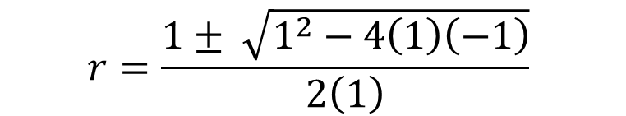
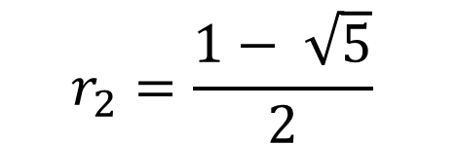
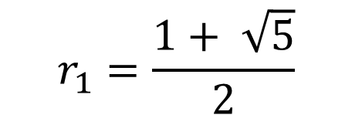
Example: Fibonacci’s Problem
n ≥ 2
Find the roots of the quadratic equation
Boundary conditions
y[ 0 ] = 1
y[ 1 ] = 1
$$r^{2}−r−1=0$$
$$r=\frac{1± \sqrt{1^{2}−4\left(1\right)\left(−1\right)}}{2\left(1\right)}$$
$$r_{1}=\frac{1+ \sqrt{5}}{2}$$
$$r_{2}=\frac{1− \sqrt{5}}{2}$$
Two roots
There is a term corresponding to each root of the characteristic equation
Solution:
$$y\left[n\right]= C_{1} {r_{1}}^{n}+C_{2} {r_{2}}^{n}$$
The form will be different if the roots are not distinct and real

Slide 17



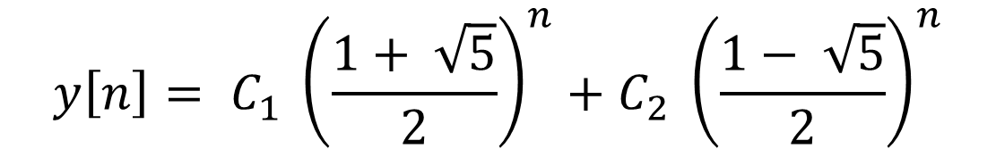
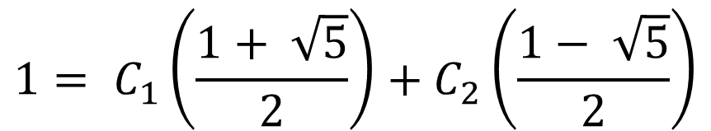
Example: Fibonacci’s Problem
n ≥ 2
$$y\left[n\right]= C_{1} {\left(\frac{1+ \sqrt{5}}{2}\right)}^{n}+C_{2} {\left(\frac{1− \sqrt{5}}{2}\right)}^{n}$$
Boundary conditions
y[ 0 ] = 1
y[ 1 ] = 1
$$1= C_{1}\left(\frac{1+ \sqrt{5}}{2}\right)+C_{2}\left(\frac{1− \sqrt{5}}{2}\right)$$
$$1= C_{1} +C_{2}$$
$$2= C_{1}\left(1+ \sqrt{5}\right)+C_{2}\left(1− \sqrt{5}\right)$$
$$2= C_{1}+C_{2}+C_{1}\sqrt{5}−C_{2}\sqrt{5}$$
$$1= \left(C_{1}−C_{2}\right)\sqrt{5}$$
$$\left(C_{1}−C_{2}\right)= \frac{1}{\sqrt{5}}$$

Slide 18
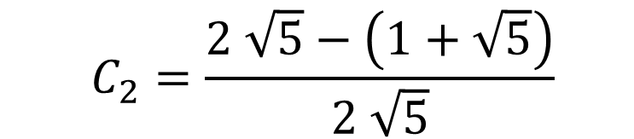

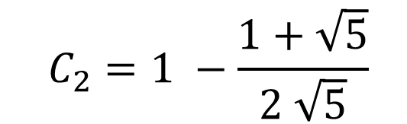
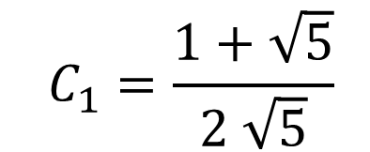

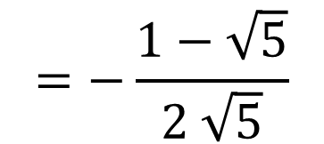

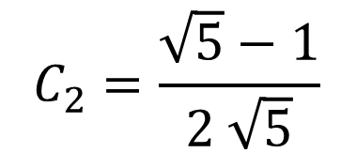
Example: Fibonacci’s Problem
n ≥ 2
$$y\left[n\right]= C_{1} {\left(\frac{1+ \sqrt{5}}{2}\right)}^{n}+C_{2} {\left(\frac{1− \sqrt{5}}{2}\right)}^{n}$$
Boundary conditions
y[ 0 ] = 1
y[ 1 ] = 1
$$C_{1} +C_{2}=1$$
$$C_{1}=\frac{1+\sqrt{5}}{2 \sqrt{5}}$$
$$C_{2}=1 −\frac{1+\sqrt{5}}{2 \sqrt{5}}$$
The two equations
$$C_{1}−C_{2}= \frac{1}{\sqrt{5}}$$
$$C_{2}=\frac{2 \sqrt{5}−\left(1+\sqrt{5}\right)}{2 \sqrt{5}}$$
Add the two equations
$$2 C_{1}=1+\frac{1}{\sqrt{5}}$$
$$C_{2}=\frac{\sqrt{5}−1}{2 \sqrt{5}}$$
$$=−\frac{1−\sqrt{5}}{2 \sqrt{5}}$$

Slide 19
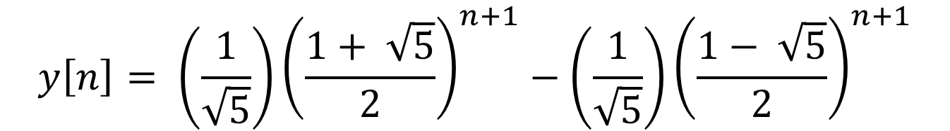
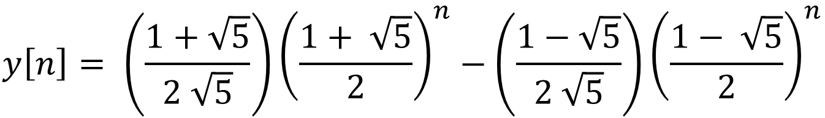
Example: Fibonacci’s Problem
n ≥ 2
$$y\left[n\right]= \left(\frac{1+\sqrt{5}}{2 \sqrt{5}}\right){\left(\frac{1+ \sqrt{5}}{2}\right)}^{n}−\left(\frac{1−\sqrt{5}}{2 \sqrt{5}}\right){\left(\frac{1− \sqrt{5}}{2}\right)}^{n}$$
Boundary conditions
y[ 0 ] = 1
y[ 1 ] = 1
$$y\left[n\right]= \left(\frac{1}{\sqrt{5}}\right){\left(\frac{1+ \sqrt{5}}{2}\right)}^{n+1}−\left(\frac{1}{\sqrt{5}}\right){\left(\frac{1− \sqrt{5}}{2}\right)}^{n+1}$$

Slide 20
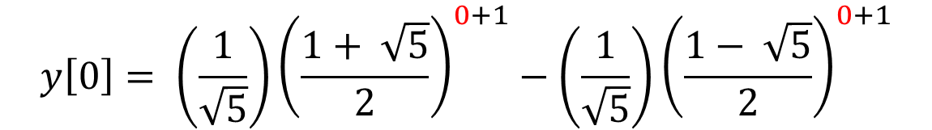

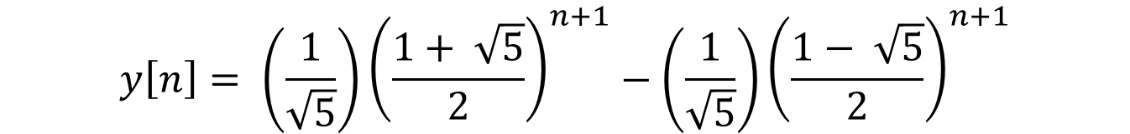
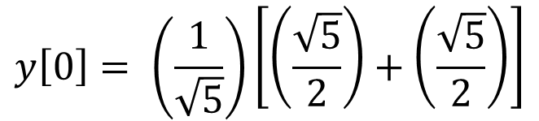
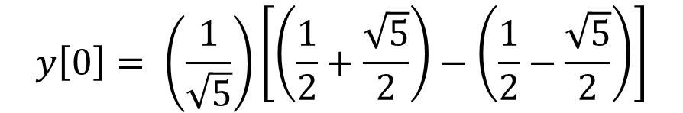
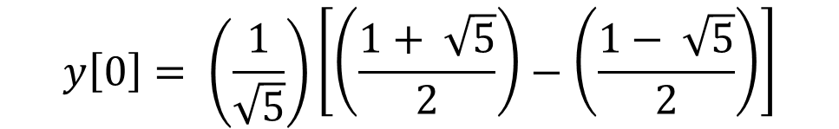
Example: Fibonacci’s Problem
Use boundary conditions to double check our result
n ≥ 2
$$y\left[n\right]= \left(\frac{1}{\sqrt{5}}\right){\left(\frac{1+ \sqrt{5}}{2}\right)}^{n+1}−\left(\frac{1}{\sqrt{5}}\right){\left(\frac{1− \sqrt{5}}{2}\right)}^{n+1}$$
Boundary conditions
y[ 0 ] = 1
y[ 1 ] = 1
$$y\left[0\right]= \left(\frac{1}{\sqrt{5}}\right){\left(\frac{1+ \sqrt{5}}{2}\right)}^{0+1}−\left(\frac{1}{\sqrt{5}}\right){\left(\frac{1− \sqrt{5}}{2}\right)}^{0+1}$$
$$y\left[0\right]= \left(\frac{1}{\sqrt{5}}\right)\left[\left(\frac{\sqrt{5}}{2}\right)+\left(\frac{\sqrt{5}}{2}\right)\right]$$
$$y\left[0\right]= \left(\frac{1}{\sqrt{5}}\right)\left[\left(\frac{1+ \sqrt{5}}{2}\right)−\left(\frac{1− \sqrt{5}}{2}\right)\right]$$
$$y\left[0\right]=1$$
$$y\left[0\right]= \left(\frac{1}{\sqrt{5}}\right)\left[\left(\frac{1}{2}+\frac{\sqrt{5}}{2}\right)−\left(\frac{1}{2}−\frac{\sqrt{5}}{2}\right)\right]$$

Slide 21
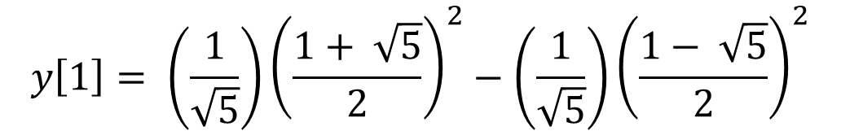

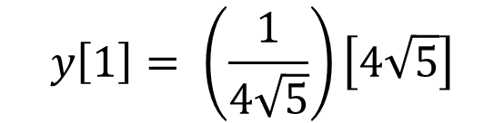
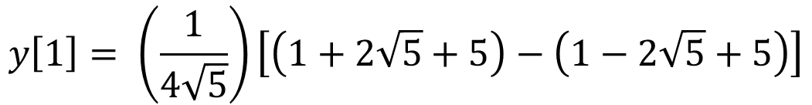
Example: Fibonacci’s Problem
n ≥ 2
$$y\left[n\right]= \left(\frac{1}{\sqrt{5}}\right){\left(\frac{1+ \sqrt{5}}{2}\right)}^{n+1}−\left(\frac{1}{\sqrt{5}}\right){\left(\frac{1− \sqrt{5}}{2}\right)}^{n+1}$$
Boundary conditions
y[ 0 ] = 1
y[ 1 ] = 1
$$y\left[1\right]= \left(\frac{1}{\sqrt{5}}\right){\left(\frac{1+ \sqrt{5}}{2}\right)}^{2}−\left(\frac{1}{\sqrt{5}}\right){\left(\frac{1− \sqrt{5}}{2}\right)}^{2}$$
$$y\left[1\right]= \left(\frac{1}{4\sqrt{5}}\right)\left[\left(1+2\sqrt{5}+5\right)−\left(1−2\sqrt{5}+5\right)\right]$$
$$y\left[1\right]= \left(\frac{1}{4\sqrt{5}}\right)\left[4\sqrt{5}\right]$$
$$y\left[1\right]=1$$

Slide 22
Find the closed form solution for the number of adult rabbits
Difference equation was the same
Characteristic equation will be the same
Roots (eigenvalues) of equation will be the same
Use the different boundary conditions to solve for the coefficients

Slide 23
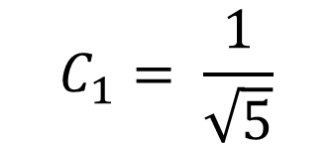


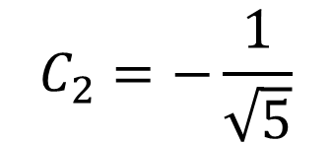
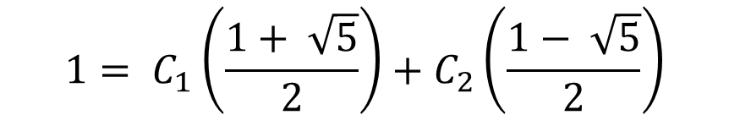

Example: Fibonacci’s Problem
n ≥ 2
$$a\left[n\right]= C_{1} {\left(\frac{1+ \sqrt{5}}{2}\right)}^{n}+C_{2} {\left(\frac{1− \sqrt{5}}{2}\right)}^{n}$$
Boundary conditions
a[ 0 ] = 0
a[ 1 ] = 1
$$1= C_{1}\left(\frac{1+ \sqrt{5}}{2}\right)+C_{2}\left(\frac{1− \sqrt{5}}{2}\right)$$
$$0= C_{1} +C_{2}$$
$$C_{1}=−C_{2}$$
$$2= C_{1}\left(1+ \sqrt{5}\right)+C_{2}\left(1− \sqrt{5}\right)$$
$$C_{1}= \frac{1}{\sqrt{5}}$$
$$2= C_{1}+C_{2}+C_{1}\sqrt{5}−C_{2}\sqrt{5}$$
$$C_{2}=−\frac{1}{\sqrt{5}}$$
$$2= \left(C_{1}−C_{2}\right)\sqrt{5}$$
$$2= \left(2 C_{1}\right)\sqrt{5}$$

Slide 24
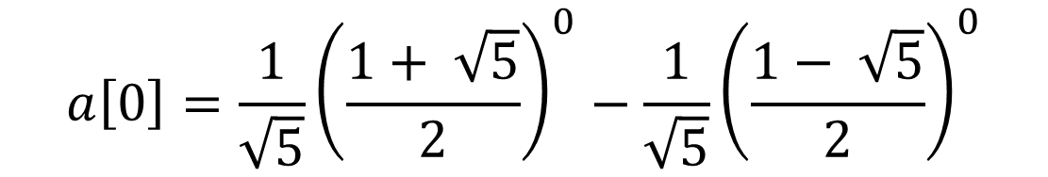
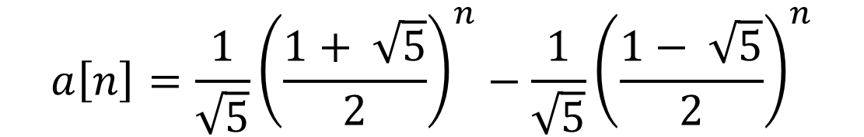

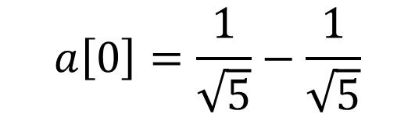
Example: Fibonacci’s Problem
double check our result
n ≥ 2
$$a\left[n\right]=\frac{1}{\sqrt{5}}{\left(\frac{1+ \sqrt{5}}{2}\right)}^{n}−\frac{1}{\sqrt{5}}{\left(\frac{1− \sqrt{5}}{2}\right)}^{n}$$
Boundary conditions
a[ 0 ] = 0
a[ 1 ] = 1
$$a\left[0\right]=\frac{1}{\sqrt{5}}{\left(\frac{1+ \sqrt{5}}{2}\right)}^{0}−\frac{1}{\sqrt{5}}{\left(\frac{1− \sqrt{5}}{2}\right)}^{0}$$
$$a\left[0\right]=\frac{1}{\sqrt{5}}−\frac{1}{\sqrt{5}}$$
$$a\left[0\right]=0$$

Slide 25
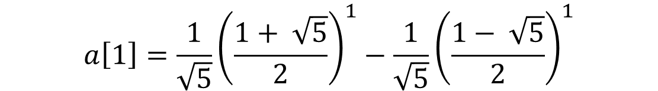


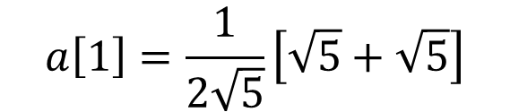

Example: Fibonacci’s Problem
n ≥ 2
$$a\left[n\right]=\frac{1}{\sqrt{5}}{\left(\frac{1+ \sqrt{5}}{2}\right)}^{n}−\frac{1}{\sqrt{5}}{\left(\frac{1− \sqrt{5}}{2}\right)}^{n}$$
Boundary conditions
a[ 0 ] = 0
a[ 1 ] = 1
$$a\left[1\right]=\frac{1}{\sqrt{5}}{\left(\frac{1+ \sqrt{5}}{2}\right)}^{1}−\frac{1}{\sqrt{5}}{\left(\frac{1− \sqrt{5}}{2}\right)}^{1}$$
$$a\left[1\right]=\frac{1}{2\sqrt{5}}\left[\left(1+ \sqrt{5}\right)−\left(1− \sqrt{5}\right)\right]$$
$$a\left[1\right]=\frac{1}{2\sqrt{5}}\left[\sqrt{5}+\sqrt{5}\right]$$
$$a\left[1\right]=1$$

Slide 26
Find the closed form solution for the number of child rabbits
Difference equation was the same
Characteristic equation will be the same
Roots (eigenvalues) of equation will be the same
Use the different boundary conditions to solve for the coefficients

Slide 27

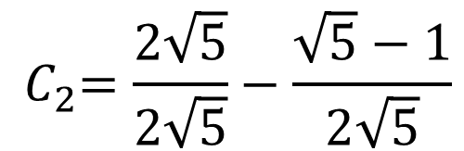

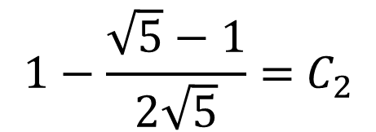

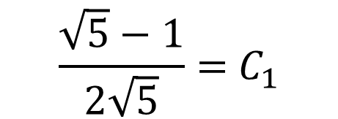
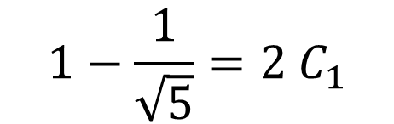
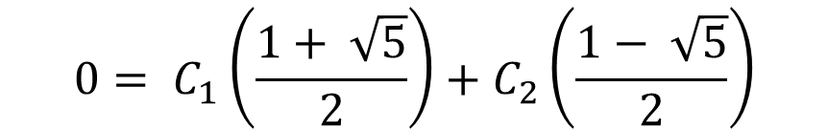
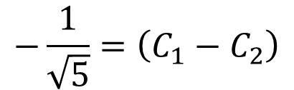
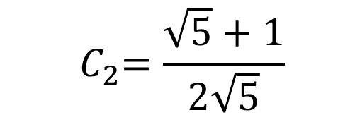
Example: Fibonacci’s Problem
n ≥ 2
$$c\left[n\right]= C_{1} {\left(\frac{1+ \sqrt{5}}{2}\right)}^{n}+C_{2} {\left(\frac{1− \sqrt{5}}{2}\right)}^{n}$$
Boundary conditions
c[ 0 ] = 1
c[ 1 ] = 0
$$0= C_{1}\left(\frac{1+ \sqrt{5}}{2}\right)+C_{2}\left(\frac{1− \sqrt{5}}{2}\right)$$
$$1= C_{1} +C_{2}$$
$$1−\frac{\sqrt{5}−1}{2\sqrt{5}}={ C}_{2}$$
$$−\frac{1}{\sqrt{5}}=\left(C_{1}−C_{2}\right)$$
$$0= C_{1}\left(1+ \sqrt{5}\right)+C_{2}\left(1− \sqrt{5}\right)$$
$$1−\frac{1}{\sqrt{5}}=2{ C}_{1}$$
$$0= C_{1}+C_{2}+C_{1}\sqrt{5}−C_{2}\sqrt{5}$$
$${ C}_{2}=\frac{2\sqrt{5}}{2\sqrt{5}}−\frac{\sqrt{5}−1}{2\sqrt{5}}$$
$$−1= \left(C_{1}−C_{2}\right)\sqrt{5}$$
$$\frac{\sqrt{5}−1}{2\sqrt{5}}={ C}_{1}$$
$$−\frac{1}{\sqrt{5}}=\left(C_{1}−C_{2}\right)$$
$${ C}_{2}=\frac{\sqrt{5}+1}{2\sqrt{5}}$$

Slide 28

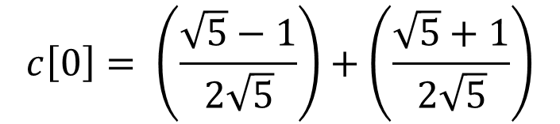
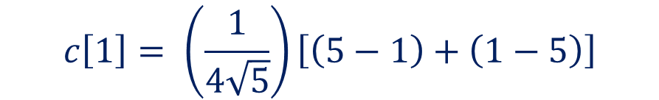
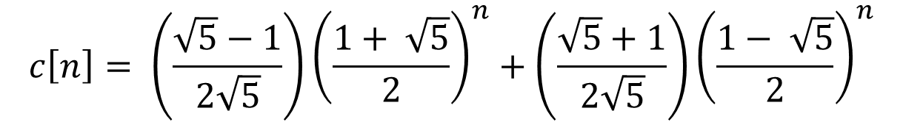
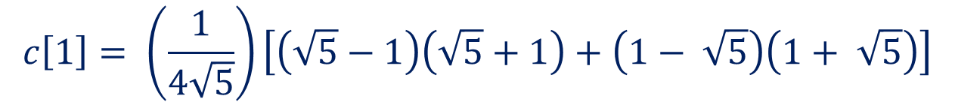
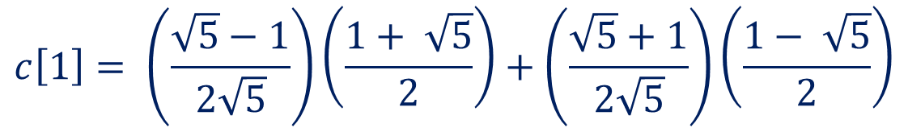
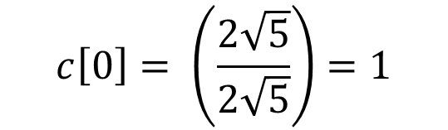
Example: Fibonacci’s Problem
Use boundary conditions to double check our result
n ≥ 2
$$c\left[n\right]= \left(\frac{\sqrt{5}−1}{2\sqrt{5}}\right){\left(\frac{1+ \sqrt{5}}{2}\right)}^{n}+\left(\frac{\sqrt{5}+1}{2\sqrt{5}}\right){\left(\frac{1− \sqrt{5}}{2}\right)}^{n}$$
Boundary conditions
c[ 0 ] = 1
c[ 1 ] = 0
$$c\left[0\right]= \left(\frac{\sqrt{5}−1}{2\sqrt{5}}\right)+\left(\frac{\sqrt{5}+1}{2\sqrt{5}}\right)$$
$$c\left[1\right]= \left(\frac{\sqrt{5}−1}{2\sqrt{5}}\right)\left(\frac{1+ \sqrt{5}}{2}\right)+\left(\frac{\sqrt{5}+1}{2\sqrt{5}}\right)\left(\frac{1− \sqrt{5}}{2}\right)$$
$$c\left[1\right]= \left(\frac{1}{4\sqrt{5}}\right)\left[\left(\sqrt{5}−1\right)\left(\sqrt{5}+1\right)+\left(1− \sqrt{5}\right)\left(1+ \sqrt{5}\right)\right]$$
$$c\left[0\right]= \left(\frac{2\sqrt{5}}{2\sqrt{5}}\right)=1$$
$$c\left[1\right]= \left(\frac{1}{4\sqrt{5}}\right)\left[\left(5−1\right)+\left(1−5\right)\right]$$
$$c\left[1\right]=0$$

Slide 29
Let’s look at what happens when there is a double root

Slide 30
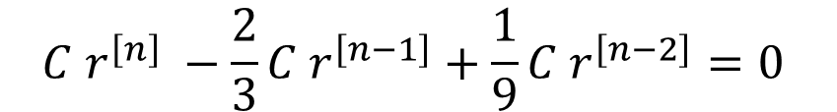


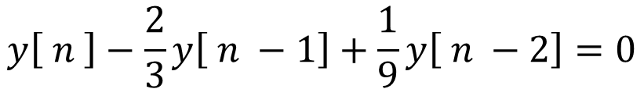
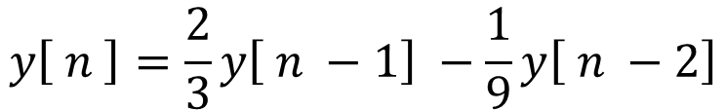
Example: Double Root Problem
n ≥ 2
$$y\left[ n \right]=\frac{2}{3}y\left[ n −1\right] −\frac{1}{9}y\left[ n −2\right]$$
Given the system equation
Boundary conditions
And the boundary conditions
y[ 0 ] = 1
y[ 1 ] = 1
Find the closed form solution
$$y\left[ n \right]−\frac{2}{3}y\left[ n −1\right]+\frac{1}{9}y\left[ n −2\right]=0$$
Rearrange the equation
Assume the form
$$y\left[n\right]=C r^{\left[n\right]}$$
$$C r^{\left[n\right]} −\frac{2}{3}C r^{\left[n−1\right]}+\frac{1}{9}{C r}^{\left[n−2\right]}=0$$
$$r^{\left[n\right]} −\frac{2}{3} r^{\left[n−1\right]}+\frac{1}{9}{ r}^{\left[n−2\right]}=0$$

Slide 31
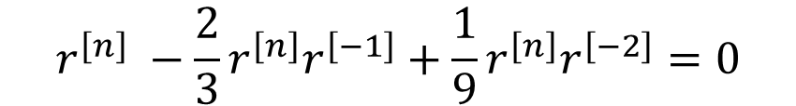

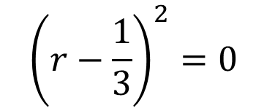


Example: Double Root Problem
n ≥ 2
$$r^{\left[n\right]} −\frac{2}{3} r^{\left[n−1\right]}+\frac{1}{9}{ r}^{\left[n−2\right]}=0$$
Boundary conditions
Factor out r^{n}
y[ 0 ] = 1
y[ 1 ] = 1
$$r^{\left[n\right]} −\frac{2}{3}r^{\left[n\right]}r^{\left[−1\right]}+\frac{1}{9}{r^{\left[n\right]}r}^{\left[−2\right]}=0$$
$$1−\frac{2}{3}r^{\left[−1\right]}+\frac{1}{9}r^{\left[−2\right]}=0$$
multiply by r²
$$r^{2}−\frac{2}{3}r+\frac{1}{9}=0$$
This is the characteristic equation
By inspection we can see that both roots are at r = 1/3
$${\left(r−\frac{1}{3}\right)}^{2}=0$$

Slide 32
Example: Double Root Problem
If there is a double root, then the solution is of the form
$$y\left[n\right]= C_{1} {r_{1}}^{n}+C_{2} n {r_{1}}^{n}$$
If there is a triple root (3), then the solution is of the form
$$y\left[n\right]= C_{1} {r_{1}}^{n}+C_{2} n {r_{1}}^{n}+C_{3} n^{2} {r_{1}}^{n}$$
If there is a root of multiplicity k, then the solution is of the form
$y\left[n\right]= C_{1} {r_{1}}^{n}+C_{2} n {r_{1}}^{n}+C_{3} n^{2} {r_{1}}^{n}$ + … + $C_{k} n^{k−1} {r_{1}}^{n}$

Slide 33
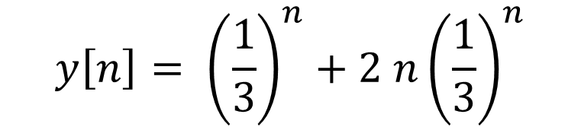


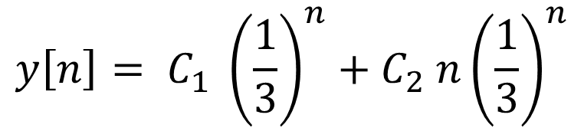
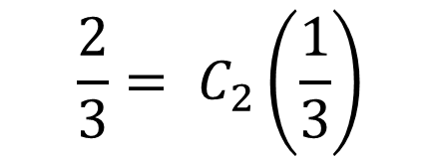
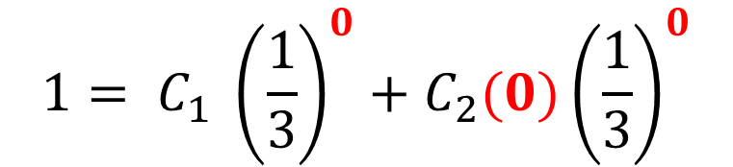

Example: Double Root Problem
n ≥ 2
Boundary conditions
y[ 0 ] = 1
y[ 1 ] = 1
This problem has a double root at r = 1/3, so
$$y\left[n\right]= C_{1} {\left(\frac{1}{3}\right)}^{n}+C_{2} n{\left(\frac{1}{3}\right)}^{n}$$
$$1= C_{1}\left(\frac{1}{3}\right)+C_{2}(1)\left(\frac{1}{3}\right)$$
$$1= C_{1} {\left(\frac{1}{3}\right)}^{0}+C_{2}(0){\left(\frac{1}{3}\right)}^{0}$$
$$\frac{2}{3}= C_{2}\left(\frac{1}{3}\right)$$
$$1= C_{1}$$
$$2= C_{2}$$
$$y\left[n\right]= {\left(\frac{1}{3}\right)}^{n}+2 n{\left(\frac{1}{3}\right)}^{n}$$

Slide 34























Example: Double Root Problem
Compare results
closed form
differences
$$y\left[n\right]= {\left(\frac{1}{3}\right)}^{n}+2 n{\left(\frac{1}{3}\right)}^{n}$$
$$y\left[ n \right]=\frac{2}{3}y\left[ n −1\right] −\frac{1}{9}y\left[ n −2\right]$$
$$={\left(\frac{1}{3}\right)}^{0}+2 (0){\left(\frac{1}{3}\right)}^{0}$$
y[ 0 ]
1
given
=1
$$={\left(\frac{1}{3}\right)}^{1}+2 (1){\left(\frac{1}{3}\right)}^{1}$$
y[ 1 ]
1
=1
$$=\frac{2}{3}(1) −\frac{1}{9}(1)$$
$$=\frac{5}{9}$$
$$={\left(\frac{1}{3}\right)}^{2}+2 (2){\left(\frac{1}{3}\right)}^{2}$$
y[ 2 ]
$$=\left(\frac{1}{9}\right)\left[1+4\right]$$
$$=\left(\frac{5}{9}\right)$$
$$=\frac{2}{3}(\frac{5}{9}) −\frac{1}{9}(1)$$
$$=\frac{10}{27}−\frac{1}{9}$$
$$=\frac{7}{27}$$
$$={\left(\frac{1}{3}\right)}^{3}+2 (3){\left(\frac{1}{3}\right)}^{3}$$
$$=\left(\frac{1}{27}\right)\left[1+6\right]$$
$$=\frac{7}{27}$$
y[ 3 ]
$$=\frac{2}{3}(\frac{7}{27}) −\frac{1}{9}(\frac{5}{9})$$
$$={\left(\frac{1}{3}\right)}^{4}+2 (4){\left(\frac{1}{3}\right)}^{4}$$
$$=\left(\frac{1}{81}\right)\left[1+8\right]$$
y[ 4 ]
$$=\frac{14}{81} −\frac{5}{81}$$
$$=\frac{9}{81}$$
$$=\frac{1}{9}$$
$$=\frac{9}{81}$$
$$=\frac{1}{9}$$

Slide 35
Let’s look at what happens when there is a complex root

Slide 36




Example: Complex Root Problem
n ≥ 2
$$y\left[ n \right]=\frac{1}{2}y\left[ n −1\right] −\frac{1}{4}y\left[ n −2\right]$$
Given the system equation
Boundary conditions
And the boundary conditions
y[ 0 ] = 1
y[ 1 ] = 1
Find the closed form solution
$$y\left[ n \right]−\frac{1}{2}y\left[ n −1\right]+\frac{1}{4}y\left[ n −2\right]=0$$
Rearrange the equation
Assume the form
$$y\left[n\right]=C r^{\left[n\right]}$$
$$C r^{\left[n\right]} −\frac{1}{2}C r^{\left[n−1\right]}+\frac{1}{4}{C r}^{\left[n−2\right]}=0$$
$$r^{\left[n\right]} −\frac{1}{2} r^{\left[n−1\right]}+\frac{1}{4}{ r}^{\left[n−2\right]}=0$$

Slide 37




Example: Complex Root Problem
$$r^{\left[n\right]} −\frac{1}{2} r^{\left[n−1\right]}+\frac{1}{4}{ r}^{\left[n−2\right]}=0$$
n ≥ 2
Boundary conditions
Factor out r^{n}
y[ 0 ] = 1
y[ 1 ] = 1
$$r^{\left[n\right]} −\frac{1}{2}r^{\left[n\right]}r^{\left[−1\right]}+\frac{1}{4}{r^{\left[n\right]}r}^{\left[−2\right]}=0$$
$$1 −\frac{1}{2}r^{\left[−1\right]}+\frac{1}{4}r^{\left[−2\right]}=0$$
Multiply by r²
$$r^{2}−\frac{1}{2}r+\frac{1}{4}=0$$
This is the characteristic equation

Slide 38




Example: Complex Root Problem
n ≥ 2
$$r^{2}−\frac{1}{2}r+\frac{1}{4}=0$$
Boundary conditions
Use quadratic equation
y[ 0 ] = 1
y[ 1 ] = 1
$$r=\frac{\frac{1}{2}± \sqrt{{\left(−\frac{1}{2}\right)}^{2}−4\left(1\right)\left(\frac{1}{4}\right)}}{2\left(1\right)}$$
$$r=\frac{\frac{1}{2}± \sqrt{\frac{1}{4}−1}}{2}$$
$$r=\frac{1}{4}±j\frac{ \sqrt{3}}{4}$$
roots are complex

Slide 39






Example: Complex Root Problem
$$r=\frac{1}{4}±j\frac{ \sqrt{3}}{4}$$
n ≥ 2
We can put the roots in polar form:
Boundary conditions
y[ 0 ] = 1
y[ 1 ] = 1
$$\left|r\right|=\sqrt{{\left(\frac{1}{4}\right)}^{2}+{\left(\frac{\sqrt{3}}{4}\right)}^{2}}$$
$$∠r=±\tan^{−1}\left(\frac{\frac{ \sqrt{3}}{4}}{\frac{1}{4}}\right)$$
$$\left|r\right|=\sqrt{\frac{1}{16}+\frac{3}{16}}$$
$$∠r=±\tan^{−1}\left(\sqrt{3}\right)$$
$$\left|r\right|=\frac{1}{2}$$

Slide 40

Example: Complex Root Problem
If there are complex roots, then they will be complex conjugates of each other (assuming that the original problem had real coefficients)
the (positive) angle of the complex root
The solution is then of the form
$$y\left[n\right]= C_{1} {\left|r\right|}^{n } \cos\left(β n+ θ\right)$$
constants to be determined from the initial conditions
$$y\left[n\right]= C_{1} {\left(\frac{1}{2}\right)}^{n}\cos\left(\left(\tan^{−1}\left(\sqrt{3}\right)\right) n+ θ\right)$$

Slide 41

Example: Complex Root Problem
$$y\left[n\right]= C_{1} {\left(\frac{1}{2}\right)}^{n}\cos\left(\left(\tan^{−1}\left(\sqrt{3}\right)\right) n+ θ\right)$$
y[ 0 ] = 1
y[ 1 ] = 1
Use trigonometric identity
$$\cos\left(a+b\right)=\cos\left(a\right)\cos\left(b\right)− \sin\left(a\right)\sin\left(b\right)$$
$$y\left[n\right]= C_{1} {\left(\frac{1}{2}\right)}^{n}\left[\cos\left(\left(\tan^{−1}\left(\sqrt{3}\right)\right) n\right)\cos\left( θ\right)−\sin\left(\left(\tan^{−1}\left(\sqrt{3}\right)\right) n\right)\sin\left( θ\right)\right]$$

Slide 42



Example: Complex Root Problem
y[ 0 ] = 1
y[ 1 ] = 1
$$y\left[n\right]= C_{1} {\left(\frac{1}{2}\right)}^{n}\left[\cos\left(\left(\tan^{−1}\left(\sqrt{3}\right)\right) n\right)\cos\left( θ\right)−\sin\left(\left(\tan^{−1}\left(\sqrt{3}\right)\right) n\right)\sin\left( θ\right)\right]$$
1
$$1= C_{1} {\left(\frac{1}{2}\right)}^{0}\left[\cos\left(\left(\tan^{−1}\left(\sqrt{3}\right)\right) 0\right)\cos\left( θ\right)−\sin\left(\left(\tan^{−1}\left(\sqrt{3}\right)\right)0\right)\sin\left( θ\right)\right]$$
$$1= C_{1} \left[\cos\left( θ\right)\right]$$
2
$$\sqrt{3}$$
1
$$1= C_{1} {\left(\frac{1}{2}\right)}^{1}\left[\cos\left(\left(\tan^{−1}\left(\sqrt{3}\right)\right) \right)\cos\left( θ\right)−\sin\left(\left(\tan^{−1}\left(\sqrt{3}\right)\right)\right)\sin\left( θ\right)\right]$$
$$1= C_{1}\frac{1}{2}\left[\frac{1}{2}\cos\left( θ\right)−\frac{\sqrt{3}}{2}\sin\left( θ\right)\right]$$

Slide 43












Example: Complex Root Problem
y[ 0 ] = 1
y[ 1 ] = 1
From first boundary condition
$$1= C_{1}\frac{1}{2}\left[\frac{1}{2}\cos\left( θ\right)−\frac{\sqrt{3}}{2}\sin\left( θ\right)\right]$$
$$1= C_{1} \left[\cos\left( θ\right)\right]$$
$$1= \left[\frac{1}{4}C_{1}\cos\left( θ\right)−\frac{\sqrt{3}}{4}C_{1}\sin\left( θ\right)\right]$$
$$−\sqrt{3}= C_{1}\sin\left( θ\right)$$
$$1= \left[\frac{1}{4}\left(1\right)−\frac{\sqrt{3}}{4}C_{1}\sin\left( θ\right)\right]$$
$$−\sqrt{3}= \tan\left(θ\right)$$
$$θ=−\frac{π}{3}$$
$$4= \left[1−\sqrt{3} C_{1}\sin\left( θ\right)\right]$$
$$C_{1}= \frac{1}{\cos\left( θ\right)}$$
$$= \frac{1}{\cos\left(−\frac{π}{3}\right)}$$
$$−3=\sqrt{3} C_{1}\sin\left( θ\right)$$
$$=2$$

Slide 44

Example: Complex Root Problem
$$y\left[n\right]=2 {\left(\frac{1}{2}\right)}^{n}\cos\left(\left(\frac{π}{3}\right) n−\frac{π}{3}\right)$$

Slide 45
Important Points
How to use difference equations to analyze of discrete functions
Using shift invariance to make descriptions causal
Finding closed form solutions of the system
Find characteristic equation
Form of solution depends upon characteristic equation roots
Unique real roots
Repeated roots
Complex roots

