Slide 1
Digital Signal Processing
Fall 2025

Slide 2
Difference Equations
(continued)

Slide 3
Last time we looked at difference equation descriptions of discrete systems
n ≥ 2
Fibonacci's rabbit problem
delay operators
Boundary conditions
Total number of rabbits each month
y[ n ] = y[ n - 2 ] + y[ n - 1 ]
y[ 0 ] = 1
y[ 1 ] = 1
second order difference equation
totals from previous months
The order corresponds to the largest delay
This would be a third order difference equation
y[ n ] = y[ n - 3 ] + y[ n - 1 ]

Slide 4

We showed that
$$r^{n}$$
is an eigenfunction of the delay operator
We found out how to get the characteristic equation from the difference equation
When the characteristic equation had unique roots, the closed form solution was:
$$y\left[n\right]= C_{1} {r_{1}}^{n}+C_{2} {r_{2}}^{n}+C_{3} {r_{3}}^{n}+C_{4} {r_{4}}^{n}+⋯$$
constants determined from initial conditions
There is a term corresponding to each root of the characteristic equation
roots of the characteristic equation
The closed form solutions are different if there are repeated roots or complex roots

Slide 5
Let’s look at what happens when there is a double root

Slide 6
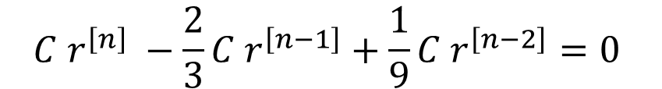


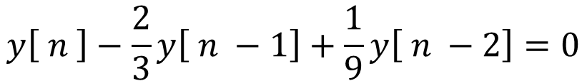
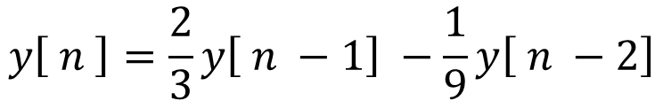
Example: Double Root Problem
n ≥ 2
$$y\left[ n \right]=\frac{2}{3}y\left[ n −1\right] −\frac{1}{9}y\left[ n −2\right]$$
Given the system equation
Boundary conditions
And the boundary conditions
y[ 0 ] = 1
y[ 1 ] = 1
Find the closed form solution
$$y\left[ n \right]−\frac{2}{3}y\left[ n −1\right]+\frac{1}{9}y\left[ n −2\right]=0$$
Rearrange the equation
Assume the form
$$y\left[n\right]=C r^{\left[n\right]}$$
$$C r^{\left[n\right]} −\frac{2}{3}C r^{\left[n−1\right]}+\frac{1}{9}{C r}^{\left[n−2\right]}=0$$
$$r^{\left[n\right]} −\frac{2}{3} r^{\left[n−1\right]}+\frac{1}{9}{ r}^{\left[n−2\right]}=0$$

Slide 7
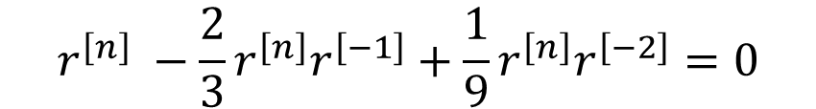

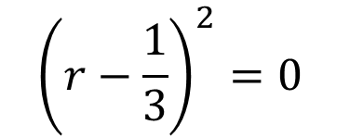


Example: Double Root Problem
n ≥ 2
$$r^{\left[n\right]} −\frac{2}{3} r^{\left[n−1\right]}+\frac{1}{9}{ r}^{\left[n−2\right]}=0$$
Boundary conditions
Factor out r^{n}
y[ 0 ] = 1
y[ 1 ] = 1
$$r^{\left[n\right]} −\frac{2}{3}r^{\left[n\right]}r^{\left[−1\right]}+\frac{1}{9}{r^{\left[n\right]}r}^{\left[−2\right]}=0$$
$$1−\frac{2}{3}r^{\left[−1\right]}+\frac{1}{9}r^{\left[−2\right]}=0$$
multiply by r²
$$r^{2}−\frac{2}{3}r+\frac{1}{9}=0$$
This is the characteristic equation
By inspection we can see that both roots are at r = 1/3
$${\left(r−\frac{1}{3}\right)}^{2}=0$$

Slide 8
Example: Double Root Problem
If there is a double root, then the solution is of the form
$$y\left[n\right]= C_{1} {r_{1}}^{n}+C_{2} n {r_{1}}^{n}$$
If there is a triple root (3), then the solution is of the form
$$y\left[n\right]= C_{1} {r_{1}}^{n}+C_{2} n {r_{1}}^{n}+C_{3} n^{2} {r_{1}}^{n}$$
If there is a root of multiplicity k, then the solution is of the form
$y\left[n\right]= C_{1} {r_{1}}^{n}+C_{2} n {r_{1}}^{n}+C_{3} n^{2} {r_{1}}^{n}$ + … + $C_{k} n^{k−1} {r_{1}}^{n}$

Slide 9
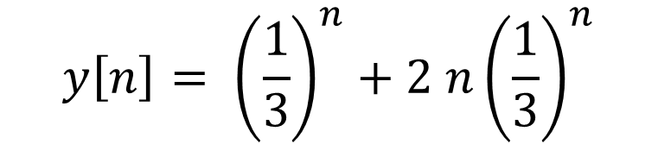


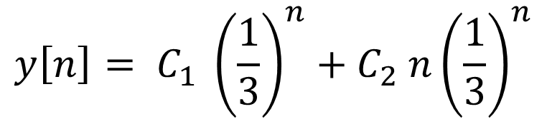
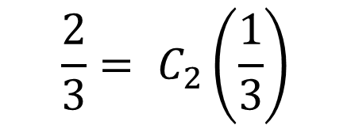
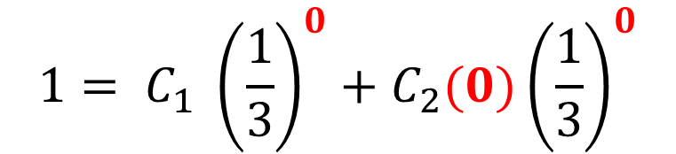
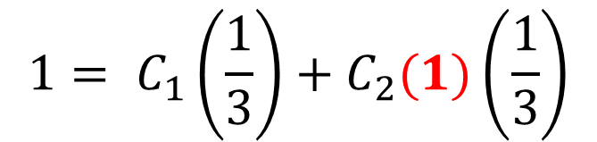
Example: Double Root Problem
n ≥ 2
Boundary conditions
y[ 0 ] = 1
y[ 1 ] = 1
This problem has a double root at r = 1/3, so
$$y\left[n\right]= C_{1} {\left(\frac{1}{3}\right)}^{n}+C_{2} n{\left(\frac{1}{3}\right)}^{n}$$
$$1= C_{1}\left(\frac{1}{3}\right)+C_{2}(1)\left(\frac{1}{3}\right)$$
$$1= C_{1} {\left(\frac{1}{3}\right)}^{0}+C_{2}(0){\left(\frac{1}{3}\right)}^{0}$$
$$\frac{2}{3}= C_{2}\left(\frac{1}{3}\right)$$
$$1= C_{1}$$
$$2= C_{2}$$
$$y\left[n\right]= {\left(\frac{1}{3}\right)}^{n}+2 n{\left(\frac{1}{3}\right)}^{n}$$

Slide 10
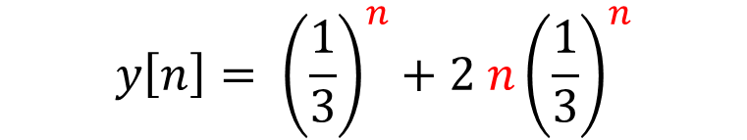
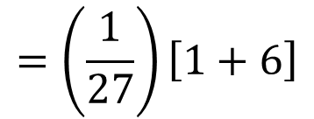
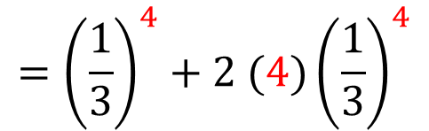
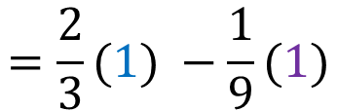
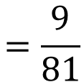
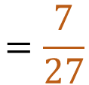
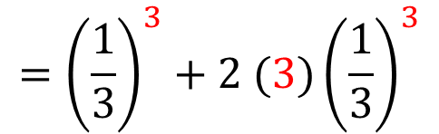

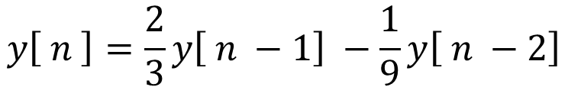
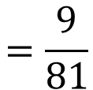
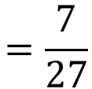
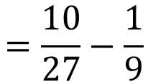
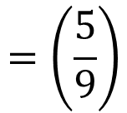
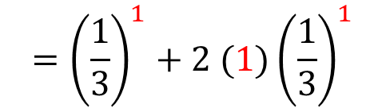
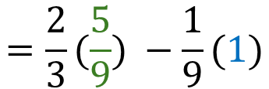
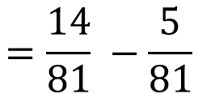
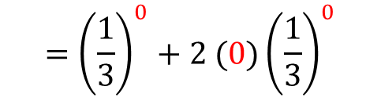

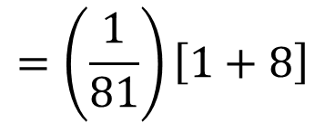

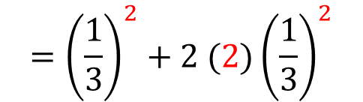
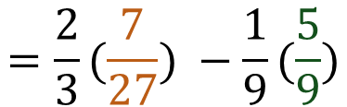

Example: Double Root Problem
Compare results
closed form
differences
$$y\left[n\right]= {\left(\frac{1}{3}\right)}^{n}+2 n{\left(\frac{1}{3}\right)}^{n}$$
$$y\left[ n \right]=\frac{2}{3}y\left[ n −1\right] −\frac{1}{9}y\left[ n −2\right]$$
$$={\left(\frac{1}{3}\right)}^{0}+2 (0){\left(\frac{1}{3}\right)}^{0}$$
y[ 0 ]
1
given
=1
$$={\left(\frac{1}{3}\right)}^{1}+2 (1){\left(\frac{1}{3}\right)}^{1}$$
y[ 1 ]
1
=1
$$=\frac{2}{3}(1) −\frac{1}{9}(1)$$
$$=\frac{5}{9}$$
$$={\left(\frac{1}{3}\right)}^{2}+2 (2){\left(\frac{1}{3}\right)}^{2}$$
y[ 2 ]
$$=\left(\frac{1}{9}\right)\left[1+4\right]$$
$$=\left(\frac{5}{9}\right)$$
$$=\frac{2}{3}(\frac{5}{9}) −\frac{1}{9}(1)$$
$$=\frac{10}{27}−\frac{1}{9}$$
$$=\frac{7}{27}$$
$$={\left(\frac{1}{3}\right)}^{3}+2 (3){\left(\frac{1}{3}\right)}^{3}$$
$$=\left(\frac{1}{27}\right)\left[1+6\right]$$
$$=\frac{7}{27}$$
y[ 3 ]
$$=\frac{2}{3}(\frac{7}{27}) −\frac{1}{9}(\frac{5}{9})$$
$$={\left(\frac{1}{3}\right)}^{4}+2 (4){\left(\frac{1}{3}\right)}^{4}$$
$$=\left(\frac{1}{81}\right)\left[1+8\right]$$
y[ 4 ]
$$=\frac{14}{81} −\frac{5}{81}$$
$$=\frac{9}{81}$$
$$=\frac{1}{9}$$
$$=\frac{9}{81}$$
$$=\frac{1}{9}$$

Slide 11
Let’s look at what happens when there is a complex root

Slide 12
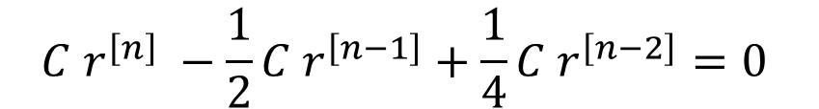

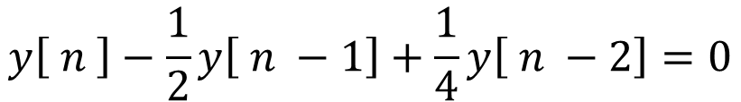
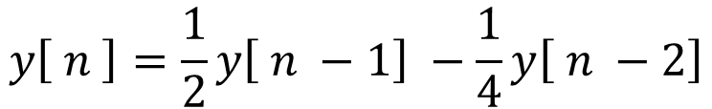
Example: Complex Root Problem
n ≥ 2
$$y\left[ n \right]=\frac{1}{2}y\left[ n −1\right] −\frac{1}{4}y\left[ n −2\right]$$
Given the system equation
Boundary conditions
And the boundary conditions
y[ 0 ] = 1
y[ 1 ] = 1
Find the closed form solution
$$y\left[ n \right]−\frac{1}{2}y\left[ n −1\right]+\frac{1}{4}y\left[ n −2\right]=0$$
Rearrange the equation
Assume the form
$$y\left[n\right]=C r^{\left[n\right]}$$
$$C r^{\left[n\right]} −\frac{1}{2}C r^{\left[n−1\right]}+\frac{1}{4}{C r}^{\left[n−2\right]}=0$$
$$r^{\left[n\right]} −\frac{1}{2} r^{\left[n−1\right]}+\frac{1}{4}{ r}^{\left[n−2\right]}=0$$

Slide 13
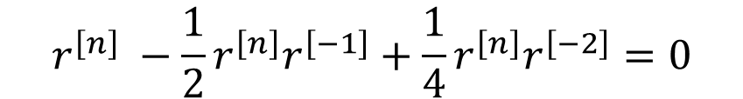



Example: Complex Root Problem
$$r^{\left[n\right]} −\frac{1}{2} r^{\left[n−1\right]}+\frac{1}{4}{ r}^{\left[n−2\right]}=0$$
n ≥ 2
Boundary conditions
Factor out r^{n}
y[ 0 ] = 1
y[ 1 ] = 1
$$r^{\left[n\right]} −\frac{1}{2}r^{\left[n\right]}r^{\left[−1\right]}+\frac{1}{4}{r^{\left[n\right]}r}^{\left[−2\right]}=0$$
$$1 −\frac{1}{2}r^{\left[−1\right]}+\frac{1}{4}r^{\left[−2\right]}=0$$
Multiply by r²
$$r^{2}−\frac{1}{2}r+\frac{1}{4}=0$$
This is the characteristic equation

Slide 14
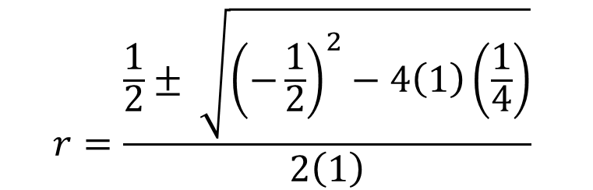

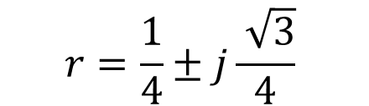
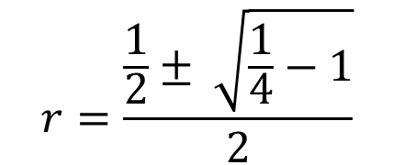
Example: Complex Root Problem
n ≥ 2
$$r^{2}−\frac{1}{2}r+\frac{1}{4}=0$$
Boundary conditions
Use quadratic equation
y[ 0 ] = 1
y[ 1 ] = 1
$$r=\frac{\frac{1}{2}± \sqrt{{\left(−\frac{1}{2}\right)}^{2}−4\left(1\right)\left(\frac{1}{4}\right)}}{2\left(1\right)}$$
$$r=\frac{\frac{1}{2}± \sqrt{\frac{1}{4}−1}}{2}$$
$$r=\frac{1}{4}±j\frac{ \sqrt{3}}{4}$$
roots are complex

Slide 15
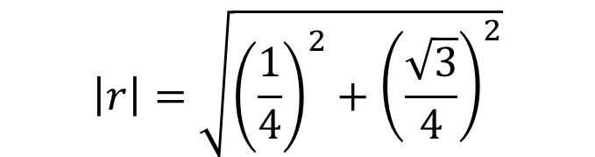

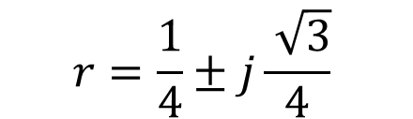
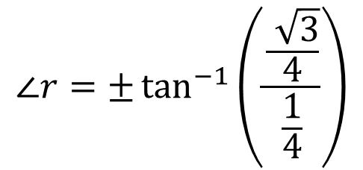
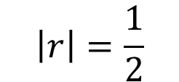
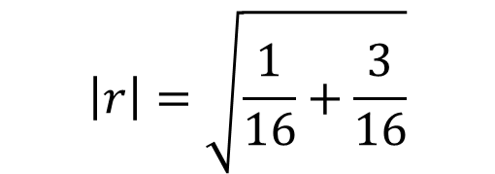
Example: Complex Root Problem
$$r=\frac{1}{4}±j\frac{ \sqrt{3}}{4}$$
n ≥ 2
We can put the roots in polar form:
Boundary conditions
y[ 0 ] = 1
y[ 1 ] = 1
$$\left|r\right|=\sqrt{{\left(\frac{1}{4}\right)}^{2}+{\left(\frac{\sqrt{3}}{4}\right)}^{2}}$$
$$∠r=±\tan^{−1}\left(\frac{\frac{ \sqrt{3}}{4}}{\frac{1}{4}}\right)$$
$$\left|r\right|=\sqrt{\frac{1}{16}+\frac{3}{16}}$$
$$∠r=±\tan^{−1}\left(\sqrt{3}\right)$$
$$\left|r\right|=\frac{1}{2}$$

Slide 16
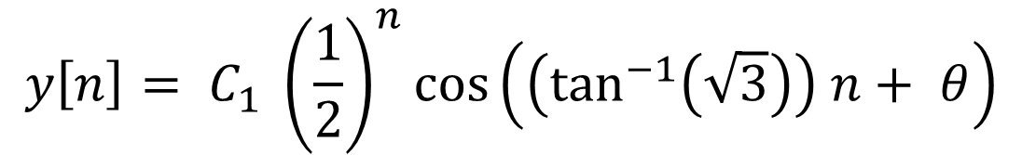
Example: Complex Root Problem
If there are complex roots, then they will be complex conjugates of each other (assuming that the original problem had real coefficients)
the (positive) angle of the complex root
The solution is then of the form
$$y\left[n\right]= C_{1} {\left|r\right|}^{n } \cos\left(β n+ θ\right)$$
constants to be determined from the initial conditions
$$y\left[n\right]= C_{1} {\left(\frac{1}{2}\right)}^{n}\cos\left(\left(\tan^{−1}\left(\sqrt{3}\right)\right) n+ θ\right)$$

Slide 17
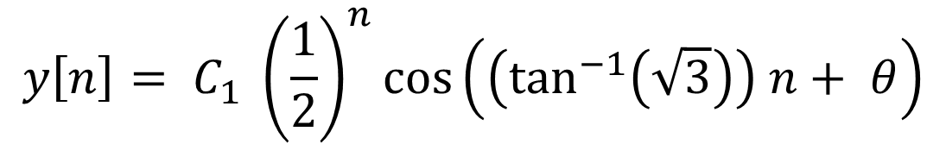
Example: Complex Root Problem
$$y\left[n\right]= C_{1} {\left(\frac{1}{2}\right)}^{n}\cos\left(\left(\tan^{−1}\left(\sqrt{3}\right)\right) n+ θ\right)$$
y[ 0 ] = 1
y[ 1 ] = 1
Use trigonometric identity
$$\cos\left(a+b\right)=\cos\left(a\right)\cos\left(b\right)− \sin\left(a\right)\sin\left(b\right)$$
$$y\left[n\right]= C_{1} {\left(\frac{1}{2}\right)}^{n}\left[\cos\left(\left(\tan^{−1}\left(\sqrt{3}\right)\right) n\right)\cos\left( θ\right)−\sin\left(\left(\tan^{−1}\left(\sqrt{3}\right)\right) n\right)\sin\left( θ\right)\right]$$

Slide 18
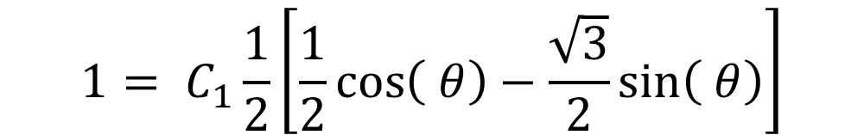


Example: Complex Root Problem
y[ 0 ] = 1
y[ 1 ] = 1
$$y\left[n\right]= C_{1} {\left(\frac{1}{2}\right)}^{n}\left[\cos\left(\left(\tan^{−1}\left(\sqrt{3}\right)\right) n\right)\cos\left( θ\right)−\sin\left(\left(\tan^{−1}\left(\sqrt{3}\right)\right) n\right)\sin\left( θ\right)\right]$$
1
$$1= C_{1} {\left(\frac{1}{2}\right)}^{0}\left[\cos\left(\left(\tan^{−1}\left(\sqrt{3}\right)\right) 0\right)\cos\left( θ\right)−\sin\left(\left(\tan^{−1}\left(\sqrt{3}\right)\right)0\right)\sin\left( θ\right)\right]$$
$$1= C_{1} \left[\cos\left( θ\right)\right]$$
2
$$\sqrt{3}$$
1
$$1= C_{1} {\left(\frac{1}{2}\right)}^{1}\left[\cos\left(\left(\tan^{−1}\left(\sqrt{3}\right)\right) \right)\cos\left( θ\right)−\sin\left(\left(\tan^{−1}\left(\sqrt{3}\right)\right)\right)\sin\left( θ\right)\right]$$
$$1= C_{1}\frac{1}{2}\left[\frac{1}{2}\cos\left( θ\right)−\frac{\sqrt{3}}{2}\sin\left( θ\right)\right]$$

Slide 19


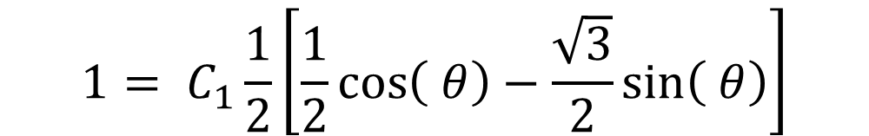

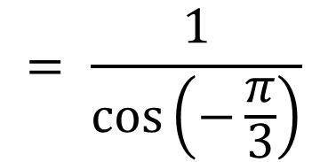


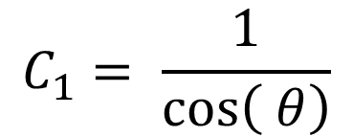

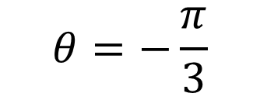
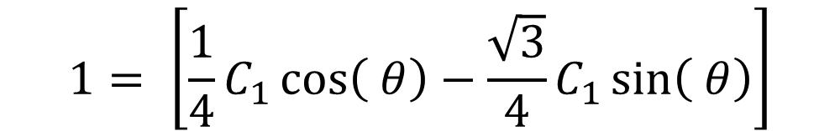

Example: Complex Root Problem
y[ 0 ] = 1
y[ 1 ] = 1
From first boundary condition
$$1= C_{1}\frac{1}{2}\left[\frac{1}{2}\cos\left( θ\right)−\frac{\sqrt{3}}{2}\sin\left( θ\right)\right]$$
$$1= C_{1} \left[\cos\left( θ\right)\right]$$
$$1= \left[\frac{1}{4}C_{1}\cos\left( θ\right)−\frac{\sqrt{3}}{4}C_{1}\sin\left( θ\right)\right]$$
$$−\sqrt{3}= C_{1}\sin\left( θ\right)$$
$$1= \left[\frac{1}{4}\left(1\right)−\frac{\sqrt{3}}{4}C_{1}\sin\left( θ\right)\right]$$
$$−\sqrt{3}= \tan\left(θ\right)$$
$$θ=−\frac{π}{3}$$
$$4= \left[1−\sqrt{3} C_{1}\sin\left( θ\right)\right]$$
$$C_{1}= \frac{1}{\cos\left( θ\right)}$$
$$= \frac{1}{\cos\left(−\frac{π}{3}\right)}$$
$$−3=\sqrt{3} C_{1}\sin\left( θ\right)$$
$$=2$$

Slide 20

Example: Complex Root Problem
$$y\left[n\right]=2 {\left(\frac{1}{2}\right)}^{n}\cos\left(\left(\frac{π}{3}\right) n−\frac{π}{3}\right)$$

Slide 21
Important Points
How to use difference equations to analyze discrete functions
Using shift invariance to make descriptions causal
Finding closed form solutions of the system
Find characteristic equation
Form of solution depends upon characteristic equation roots
Unique real roots
Repeated roots
Complex roots

Slide 22
So far, we have ignored any input to the system
We had initial conditions (boundary conditions) to constrain the problem
No rabbits added to the enclosure
No rabbit deaths
Next we will look at systems that include inputs

Slide 23
Convolution

Slide 24




linear, shift invariant
Given the impulse response of a system, h[n], and an input to the system, x[n], the output of the system is given by the convolution of the input and the system impulse response
$$y\left[ n \right]=h \left[ n \right]∗x[ n ]$$
$$=x\left[ n \right]∗h[ n ]$$
Commutative
Convolution of discrete signals is similar to convolution of continuous signals
$$y\left[ n \right]=\sum_{k=−∞}^{∞}{h \left[ k \right] x[ n −k ]}$$
$$=\sum_{k=−∞}^{∞}{h \left[ n−k \right] x[ k ]}$$
Convolution sum instead of convolution integral

Slide 25

Let’s find the output of a system with the following impulse response and input
$$y\left[ n \right]=\sum_{k=−∞}^{∞}{h \left[ k \right] x[ n −k ]}$$

Slide 26

Form the different signals
making index negative switches the direction
$$y\left[ n \right]=\sum_{k=−∞}^{∞}{h \left[ k \right] x[ n −k ]}$$
k
n
adding a constant to the index delays the signal
change of variables
k
k

Slide 27

Form the different signals
$$y\left[ n \right]=\sum_{k=−∞}^{∞}{h \left[ k \right] x[ n −k ]}$$

Slide 28
Form the different signals
$$y\left[ n \right]=\sum_{k=−∞}^{∞}{h \left[ k \right] x[ n −k ]}$$

Slide 29

Find the output y[-6]
n = -6
$$y\left[ −6 \right]=\sum_{k=−∞}^{∞}{h \left[ k \right] x[ −6 −k ]}$$
k

Slide 30


Find the output y[-6]
For each value of k from -∞ to ∞
$$y\left[ −6 \right]=\sum_{k=−∞}^{∞}{h \left[ k \right] x[ −6 −k ]}$$
Form product h[k] x[n-k ]
and add all of these products together
$$y\left[ −6 \right]=0$$
h[k]
h[k] = 0 for k < 0
x[n-k] = 0 for k > 0

Slide 31
Find the output y[-6]
For each value of k from -∞ to ∞
$$y\left[ −6 \right]=\sum_{k=−∞}^{∞}{h \left[ k \right] x[ −6 −k ]}$$
Form product h[k] x[n-k ]
and add all of these products together
$$y\left[ −6 \right]=0$$
h[k]
k
h[k] = 0 for k < 0
x[-6 -k] = 0 for k > 0

Slide 32


The output y[n] will be zero for all negative values of n
The output will be zero for all values of n where h[k] and x[n-k] do not overlap
h[k]
$$y\left[ 0 \right]=\sum_{k=−∞}^{∞}{h \left[ k \right] x[ 0 −k ]}$$
$$= \left(0.05\right)\left(25\right)=1.25$$

Slide 33

Calculate the output y[1]
x[1-k]
h[k]
$$y\left[ 1 \right]=\sum_{k=−∞}^{∞}{h \left[ k \right] x[ 1 −k ]}$$
$$= \left(0.05\right)\left(15\right)+\left(0.2\right)\left(25\right)=5.75$$

Slide 34


Calculate the output y[2]
x[2-k]
h[k]
$$y\left[ 2 \right]=\sum_{k=−∞}^{∞}{h \left[ k \right] x[ 2 −k ]}$$
$= \left(0.05\right)\left(9\right)+\left(0.2\right)\left(15\right)+\left(0.3\right)\left(25\right)=10.$95

Slide 35


Calculate the output y[3]
x[3-k]
h[k]
$$y\left[ 3 \right]=\sum_{k=−∞}^{∞}{h \left[ k \right] x[ 3 −k ]}$$
$$= \left(0.05\right)\left(6\right)+\left(0.2\right)\left(9\right)+\left(0.3\right)\left(15\right)+(0.4)\left(25\right)=16.6$$

Slide 36

Calculate the output y[4]
x[4-k]
h[k]
$$y\left[ 4 \right]=\sum_{k=−∞}^{∞}{h \left[ k \right] x[ 4 −k ]}$$
$$= \left(0.05\right)\left(−25\right)+\left(0.2\right)\left(6\right)+\left(0.3\right)\left(9\right)+(0.4)\left(15\right)+(0.45)\left(25\right)=19.9$$

Slide 37
Input
Final Output
Observations:
Output has more data than the input
length of Output = length of input + length of impulse response - 1
Output
Peaks are delayed
Peaks are smoothed
This is a type of low pass filter

Slide 39

Difference Equation Practice Problem
Given the system equation
$$y\left[ n \right]=\frac{5}{6}y\left[ n −1\right] −\frac{1}{6}y\left[ n −2\right]$$
for n ≥ 2
And the boundary conditions
y[ 0 ] = 0
y[ 1 ] = 1
Find the closed form solution for the system

