Slide 1
Digital Signal Processing
Fall 2025

Slide 2
Practice Problems

Slide 3

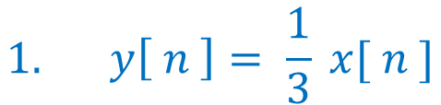


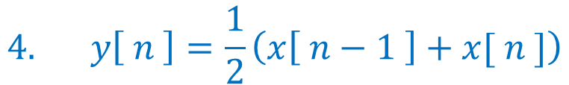
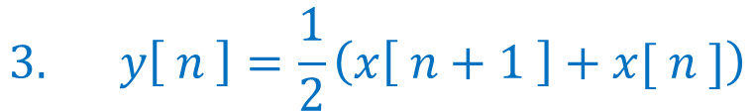

Each of the equations below represents a system. For each system state whether the system is
causal and memoryless
causal with memory
noncausal
$$1. y\left[ n \right]= \frac{1}{3} x[ n ]$$
$$4. y\left[ n \right]=\frac{1}{2}\left(x\left[ n−1 \right]+x[ n ]\right)$$
b) causal with memory
a) causal and memoryless
$$5. y\left[ n \right]=2 \cos\left(0.3 π n \right){ }$$
$$2. y\left[ n \right]=2\left(y\left[ n −1 \right]+x[ n ]\right)$$
a) causal and memoryless
b) causal with memory
$$6. y\left[ n \right]=2 ( y\left[ n −1 \right]∗x\left[ n \right]){ }$$
$$3. y\left[ n \right]=\frac{1}{2}\left(x\left[ n+1 \right]+x[ n ]\right)$$
b) causal with memory
$$7. y\left[ n \right]=4 {\left(0.7\right)}^{n} u[ n ]$$
c) noncausal
a) causal and memoryless

Slide 4

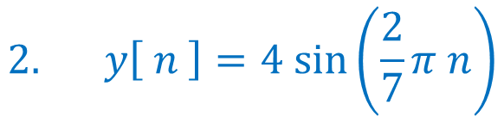
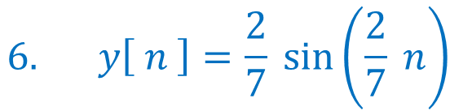

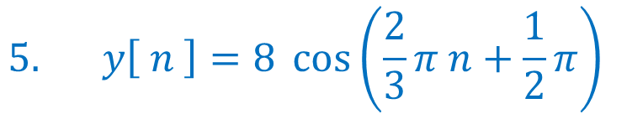
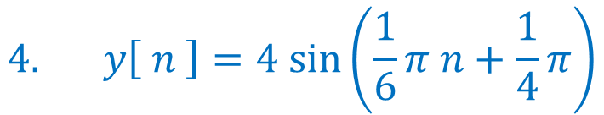
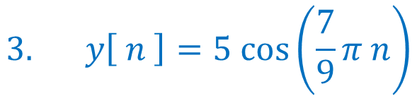
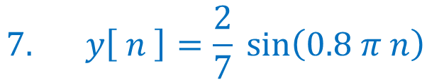
Each of the following, state if the system is periodic
If the system is periodic, give the period, N
$$5. y\left[ n \right]=8 \cos\left(\frac{2}{3}π n+\frac{1}{2}π\right){ }$$
$$1. y\left[ n \right]=2 \cos\left(0.3 π n \right){ }$$
$$2. y\left[ n \right]=4 sin⁡\left(\frac{2}{7}π n\right)$$
$$6. y\left[ n \right]=\frac{2}{7} sin\left(\frac{2}{7} n\right){ }$$
$$3. y\left[ n \right]=5 cos⁡\left(\frac{7}{9}π n\right)$$
$$7. y\left[ n \right]=\frac{2}{7} sin\left(0.8 π n\right){ }$$
$$4. y\left[ n \right]=4 sin⁡\left(\frac{1}{6}π n+\frac{1}{4}π\right)$$
$$8. y\left[ n \right]=\cos\left(1.5 π n\right){ }$$

Slide 5
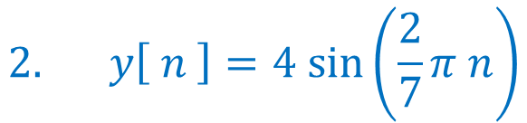



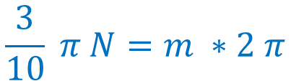


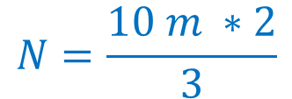
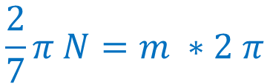


Basic Signals
sinusoidal signals practice problems
$$2. y\left[ n \right]=4 sin⁡\left(\frac{2}{7}π n\right)$$
$$1. y\left[ n \right]=2 \cos\left(0.3 π n \right){ }$$
$$Ω_{o}N=m ∗2 π$$
$$Ω_{o}N=m ∗2 π$$
$$0.3 π N=m ∗2 π$$
$$\frac{2}{7}π N=m ∗2 π$$
$$\frac{3}{10} π N=m ∗2 π$$
$$N=7 m$$
$$N=\frac{10 m ∗2}{3}$$
$$N=7$$
Let m = 3
$$N=20$$

Slide 6

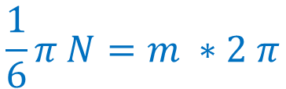
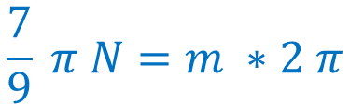
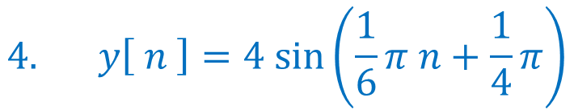

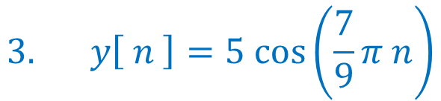
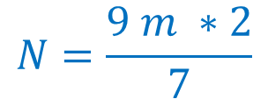

Basic Signals
sinusoidal signals practice problems
$$3. y\left[ n \right]=5 cos⁡\left(\frac{7}{9}π n\right)$$
$$4. y\left[ n \right]=4 sin⁡\left(\frac{1}{6}π n+\frac{1}{4}π\right)$$
$$Ω_{o}N=m ∗2 π$$
$$Ω_{o}N=m ∗2 π$$
$$\frac{7}{9} π N=m ∗2 π$$
$$\frac{1}{6}π N=m ∗2 π$$
$$N=12 m$$
$$N=\frac{9 m ∗2}{7}$$
$$N=12$$
Let m = 7
$$N=18$$

Slide 7

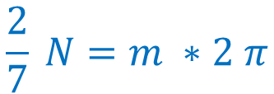
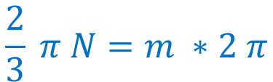


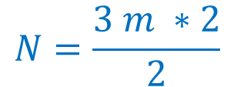
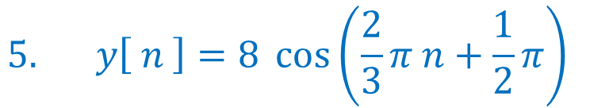
Basic Signals
sinusoidal signals practice problems
$$5. y\left[ n \right]=8 \cos\left(\frac{2}{3}π n+\frac{1}{2}π\right){ }$$
$$6. y\left[ n \right]=\frac{2}{7} sin\left(\frac{2}{7} n\right){ }$$
$$Ω_{o}N=m ∗2 π$$
$$Ω_{o}N=m ∗2 π$$
$$\frac{2}{3} π N=m ∗2 π$$
$$\frac{2}{7} N=m ∗2 π$$
$N=7 m$ $π$
$$N=\frac{3 m ∗2}{2}$$
Let m = 1
not periodic
$$N=3$$

Slide 8

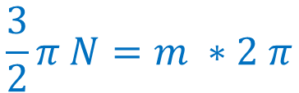
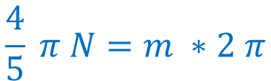
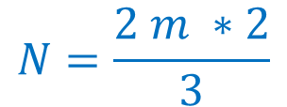

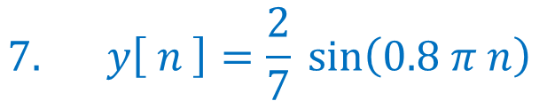
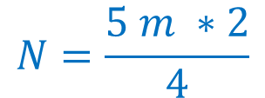

Basic Signals
sinusoidal signals practice problems
$$7. y\left[ n \right]=\frac{2}{7} sin\left(0.8 π n\right){ }$$
$$8. y\left[ n \right]=\cos\left(1.5 π n\right){ }$$
$$Ω_{o}N=m ∗2 π$$
$$Ω_{o}N=m ∗2 π$$
$$\frac{4}{5} π N=m ∗2 π$$
$$\frac{3}{2}π N=m ∗2 π$$
$$N=\frac{2 m ∗2}{3}$$
Let m = 3
$$N=\frac{5 m ∗2}{4}$$
$$N=4$$
Let m = 2
$$N=5$$

