Slide 1
Digital Signal Processing
Fall 2025

Slide 2
Frequency Response

Slide 3
What we have done so far:
Differences between discrete signals and continuous signals
Notations
Periodicity
Sampling
Quantization noise
Additivity of Gaussian noise
Aliasing
Nyquist theorem

Slide 4
What we have done so far:
Difference equation description of discrete signals
Fibonacci’s rabbits
Closed form solutions
Eigenfunction A r ^{n}
Use boundary conditions to find solutions for Fibonacci’s rabbits
Example with double roots for characteristic equation
Slightly different forms
Example with complex roots for characteristic equation
We were solving homogeneous equations
No inputs except initial conditions

Slide 5
What we have done so far:
Convolution sum
Find the output of a system if we know the inputs and the impulse response of the system
Today we will start looking at the frequency domain properties of discrete systems

Slide 6




Eigenfunctions of Linear Shift Invariant Discrete Time Systems
We previously said that
C
was an eigenfunction of the systems
$$x\left[n\right]= r^{ n}$$
We used this to help us find closed form solutions
Rearrange this equation
$$x\left[n\right]= {\left(e^{\ln{r}}\right)}^{ n}$$
$$= {\left(e\right)}^{ n\ln{r}}$$
$$x\left[n\right]= e^{ a n}$$
is also an eigenfunction of the systems

Slide 7


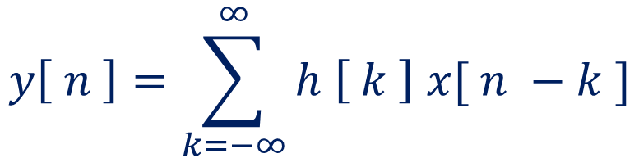
Eigenfunctions of Linear Shift Invariant Discrete Time Systems
$$x\left[n\right]= e^{ a n}$$
This is an eigenfunction even if a is complex
Consider an input
$$x\left[n\right]= e^{ jω n}$$
The output is given by the convolution sum
$$y\left[ n \right]=\sum_{k=−∞}^{∞}{h \left[ k \right] x[ n −k ]}$$

Slide 8
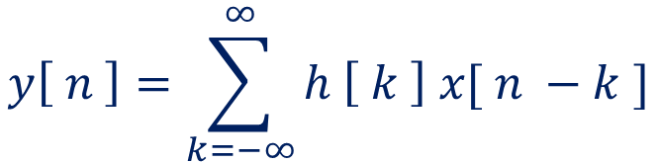
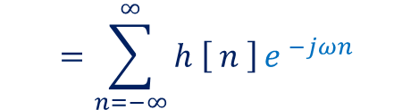
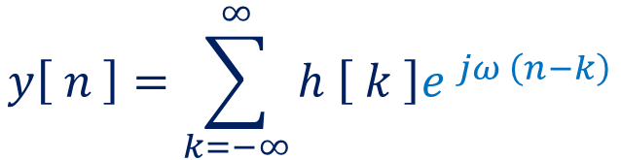
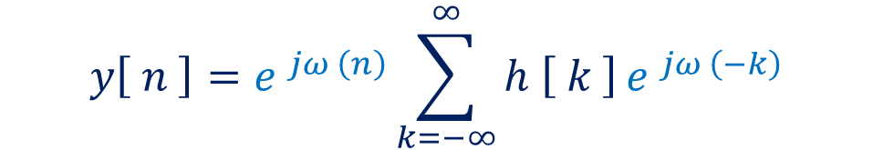
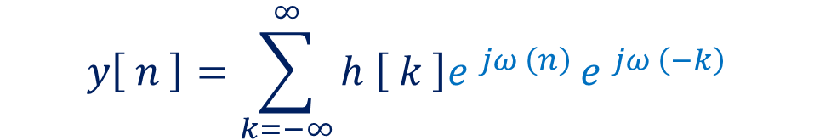

Eigenfunctions of Linear Shift Invariant Discrete Time Systems
$$y\left[ n \right]=\sum_{k=−∞}^{∞}{h \left[ k \right] x[ n −k ]}$$
$$x\left[n\right]= e^{ jω n}$$
$$y\left[ n \right]=\sum_{k=−∞}^{∞}{h \left[ k \right]e^{ jω \left(n−k\right)}}$$
This term is independent of k
$$y\left[ n \right]=\sum_{k=−∞}^{∞}{h \left[ k \right]e^{ jω \left(n\right)}}e^{ jω \left(−k\right)}$$
$$y\left[ n \right]=e^{ jω \left(n\right)}\sum_{k=−∞}^{∞}{h \left[ k \right]}e^{ jω \left(−k\right)}$$
This term is independent of n
This term is dependent on ω
This term is the same as the input
$$=\sum_{n=−∞}^{∞}{h \left[ n \right]}e^{ −jωn }$$
Therefore, it is an eigenfunction
We call it the frequency response

Slide 9
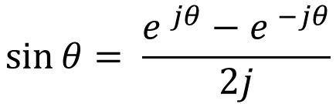

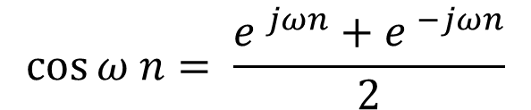
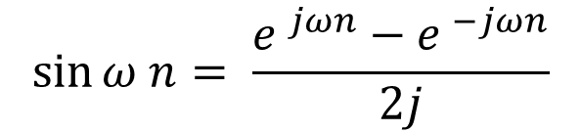
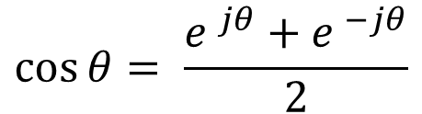
Eigenfunctions of Linear Shift Invariant Discrete Time Systems
$$x\left[n\right]= e^{ jω n}$$
Complex exponentials are eigenfunctions of discrete time shift invariant systems
Sine and cosine functions are eigenfunctions of discrete time shift invariant systems
Euler’s relationships
$$\sin{θ}= \frac{e^{ jθ}−e^{ −jθ}}{2j}$$
$$\sin{ω n}= \frac{e^{ jωn}−e^{ −jωn}}{2j}$$
$$\cos{θ}= \frac{e^{ jθ}+e^{ −jθ}}{2}$$
$$\cos{ω n}= \frac{e^{ jωn}+e^{ −jωn}}{2}$$

Slide 10
Complex exponentials are eigenfunctions of discrete time shift invariant systems
$$x\left[n\right]= e^{ jω n}$$
Why is this important?
Essentially arbitrary inputs can be expressed in terms of the sums of complex exponential functions or sinusoidal functions
These signals will have their amplitude and phase modified by the system, but their frequencies will be unchanged
We can look at the frequency characteristics of the systems

Slide 11


System described by difference equations:
Example:
$$y\left[n\right]=a y\left[n−1\right]+x[n]$$
y[n] = 0 for all n < 0
(causal)
We want to find the system response, h[k]
The system response corresponds to the output when the input is an impulse
impulse response
$$y\left[n\right]=a y\left[n−1\right]+δ[n]$$

Slide 12

















System described by difference equations:
Example:
$$y\left[n\right]=a y\left[n−1\right]+δ[n]$$
y[n] = 0 for all n < 0
$$y\left[0\right]=a y\left[−1\right]+δ[0]$$
$$y\left[3\right]=a y\left[2\right]+δ[3]$$
$$=a (0)+1$$
$$=1$$
$$=a (\text{a}\text{2})+0$$
$$=a3$$
$$y\left[1\right]=a y\left[0\right]+δ[1]$$
$$y\left[4\right]=a y\left[3\right]+δ[4]$$
$$=a (1)+0$$
$$=a$$
$$=a (\text{a}\text{3})+0$$
$$=a4$$
$$y\left[2\right]=a y\left[1\right]+δ[2]$$
$$h\left[n\right]=an u\left[n\right]$$
$$=a (a)+0$$
$$=a2$$
Stable for |a| < 1
BIBO

Slide 13
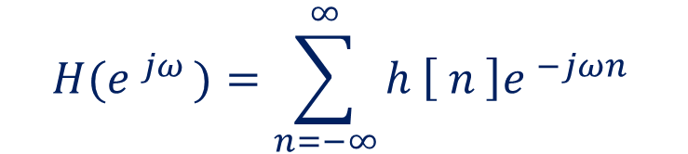

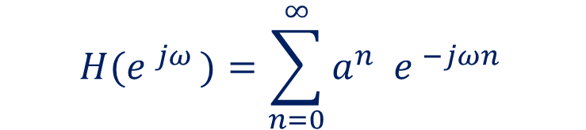
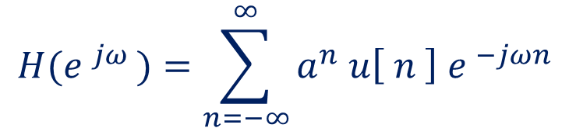
System described by difference equations:
Example:
$$h\left[n\right]=an u\left[n\right]$$
find frequency response
$$H(e^{ jω })=\sum_{n=−∞}^{∞}{h \left[ n \right]e^{ −jωn }}$$
symbol we will use for frequency response
$$H(e^{ jω })=\sum_{n=−∞}^{∞}{a^{n} u\left[ n \right]{ e}^{ −jωn }}$$
$$H(e^{ jω })=\sum_{n=0}^{∞}{a^{n} { e}^{ −jωn }}$$

Slide 14
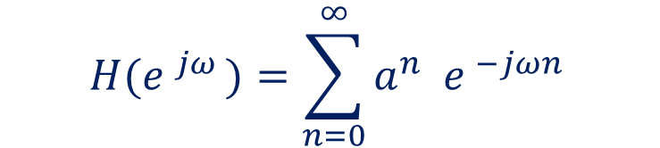

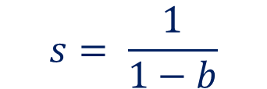
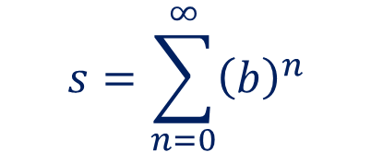
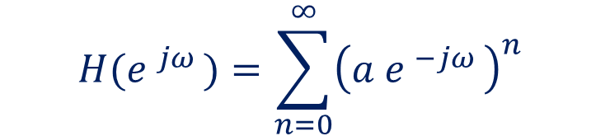
System described by difference equations:
Example:
$$h\left[n\right]=an u\left[n\right]$$
find frequency response
$$H(e^{ jω })=\sum_{n=0}^{∞}{a^{n} { e}^{ −jωn }}$$
$$s=\sum_{n=0}^{∞}{{\left(b\right)}^{n} }$$
$$H(e^{ jω })=\sum_{n=0}^{∞}{{\left(a{ e}^{ −jω }\right)}^{n} }$$
geometric series
if 0 < b < 1
$$s= \frac{1}{1−b}$$
$$H(e^{ jω })=\frac{1}{1−a{ e}^{ −jω }}$$

Slide 15





System described by difference equations:
Example:
$$h\left[n\right]=an u\left[n\right]$$
find frequency response
$$H(e^{ jω })=\frac{1}{1−a{ e}^{ −jω }}$$
find magnitude and phase
find real and imaginary parts
$$H(e^{ jω })=\frac{1}{1−a\left(\text{cos} \text{ω}− \text{j} \text{sin} \text{ω}\right)}$$
$$e^{ jω }=\cos{ω}+j \sin{ω}$$
$$e^{ −jω }=\cos{ω}−j \sin{ω}$$
$$H(e^{ jω })=\frac{1}{1−a \text{cos} \text{ω}\text{ +}\text{j} a \text{sin} \text{ω}}$$
imaginary part
real part

Slide 16

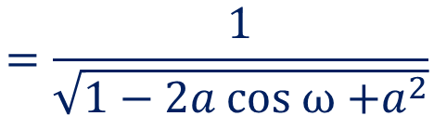
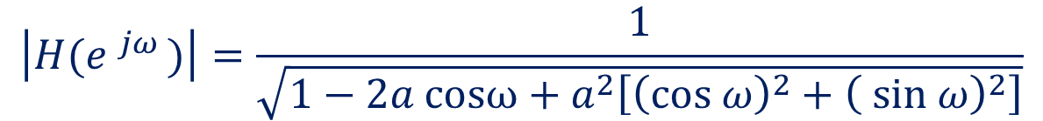
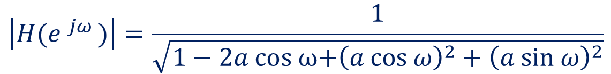
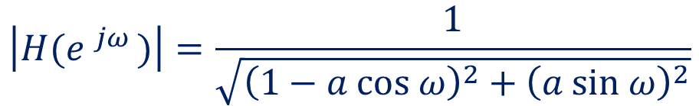
System described by difference equations:
Example:
$$h\left[n\right]=an u\left[n\right]$$
find frequency response
$$H(e^{ jω })=\frac{1}{1−a \text{cos} \text{ω}\text{ +}\text{j} a \text{sin} \text{ω}}$$
find magnitude and phase
$$\left|H(e^{ jω })\right|=\frac{1}{\sqrt{{\left(1−a \text{cos} \text{ω}\right)}^{2}+{\left(a \text{sin} \text{ω}\right)}^{2}}}$$
$$\left|H(e^{ jω })\right|=\frac{1}{\sqrt{1−2a \text{cos} ω\text{+}{\left(a \text{cos} \text{ω}\right)}^{2}+{\left(a \text{sin} \text{ω}\right)}^{2}}}$$
$$\left|H(e^{ jω })\right|=\frac{1}{\sqrt{1−2a \text{cos}ω \text{+ }a^{2}\left[{\left(\text{cos} \text{ω}\right)}^{2}+{\left( \text{sin} \text{ω}\right)}^{2}\right]}}$$
$$=\frac{1}{\sqrt{1−2a \text{cos} ω\text{ +}a^{2}}}$$

Slide 17

System described by difference equations:
Example:
$$h\left[n\right]=an u\left[n\right]$$
find frequency response
$$H(e^{ jω })=\frac{1}{1−a \text{cos} \text{ω}\text{ +}\text{j} a \text{sin} \text{ω}}$$
find magnitude and phase
$$∡H(e^{ jω })=\tan^{−1}{\frac{− a \text{sin} ω}{\left(1−a \text{cos} \text{ω}\right)}}$$

Slide 18




Example:
frequency response
$$h\left[n\right]=an u\left[n\right]$$
$$\left|H(e^{ jω })\right|=\frac{1}{\sqrt{1−2a \text{cos} ω\text{ +}a^{2}}}$$
$$∡H(e^{ jω })=\tan^{−1}{\frac{− a \text{sin} ω}{\left(1−a \text{cos} \text{ω}\right)}}$$
$$a=0.7$$

Slide 19
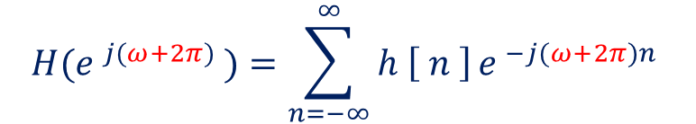
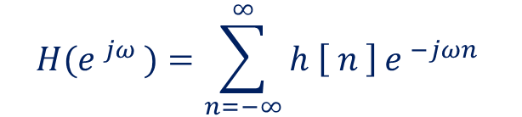

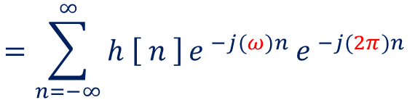
Important Points
The frequency response is a function of the continuous variable ω
The frequency response is periodic in ω
The period is 2π
$$H(e^{ jω })=\sum_{n=−∞}^{∞}{h \left[ n \right]}e^{ −jωn }$$
1
$$H(e^{ j(ω+2π) })=\sum_{n=−∞}^{∞}{h \left[ n \right]}e^{ −j(ω+2π)n }$$
$$=\sum_{n=−∞}^{∞}{h \left[ n \right]}e^{ −j(ω)n }e^{ −j(2π)n }$$
$$=H(e^{ jω })$$

Slide 20
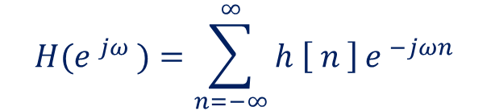
Relationship between frequency response and Fourier coefficients
The frequency response is a periodic function of the continuous variable ω
Periodic functions of continuous variables can be expressed as a Fourier series
$$H(e^{ jω })=\sum_{n=−∞}^{∞}{h \left[ n \right]}e^{ −jωn }$$
The values of h[n] are the Fourier coefficients of the frequency response
We can generalize this relationship to find the frequency domain representation of any sequence

Slide 21
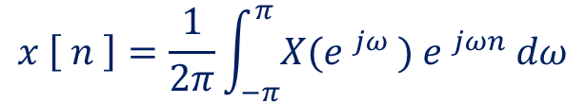
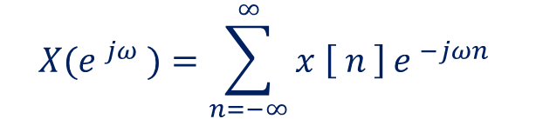
Fourier transform
We can generalize this relationship to find the frequency domain representation of a more general sequence
$$X(e^{ jω })=\sum_{n=−∞}^{∞}{x \left[ n \right]}e^{ −jωn }$$
frequency domain representation
time domain representation
Transform pair:
$$x \left[ n \right]=\frac{1}{2π}\int_{−π}^{π}{X(e^{ jω }){ e}^{ jωn }dω}$$

Slide 22
Properties of Fourier transform
Convolution
$$x \left[ n \right]∗h\left[n\right]=X\left(e^{ jω }\right) ∙H(e^{ jω })$$
multiplication in frequency domain
convolution in time domain

Slide 23



Properties of Fourier transform
Symmetry properties for real sequences
$X\left(e^{ jω }\right)=$ $X^{∗}\left(e^{ −jω }\right)$
$$X\left(e^{ jω }\right)=X_{real}\left(e^{ jω }\right)+j X_{im}\left(e^{ jω }\right)$$
X_{real} is an even function
X_{im} is an odd function
$$X^{∗}\left(e^{ −jω }\right)=X_{real}\left(e^{ −jω }\right)−j X_{im}\left(e^{ −jω }\right)$$
$$\left|X\left(e^{ jω }\right)\right|$$
magnitude is an even function
$$∡X\left(e^{ jω }\right)$$
phase is an odd function

Slide 28
Frequency domain properties
Fourier transform periodic
Reinforce Nyquist criterion?
Z transform replaces Laplace transform
Regions of convergence?

