Slide 1
Digital Signal Processing
Fall 2025

Slide 2
Practice Problems

Slide 3

















Problem 1: A signal has a range from 0 Volts to +5 Volts and contains noise that has a root-mean-squared (rms) value of 2 mV. The signal is to be digitized by an A/D converter. The maximum permissible noise (after conversion) is 2.2 mV rms. What is the minimum number of bits for the A/D converter? What will be the noise level in the output of the A/D converter if this number of bits are used?
Find number of bits
Find quantization noise (rms)
Find step size
$$Step size= \frac{Range}{2^{bits}}$$
${σ^{2}}_{tot}={σ^{2}}_{q}+$ ${σ^{2}}_{other}$
$$Q_{error,rms}= \frac{Step Size}{\sqrt{12}}$$
$${(2.2 mV)}^{2} ={σ^{2}}_{q}+{(2.0 mV)}^{2}$$
$$3.2 mV= \frac{5 V}{2^{n}}$$
$$Step Size=Q_{error,rms}\sqrt{12}$$
$${σ^{2}}_{q}={(2.2 mV)}^{2}−{(2.0 mV)}^{2}$$
$$2^{n}= \frac{5 V}{0.0032 V}=1563$$
$$Step Size=\left(0.92 mV\right) \sqrt{12}$$
$${σ^{2}}_{q}=4.84 {mV}^{2}−4.0 {mV}^{2}$$
$$=3.2 mV$$
$$n= \log_{2}{1563}$$
$$σ_{q}=\sqrt{0.84 {mV}^{2}}$$
$$n=10.6$$
$$=0.92 mV$$
$$n=11$$
$$n=12$$

Slide 4


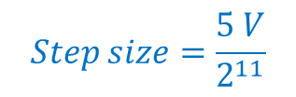
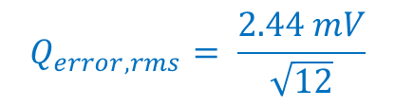






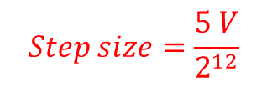



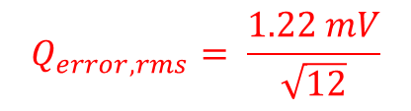

Problem 1: A signal has a range from 0 Volts to +5 Volts and contains noise that has a root-mean-squared (rms) value of 2 mV. The signal is to be digitized by an A/D converter. The maximum permissible noise (after conversion) is 2.2 mV rms. What is the minimum number of bits for the A/D converter? What will be the noise level in the output of the A/D converter if this number of bits are used?
Find total noise
Find quantization error
Find step size
${σ^{2}}_{tot}={σ^{2}}_{q}+$ ${σ^{2}}_{other}$
$$Q_{error,rms}= \frac{Step Size}{\sqrt{12}}$$
$${σ^{2}}_{tot}={(0.70 mV)}^{2}+{(2.0 mV)}^{2}$$
11 bit
12 bit
$$Step size=\frac{5 V}{2^{11}}$$
$$Step size=\frac{5 V}{2^{12}}$$
$${σ^{2}}_{tot}=4.49 {mV}^{2}$$
$$Q_{error,rms}= \frac{2.44 mV}{\sqrt{12}}$$
$$=0.70 mV$$
$$σ_{tot}=2.12 mV$$
(rms)
$$=2.44 mV$$
$$=1.22 mV$$
$$Q_{error,rms}= \frac{1.22 mV}{\sqrt{12}}$$
$${σ^{2}}_{tot}={(0.35 mV)}^{2}+{(2.0 mV)}^{2}$$
$$=0.35 mV$$
$${σ^{2}}_{tot}=4.12 {mV}^{2}$$
$$σ_{tot}=2.03 mV$$
(rms)

Slide 5




Each of the signals below is to be sampled at the indicated frequency or period.
Indicate if aliasing will occur
If aliasing will occur, indicate the frequency at which the aliased signal will appear
If aliasing will occur, state the minimum sampling frequency (or maximum sampling period) needed to prevent aliasing
$$2. y\left(t\right)=2 \cos\left(600 π t\right)$$
sampled at a frequency of 1000 Hz
$$3. y\left(t\right)=2 \sin\left(50 π t\right)$$
sampled at a period of 25 mS
$$4. y\left(t\right)=2 \sin\left(200 π t\right)$$
sampled at a period of 10 mS
$$5. y\left(t\right)=5 \cos\left(1000 π t\right)$$
sampled at a frequency of 800 Hz

Slide 6
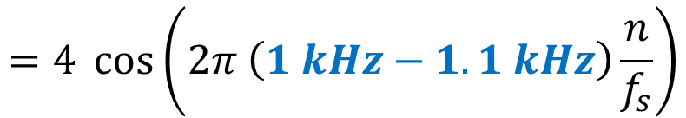


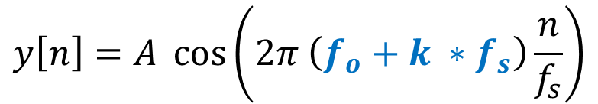
$$2. y\left(t\right)=2 \cos\left(600 π t\right)$$
sampled at a frequency of 1000 Hz
rewrite equation
$$y\left(t\right)=2 \cos\left(2π∙300 t\right)$$
300 Hz signal
minimum sampling frequency to prevent aliasing is 600 Hz
The signal is being sampled at a rate higher than the minimum sampling frequency
No aliasing will occur
$$y\left[n\right]=A \cos\left(2π \left(f_{o}+k ∗f_{s}\right)\frac{n}{f_{s}}\right)$$
$$=4 \cos\left(2π \left(1 kHz−1.1 kHz\right)\frac{n}{f_{s}}\right)$$

Slide 7

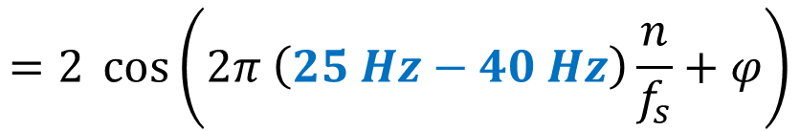
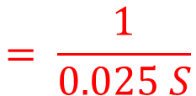

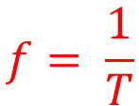
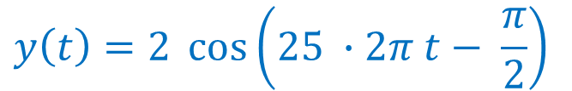

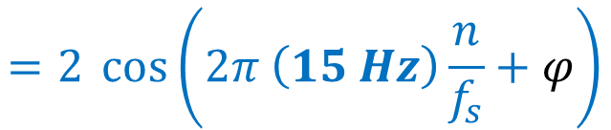
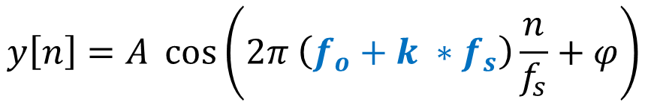
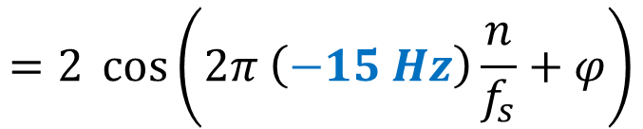
$$3. y\left(t\right)=2 \sin\left(50 π t\right)$$
sampled at a period of 25 mS
T
rewrite equation
$$y\left(t\right)=2 \sin\left(25 ∙2π t\right)$$
$$f= \frac{1}{T}$$
$$= \frac{1}{0.025 S}$$
$$=40 Hz$$
$$y\left(t\right)=2 \cos\left(25 ∙2π t− \frac{π}{2}\right)$$
25 Hz signal
50 Hz minimum sampling frequency
The signal is being sampled at less than the minimum sampling frequency
Aliasing will occur
(k = -1)
$$y\left[n\right]=A \cos\left(2π \left(f_{o}+k ∗f_{s}\right)\frac{n}{f_{s}}+φ\right)$$
$$=2 \cos\left(2π \left(25 Hz−40 Hz\right)\frac{n}{f_{s}}+φ\right)$$
$$=2 \cos\left(2π \left(−15 Hz\right)\frac{n}{f_{s}}+φ\right)$$
$$=2 \cos\left(2π \left(15 Hz\right)\frac{n}{f_{s}}+φ\right)$$
signal will appear at 15 Hz

Slide 8
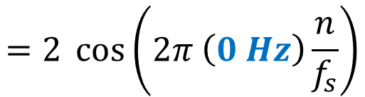


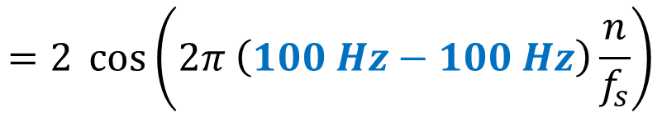
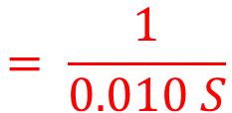
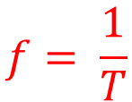


$$4. y\left(t\right)=2 \sin\left(200 π t\right)$$
sampled at a period of 10 mS
T
rewrite equation
$$y\left(t\right)=2 \sin\left(100 ∙2π t\right)$$
$$f= \frac{1}{T}$$
$$= \frac{1}{0.010 S}$$
$$=100 Hz$$
100 Hz signal
200 Hz minimum sampling frequency
The signal is being sampled at less than the minimum sampling frequency
Aliasing will occur
(k = -1)
$$y\left[n\right]=A \cos\left(2π \left(f_{o}+k ∗f_{s}\right)\frac{n}{f_{s}}\right)$$
$$=2 \cos\left(2π \left(100 Hz−100 Hz\right)\frac{n}{f_{s}}\right)$$
$$=2 \cos\left(2π \left(0 Hz\right)\frac{n}{f_{s}}\right)$$
signal will appear at DC
(0 Hz)

Slide 9

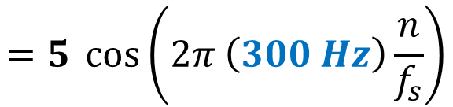
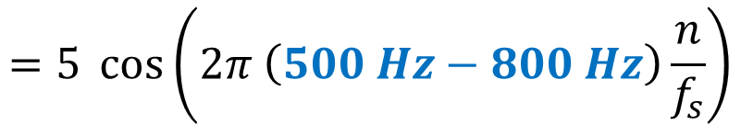

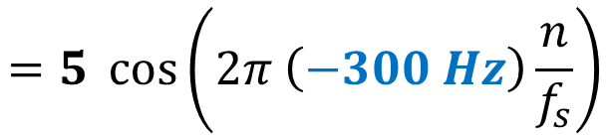

$$5. y\left(t\right)=5 \cos\left(1000 π t\right)$$
sampled at a frequency of 800 Hz
rewrite equation
$$y\left(t\right)=5 \cos\left(500 ∙ 2π t\right)$$
500 Hz signal
1000 Hz minimum sampling frequency
The signal is being sampled at less than the minimum sampling frequency
Aliasing will occur
(k = -1)
$$y\left[n\right]=A \cos\left(2π \left(f_{o}+k ∗f_{s}\right)\frac{n}{f_{s}}\right)$$
$$=5 \cos\left(2π \left(500 Hz−800 Hz\right)\frac{n}{f_{s}}\right)$$
$$=5 \cos\left(2π \left(−300 Hz\right)\frac{n}{f_{s}}\right)$$
$$=5 \cos\left(2π \left(300 Hz\right)\frac{n}{f_{s}}\right)$$
signal will appear at 300 Hz

