Slide 1
Digital Signal Processing
Fall 2025

Slide 2
z transforms
Discrete equivalent of Laplace transforms

Slide 3
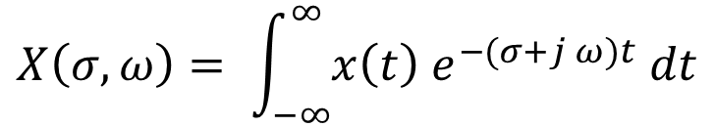
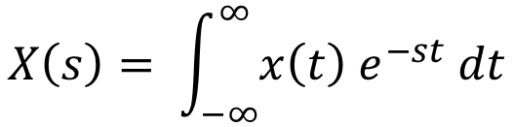
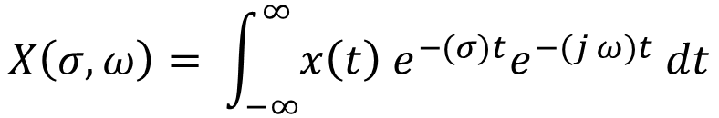
Going from Laplace transforms to z transforms
s = σ + j ω
$$X\left(s\right)= \int_{−∞}^{∞}{x\left(t\right){ e}^{−st} dt}$$
$$X\left(σ,ω\right)= \int_{−∞}^{∞}{x\left(t\right){ e}^{−(σ+j ω)t} dt}$$
$$X\left(σ,ω\right)= \int_{−∞}^{∞}{x\left(t\right){{ e}^{−(σ)t}e}^{−(j ω)t} dt}$$

Slide 4
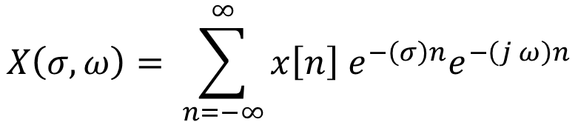
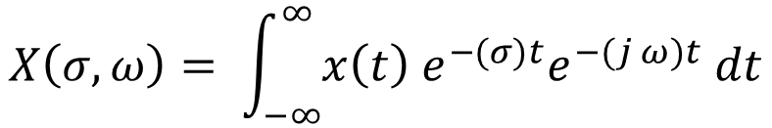

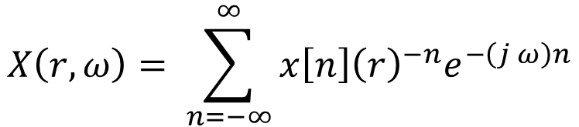
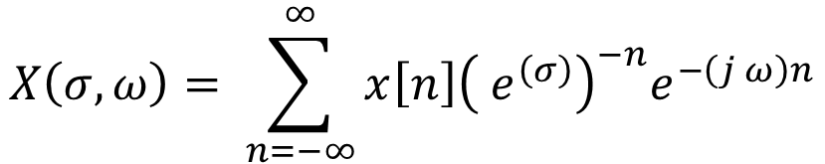
Going from Laplace transforms to z transforms
$$X\left(σ,ω\right)= \int_{−∞}^{∞}{x\left(t\right){{ e}^{−(σ)t}e}^{−(j ω)t} dt}$$
$$X\left(σ,ω\right)= \sum_{n=−∞}^{∞}{x\left[n\right]{{ e}^{−\left(σ\right)n}e}^{−\left(j ω\right)n}}$$
$$X\left(σ,ω\right)= \sum_{n=−∞}^{∞}{x\left[n\right]{{\left({ e}^{\left(σ\right)}\right)}^{−n}e}^{−\left(j ω\right)n}}$$
$r=e^{σ}$
$$X\left(r,ω\right)= \sum_{n=−∞}^{∞}{x\left[n\right]{{\left(r\right)}^{−n}e}^{−\left(j ω\right)n}}$$

Slide 5
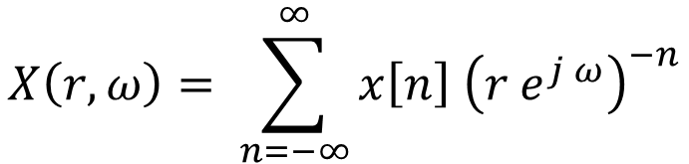
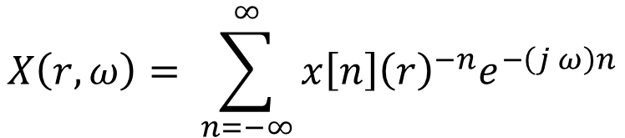
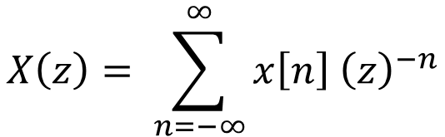

Going from Laplace transforms to z transforms
$$X\left(r,ω\right)= \sum_{n=−∞}^{∞}{x\left[n\right]{{\left(r\right)}^{−n}e}^{−\left(j ω\right)n}}$$
$$X\left(r,ω\right)= \sum_{n=−∞}^{∞}{x\left[n\right] {\left(r e^{j ω}\right)}^{−n}}$$
$$z=r{ e}^{\left(j ω\right)}$$
$$X\left(z\right)= \sum_{n=−∞}^{∞}{x\left[n\right] {\left(z\right)}^{−n}}$$
This is the definition of the z transform

Slide 6



Comparing Laplace transforms and z transform variables
Laplace transform variable, s
z transform variable, z
σ + j ω
$$z=r{ e}^{jω}$$
eigenfunctions
$$x\left(t\right)=A{ e}^{s t}$$
eigenfunctions
$$x\left(n\right)=A{ z}^{n}$$
j ω
Im
the magnitude of the poles determines stability
σ
r
x
x
ω
Re
1
a causal system is stable if the real part of all poles are negative
the real part of the poles determines stability
a causal system is stable if the magnitude of all poles is less than 1

Slide 7
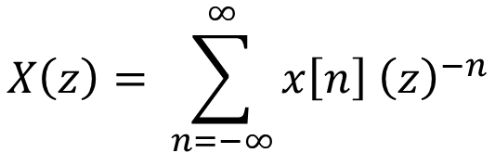
What do z transforms do for us?
Many functions do not converge for Fourier transforms
Multiplying by a decreasing exponential allows better convergence
$$X\left(z\right)= \sum_{n=−∞}^{∞}{x\left[n\right] {\left(z\right)}^{−n}}$$
We can bring more functions into the frequency domain

Slide 8
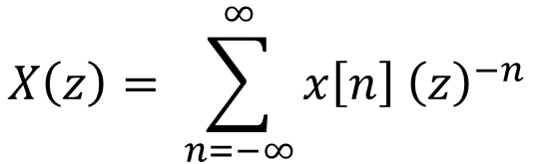
Not all z transforms will converge
The z transforms will have regions of convergence
values of the magnitude of z where the transform does converge
$$X\left(z\right)= \sum_{n=−∞}^{∞}{x\left[n\right] {\left(z\right)}^{−n}}$$

Slide 9

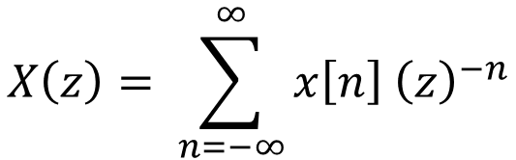
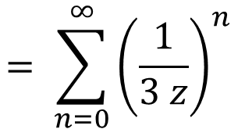
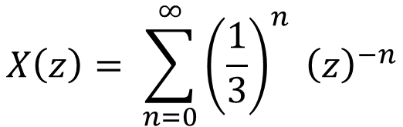
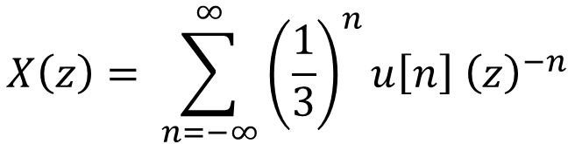
Not all z transforms will converge
$$x\left[n\right]= {\left(\frac{1}{3}\right)}^{n}u[n]$$
Example: let
$$X\left(z\right)= \sum_{n=−∞}^{∞}{x\left[n\right] {\left(z\right)}^{−n}}$$
$$X\left(z\right)= \sum_{n=−∞}^{∞}{{\left(\frac{1}{3}\right)}^{n}u\left[n\right] {\left(z\right)}^{−n}}$$
$$X\left(z\right)= \sum_{n=0}^{∞}{{\left(\frac{1}{3}\right)}^{n} {\left(z\right)}^{−n}}$$
$$= \sum_{n=0}^{∞}{{\left(\frac{1}{3 z}\right)}^{n} }$$

Slide 10
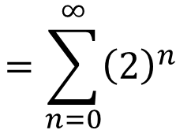
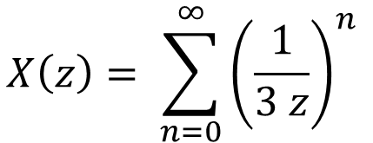
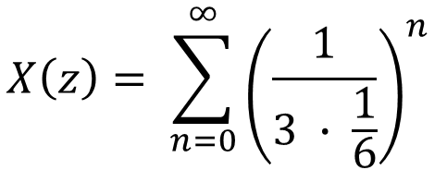

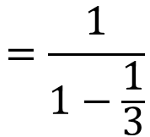
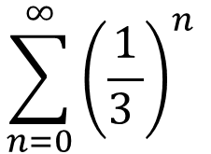
Not all z transforms will converge
$$x\left[n\right]= {\left(\frac{1}{3}\right)}^{n}u[n]$$
$$X\left(z\right)= \sum_{n=0}^{∞}{{\left(\frac{1}{3 z}\right)}^{n} }$$
Example: let
Clearly, if we let z = 1, this is a geometric series that converges
$$\sum_{n=0}^{∞}{{\left(\frac{1}{3 }\right)}^{n} }$$
$$=\frac{1}{1−\frac{1}{3}}$$
$$=\frac{3}{2}$$
$$X\left(z\right)= \sum_{n=0}^{∞}{{\left(\frac{1}{3 ∙ \frac{1}{6}}\right)}^{n} }$$
$$=\sum_{n=0}^{∞}{{\left(2\right)}^{n} }$$
What if we let z = 1/6 ?
which diverges
The values of z that cause the sum to converge are called the region of convergence (ROC)

Slide 11
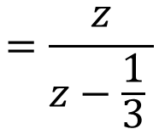

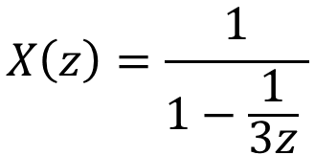

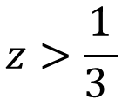
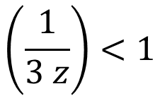
Not all z transforms will converge
$$x\left[n\right]= {\left(\frac{1}{3}\right)}^{n}u[n]$$
$$X\left(z\right)= \sum_{0}^{∞}{{\left(\frac{1}{3 z}\right)}^{n} }$$
Example: let
$$\left(\frac{1}{3 z}\right)<1$$
For the sum to converge we need
$$z>\frac{1}{3 }$$
or equivalently,
Im
The sum then converges to
region of convergence
$$X\left(z\right)=\frac{1}{1−\frac{1}{3z} }$$
$$=\frac{z}{z−\frac{1}{3} }$$
$$\frac{1}{3 }$$
x
Re
1
This has a pole at z = 1/3 and a zero at the origin

Slide 12

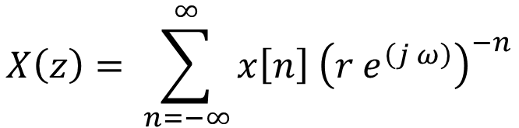
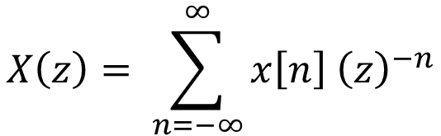
Not all z transforms will converge
z transform
$$X\left(z\right)= \sum_{n=−∞}^{∞}{x\left[n\right] {\left(z\right)}^{−n}}$$
$$z=r{ e}^{\left(j ω\right)}$$
$$X\left(z\right)= \sum_{n=−∞}^{∞}{x\left[n\right] {\left(r{ e}^{\left(j ω\right)}\right)}^{−n}}$$
region of convergence
Im
if r = 1, then the z transform is the same as the Fourier transform
$$\frac{1}{3 }$$
x
Re
if the unit circle is in the region of convergence, then the Fourier transform exists (transform converges)
1

Slide 13
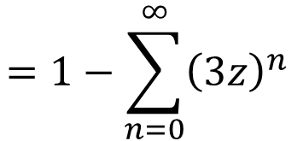
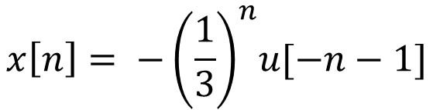
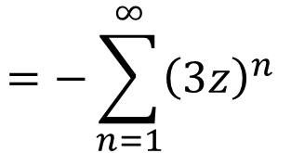
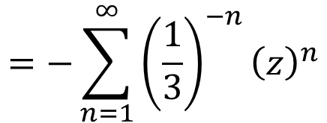
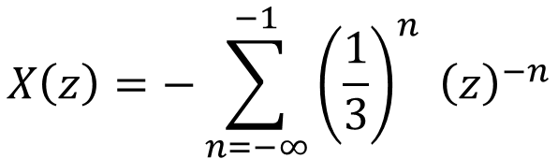
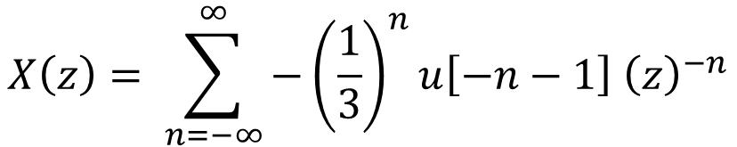
Example 2
$$x\left[n\right]= {−\left(\frac{1}{3}\right)}^{n}u[−n−1]$$
Example 2: let
$$X\left(z\right)= \sum_{n=−∞}^{∞}{x\left[n\right] {\left(z\right)}^{−n}}$$
$$X\left(z\right)= \sum_{n=−∞}^{∞}{−{\left(\frac{1}{3}\right)}^{n}u\left[−n−1\right] {\left(z\right)}^{−n}}$$
$$X\left(z\right)=−\sum_{n=−∞}^{−1}{{\left(\frac{1}{3}\right)}^{n} {\left(z\right)}^{−n}}$$
$$=−\sum_{n=1}^{∞}{{\left(\frac{1}{3}\right)}^{−n}{\left(z\right)}^{n}}$$
$$=−\sum_{n=1}^{∞}{{\left(3z\right)}^{n} }$$
$$=1−\sum_{n=0}^{∞}{{\left(3z\right)}^{n} }$$

Slide 14
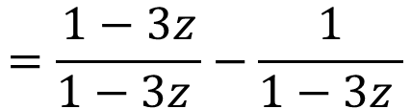
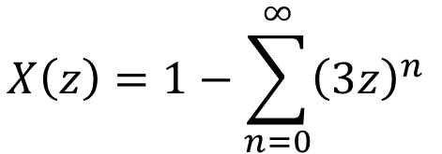

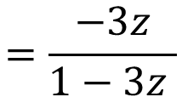
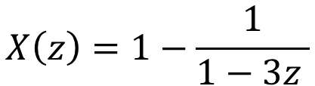
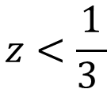
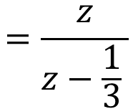
Im
Example 2
$$\frac{1}{3 }$$
x
Re
$$x\left[n\right]= {−\left(\frac{1}{3}\right)}^{n}u[−n−1]$$
1
Example 2: let
$$X\left(z\right)=1−\sum_{n=0}^{∞}{{\left(3z\right)}^{n} }$$
For the sum to converge we need
$$z<\frac{1}{3 }$$
$$\frac{−\frac{1}{3}}{−\frac{1}{3}}$$
$$X\left(z\right)=1−\frac{1}{1−3z }$$
$$=\frac{1−3z}{1−3z }−\frac{1}{1−3z }$$
$$=\frac{−3z}{1−3z }$$
$$=\frac{z}{z−\frac{1}{3} }$$
The unit circle is not in the region of convergence, so the Fourier transform does not exist
These examples had the same pole and zero, but different regions of convergence

Slide 15

These examples had the same pole and zero, but different regions of convergence
The regions of convergence are always circular or rings
The regions of convergence are always centered at the origin
The regions of convergence are always bounded by poles or the origin or infinity
region of convergence
Im
There can be no poles in the regions of convergence
$$\frac{1}{3 }$$
x
x
Re
1

Slide 16



Finite length sequences have the entire plane, except possibly zero or infinity, for regions of convergence
Im
Right sided sequences have x[n] = 0 for all n < n_{o}
The region of convergence
$$R_{x−}< \left|z\right|< ∞$$
$$\frac{1}{3 }$$
x
x
Re
1
Left sided sequences have x[n] = 0 for all n > n_{o}
The region of convergence
$$0< \left|z\right|<R_{x+}$$
Two sided sequences
$$R_{x−}< \left|z\right|<R_{x+}$$

Slide 17
Stable systems have the unit circle in the region of convergence
For causal systems, h[n] is right sided, and the region of convergence is outside of the outermost pole
We can use these characteristics to help us identify the region of convergence of a system

Slide 18
Example 3
A causal system has poles and zeros as indicated. Draw the region of convergence. Is the system stable?
Im
the two complex conjugate poles are on the boundary
Since the system is causal, the region of convergence starts at the outermost pole(s) and extends to infinity.
x
The unit circle is in the region of convergence, so the system is stable.
Re
x
1
x

Slide 19
Example 4
A stable system has poles and zeros as indicated. Draw the region of convergence. Is the system causal? Is the system formed from a right sided sequence, a left sided sequence, or a two-sided sequence?
Im
Since the system is stable, unit circle is in the region of convergence.
the two poles are on the boundaries
No poles can be in the region of convergence, so the region of convergence must be bounded by poles on either side of the unit circle.
Re
x
x
x
The system must be two-sided and therefore noncausal.
1

Slide 20
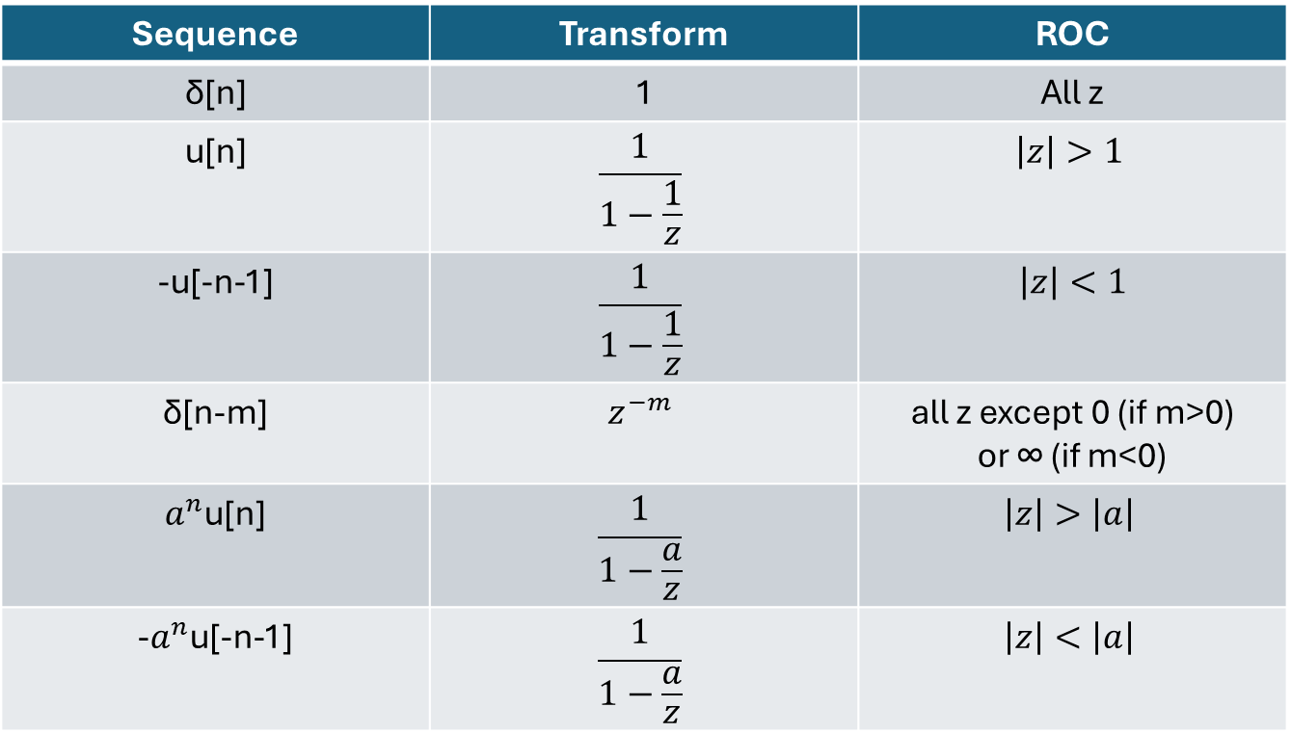
Some transform pairs
Sequence | Transform | ROC
δ[n] | 1 | All z
u[n] | $$\frac{1}{1−\frac{1}{z}}$$ | $$\left|z\right|>1$$
-u[-n-1] | $$\frac{1}{1−\frac{1}{z}}$$ | $$\left|z\right|<1$$
δ[n-m] | $$z^{−m}$$ | all z except 0 (if m>0) or ∞ (if m<0)
$a^{n}$u[n] | $$\frac{1}{1−\frac{a}{z}}$$ | $$\left|z\right|>\left|a\right|$$
-$a^{n}$u[-n-1] | $$\frac{1}{1−\frac{a}{z}}$$ | $$\left|z\right|<\left|a\right|$$
Common z transform pairs

Slide 21
Inverse z transform
The easiest way to perform an inverse z transform is to recognize the transform pair from the table of transform pairs
Partial fraction expansion can be used to simplify more complex expressions into the sum of smaller expressions

Slide 22
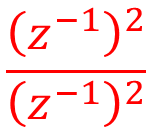
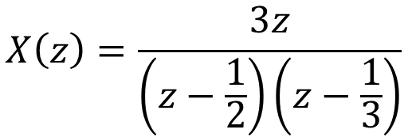
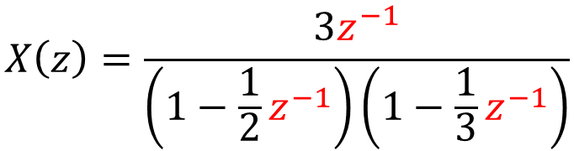
Example 5
outermost pole is on the boundary
Find the time domain description of a causal system represented by the equation
Im
extends to infinity
$$X\left(z\right)=\frac{3z}{\left(z−\frac{1}{2}\right)\left(z−\frac{1}{3}\right)}$$
$$\frac{{\left(z^{−1}\right)}^{2}}{{\left(z^{−1}\right)}^{2}}$$
Do partial fraction expansion
Express in terms of z⁻¹
Re
x
x
$$X\left(z\right)=\frac{3z^{−1}}{\left(1−\frac{1}{2}z^{−1}\right)\left(1−\frac{1}{3}z^{−1}\right)}$$
1

Slide 23
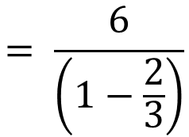
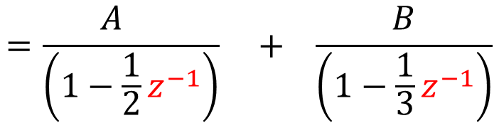
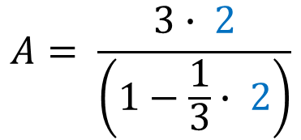

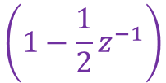
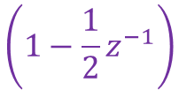


Example 5
0
2
2
$$\left(1−\frac{1}{2}z^{−1}\right)$$
$$\left(1−\frac{1}{2}z^{−1}\right)$$
$$\left(1−\frac{1}{2}z^{−1}\right)$$
$$X\left(z\right)=\frac{3z^{−1}}{\left(1−\frac{1}{2}z^{−1}\right)\left(1−\frac{1}{3}z^{−1}\right)}$$
$$=\frac{A }{\left(1−\frac{1}{2}z^{−1}\right)} + \frac{B}{\left(1−\frac{1}{3}z^{−1}\right)}$$
2
Method of residues
let z = 1/2
z⁻¹ = 2
$$A= \frac{3∙ 2}{\left(1−\frac{1}{3}∙ 2\right)}$$
$$= \frac{6}{\left(1−\frac{2}{3}\right)}$$
$$=18$$

Slide 24







Example 5
0
3
3
$$\left(1−\frac{1}{3}z^{−1}\right)$$
$$\left(1−\frac{1}{3}z^{−1}\right)$$
$$\left(1−\frac{1}{3}z^{−1}\right)$$
$\frac{3z^{−1}}{\left(1−\frac{1}{2}z^{−1}\right)\left(1−\frac{1}{3}z^{−1}\right)}$ $=\frac{A }{\left(1−\frac{1}{2}z^{−1}\right)} + \frac{B}{\left(1−\frac{1}{3}z^{−1}\right)}$
3
let z = 1/3
z⁻¹ = 3
$$B= \frac{3∙3}{\left(1−\frac{1}{2}∙3\right)}$$
$$= \frac{9}{\left(1−\frac{3}{2}\right)}$$
$$=−18$$

Slide 25




Sequence | Transform | ROC
$a^{n}$u[n] | $$\frac{1}{1−\frac{a}{z}}$$ | $$\left|z\right|>\left|a\right|$$
-$a^{n}$u[-n-1] | $$\frac{1}{1−\frac{a}{z}}$$ | $$\left|z\right|<\left|a\right|$$
Example 5
$$X\left(z\right)=\frac{3z^{−1}}{\left(1−\frac{1}{2}z^{−1}\right)\left(1−\frac{1}{3}z^{−1}\right)}$$
$$=\frac{18 }{\left(1−\frac{1}{2}z^{−1}\right)} + \frac{−18}{\left(1−\frac{1}{3}z^{−1}\right)}$$
top one is causal
$$x\left[n\right]=18{\left(\frac{1}{2}\right)}^{n}u\left[n\right]−18{\left(\frac{1}{3}\right)}^{n}u\left[n\right]$$

Slide 27
Practice Problems

Slide 28
Problem 1
A stable system has poles and zeros as indicated. Draw the region of convergence. Is the system causal? Does the system have a right-sided sequence, a left-sided sequence, or a two-sided sequence?
Im
Re
x
x
1

Slide 29
Problem 2
An unstable causal system has poles and zeros as indicated. Draw the region of convergence.
Im
Re
x
x
1

Slide 30

Problem 3
Find the time domain description of a causal system represented by the equation
$$X\left(z\right)=\frac{3z}{\left(z−\frac{2}{5}\right)\left(z−\frac{1}{4}\right)}$$
Is the system stable?
x

