Slide 1
Difference Equations Practice Problem

Slide 2
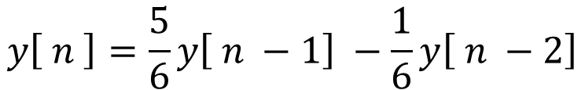
Difference Equation Practice Problem
Given the system equation
$$y\left[ n \right]=\frac{5}{6}y\left[ n −1\right] −\frac{1}{6}y\left[ n −2\right]$$
for n ≥ 2
And the boundary conditions
y[ 0 ] = 0
y[ 1 ] = 1
Find the closed form solution for the system

Slide 3
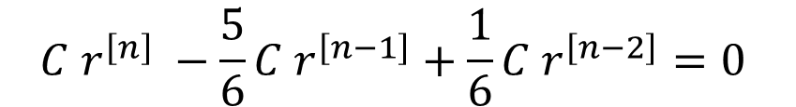


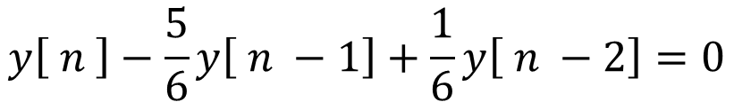
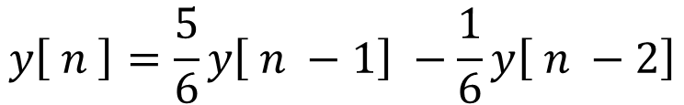
Difference Equation Practice Problem
n ≥ 2
$$y\left[ n \right]=\frac{5}{6}y\left[ n −1\right] −\frac{1}{6}y\left[ n −2\right]$$
Given the system equation
Boundary conditions
And the boundary conditions
y[ 0 ] = 0
y[ 1 ] = 1
Find the closed form solution
$$y\left[ n \right]−\frac{5}{6}y\left[ n −1\right]+\frac{1}{6}y\left[ n −2\right]=0$$
Rearrange the equation
Assume the form
$$y\left[n\right]=C r^{\left[n\right]}$$
$$C r^{\left[n\right]} −\frac{5}{6}C r^{\left[n−1\right]}+\frac{1}{6}{C r}^{\left[n−2\right]}=0$$
$$r^{\left[n\right]} −\frac{5}{6} r^{\left[n−1\right]}+\frac{1}{6}{ r}^{\left[n−2\right]}=0$$

Slide 4
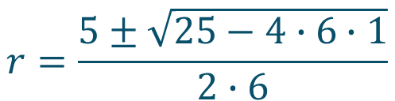
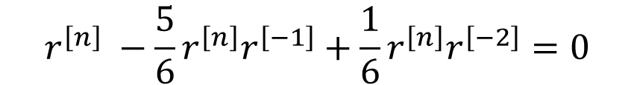


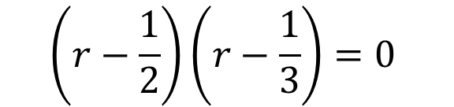


Difference Equation Practice Problem
n ≥ 2
$$r^{\left[n\right]} −\frac{5}{6}r^{\left[n−1\right]}+\frac{1}{6}{ r}^{\left[n−2\right]}=0$$
Boundary conditions
Factor out r^{n}
y[ 0 ] = 0
y[ 1 ] = 1
$$r^{\left[n\right]} −\frac{5}{6}r^{\left[n\right]}r^{\left[−1\right]}+\frac{1}{6}{r^{\left[n\right]}r}^{\left[−2\right]}=0$$
$$1−\frac{5}{6}r^{\left[−1\right]}+\frac{1}{6}r^{\left[−2\right]}=0$$
multiply by r²
$$r^{2}−\frac{5}{6}r+\frac{1}{6}=0$$
This is the characteristic equation
or
$$6 r^{2}−5r+1=0$$
By inspection we can see that roots are at r = 1/3 and at r = 1/2
$$\left(r−\frac{1}{2}\right)\left(r−\frac{1}{3}\right)=0$$
$$r=\frac{5±\sqrt{25−4∙6∙1}}{2∙6}$$

Slide 5
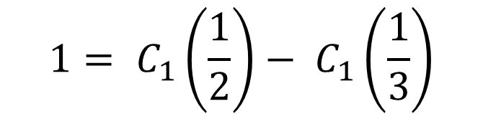



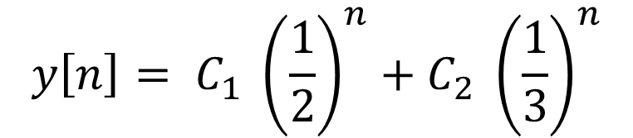
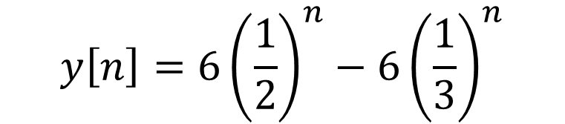

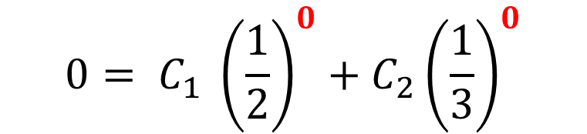
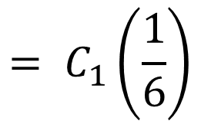
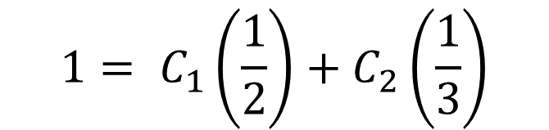
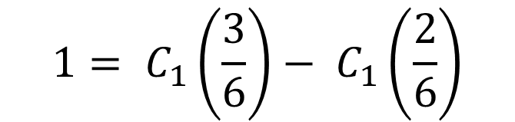
Difference Equation Practice Problem
Boundary conditions
This problem has a roots at r = 1/3 and at r = 1/2, so
y[ 0 ] = 0
y[ 1 ] = 1
$$1= C_{1}\left(\frac{1}{2}\right)+C_{2}\left(\frac{1}{3}\right)$$
$$y\left[n\right]= C_{1} {\left(\frac{1}{2}\right)}^{n}+C_{2} {\left(\frac{1}{3}\right)}^{n}$$
$$1= C_{1}\left(\frac{1}{2}\right)− C_{1}\left(\frac{1}{3}\right)$$
$$0= C_{1} {\left(\frac{1}{2}\right)}^{0}+C_{2}{\left(\frac{1}{3}\right)}^{0}$$
$$1= C_{1}\left(\frac{3}{6}\right)− C_{1}\left(\frac{2}{6}\right)$$
$$= C_{1}\left(\frac{1}{6}\right)$$
$$0=C_{1}+ C_{2}$$
$$C_{2}=− C_{1}$$
$$y\left[n\right]=6{\left(\frac{1}{2}\right)}^{n}−6{\left(\frac{1}{3}\right)}^{n}$$
$$6 = C_{1}$$
$$C_{2}=−6$$

