Slide 1
Digital Signal Processing
Fall 2025

Slide 2
Discrete Fourier transforms

Slide 3
Discrete Fourier transforms are of finite length
Discrete Fourier transforms correspond to samples of the Fourier transform
or samples of the z transform
Discrete Fourier transforms can be related to the Fourier series of periodic signals
We will start by looking at the Fourier series of periodic signals

Slide 4
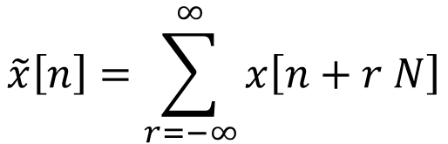

Given a finite length sequence, x[n]
of length N
We can construct a periodic sequence by just repeating the finite sequence
$$\tilde{x}\left[n\right]=\sum_{r=−∞}^{∞}{x\left[n+r N\right]}$$
$$\tilde{x}\left[n\right]$$
We can get back our original sequence by extracting one period from the infinite periodic sequence

Slide 5
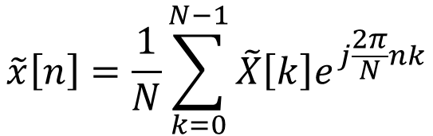
The infinite periodic sequence $\tilde{x}\left[n\right]$ will have a Fourier series representation
We can define the Fourier series representation of the infinite series as the discrete Fourier transform of the finite length sequence
We can form the periodic sequence from the Fourier series coefficients
frequency related basis functions
Fourier series coefficients
$$\tilde{x}\left[n\right]=\frac{1}{N}\sum_{k=0}^{N−1}{\tilde{X}\left[k\right]e^{j\frac{2π}{N}nk}}$$

Slide 6
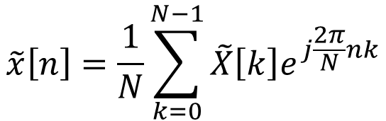
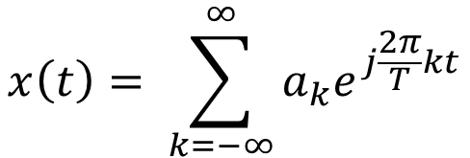
We can form the periodic sequence from the Fourier series coefficients
Fourier series coefficients
frequency related basis functions
$$\tilde{x}\left[n\right]=\frac{1}{N}\sum_{k=0}^{N−1}{\tilde{X}\left[k\right]e^{j\frac{2π}{N}nk}}$$
k=3
k=2
Different limits of summation
k=4
k=1
k=5
k=0
k=10
Compare to the continuous time Fourier series reconstruction
k=6
k=9
Fourier series coefficients
frequency related basis functions
k=7
k=8
$$x\left(t\right)= \sum_{k=−∞}^{∞}{a_{k}e^{j\frac{2π}{T}kt}}$$
no new basis functions
fundamental angular frequency, ω_{o}
The difference is because of the basis functions

Slide 7
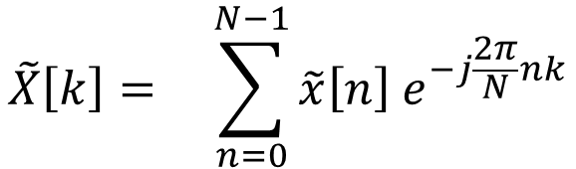
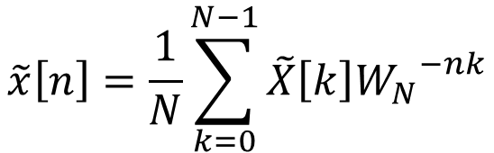
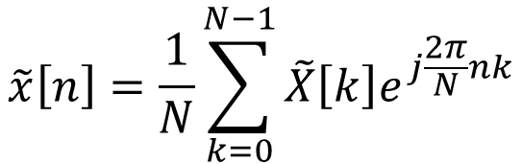
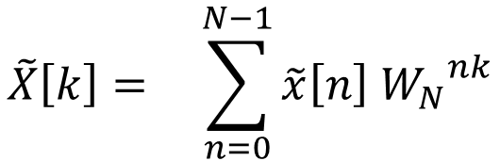


How do we get the Fourier series coefficients?
Synthesis equation
$$\tilde{X}\left[k\right]= \sum_{n=0}^{N−1}{\tilde{x}\left[n\right] e^{−j\frac{2π}{N}nk}}$$
$$\tilde{x}\left[n\right]=\frac{1}{N}\sum_{k=0}^{N−1}{\tilde{X}\left[k\right]e^{j\frac{2π}{N}nk}}$$
$$\frac{1}{N}$$
Analysis equation
normalization factor
some people put the normalization factor here instead
The normalization factor can go one place or the other, but not both
The coefficients are periodic (in k), but we only use one period of them
Alternate notation:
define
$$W_{N}=e^{−j\frac{2π}{N}}$$
Synthesis equation
Analysis equation
$$\tilde{X}\left[k\right]= \sum_{n=0}^{N−1}{\tilde{x}\left[n\right] {W_{N}}^{nk}}$$
$$\tilde{x}\left[n\right]=\frac{1}{N}\sum_{k=0}^{N−1}{\tilde{X}\left[k\right]{W_{N}}^{−nk}}$$

Slide 8
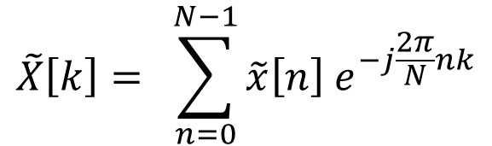
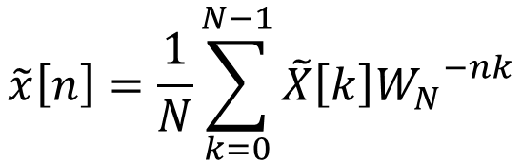
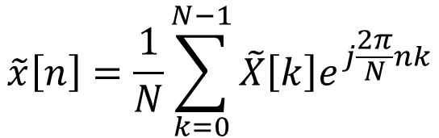
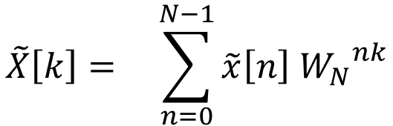
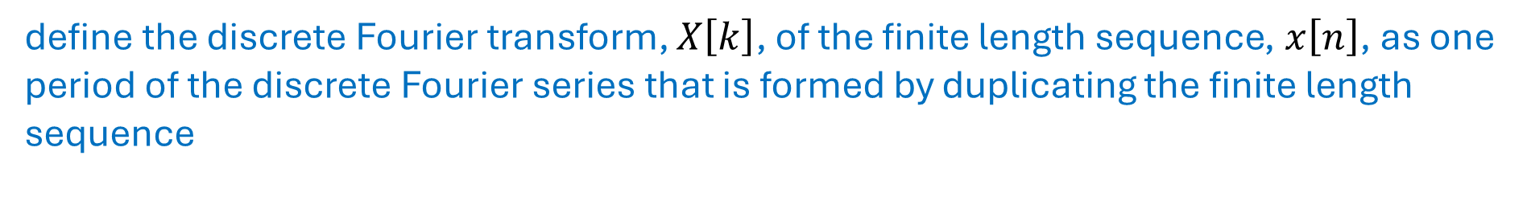

Formulas for Fourier series synthesis and analysis
Synthesis equation
$$\tilde{X}\left[k\right]= \sum_{n=0}^{N−1}{\tilde{x}\left[n\right] e^{−j\frac{2π}{N}nk}}$$
$$\tilde{x}\left[n\right]=\frac{1}{N}\sum_{k=0}^{N−1}{\tilde{X}\left[k\right]e^{j\frac{2π}{N}nk}}$$
Analysis equation
or
$$\tilde{X}\left[k\right]= \sum_{n=0}^{N−1}{\tilde{x}\left[n\right] {W_{N}}^{nk}}$$
$$\tilde{x}\left[n\right]=\frac{1}{N}\sum_{k=0}^{N−1}{\tilde{X}\left[k\right]{W_{N}}^{−nk}}$$
$$W_{N}=e^{−j\frac{2π}{N}}$$
Both the coefficients and the sequence are periodic
but we only use one period of them
define the discrete Fourier transform, $X\left[k\right]$, of the finite length sequence, $x\left[n\right]$, as one period of the discrete Fourier series that is formed by duplicating the finite length sequence

Slide 9







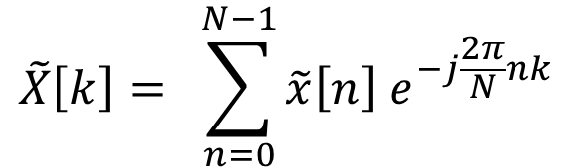









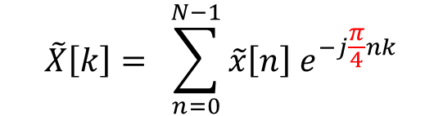



x[n] = { 1, 1, 1, 0, 1, 0, 0, 0}
Example 1: Calculating a Discrete Fourier Transform
Analysis equation
$$\tilde{X}\left[k\right]= \sum_{n=0}^{N−1}{\tilde{x}\left[n\right] e^{−j\frac{2π}{N}nk}}$$
$$\tilde{X}\left[k\right]= \sum_{n=0}^{N−1}{\tilde{x}\left[n\right] e^{−j\frac{π}{4}nk}}$$
n | 0 | 1 | 2 | 3 | 4 | 5 | 6 | 7
k=0
1
2
3
4
5
6
7
1
1
1
0
1
0
0
0
4
N = 8
1
$$\frac{1}{\sqrt{2}} − \frac{j}{\sqrt{2}}$$
-j
0
-1
0
0
0
$$\frac{1}{\sqrt{2}}−j\left(1+\frac{1}{\sqrt{2}}\right)$$
$$e^{−j\frac{π}{2}n}$$
1
-j
-1
0
1
0
0
0
1-j
$$e^{−j\frac{3π}{4}n}$$
1
-$\frac{1}{\sqrt{2}} − \frac{j}{\sqrt{2}}$
j
0
-1
0
0
0
$$−\frac{1}{\sqrt{2}}+j\left(1−\frac{1}{\sqrt{2}}\right)$$
$$−\frac{1}{\sqrt{2}}+ \frac{j}{\sqrt{2}}$$
$$\frac{1}{\sqrt{2}}+ \frac{j}{\sqrt{2}}$$
1
-1
1
0
1
0
0
0
2
$$e^{−jπn}$$
$$e^{−j\frac{5π}{4}n}$$
1
$$−\frac{1}{\sqrt{2}}+ \frac{j}{\sqrt{2}}$$
-j
0
-1
0
0
0
$$−\frac{1}{\sqrt{2}}−j\left(1−\frac{1}{\sqrt{2}}\right)$$
$−$1
$$e^{−j\frac{3π}{2}n}$$
1
j
-1
0
1
0
0
0
1+j
1
j
0
-1
0
0
0
-$\frac{1}{\sqrt{2}} − \frac{j}{\sqrt{2}}$
$$\frac{1}{\sqrt{2}} − \frac{j}{\sqrt{2}}$$
$$e^{−j\frac{7π}{4}n}$$
-$\frac{1}{\sqrt{2}}+ \frac{j}{\sqrt{2}}$
$$−\frac{1}{\sqrt{2}}+j\left(1+\frac{1}{\sqrt{2}}\right)$$

Slide 11
Practice Problem
Problem 1: Calculate the Discrete Fourier Transform of the following signal.
x[n] = { 1, 0, 1, 1 }

