Slide 1
Digital Signal Processing
Fall 2025

Slide 2
Signal Flow Graphs
How to visualize equations
Showing relationships between variables

Slide 3

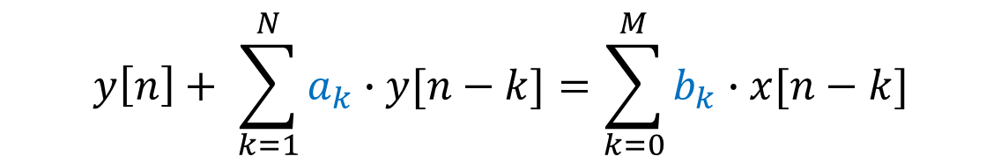
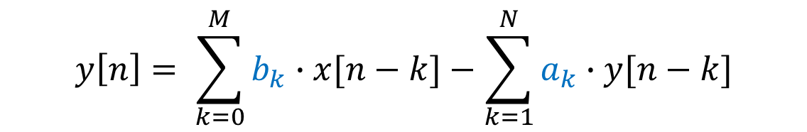


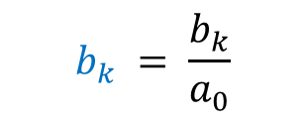

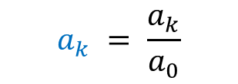

$$N^{th} order$$
Linear Constant Coefficient Difference Equations
$$\sum_{k=0}^{N}{a_{k}∙y[n−k]}=\sum_{k=0}^{M}{b_{k}∙x[n−k]}$$
This can be written in different ways
Coefficients normalized
$$y\left[n\right]+ \sum_{k=1}^{N}{a_{k}∙y[n−k]}=\sum_{k=0}^{M}{b_{k}∙x[n−k]}$$
$$a_{k} = \frac{a_{k}}{a_{0}}$$
$$b_{k} = \frac{b_{k}}{a_{0}}$$
$$y\left[n\right]= \sum_{k=0}^{M}{b_{k}∙x[n−k]}−\sum_{k=1}^{N}{a_{k}∙y[n−k]}$$
$$a_{k}=−a_{k}$$
$$+$$
$$a_{k}$$

Slide 4
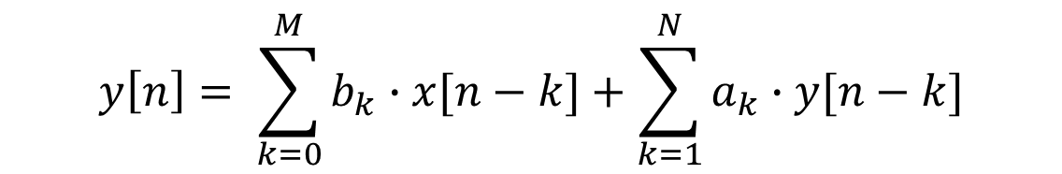
$$N^{th} order$$
Linear Constant Coefficient Difference Equations
$$y\left[n\right]= \sum_{k=0}^{M}{b_{k}∙x[n−k]}+\sum_{k=1}^{N}{a_{k}∙y[n−k]}$$
What do we need to do to calculate y[n] ?
What information do we need?
We want a graphical way to represent these
We need to multiply
We need inputs
Current inputs
We need to add
Past inputs
We need to delay information
We need past outputs
save present inputs/outputs for future calculations
We need coefficients

Slide 5

Block Diagram Representation
a
We need to multiply
x[n]
a ∙ x[n]
x₁
+
x₁ + x₂
We need to add
x₂
We need to delay information
x[n]
$$z^{−1}$$
x[n-1]
X[z]
z⁻¹ ∙X[z]

Slide 6


Block Diagram Representation
Consider the equation
y[n] = 3 x[n] – 2 y[ n – 1] + y[ n -2]
x[n]
3
+
y[n]
$$z^{−1}$$
+
–2
y[n-1]
– 2y[n-2] + y[n-2]
$$z^{−1}$$
y[n-2]

Slide 7
Signal Flow Graphs
nodes connected by directed branches
W_{b} = a ∙ x[n]
We can refer to branches by the labels of the nodes that they originate from and terminate at
network nodes
branch bd
source node
a
sink node
W_{b}
W_{d}
x[n]
y[n]
nodes are labelled
node a
node b
W_{c}
node d
node e
Each node has an associated variable
node c
The output is a function of the input variable
Each branch has an input and an output
The transmittance or gain of the branches can be indicated by a value by the branch
The input is the variable associated with the node where the branch starts
The node value is the sum of the outputs of the branches that end at the node

Slide 8


Signal Flow Graph
Consider the equation
y[n] = 3 x[n] – 2 y[ n – 1] + y[ n -2]
Y[z] = 3 X[z] – 2 z⁻¹ Y[z] + z⁻² Y[z]
X[z]
Y[z]
3
a
1
b
1
x[n]
y[n]
1
–2
$$z^{−1}$$
d
$$z^{−1}$$
c
W_{c} = z⁻¹ Y(z)
W_{d} = z⁻² Y(z)

Slide 10




Signal Flow Graph Example 2
Consider the equation
y[n] = 3 x[n] + 2 x[n-1] –x[n-2] – 2 y[ n – 1] + y[ n -2]
Y[z] = 3 X[z] + 2 z⁻¹ X[z] – z⁻² X[z] – 2 z⁻¹ Y[z] + z⁻² Y[z]
X[z]
3
Y[z]
$$z^{−1}$$
$$z^{−1}$$
2
–2
$$z^{−1}$$
$$z^{−1}$$
-1
1

Slide 11
Practice Problems

Slide 12
Practice Problem 1
Make a signal flow graph for the system described by the equation
y[n] = 2 x[n] – 6 x[n-1] + 2 x[n-3] – 4 y[ n – 2] + y[ n -3]

