Slide 1
CSC314 Day 16
Transaction processing
Concurrency Control

Slide 2
Transaction ACID Properties
Atomic
Transaction cannot be subdivided
Consistent
Constraints don’t change from before transaction to after transaction
Isolated
Database changes not revealed to users until after transaction has completed
Durable
Database changes are permanent

Slide 3
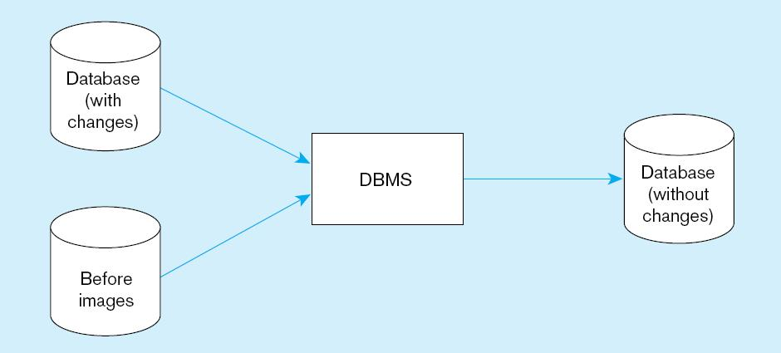
Figure 11-9 Basic recovery techniques
a) Rollback
Chapter 11
© 2013 Pearson Education, Inc. Publishing as Prentice Hall
3

Slide 4
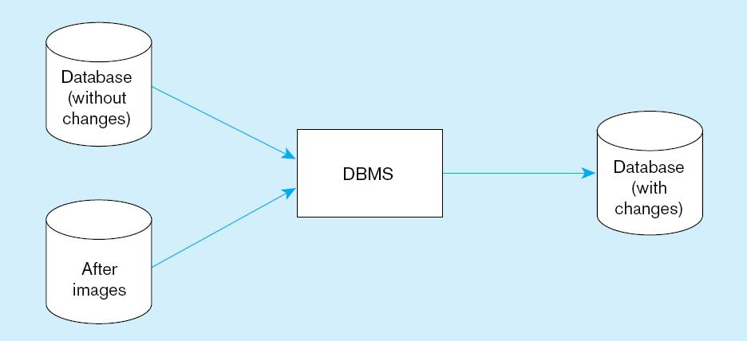
Figure 11-9 Basic recovery techniques (cont.)
b) Rollforward
Chapter 11
© 2013 Pearson Education, Inc. Publishing as Prentice Hall
4

Slide 5
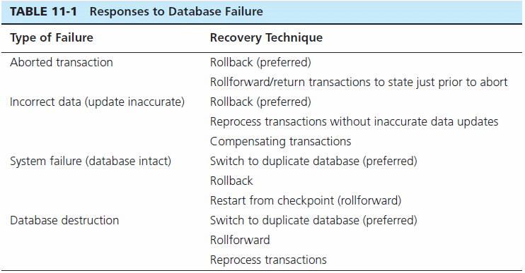

Slide 6
Control concurrent Access
Problem–in a multi-user environment, simultaneous access to data can result in interference and data loss (lost update problem)
Solution–Concurrency Control
The process of managing simultaneous operations against a database so that data integrity is maintained and the operations do not interfere with each other in a multi-user environment

Slide 7
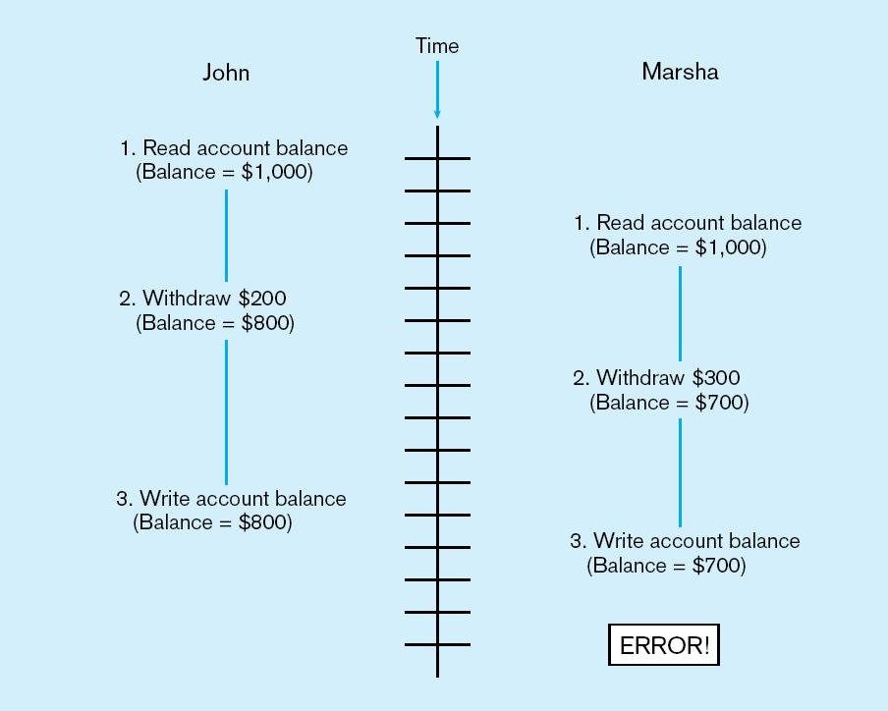
Figure 11-10 Lost update (no concurrency control in effect)
Simultaneous access causes updates to cancel each other.
A similar problem is the inconsistent read problem.

Slide 8
Concurrency Control Techniques
Serializability
Finish one transaction before starting another
Locking Mechanisms
The most common way of achieving serialization
Data that is retrieved for the purpose of updating is locked for the updater
No other user can perform update until unlocked

Slide 9
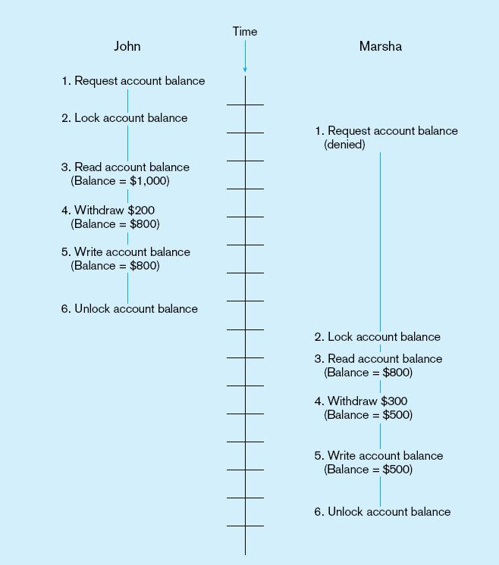
Figure 11-11: Updates with locking (concurrency control)
This prevents the lost update problem
Chapter 11
© 2013 Pearson Education, Inc. Publishing as Prentice Hall
9

Slide 10
Locking Mechanisms
Locking level:
Database–used during database updates
Table–used for bulk updates
Block or page–very commonly used
Record–only requested row; fairly commonly used
Field–requires significant overhead; impractical
Types of locks:
Shared lock–Read but no update permitted. Used when just reading to prevent another user from placing an exclusive lock on the record
Exclusive lock–No access permitted. Used when preparing to update

Slide 11
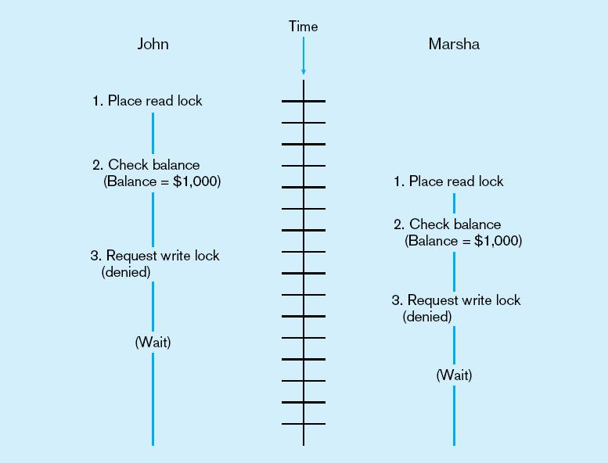
Deadlock
An impasse that results when two or more transactions have locked common resources, and each waits for the other to unlock their resources
Figure 11-12
The problem of deadlock
John and Marsha will wait forever for each other to release their locked resources!

Slide 12
Managing Deadlock
Deadlock prevention:
Lock all records required at the beginning of a transaction
Two-phase locking protocol
Growing phase
Shrinking phase
May be difficult to determine all needed resources in advance
Deadlock Resolution:
Allow deadlocks to occur
Mechanisms for detecting and breaking them
Resource usage matrix

Slide 13
Versioning
Optimistic approach to concurrency control
Instead of locking
Assumption is that simultaneous updates will be infrequent
Each transaction can attempt an update as it wishes
The system will reject an update when it senses a conflict
Use of rollback and commit for this

Slide 14
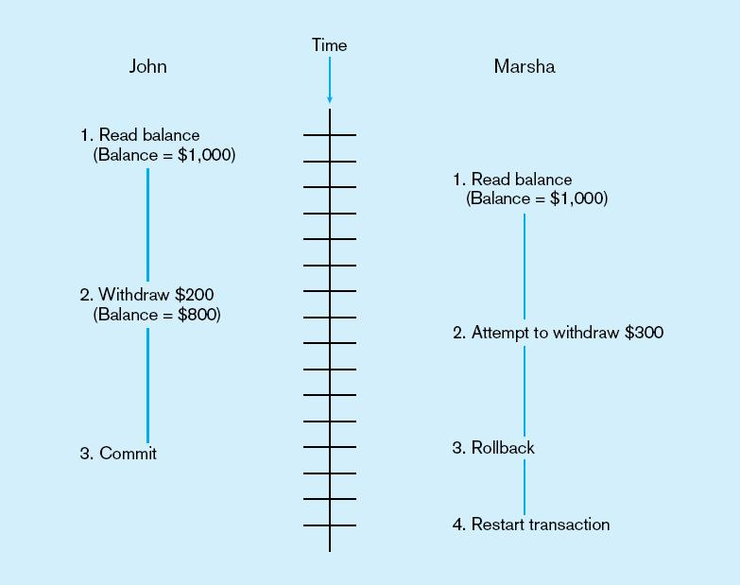
Figure 11-14 The use of versioning
Better performance than locking
Chapter 11
© 2013 Pearson Education, Inc. Publishing as Prentice Hall
14

Slide 15
Data Dictionaries and Repositories
Data dictionary
Documents data elements of a database
System catalog
System-created database that describes all database objects
Information Repository
Stores metadata describing data and data processing resources
Information Repository Dictionary System (IRDS)
Software tool managing/controlling access to information repository

Slide 16
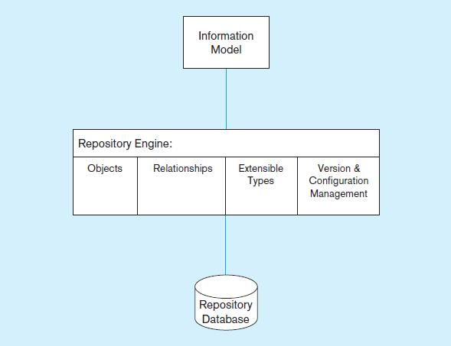
Figure 11-15 Three components of the repository system architecture
A schema of the repository information
Software that manages the repository objects
Where repository objects are stored
Source: based on Bernstein, 1996.
Chapter 11
© 2013 Pearson Education, Inc. Publishing as Prentice Hall
16

Slide 17
Database Performance Tuning
DBMS Installation
Setting installation parameters
Memory and Storage Space Usage
Set cache levels
Choose background processes
Data archiving
Input/output (I/O) Contention
Use striping
Distribution of heavily accessed files
CPU Usage – Monitor CPU load
Application tuning
Modification of SQL code in applications
Use of heartbeat queries

Slide 18
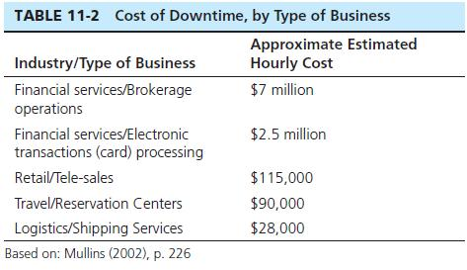
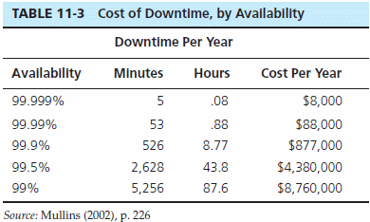
Cost of Downtime
Downtime is expensive

Slide 19
Data Availability
How to ensure availability
Hardware failures–provide redundancy for fault tolerance
Loss of data–database mirroring
Human error–standard operating procedures, training, documentation
Maintenance downtime–automated and non-disruptive maintenance utilities
Network problems–careful traffic monitoring, firewalls, and routers

