Slide 1
Data Modeling and the Entity-Relationship Model
DAVID M. KROENKE and DAVID J. AUER
DATABASE CONCEPTS, 6th Edition
Chapter Four

Slide 2
Chapter Objectives
Learn the basic stages of database development
Understand the purpose and role of a data model
Know the principal components of the E-R data model
Understand how to interpret traditional E-R diagrams
Understand how to interpret the Information Engineering (IE) model’s Crow’s Foot E-R diagrams
Learn to construct E-R diagrams
Know how to represent 1:1, 1:N, N:M, and binary relationships with the E-R model

Slide 3
Chapter Objectives (Cont’d)
Understand two types of weak entities and know how to use them
Understand nonidentifying and identifying relationships and know how to use them
Know how to represent subtype entities with the E-R model
Know how to represent recursive relationships with the E-R model
Learn how to create an E-R diagram from source documents

Slide 4
Three Stages of Database Development
The three stages of database development are:
Requirements Analysis Stage
Component Design Stage
Implementation Stage
These three stages are part of the five stage Systems Development Life Cycle (SDLC) model—See online Appendix F—Getting Started in Systems Analysis and Design, for more information

Slide 5
The Requirements Analysis Stage
Sources of requirements
User Interviews
Forms
Reports
Queries
Use Cases
Business Rules

Slide 6
Requirements Become the E-R Data Model
After the requirements have been gathered, they are transformed into an Entity Relationship (E-R) Data Model.
The most important elements of E-R Models are:
Entities
Attributes
Identifiers
Relationships

Slide 7
Entity Class versus Entity Instance
An entity class is a description of the structure and format of the occurrences of the entity.
An entity instance is a specific occurrence of an entity within an entity class.

Slide 8
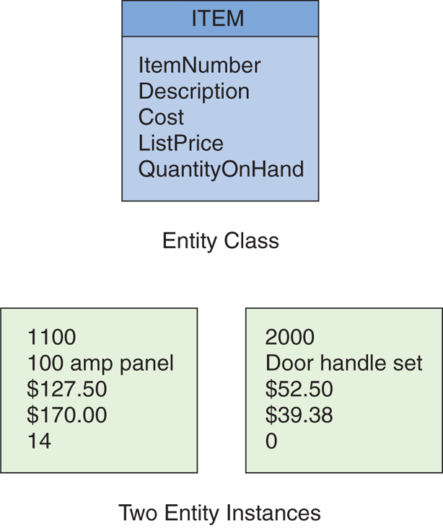
Entity Class and Entity Instance
Figure 4-2: The ITEM Entity and Two Entity Instances

Slide 9
Attributes
Entities have attributes that describe the entity’s characteristics:
ProjectName
StartDate
ProjectType
ProjectDescription
Attributes have a data type and properties.

Slide 10
Identifiers
Entity instances have identifiers.
An identifier will identify a particular instance in the entity class:
SocialSecurityNumber
StudentID
EmployeeID

Slide 11
Identifier Types
Uniqueness
Identifiers may be unique or nonunique.
If the identifier is unique, the data value for the identifier must be unique for all instances.
Composite
A composite identifier consists of two or more attributes.
E.g., OrderNumber & LineItemNumber are both required.

Slide 12
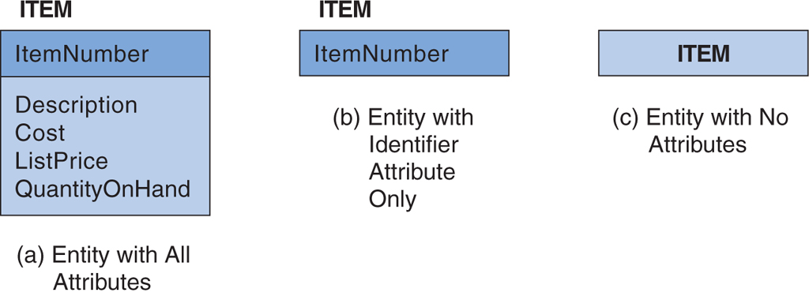
Levels of Entity Attribute Display
Figure 4-3: Levels of Entity Attribute Display

Slide 13
Relationships
Entities can be associated with one another in relationships.
Relationship degree defines the number of entity classes participating in the relationship:
Degree 2 is a binary relationship.
Degree 3 is a ternary relationship.

Slide 14
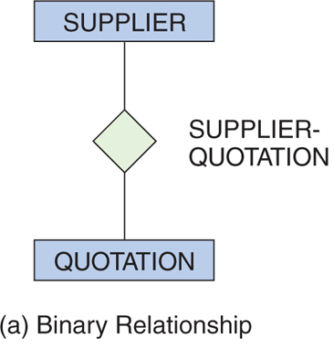
Degree 2 Relationship: Binary
Figure 4-4: Example Relationships

Slide 15
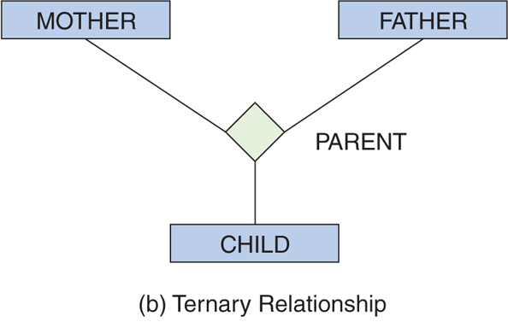
Degree 3 Relationship: Ternary
Figure 4-4: Example Relationships

Slide 16
One-to-One Binary Relationship
1:1 (one-to-one)
A single entity instance in one entity class is related to a single entity instance in another entity class.
An employee may have no more than one locker; and
A locker may only be accessible by one employee
(a) One-to-One Relationship
Figure 4-5: Three Types of Binary Relationships

Slide 17
One-to-Many Binary Relationship
1:N (one-to-many)
A single entity instance in one entity class is related to many entity instances in another entity class.
A quotation is associated with only one item; and
An item may have several quotations
(b) One-to-Many Relationship
Figure 4-4: Three Types of Binary Relationships

Slide 18
Many-to-Many Binary Relationship
N:M (many-to-many)
Many entity instances in one entity class is related to many entity instances in another entity class:
a supplier may supply several items; and
a particular item may be supplied by several suppliers.
(c) Many-to-Many Relationship
Figure 4-5: Three Types of Binary Relationships

Slide 19
Maximum Cardinality
Relationships are named and classified by their cardinality, which is a word that means count.
Each of the three types of binary relationships shown above have different maximum cardinalities.
Maximum cardinality is the maximum number of entity instances that may participate in a relationship instance—one, many, or some other fixed number.

Slide 20
Minimum Cardinality
Minimum cardinality is the minimum number of entity instances that must participate in a relationship instance.
These values typically assume a value of zero (optional) or one (mandatory).

Slide 21
Cardinality Example
Maximum cardinality is many for both ITEM and SUPPLIER.
Minimum cardinality is zero (optional) for ITEM and one (mandatory) SUPPLIER.
A SUPPLIER does not have to supply an ITEM.
An ITEM must have a SUPPLIER.
Figure 4-6: A Relationship with Minimum Cardinalities

Slide 22
Entity-Relationship Diagrams
The diagrams in previous slides are called entity-relationship diagrams.
Entity classes are shown by rectangles.
Relationships are shown by diamonds.
The maximum cardinality of the relationship is shown inside the diamond.
The minimum cardinality is shown by the oval or hash mark next to the entity.
The name of the entity is shown inside the rectangle.
The name of the relationship is shown near the diamond.

Slide 23
HAS-A Relationships
The relationships in the previous slides are called HAS-A relationships.
The term is used because each entity instance has a relationship to a second entity instance:
An employee has a badge.
A badge has an employee.

Slide 24
Types of Entity-Relationship Diagrams
Information Engineering (IE) [James Martin 1990]—Uses “crow’s feet” to show the many sides of a relationship, and it is sometimes called the crow’s foot model.
Integrated Definition 1, Extended 3 (IDEF1X) is a version of the E-R model that is a national standard.
Unified Modeling Language (UML) is a set of structures and techniques for modeling and designing object-oriented programs (OOP) and applications

Slide 25
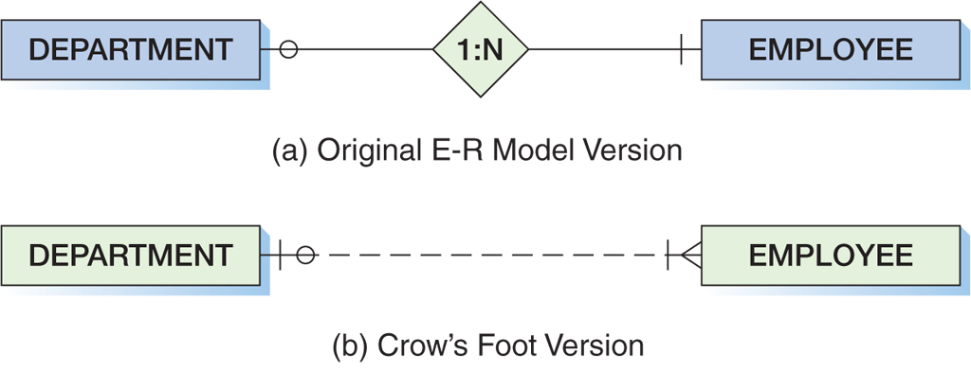
Crow’s Foot Example: One-to-Many Relationship
Figure 4-7: Two Versions of a 1:N Relationship

Slide 26
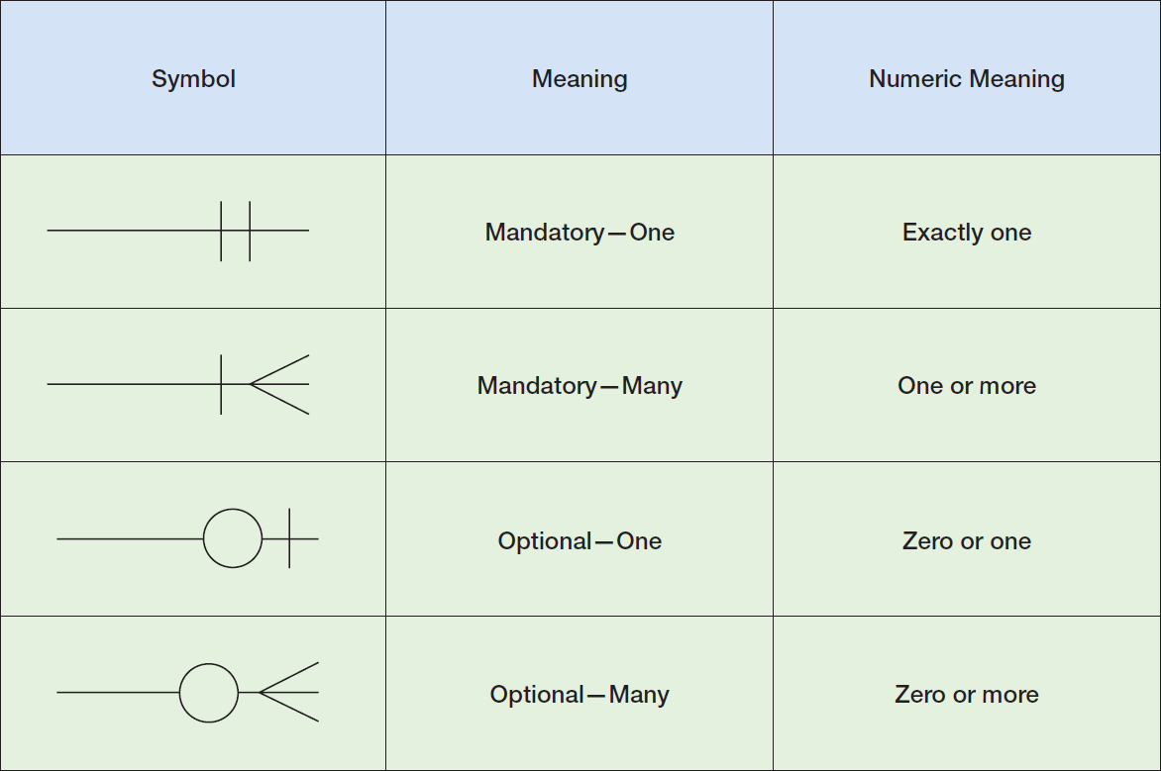
Crow’s Foot Symbols
Figure 4-8: Crow’s Foot Notation

Slide 27
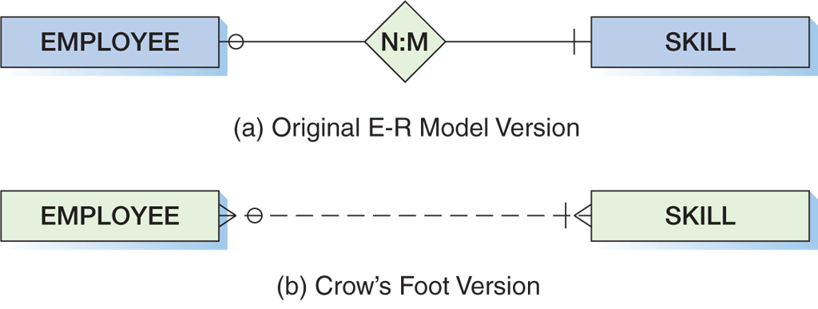
Crow’s Foot Example: Many-to-Many Relationship
Figure 4-9: Two Versions of an N:M Relationship

Slide 28
Weak Entity
A weak entity is an entity that cannot exist in the database without the existence of another entity.
Any entity that is not a weak entity is called a strong entity.

Slide 29
ID-Dependent Weak Entities
An ID-Dependent weak entity is a weak entity that cannot exist without its parent entity.
An ID-dependent weak entity has a composite identifier.
The first part of the identifier is the identifier for the strong entity.
The second part of the identifier is the identifier for the weak entity itself.

Slide 30
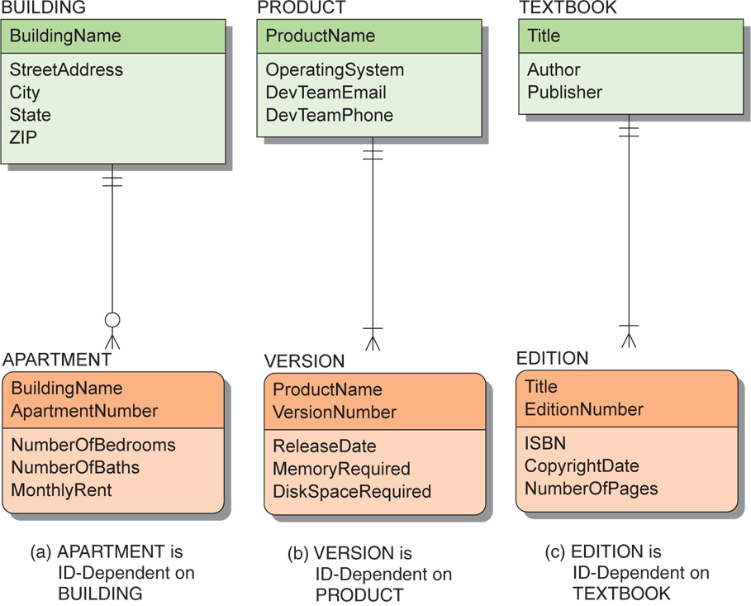
ID-Dependent Weak Entity Examples
Figure 4-10: Example ID-Dependent Entities

Slide 31
Weak Entity Relationships
The relationship between a strong and weak entity is termed an identifying relationship if the weak entity is ID-dependent.
Represented by a solid line
The relationship between a strong and weak entity is termed a nonidentifying relationship if the weak entity is non-ID-dependent.
Represented by a dashed line
Also used between strong entities

Slide 32
Weak Entity Identifier: Non-ID-dependent
All ID-dependent entities are weak entities, but there are other entities that are weak but not ID-dependent.
A non-ID-dependent weak entity may have a single or composite identifier, but the identifier of the parent entity will be a foreign key.

Slide 33
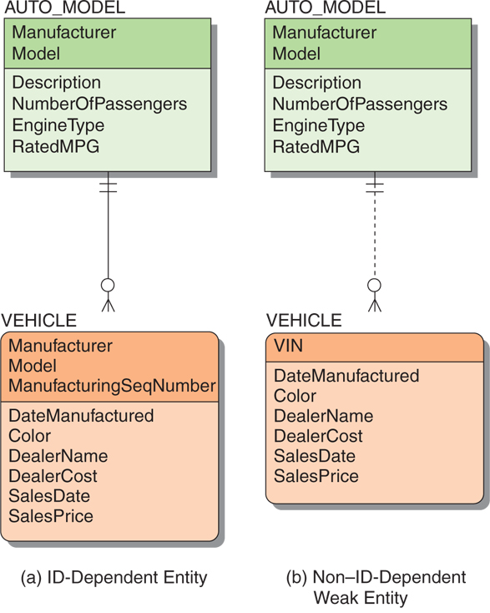
Non-ID-Dependent Weak Entity Examples
Figure 4-11: Weak Entity Examples

Slide 34
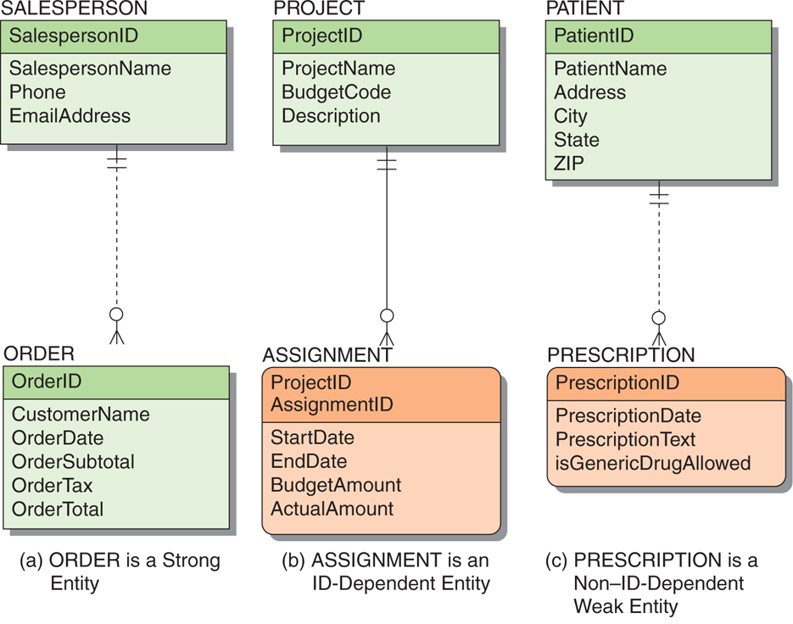
Strong and Weak Entity Examples
Figure 4-12: Examples of Required Entities

Slide 35
Associative Entities
An associative entity (also called an association entity) is used when there are attributes that are associated with the relationship between two entities rather than with either of the two entities themselves.
A new entity is then created to:
Link the two original entities
Hold the attributes

Slide 36
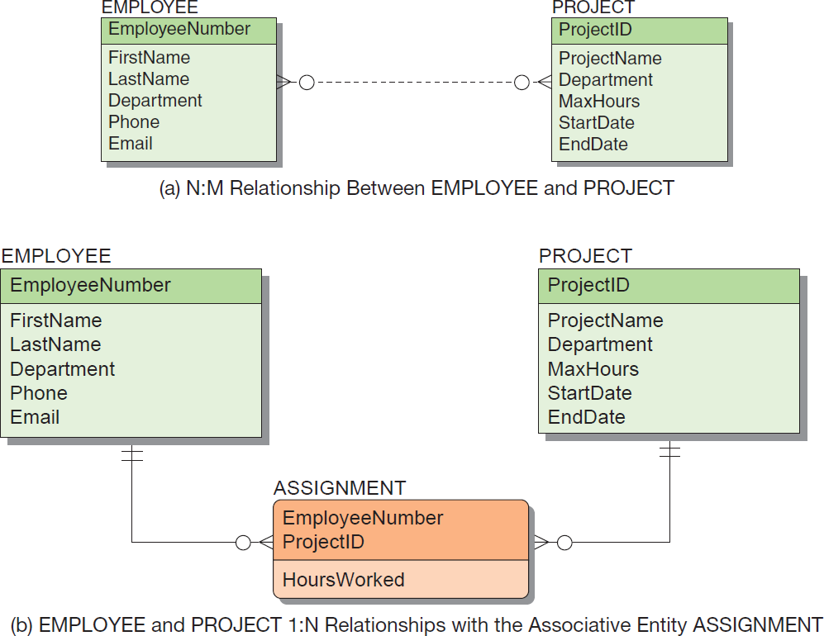
Associative Entities (Cont’d)
Figure 4-13: The Associative Entity

Slide 37
Subtype Entities
A subtype entity is a special case of another entity called supertype.
An attribute of the supertype may be included that indicates which of the subtypes is appropriate for a given instance; this attribute is called a discriminator.
Subtypes can be exclusive or inclusive.
If exclusive, the supertype relates to at most one subtype.
If inclusive, the supertype can relate to one or more subtypes.

Slide 38
Subtype Entity Identifiers
The relationships that connect supertypes and subtypes are called IS-A relationships because a subtype is the same entity as the supertype.
The identifier of a supertype and all of its subtypes is the same attribute.

Slide 39
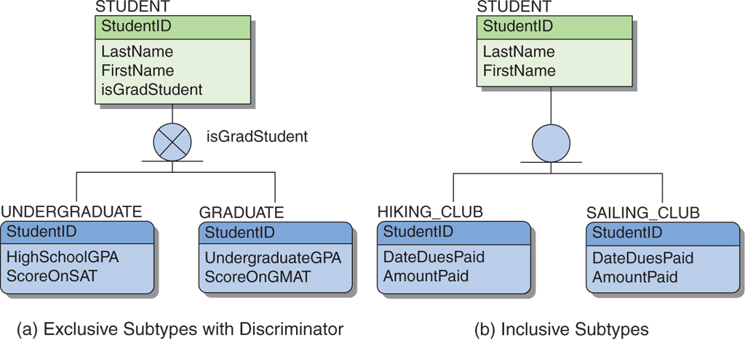
Subtype Entity Examples
Figure 4-14: Example Subtype Entities

Slide 40
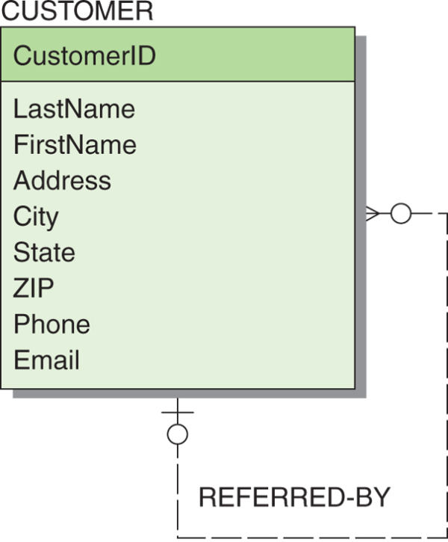
Recursive Relationships
It is possible for an entity to have a relationship to itself—this is called a recursive relationship.
Figure 4-15: Example Recursive Relationship

Slide 41
Developing an E-R Diagram
Heather Sweeney Designs will be used as an ongoing example throughout Chapters 4, 5, 6 and 7.
Heather Sweeney is an interior designer who specializes in home kitchen design.
She offers a variety of free seminars at home shows, kitchen and appliance stores and other public locations.
She earns revenue by selling books and videos that instruct people on kitchen design.
She also offers custom-design consulting services.

Slide 42
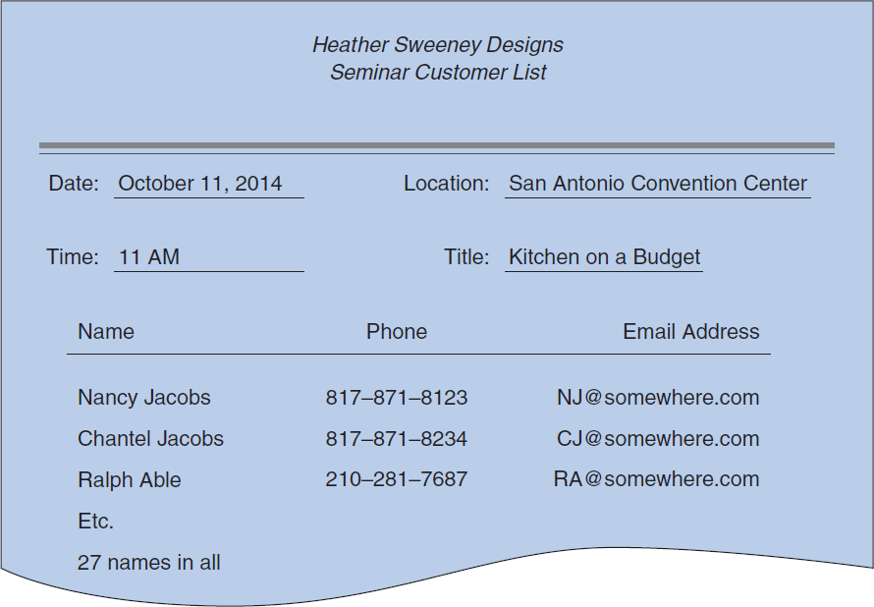
Heather Sweeney Designs: The Seminar Customer List
Figure 4-16: Example Seminar Customer List

Slide 43
Heather Sweeney Designs: Initial E-R Diagram I
(a) First Version of the SEMINAR and CUSTOMER E-R Diagram
Figure 4-17: Initial E-R Diagram for Heather Sweeney Designs

Slide 44
Heather Sweeney Designs: Initial E-R Diagram II
(b) Second Version of the SEMINAR and CUSTOMER E-R Diagram
Figure 4-17: Initial E-R Diagram for Heather Sweeney Designs

Slide 45
Heather Sweeney Designs: Initial E-R Diagram III
(c) Third Version of the SEMINAR and CUSTOMER E-R Diagram
Figure 4-17: Initial E-R Diagram for Heather Sweeney Designs

Slide 46
Heather Sweeney Designs: The Customer Form Letter
Figure 4-18:
Heather Sweeney Designs
Customer Form Letter

Slide 47
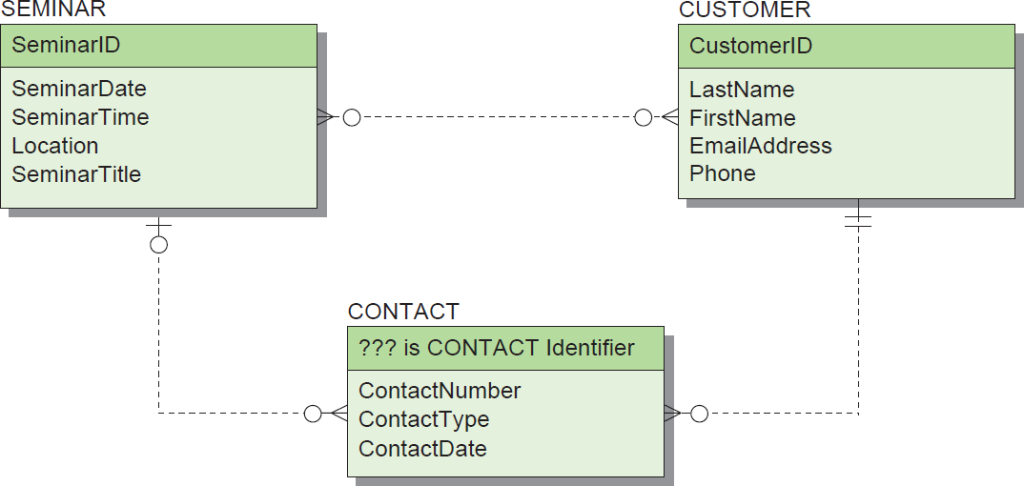
Heather Sweeney Designs: Data Model with CONTACT
(a) First Version with CONTACT
Figure 4-19: Heather Sweeney Designs Data Model with CONTACT

Slide 48
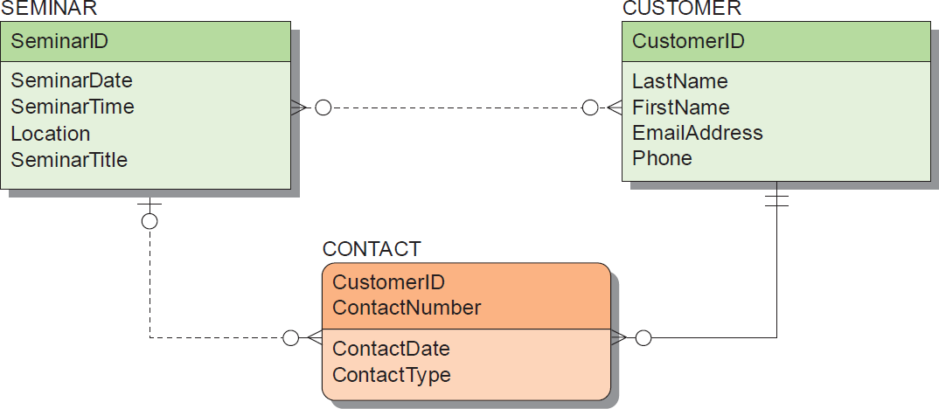
Heather Sweeney Designs: Data Model with CONTACT as Weak Entity
(b) Second Version with CONTACT as a Weak Entity
Figure 4-19: Heather Sweeney Designs Data Model with CONTACT

Slide 49
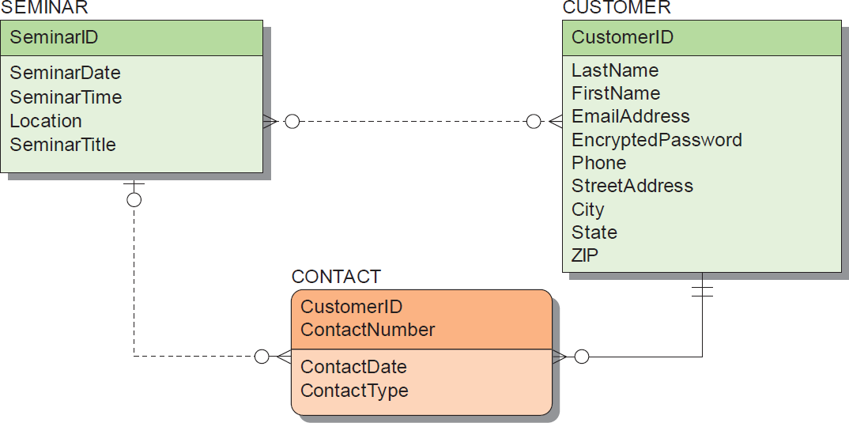
Heather Sweeney Designs: Data Model with Modified CUSTOMER
(c) Third Version with Modified CUSTOMER
Figure 4-19: Heather Sweeney Designs Data Model with CONTACT

Slide 50
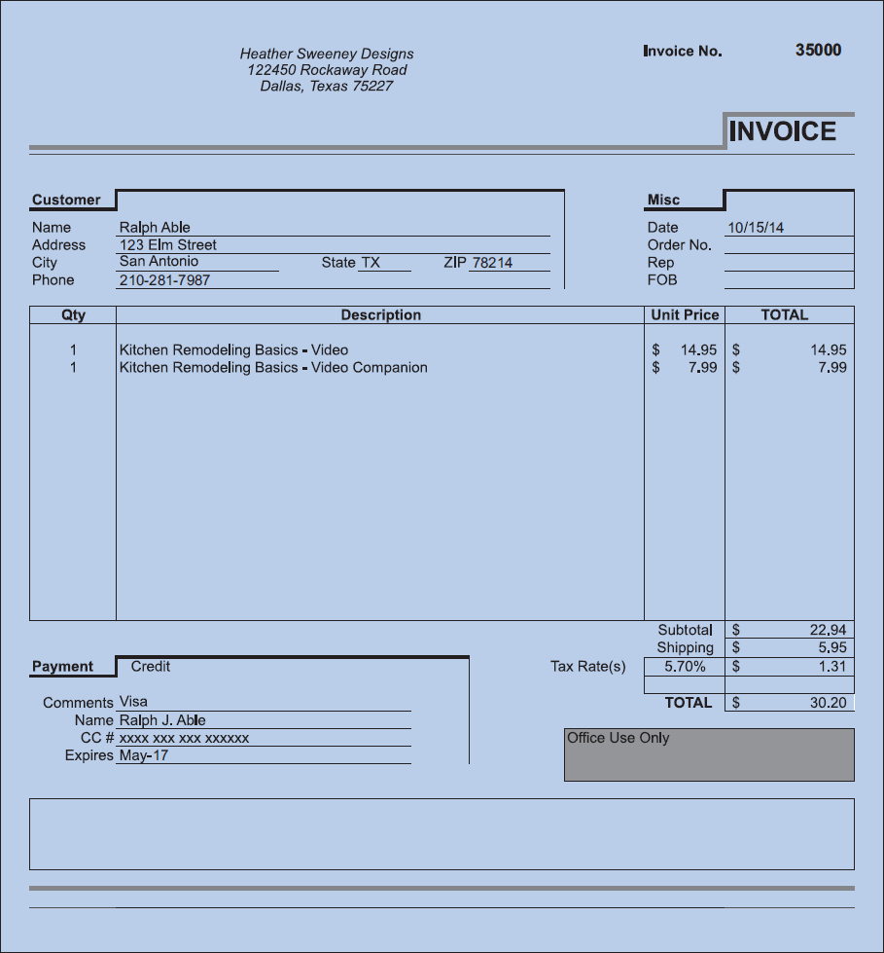
Heather Sweeney Designs: Sales Invoice
Figure 4-20: Heather Sweeney Designs Sales Invoice

Slide 51
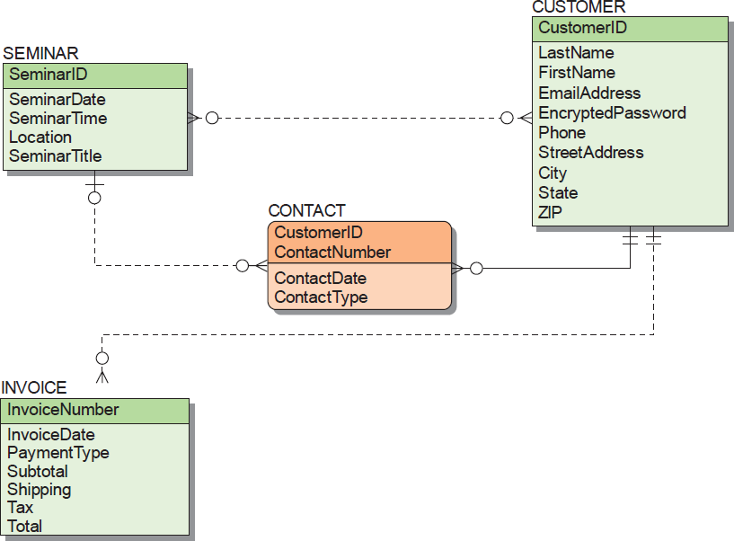
Heather Sweeney Designs: Data Model with INVOICE
(a) Version with INVOICE
Figure 4-21: The Final Data Model for Heather Sweeney Designs

Slide 52
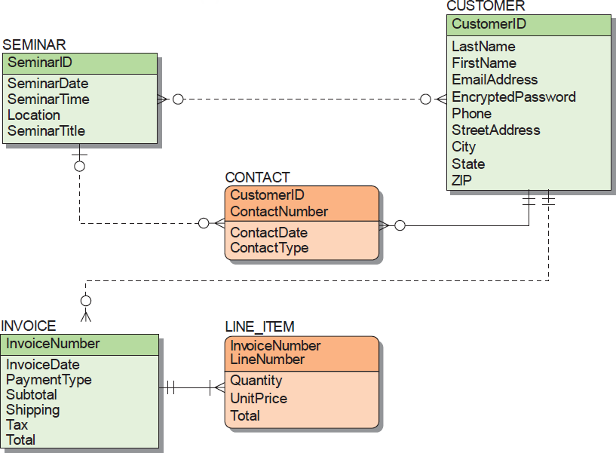
Heather Sweeney Designs: Data Model with LINE_ITEM
(b) Version with LINE_ITEM
Figure 4-21: The Final Data Model for Heather Sweeney Designs

Slide 53
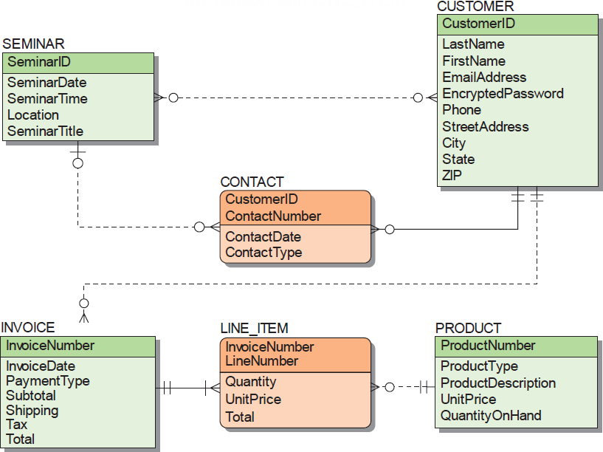
Heather Sweeney Designs: Final Data Model
(c) The Finished Data Model
Figure 4-21: The Final Data Model for Heather Sweeney Designs

Slide 54
Heather Sweeney Designs: Business Rules and Model Validation
Business rules may constrain the model and need to be recorded.
Heather Sweeney Designs has a business rule that no more than one form letter or email per day is to be sent to a customer.
After the data model has been completed, it needs to be validated.
Prototyping is commonly used to validate forms and reports.

Slide 55
DAVID M. KROENKE and DAVID J. AUER
DATABASE CONCEPTS, 7th Edition
All rights reserved. No part of this publication may be reproduced, stored in a retrieval system, or transmitted, in any form or by any means, electronic, mechanical, photocopying, recording, or otherwise, without the prior written permission of the publisher. Printed in the United States of America.
Copyright © 2015 Pearson Education, Inc.
Publishing as Prentice Hall

Slide 56
Data Modeling and the Entity-Relationship Model
DAVID M. KROENKE and DAVID J. AUER
DATABASE CONCEPTS, 7th Edition
End of Presentation on Chapter Four

