Slide 1
Database Administration
DAVID M. KROENKE and DAVID J. AUER
DATABASE CONCEPTS, 7th Edition
Chapter Six

Slide 2
Chapter Objectives
Understand the need for and importance of database administration
Learn different ways of processing a database
Understand the need for concurrency control, security, and backup and recovery
Learn about typical problems that can occur when multiple users process a database concurrently
Understand the use of locking and the problem of deadlock
Learn the difference between optimistic and pessimistic locking

Slide 3
Chapter Objectives (Cont’d)
Know the meaning of ACID transaction
Learn the four 1992 ANSI standard isolation levels
Understand the need for security and specific tasks for improving database security
Know the difference between recovery via reprocessing and recovery via rollback/rollforward
Understand the nature of the tasks required for recovery using rollback/rollforward
Know basic administrative and management DBA functions

Slide 4
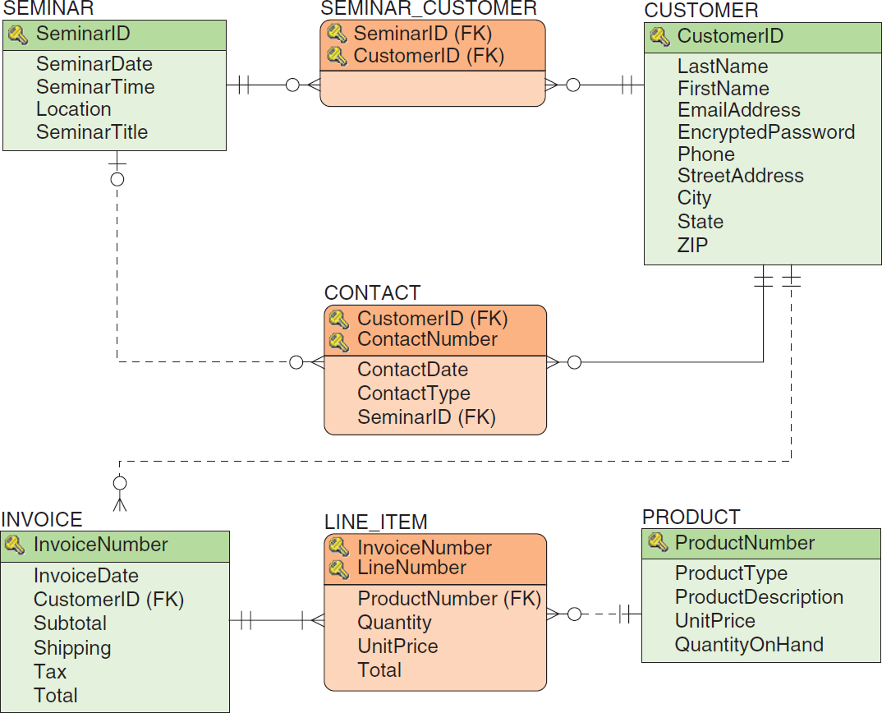
Heather Sweeney Designs: Database Design

Slide 5
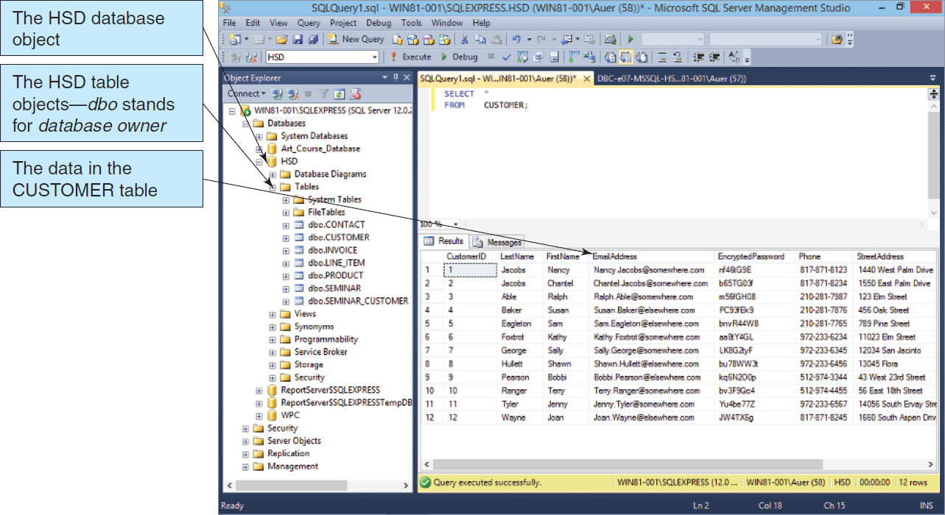
Heather Sweeney Designs: HSD Database in Microsoft SQL Server 2014
Figure 6-1: The HSD Database in Microsoft SQL Server 2014

Slide 6
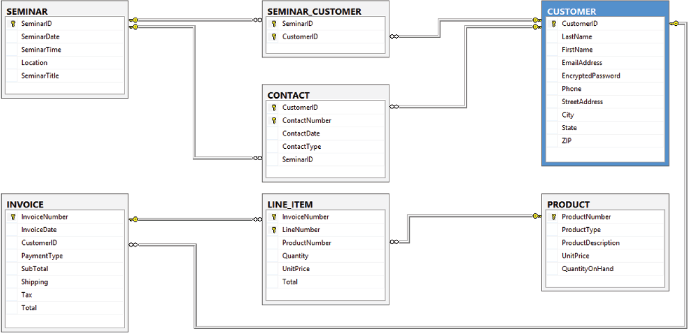
Heather Sweeney Designs: HSD Database Diagram in SQL Server 2012

Slide 7
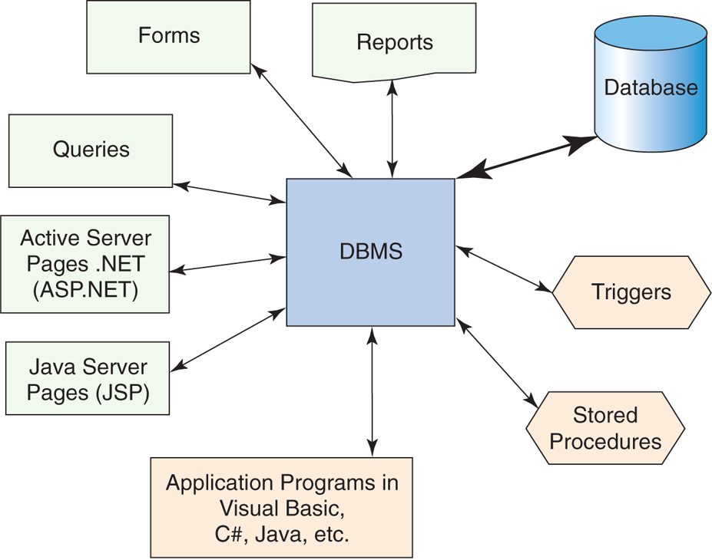
The Database Processing Environment
Figure 6-2: The Database Processing Environment

Slide 8
Control, Security and Reliability
Three necessary database administration functions are:
Concurrency control
Security
Backup and Recovery

Slide 9
Concurrency Control
Concurrency control ensures that one user’s actions do not adversely impact another user’s actions.
At the core of concurrency is accessibility.
In one extreme, data becomes inaccessible once a user touches the data.
This ensures that data that is being considered for update is not shown.
In the other extreme, data is always readable.
The data is even readable when it is locked for update.

Slide 10
Concurrency Control (continued)
Interdependency
Changes required by one user may impact others.
Concurrency
People or applications may try to update the same information at the same time.
Record retention
When information should be discarded

Slide 11
Need for Atomic Transactions
A database operation typically involves several transactions.
These transactions are atomic and are sometimes called logical units of work (LUW).
Before an operation is committed to the database, all LUWs must be successfully completed.
If one or more LUW is unsuccessful, a rollback is performed and no changes are saved to the database.

Slide 12
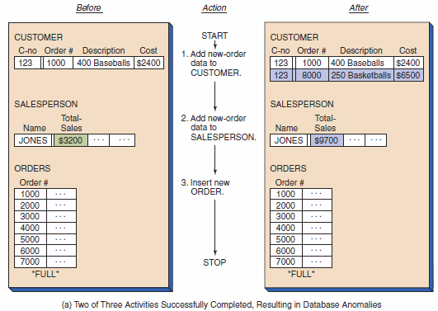
Transaction Example I
Figure 6-3: Comparison of the Results of Applying Serial Actions Versus a Multiple-Step Transaction

Slide 13
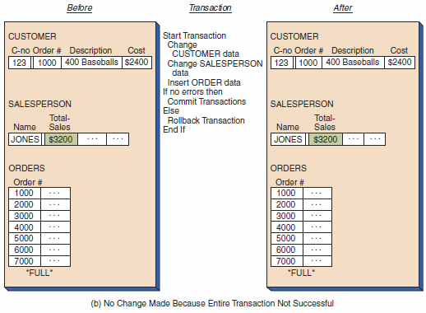
Transaction Example II
Figure 6-3: Comparison of the Results of Applying Serial Actions Versus a Multiple-Step Transaction (Cont’d)

Slide 14
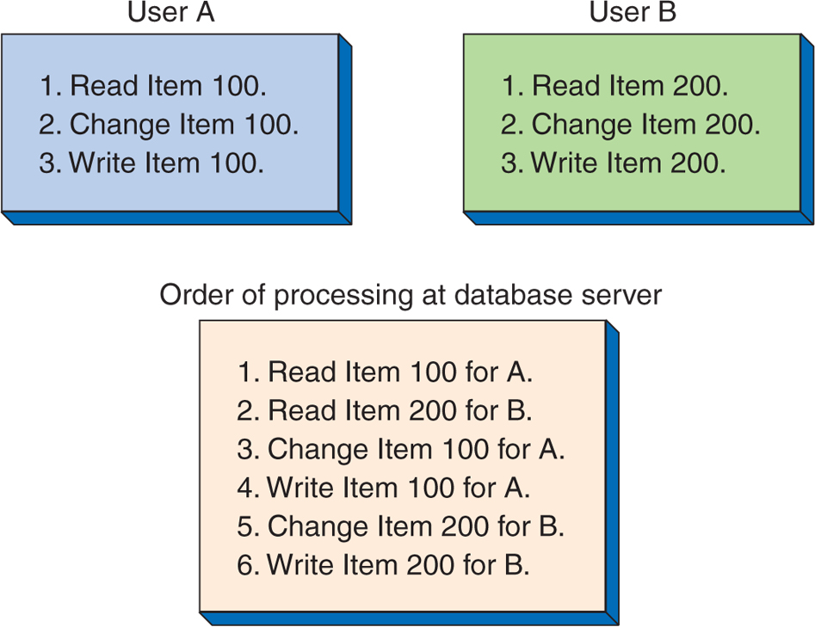
Concurrent Processing Example
Figure 6-4: Example of Concurrent Processing of Two Users’ Tasks

Slide 15
Lost Update Problem
If two or more users are attempting to update the same piece of data at the same time, it is possible that one update may overwrite the other update

Slide 16
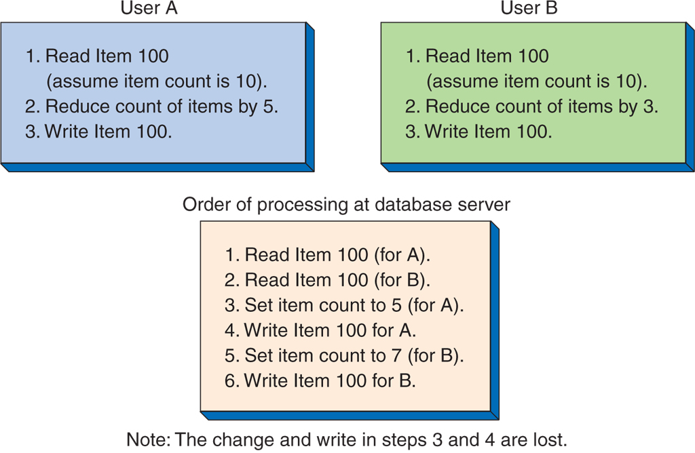
Lost Update Problem Example
Figure 6-5: Example of the Lost Update Problem

Slide 17
Concurrency Issues
Dirty reads
The transaction reads a changed record that has not been committed to the database.
Inconsistent reads
The transaction re-reads a data set and finds that the data has changed.
Phantom reads
The transaction re-reads a data set and finds that a new record has been added.

Slide 18
Resource Locking
To avoid concurrency issues, resource locking will disallow transactions from reading, modifying and/or writing to a data set that has been locked.

Slide 19
Implicit versus Explicit Resource Locking
Implicit locks are issued automatically by the DBMS based on an activity.
Explicit locks are issued by users requesting exclusive rights to the data.

Slide 20
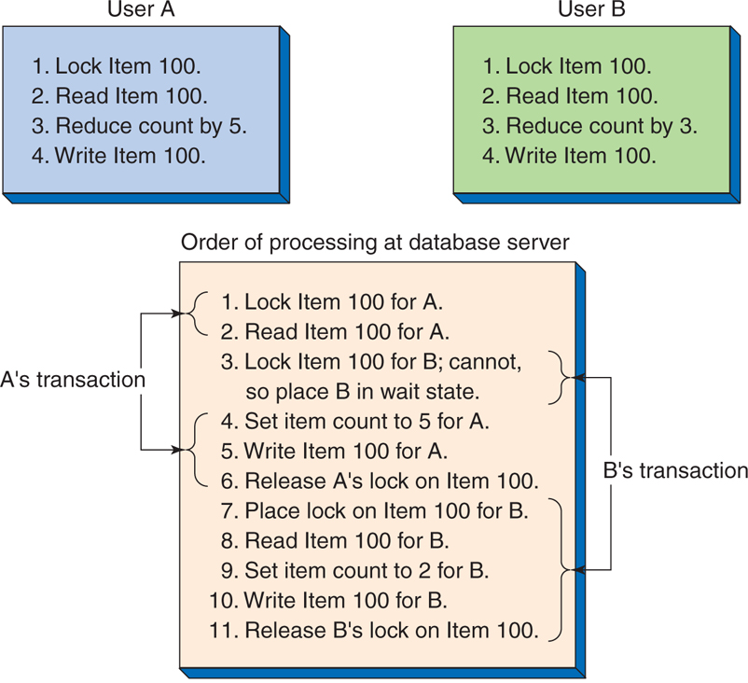
Concurrent Processing with Explicit Locking Example
Figure 6-6: Example of Concurrent Processing with Explicit Locks

Slide 21
Serializable Transactions
When two or more transactions are processed concurrently, the results in the database should be logically consistent with the results that would have been achieved had the transactions been processed in an arbitrary serial fashion.
A scheme for processing concurrent transactions in this way is said to be serializable.

Slide 22
Two-Phased Locking
One way to achieve serializable transactions is by using two-phased locking.
Two-phased locking lets locks be obtained and released as they are needed.
A growing phase, when the transaction continues to request additional locks
A shrinking phase, when the transaction begins to release the locks

Slide 23
Deadlock
As a transaction begins to lock resources, it may have to wait for a particular resource to be released by another transaction.
On occasions, two transactions may indefinitely wait on each another to release resources—This condition is known as a deadlock or the deadly embrace.

Slide 24
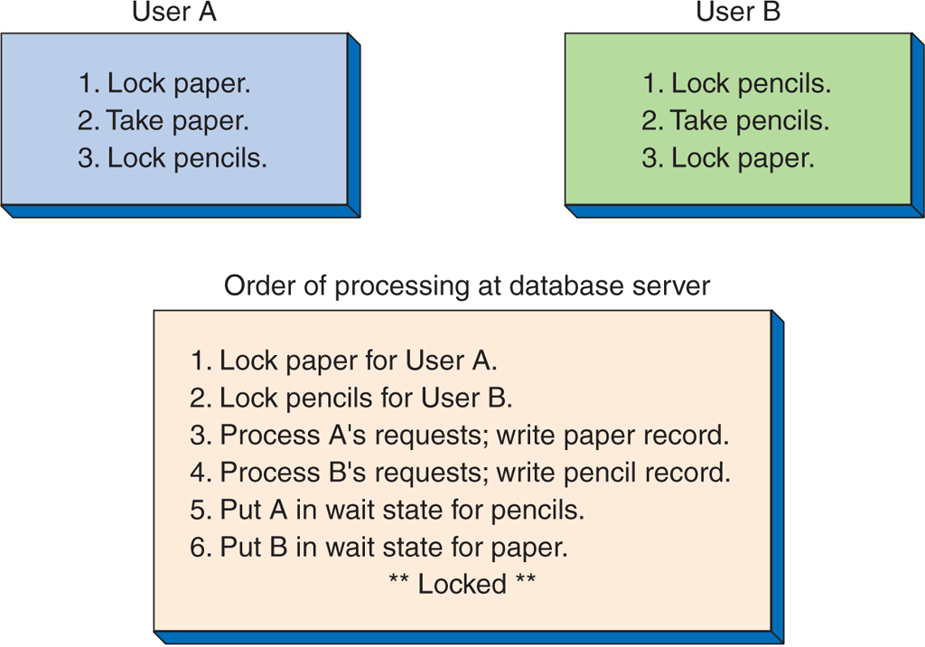
Deadlock Example
Figure 6-7: Example of Deadlock

Slide 25
Optimistic Locking versus Pessimistic Locking
Optimistic Locking
Read data
Process transaction
Issue update
Look for conflict
IF no conflict occurred
THEN commit transaction
ELSE rollback and repeat transaction
Pessimistic Locking
Lock required resources
Read data
Process transaction
Issue commit
Release locks

Slide 26
Optimistic Locking Example
Figure 6-8: Example of Optimistic Locking

Slide 27
Pessimistic Locking Example
Figure 6-9: Example of Pessimistic Locking

Slide 28
SQL Transaction Control Language (TLC)
The SQL BEGIN TRANSACTION statement
The SQL COMMIT TRANSACTION statement
The SQL ROLLBACK TRANSACTION statement
NOTE: Exact SQL syntax varies between DBMS products.

Slide 29
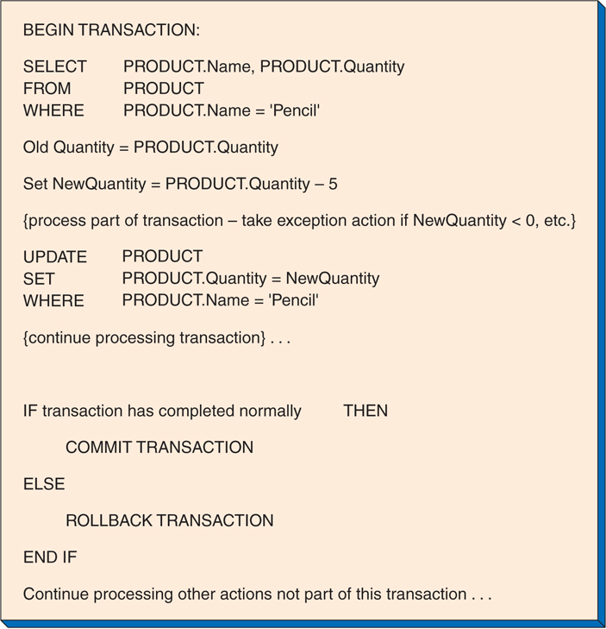
Marking Transaction Boundaries Example
Figure 6-10: Example of Marking Transaction Boundaries

Slide 30
Consistent Transactions
Consistent transactions are often referred to by the acronym ACID.
Atomic
Consistent
Isolated
Durable

Slide 31
ACID: Atomic
An atomic transaction is one in which all of the database actions occur or none of them do.
A transaction consists of a series of steps. Each step must be successful for the transaction to be saved.
This ensures that the transaction completes everything it intended to do before saving the changes.

Slide 32
ACID: Consistent
No other transactions are permitted on the records until the current transaction finishes.
This ensures that the transaction integrity has statement level consistency among all records.

Slide 33
ACID: Isolation
Within multiuser environments, different transactions may be operating on the same data.
As such, the sequencing of uncommitted updates, rollbacks, and commits continuously change the data content.
The 1992 ANSI SQL standard defines four isolation levels that specify which of the concurrency control problems are allowed to occur.

Slide 34
ACID: Durable
A durable transaction is one in which all committed changes are permanent.

Slide 35
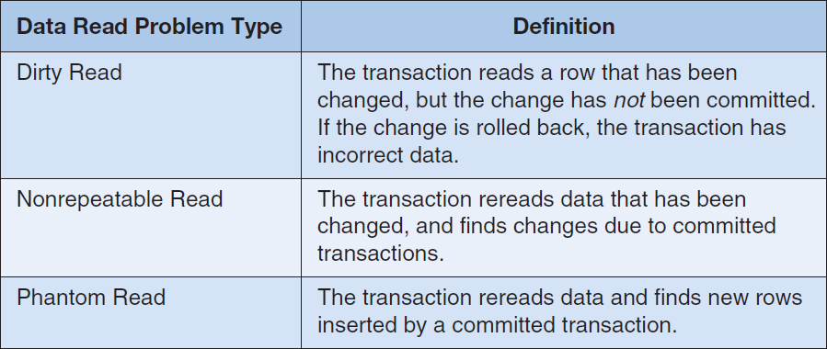
Summary of Data Read Problems
Figure 6-11: Summary of Data Read Problems

Slide 36
1992 ANSI SQL Isolation levels
Figure 6-12: Summary of Isolation Levels

Slide 37
Cursors
A cursor is a pointer into a set of rows that are the result set from an SQL SELECT statement.
Cursors are usually defined using SELECT statements.
DECLARE CURSOR TransCursor AS
SELECT *
FROM SALE_TRANSACTION
WHERE PurchasePrice > '10000';

Slide 38
Cursor Types
Forward only or scrollable
In SQL Server, for forward only or scrollable cursors, there are three types:
Static cursor
Keyset cursor
Dynamic cursor
Other DBMS products may define a different set of cursors.

Slide 39
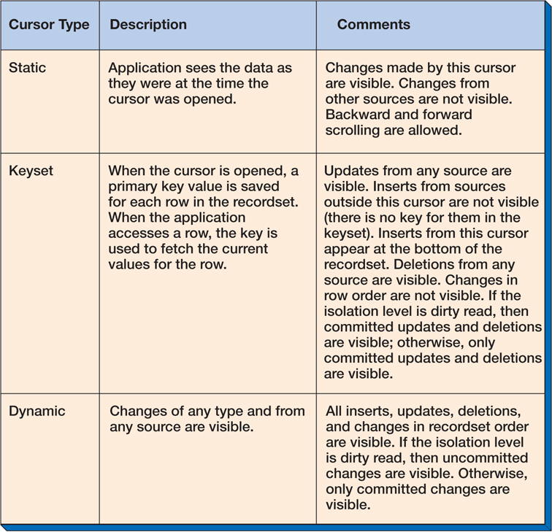
Summary of Cursor Types
Figure 6-13: Summary of Cursor Types

Slide 40
A Note on Cursor Types
Other DBMS products may define a different set of cursors.
In this case, the forward only cursor is considered a separate cursor type, and only a scrollable cursor may be static, keyset, or dynamic.

Slide 41
Database Security
Database Security strives to ensure that
Only authenticated users
Perform authorized activities
Figure 6-14: Database Security Authentication and Authorization

Slide 42
Processing Rights and Responsibilities
Processing rights define who is permitted to do what and when.
The individuals performing these activities have full responsibility for the implications of their actions.
Individuals are identified by a username and a password.

Slide 43
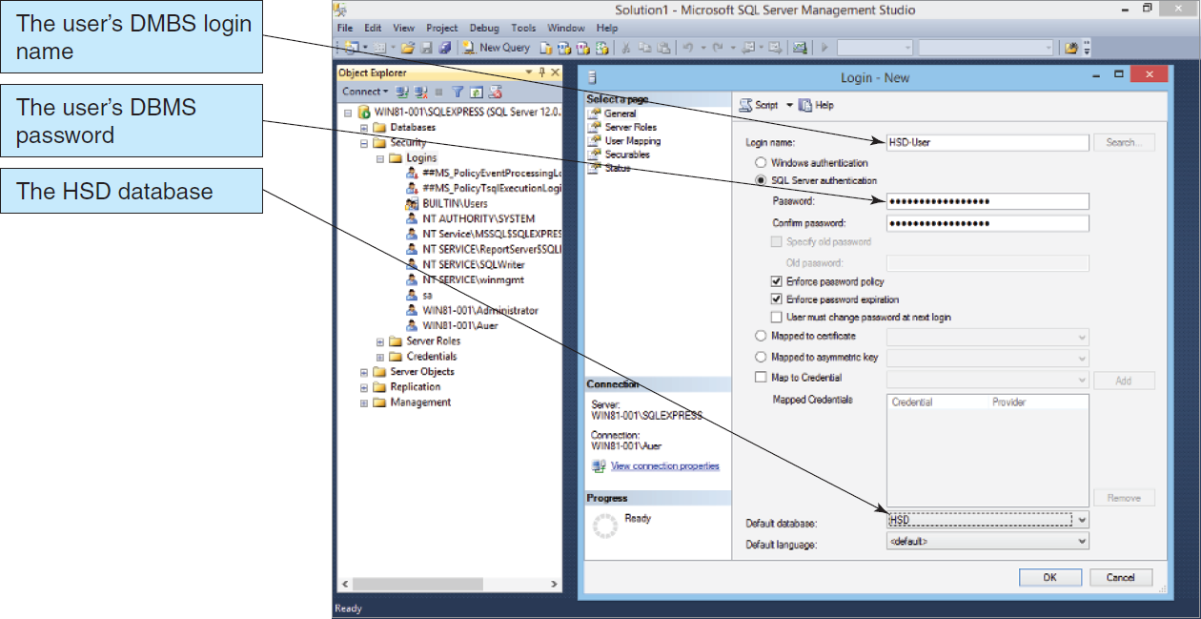
User Accounts in SQL Server 2014: Server Login Account
Figure 6-15: Creating the Database Server Login

Slide 44
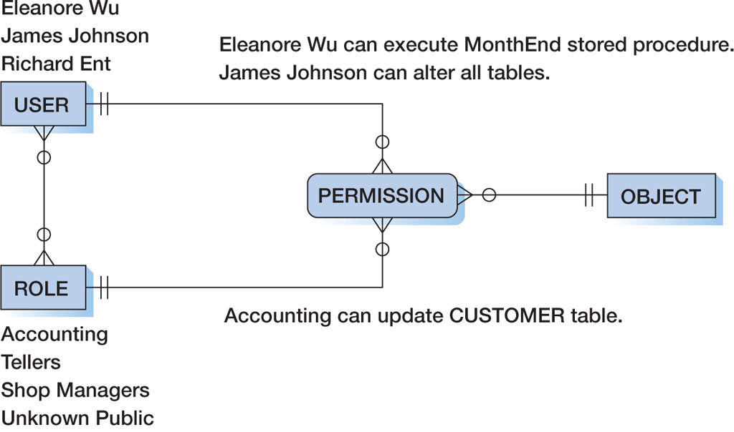
A Model of DBMS Security
Figure 6-16: A Model of DBMS Security

Slide 45
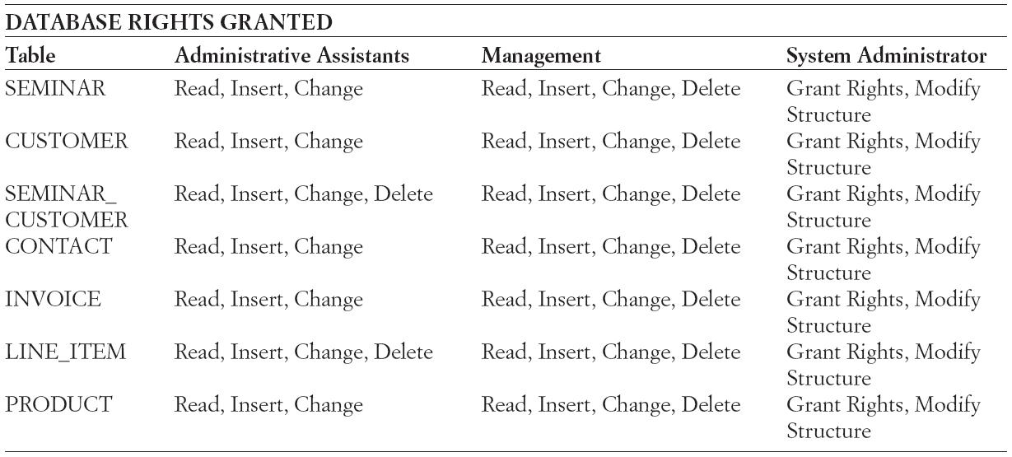
Processing Rights at Heather Sweeney Designs
Figure 6-17: Processing Rights at Heather Sweeney Designs

Slide 46
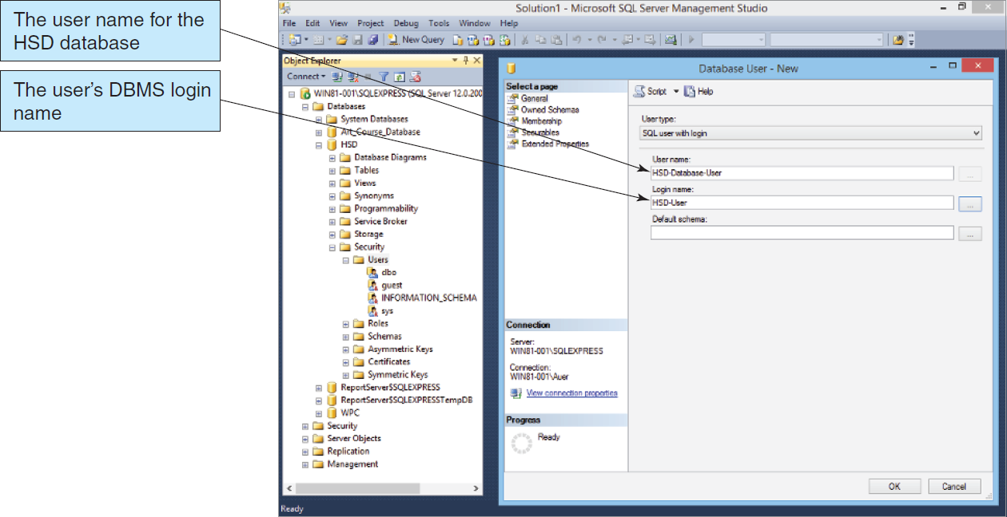
User Accounts in SQL Server 2014: Database User
Figure 6-18: Creating the Database User Name

Slide 47
Granting Permissions
Database users are known as an individual and as a member of one or more roles.
Granting access and processing rights/privileges may be granted to an individual and/or a role.
Users possess the compilation of rights granted to the individual and all the roles for which they are members.

Slide 48
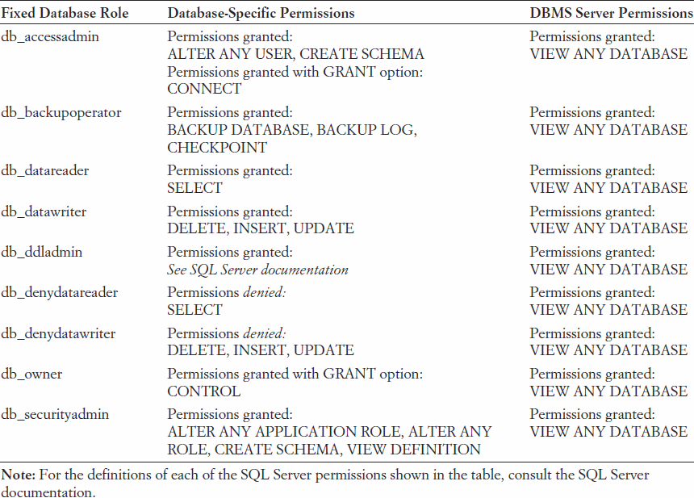
SQL Server 2014 Fixed Database Roles
Figure 6-19: SQL Server Fixed Database Roles

Slide 49
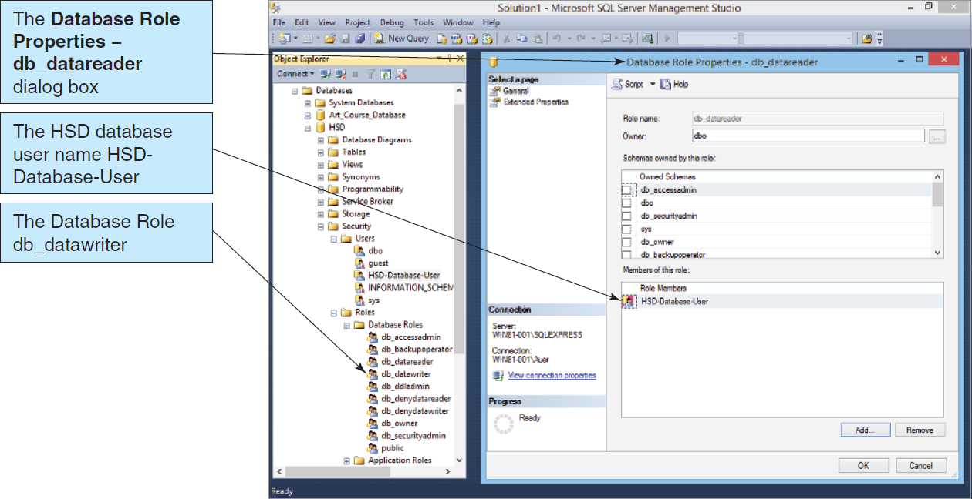
Assigning HSD-Database-User to the SQL Server 2014 db_datareader Role
Figure 6-20: Assigning HSD-Database-User to the db_datareader Role

Slide 50
Database Security Guidelines
Run the DBMS behind a firewall.
Apply the latest operating system and DBMS service packs and patches.
Limit DBMS functionality to needed features.
Protect the computer that runs the DBMS.
Manage accounts and passwords.

Slide 51
Database Backup and Recovery
Common causes of database failures
Hardware failures
Programming bugs
Human errors/mistakes
Malicious actions
As these issues are impossible to completely avoid, recovery procedures are essential.

Slide 52
Recovery via Reprocessing
In reprocessing, all activities since the backup was performed are redone.
This is a brunt-force technique.
This procedure is costly in the effort involved in re-entering the data.
This procedure is risky in that human error is likely and in that paper record-keeping may not be accurate.

Slide 53
Recovery via Rollback and Rollforward
Most database management systems provide a mechanism to record activities into a log file.
To undo a transaction the log must contain a copy of every database record before it was changed.
Such records are called before-images.
A transaction is undone by applying before-images of all its changes to the database.
To redo a transaction the log must contain a copy of every database record (or page) after it was changed.
These records are called after-images.
A transaction is redone by applying after-images of all its changes to the database.
The log file is then used for recovery via rollback or rollforward.

Slide 54
Rollback
Rollback
Log files save activities in sequence order.
It is possible to undo activities in reverse order that they were originally executed.
This is performed to correct/undo erroneous or malicious transaction(s) after a database is recovered from a full backup.

Slide 55
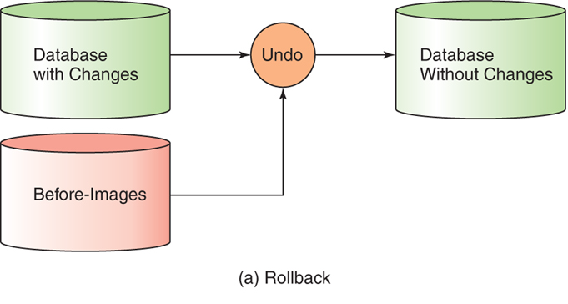
Rollback Example
Figure 6-22: Undo and Redo Transactions

Slide 56
Rollforward
Rollforward
Activities recorded in the log files may be replayed.
In doing so, all activities are re-applied to the database.
This procedure is used to resynchronize restored database data by adding transactions to the last full backup.

Slide 57
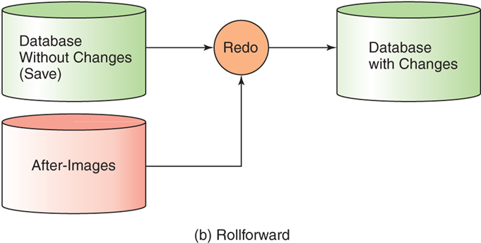
Rollforward Example
Figure 6-22: Undo and Redo Transactions (Cont’d)

Slide 58
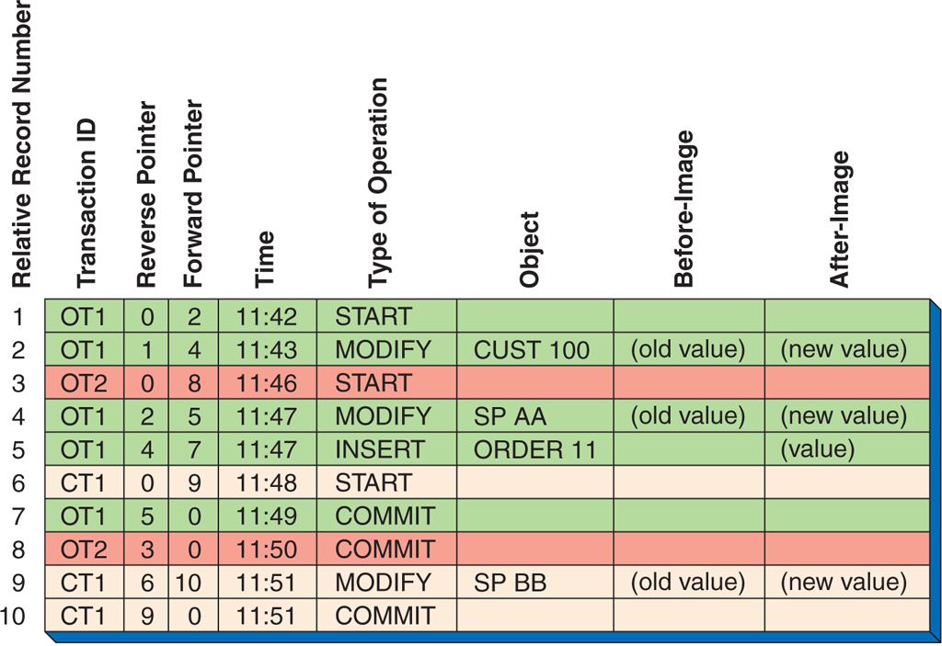
Example Transaction Log
Figure 6-23: Transaction Log Example

Slide 59
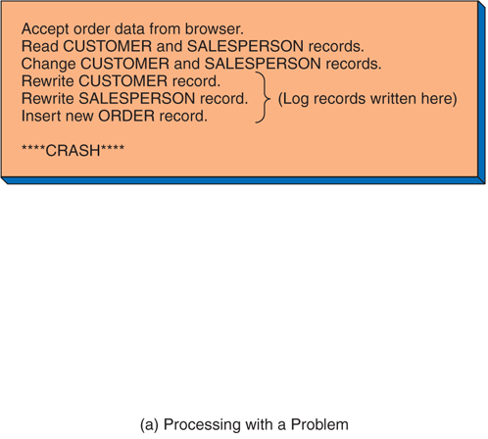
Recovery Example I
Figure 6-24: Recovery Example

Slide 60
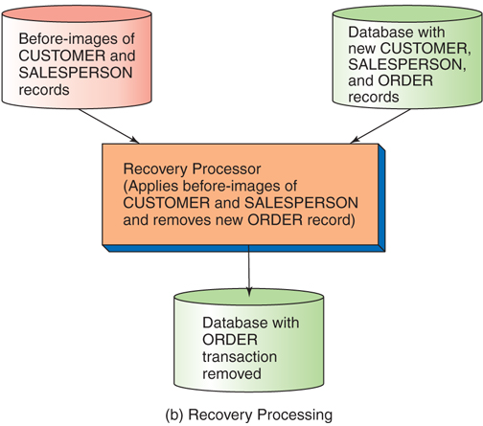
Recovery Example I
Figure 6-24: Recovery Example (Cont’d)

Slide 61
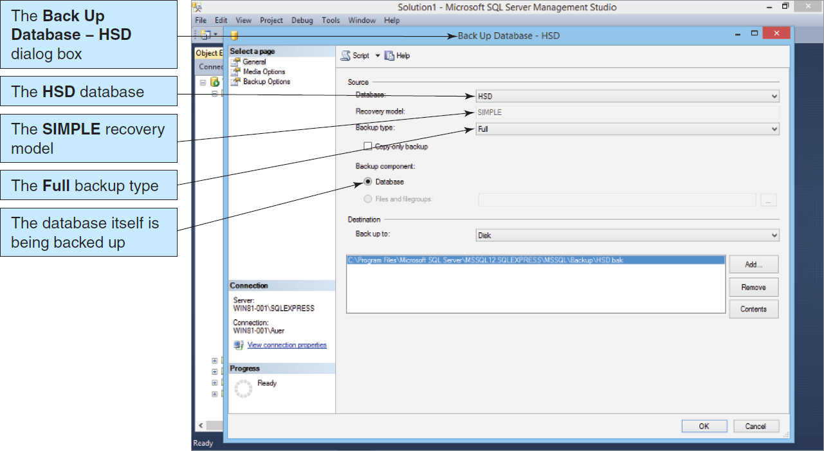
Backing Up the HSD Database Microsoft SQL Server 2014
Figure 6-25: Backing Up the HSD Database

Slide 62
Additional DBA Responsibilities
The DBA needs to ensure that a system exists to gather and record user reported errors and other problems.
A means needs to be devised to prioritize those errors and problems and to ensure that they are corrected accordingly .
The DBA needs to create and manage a process for controlling the database configuration.
Procedures for recording change requests
Conducting user and developer reviews of such requests
Creating projects and tasks
The DBA is responsible for ensuring that appropriate documentation is maintained.
Database structure
Concurrency control
Security
Backup and recovery
Applications used

Slide 63
DAVID M. KROENKE and DAVID J. AUER
DATABASE CONCEPTS, 7th Edition
All rights reserved. No part of this publication may be reproduced, stored in a retrieval system, or transmitted, in any form or by any means, electronic, mechanical, photocopying, recording, or otherwise, without the prior written permission of the publisher. Printed in the United States of America.
Copyright © 2015 Pearson Education, Inc.
Publishing as Prentice Hall

Slide 64
Database Administration
DAVID M. KROENKE and DAVID J. AUER
DATABASE CONCEPTS, 7th Edition
End of Presentation on Chapter Six

